Slide 1
The Italian Revenue Agency
Definitions, powers, acts, etc.

Slide 2
Preview
What is the IRA and which are its activities?
How are taxpayers’ tax returns inspected?
What can taxpayers do in case of a tax audit?

Slide 3
The Italian Revenue Agency
The Italian Revenue Agency is a non-economic public body that, since 2001, operates to ensure the highest level of tax compliance
https://www.agenziaentrate.gov.it/portale/
Activities:
Services, assistance and information to taxpayers;
Acquisition and processing of tax returns and acts;
Recovery of tax evasion and tax avoidance;
Interpretation of regulations.

Slide 4
Tax Evasion
The term applies to the avoidance of tax by unlawful means, i.e. the taxpayer pay less tax than he is compelled to pay purposedly
Omission of taxable income, failure to file a return, sham transactions, etc.
The element of illegality distinguish tax evasion from tax avoidance

Slide 5
Tax Avoidance
The term is used to denote the reduction of tax by legal means.
Aim: avoid obligations or prohibitions envisaged by the tax system and obtain tax reductions;
No economic reasons
It often has a pejorative overtone where it’s used to describe avoidance achieved by artificial arrangements of business affairs to take advantage of loopholes, anomalies or other deficiencies of tax law.
Anti-avoidance measures: rules introduced to prevent types of avoidance which are disapproved by the legislature

Slide 6
Strengthening tax administration
In 2002, the Forum on Tax Administration (FTA) was created to bring together tax commissioners
The FTA aims to create a forum through which tax administrators can identify, discuss and influence relevant global trends and develop new ideas to enhance tax administration around the world
Activities:
Global forum where Commissioners and their teams can share experiences and expertise on tax administration issues
Engaging in dialogue with key stakeholders (taxpayers, tax intermediaries, tax policy)
Promoting enhanced co-operation between countries and working co-operatively with other international and regional tax organizations

Slide 7
Tax return
Self-assessment principle
A tax return is a form filed to a tax authority that reports income, expenses, and other pertinent tax information.
Tax returns allow taxpayers to calculate their tax liability, schedule tax payments, or request refunds for the overpayment of taxes.
https://www.agenziaentrate.gov.it/portale/web/guest/modelli-e-istruzioni-redditi-pf-2022-cittadini

Slide 8
Inspection of tax returns
Examination of the tax return in order to verify whether or not it is correct;
Phases:
Initial inspection carried out automatically by the Information System on all tax returns;
Formal inspection: inspection carried out on samples of tax returns by the office of the Revenue Agency;
Substantial inspection: phase intended to rectify the individual incomes declared and to identify subjects who, although being obliged to submit the tax return, have not provided to do so.

Slide 9
Formal inspection of tax returns
Activity carried out by the offices of the Revenue Agency concerning the tax returns selected on the basis of criteria established by the Revenue Agency;
The formal inspection verifies whether the information declared is in conformity with the documentation kept by the taxpayer and with the data gathered from the tax returns of other subjects;
The taxpayer is invited by the tax office to exhibit or transmit the documentation demonstrating the correctness of the information declared and to provide clarifications;
The outcome of the formal inspection is then communicated to the taxpayer.

Slide 10
Formal inspection of tax returns

Slide 11
Substantial inspection of tax returns
Assessment
Action taken by the Revenue Agency to determine the taxable income and tax for the taxpayer;
The powers of the offices are exerted on the taxpayers through accesses, inspections and verifications, with the request for information and documents to the taxpayer and third parties (ex. questionnaire);
The assessment procedure is normally concluded with the notification of the charges through a specific notice.

Slide 12
Time limitations
From the fiscal year in progress at 31.12.2016, the Italian Tax Authorities are entitled to assess tax returns (e.g. Irpef, Ires, Vat…) up to:
The end of the fifth calendar year, following the year in which the tax return was filed (previously: up to the end of the fourth calendar year);
The end of the seventh calendar year following the year in which the tax return should have been filed (previously: up to the end of the fifth calendar year)

Slide 13
Substantial inspection of tax returns
Report of verification
Deed written by the officials in charge of substantial tax inspection at the end of verifications, accesses and inspections carried out on a taxpayer;
The report highlights the irregularities committed by the taxpayer with regard to his fiscal obligations;
Taxpayer’s defense report (optional);
On the basis of the report, the competent tax office can issue a verification notice in order to recover the unpaid taxes and to establish the relevant penalties.

Slide 14
Report of verification

Slide 15
Verification notice
Deed through which the taxoffice formally notifies a debt to the taxpayer;
The notice must be motivated, otherwise it is invalid;
The notice must indicate:
The taxable base ascertained and the rates applied;
The taxes settled, gross and net of deductions, withholdings taxes and tax credits;
The office where it is possible to obtain information as well as the person responsible for the procedure;
The modalities and deadline for payment;
The judicial authority to which it is possible to appeal.

Slide 16
Verification notice

Slide 17
Verification notice
After the taxpayer has received a verification notice:
Acquiescence;
Self-defence (“autotutela”);
Verification with acceptance;
Tax litigation.

Slide 18
Acquiescence
No contesting;
Payment within the deadlines of the amounts due following an assessment carried out by the Revenue Agency;
The amounts due following the assessment can also be paid in installments. In this case legal interests have to be paid;
Right to penalty reduction.

Slide 19
Autotutela – self defence
The possibility that every public administration has to correct its own errors without the need for a judicial decision;
The Revenue Agency makes the correction either on request of the taxpayer or on its own initiative;
Errors’ examples: mistaken identity, obvious logical or calculation errors, errors concerning the total amount of tax due, double imposition, lack of consideration of payments regularly made.

Slide 20
Verication with acceptance
Procedure on the basis of which the correction of the declared taxable base is made through discussions between the financial offices and the taxpayer;
It is concluded with a document of the office signed, for acceptance, also by the taxpayer;
Advantages for the taxpayer: reduction of penalties;
The procedure ends with the payment of the total amount due, which can even be made in installments. In such case legal interests are due.

Slide 21
Tax controversy
In case the taxpayer decides not to accept the challenges by the tax authorities, the taxpayer may start a tax dispute

Slide 22
Tax dispute
Appeal: deed through which taxpayers can oppose the decisions taken by the Tax Administration;
Peremptory time limit: 60 days after notice of tax assessment;
Must contain the following indications: tax commission to which it is directed, name of the appellant, his residence, his tax code, the office appealed against, details of the deed appealed against, object of the request, factual and legal issues to prove its groundings, signature;
The appeal shall be submitted directly to the counterpart (i.e. The Revenue Agency).

Slide 23
Tax litigation
Tax proceedings start in front of the tax commissions with the “entry of appearance”;
“Tax commissions”: jurisdictional legal bodies competent for disputes relating to tax matters
“Entry of appearance”: filing of the appeal to the tax commission together with other documents required by law

Slide 24
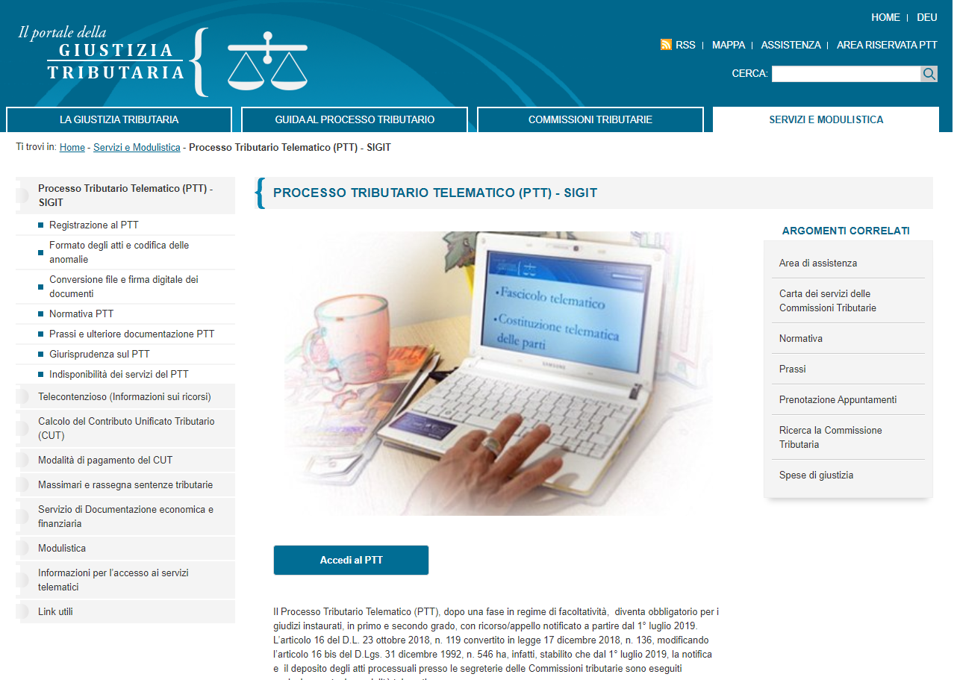
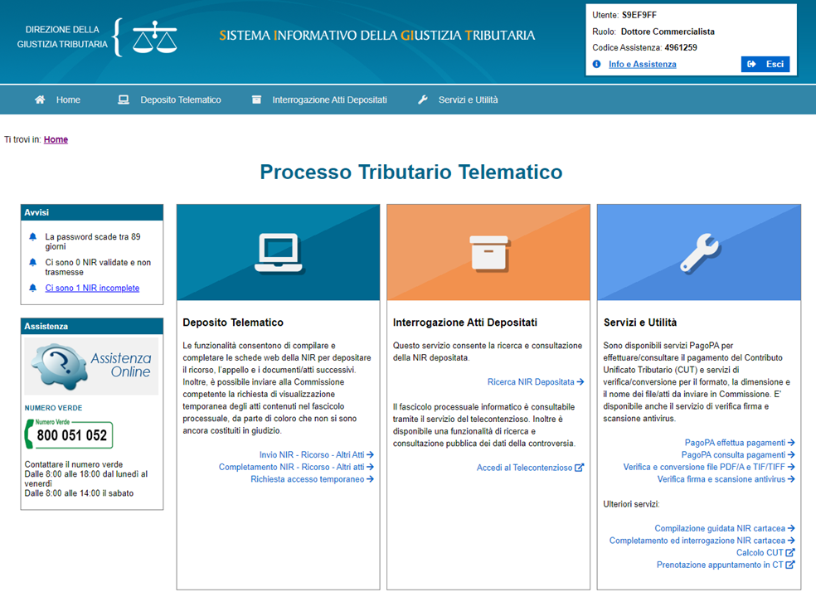
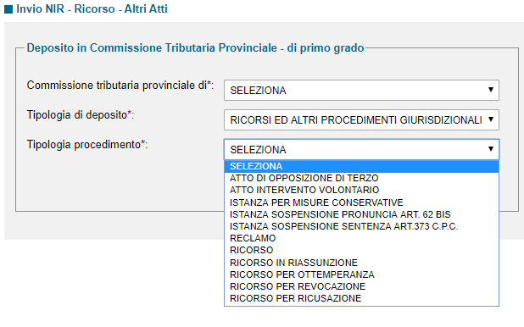
processo-tributario-telematico-ptt-sigit

Slide 25
Tax litigation

Slide 26
Summary
Assessment
Aquiescence
Self defense
Verification with acceptance
Report of verification
(PVC)
Verification notice
(avviso di accertamento)
Tax litigation
1 st taxpayer defense

