Slide 1
Main issues of International Taxation
Introduction to Italian Law – Tax Law

Slide 2
International taxation… a preview
Scope and goals of international taxation;
Tax treaties, tax treaties’ models;
International double taxation: issues, relief mechanisms and MAP.

Slide 3
What is international taxation?
It is a system of rules referring to international aspects of the income tax law of certain countries;
Scope of international taxation: it covers all tax issues arising under a country’s tax law that includes some foreign elements;
For example income tax concerning:
  Cross-border trade in goods and services;
  Cross-border manufacturing by a multinational enterprise;
  Cross-border investments by individuals or investment funds;
  Taxation of individuals working abroad;
  Digital economy.

Slide 4
Tax treaties
It doesn't exist an overriding international law of taxation, arising from customary practice or from international entities such as UN or OECD;
A great role is however played by the tax treaties, which impose significant limitations on the taxation power of the treaty partners.
Tax treaties represent an important aspect of international tax rules of most countries: over 2,000 bilateral income tax treaties are currently in effect, and the number is growing.

Slide 5
Tax treaties
Art. 2 of the Vienna Convention: “A treaty is an international agreement concluded between states and governed by international law”;
Tax treaties confer rights and impose obligations on the contracting states;
Tax treaties don’t impose tax. Rather, they limit the taxes otherwise imposed by a State;
Treaties, once signed, are binding for the States, although to be effective on taxpayers they need to be incorporated into a domestic statute.

Slide 6
Treaties and domestic law
The relationship between tax treaties and domestic tax legislation, and the risk of a conflict, is often resolved according the supremacy to tax treaties;
Basic principle: the treaty should prevail in the event of a conflict between the provisions of domestic law and a treaty (“treaty override”).
This is the case of Italy, where a subsequent domestic law cannot override the provisions of a tax treaty, according to the “specialty principle”

Slide 7
Objectives of tax treaties 1/3
The objective of tax treaties is to facilitate cross-border trade and investment by eliminating the tax impediments in cross-border flows;
To achieve this goal, the most important provisions of a tax treaty are intended to eliminate the double taxation (operational objective);
For example, tax treaties provide for:
  Tie-breaker rules to avoid double residence;
  Limit or eliminate source jurisdiction on certain types of income;
  Require residence country to provide relief for source country tax either by granting exemption or a foreign tax credit.

Slide 8
Objectives of tax treaties 2/3
Ancillary objectives:
Moreover a tax treaty’s aim is to prevent tax evasion, although few provisions are designed to achieve it;
Elimination of discrimination against foreign nationals and nonresidents;
Exchange of information between the Contracting States. It is an important tool in combatting fiscal evasion;
Provide dispute resolution mechanisms;

Slide 9
Objectives of tax treaties 3/3
A major objective of most tax treaties is to provide for reduced rates on withholding tax on certain investment income (dividends, interests, royalties);
The goal is to provide for some sharing of tax yield between the source and the residence country

Slide 10
Italy – bilateral agreements
Italy has entered in bilateral agreements with many foreign countries, within and outside EU, to avoid double taxation on income and property;
These agreements establish the range of the power to set taxes in the two States;
Depending on the categories involved, these agreements plan the possibility for both States to tax the same income (“concurrent taxation”) or, sometimes, the exclusive taxation by one State only
http://www.finanze.gov.it/opencms/it/fiscalita-comunitaria-e-internazionale/convenzioni-e-accordi/convenzioni-per-evitare-le-doppie-imposizioni/

Slide 11
Model Tax Treaties // OECD
OECD (Organization for Economic Co-operation and Development) Model Tax Convention on Income and on Capital
the mission of the OECD is to promote policies that will improve the economic and social well-being of people around the world.
set international standards on a wide range of topics: taxation, finance, environment, trade, social and welfare, competition, digitalization… (see: https://www.oecd.org/)

Slide 12
Model Tax Treaties
The Oecd Model Tax Convention on Income and on Capital was first published, in draft form, in 1963 – revised in 1977, 1992 … 2017;
A detailed commentary, organized on an article-by-article basis, accompanies the Oecd Model Treaty. It is very important with respect to the interpretation and application of tax treaties; (http://www.oecd.org/berlin/publikationen/43324465.pdf)
The Oecd Model eliminates or mitigates double taxation by requiring the source country to give up some or all of its tax on certain categories of income earned by residents of the other treaty country.
12
28/04/2022
Notes:
12

Slide 13
Model Tax Treaties
Structure of the Oecd Model:
http://www.oecd.org/tax/treaties/
..\..\2020\10_International Taxation\2014-model-tax-convention-articles.pdf
Art. 4: definition of “resident”;
Art. 10: taxation of dividends;
Art. 11: taxation of interests;
Art. 12: taxation of royalties;
Art. 21: taxation of “other income”;
Art. 26: exchange of information.
13
28/04/2022
Notes:
13

Slide 14
International double taxation
The term is not defined by the Oecd Model itself or in the Commentary to the Treaty;
Def.: “imposition of comparable income taxes by two or more sovereign countries on the same item of income of the same taxable person for the same taxable period” – juridical/legal definition;
Economic concept of double taxation: it occurs whenever there is multiple taxation of the same items of economic income.
14
28/04/2022
Notes:
14

Slide 15
The risk of double taxation
Residence-source conflicts (1)
Residence
Income
State A
State B
Residence-residence conflicts (2)
Residence
Residence
State A
State B

Slide 16
The risk of double taxation (1)
Residence-source conflicts: one country asserts the right to tax foreign-source income of a taxpayer because the taxpayer is resident of that country and another country asserts the right to tax the same income because the source of the income is in that country.
When a person earns income from abroad, the tax claim of the source jurisdiction may overlap the claim of the residence jurisdiction;
Consequently, foreign-source income earned by a resident of a country may be taxed by both the country of source and the country of residence, absent relief provisions designed to prevent double taxation;
If income tax rates are low, the inefficiencies and unfairness caused by double taxation are modest enough to be bearable;
But when tax rates reach the levels that now prevail, double-tax burdens can become onerous and interfere substantially with international commerce.

Slide 17
Relief mechanisms
No international consensus has been reached on the appropriate method for granting relief from international double taxation.
However, the following methods are in common use:
  Exemption method;
  Credit method.

Slide 18
Exemption method
The residence country provides its taxpayers with an exemption for foreign – source income;
The country of residence taxes its residents only on their domestic-source incomes, while foreign-source incomes are exempted (territorial basis of taxation);
This method completely eliminates residence-source international double taxation because only one jurisdiction, the source country, is imposing tax;
This method is relatively simple for the tax authorities to administer and is effective in eliminating international double taxation.

Slide 19
Credit method
The residence country provides its taxpayers with a credit against taxes otherwise payable for income-taxes paid to a foreign country;
Under this method, foreign taxes paid by the resident taxpayer on foreign-source income reduce the domestic tax by the amount of the foreign tax.

Slide 20
Treaty aspects
Exemption method | Credit method
Simplicity Low administrative burden | Low level of tax planning activity Ability to deduct foreign losses against domestic income
Need for expense allocation rules No deduction of foreign losses against domestic income High sensitivity to tax planning activity | Complexity of rules on: (i) foreign tax credit limitation; and (ii) indirect tax credit High administrative burden
20
28/04/2022

Slide 21
The risk of double taxation (2)
Residence-residence conflicts: two or more countries assert the right to tax the same income of a taxpayer because they claim the taxpayer is a resident of their country;
Case of “dual-resident taxpayer”;
To exercise residence jurisdiction, a country must provide rules that classify individuals and legal entities either as residents or nonresidents.

Slide 22
Tie-breaker rules for individuals
Tie breaker rules for individuals:
  1) Place where the individual has a permanent home;
  2) Country in which the centre of the individual’s vital interests is located;
  3) Location of the individual’s habitual dwelling;
  4) Country of citizenship.
If these rules are ineffective in making the individual a resident of only one country for treaty purposes, the competent tax authorities of the two countries are mandated to determine residence by mutual agreement

Slide 23
Tie-breaker for legal entities
Tie breaker rules for legal entities: where the effective place of management is located (art. 4.3 Oecd Model);
Some treaties use place of incorporation as the tie-breaker rule if the company is incorporated in one of the treaty countries;
Many treaties attempt to resolve conflicts over the residence of entities by referring the issue to the competent authorities.
23
28/04/2022
Notes:
23

Slide 24
Mutual agreement procedure (MAP)
Art. 25 Oced Model;
The MAP allows the competent authorities of the contracting States to interact in order to resolve international tax disputes;
aim: discuss cross-border taxation of specific transactions or situations with a view to coordinate the approach for the benefits of the taxpayers involved.

Slide 25
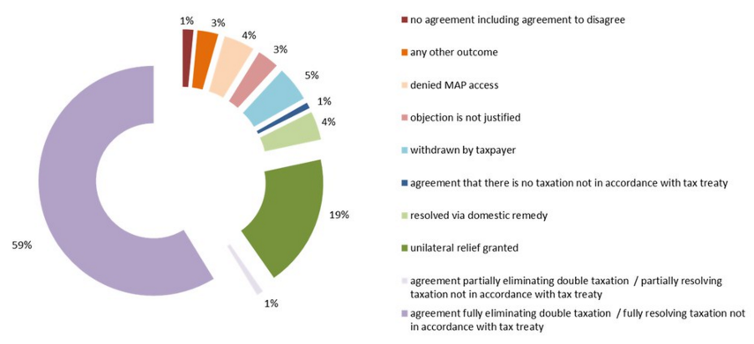
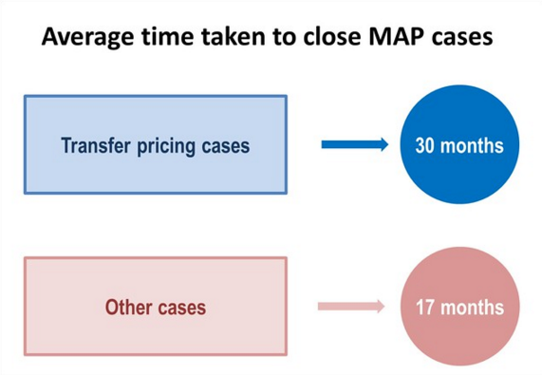
Mutual agreement procedure (MAP)

