Slide 1
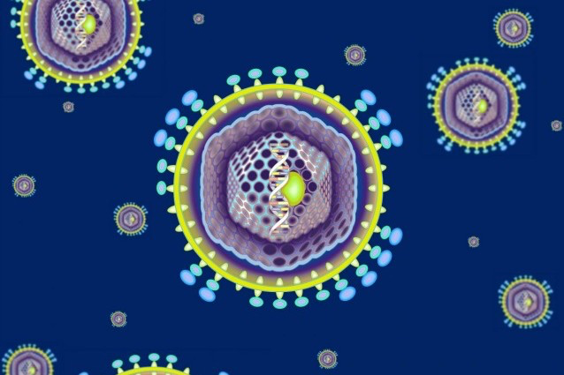
” i virus sono il creatore nascosto che ha contribuito a renderci umani”
Luis Villarreal
Parte delle nostre vite in un senso piu’ letterale di quanto immaginiamo e almeno il 30% degli adattamenti evolutivi a livello molecolare è servito a difenderci dai virus.
M. Comar
Dip. Scienze Mediche, Chirurgiche e della Salute
Universita’ degli Studi di Trieste
IRCCS-Burlo Garofalo, Trieste
Notes:
1

Slide 2
THE VIROME
The virome can be described as the set of all viruses that are found in a particular enviroment.
It forms part of the microbiome
In humans different virome exists since different bacteria communities or microbiome harbor human body

Slide 3
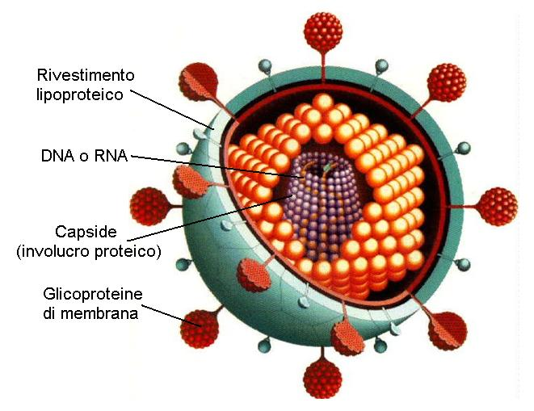
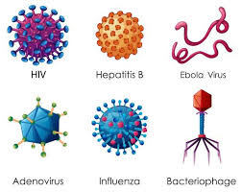
Viruses are parasitic biologic entities that require host cells for replication
Notes:
3

Slide 4

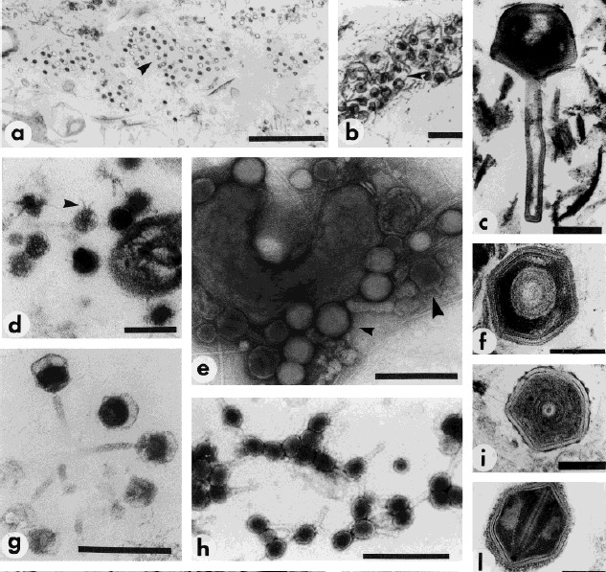
The global virome
10⁷ viruses per ml in sea water
Viruses outnumber hosts by ~10-fold in sea water
10³¹ viral particles on Earth
Numerically most successful biological entities
Data from Lita Proctor, Forrest Rohwer, Curtis Suttle and others
Proctor, 1997

Slide 5
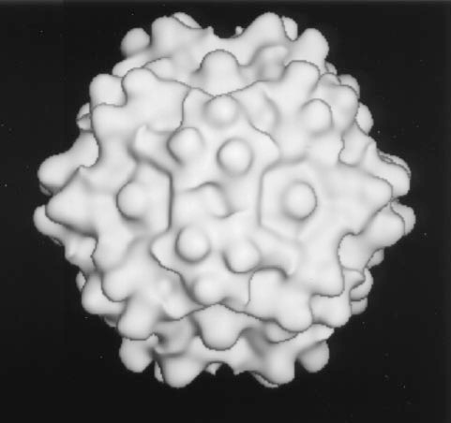
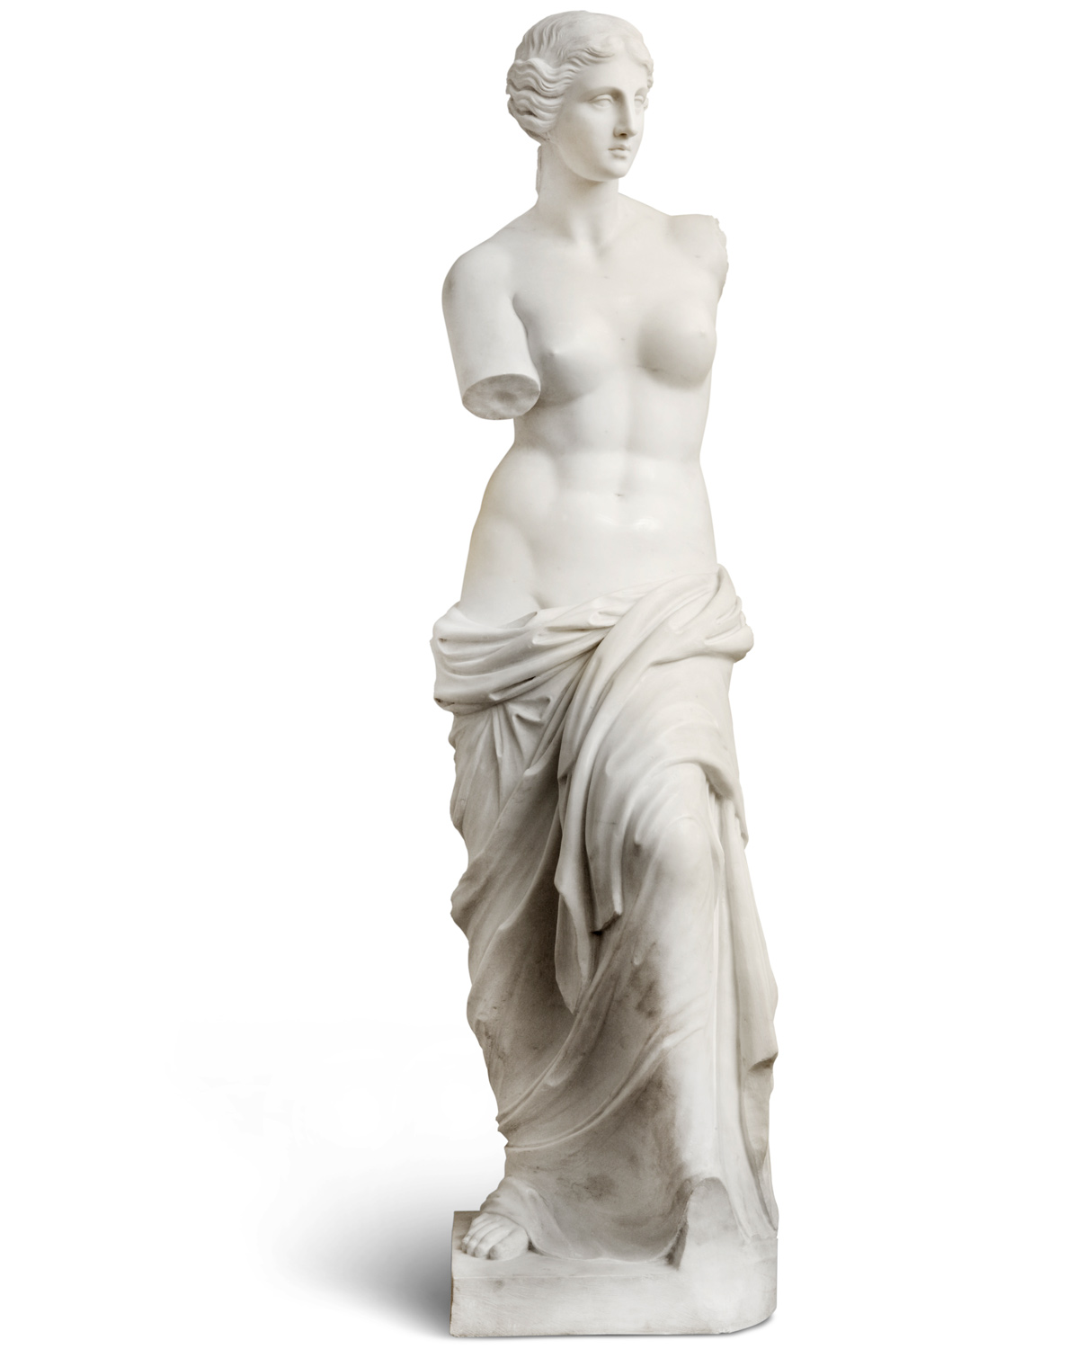
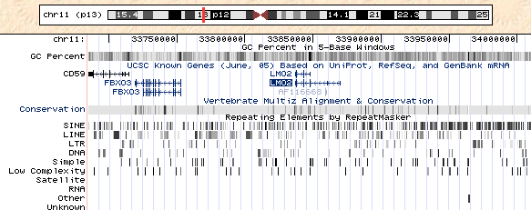
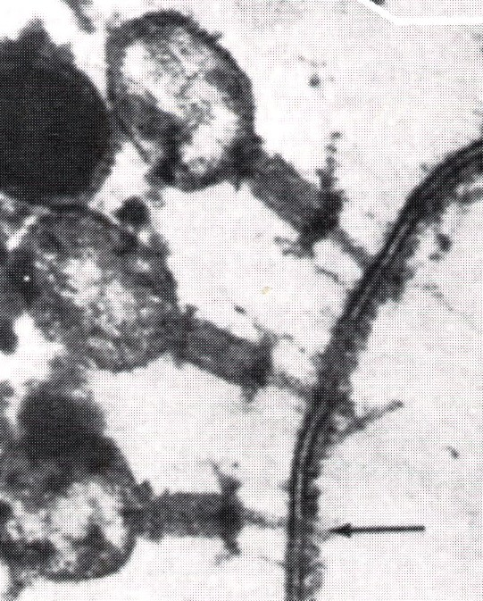
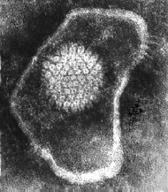
The Human Virome
Transient
Persistent/latent infections
infections with animal cell viruses
 |  | Bacteriophage predators of bacteria
Virus
seropositive
EBV
VZV
Herpes
HSV1
HPV
CMV
HSV2
HIV
HCV
100%
95%
80%
68%
60%
59%
22%
1%
1%
Endogenous retroviruses
8% of human DNA
10¹⁰-10¹¹
per gram of stool
Notes:
)

Slide 6
Eukaryotic are relevant as pathogen causing acute or persistent infections hestablishING a long term relationship with the host and influence the inflammatory status of the body.
Other are found in healthy individuals without apparent disease.
Many sequences are integrated in human genome reffered as endogenous viral elements (EVEs) including retroviral (8%).
Some remains as complete ORFs, and seem to be functional.
Gammaretroviruses HERV-T envelope sequences remains functional in primate for milions of years.
EUKARYOTIC virus

Slide 7
BACTERIOPHAGE
Role as modulators of bacteriome
Direct impact on inflammation as in Crohn’s disease.
They can use 2 different cycles to infect and regulate bacterial communities- lytic and lysogenic:
1-In the lityc cycle the infection results in the distruction of infected cells and release progeny
2-In the lysogenic cycle , they integrate their genome in host genome as prophage.

Slide 8
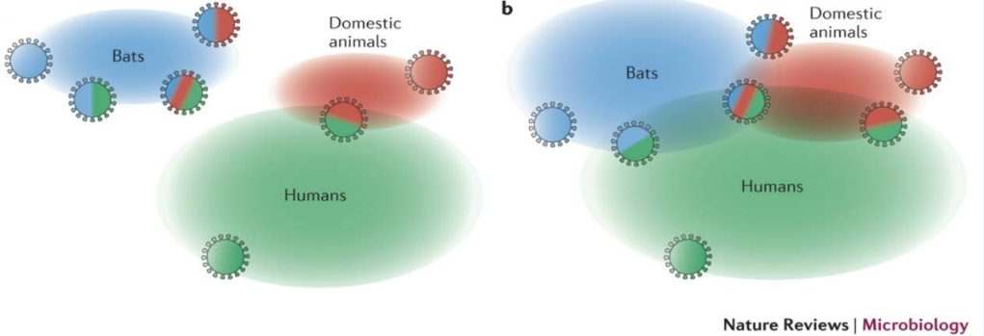
Trans-species transfer of viruses: a moving target
Graham et al. Nat Rev Microbiol 2013
▪ >80 Mio pet cats worldwide
▪ Feline Co-infections common (40% of cats shed >5 viruses in feces)
▪ Novel viruses in asymptomatic cats (Sakobuvirus, Bocavirus, Astroviren, Picobirnavirus)
Ng et al. Veterinary Microbiol 2013; Benedictis et al. Infection, Genetics, Evolution 2011

Slide 9
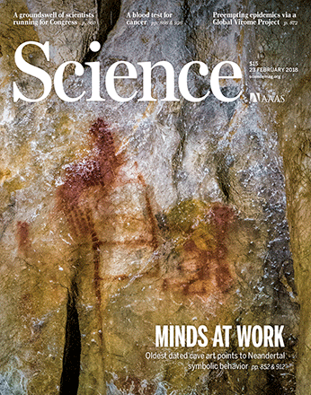
The HUMAN VIROME project
GVP paper published in Science
"Outbreaks of novel and deadly viruses highlight global vulnerability to emerging diseases, with many having massive health and economic impacts...
Our ability to mitigate disease emergence is undermined by our poor understanding of the diversity and ecology of viral threats, and of the drivers of their emergence.
We describe a Global Virome Project (GVP) aimed to launch in 2018 that will help identify the bulk of this viralthreat and provide timely data for public health interventions against future pandemics."
Notes:
Ngs matagenomica

Slide 10
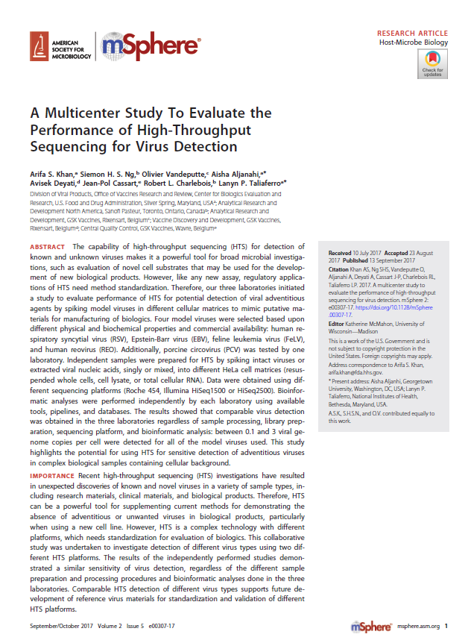
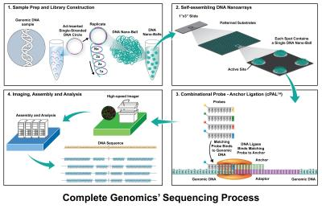
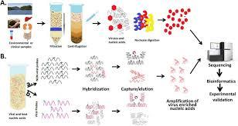

Slide 11
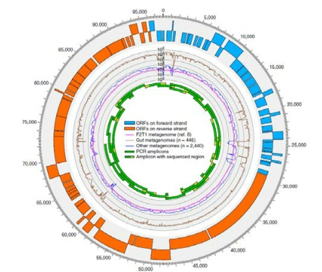
Cross Assembly phage (2014)
the first organism named after metagenomic analysis
▪ 6x more abundant in feces than all other known phages together
▪ 90% of all reads in virus-like particle (VLP)-derived metagenomes
▪ 22% of total community metagenomes
▪ 1.68% sequences in the database →
of all human fecal metagenomic sequencing reads in the public datab
▪ Year of discovery: 2014
▪ Majority of crAssphage-encoded
proteins match no known
discarded as data junk
Dutilh et al. Nat Comm 2014
Notes:
11

Slide 12
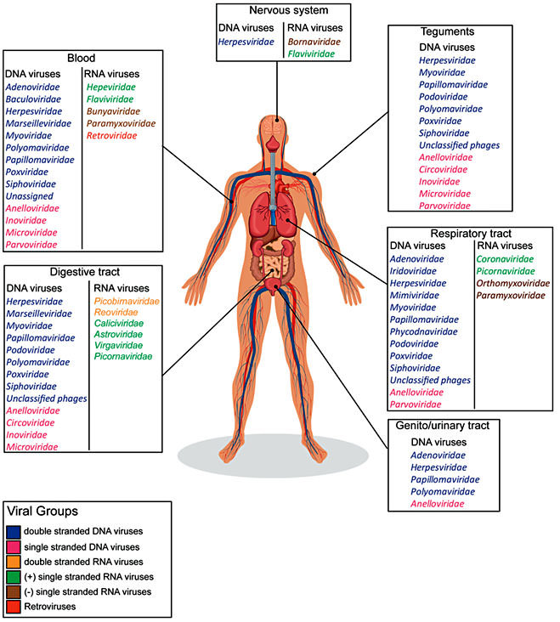
Eukaryotes virus in symptomatic and asymptomatic individuals

Slide 13
VIRUS in HUMAN BLOOD

Slide 14
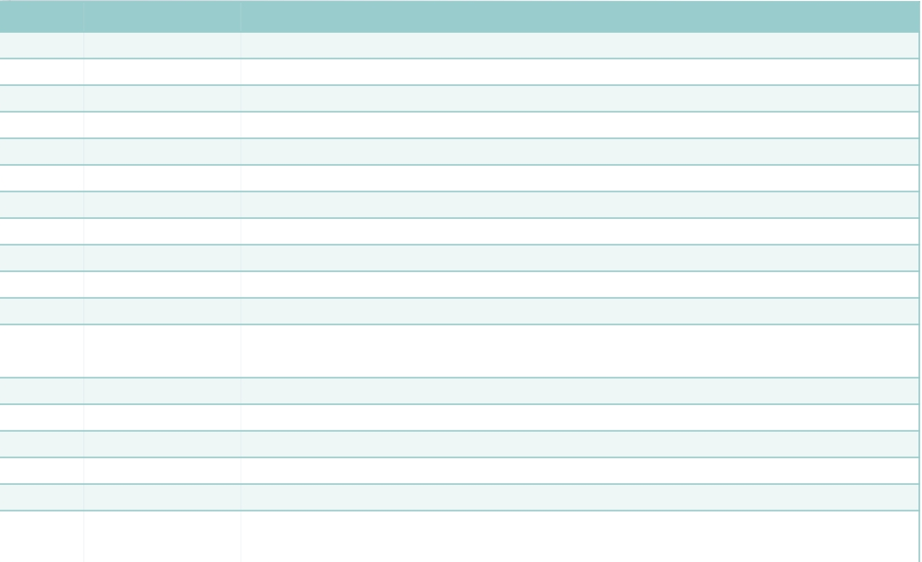
The „silent“ human virome
Group Family Species
dsDNA Adenoviridae Enteric adenovirus 40, 41
Iridoviridae Lymphocystis disease virus
Myoviridae phiBCD7, Bacillus phage G, phiP-SSM4
Podoviridae Enterobacteria phage P22, phage T3
Siphoviridae Listeria phage A118, phiE125 Lactococcus phage bIL285, phiCP39-O, Clostridium
Phages Halophage eHP-10
Papillomaviridae Human papillomavirus 6, 18, 66
Polyomaviridae BK virus, JC virus, SV40 virus, Human polyomavirus 9, 12, Merkel cell polyomavirus
Herpesviridae Epstein-Barr virus, Human cytomegalovirus
ssDNA Anelloviridae TTV
Circoviridae Chicken anemia virus, TN9, PK5034, PK5222, NG12
Microviridae
Chlamydia phage 1,3,4, Bdellovibrio phage phiMH2K, Chlamydia phage CPG1, Spiroplasma phage 4, Chlamydia phage CPAR39
dsRNA Picobirnaviridae Human picobirnavirus
Reoviridae Human rotavirus
(+) ssRNA Caliciviridae Norwalk virus
Astroviridae Human astrovirus
Virgaviridae Pepper mild mottle virus, Tobacco mosaic virus
Picornaviridae
Cosavirus, Klassevirus/salivirus, Aichi virus, Enterovirus, Parechovirus, Saffold
cardiovirus, Echovirus, Coxsackievirus, Poliovirus
Popgeorgiev et al. Intervirology 2013; Wylie et al. BMC Biology 2014; Foulongne et al. PlosOne 2012

Slide 15
VIRUS and HUMAN CANCER

Slide 16
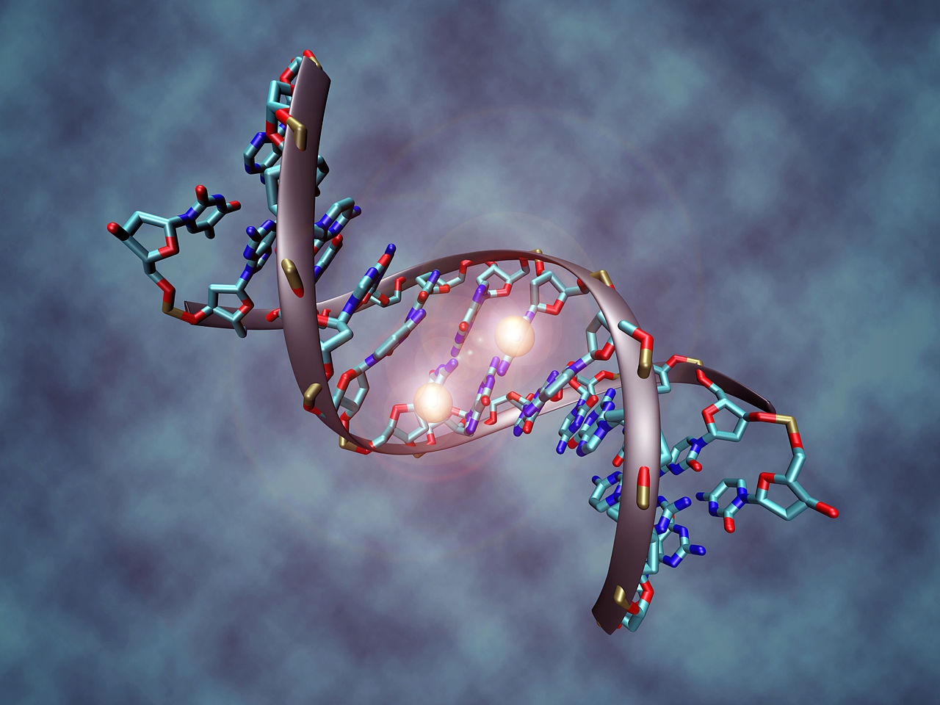
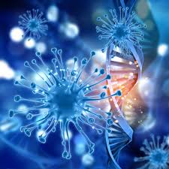
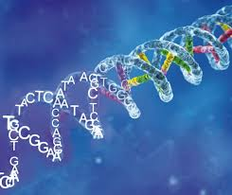
VIRUS Integration in Human DNA

Slide 17
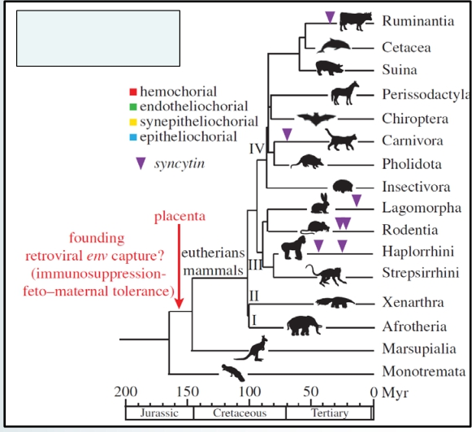
Human Endogenous Retrovirus HERV-W env (syncytin-1/sincitina-1)
Physiologic functions of syncytins
▪ Inserted in human-prehominoids chromosome 7q21, 40-45 millions years ago
▪ Absolute requirement for placenta development and embryo survival
▪ Positive selective advantage – switch from egg to uterus
▪ Induction of maternal immune tolerance to fetus?
▪ Cellular resistance against infection by retroviruses of family spleen necrosis virus
Syncytin gene capture events
Lavialle et al. Phil. Trans. R. Soc. B 2013; Blesa et al. Cancer Therapy 2008

Slide 18
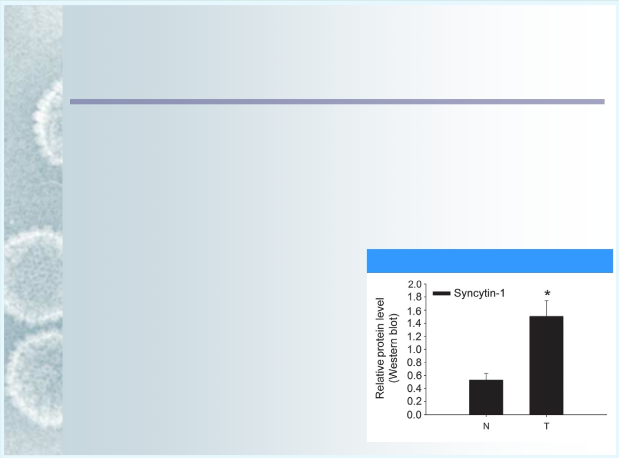
Role of HERV-W env (syncytin-1) in human cancer
▪ Overexpressed in 76% of urothelial cell carcinoma tissues (controls, 6%)
▪ Overexpression increases proliferation and viability of immortalized human uroepithelial cells
▪ Involved in mediating cancer-endothelial cell fusions in vitro
▪ Syncytin-1 expression = positive prognostic factor in breast cancer
▪ Syncytin-1 expression in 38% of all breast cancer samples
▪ Upregulated in endometrial carcinoma
Urogenital cancer tissue
Yu et al. Oncogene 2014; Blesa et al. Cancer Therapy 2008; Larsson et al. Placenta 2002
Notes:
18

Slide 19

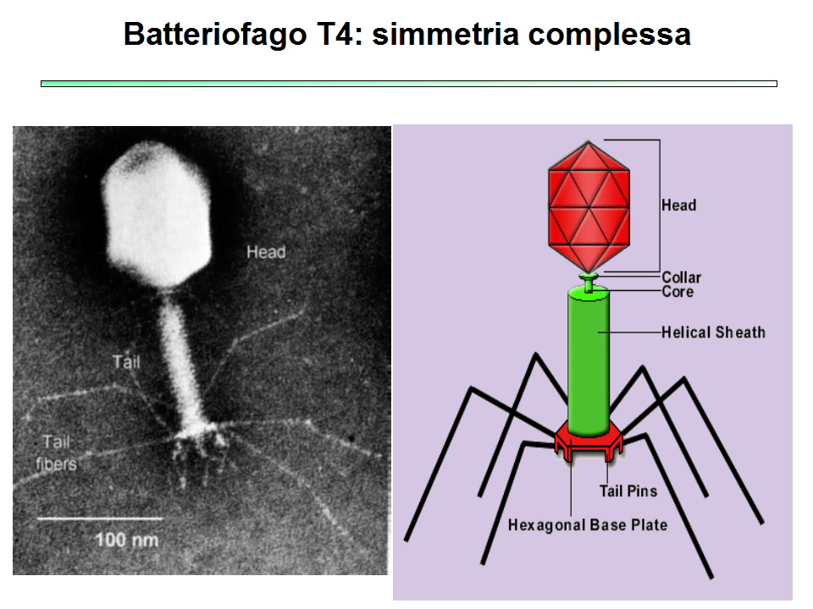
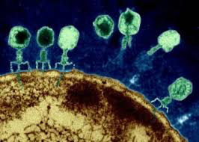
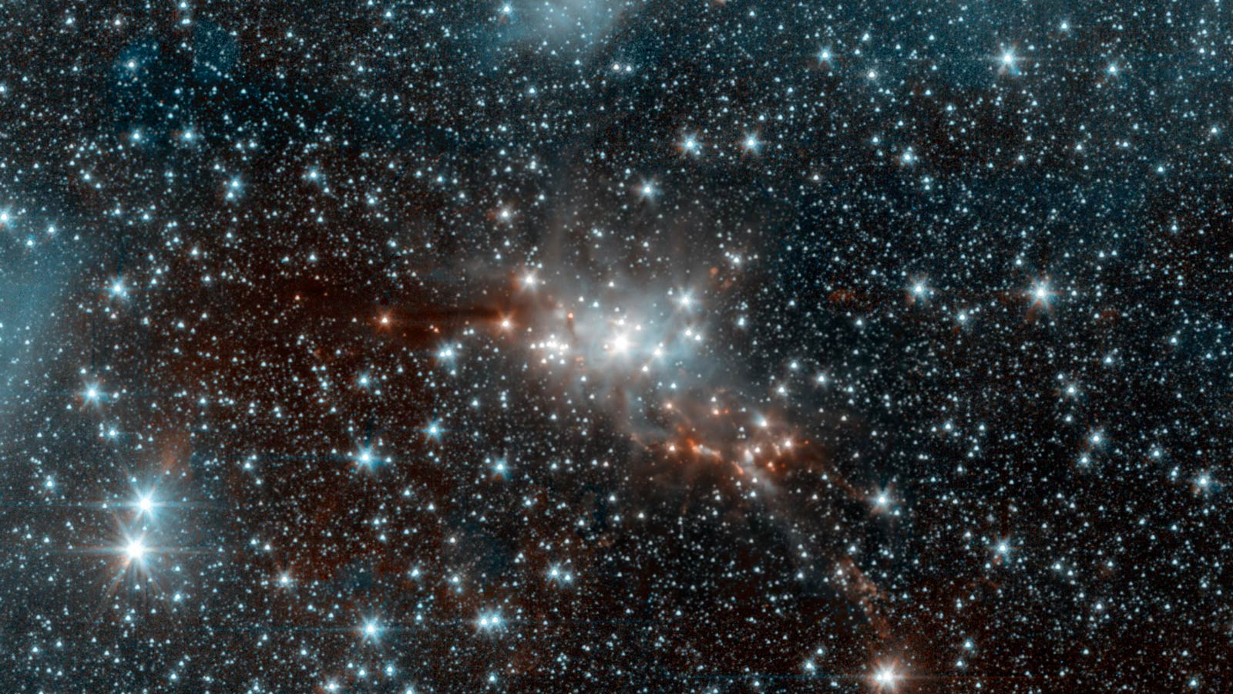
10³¹ phage on earth
10 phage for bacteria
10²²-10²⁴ stars in entire universe

Slide 20
Phage
Phage- bacteria predation dynamics or Kill-the winner
Phage kill only the dominant bacterial strains to reestablish a microbiological equilibrium.
In humans different niche contain stable communities of phage and bacteria as consequence of a predominant phage lysogenic cycle. Es: role of lytic phage into the development of disease (periodontitis)
Phage-induced bacterial genome modification
They offer evolutionary advantage to bacteria by stimulating mutations, adaptations and antibiotic resistance, by horizontal gene transfer. Es: profhage of enterococcus feacalis adhesion to human platelets , first step of infective endocarditis
Phage –human immune system dynamics
Pahge and microbiota colonize mucosal surface and are considered as part of innate immune system as they provide physical and biochemical antimicrobial defence.
Notes:
.

Slide 21
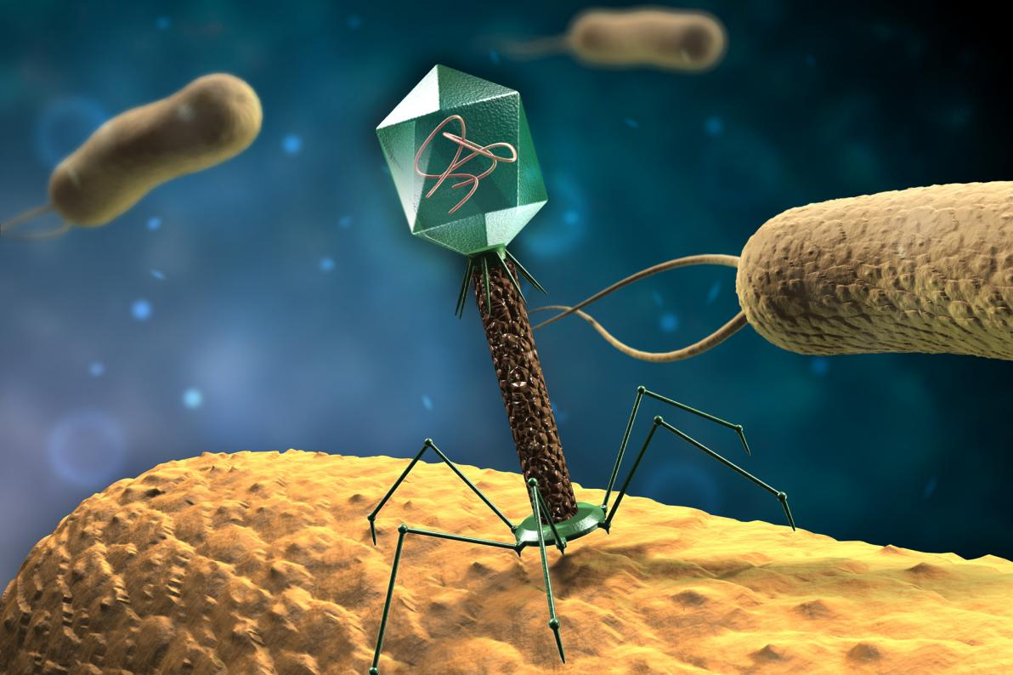
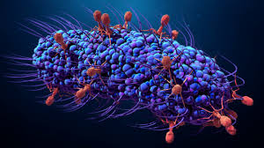
Bacteriophages shape the microbiota of all metazoans
Notes:
.

Slide 22
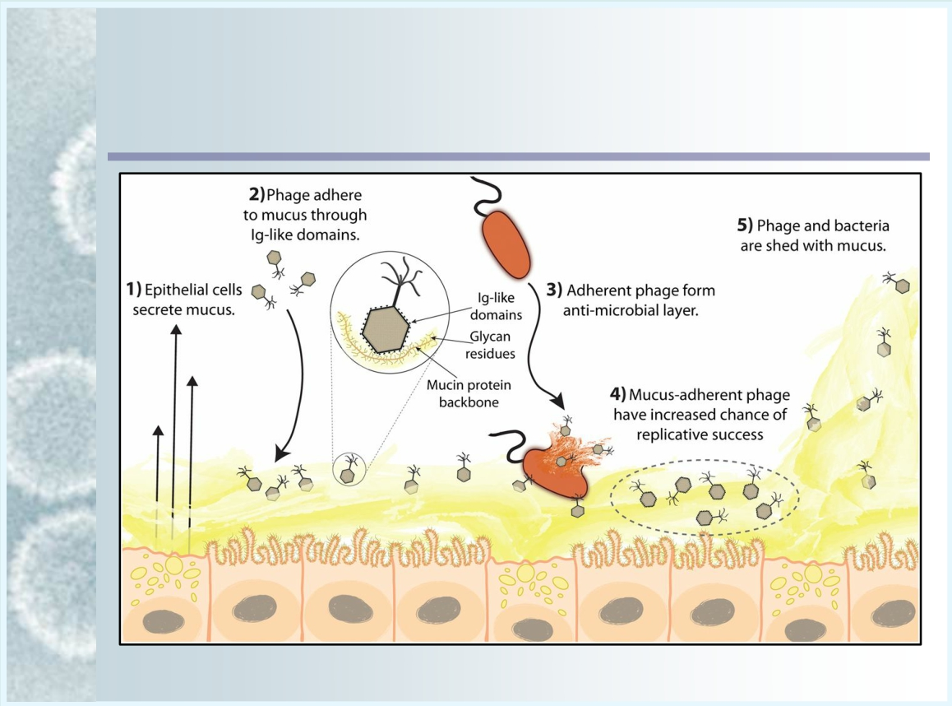
Intestinal Bacteriophages
Phages protect from pathogenic Bacteria: co-evolution with metazoan
Barr et al. PNAS 2013

Slide 23
The VIROME is more than a source of pathogens
THE EMERGING PARADIGM
The virome can influence the host in a profound way independent of classical viral disease
A systemic virus is inherited from parents very early in life.
The virome may be properly seen as a significant part of our individual genetic identity, whether or not the virus is integrated into our chromosome
Notes:
.

Slide 24
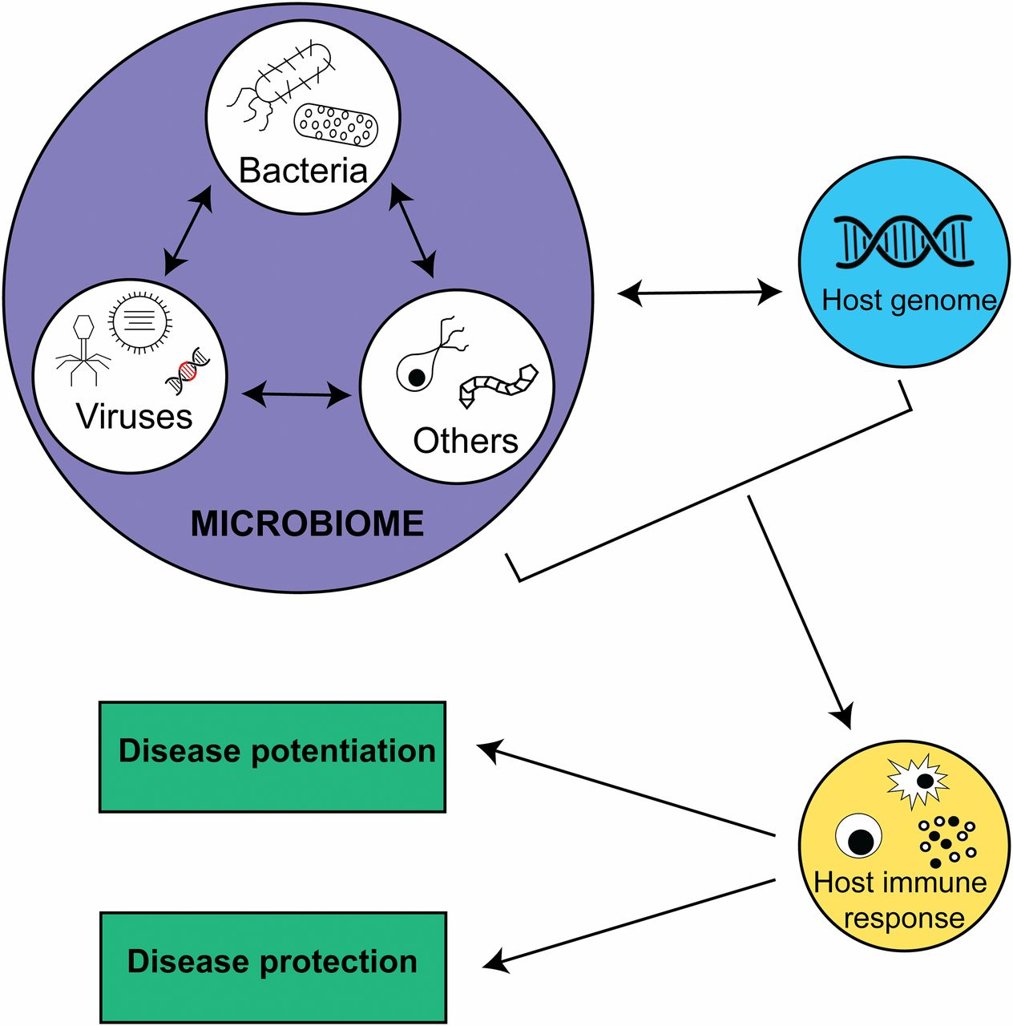
Virome
stimulates low level of immune response in asymptomatic host.

Slide 25
Notes:
.

Slide 26
birth mode results in distinctly different viral communities, with Spontaneous Vaginal Delivery infants having greater viral and bacteriophage diversity

Slide 27
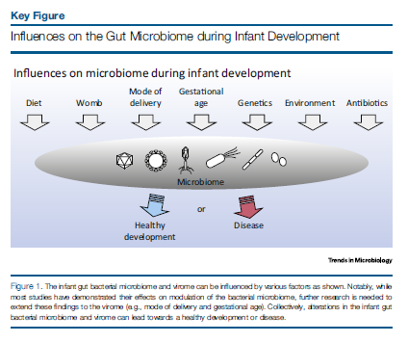
Bacterial and virus cooperation…

Slide 31
