Slide 1
Storia globale 2022-2023
Guido Abbattista (Università di Trieste)
*

Slide 2
Edward A. Mccord, The Power of the Gun. The Emergence of Modern Chinese Warlordism, Berkeley- Los Angeles-Oxford, University of California Press, 1993
https://publishing.cdlib.org/ucpressebooks/view?docId=ft167nb0p4&chunk.id=d0e288&toc.depth=1&toc
.id=d0e288&brand=ucpress
«For the first two centuries of its existence, the Qing dynasty's army was divided into two distinct branches. The first branch was the Banner Army (baqi , literally the "eight banners"), an organization of hereditary soldiers established before the Manchu penetration of the Great Wall. This army was primarily a Manchu force in that most adult male members of the Manchu tribal population were enrolled in it, but elements of it were also culled from Chinese and Mongol subject populations. After the Manchu conquest of China proper, most of the Banner Army was concentrated in garrisons around Beijing as a capital guard. Another large portion, stationed in the northeast, protected the Manchu homeland. Finally, other Banner garrisons were located at strategic points throughout the provinces and along the northern frontier.[1] The second branch of the Qing military was the Green Standard Army (lüying ). This was a predominantly Han Chinese force, formed after the Manchu conquest, largely modeled on the military organization of the preceding Ming dynasty. Charged primarily with the maintenance of local order, Green Standard troops were scattered throughout the country in small garrisons.[2] One significant feature of the traditional Qing military system was its careful elaboration of checks and balances aimed at preventing the concentration of military power in a manner that might present a threat to dynastic rule. The separation of Banner and Green Standard armies was in itself an attempt to make each branch serve as a check on the other. Thus, no unified command was ever created over both of these branches, and each had its own distinct administration. Even the troop deployment of the two branches had a counterbalancing purpose. Although the Green Standard Army was over twice as large as the Banner Army, the Banner Army's larger, strategically placed garrisons served as a check upon the more fragmented Green Standard forces.
*

Slide 3
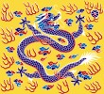
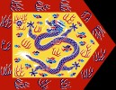
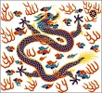
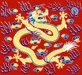
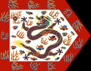
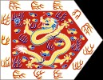
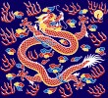
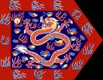
L’esercito Qing
Il sistema delle 8 bandiere: ogni bandiera 5 reggimenti, ogni reggimento 5 compagnie di 300 uomini (in teoria ogni bandiera è di circa 7500 uomini, al momento della conquista la stima è di 900).
Le tre bandiere superiori, al comando diretto dell’imperatore:
Le cinque bandiere inferiori, al comando di principi del clan imperiale
*

Slide 4
L’esercito Qing
«Battaglioni verdi»: soldati Han, in origine truppe Ming
entrate nell’esercito Mancese
Gendarmi dell’impero alle dipendenze del Ministero della Guerra
Sorveglianza e ordine pubblico distribuiti sul territorio: una sorta di esercito territoriale
Problemi maggiori nel sec. XVIII:
  Scarsa preparazione degli ufficiali
  Corruzione
  Scarso addestramento e organizzazione
  Cattivo armamento
  Mancanza di comando unificato
*

Slide 5
Principali campagne militari Qing nel sec. XVIII
Le 10 «grandi campagne» (guerre di frontiera):
  3 campagne conto i Mongoli Zungari, loro genocidio pacificazione dello Xinjiang, 1755-1759
  2 campagne per reprimere le popolazioni tibetane Jinchuan nello Sichuan, 1747-1749 e 1771-1776
  Campagne in Birmania, 1765-1769
  Campagna contro la ribellione a Taiwan (1786-1788)
  2 campagne contro i Gurkha nepalesi 1788-1793
  Campagne in Vietnam, 1788-1789 (intervento per risolvere a favore
dei Qing lotte dinastiche entro la famiglia Lê)
*

Slide 6
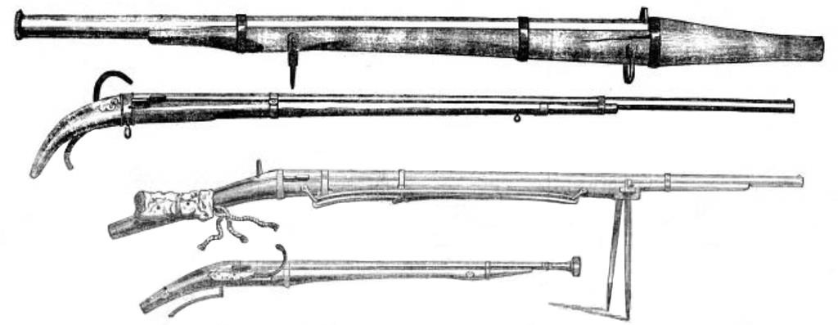
Armi cinesi all’epoca della I guerra dell’Oppio
*

Slide 7
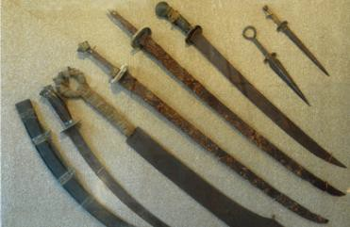
Armi cinesi all’epoca della I guerra dell’Oppio
*

Slide 8
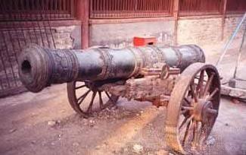
Cannone Qing
*

Slide 9

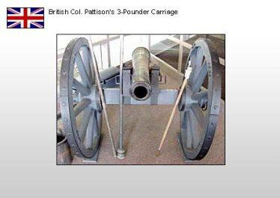
Armi britanniche
*

Slide 10
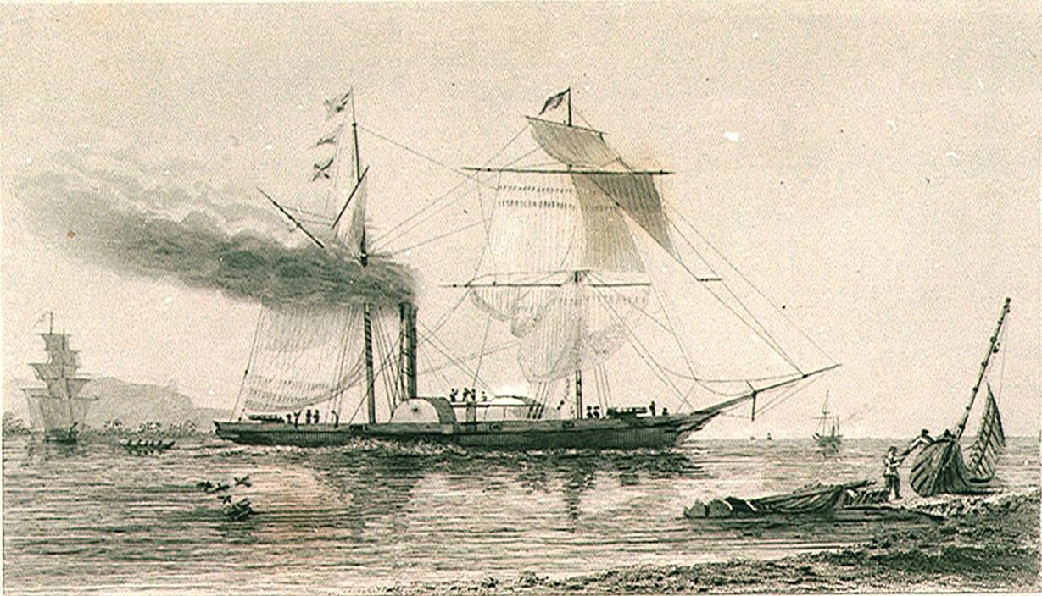
La «Nemesis», 1839, prima nave da guerra oceanica in ferro e a vapore
*

Slide 11
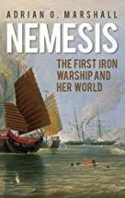
Storia della spedizione della «Nemesis»
W. D. Bernard, W. H. Hall, Narrative of the voyages and services of the Nemesis, from 1840 to 1843; and of the combined naval and military operations in China: comprising a complete account of the colony of Hong-Kong, and remarks on the character and habits of the Chinese, London, 1844
https://archive.org/details/narrativevoyage04hallgoog
Adrian G. Marshall, Nemesis:
The First Iron Warship and Her World, 2015
*

Slide 12
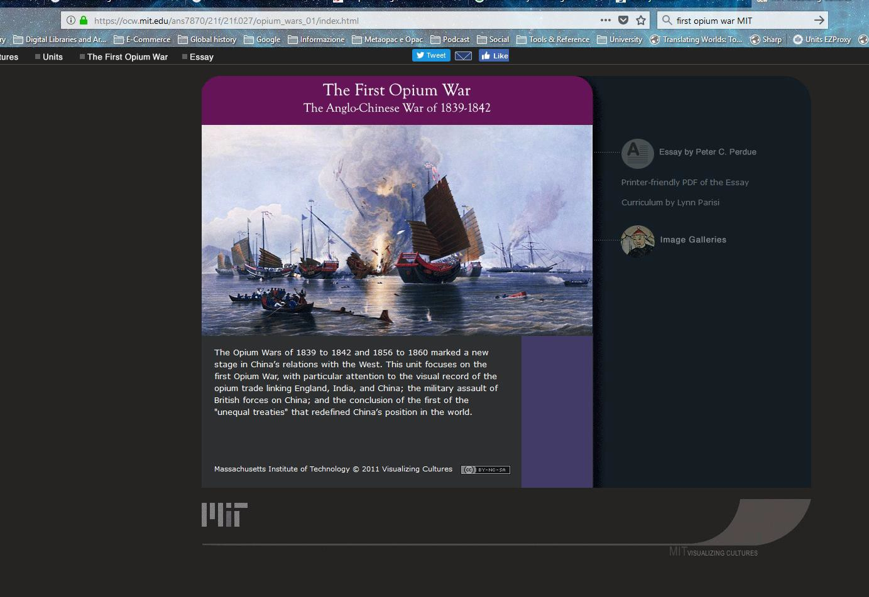
The First Opium War
MIT Visualizing Cultures
https://ocw.mit.edu/ans7870/21f/21f.027/opium_wars_01/index.html
*

