Slide 1
Reducing congestion and pollution in practice. The case of Ecopass Area C and Area B in Milan

Slide 2
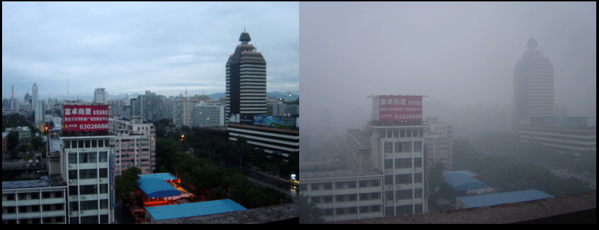
Congestion and air pollution in world cities
Beijing air on a 2005-day after rain (left) and a smoggy day (right)

Slide 3
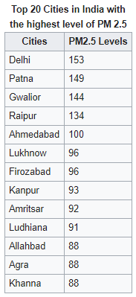
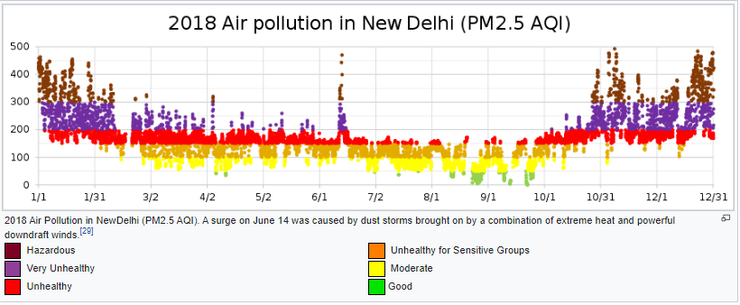
Air pollution in India
Exposure to particulate matter for a long time can lead to respiratory and cardiovascular diseases such as asthma, bronchitis, COPD, lung cancer and heart attack. The Global Burden of Disease Study for 2010, published in 2013, had found that outdoor air pollution was the fifth-largest killer in India and around 620,000 early deaths occurred from air pollution-related diseases in 2010.

Slide 4
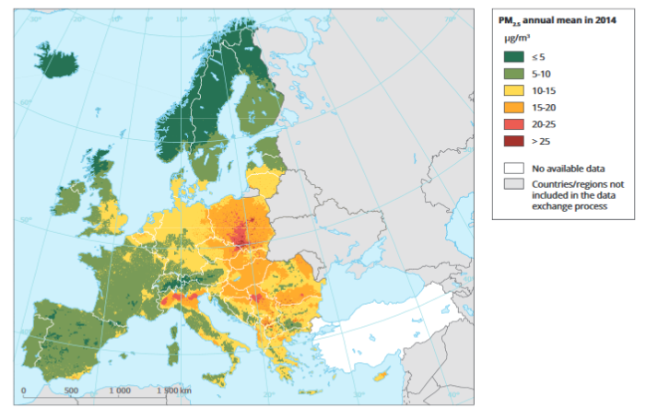
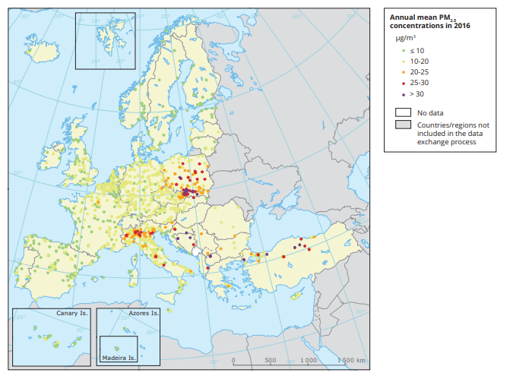
Inquinamento atmosferico locale
https://www.eea.europa.eu/publications/air-quality-in-europe-2017
La pianura padana è climaticamente una delle zone a maggior ristagno di inquinanti atmosferici

Slide 5
Reducing congestion and improving air pollution
Congestion can be reduced by either increasing road capacity (supply), or by reducing traffic (demand).
Capacity can be increased in a number of ways, but needs to take account of latent demand otherwise it may be used more strongly than anticipated.
Reducing road capacity has in turn been attacked as removing free choice as well as increasing travel costs and times, placing an especially high burden on the low income residents who must commute to work.

Slide 6
Reducing car traffic
Infrastructural or regulatory policies
  Reduction of road capacity
  Road space rationing
  Parking restrictions
  Permits
  Number plate restrictions
  Cap and trade
Financial policies
  Road pricing\Cordon pricing
  Registration tax, circulation tax
  Fuel tax
Promote alternatives to car use
  Cycling promotion through legislation
  Bike lane
  Incentives to use public transport
  Park and ride facilities
Reduce the need to travel
  more flexible work place practices
  Telecommuting
  Online shopping promotion
Increasing traffic efficiency – traffic management
Intelligent transportation system, which guide traffic:
Traffic reporting, via radio, GPS and mobile apps, to advise road users
Variable message signs installed along the roadway, to advise road users
Navigation systems, possibly linked up to automatic traffic reporting
Traffic counters permanently installed, to provide real-time traffic counts
Automated highway systems, a future idea which could reduce the safe interval between cars (required for braking in emergencies) and increase highway capacity by as much as 100% while increasing travel speeds
Parking guidance and information systems providing dynamic advice to motorists about free parking

Slide 7
Reducing congestion
Reduction of road capacity to force traffic onto other travel modes (traffic calming)
Road space rationing, where regulatory restrictions prevent certain types of vehicles from driving under certain circumstances or in certain areas.
"Cap and trade", in which only licensed cars are allowed on the roads. A limited quota of car licences are issued each year and traded in a free market fashion.
Number plate restrictions based on days of the week
Parking restrictions, making motor vehicle use less attractive by increasing the monetary and non-monetary costs of parking.
Permits, where only certain types of vehicles (such as residents) are permitted to enter a certain area, and other types (such as through-traffic) are banned.
Road pricing, charging money for access onto a road/specific area at certain times, congestion levels or for certain road users.
Cordon pricing, where a certain area, such as the inner part of a congested city, is surrounded with a cordon into which entry with a car requires payment.
Bike lane constructed in areas of low space to encourage use of human-sized transportation
Incentives to use public transport, increasing modal shares. This can be achieved through infrastructure investment, subsidies, transport integration, pricing strategies that decrease the marginal cost/fixed cost ratios, improved timetabling and greater priority for buses to reduce journey time e.g. bus lanes or bus rapid transit
Park and ride facilities allowing parking at a distance and allowing continuation by public transport or ride sharing (at metro stations, freeway entrances in suburban areas, and at the edge of smaller cities).
Cycling promotion through legislation, cycle facilities, subsidies, and awareness campaigns

Slide 8
Cities that applied a charging scheme
Singapore - The world's first congestion pricing scheme was introduced in Singapore's core central business district in 1975 as the Singapore Area Licensing Scheme.
Norway: electronic urban tolling on the main road corridors into Bergen (1986), Oslo (1990) and then the Trondheim.
London - congestion charge in 2003.
Santiago de Chile: Congestion pricing in urban freeways between 2004 and 2005, Santiago de Chile. The first 100% non-stop urban toll for concessioned freeways passing through a downtown area,
Stockholm - congestion tax covering Stockholm City Centre operational on a permanent basis since 1 August 2007;
Sydney: In January 2009, variable tolls were implemented at Sydney Harbour Bridge
Gothenburg: congestion tax in 2013.
Shanghai - Main roadways and highways in are tolled
Hong Kong: Electronic Road Pricing system operated between 1983 and 1985 with positive results. Public opposition stalled its permanent implementation. Proposals were however raised again in 2012.

Slide 9
Charging schemes: Ecopass and Area C in Milan

Slide 10
Milan
One of the largest Italian metropolitan areas. It comprises 3.7 million inhabitants (1.9 million within the city boundaries) and is the main centre of the polycentric Lombardy region of about 9.5 million inhabitants. Although the area is served by an important transport public network, Milan is one of the cities with the highest car concentration in the world: 0.6 cars per inhabitant (0.74 including all vehicles).
The high reliance on car use for travel together with adverse geo-climatic conditions of the Padania region result in very high pollution levels.
Since the national legislation requires Mayors to drastically intervene to curb pollution (even with a temporary ban of private vehicles’ traffic) in order to improve the quality of the urban environment, the Milan city administration, with Major Mrs. Letizia Moratti, decided to introduce, starting January 2008, a package of transport policies including Ecopass.

Slide 11
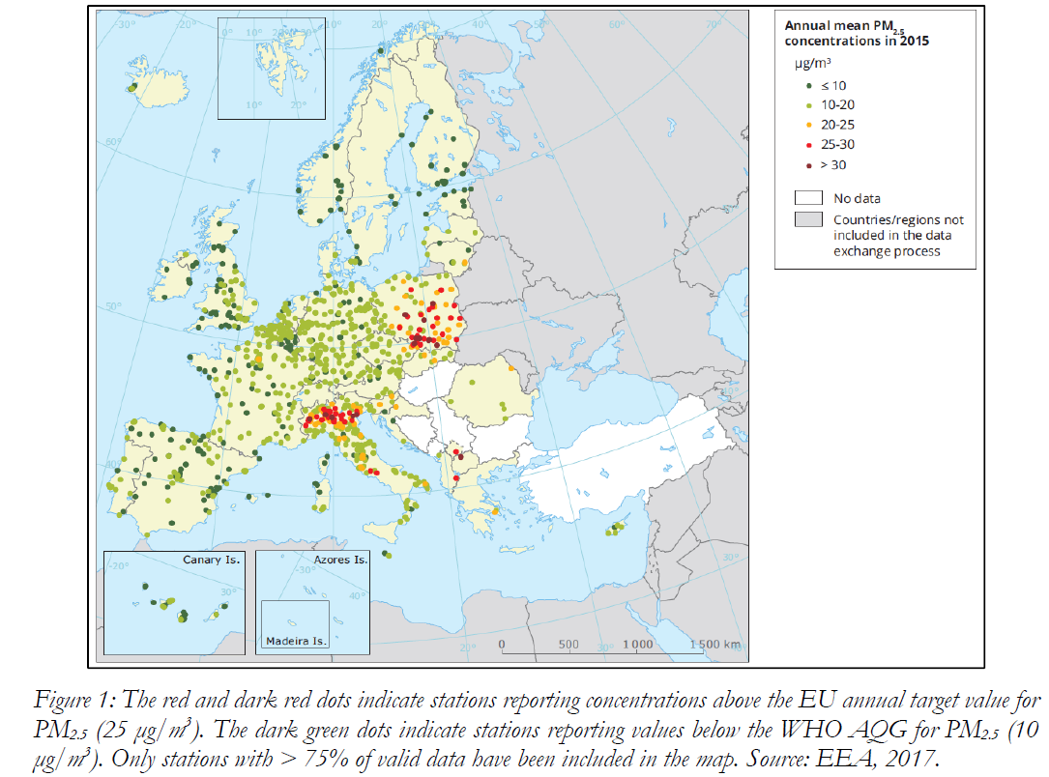
Adverse health effects and remature deaths are two of the major effects of poor air quality and current estimates suggest that exposure to PM2.5 is responsible of an average life loss of about 8 to 10 months in the most polluted European regions
(Southern Poland, Po Valley, Benelux…) and cities.
https://ec.europa.eu/jrc/en/publication/eur-scientific-and-technical-research-reports/urban-pm25-atlas-air-quality-european-cities

Slide 12
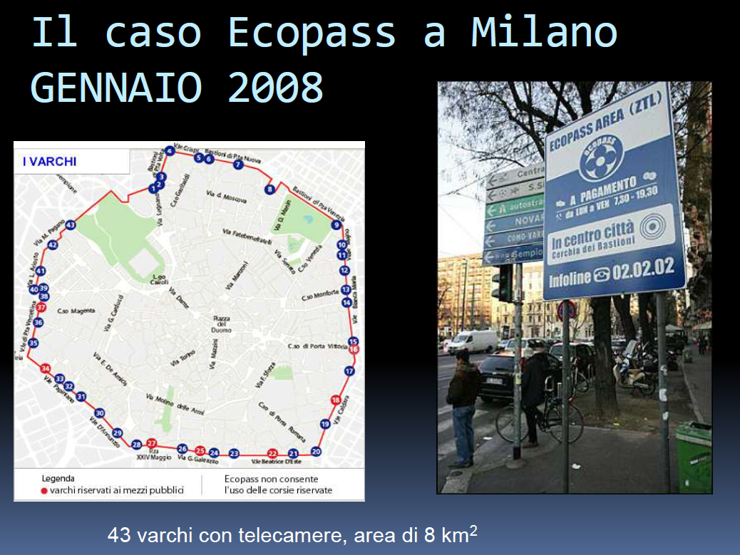

Slide 13
Ecopass - 2008
The Ecopass road pricing scheme requires that the vehicles entering the 8 km² area between 7:30 and 19:30 pay a charge. The charging area is relatively small compared to London (22 km² in the period from February 2003 until February 2007, 39 km² in the period between 2007 and January 2011, back to 22 km² from January 2011 to these days) and Stockholm (47 km²), but is comparable to Singapore (7 km²). The choice of the location and of the dimension of the charging area has been based on the historic urban layout, rather than on theoretical transport planning considerations.
A crucial decision was made to set the charge according to the Euro 5 emission standard classes. In contrast with theoretical prescriptions, no differentiation is made according to access time to the charging area, within the charging window (7:30-19:30). This is because the charge is mainly conceived and communicated as a pollution charge and not as a congestion one.

Slide 14
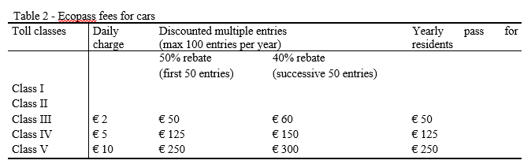
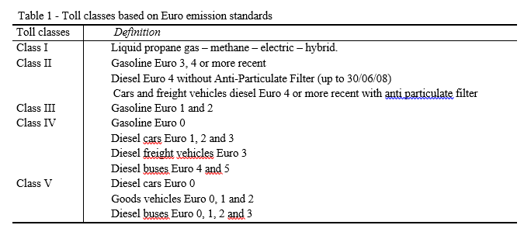
The fare structure

Slide 15
Implementation
Technology: an automatic-number-plate-recognition (ANPR) technology
Discounts are also available for residents in the tolled area. A number of categories are
Exempted users: motorcycles and scooters, public transport, vehicles for handicapped people, Army and Police (State and local) vehicles, vehicles used for public services, ambulances and, from 10 a.m. to 16 p.m., vehicles transporting exclusively perishable and refrigerated food products, provided a permit is purchased from the municipality.
The Ecopass scheme is part of a wider transport policy package including short-term policies such as traffic calming measures, new bus lanes, increased bus frequency, increase in parking restriction and fees, and medium-term policies such as park-and-ride facilities and underground network extensions.

Slide 16
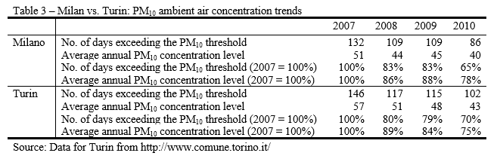
The impact on air pollution
Table 3 compares the PM₁₀ ambient air concentration trends in Milan and Turin. Turin has been chosen since it is located near Milan, it has a similar latitude and similar meteorological conditions. The number in inhabitants is slightly higher in Milan (1.3 million vs. 0.9 million inhabitants). Turin has also implemented many traffic policies aimed at reducing air pollution (public transport improvements; car, van and bike sharing; incentives to adopt cleaner vehicles for public and private transport; information campaigns) but did not follow Milan in the implementation of an environmentally-based charge.
Turin shows higher levels of PM10 ambient air concentration than Milan both in terms of number of days exceeding the PM10 threshold and average annual PM10 concentration levels. Both cities succeeded in reducing air pollution at a similar pace. The relative higher success of one city versus the other depends on the year of comparison. Unfortunately, since: a) the data concern the entire city area whereas Ecopass is limited to the Milan historical city center; b) concentration levels are very much depend on all city policies including the mandatory private-car total bans enacted both in Turin and Milan during the winter time when threshold infringements exceeded more than three days in a row

Slide 17
The impact on traffic
The total number of vehicles daily entering the Ecopass area initially decreased drastically but, starting from the year 2009, there is a tendency to increase again. This had positive effects both on air quality and on congestion in the first year, but at least the effect on congestion might have stopped.
The composition of the vehicles daily entering the Ecopass area has changed drastically, and, judging from the class they belong to, this means that the vehicles are becoming “cleaner” and air quality goals closer. In fact, the number of vehicles belonging to the tolled classes on the total entering vehicles drops from 42% in the year 2007, to 23% in the year 2008, to 16% in the year 2009 and finally to 15% in the first half of the year 2010.
There has been also an increase of the vehicles using “alternative fuels” or with “zero emission”. The number of passenger vehicles entering the Ecopass area with these characteristics increased from a daily value of 1,002 in the pre-Ecopass year to 4,574 in June 2010. Freight vehicles with the same characteristics and in the same period increased from 92 to 1,089.

Slide 18
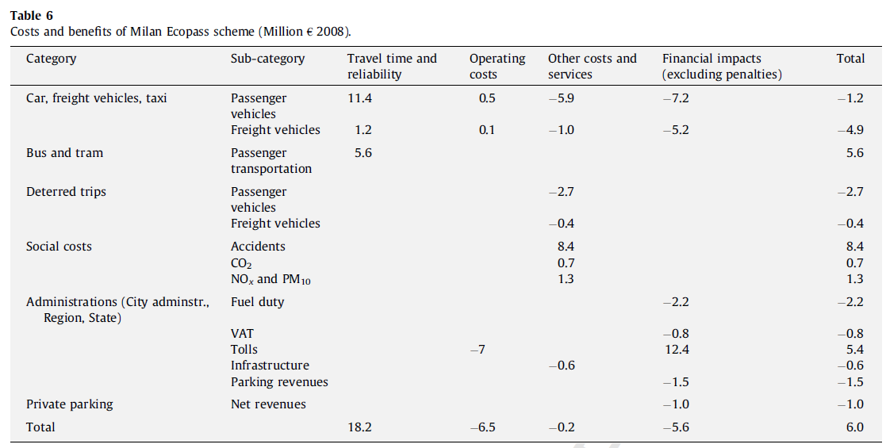
Cost-benefit analysis

Slide 19
Area C: Congestion charge 2012
Area C is a congestion charge introduced in Milan, Italy, on January 16, 2012, replacing the previous pollution charge Ecopass and based on the same designated traffic restricted zone or ZTL (Italian: Zona a Traffico Limitato), corresponding to the central Cerchia dei Bastioni area. The area is accessible through 43 gates, monitored by video cameras.
The charge applies to every vehicle entering the city centre on weekdays (except Saturday) from 7:30 am to 7:30 pm, on Thursdays the operation is limited to 6 pm. Every vehicle entering the charging zone must pay €5 regardless of its pollution level. Residents inside the restricted area must also pay to reach their houses but they have 40 free accesses per year and a discounted fare of €2
Access to the area is forbidden for diesel Euro 3 or below, gasoline Euro 0, and private vehicles over 7 m (23 ft) long. Electric vehicles, motorcycles and scooters, public utilities' vehicles, police and emergency vehicles, buses and taxis are exempt from the charge. Hybrid electric and bi-fuel natural gas vehicles (CNG and LPG) were exempt until 1 January 2013. This was later extended until the end of 2016.

Slide 20
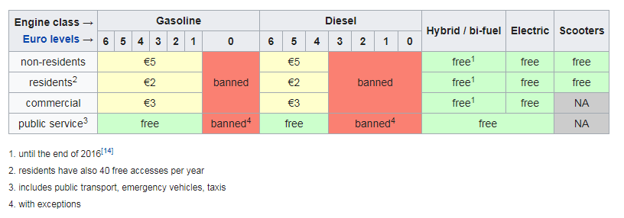
The tax structure

Slide 21
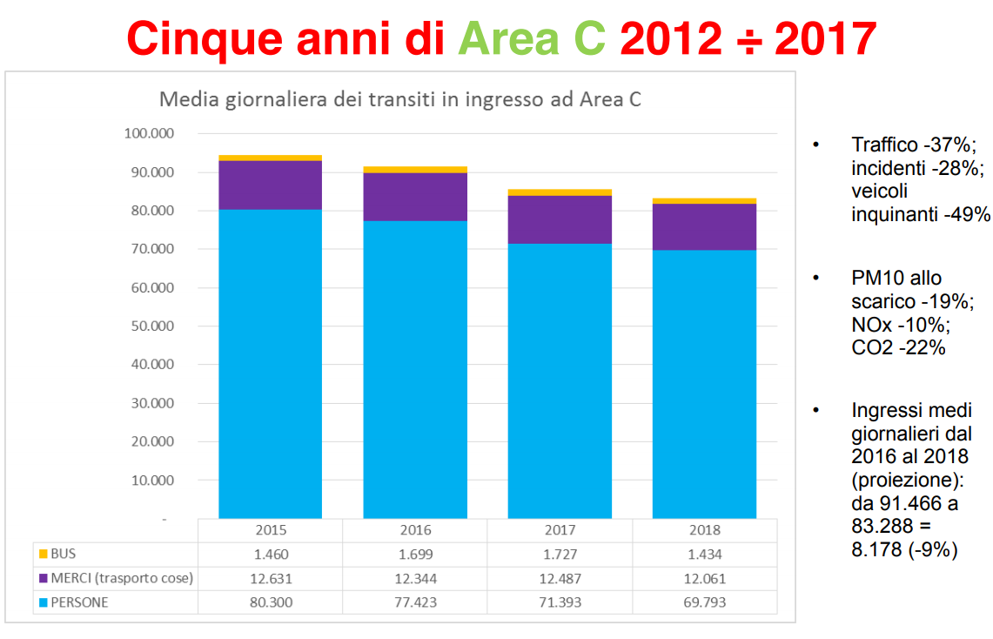
Impacts of Area C

Slide 22
Revenues
All net earnings from the scheme are invested to promote sustainable mobility and policies to reduce air pollution, including the redevelopment, protection and development of public transport, "soft mobility" (pedestrians, cycling, Zone 30) and systems to rationalize the distribution of goods.
In 2012, the program had a total revenue of about €20.3 million and net earnings after expenses of over €13 million.
These resources were used to increase service on the Milan Metro, on surface public transportation network and to finance the extension of the BikeMi bike sharing scheme.

Slide 23
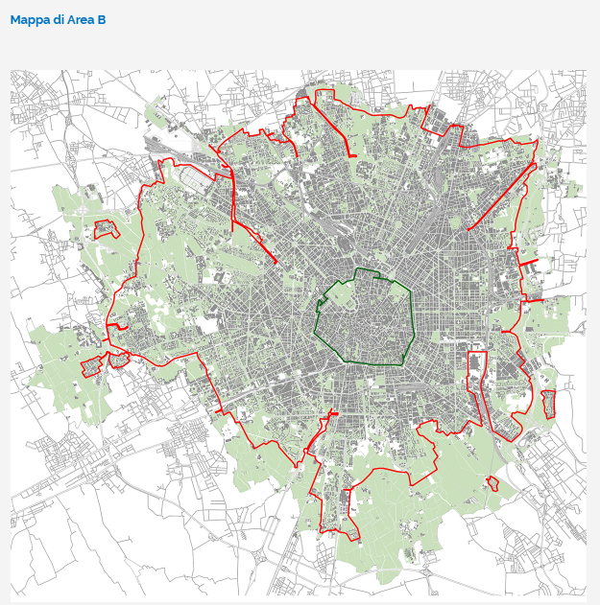
Area B: regulation

Slide 24
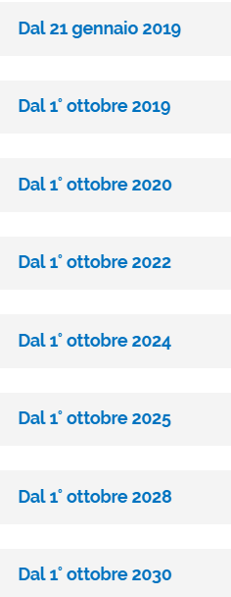
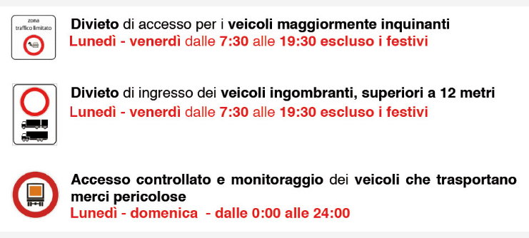
What is Area B?
Area B is a limited traffic zone. Access is prohibited to some vehicle classes. The is no charge. Access is controlled in 186 access points
access limitations increasingly stricter

Slide 25
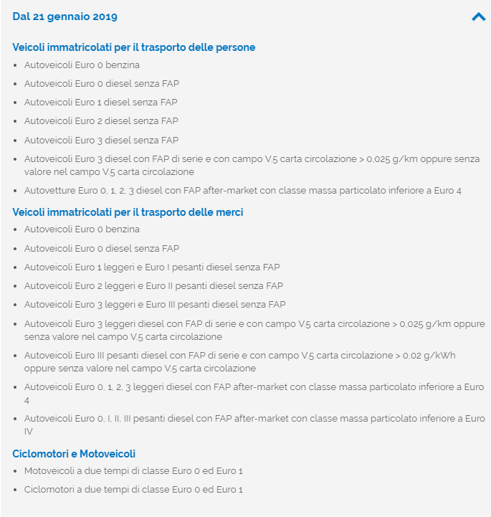
Not allowed vehicles:
Passeger car vehicles: Euro 0
Passeger diesel vehicles: Euro 0, 1, 2, 3
installazione FAP (Filtro anti-particolato)

Slide 26
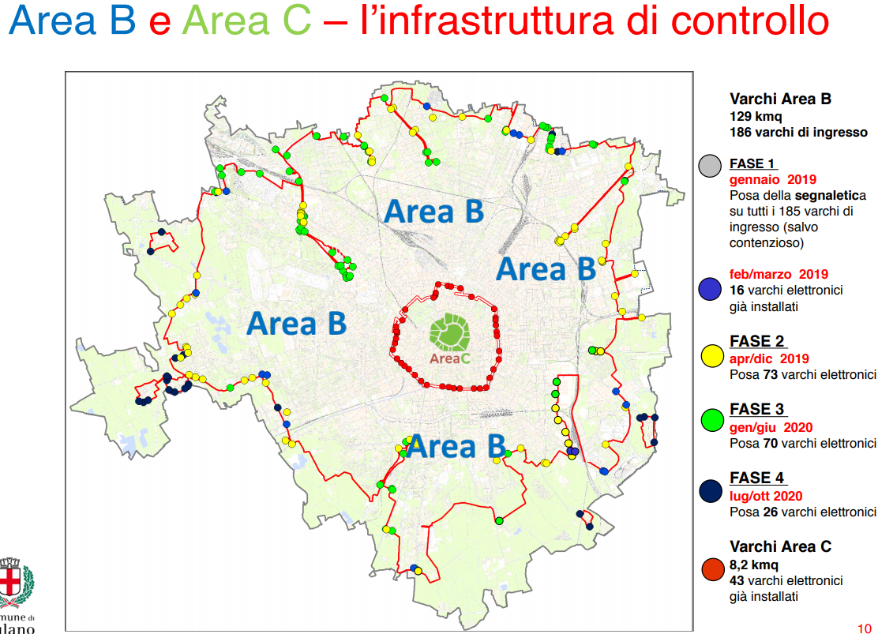
Access control

Slide 27
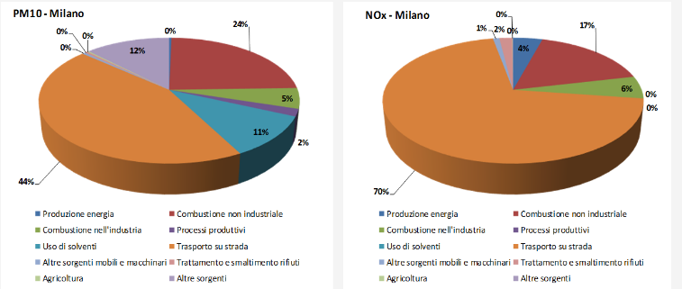
Motivations: road transport causes most of the air pollutants emissions

Slide 28
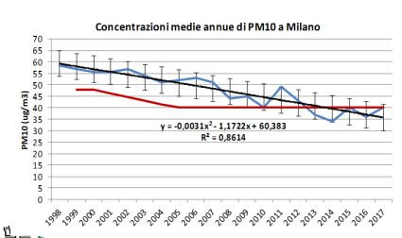
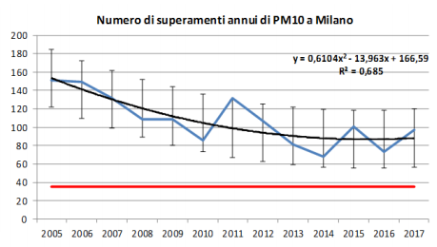
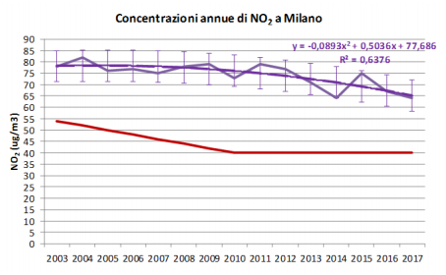

On the right track, but improvements are needed

Slide 29
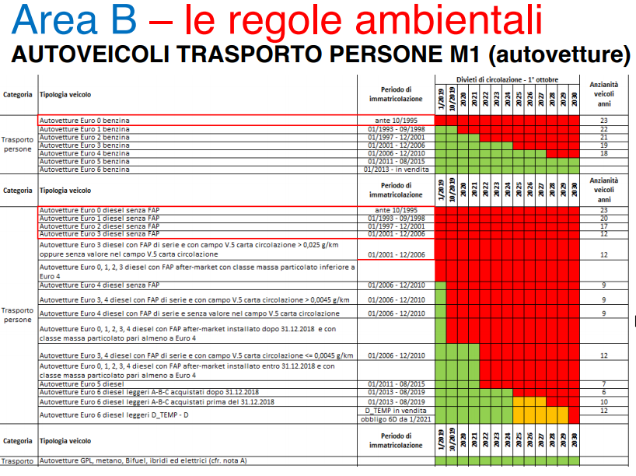
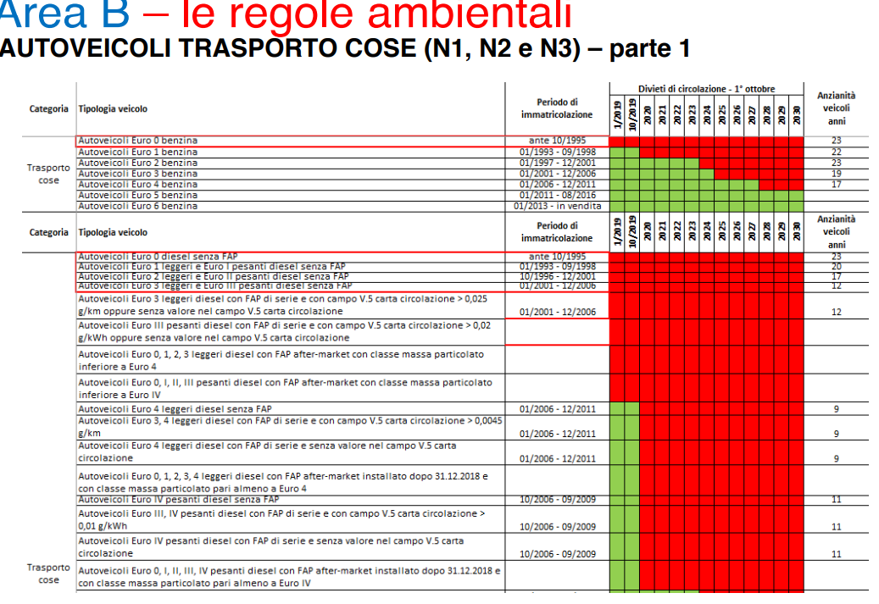
Gradually stricter rules

Slide 30
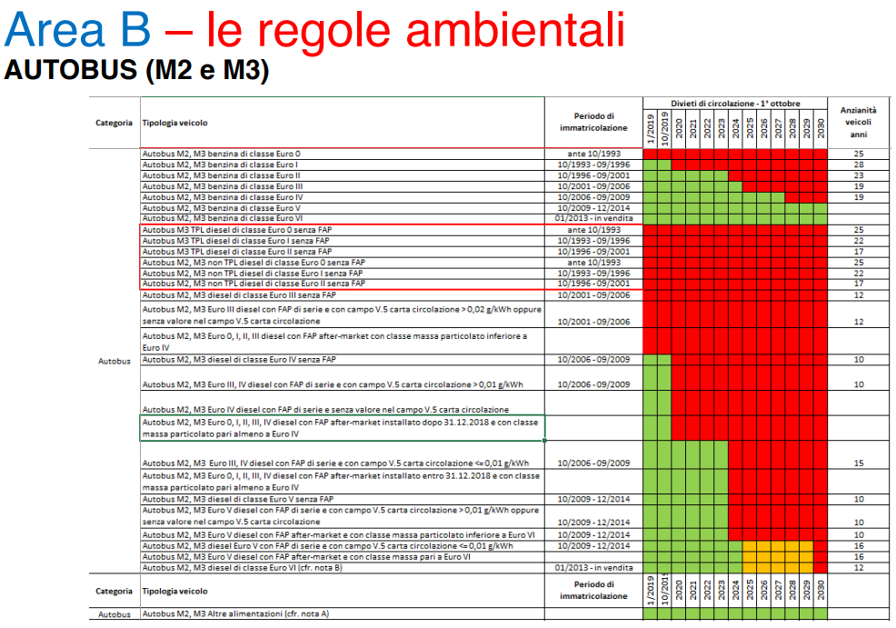
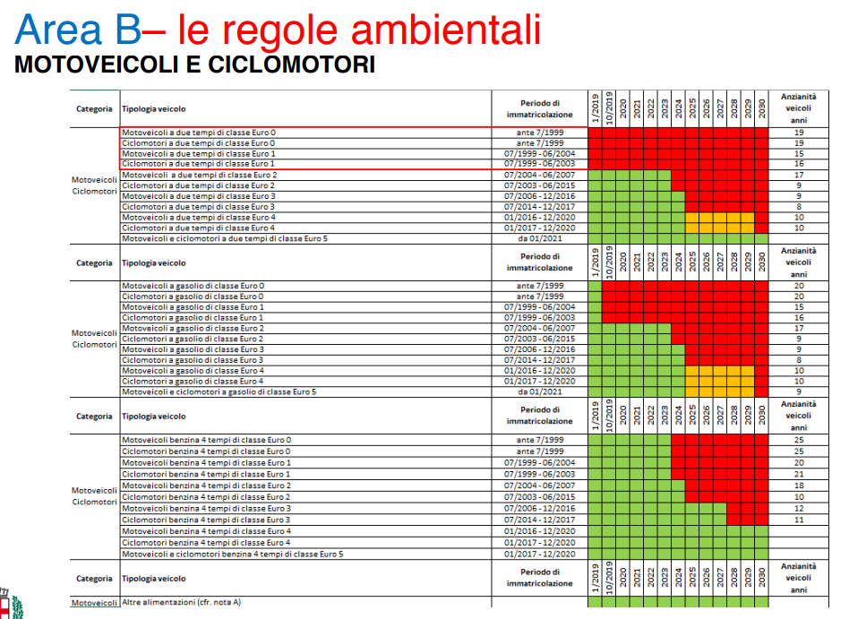

Slide 31
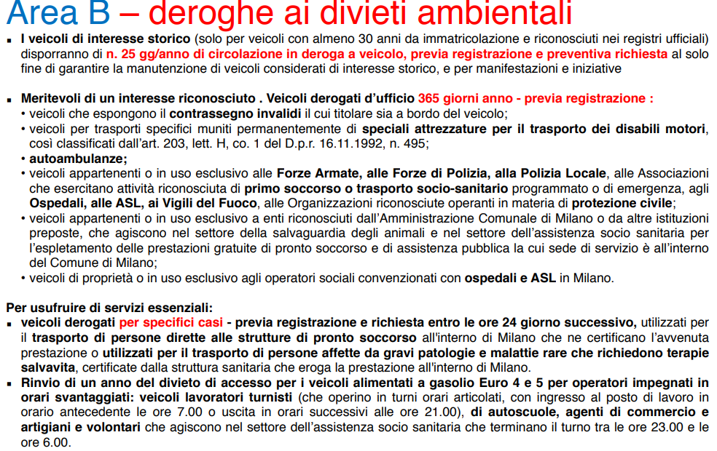
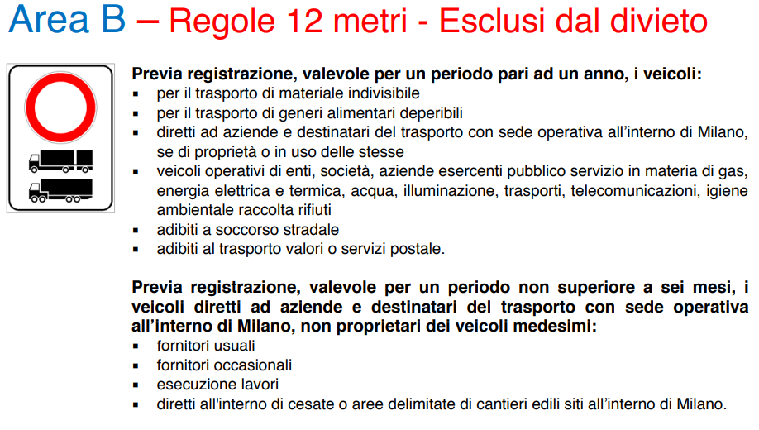
Various exceptions

Slide 32
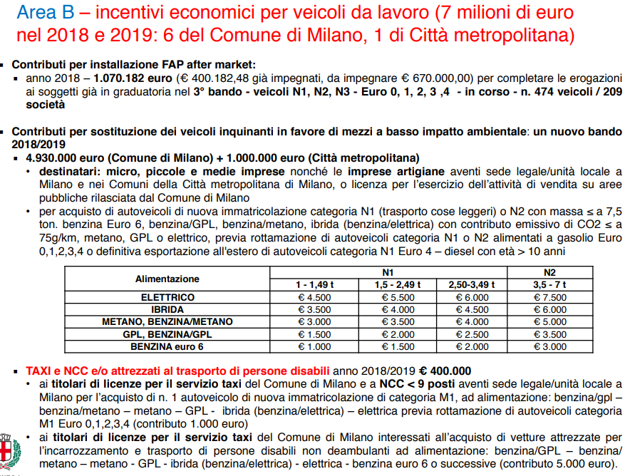
Ecomic incentives

Slide 33
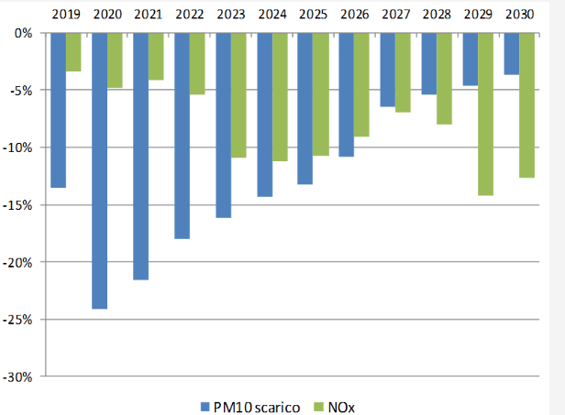
Estimated impacts

Slide 34
Accompaning policies: public transport, car sharing, bike sharing, scooter sharing
Public transport
  Supply increase: Da 2011 a 2017 il trasporto pubblico è cresciuto di 11,6 milioni di km*vetture (+8,2%);
  Users increase: Nel 2018 il trasporto pubblico ha avuto +4% di utenti grazie anche a potenziamenti urbani ed extraurbani per 1 milione km*vetture (linee 45, 71, 64, 46, 78, 51, prolungamento del tram 15 a Rozzano).
  Longer metro lines: Nel 2020 potenziamento di 2 milioni di km*vetture con prolungamento M1 da Sesto FS a Monza-Cinisello Balsamo. Nel 2021 potenziamento di 2,5 km*vetture con apertura M4 Linate-Forlanini FS e prolungamento tram 7 a quartiere Adriano.
  Single ticket: Nel 2019-2020 nuovo sistema unico tariffario in tutta la Città metropolitana di Milano e la provincia di Monza e Brianza con riduzione delle diseguaglianze, e introduzione della bigliettazione elettronica.
Vehicle sharing in Milan (2017):
  Bike sharing: 4.650 station-based e 12.000 free-floating bikes;
  Car sharing: 3.428 station-based and free-floating bikes cars
  Scooter sharing; 200 scooters

Slide 35
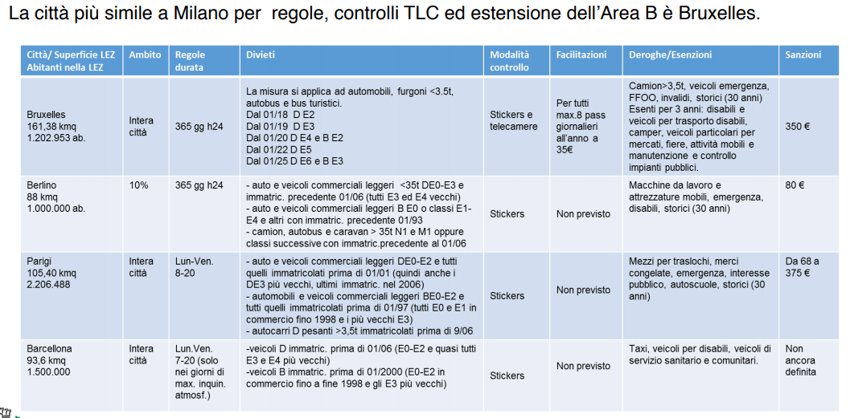
Similar policies in other European cities

Slide 36
Have a nice day!

