Slide 1
Road Freight Transportation: the truck

Slide 2
The technology

Slide 3
Technical aspects of truck
A truck (or lorry) is a motor vehicle designed to transport cargo.
Trucks vary greatly in size, power, and configuration, depending on the different goods and purposes
Modern trucks are largely powered by diesel engines, although small to medium size trucks with gasoline engines exist in the US.
The diesel engine, named after Rudolf Diesel, is an internal combustion engine in which the ignition of the fuel which is injected into the combustion chamber is caused by the elevated temperature of the air in the cylinder due to mechanical compression. This contrasts with spark-ignition engines such as a petrol engine (gasoline engine) or gas engine (using a gaseous fuel as opposed to petrol), which use a spark plug to ignite the air-fuel mixture.

Slide 4
Types of trucks by size
Ultra light trucks
Very light trucks
Light trucks
Medium trucks
Heavy trucks
Off-road trucks

Slide 5
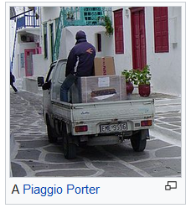
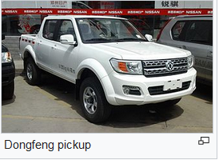
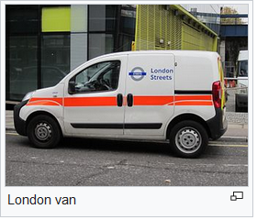
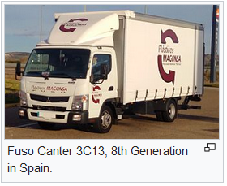
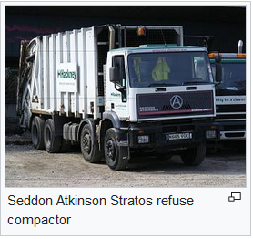
Very light trucks
Medium trucks
Heavy trucks

Slide 6
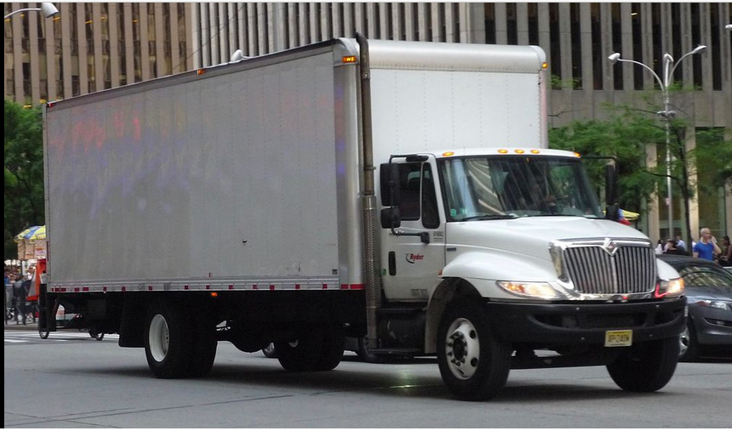
Box truck

Slide 7
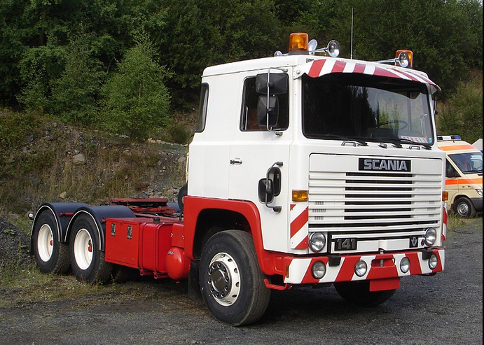
Semi-tractor

Slide 8
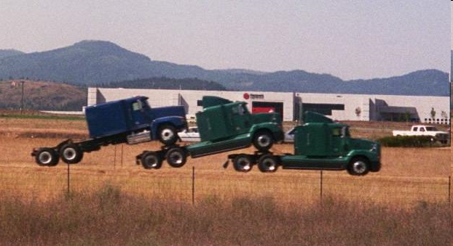
In North America, semi tractors usually have 3 axles, A smaller tractor, having a single drive axle (six wheeler) is often used to pull shorter trailers in tight urban environments, such as downtown areas where a 60-foot rig would be too difficult to maneuver. These tractors are referred to as day cabs and do not have sleepers.

Slide 9
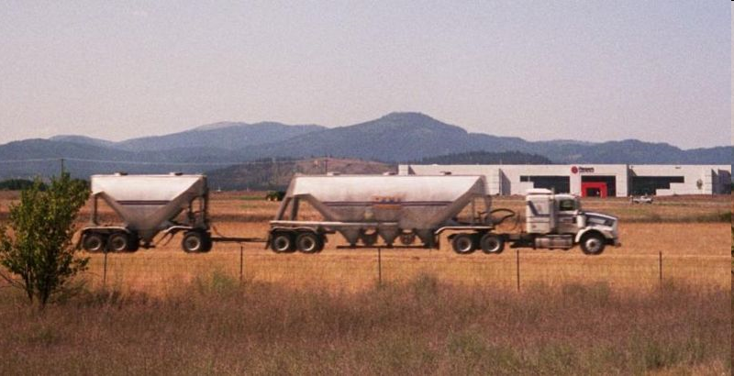
The cargo trailer usually has two "tandem" axles at the rear, each of which has dual wheels, or 8 wheels on the trailer. Many trailers are equipped with movable tandems that can be set to balance the weight of the trailer to stay within legal limits.

Slide 10
Rules governing the maximum size and weight of vehicles differ between states in the US
The Department of Transportation has established these vehicle limits: 102 inches wide, 13.5 feet in height, and 80,000 lbs gross weight. These limits can be exceeded as individual States have the right to issue temporary oversize and/or overweight permits.

Slide 11
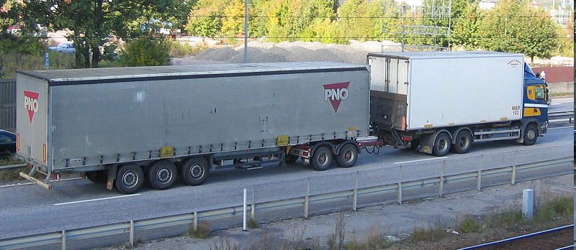
A truck pulling a trailer using a trailer dolly.
The noticeable difference between tractor units in the U.S. and Continental Europe is that most European models are "cab over engine" (COE or forward control), while most U.S. trucks are conventional (or normal control).

Slide 12
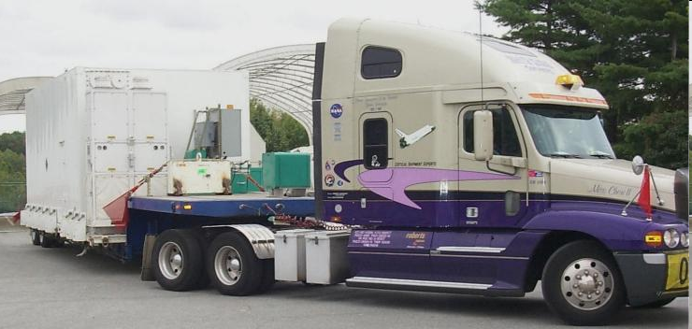
Semi-trailer truck with 'sleeper' behind the cab.

Slide 13
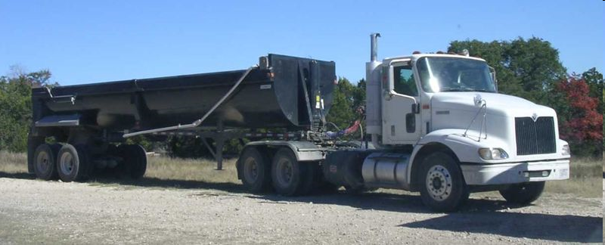
Tractor with end-dump semi-trailer

Slide 14
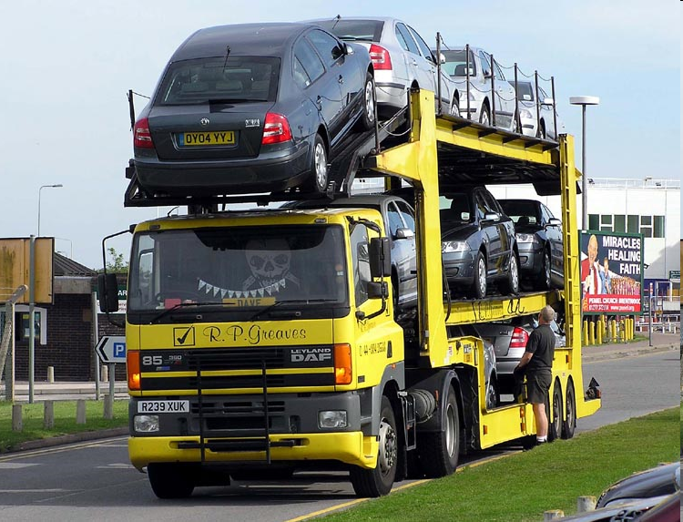
A tractor with an auto-transport semi-trailer
Notes:
Nome italilano: bisarche

Slide 15
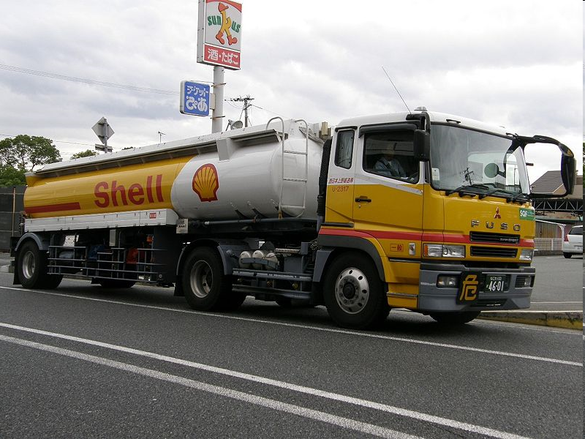
Tank trucks are referenced by their size or volume capacity. Large trucks typically have capacities ranging from 5,500 gallons (20,820 litres) to 9,000 gallons (34,069 litres).
Notes:
Tank trucks are referenced by their size or volume capacity. Large trucks typically have capacities ranging from 5,500 gallons (20,820 litres) to 9,000 gallons (34,069 litres).

Slide 16
Europe
In Sweden the allowed length is 24 meters (78.7 ft) for all vehicles and 25.25 meters (82.8 ft) for trucks with two trailers. In 1997 the rules were changed, following the European Economic Area rules, allowing trucks to pull two trailers with a total length of 25.25 meters (82.8 ft), assuming certain conditions were met, like ABS on all vehicles.
In Finland most trucks can tow any trailer as long as total length stays within 25.25 meters (82.8 ft).
The allowed gross weight in both countries is up to 60 tons (132,277 lb) depending on the distance between the first and last axle.

Slide 17
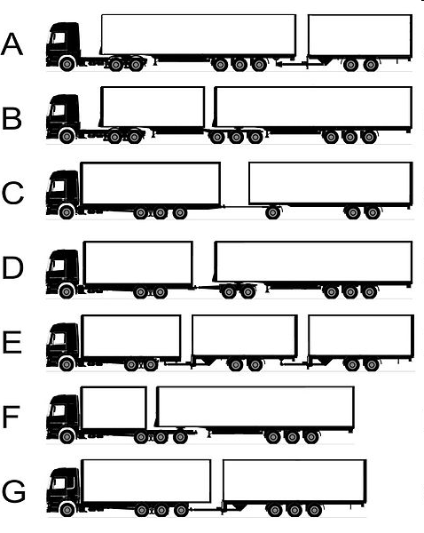
The 25,25 metres truck combinations were developed under the branding of EcoCombi which influenced the name of EuroCombi for an ongoing standardization effort where such truck combinations shall be legal to operate in all jurisdictions of the European Economic Area.

Slide 18
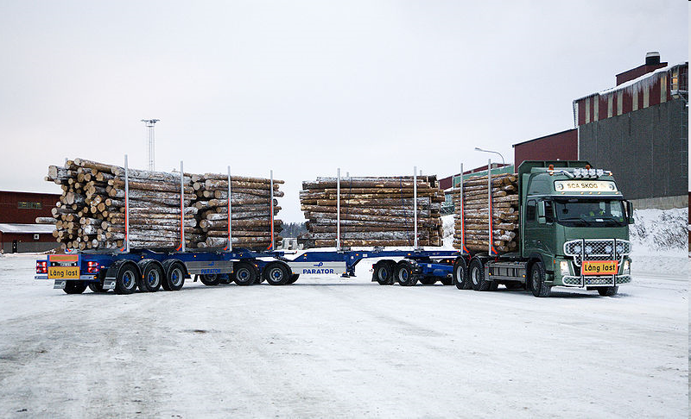
Starting in Dec. 2008, 30 meter long truck trailer combinations with a gross weight of 90 metric tons, 200,000lbs., were allowed in Sweden. It's estimated that this will give a 20% lower cost and 20-25% CO2 emissions reduction compared to if the timber instead would have been transported with regular 60 ton truck combinations. The braking distance, road wear, and traffic safety will be either the same or improved with the 90 ton truck-trailer.
30 meter and 90 ton combination

Slide 19
Italy

Slide 20
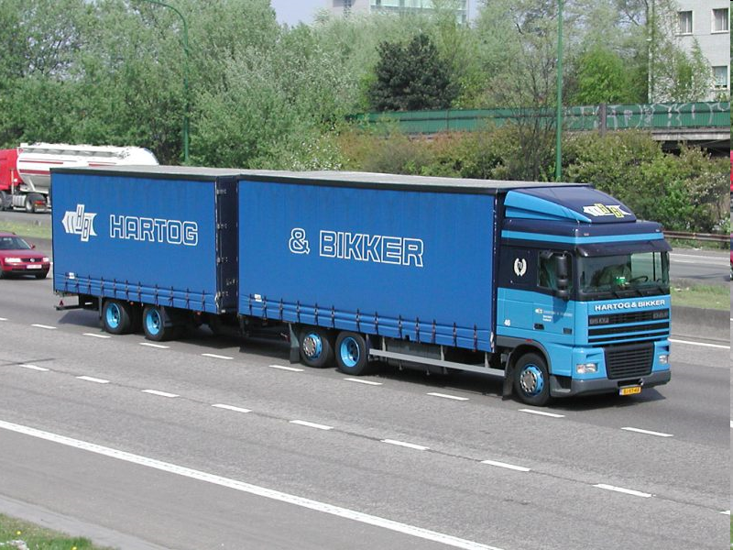
Per autotreno si intende quel convoglio costituito da qualsiasi autoveicolo e da un rimorchio separato, quest'ultimo un veicolo sprovvisto di motore.

Slide 21
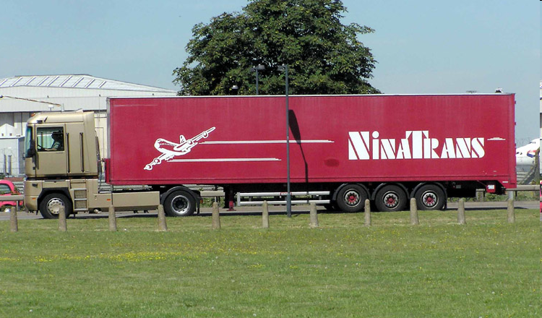
L'autoarticolato viene definito nel nostro Codice della strada all'articolo 54 comma i come "complessi di veicoli costituiti da un trattore e da un semirimorchio."

Slide 22


Autoarticolato vs. autotreno
The strengths of the autoarticolato (compared to the autotreno):
A uniform loading plan with a useful length of 13,60 m which allows the load of objects of particular clutter.
The possibility to separate the two units and use the semi-tractor for another semi-trailer during the waiting times at the loading or unloading warehouse.
A greater possibility of using intermodal transport even by loading the trailer on a ship, ferry or rail.
The weaknesses of the autoarticolato (compared to the autotreno):
A lower overall loading capacity, both because of the overall length that can be achieved by the two separate cargo compartments and the possibility of having a particularly low trailer which use smaller tires than the ones used on a semitrailer.
The possibility to use only the first part of the autotreno, allowing greater flexibility

Slide 23
Truck Manufacturing: a very important industry
Used elsewhere:
* DAF
* Mercedes-Benz
* Iveco
* MAN
* Renault
* Scania
* Volvo
* Kamaz
* Tatra
* Nissan UD
* Hino
Used in the United States:
* American Coleman
* Ford
* Freightliner
* Kenworth
* International
* Mack
* Peterbilt
* Sterling
* Volvo
* Western Star
* Hino

Slide 24
Alternative-fuelled trucks

Slide 25
Truck manufacturers
Open competition among alternative propulsion systems
Truck manufacturers aiming :
Mainly at hydrogen: Hyzon Motors, Hyundai, …
Both at hydrogen and electricity: Daimler, Nikola Motors,….
Mainly at electricity: Tesla, VW (Volvo, Man, Scania), BYD, …

Slide 26
Electric truck

Slide 27
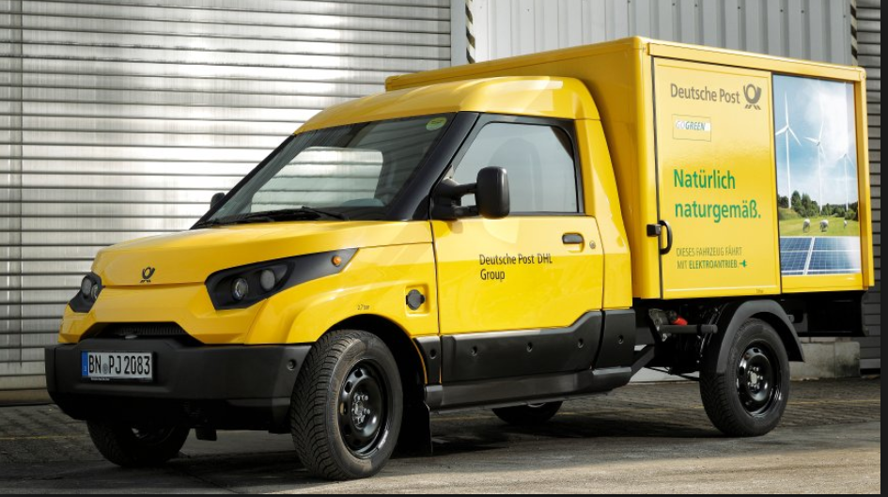
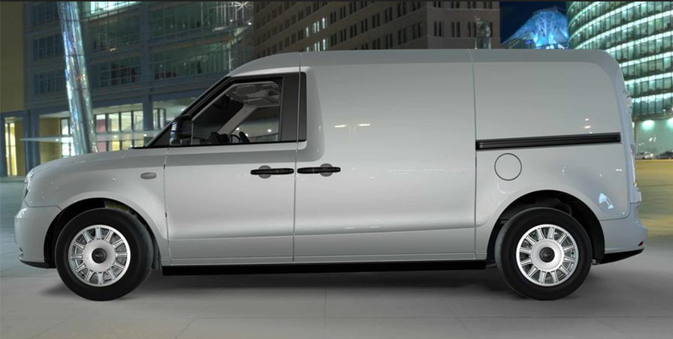
Urban goods distribution
This was a privately organized research initiative at the RWTH Aachen University which later became an independent company in Aachen
In April 2016, Deutsche Post DHL Group announced that StreetScooter GmbH would be scaling up to manufacture approximately 10,000 of the Work vehicles annually, starting in 2017.
Die London Electric Vehicle Company (LEVC) zeigt ein erstes Foto ihres elektrifizierten Transporters, der Ende 2019 in den Handel kommen soll.

Slide 28
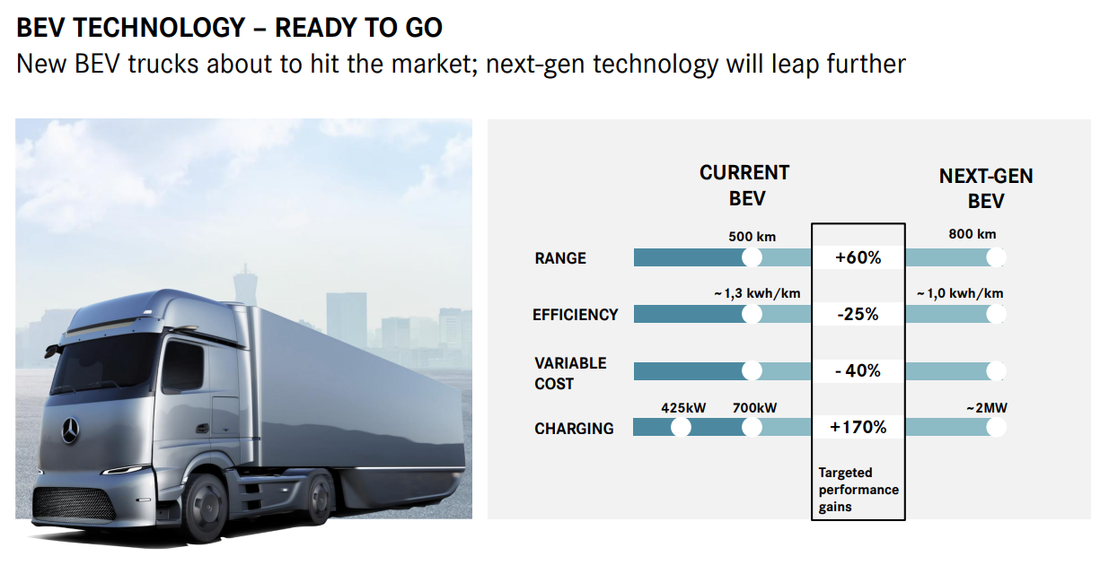
Long distance trucks: Daimler

Slide 29
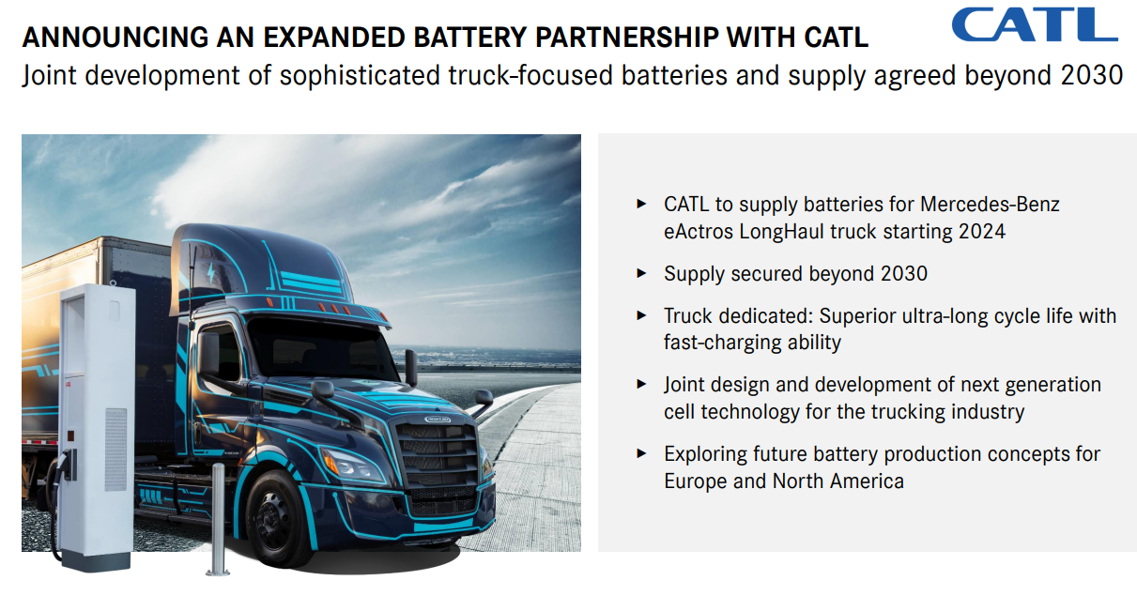

Slide 30
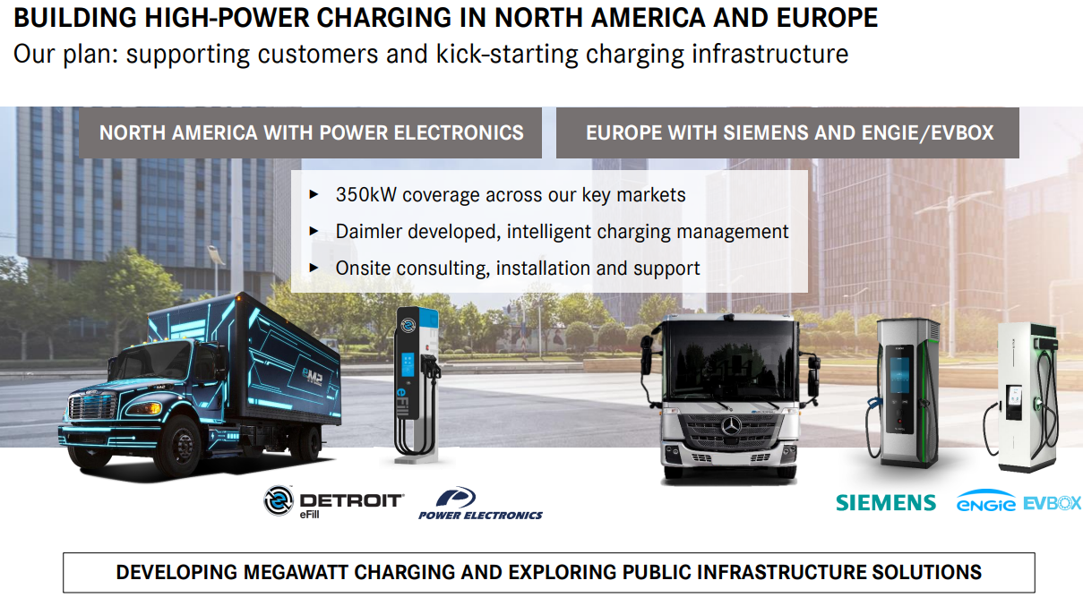

Slide 31
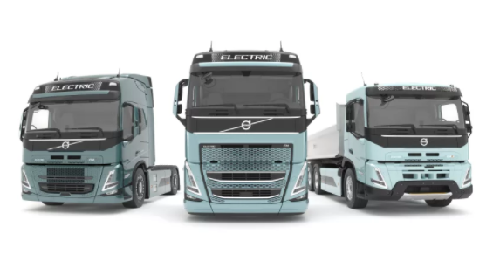
Volvo FH, FM e FMX
Con l’inizio delle vendite di tre nuovi camion completamente elettrici – FH, FM e FMX – Volvo Trucks è ora in grado di offrire una gamma completa di sei modelli elettrici. La produzione dei nuovi camion inizierà con i trattori nella seconda metà del 2022, con gli autocarri a seguire nel 2023.
Batterie di nuova generazione ad alta densità di energia: sei pacchi di batterie, capacità nominale di 540 kWh, autonomia fino a 300 km*.
Ricarica flessibile e veloce: due modalità di ricarica: AC fino a 43 kW, ideale per la ricarica notturna o DC molto più veloce, fino a 250 kW, molto utile in caso di turni di guida consecutivi o per una ricarica durante la pausa pranzo, per aggiungere ulteriore autonomia. Con un caricatore DC da 250 kW, è possibile ricaricare fino all’80% della batteria in meno di 90 minuti**.

Slide 32
Hydrogen trucks

Slide 33
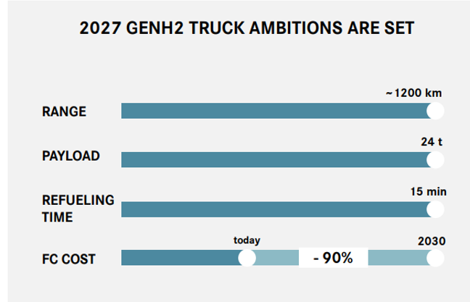
La strategia Daimler per H2 Truck
FUEL CELL systems
LIQUID HYDROGEN REFUELING
HYDROGEN INDUSTRY PUSH
NEW HYDROGEN CORRIDOR LAUNCHED - SHELL

Slide 34
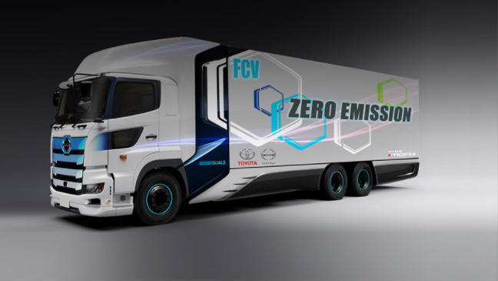
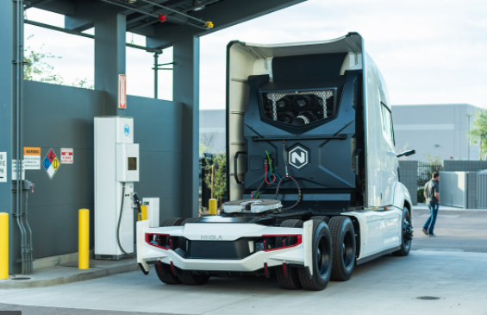
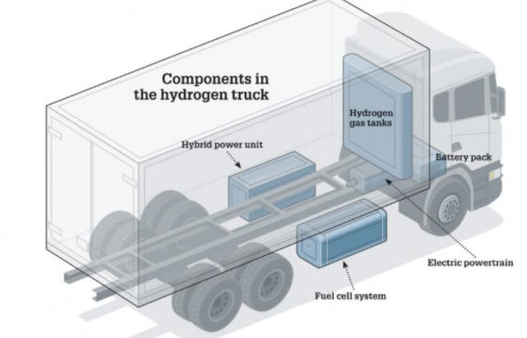
Long distance hydrogen trucks

Slide 35
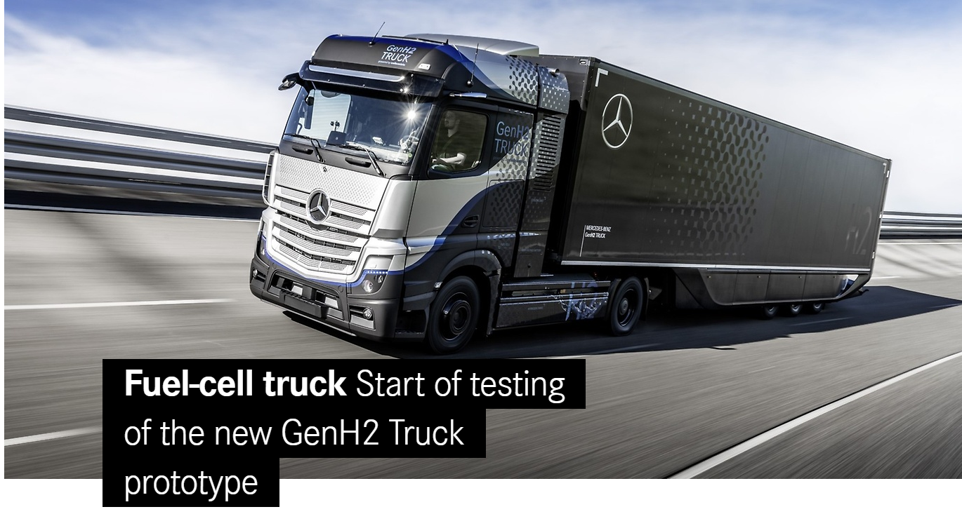
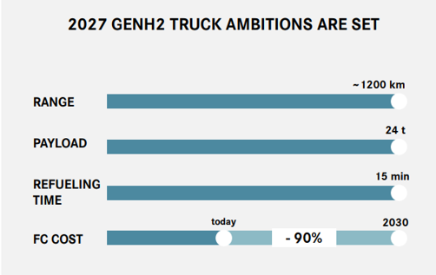
Daimler Trucks: Mercedes-Benz GenH2 Truck. In sperimentazione da Aprile 2021
Daimler Trucks & Buses is one of the world’s largest commercial vehicle manufacturers, with more than 35 primary locations around the world and around 100,000 employees.

Slide 36
Daimer: H2 e BEV trucks
WE ARE COMMITTED TO BOTH BEV & HYDROGEN SOLUTIONS: BEV and FCEV are complementary and both will be needed
Parity for BEV possible after 2025
Parity for FCEV possible after 2027
Sintesi: H2 Camion
prototipi
in produzione di serie dal 2022
TCO parity dal 2027 (Stima Daimler)

Slide 37
Traffic types and definitions

Slide 38
Definitions
National road freight transport is defined as road transport between two sites (a place of loading and a place of unloading) located in the same country by a vehicle registered in that country.
International road freight transport is defined as the transport by road between two sites in two different countries irrespective of the country in which the vehicle is registered. It is composed of 4 categories:
  International loaded: Place of loading of goods in reporting country (i.e. country in which the vehicle performing the transport is registered) and place of unloading in a different country. E.g. Italian truck loading in Italy and unloading in France.
  International unloaded: Place of unloading of goods in reporting country (i.e. country in which the vehicle performing the transport is registered) and place of loading in a different country. E.g. Italian truck loading in France and unloading in Italy.
  Cross-trade is international road transport between two different countries performed by a road motor vehicle registered in a third country. A third country is a country other than the country of loading/embarkation and than the country of unloading/disembarkation. This transport is reported by the country in which the vehicle is registered. E.g. Polish truck loading in France and unloading in Italy.
  Cabotage is road transport by a motor vehicle registered in a country performed on the national territory of another country. E.g. Italian truck loading in France and unloading in France. In the EU hauliers are allowed up to three cabotage operations within 7 days following an incoming international carriage.
Total international transport – loaded, unloaded, cross-trade and cabotage - includes transport reported by hauliers registered in reporting countries performed, completely or partially, outside these countries. Transport undertaken by hauliers registered in other countries is not included.

Slide 39
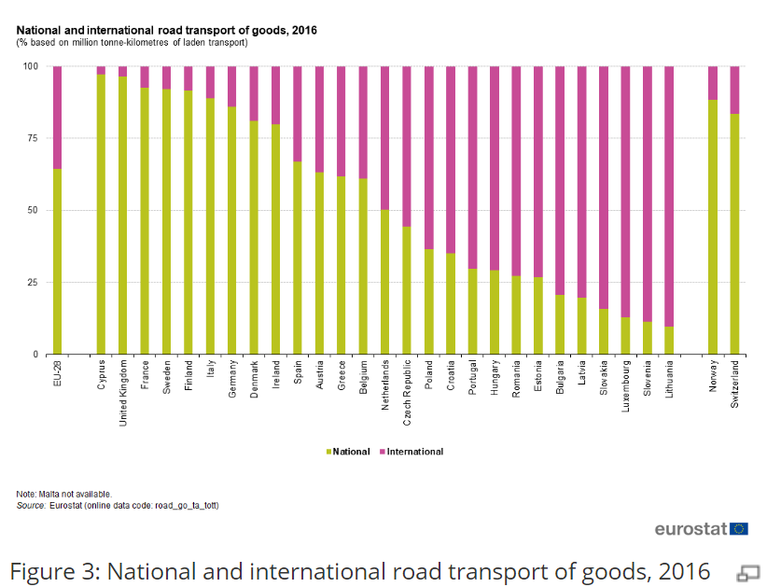

Slide 40
Strong and weak points of road freight transport

Slide 41
Strengths of road freight transport
Road transport possesses significant advantages over other modes:
The capital cost of vehicles is relatively small, which makes it comparatively easy for new users to entry. This helps ensure that the trucking industry, for example, is highly competitive. Low capital costs also ensure that innovations and new technologies can diffuse quickly through the industry.
door-to-door service from the point of origin to the destination.
flexibility of route choice, once a network of roads is provided.
high relative speed of vehicles, the major constraint being government-imposed speed limits.
No loading and unloading (as in multimodal transport)
These multiple advantages have led to their market dominance for short-to-medium distance trips.

Slide 42
Weaknesses of freight road transport
A driver for each truck
Empty returns
Low loading capacity
Unpredictable transport times (?)
Long distances (expensive)
Dangerous goods
Externalities (energy, accidents, congestion, air pollution, noise)

Slide 43
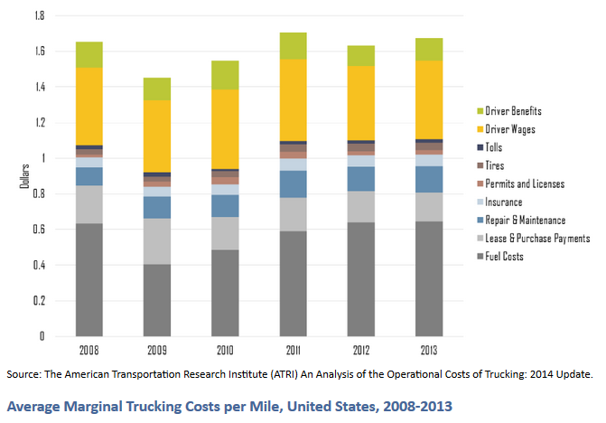
Average Marginal Trucking Costs per Mile, United States, 2008-2013
Trucking is a highly competitive industry since the barriers of entry are low. The two most significant operating costs of trucking are fuel (38%) and wages and benefits (35%). Jointly, they account for about 73% of all costs. There is very little flexibility in this cost structure, implying that fluctuations in energy prices cannot be mitigated well and impact directly the low profit margins of the industry (less than 10%).

Slide 44
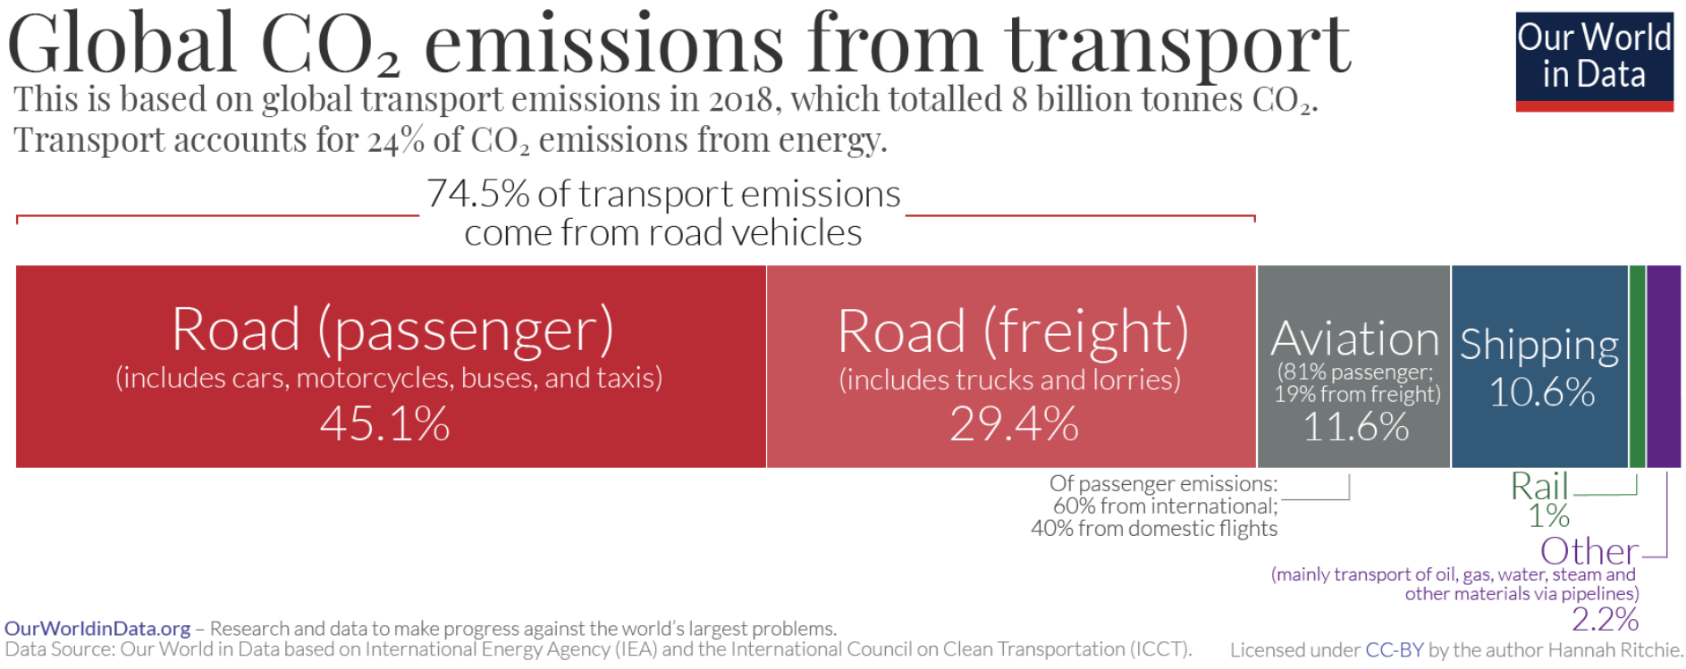
The environmental impact
https://ourworldindata.org/co2-emissions-from-transport

Slide 45
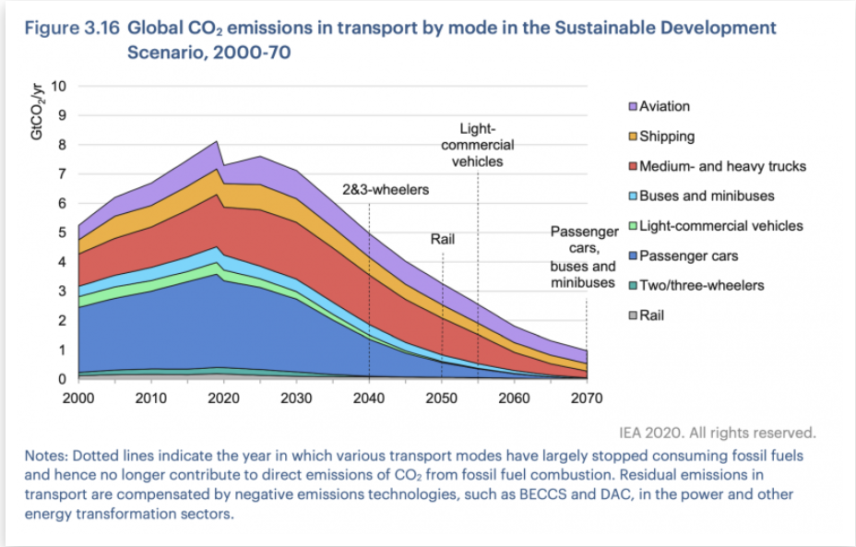
https://ourworldindata.org/co2-emissions-from-transport

Slide 46
Statistics: The importance of road freight transport

Slide 47
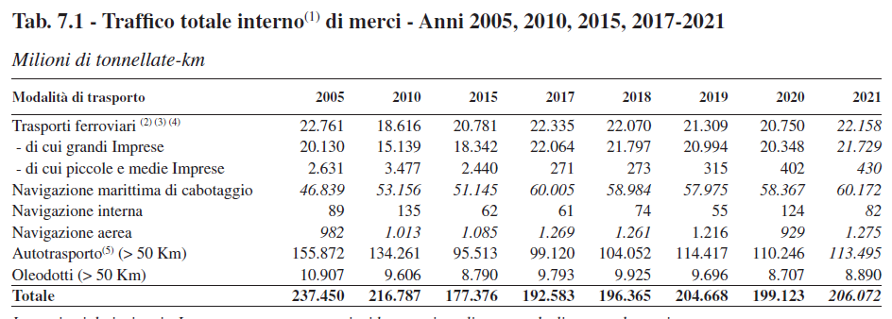
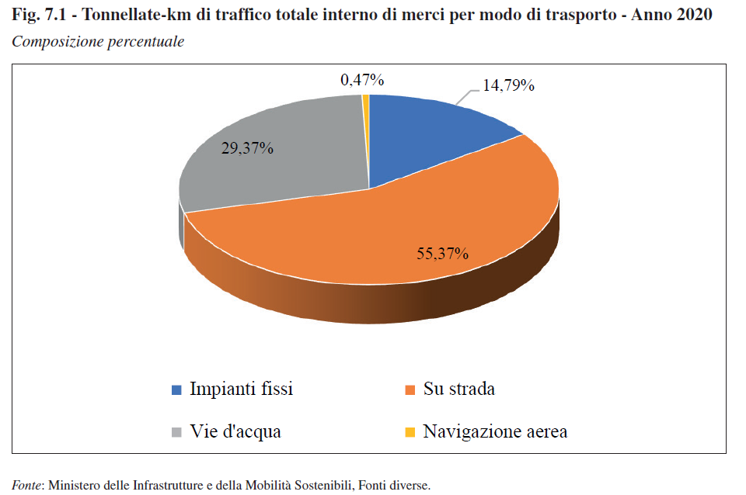
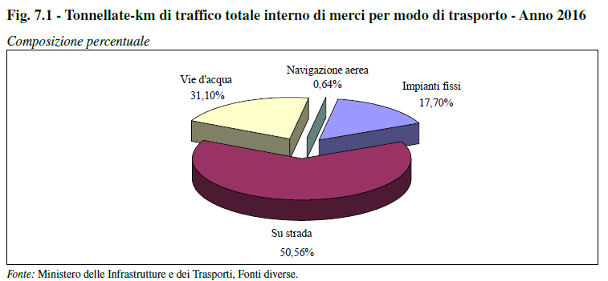
More than half of the goods travel by road

Slide 48
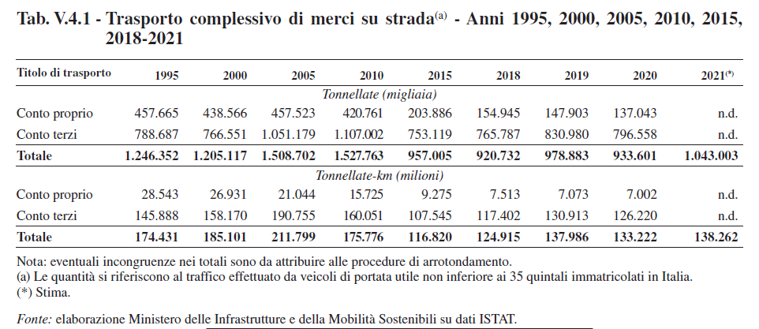
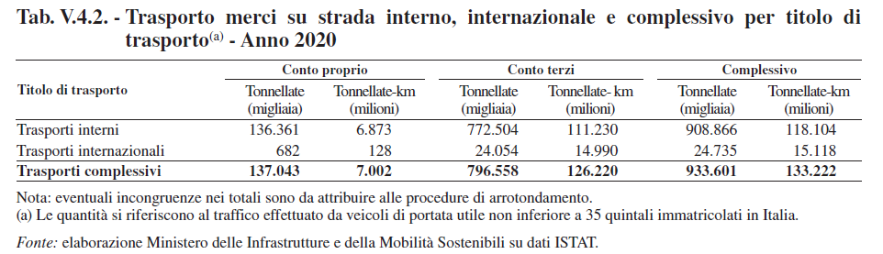

Slide 49
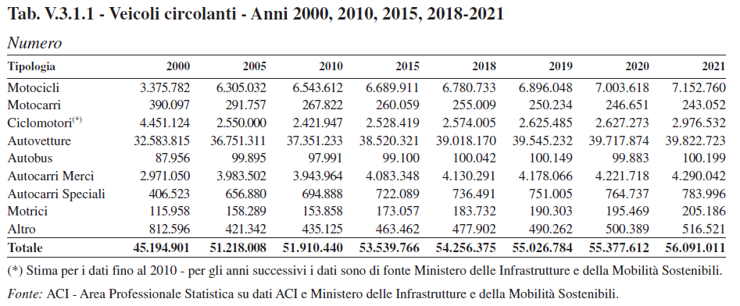
Increasing number of truck on the Italian roads

Slide 50
Freight road transport and logistics: summary
The most important mode of inland freight transport. Its efficiency and reliability is crucial for economic development.
Relatively little known and studied

Slide 51
The actors of the road freight transport sector
Carrier: truck driver or the truck company
Freight forwarder
Courier
Third-party logistic operator
Multi-modal transport operator

Slide 52
Carrier
A carrier is a person or company that transports goods or people for any person or company and that is responsible for any possible loss of the goods during transport. A common carrier offers its services to the general public under license or authority provided by a regulatory body.
A truck driver (commonly referred to as a trucker, teamster or driver in the United States and Canada; a truckie in Australia and New Zealand; a lorry driver, or driver in Ireland, the United Kingdom, India and Pakistan) is a person who earns a living as the driver of a truck (usually a semi truck, box truck or dump truck).
Almost everywhere, the road transport operators are small enterprises acting often as individual or natural persons, known as the “one man/one truck” or “driver-owner” model.
The driver is a key asset for a road transport company; his capabilities to act economically, timely and to the satisfaction of the clients will considerably influence the image of the company and therefore its positioning on the market. The vehicle together with the driver and the infrastructure are transport’s inextricably linked and interdependent essential components determining the performance of road transport services in terms of safety, cleanliness, accessibility and affordability.

Slide 53
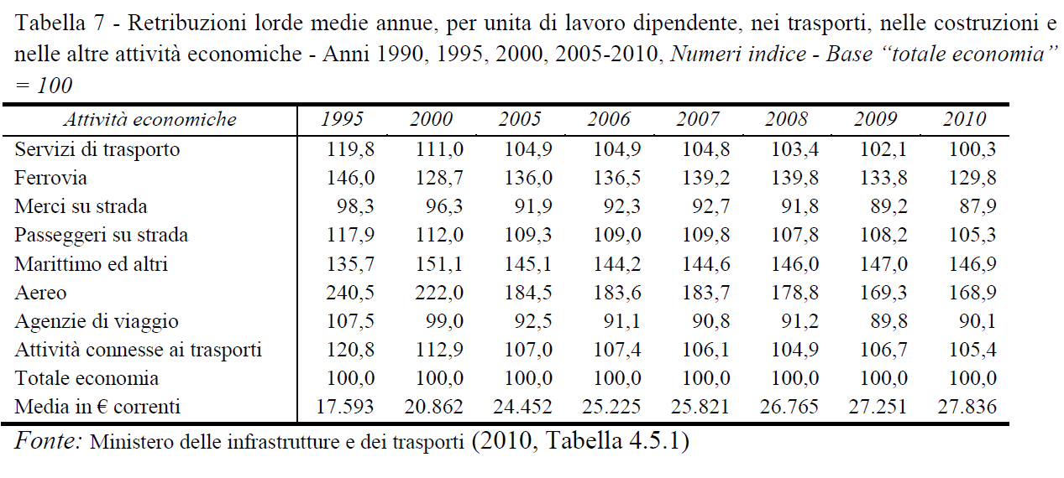
Italian statistics
Freight road transport pay the lowest wages among the various transport modes

Slide 54
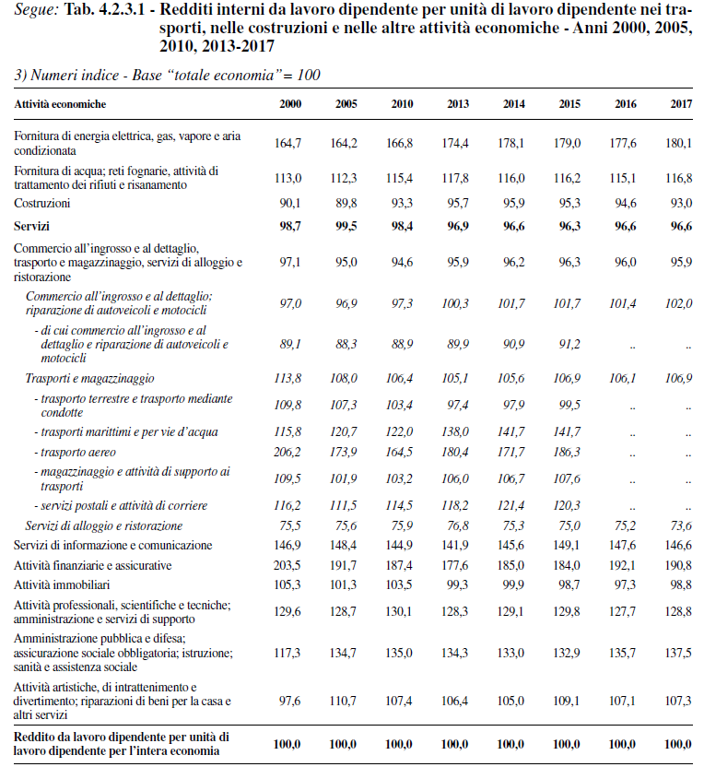

Slide 55
Trucking companies
Trucking companies (AE) or haulage companies or hauliers accept cargo for road transport. Truck drivers operate either independently (Business Model 1)– working directly for the client – or through freight carriers or shipping agents (BM2). Some big companies (e.g. grocery store chains) operate their own internal trucking operations (own-account transport, BM3).
Some road transportation is done on regular routes or for only one consignee per run, while others transport goods from many different loading stations/shippers to various consignees. On some long runs only cargo for one leg of the route (to) is known when the cargo is loaded. Truckers may have to wait at the destination for the return cargo (from).
A bill of lading issued by the shipper provides the basic document for road freight. On cross-border transportation the trucker will present the cargo and documentation provided by the shipper to customs for inspection. This also applies to shipments that are transported out of a free port.
To avoid accidents caused by fatigue, truckers have to keep to strict rules for drivetime and required rest periods. Tachographs record the times the vehicle is in motion and stopped. Some companies use two drivers per truck to ensure uninterrupted transportation; with one driver resting or sleeping in a bunk in the back of the cab while the other is driving.

Slide 56
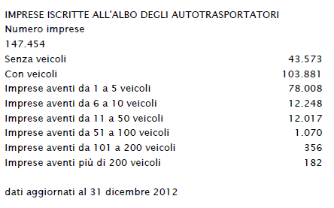
Italian data on the size of the firms
Many small firms («padroncini»)
https://www.trasportoeuropa.it/notizie/autotrasporto/prosegue-lestinzione-dei-padroncini-nellautotrasporto/
Autotrasporto (fonte: Infocamere), dal 2014 al 2019 hanno chiuso circa diecimila imprese, soprattutto di piccole dimensioni. Secondo il censimento compiuto al 31 agosto 2019, in Italiana operano 89.770 imprese di autotrasporto in conto terzi. Restano prevalenti le aziende individuali (46.991 unità) ma negli ultimi cinque anni sono calate del 21,4%. Sul versante opposto, le società di capitali sono aumentate del 24,7% e quelle consortili del 7,5%. Per quanto riguarda l'aggregazione i contratti di rete tra imprese del trasporto sono aumentati del 461% dal 2008 al 2018 e oggi coinvolgono 432 organizzazioni.
Sul versante dell'occupazione, il libro riporta i dati dell'Albo Nazionale dell'Autotrasporto, secondo cui gli addetti del settore sono aumentati dai 307mila del 2014 ai 328.627 del 2018 e ce ne potrebbero essere di più, perché le imprese italiane cercano, senza trovarli, 15mila autisti. Infatti, si stanno esaurendo i tradizionali serbatoi dell'Europa orientale e le imprese stanno guardando verso l'Africa settentrionale e perfino l'Asia.

Slide 57
Truck driver problems
Economic
  Unpaid work time
  Time off
Working issues
  Safety
  Parking
  Idling restrictions
  DAC Reporting
  Satellite tracking
Health issues
  Obesity
  Sleep disorders and deprivation
  Other health problems
Drivers shortage
https://www.youtube.com/watch?v=f76q62k1cB0

Slide 58
Truck driver problems
Unpaid work time: In the United States, there is a lot of unpaid time, usually at a Shipper or Receiver where the truck is idle awaiting loading or unloading
Time off: Due to the nature of the job, most drivers stay out longer than 4 weeks at a time. A few for months on end and even longer. For the average large company driver in the United States 6 weeks is the average, with each week out garnering the driver one day off. This accrues to a set maximum usually 6 or 7 days. This is the average for OTR (Over The Road) Line Haul and Regional drivers. Vocational and Local drivers are usually home every night or every other night. Most tractors are equipped with sleeper berths
Safety: truck drivers have a higher total number of fatalities than any other occupation, accounting for 12% of all work-related deaths.

Slide 59
Parking: One challenge of finding truck parking is made difficult perhaps not because there are insufficient parking spaces "nationwide", but where the majority of those spaces are not located, and most needed, near the most densely populated areas where demand for trucked goods is greatest. As urban areas continue to sprawl, land for development of private truck stops nearby becomes prohibitively expensive and there seems to be an understandable reluctance on the part of the citizenry to live near a facility where a large number of trucks may be idling their engines all night, every night, or to experience the associated increase in truck traffic on local streets.

Slide 60
Idling restrictions: Idling restrictions further complicate the ability of drivers to obtain adequate rest, as this example from California may illustrate. Commercial diesel-fueled vehicles are subject to the following idling restrictions. You may not: a) idle the vehicle’s primary diesel engine for more than five minutes at any location.; b) operate a diesel-fueled auxiliary power system which powers a heater, air conditioner, or any additional equipment for sleeper-berth equipped vehicles during sleeping or resting periods for more than five minutes at any location within 100 feet of a restricted area.
DAC Reporting: A truck driver's “DAC Report” refers to the employment history information submitted by former employers to Hire Right & USIS Commercial Services Inc. A truck driver’s DAC Report contains the driver’s identification, the name and address of the contributing trucking company, the driver’s dates of employment with that company, the driver’s reason for leaving that company, whether the driver is eligible for rehire, and comments about the driver’s work record (e.g. good, satisfactory, too many late deliveries, etc.). A separate section of the DAC report contains incident/accident information as well as CSA 2010 Pre-Employment Screening Program (PSP) Reports.

Slide 61
Satellite tracking: Many companies today utilize some type of satellite vehicle tracking or trailer tracking to assist in fleet management.
A special location tracking device also known as a tracker or an AVL (Automatic Vehicle Location) unit is installed on a truck and automatically determines its position in real-time and sends it to a remote computer database for visualizing and analysis. An "in cab" communication device AVL unit often allows a driver to communicate with their dispatcher, who is normally responsible for determining and informing the driver of their pick-up and drop-off locations. If the AVL unit is connected to a Mobile data terminal or a computer it also allows the driver to input the information from a bill of lading (BOL) into a simple dot matrix display screen. This system also allows the company to track the driver's fuel usage, speed, gear optimization, engine idle time, location, the direction of travel, and the amount of time spent driving.

Slide 62
Sleep disorders and deprivation: Truck drivers are also sensitive to sleep disorders because of the long hours required at the wheel and, in many cases, the lack of adequate rest.
Obesity: According to a 2007 study in the Journal of the American Dietetic Association, 86% of the estimated 3.2 million truck drivers in the United States are overweight or obese. Some key risk factors for obesity in truckers are poor eating habits, lack of access to healthy food, lack of exercise, sedentary lifestyle, long work hours, and lack of access to care..
Other health problems: Truckers in the US smoke at twice the rate of other working adults; Truckers reported having two or more risk factors, which were defined as high blood pressure, obesity, smoking, high cholesterol, no physical activity, or sleep deprivation. Truck drivers also suffer from musculoskeletal disorders, cardiovascular disease, and stress at higher rates.

Slide 63
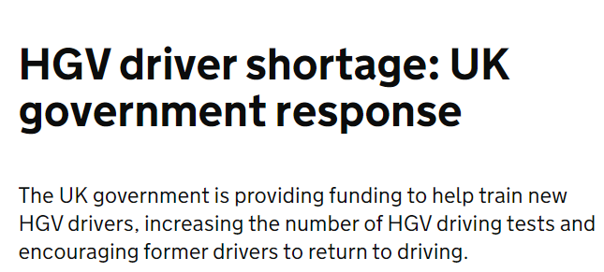
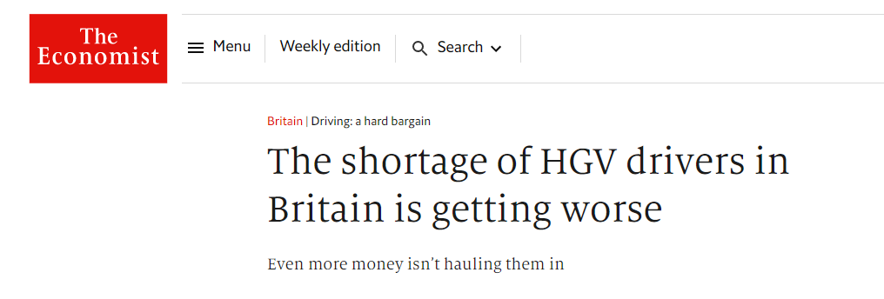
Turnover and driver shortage
Turnover and driver shortage: In 2006, the U.S. trucking industry as a whole employed 3.4 million drivers. A major problem for the long-haul trucking industry is that a large percentage of these drivers are aging, and are expected to retire. Very few new hires are expected in the near future, resulting in a driver shortage. Employee turnover within the long-haul trucking industry is notorious for being extremely high.
Federtransporti 2020: 15,000 truck drivers missing in Italy
The BBC reported in October 2021 that there was a shortage of more than 100,000 qualified drivers in the UK. The RHA described the number of factors adding to the driver shortage as the 'perfect storm', and this included Covid, an ageing workforce, Brexit, and a backlog of driving tests

Slide 64
The Polish truck drivers
The penetration of third country hauliers in the main flows varied substantially. Third country penetration varied from 45.3 % for Austria/Italy traffic, 35.2 % for France/Italy and 34.4 % for France and the Netherlands to 1.2 % for Ireland/United Kingdom, 1.1 % for the Czech Republic/Poland and 0.6 % for Spain/Portugal.
Poland emerged as the most successful third country with its hauliers appearing as the main other haulier in several of the top 20 country to country markets. In most cases, there is a geographical link between the third country and the countries where the transport is performed.

Slide 65
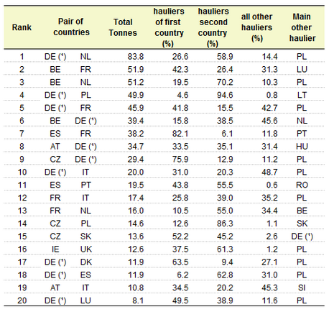
The Polish truck drivers

Slide 66
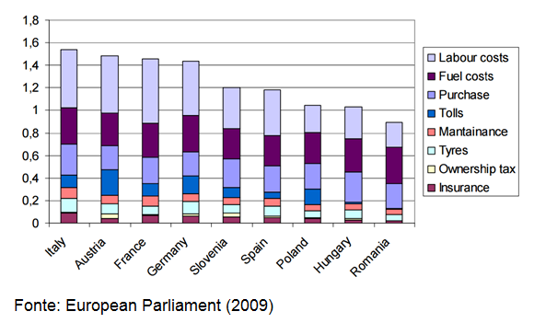
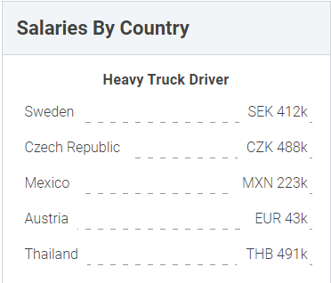
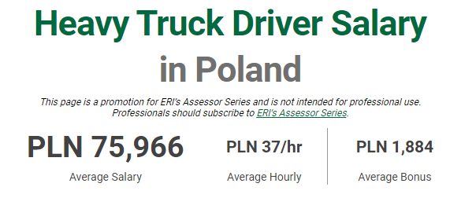
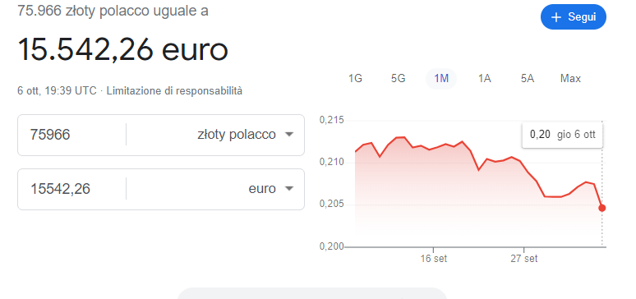
https://www.erieri.com/salary/job/heavy-truck-driver/poland

Slide 67



Fuel cost varies by country because of different taxation

Slide 68


https://autotraveler.ru/en/spravka/fuel-price-in-europe.html#.W_KnHDhKiUk

Slide 69
Freight forwarder
A freight forwarder, forwarder, or forwarding agent, also known as a non-vessel operating common carrier (NVOCC), is a person or company that organizes shipments for individuals or corporations to get goods from the manufacturer or producer to a market, customer or final point of distribution.
Forwarders contract with a carrier or often multiple carriers to move the goods. A forwarder does not move the goods but acts as an expert in the logistics network. These carriers can use a variety of shipping modes, including ships, airplanes, trucks, and railroads, and often multiple modes for a single shipment.
International freight forwarders typically handle international shipments. International freight forwarders have additional expertise in preparing and processing customs and other documentation and performing activities pertaining to international shipments.
Information typically reviewed by a freight forwarder includes the commercial invoice, shipper's export declaration, bill of lading and other documents required by the carrier or country of export, import, and/or transshipment. Much of this information is now processed in a paperless environment.

Slide 70
Courier
Couriers are distinguished from ordinary mail services by features such as speed, security, tracking, signature, specialization and individualization of express services, and swift delivery times, which are optional for most everyday mail services. As a premium service, couriers are usually more expensive than standard mail services, and their use is normally limited to packages where one or more of these features are considered important enough to warrant the cost.
Courier services operate on all scales, from within specific towns or cities, to regional, national and global services. Large courier companies include DHL, FedEx, EMS International, TNT, UPS, and Aramex. These offer services worldwide, typically via a hub and spoke model.

Slide 71
Third-party logistics operators
Third-party logistics (abbreviated 3PL, or sometimes TPL) in logistics and supply chain management is a company's use of third-party businesses to outsource elements of the company's distribution and fulfillment services.
Third-party logistics providers typically specialize in integrated operation, warehousing and transportation services which can be scaled and customized to customers' needs based on market conditions, such as the demands and delivery service requirements for their products and materials. Often, these services go beyond logistics and include value-added services related to the production or procurement of goods, i.e., services that integrate parts of the supply chain. When this integration occurs, the provider is then called a third-party supply chain management provider (3PSCM) or supply chain management service provider (SCMSP). 3PL targets particular functions within supply management, such as warehousing, transportation, or raw material provision.

Slide 72
Outsourcing logistics: pros and cons
Advantages
Cost and time savings. Logistics is the core competence of third-party logistics providers. Providers may have better related knowledge and greater expertise than the producing or selling company, and may also have more global networks enabling greater time and cost efficiencies. The equipment and the IT systems of 3PL providers are constantly updated and adapted to match the requirements of their customers and their customer’s suppliers. Producing or selling companies often do not have the time, resources, or expertise to adapt their equipment and systems as quickly.[
Low capital commitment . If most or all operative functions are outsourced to a 3PL provider, there is usually no need for the client to own its own warehouse or transport facilities, lowering the amount of capital required for the client's business. This is particularly beneficial if a company's warehouse has high variations in capacity utilization, leading to over purchasing of warehouse capacity and reducing profitability.
Focus. Logistics outsourcing allows companies with limited logistics expertise to focus on their core business.
Flexibility. Third-party logistics providers can provide higher flexibility for geographic distribution and may offer a larger variety of services than clients could provide for themselves. This also allows businesses to more predictably manage their resources including workforce size, and turn fixed costs into variable costs.

Slide 73
Outsourcing logistics: pros and cons
Disadvantages
Loss of control. One disadvantage is the loss of control a client has by using third-party logistics. With outbound logistics, the 3PL provider usually assumes communication and interactions with a firm's customer or supplier.
IT. The IT systems of the provider and the client must be interoperable. Technology helps increase visibility for the client by way of continuous status updates via Dispatch Management Software and Electronic Data Interchange (EDI) which does involve a cost, but it can help avoid penalties for delays and subsequent financial losses such as from not unloading freight in time.

Slide 74
Multimodal transport operators (MTO)

Slide 75


A Trieste case study

Slide 76


Slide 77
Alcune tappe dello sviluppo di Autamarocchi
1986 - Nasce a Trieste, frutto dell’esperienza di due aziende (Auta S.p.A. e Marocchi S.p.A.) protagoniste dagli anni Settanta nel trasporto dei container.
1998 – Ampliamento dell’attività nella "logistica integrata" con impianti e attività a Padova, Trieste e Udine.
2002 - Anno della maggiore crescita, con un incremento dei ricavi del 25% in un solo esercizio. Estende i suoi servizi a tutte le principali compagnie di navigazione presenti sul mercato italiano. Acquisisce il controllo di Gemaco, Terminal container con sede a Milano.
2005 - Internazionalizzazione: nasce "Autamarocchi k.f.t." a Budapest (Ungheria), viene acquisito il controllo di "FEMIA d.o.o." a Koper (Slovenia) e si definisce una partecipazione in "Chemol logistics" a Budapest (Ungheria).
2011 - La flotta cresce e con essa la consapevolezza del rispetto per l’ambiente. Sono 80 i nuovi trattori stradali del tipo Mercedes 1844 Euro 5 in classe EEV (Enhanced Environmentally Friendly ehicles). Il 2011 è un anno speciale nella nostra storia: il venticinquesimo anno di attività Auta Marocchi S.p.A. Una storia iniziata nel 1986 .. un progetto “importante” e “originale”: una grande azienda con una propria flotta al servizio dei clienti e quindi presente in tutti i principali porti, interporti e aree industriali d’Italia per servire l’economia del nostro paese anche l’estero. Eravamo allora in un contesto di vettori monoveicolari ... Da anni siamo una delle principali aziende di autotrasporto d’Italia.
2012 - Nuova Control Room dei trasporti: caratterizzata da un video wall di 6x2,5 mt per un monitoraggio continuo dei trasporti e della sicurezza. Tanta tecnologia e soprattutto un nuovo modo di lavorare, frutto dell'interazione tra i servizi di customer care, dei truck e fleet manager dei dispacher e dell'assistenza tecnica. Con uno sviluppo “Proprietario” realizzato “In House”, Autamarocchi ha utilizzato l’HW consumer electronic del Black Berry come strumento di scambio dati e informazioni, sia tra lo staff della Control Room che del sistema gestionale e il singolo autista/mezzo.
rafforzamento della flotta specializzata nel trasporto dei Reefer Container e dei Rifiuti in container; apertura di Ravenna e Bologna, due nuove filiali operative trasporti;
2013 - con il Ministero dell’Ambiente per un piano volontario di monitoraggio e riduzione della CO2 e delle altre emissioni dannose. Sviluppo del trasporto combinato strada e rotaia, l’accordo “Milano” tra Ministero dell’Ambiente, Autamarocchi e Trenitalia

Slide 78
Alcune tappe dello sviluppo di Autamarocchi
2014 -Viene introdotta la versione 2.0 della Control Room, con la quale è possibile in tempo reale il monitoraggio dei percorsi e l’analisi dei tempi d’attesa all’ingresso dei termina. Lancio di nuovi servizi speciali, come il trasporto di merci ad alto valore e alto rischio (HVHR). Servizi speciali “Pharma” che coniugano la grande esperienza nel trasporto dei container Reefer con quelli HVHR (high value high risk), nel rispetto delle normative dei due settori ma sempre con servizi “su misura” dei nostri clienti.
2015 - Cresce la presenza sui mercati del centro Europa, dopo l’Ungheria e la Slovenia, nascono Autamarocchi Gmbh a Graz in Austria. Un network che completa il progetto “North Adriatic Gate”, dedicato al centro Europa attraverso una rete di trasporti che la lega ai porti di Trieste, Koper e Rijeka.
2017 - Parte la rivoluzione “Android” nella gestione delle comunicazioni tra la Control Room ed i nostri autisti che ora sono dotati di un nuovo OBC (on board computer) basato su un HW smartphone e SW Android. Il nuovo sistema consente tra l’altro la firma digitale del ricevitore, la trasmissione di foto e documenti, funge da back up del sistema di localizzazione e mantiene la funzione della stampa a bordo dei documenti. Un importante rinnovo della flotta con mezzi modernissimi e tutti in classe Euro 6. Sono 120 mezzi in un anno e tra di loro i primi 20 veicoli IVECO STRALIS NP (Natural Power), alimentati a metano liquido, veri campioni nella riduzione delle emissioni. Per la sua politica di rispetto dell’ambiente, Autamarocchi si aggiudica il premio Green Award agli “Italian Terminal and Logistics Awards” di Piacenza. Il trasporto FTL diventa sempre di più intermodale. Non solo ferrovia con i nuovi semirimorchi tipo “Huckepack” ma anche “Short Sea” per collegare il Sud Italia ed il Mediterraneo al Nord Europa. Cresce il network dei depositi container con l’apertura del Terminal di Pioltello (Milano) e l’HUB di Pontenure (Piacenza).
2018 - Nei primi mesi viene completato il progetto “Android” con la completa distribuzione agli autisti dello smartphone con la App aziendale. L’acquisto di ulteriori 20 trattori Iveco LNG rendono Autamarocchi la flotta LNG più grande in Italia. Autamarocchi, attraverso l’integrazione dei propri sistemi ICT con quelli dei propri clienti diventa portabandiera della logistica 4.0.

Slide 79
Alcune tappe dello sviluppo di Autamarocchi
2019 - Nuove frontiere nel trasporto: La Turchia con le Autostrade del mare. La ns. organizzazione per un servizio “Door to Door”, tutto incluso, con l’impiego dei primi 200 modernissimi semirimorchi intermodali tipo Huckepack P400, geolocalizzati, con buca coils, ed un’organizzazione focalizzata sui porti di Trieste con destinazione Pendik (Istanbul), Mersin e Izmir.
2020 - Il rinnovo della flotta incrementa quella dedicata al trasporto dei Reefer Container. Sono 50 i Mercedes New Actros consegnati a Marzo – Aprile 2020, tutti dotati dell’ultima generazione di GenSet realizzati su progetto Autamarocchi. La flotta equipaggiata con i GenSet è ora di 210 mezzi per consolidare una grande offerta di servizio nel trasporto container e la leadership di mercato.
2021 - Si consolida il servizio "Combinato" Italia - Turchia e Grecia con l'apertura di nuove filiali a Istanbul e Izmir. Il 2021 è soprattutto l'anno dello sviluppo dell' intermodale con le nuove linee per la Germania, paesi bassi e Slovacchia. Con l'intermodale cresce la flotta di semirimorchi tipo Huckepack, anche mega, che ora sono 400.

Slide 80
Seller-buyer relationship: the Incoterms

Slide 81
Incoterms
The Incoterms or International Commercial Terms are a series of pre-defined commercial terms published by the International Chamber of Commerce (ICC) relating to international commercial law.
Incoterms rules are intended primarily to clearly communicate the tasks, costs, and risks associated with the global or international transportation and delivery of goods.
The Incoterms rules are accepted by governments, legal authorities, and practitioners worldwide for the interpretation of most commonly used terms in international trade.
The first work published by the ICC on international trade terms was issued in 1923. Incoterms 2010 have been published on January 1, 2011. The ICC has begun consultations on a new revision of Incoterms, to be called Incoterms 2020.

Slide 82


Slide 83


Slide 84
Definition of terms
Delivery: The point in the transaction where the risk of loss or damage to the goods is transferred from the seller to the buyer
Arrival: The point named in the Incoterm to which carriage has been paid
Free: Seller has an obligation to deliver the goods to a named place for transfer to a carrier
Carrier: Any person who, in a contract of carriage, undertakes to perform or to procure the performance of transport by rail, road, air, sea, inland waterway or by a combination of such modes
Freight forwarder: A firm that makes or assists in the making of shipping arrangements;
Terminal: Any place, whether covered or not, such as a dock, warehouse, container yard or road, rail or air cargo terminal
To clear for export: To file Shipper’s Export Declaration and get export permit

Slide 85
Rules for any mode of transport
EXW – Ex Works (named place of delivery)
The seller makes the goods available at their premises, or at another named place. This term places the maximum obligation on the buyer and minimum obligations on the seller. The Ex Works term is often used while making an initial quotation for the sale of goods without any costs included. EXW means that a buyer incurs the risks for bringing the goods to their final destination. Either the seller does not load the goods on collecting vehicles and does not clear them for export, or if the seller does load the goods, he does so at buyer's risk and cost.
FCA – Free Carrier (named place of delivery)
The seller delivers the goods, cleared for export, at a named place (possibly including the seller's own premises). The goods can be delivered to a carrier nominated by the buyer, or to another party nominated by the buyer.
CPT – Carriage Paid To (named place of destination)
The seller pays for the carriage of the goods up to the named place of destination. However, the goods are considered to be delivered when the goods have been handed over to the first or main carrier, so that the risk transfers to buyer upon handing goods over to that carrier at the place of shipment in the country of Export.
CIP – Carriage and Insurance Paid to (named place of destination)
This term is broadly similar to the above CPT term, with the exception that the seller is required to obtain insurance for the goods while in transit

Slide 86
Rules for any mode of transport
DAP – Delivered At Place (named place of destination)
The seller delivers when the goods are placed at the disposal of the buyer on the arriving means of transport ready for unloading at the named place of destination. Under DAP terms, the risk passes from seller to buyer from the point of destination mentioned in the contract of delivery.
DDP – Delivered Duty Paid (named place of destination)
Seller is responsible for delivering the goods to the named place in the country of the buyer, and pays all costs in bringing the goods to the destination including import duties and taxes. The seller is not responsible for unloading.
DAT – Delivered At Terminal (named terminal at port or place of destination)
This Incoterm requires that the seller delivers the goods, unloaded, at the named terminal. The seller covers all the costs of transport (export fees, carriage, unloading from main carrier at destination port and destination port charges) and assumes all risk until arrival at the destination port or terminal.

Slide 87
Rules for sea and inland waterway transport
FAS – Free Alongside Ship (named port of shipment)
The seller delivers when the goods are placed alongside the buyer's vessel at the named port of shipment. This means that the buyer has to bear all costs and risks of loss of or damage to the goods from that moment. The FAS term requires the seller to clear the goods for export, which is a reversal from previous Incoterms versions that required the buyer to arrange for export clearance.
FOB – Free on Board (named port of shipment)
The seller bears all costs and risks up to the point the goods are loaded on board the vessel. The seller's responsibility does not end at that point unless the goods are "appropriated to the contract" that is, they are "clearly set aside or otherwise identified as the contract goods". The seller must also arrange for export clearance. On the other hand, the buyer pays cost of marine freight transportation, bill of lading fees, insurance, unloading and transportation cost from the arrival port to destination.

Slide 88

Maritime Incoterms: graphical description

Slide 89
Rules for sea and inland waterway transport
CFR – Cost and Freight (named port of destination)
The seller pays for the carriage of the goods up to the named port of destination. Risk transfers to buyer when the goods have been loaded on board the ship in the country of Export. The Shipper is responsible for origin costs including export clearance and freight costs for carriage to named port. The shipper is not responsible for delivery to the final destination from the port (generally the buyer's facilities), or for buying insurance.
CIF – Cost, Insurance & Freight (named port of destination)
This term is broadly similar to the above CFR term, with the exception that the seller is required to obtain insurance for the goods while in transit to the named port of destination. CIF requires the seller to insure the goods for 110% of their value under at least the minimum cover of the Institute Cargo Clauses of the Institute of London Underwriters (which would be Institute Cargo Clauses (C)), or any similar set of clauses. The seller must also turn over documents necessary, to obtain the goods from the carrier or to assert claim against an insurer to the buyer. The documents include (as a minimum) the invoice, the insurance policy, and the bill of lading. These three documents represent the cost, insurance, and freight of CIF. The seller's obligation ends when the documents are handed over to the buyer.

Slide 90
Manufacturer-carrier relationship

Slide 91
The manufacturers’ point of view: the level of satisfaction with the freight road transport service
Transport times: 33% very satisfied, 50% enough satisfied, 10% modestly satisfied, 6% unsatisfied
Reliability: 40% very satisfied, 49% enough satisfied, 4% modestly satisfied, 6% unsatisfied
Transport costs: 5% of the product value
From Danielis e Torbianelli (2007). Interviews to 51manufatturing firms in Friuli Venezia Giulia

Slide 92
Complaints from the Association of the Italian carriers (ANITA)
Cost increases (diesel costs)
Economic uncertainty
Very low profit margins (Price squeeze from manufacturing firms) due to high competitive pressure
Unfair competition from foreign carriers
Road Tolls (vignette, highway tolls, etc.)

Slide 93
European and Italian road freight transport policy and regulation
European regulation: the sectors fluctuates from “mild” regulation to deregulation
Italian regulation: decreto legislativo 286/2005

Slide 94
decreto legislativo 286/2005
Price controls (from «floor and ceiling» fares) to miminum safety costs
  L’abolizione delle vecchie tariffe a forcella, che erano rimaste formalmente in vigore. Successive norme hanno però introdotto i “costi minimi di sicurezza”, predisposti dalla Consulta della logistica, al fine di fornire una base di riferimento per i contratti nel settore dell'autotrasporto.
Illegal contracts when against transport safety
  La previsione di nullità delle clausole dei contratti di trasporto che comportano modalità e condizioni di esecuzione delle prestazioni contrarie alle norme sulla sicurezza della circolazione stradale.
Written contracts insteat of oral agreements
  disposizioni che rendono più conveniente la forma scritta del contratto di trasporto;

Slide 95
decreto legislativo 286/2005
Collective responsability (seller, buyer, carrier) for the adherence to the safety requirements (drivers’ rests, weight, size, setup of the goods, ecc.)
  La responsabilità condivisa tra tutti i soggetti della filiera del trasporto (vettore, committente, caricatore e proprietario delle merci) per alcune frequenti violazioni alle disposizioni sulla circolazione stradale e sulla sicurezza sociale quali la sagoma limite, la massa limite, i limiti di velocità, la sistemazione di carico sui veicoli, il sovraccarico, i tempi di guida e di riposo.
Continuous drivers’ training and drivers’ list
  L'obbligo di una qualificazione iniziale e di una formazione periodica degli esercenti il servizio di autotrasporto attraverso un certificato di idoneità professionale comprovante la qualificazione iniziale o la formazione periodica, gestita dal Comitato centrale per l’Albo nazionale degli autotrasportatori che opera nell'ambito del Ministero delle infrastrutture e dei trasporti.
Minimum fares: not allowed by the EU
  costi minimi di esercizio che garantiscano il rispetto dei parametri di sicurezza (Articolo 83 bis, commi 1 e 2, commi 4 e 4-bis della legge 6 agosto 2008, n. 133 di conversione del decreto legge 25 giugno 2008, n. 112 e s.m.i.). Prescrizione recentemente impugnata dalla Commissione Europea

Slide 96
Conclusions on road freight transport
Characteristics of the sector
  Crucial for freight mobility and economic development. It transports most of the goods over the short to medium distances (less over the long distances)
  Constant technological innovation to: vehicles, tracking methods, organization
  Strong competition: The simpler the task and the lower the capital requirements, the higher the competition and the lower the margins. Risk: excessive competition
Major concerns: professional drivers, efficient vehicles, empty-returns, externalities (accidents, congestion and pollution)
Policies: Increase drivers skills, respect the rules (speed, loads, resting times), modern trucks, non-fossil fueled trucks, increase the load factor, healthy competition in open markets

Slide 97
Have a nice day!

