Slide 1
Sea ports and the Port of Trieste
Some of the content is taken from: Jean-Paul Rodrigue, Claude Comtois and Brian Slack (2009), THE GEOGRAPHY OF TRANSPORT SYSTEMS, New York: Routledge, 352 pages. ISBN 978-0-415-48324-7 - http://people.hofstra.edu/geotrans/

Slide 2
Video: la storia del porto di Trieste
Trieste, nasce una città (storico, le due città) https://www.youtube.com/watch?v=plPNR9qVgP0&ab_channel=ClubTouristiTriestiniCTT
**Trieste - Un porto e la sua città - prima parte: http://www.youtube.com/watch?v=zlHm1BYkYXc&feature=relmfu
**Trieste - Un porto e la sua città - ultima parte: http://www.youtube.com/watch?feature=endscreen&v=XrhxSJngxn0&NR=1
Il porto franco di Trieste: http://www.youtube.com/watch?v=RcaYkKzQQcA
***Trieste, il suo porto: http://www.youtube.com/watch?v=B9mcNAS39Vg
Trieste e le sue industrie (not available):
http://www.youtube.com/watch?v=XrhxSJngxn0
TRIESTE aspetti di una proposta
https://www.youtube.com/watch?v=GjIrneR39oE

Slide 3
Three port concepts
Port-emporium
The industrial port or the port as a clusters
The modern harbor or gateway port

Slide 4
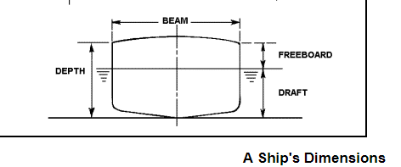

Slide 5
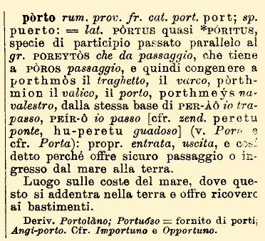

Slide 6
1. Port-emporium
Ports are points of convergence between two geographical domains of freight circulation (sometimes passengers); the land and maritime domains.
The term port comes from the Latin portus, which means gate or gateway. An emporium refers to a trading post, factory, or market of Classical antiquity, derived from the Ancient Greek: ἐμπόριον (empórion), which becomes Latin: emporium. The best known emporium of the classic antiquity is the emporium of Piraeus, the port of Athens. The plural is emporia in both languages, although in Greek the plural undergoes a semantic shift to mean "merchandise".
Ship draft was small, so many sites were suitable.
Ports are bound by the need to serve ships, and so access to navigable water has been historically the most important site consideration. Before the industrial revolution, ships were the most efficient means of transporting goods, and thus port sites were frequently chosen at the head of water navigation, the most upstream site. Many major cities owed their early pre-eminence to this fact, such as London on the Thames, Montreal on the St. Lawrence River or Guangzhou on the Pearl River.

Slide 7
1. Port-emporium
“By the Middle Ages, with inland land transport generally poor, the advantages of the sea as a highway had led to the development in Europe of coastal settlements based on seaport activities. The location of such settlements typically reflected natural advantages, both water site and land site, though the exploitation of opportunities for water-borne transport could be as much dependent on political and cultural factors as geographical. These opportunities were increased by the development of more accurate navigation systems, which assisted the internationalisation of trade. As a result, some of these settlements had become city ports, with mercantile and industrial communities handling and processing goods from distant lands which found a market in the interior and in the settlement itself. “ (Sarah Palmer, Current port trends in an historical perspective, Journal of maritime research)
Port terminals where located close to a city as the initial rationale for the existence of the city. The proximity to downtown areas also insured the availability of large pools of workers to perform the labor intensive transshipment activities that used to characterize port operations. But these activities tended to have low productivity levels as a stevedoring team could handle 10 to 15 tons per day and a berth could handle 150,000 tons per year. At their peak in the early 1950s ports such as London and New York each employed more than 50,000 longshoremen. Containerization had the dramatic impact of lowering the need for labor for port operations. For instance, the number of longshoremen jobs in the Port of New York and New Jersey declined from 35,000 in the 1960s to about 3,500 in the 1990s.
Ports were poorly connected to the hinterland.

Slide 8
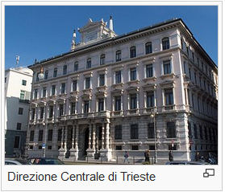
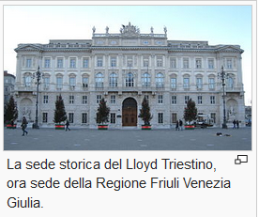
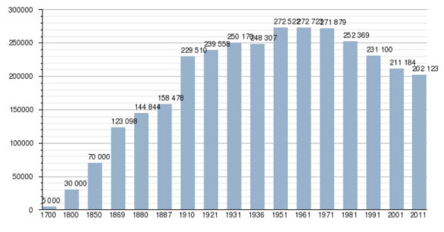
Porto «emporiale» di Trieste
Assicurazioni Generali (1831)
Lloyd Austriaco (1836) una branca dell'Österreichischer Lloyd-Lloyd Austriaco, poi Lloyd Triestino di navigazione (1919) poi Italia Marittima (2006), Lloyd Triestino alla fine del 1998 venne acquisito dalla multinazionale taiwanese Evergreen Marine , (1900) 69 piroscafi, 17 linee
Arsenale Lloyd (1837) - presso il vecchio lazzaretto, 1853 alla presenza dell'Arciduca Ferdinando Massimiliano
Riunione Adriatica di Sicurtà (1838) oggi Gruppo Allianz
Barone Revoltella (Companie Universella Canal de Suez) Compagnia di Suez di cui Pasquale Revoltella, uno dei componenti del consiglio di amministrazione del Lloyd, ebbe la carica di vice presidente
1867 con la realizzazione della Südbahn (Ferrovia Meridionale)
1891 – Associazione degli interessati nel commercio del caffè (Borsa),
Pontebbana
Anni 20 – Molo 5 e 6, snodi ferroviari
Stazione marittima (1930)
1960 – Scalo legnami, silos granario, oleodotto transalpino Trieste-Ingolstadt
1970 – Molo 7

Slide 9
2. The industrial port or the port as a clusters
Port clusters as inter-organizational network among actors belonging to different sectors.
Transport activities:
Cargo handling: Loading, unloading and transshipment activities, Pilotage, Port engineering
Transport: Shipping services, Inland shipping services, Salvage services, Shipbrokers, Rail transport, Pipeline transport, Trucking services
Logistics: Transport intermediaries (forwarders and shipping agents), Warehousing and storage, Logistics consultancy services
Service
Trade: intermediaries in oil, fuel and chemical products; intermediaries in metals, ores and food, fuel, grain, metals and mineral oil
Services: insurance and banking
Manufacturing: (industries that need direct quay access located near a port):
Oil refining, Flour milling, Cokes manufacturing, chemical manufacturing, Production of iron and steel, Shipbuilding and repair, Specialized suppliers to port industries.

Slide 10
Industrial port: the case of Trieste
1960: 3.000 industrial firms (46 thousand employees):
shipbuilding: (Cantieri Riuniti dell’Adriatico, IRI, 14 thousand employees) + other small private firms, Cantiere S. Marco, Arsenale Triestino (1.700 employees)
Big engines: (Fabbriche macchine S. Andrea)
Metals and the iron and steel industry: Ilva (1500 employees), Metalmeccanica (13 th. employees)
Wine and liquors: Stock
Grains and coffee for the food industry: fish and pickles (Salvador), Dreher (beer), Pasta, Cafe (Illy, Hausbrand), Tabaco (Monopoli di Stato)
Wood for the paper industry: Cartiera del Timavo, game cards (Modiano), Tipografie, sugheria
Cotton and natural fibers for the textile industry: Liutificio Triestino (sacchi), Cotonificio, clothing (400 employees), Snia Viscosa
Minerals for the chemical and pharmaceutical industry, colors (Venezian, Italo Svevo)
Local stone for the cement and marble industry: Cementificio (Italcementi), cava Romana
Oil for refineries: refineries (Aquila, Esso), SIOT (Oleodotto transalpino)

Slide 11
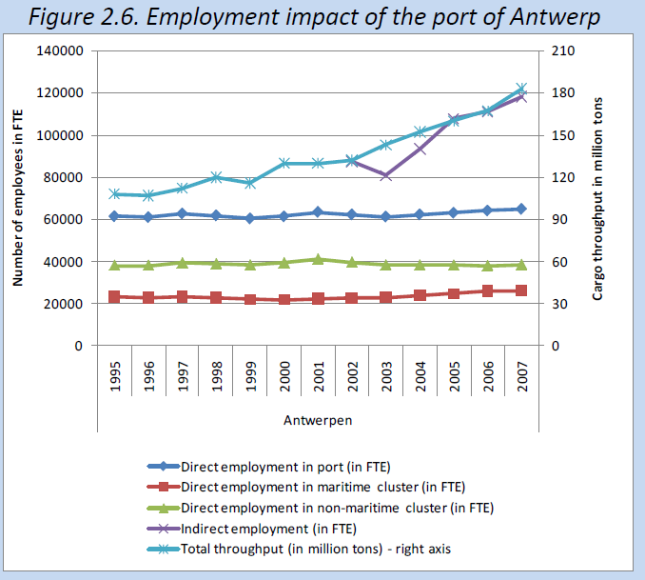

Slide 12
Video on the port of Rotterdam
Rotterdam Your World Class Port (not available): http://www.youtube.com/watch?v=3LOdoBuNefo
**Port of Rotterdam Intermodal: http://www.youtube.com/watch?v=ljg38TAX2HE&feature=related
**The Rotterdam Supply Chain: http://www.youtube.com/watch?v=npybucxUiYU&feature=related
**Distri Rail train - port of Rotterdam: https://www.youtube.com/watch?v=Zv6igSHBbyc
Port Of Rotterdam Documentary High Quality National Geographic Megastructures Documentary: https://www.youtube.com/watch?v=f_GPTWxBx7A&t=1759s

Slide 13
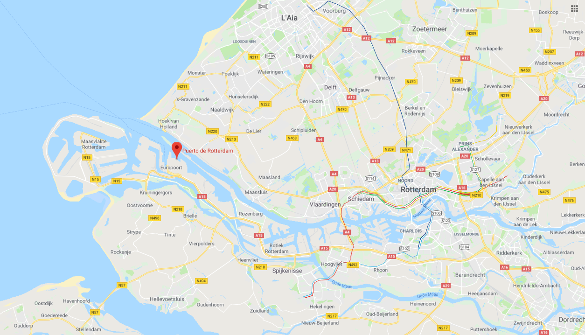

Slide 14
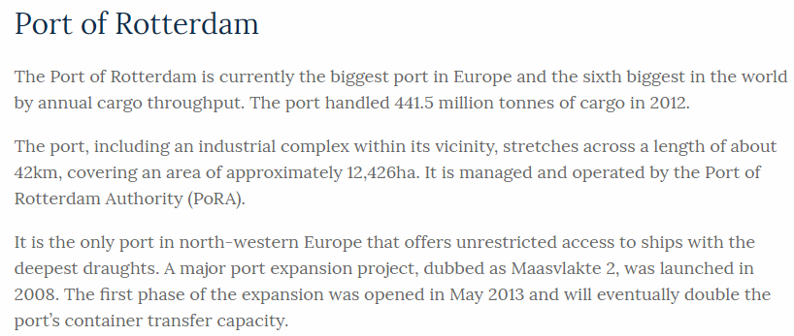
124,26 km²
Notes:
Provincia di Trieste 212,5 km²

Slide 15
Comparison between the Belgian ports and the FVG ports
Porto | Traffico (mil. tonn.) | Superf. (km²) | Val. agg./tonn | Val. agg./km² | Add/tonn | Add/km²
Anversa | 182,9 | 130,6 | 53,8 | 75,3 | 343,3 | 480,9
Ghent | 25,1 | 46,7 | 153,5 | 82,6 | 1.119,1 | 601,9
Oostend | 8,0 | 6,6 | 55,1 | 67,2 | 586,6 | 715,4
Zeebrugge | 42,1 | 28,5 | 21,1 | 31,3 | 253,2 | 374,4
Bruxelles | 4,3 | 0,7 | 167,3 | 1.027,4 | 140,9 | 865,7
Liegi | 15,8 | 3,7 | 88,4 | 378,2 | 727,5 | 3.112,7
SPR FVG | 52,0 | 3,3 | 25,2 | 391,2 | 267,0 | 4.148,9
Fonte: Mathys (2009) ed elaborazioni proprie

Slide 16
3. The modern harbor or gateway port
The modern port, which has been developing since the 1980s, is characterized by containerized traffic and its integration into a logistic network where land and sea segments are strongly integrated.
The efficiency of a port is heavily influenced by its ability to connect with the hinterland (to be able to quickly bring the goods to the final destination). The port is a node of the logistic network.
The movement of goods is increasingly mechanized and the employment in port operations is drastically reduced.
Another feature of the modern harbor is that it needs a lot of space (for the mooring of ships and above all for the storage of goods).
The modern harbor, like the industrial one, remains disconnected from the city and the local community. Local employment declines and conflicts arise over the use of urban or natural areas for port purposes and concerning the congestion created by trucks coming from or heading to the port.

Slide 17
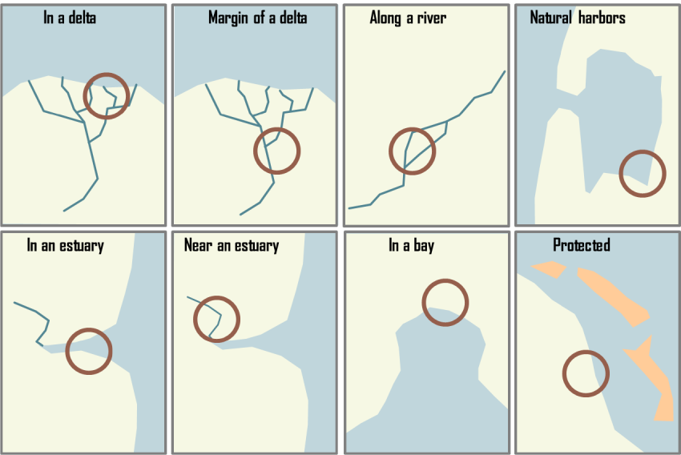
Port typologies

Slide 18
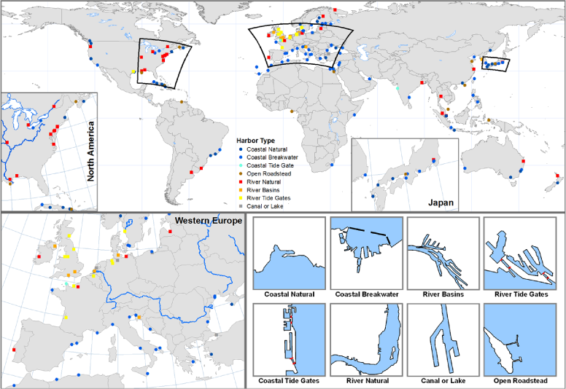
Port typologies

Slide 19
The gradual shift from conventional break-bulk terminals to container terminals since the early 1960s brought about a fundamental change in layout of terminals as well as site selection.
Containerized transportation has substantially changed port dynamics to favor the emergence of specialized container ports. As compared to conventional break-bulk cargo ships containerships did not have onboard cranes, container terminal facilities had to provide capital intensive cranes and well as ample storage space to stack containers dockside. Finger piers were no longer adequate and berths were redesigned to accommodate for quick ship turnaround and more effective dockside operations between the crane and the container storage areas.
Containerization has consequently become a fundamental function of global port operations and has changed the structure and configuration of port terminals that tend to occupy more space. While inland port sites (such as at the end of a bay or along a river) generally have the advantage of being closer to the final market they imply longer deviations from maritime shipping routes. Therefore the most successful inland ports sites are those that act as gateways.

Slide 20
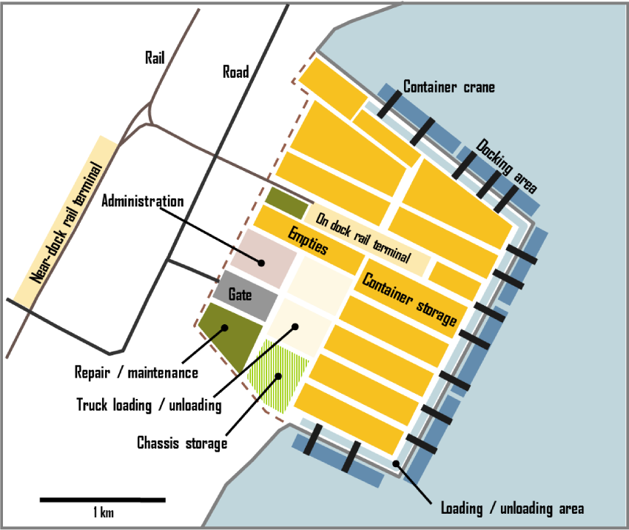
Example of berth layout

Slide 21
To handle this freight, port infrastructures jointly have to accommodate transshipment activities both on ships and inland and thus facilitate convergence between land transport and maritime systems. It includes:
Maritime access - the physical capacity to accommodate ship operations: 1. tidal range, 2. channel and berth depths (about 70% of world ports have depths of less than 10 meters, there is thus a pressure in increase channel depth where possible, but this is a costly and environmentally controversial endeavor. Many ports are also impacted by sedimentation, particularly ports in river deltas. This requires continuous dredging, which adds to the costs of port operations.)
Maritime interface: the amount of shoreline that has good maritime access. Even if a port site has an excellent maritime access, namely deep water waterways, there may not be enough land available to guarantee its future development and expansion. Containerization has expanded the land consumption requirements of many ports. It is therefore not surprising to see that modern port expansion projects involve significant capital investments to create artificial port facilities.
Infrastructures and equipment such as piers, basins, stacking or storage areas, warehouses, and equipment such as cranes, all of which involving high levels of capital investment. In turn, these infrastructures consume land which must be available to insure port expansion. Keeping up with the investment requirements of modern port operations has become a challenge for many ports.
Land access. Access from the port to industrial complexes and markets insure its growth and importance. This requires efficient inland distribution systems, such as fluvial, rail (mainly for containers) and road transportation. The land access to ports located in densely populated areas is facing increasing congestion. For instance, the ports of Los Angeles and Long Beach invested massively to develop the Alameda rail corridor in an attempt to promote inland access and reduce truck congestion. A similar trend has taken place in Europe where ports such as Rotterdam and Antwerp have been involved in the setting on inland barge and rail shuttle services.

Slide 22
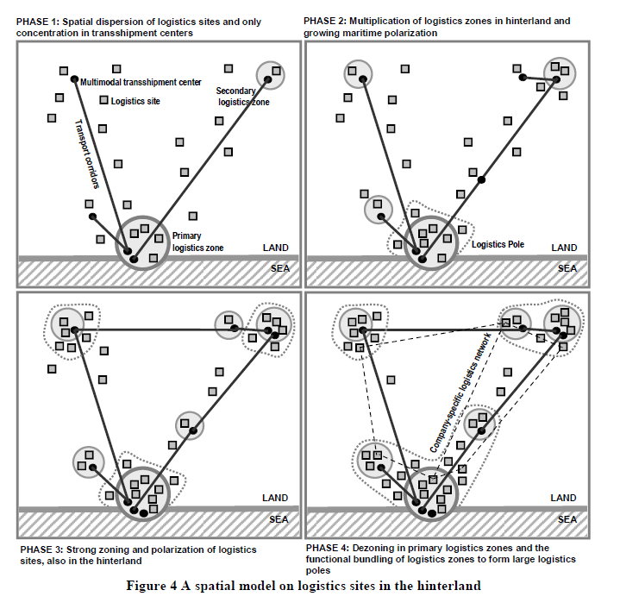

Slide 23
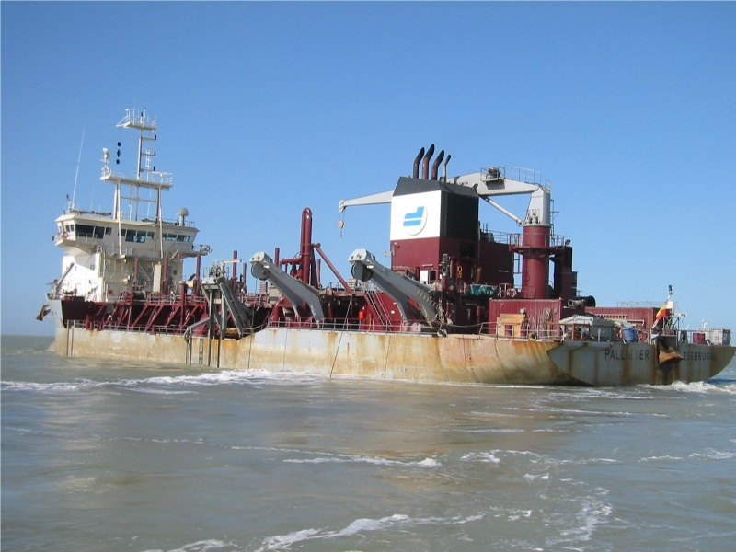
Dredging Ship at the Port of Zeebrugge, Belgium – Photo: Dr. Jean-Paul Rodrigue, 2006.

Slide 24
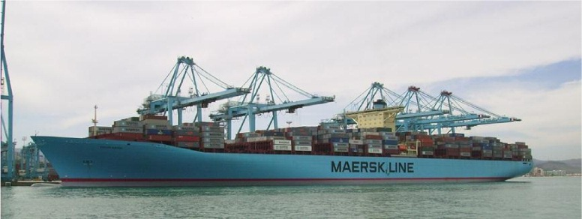
'E' Class Containership, The Evelyn Maersk Launched in 2006, the Emma Maersk is part of the largest class ('E') of containership built to date. The vessels in this class have 397 meters in length, a width of 56 meters and a deadweight of 156,907 tons. For this impressive size only a crew of 13 is required. Depending on the load configuration, its capacity is in the range of 12,000 to 13,500 TEU, which can be accommodated in rows of 22 containers. A problem related to this class of containership relates to its draft of 17.5 meters (57 feet), limiting the number of port terminals it can call to. It is well above the current specifications of the Panama Canal, placing this ship in the Post Panamax category. The above photo depicts the Evelyn Maersk at the APM terminal in the port of Algeciras, Spain. Handling a Post Panamax containership requires about 150 moves per hour, which transcribes in using five cranes able to handle 30 moves per hour each.

Slide 25
The city and the port
the city and the port are often competing for the same land, which can create priority problems (port versus waterfront development for instance).
Ports thus have a complex set of relationships, sometimes conflicting, with the cities they service, often a function of the port and city size.
The pressure of many ports on their sites is even more demanding than those of airports because they have to be adjacent to deep water.
Such sites are very limited, and may give rise to conflicts with the city at large that sees waterfront land as potential park space, or as environmentally sensitive.
Many ports are now constrained by urban and environmental pressures, which did not exist when the existing facilities were developed.

Slide 26
Ports
About commercial 4,600 ports are in operation worldwide, but only less than one hundred ports have a global importance.
There are about 500 container ports with 180 handling a traffic of more half a million TEU.
Maritime traffic thus has a high level of concentration in a limited number of large ports, a process mainly attributed constraints related to maritime access and infrastructure development.

Slide 27
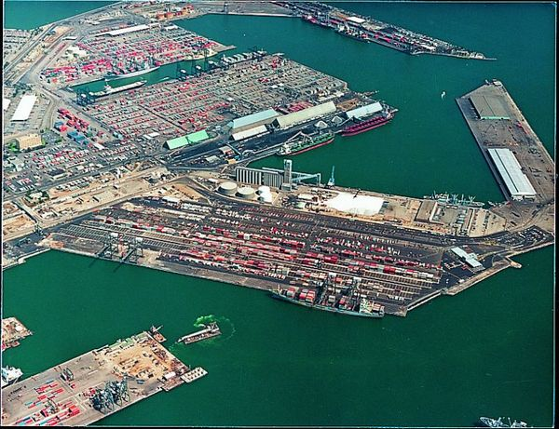

Slide 28
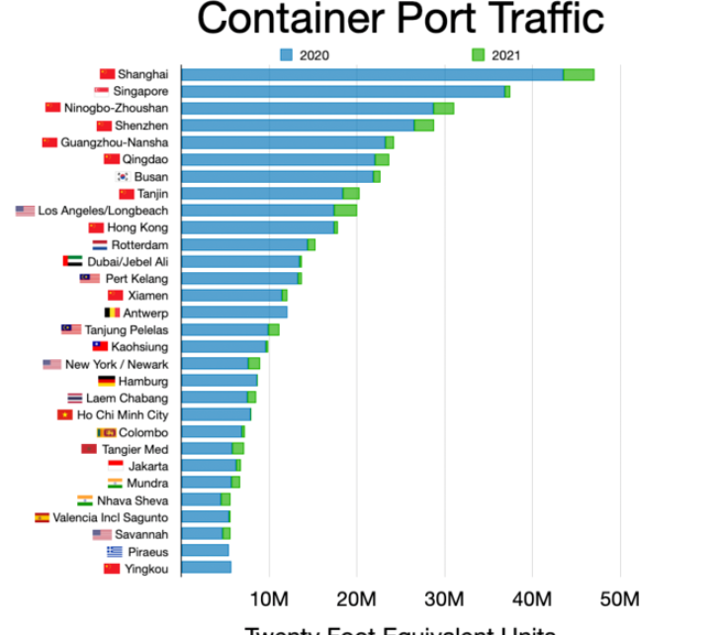
https://en.wikipedia.org/wiki/File:Container_port_traffic.webp

Slide 29
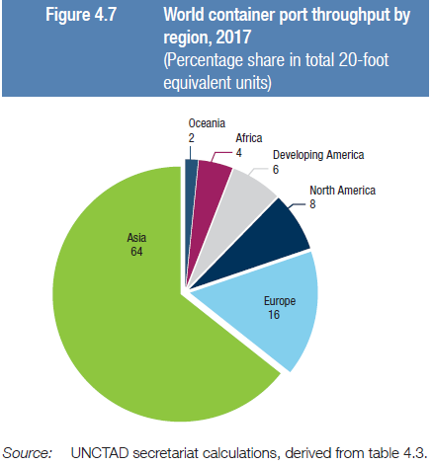
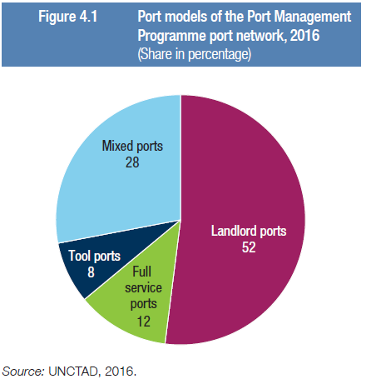
Mixed ports: partly private e partly landlord

Slide 30
Port Administration Models (https://ppiaf.org/sites/ppiaf.org/files/documents/toolkits/Portoolkit/Toolkit/module3/port_functions.html)
A number of factors influence the way ports are organized, structured, and managed, including: the socioeconomic structure of a country (market economy, open borders); historical developments (for example, former colonial structure); location of the port (urban area or in isolated regions), types of cargoes handled (liquid and dry bulk, general cargo, or containers).
Four main categories of ports have emerged over time: the public service port, the tool port, the landlord port, and the fully privatized port or private service port.
These models are distinguished by how they differ with respect for such characteristics as: public, private, or mixed provision of service; local, regional, or global orientation; ownership of infrastructure (including port land), ownership of superstructure and equipment (particularly ship-to-shore handling equipment, sheds, and warehouses); status of dock labor and management.

Slide 31
Port Administration Models (https://ppiaf.org/sites/ppiaf.org/files/documents/toolkits/Portoolkit/Toolkit/module3/port_functions.html)
Service Ports
Service ports have a predominantly public character. The number of service ports is declining. Many former service ports are in transition toward a landlord port structure, such as Colombo (Sri Lanka), Nhava Sheva (India), and Dar es Salaam (Tanzania). However some ports in developing countries are still managed according to the service model. Under it, the port authority offers the complete range of services required for the functioning of the seaport system. The port owns, maintains, and operates every available asset (fixed and mobile), and cargo handling activities are executed by labor employed directly by the port authority.
Tool Ports
In the tool port model, the port authority owns, develops, and maintains the port infrastructure as well as the superstructure, including cargo handling equipment such as quay cranes and forklift trucks. Port authority staff usually operates all equipment owned by the port authority. Other cargo handling on board vessels as well as on the apron and on the quay is usually carried out by private cargo handling firms contracted by the shipping agents or other principals licensed by the port authority. The Port of Chittagong (Bangladesh) is a typical example of the tool port. The Ports Autonomes in France are also examples, in particular the container terminals, which are managed and operated along the principles of the tool port, although for more recent terminals the private terminal operators have made the investment in gantry cranes. This arrangement has generated conflicts between port authority staff and terminal operators, which has impeded operational efficiency.

Slide 32
Port Administration Models (https://ppiaf.org/sites/ppiaf.org/files/documents/toolkits/Portoolkit/Toolkit/module3/port_functions.html)
Landlord Ports
The landlord port is characterized by its mixed public-private orientation. Under this model, the port authority acts as regulatory body and as landlord, while port operations (especially cargo handling) are carried out by private companies. Examples of landlord ports are Rotterdam, Antwerp, New York, and since 1997, Singapore. Today, the landlord port is the dominant port model in larger and medium-sized ports. In the landlord port model, infrastructure is leased to private operating companies or to industries such as refineries, tank terminals, and chemical plants. The lease to be paid to the port authority is usually a fixed sum per square meter per year, typically indexed to some measure of inflation. The level of the lease amount is related to the initial preparation and construction costs. The private port operators provide and maintain their own superstructure including buildings (offices, sheds, warehouses, container freight stations, workshops). They also purchase and install their own equipment on the terminal grounds as required by their business. In landlord ports, dock labor is employed by private terminal operators, although in some ports part of the labor may be provided through a portwide labor pool system.
Fully Privatized Ports
Fully privatized ports are few in number, and can be found mainly in the United Kingdom (U.K.) and New Zealand. Full privatization is considered by many as an extreme form of port reform. It suggests that the state no longer has any meaningful involvement or public policy interest in the port sector. In fully privatized ports, port land is privately owned. This requires the transfer of ownership of such land from the public to the private sector.

Slide 33
Strengths and weaknesses of port management models (A. Baird and P. Kent, 2001)

Slide 34
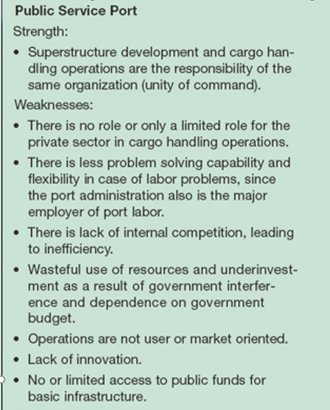
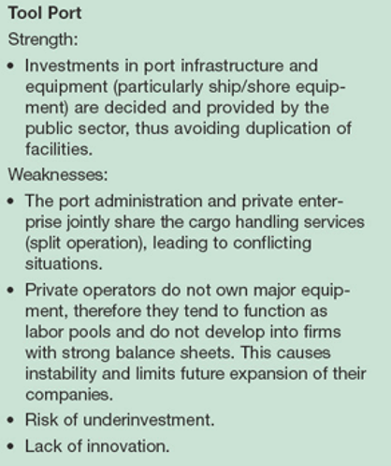

Slide 35
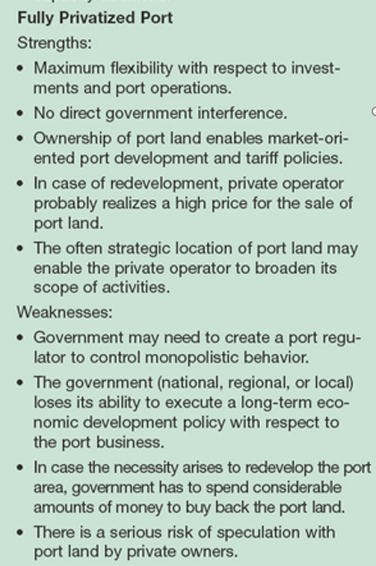
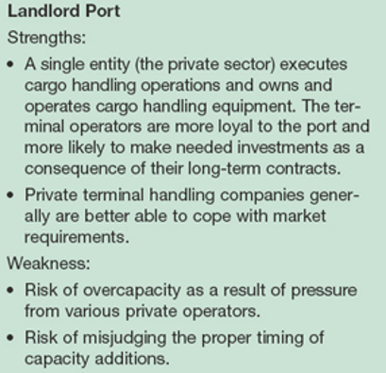

Slide 36
Italian ports

Slide 37
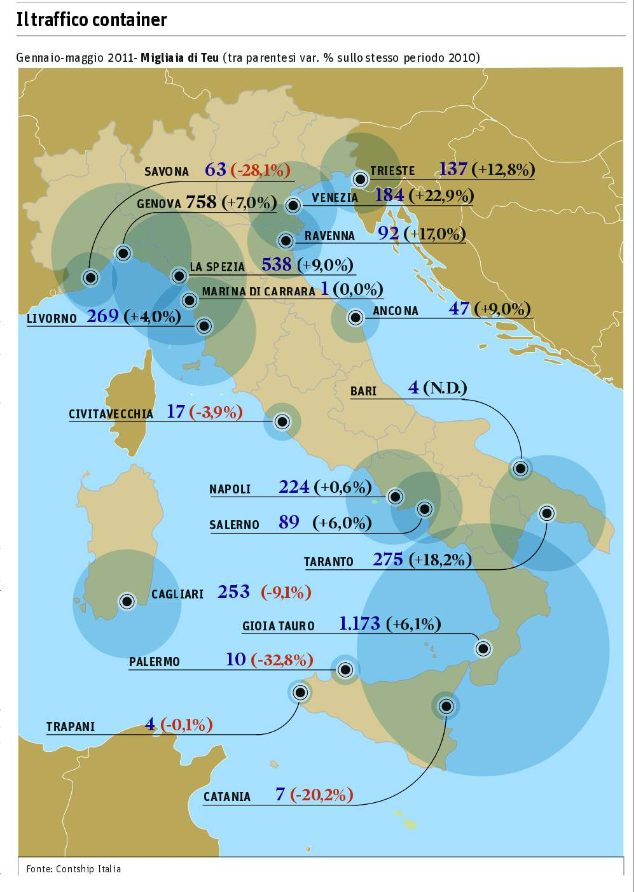
Rappresentazione geografica

Slide 38
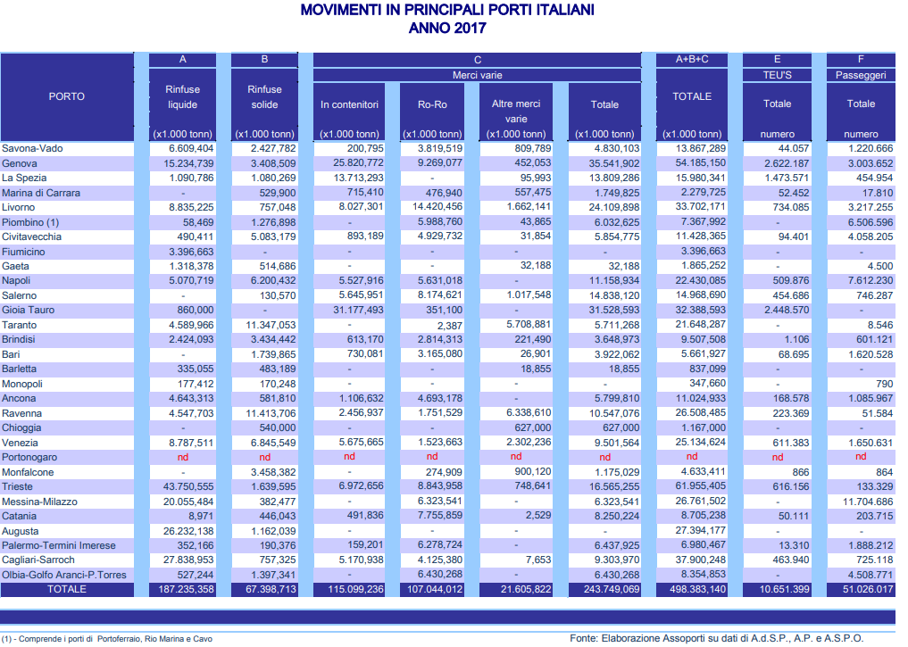

Slide 39
Autorità di sistema portuale
L'autorità di sistema portuale, in Italia, è l’ente pubblico di personalità giuridica che amministra un sistema di uno o più porti di rilevanza internazionale o nazionale. Ha, tra gli scopi istituzionali, la gestione e l'organizzazione di beni e servizi nel rispettivo ambito portuale. Rappresenta i porti di sua competenza in tutto il mondo. Tale ente, con il nome originario di Autorità portuale, è stato istituito in Italia con la legge del 28 gennaio 1994 n. 84 nell'ambito del riassetto della legislazione in materia portuale. La legge che dal 2016 regola le attività e la localizzazione delle Autorità di sistema portuale (A.d.S.P.) è il decreto legislativo del 4 agosto 2016, n° 169.
L'autorità di sistema portuale è dotata di autonomia amministrativa, nonché di autonomia di bilancio e finanziaria nei limiti previsti dalla legge. Ad essa sono state attribuite numerose funzioni, alcune delle quali in precedenza svolte dall'Autorità marittima. Tali funzioni sono così sintetizzate:
Pianificazione territoriale dell'ambito portuale. Il piano regolatore portuale, adottato dal comitato portuale previa intesa con il comune interessato, individua le caratteristiche e la funzione delle aree interessate e definisce l'ambito complessivo del porto, comprese le aree adibite alla produzione industriale, all'attività cantieristica e alle infrastrutture stradali e ferroviari. Il piano successivamente è trasmesso al Consiglio superiore dei lavori pubblici che deve esprimersi entro 45 giorni ed è infine approvato dalla Regione;
Indirizzo, programmazione, coordinamento, promozione e controllo delle operazioni portuali e delle altre attività esercitate nei porti, individuando le strategie di sviluppo delle attività portuali e gli interventi nella garanzia del rispetto degli obiettivi prefissati, anche in riferimento alla sicurezza rispetto a rischi di incidenti connessi alle attività in questione ed alle condizioni di igiene del lavoro;
Manutenzione ordinaria e straordinaria delle parti comuni nell'ambito portuale, compresa la manutenzione per il mantenimento dei fondali, previa convenzione con il Ministero dei lavori pubblici. Tale funzione è affidata in concessione all'autorità portuale mediante gara pubblica;
Affidamento e controllo delle attività dirette alla fornitura di servizi di interesse generale, non strettamente connessi alle operazioni portuali;
Amministrazione delle aree e dei beni del demanio marittimo compresi nell'ambito della circoscrizione territoriale.

Slide 40
Con la riforma dell'estate del 2016 ("Riorganizzazione, razionalizzazione e semplificazione delle Autorità Portuali") le Autorità portuali italiane sono state ridotte da 23 a 15 e hanno assunto la nuova denominazione di Autorità di Sistema Portuale (A.d.S.P.), con le seguenti sedi:
porto di Genova: sede dell'autorità di sistema portuale del Mar Ligure occidentale (porti di Genova, Savona e Vado Ligure);
porto della Spezia: sede dell'autorità di sistema portuale del Mar Ligure orientale (porti di La Spezia e Marina di Carrara);
porto di Livorno: sede dell'autorità di sistema portuale del Mar Tirreno settentrionale (porti di Livorno, Capraia, Piombino, Portoferraio, e Rio Marina e Cavo);
porto di Civitavecchia: sede dell'autorità di sistema portuale del Mar Tirreno centro-settentrionale (porti di Civitavecchia, Fiumicino e Gaeta);
porto di Napoli: sede dell'autorità di sistema portuale del Mar Tirreno centrale (porti di Napoli, Salerno e Castellammare di Stabia);
porto di Cagliari: sede dell'autorità di sistema portuale del "Mare di Sardegna" (porti di Cagliari, Foxi-Sarroch, Olbia, Porto Torres, Golfo Aranci, Oristano, Portoscuso-Portovesme e Santa Teresa di Gallura). La sede dell'A.d.S.P. "Mare di Sardegna" non è stata ancora definitivamente individuata (art. 7, comma 3, D.Lgs, n. 169/2016);
porto di Palermo: sede dell'autorità di sistema portuale della Sicilia occidentale (porti di Palermo, Termini Imerese, Porto Empedocle e Trapani);
porto di Augusta: sede dell'autorità di sistema portuale della Sicilia orientale (porti di Augusta e Catania);
porto di Gioia Tauro: sede dell'autorità di sistema portuale del Mare Tirreno Meridionale, del Mar Jonio e dello Stretto (porti di Gioia Tauro, Crotone, Corigliano Calabro, Taureana di Palmi, Villa San Giovanni, Messina, Milazzo, Tremestieri, Vibo Valentia e Reggio Calabria);
porto di Taranto: sede dell'autorità di sistema portuale del Mar Ionio (porto di Taranto);
porto di Bari: sede dell'autorità di sistema portuale del Mare Adriatico meridionale (porti di Bari, Brindisi, Manfredonia, Barletta e Monopoli);
porto di Ancona: sede dell'autorità di sistema portuale del Mare Adriatico Centrale (porti di Ancona, Falconara Marittima, Pescara, Pesaro, San Benedetto del Tronto - esclusa darsena turistica - e Ortona);
porto di Ravenna: sede dell'autorità di sistema portuale del Mare Adriatico Centro-Settentrionale (porto di Ravenna);
porto di Venezia: sede dell'autorità di sistema portuale del Mare Adriatico Settentrionale (porti di Venezia e Chioggia);
porto di Trieste: sede dell'autorità di sistema portuale del Mare Adriatico Orientale (porti di Trieste e Monfalcone).

Slide 41
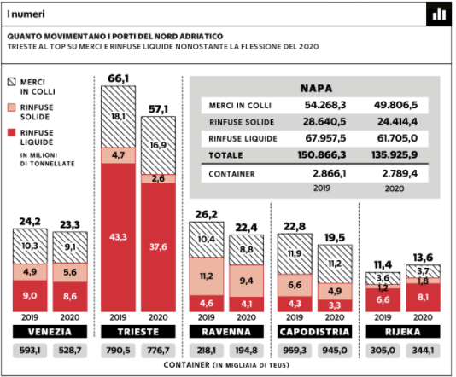

Slide 42
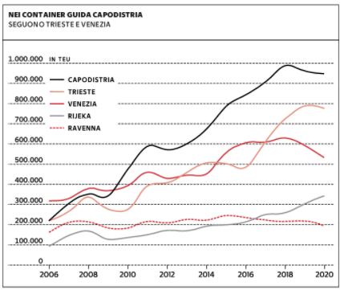

Slide 44
Who determines the success of a port?
Possible answers:
The shipping companies: they control the routes and decide which ports to call
The terminal operators: they decide how much to invest in port infrastructures (berths, cranes, ICT) and determine the efficiency of a port
The port authority: they manage the port, collect port fees, allocate port space and promote the port (See in particular the role of the port authority as a result of the 1994 Reform Act No. 84, reformed as law n.203 in 31-8-2016, 15 Autorità di sistema portuale)
The geography: the location of the port is crucial. The port should have: 1) enough space, 2) be located close to an industrial region, and be part of an network of inland terminals;
The State: the State provides the rail and road infrastructure than enhance its accessibility and increase the catchment area.

Slide 45
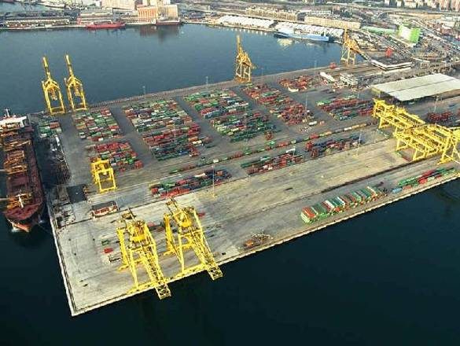
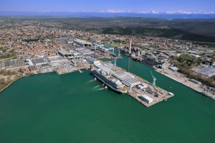
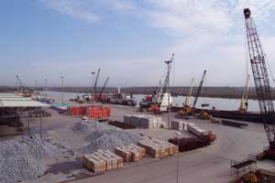
The FVG port system

Slide 46
For Italian students only – not included in the exam

Slide 47
Il sistema marittimo-portuale del Friuli Venezia Giulia. Caratteristiche economiche e interdipendenze settoriali
Romeo Danielis
Università degli Studi di Trieste

Slide 48
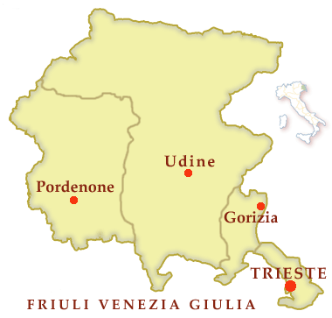
Il sistema marittimo-portuale del Friuli Venezia Giulia
Monfalcone
Porto Nogaro

Slide 49
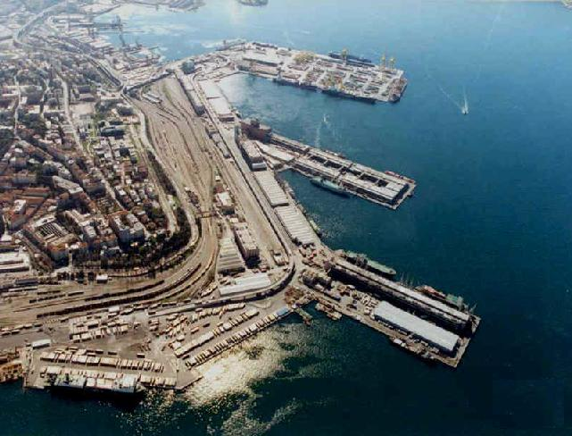
Il porto di Trieste

Slide 50
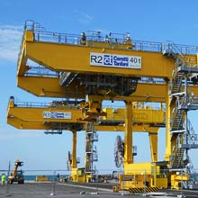

Slide 51
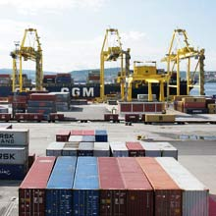

Slide 52
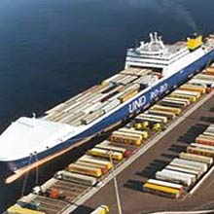

Slide 53
I flussi di traffico nel Porto di Trieste (fonte: Eva Vocci, Tesi di laurea in economia dei trasporti, AA 2011) – in tonnellate
Anno | Volume totale | Sbarchi | Imbarchi | Petrolio | Volume totale al netto petrolio
1880-1889 | 1.225.300 |  |  |  | 1.225.300
1913 | 3.449.730 | 2.314.018 | 1.135.712 |  | 3.449.730
1926-1930 | 2.552.607 | 1.730.136 | 822.471 |  | 2.552.607
1946 | 1.735.677 | 1.669.628 | 66.049 |  | 1.735.677
1950 | 3.495.456 | 2.383.181 | 1.112.275 |  | 3.495.456
1960 | 5.065.611 | 3.839.622 | 1.225.989 |  | 5.065.611
1968 | 20.894.816 | 19.133.803 | 1.761.013 | 14.659.353 | 6.235.463
1973 | 37.522.180 | 35.611.780 | 1.910.400 | 29.938.709 | 7.583.471
1980 | 37.225.806 | 34.429.437 | 2.796.369 | 27.889.000 | 9.336.806
1990 | 34.174.820 | 31.272.785 | 2.902.035 | 26.413.969 | 7.760.851
1999 | 44.514.000 | 39.430.900 | 5.083.100 | 34.800.000 | 9.714.000
2009 | 40.986.000 | 37.170.000 | 3.816.000 | 31.767.000 | 9.219.000

Slide 54
Merci movimentate nel porto di Trieste (milioni di tonnellate)

Slide 55
Statistiche recenti del Porto di Trieste
 | 2011 | 2012 | 2013 | 2014 | 2.015
Rinfuse liquide | 35.229.638 | 35.967.976 | 41.992.066 | 41.685.326 | 41.286.761
di cui :
petrolio greggio | 34.228.706 | 35.014.883 | 41.284.644 | 41.493.027 | 40.824.108
prodotti raffinati | 989.946 | 936.173 | 564.292 | 536.238 | 304.064
Altre rinfuse liquide | 10.986 | 16.920 | 143.130 | 241.840 | 158.589
Rinfuse solide | 1.720.095 | 1.778.471 | 986.614 | 790.057 | 1.607.232
di cui :
minerali | 500.324 | 333.476 | 36.967 | 226.743 | 666.694
carboni | 616.426 | 658.051 | 637.514 | 442.461 | 512.361
Cereali e semi oleosi | 105.181 | 126.785 | 57.536 | 101.986 | 112.276
Altre rinfuse solide | 498.164 | 660.159 | 254.597 | 5.810 | 315.901
Merci varie in colli | 11.288.244 | 11.460.423 | 13.607.028 | 13.962.980 | 14.267.201
TOTALE GENERALE | 48.237.977 | 49.206.870 | 56.585.708 | 57.153.931 | 57.161.194

Slide 56
TIPOLOGIA DI TRASPORTO
 | 2011 | 2012 | 2013 | 2014 | 2015
MOVIMENTO CONTENITORI T.E.U. (incl. shiftin | 393.186 | 408.023 | 458.597 | 506.011 | 501.268
full container (tonn.) * | 4.644.396 | 5.374.226 | 6.040.355 | 5.749.001 | 5.273.820
N° CAMION SU NAVI FERRY/ RO-RO | 223716 | 212633 | 271519 | 296700 | 301116
ro-ro /ferry (tonn.) * | 5.817.998 | 5.362.349 | 6.847.383 | 8.384.944 | 8.356.699
NAVI CONVENZIONALI (tonn. general cargo) | 1.610.806 | 1.752.512 | 719.290 | 118.124 | 171.813
MOVIMENTO PASSEGGERI (N°) | 56973 | 98647 | 98647 | 118124 | 171813
di cui: crocieristi in transito | 9.384 | 15.295 | 15.295 | 24.389
crocieristi sbarco/imbarco | 18790 | 54357 | 54357 | 85455
MOVIMENTO NAVI (N°) | 3.982 | 4.022 | 4.022 | 3.949

Slide 57
Confronto tra i porti belgi ed il SPR FVG
Porto | Traffico (mil. tonn.) | Superf. (km²) | Val. agg./tonn | Val. agg./km² | Add/tonn | Add/km²
Anversa | 182,9 | 130,6 | 53,8 | 75,3 | 343,3 | 480,9
Ghent | 25,1 | 46,7 | 153,5 | 82,6 | 1.119,1 | 601,9
Oostend | 8,0 | 6,6 | 55,1 | 67,2 | 586,6 | 715,4
Zeebrugge | 42,1 | 28,5 | 21,1 | 31,3 | 253,2 | 374,4
Bruxelles | 4,3 | 0,7 | 167,3 | 1.027,4 | 140,9 | 865,7
Liegi | 15,8 | 3,7 | 88,4 | 378,2 | 727,5 | 3.112,7
SPR FVG | 52,0 | 3,3 | 25,2 | 391,2 | 267,0 | 4.148,9
Fonte: Mathys (2009) ed elaborazioni proprie

Slide 58
Il porto di Trieste
Il porto di Trieste ha fondali molto profondi: minimo 18 metri lungo banchina. Il rischio di nebbia è molto limitato.
La superficie complessiva del porto è di 2,304 km2 (di cui 1,765 di punti franchi); le aree di deposito e stoccaggio sono pari a 925.000 m2 (di cui coperte 500.000 m2); la lunghezza delle banchine ammonta a 12 km e sono tutte servite da rotaie.
Il porto è suddivisibile in cinque aree, tre delle quali adibite a fini commerciali (il porto vecchio, il porto nuovo, lo scalo legnami), mentre le due rimanenti sono utilizzate a scopi industriali (il terminal industriale ed il terminal petroli che serve l'oleodotto Trieste-Ingolstadt).

Slide 59
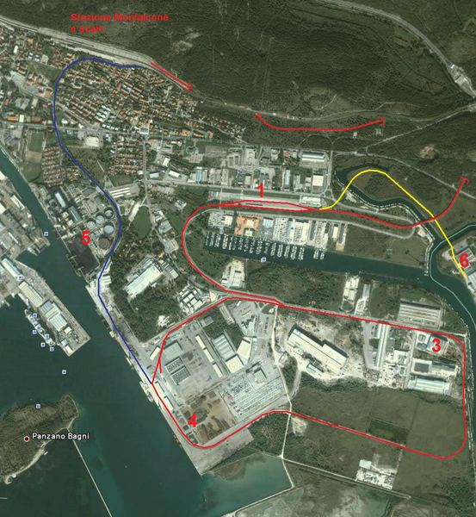
Il porto di Monfalcone

Slide 60
Il porto di Monfalcone
L’area portuale ha una superficie di 0,68 km2. I fondali variano tra i 9,5 e gli 11,7 metri con la previsione di arrivare mediante dragaggi a 13 metri. Le banchine, completamente attrezzate per la manipolazione di qualsiasi tipo di merce, sono operative per 1,5 km. Sono disponibili 9 accosti presso la banchina “Portorosega”, 2 accosti a servizio della centrale termoelettrica presso la banchina “E-ON”, 1 accosto presso la banchina De Franceschi (silos cereali).
Nell’attuale fase di sviluppo dell’attività del porto, che risulta in continua costante crescita, vengono manipolate oltre 4,4 milioni di tonnellate di merce varia: caolino, carbone, cellulosa, cemento, cereali, legname, impiantistica, minerali diversi alla rinfusa, prodotti lapidei, prodotti siderurgici, rottami di ferro, autovetture. Il porto, specializzato in general cargo e dry bulk cargo, possiede vasta e specifica esperienza per la movimentazione di prodotti forestali.

Slide 61
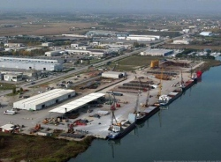
Il porto di Porto Nogaro

Slide 62
Il porto di Porto Nogaro
Il porto di Nogaro è l’unico operativo nella provincia di Udine e sorge sulle rive del fiume Corno. Vi si accede dal Mare Adriatico attraverso un canale translagunare lungo circa 3 miglia ed il canale navigabile dell’Aussa Corno. Lo scalo si articola in due strutture pubbliche, Porto Vecchio e Porto Margreth, e in una banchina privata delle ex-Industrie Chimiche Caffaro, cui si accede tramite il canale artificiale Banduzzi, che misura circa 1,5 miglia.
Porto Vecchio ha uno sviluppo di banchine di 400 metri lineari ed un pescaggio di -4,5 metri sul livello del mare, mentre Porto Margreth beneficia di un tirante d'acqua a -7,5 metri sul livello del mare con uno sviluppo di banchine attualmente pari a 860 metri lineari. L'area di Porto Nogaro comprende inoltre 36 ettari di piazzali portuali infrastrutturati con raccordo ferroviario, magazzini coperti ed aree di stoccaggio scoperte.
Di notevole importanza è il collegamento con il vicino Interporto Alpe Adria di Cervignano del Friuli, in funzione di un miglioramento dell'intermodalità e della logistica di Porto Nogaro. Inoltre sono presenti nella Zona Industriale di riferimento dell'Aussa-Corno alcune strutture private per lo stoccaggio e la lavorazione delle merci.
Le navi che gravitano su Porto Nogaro stazzano mediamente 3-4.000 tonnellate, con punte fino a 7.000. Data la natura fluviale del canale di accesso al Porto, le navi a chiglia piatta hanno maggiore facilità di ingresso.

Slide 63
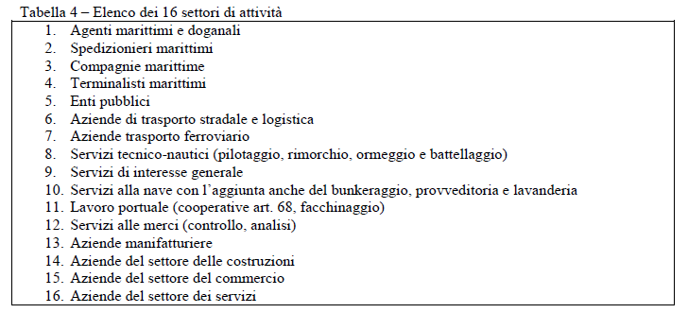
Settori di attività

