Slide 1
Air transport

Slide 2
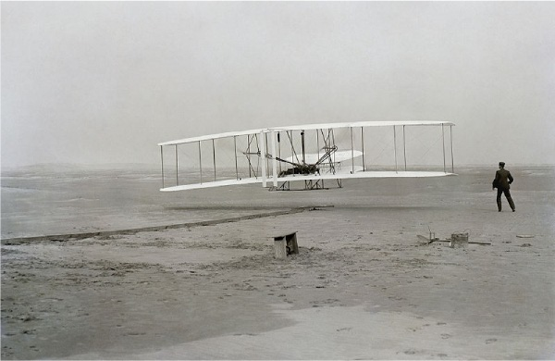
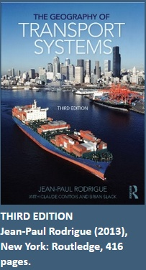
Air transport
Wright Brothers First Flight, 1903

Slide 3
The Rise of Air Transportation
Air transportation was slow to take off after the Wright Brothers breakthrough at Kitty Hawk in 1903.
On January 1, 1914, the world’s first scheduled flight with a paying passenger hopped across the bay separating Tampa and St. Petersburg, Florida for a fare that eventually stabilized at $10 per person, round-trip (about $200 in 2006 dollars).
World War I provided the first real spur to the development of commercial aviation. The war left a legacy of thousands of unemployed pilots and surplus aircraft along with an appreciation for the future significance of this new technology.

Slide 4
The Rise of Air Transportation
1919 marked the first commercial international air transport service between England and France.
In Europe, governments established new passenger airlines while on the other side of the Atlantic, the American government ran a heavily subsidized airmail. Airmail was one of the earliest avenues via which air transportation became commercially relevant .
US airmail also subsidized the emergence of the first major US passenger airlines. By the eve of World War II, air travel was quite literally taking off.

Slide 5
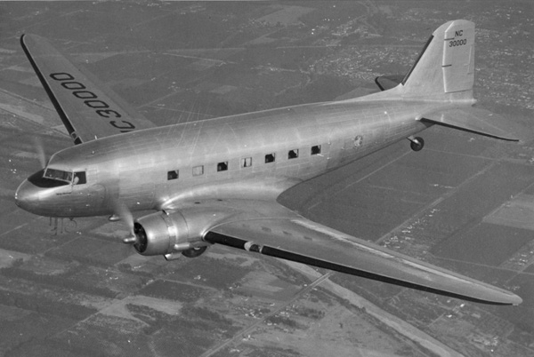
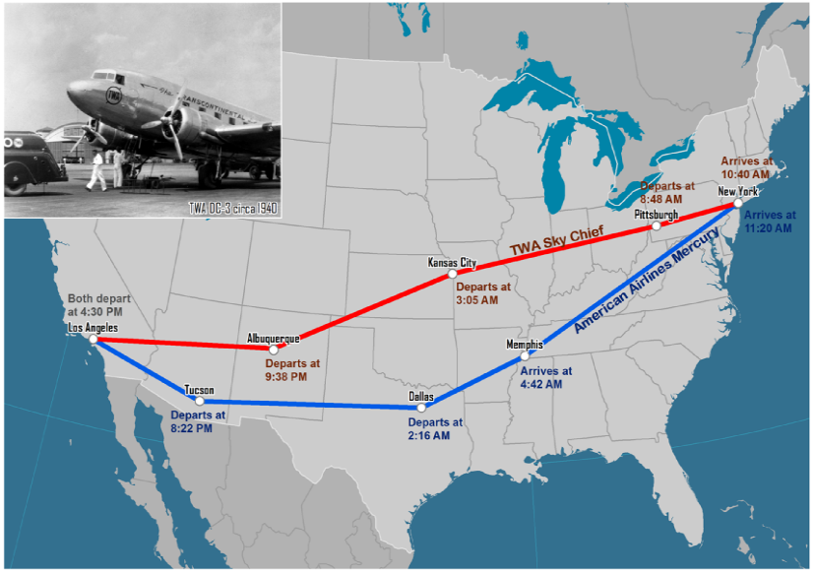
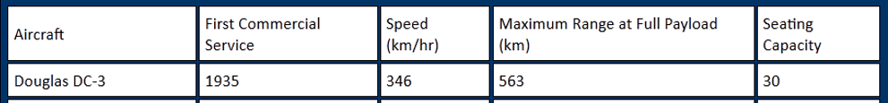
The Douglas DC-3, the first airliner that could fly profitably without government subsidies (air mail routes). The 21-seat DC-3 was a long-range aircraft for its time, able to fly across the US stopping just three times. By 1941, 80% of all commercial aircraft in the US were DC-3s.

Slide 6
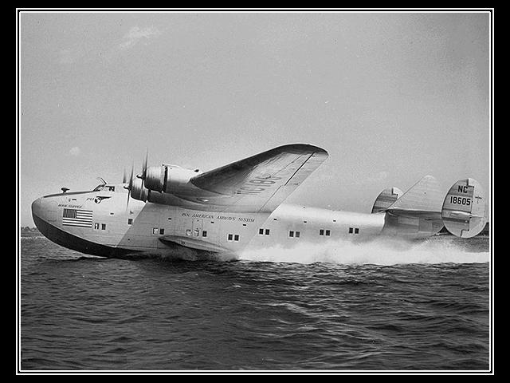
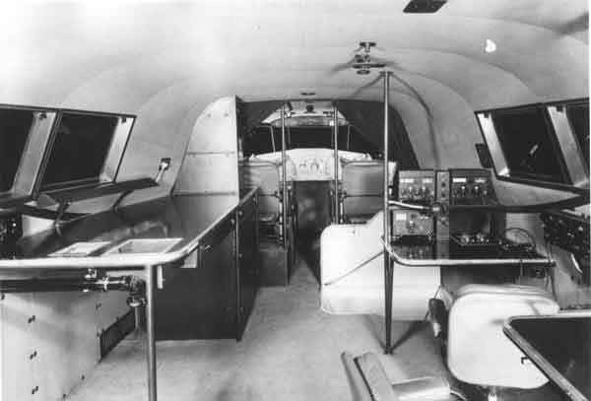
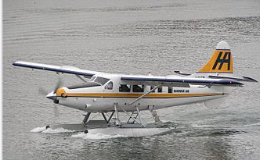
Seaplanes (idrovolanti)
A seaplane is a powered fixed-wing aircraft capable of taking off and landing (alighting) on water. Seaplanes are usually divided into two categories based on their technological characteristics: floatplanes and flying boats.
In the 1930s, flying boats made it possible to have regular air transport between the U.S. and Europe, opening up new air travel routes to South America, Africa, and Asia. In areas where there were no airfields for land-based aircraft, flying boats could stop at small island, river, lake or coastal stations to refuel and resupply.
They were used both for the mail service and for passengers. By 1931, mail from Australia was reaching Britain in just 16 days − less than half the time taken by sea. The market for long-haul travel was very small, partly because of the extraordinarily high cost. Only the elite or government officials was able to afford air travel.
flying boats
Boeing 314 Clipper
floatplane

Slide 7
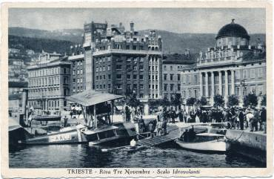
Seaplane line Trieste-Torino

Slide 8
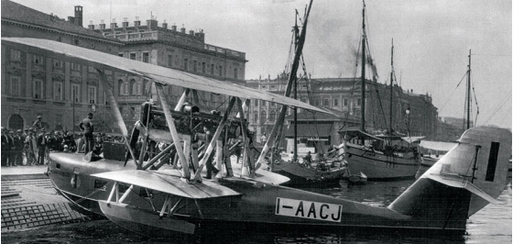
Seaplane line Trieste-Torino

Slide 9
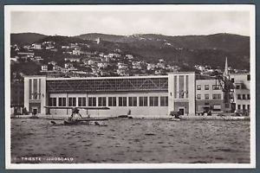
Seaplane line airline station Trieste-Torino

Slide 10
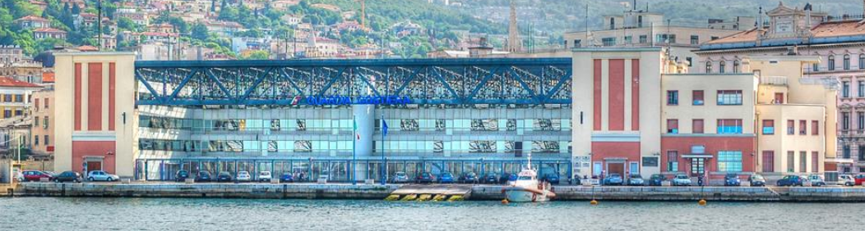
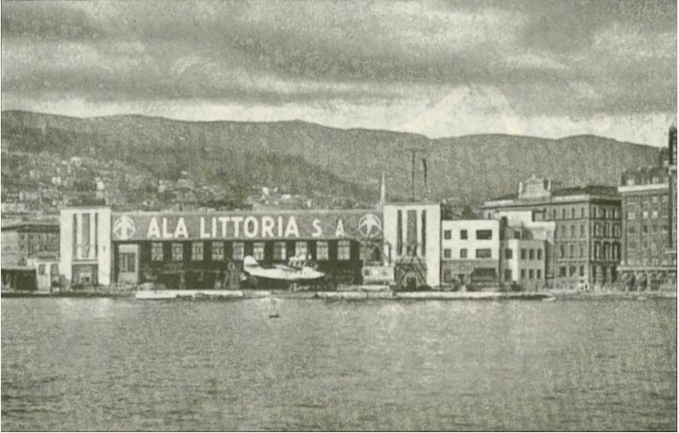
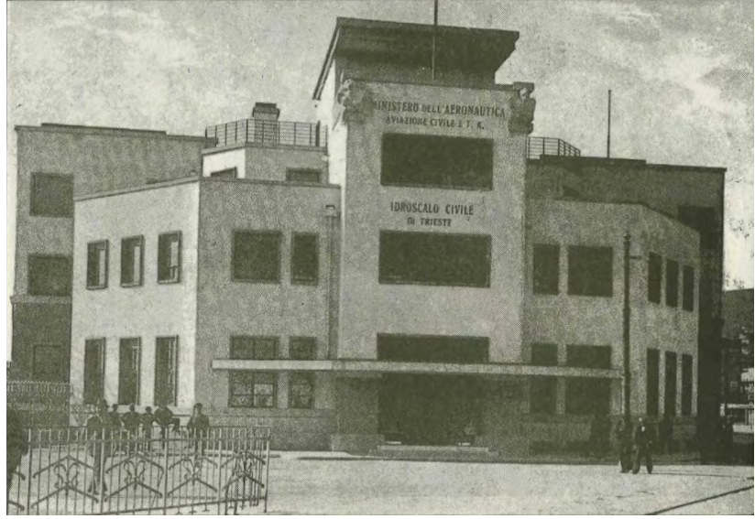
Capitaneria di Porto di Trieste
Fine anni '30: l'Idroscalo con l'insegna della compagnia di bandiera «ALA LITTORIA»; sulla banchina, si nota, «a secco», un idrovolante «Macchi-C 94»; (da una cartolina edita nel 1939)

Slide 11
Rise and fall of seaplanes
Delivering the mail as quickly as possible generated a lot of competition and some innovative designs.
The military value of flying boats was well-recognized, and every country bordering on water operated them in a military capacity at the outbreak of the war. They were utilized in various tasks from anti-submarine patrol to air-sea rescue and gunfire spotting for battleships.
They could fly very long distances but their slow speeds undercut their profitability for passenger transport. However, the double-deck Boeing 314 Clipper remained common through World War II.
The War again encouraged the rapid growth of air transportation.
After World War II, the use of flying boats rapidly declined for several reasons. The ability to land on water became less of an advantage owing to the considerable increase in the number and length of land-based runways during World War II. Further, as the speed and range of land-based aircraft increased, the commercial competitiveness of flying boats diminished.
Indeed, it was only after World War II that air transportation became the dominant mode of long-haul passenger travel in developed country markets.

Slide 12
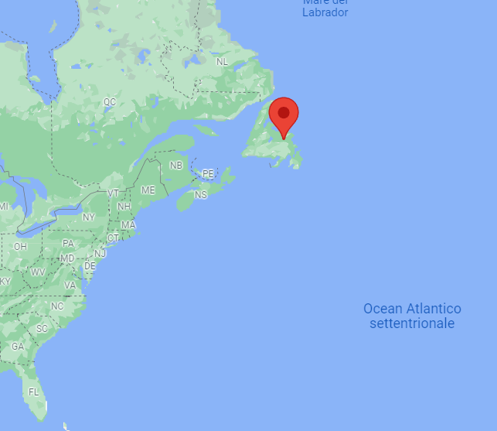
Transatlantic passenger service flights
First solo transatlantic flight and first non-stop fixed-wing aircraft flight between America and mainland Europe
  On 20–21 May 1927, Charles A. Lindbergh flew his Ryan monoplane (named Spirit of St. Louis), 3,600 nautical miles (6,700 km), from Roosevelt Field, New York to Paris–Le Bourget Airport, in 33½ hours.
First jet aircraft transatlantic passenger service
  On 4 October 1958, British Overseas Airways Corporation (BOAC) flew the first jet airliner service using the de Havilland Comet, when G-APDC initiated the first transatlantic Comet 4 service and the first scheduled transatlantic passenger jet service in history, flying from London to New York with a stopover at Gander, Newfoundland.

Slide 13
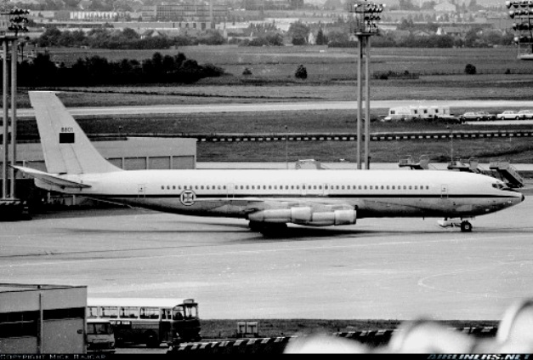
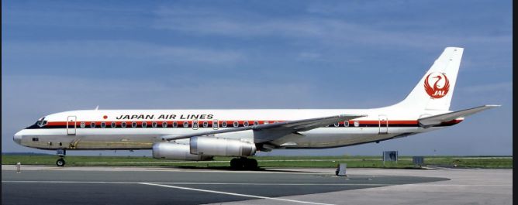
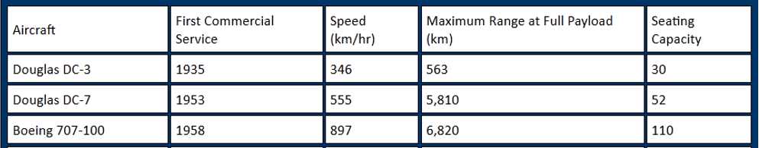
In 1956, more people traveled on intercity routes by air than by Pullman car (sleeper) and coach class trains combined in the US. In 1958, airlines carried more passengers than ocean liners across the Atlantic for the first time.
In October 1958, the Boeing 707 took its first commercial flight. The 707 was not the first jetliner, but it was the first successful one. The 707 and other early jets, especially the Douglas DC-8, doubled the speed (from 350 mph (propeller plane) to 590 mph) of air transportation and radically increased the productivity of airlines which enabled fares to fall. Just a few years after the 707’s debut, jet service had been extended to most major world markets.
Douglas DC-8
Boeing 707
Douglas DC-8 - Lenght: 46 m; Max speed: 946 km/h; Range: 4.800 km; First flight: May 30, 1958; produced until 1972 with 556.
The DC-8 Series 61 and 63 had a seating capacity of 269 passengers, the largest passenger-carrying capacity available. That remained so until the Boeing 747 arrived in 1970.

Slide 14
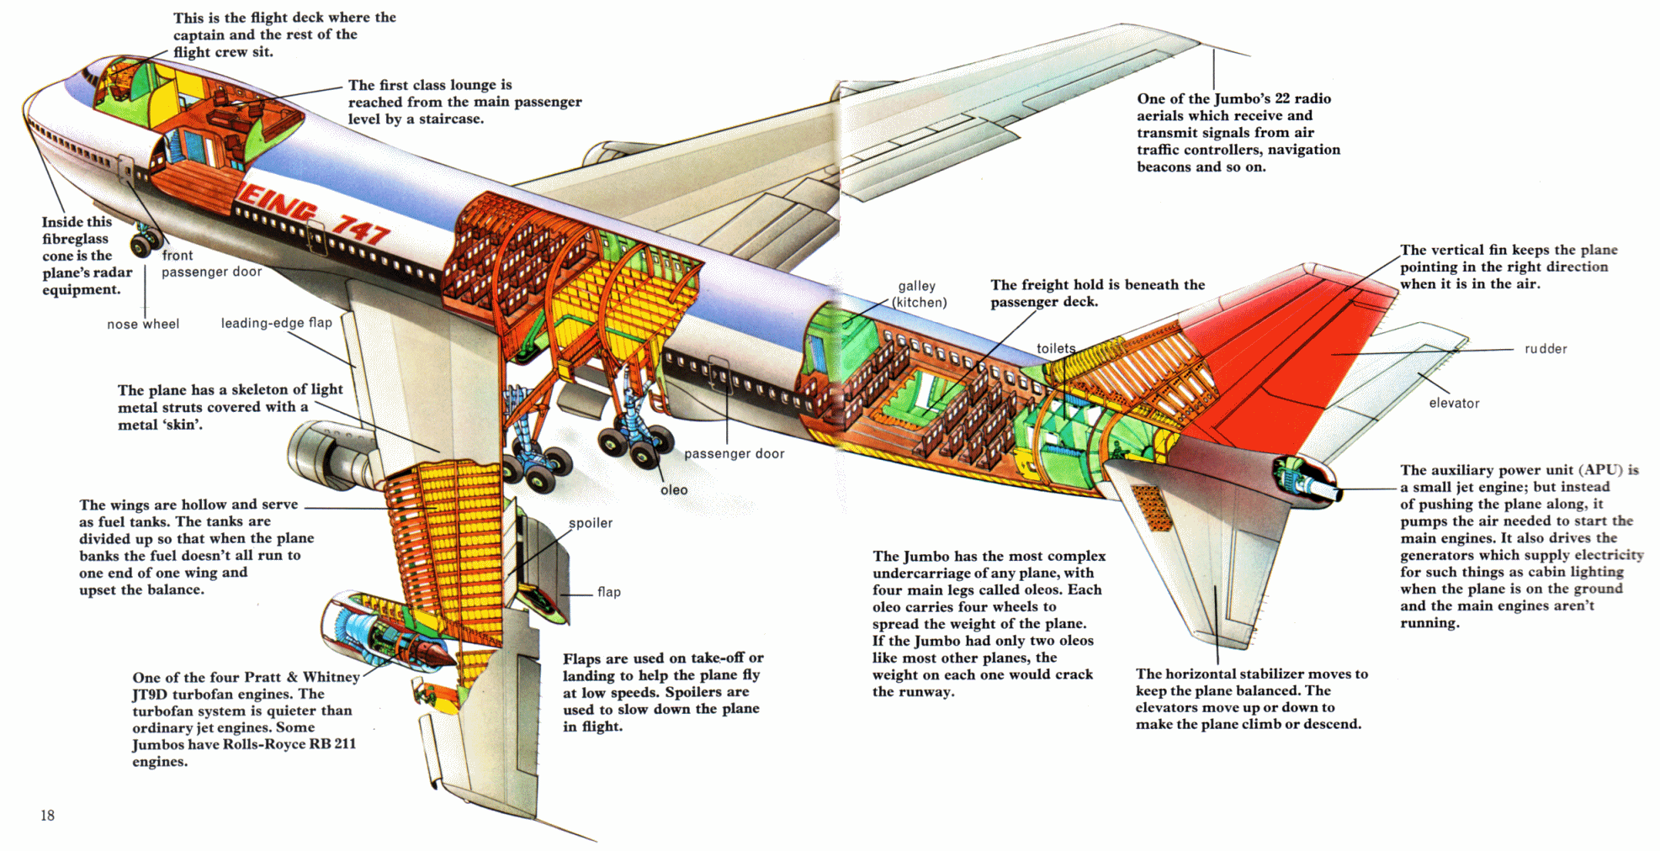
The Boeing 747 is an American wide-body commercial jet airliner and cargo aircraft, often referred to by its original nickname, "Jumbo Jet". Its distinctive "hump" upper deck along the forward part of the aircraft makes it among the world's most recognizable aircraft, and it was the first wide-body produced. Manufactured by Boeing's Commercial Airplane unit in the United States, the original version of the 747 was envisioned to have 150 percent greater capacity than the Boeing 707, one of the common large commercial aircraft of the 1960s. First flown commercially in 1970, the 747 held the passenger capacity record for 37 years.

Slide 15
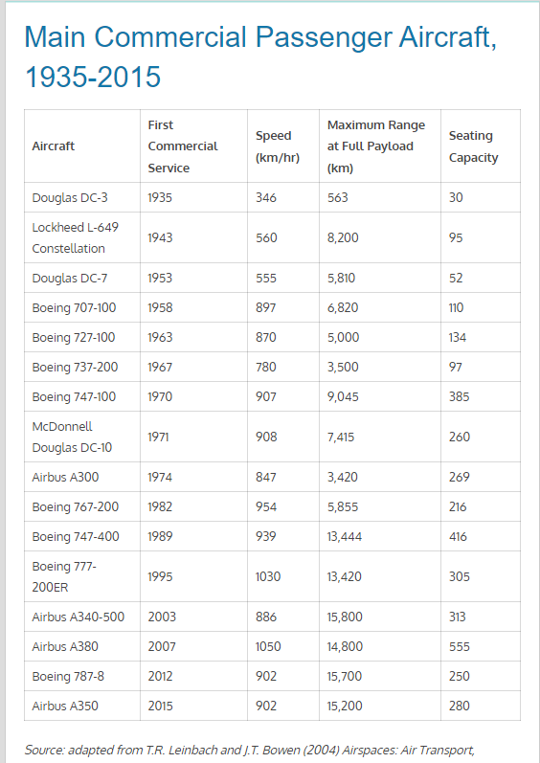

Slide 16
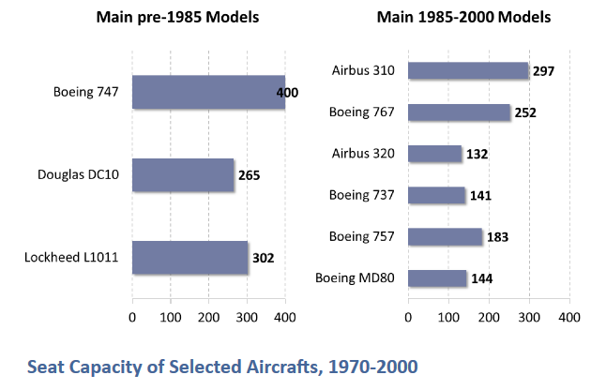
Seat Capacity of Selected Aircrafts, 1970-2000
Main pre-1985 models are characterized by high capacity, such as the 747 and the L1011. They were attempts to replace low capacity and low performance models. While the 747 and the DC10 were mainly built for intercontinental flights (the 747-100 was also used for short high capacity flights, mainly in Japan), the L1011 targeted continental services. Although Boeing continued to provide high capacity planes (747-400 and 777-300), main post-1985 models have a lower capacity but increased fuel efficiency. This fits well the requirements of regional hub-and-spoke networks that have emerged since deregulation (1978) where smaller capacities and high frequencies are the norm.

Slide 17
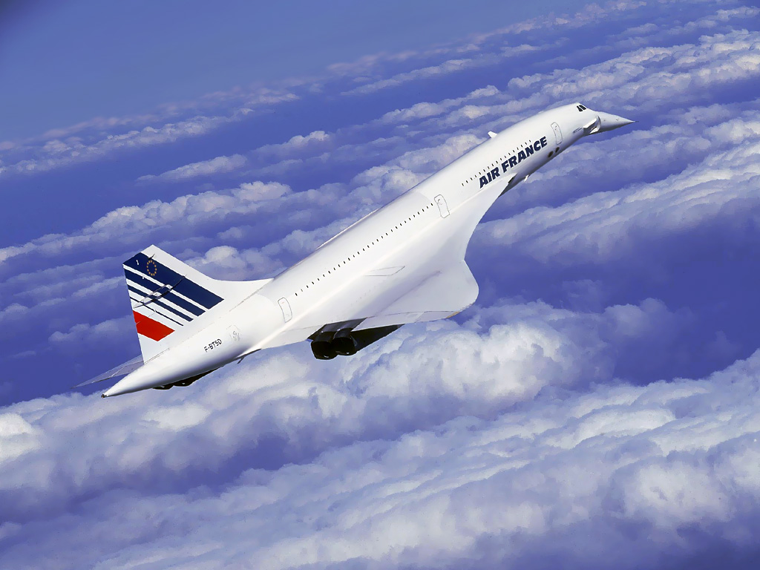
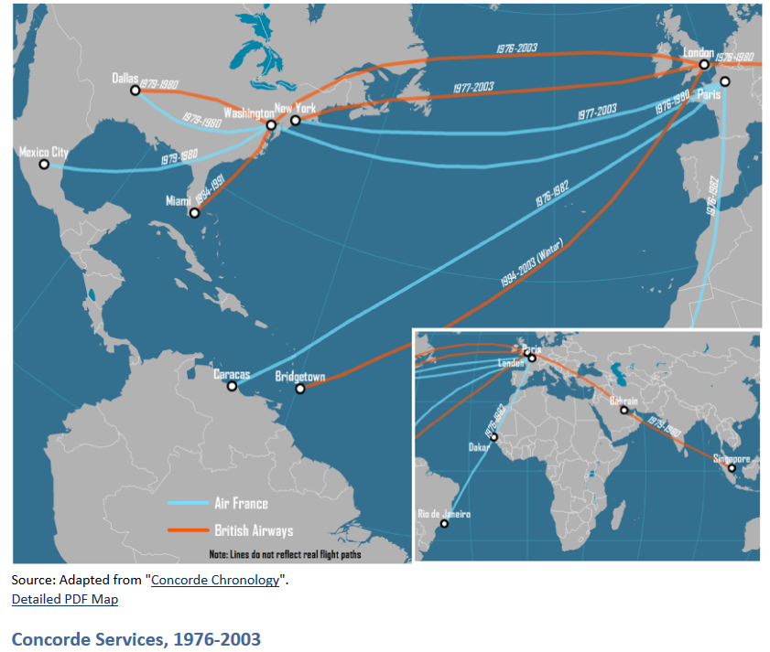
Since their introduction in the late 1950s, commercial jets have not improved in terms of speed. The fastest airliners in regular use today are about as fast as the 707. The Anglo-French Concorde which cruised at twice the speed of sound was hamstrung by very poor economics – it weighed half as much as a first-generation 747 but could carry only a quarter as many passengers and had a range more than 3,000 kilometers shorter. Moreover, the Concorde was an early target of the nascent environmental movement, and restrictions on overland supersonic flights severely limited the market for the airliner. The only carriers to regularly operate it were British Airways and Air France, and although many cities had Concorde services in the first halcyon years of its early use, by the time the supersonic transport (SST) was finally grounded in 2003, only London, Paris, New York, and Washington had scheduled year-round services.

Slide 18
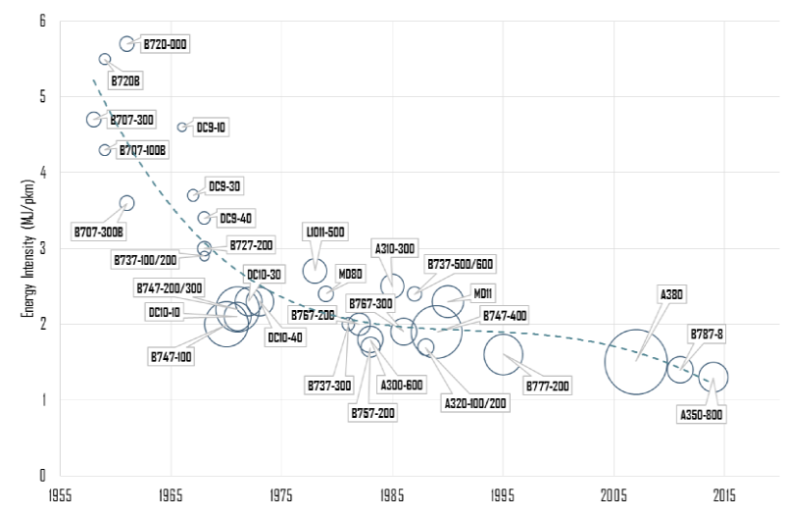
Fuel Efficiency, Selected Passenger Jet Planes: increase
Fuel efficiency is an important component of aircraft operations, so the evolution of jet planes goes on par with the evolution of their fuel efficiency (here measured in mega joules per passenger-km). Several factors contributed to the improvements in energy efficiency of aircraft in recent decades:
Improvements in engine fuel per unit of thrust: About 70%.
Aerodynamic improvements: About 25%.
Other factors such as economies of scale of larger aircraft: About 5%.

Slide 19
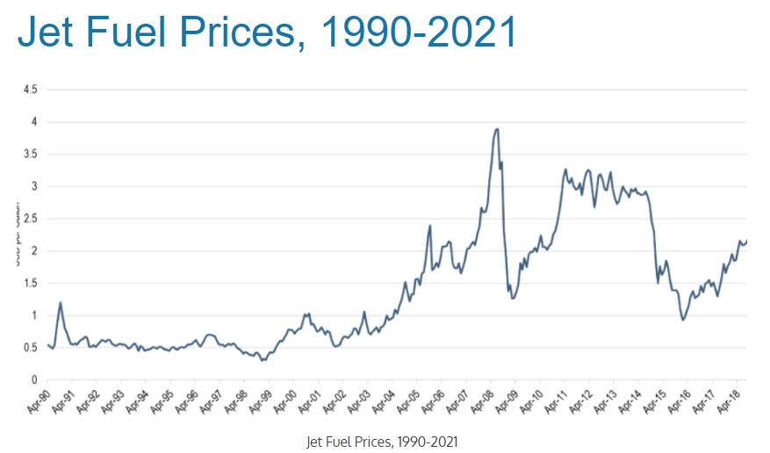
Jet fuel prices: fluctuate
Fuel accounts for about 40% to 50% of air operating costs of a flight, depending of the type of plane used (economies of scale and fuel efficiency are directly related)

Slide 20
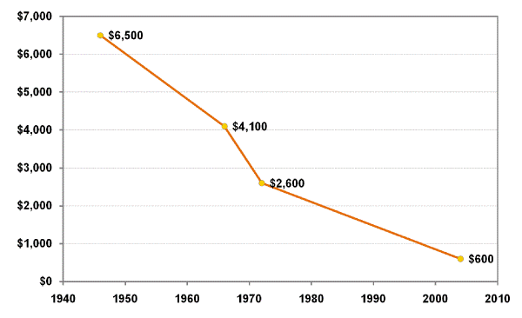
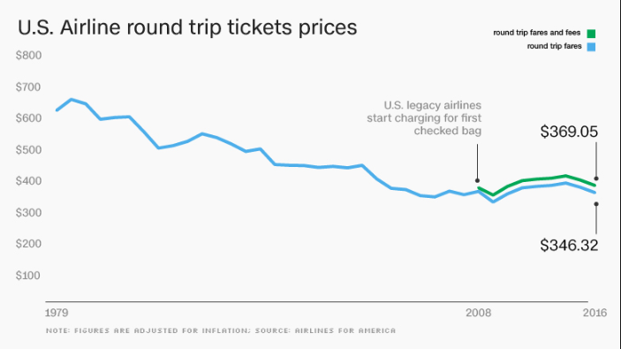
Airline tickets: sharp decrease!
Average Airfare (roundtrip) between New York and London, 1946-2004 (in 2004 dollars)
American prices

Slide 21
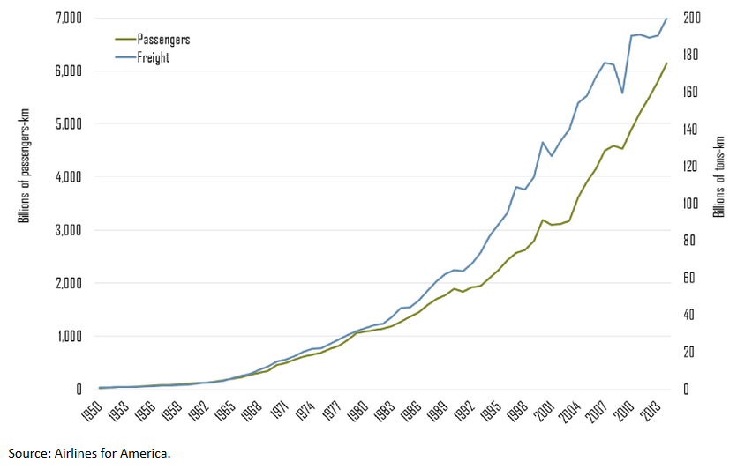
World Air Travel and World Air Freight Carried, 1950-2014

Slide 22
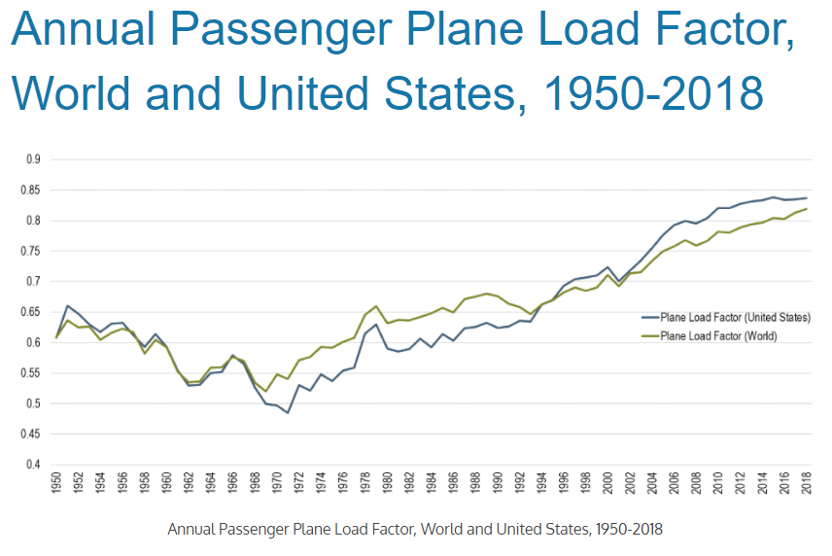
Load factor increase

Slide 23
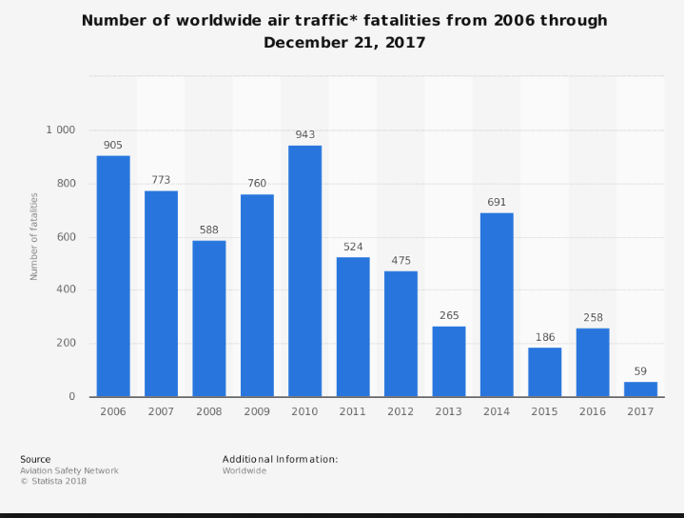
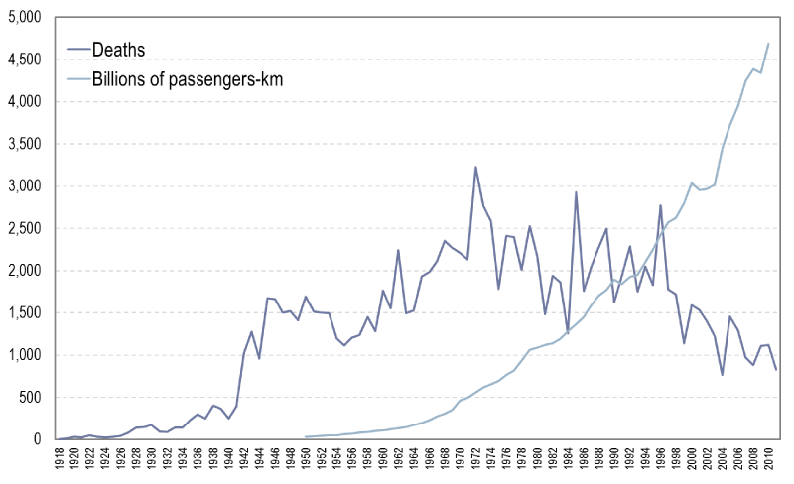
Fatalities decrease
Number of Yearly Fatalities due to Air Transport Crashes, 1918-2011

Slide 24
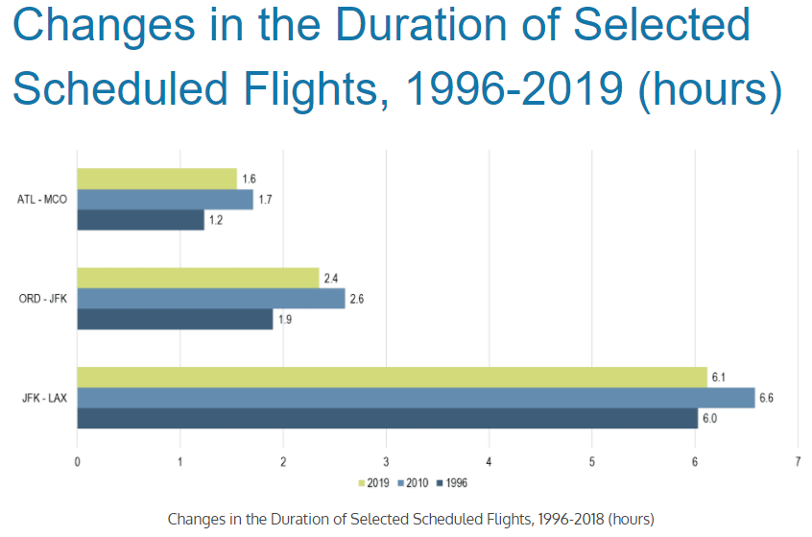
Duration of Selected Scheduled Flights, 1996-2010 (hours): worsened
The growth and compounding of airport congestion has incited airlines to extend the scheduled duration of many of their flights so that they have a higher chance of remaining "on time". The delay issues are not related with the flight time per sè but to ground operations at the airport terminal (e.g. gate access, takeoff queues, etc.).

Slide 25
Summary of the technological development
A new mode of transport is born: 1903
WWI to WWII: pilots, passenger transport, air mail, increased range and speed, first profitable internal flights (Douglas DC-3), “flying boats”
After WWII: (DC8, Boeing 707) increasing range, seating capacity, speed..
1970-2000: a lower capacity but increased fuel efficiency
2000 onwards: decreased cost and prices, increased load factor, increased volume, decreased fatalities, stable transport time

Slide 26
Air transport policy and market trends
Air transport liberalization
  Efficiency gains
  Network optimization
  Low cost carriers

Slide 27
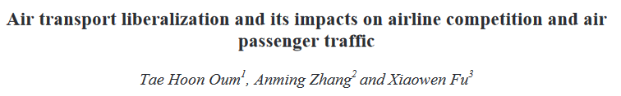
Open skies: air transport liberalization
Liberalization has led to substantial economic and traffic growth. Such positive effects are mainly due to increased competition and efficiency gains in the airline industry, as well as positive externalities to the overall economy;
Liberalization allows airlines to optimize their networks within and cross continental markets. As a result, traffic flow patterns will change accordingly.
There is a two-way relationship between the expansion of Low Cost Carriers (LCCs) vs. liberalization. The fast growth of LCCs leads to increased competition and stimulated traffic, calling for the removal of restrictions on capacity, frequency and pricing.

Slide 28
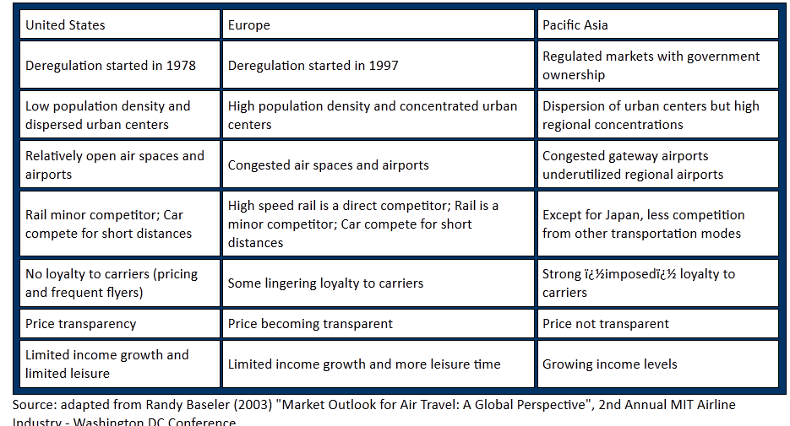
Characteristics of the main markets in 2003

Slide 29
Low-cost carriers vs Full service carriers: the business model

Slide 30
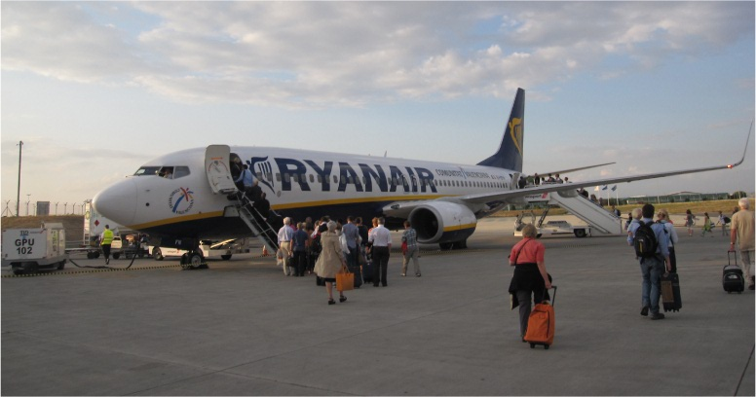
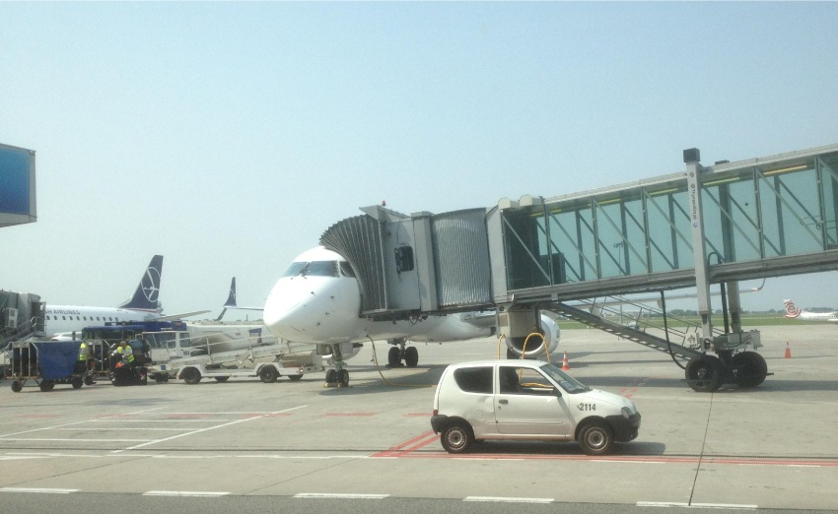
Stair boarding
Sky bridging or jetways

Slide 31
The LCC business model: aircraft type and operations
Most LCCs (low-cost carriers) operate aircraft configured with a single passenger class, and most operate just a single aircraft type, so cabin and ground crew will only have to be trained to work on one type of aircraft, however some low-cost carriers operate more than one type. This is also beneficial from a maintenance standpoint as spare parts and mechanics will only be dedicated to one type of aircraft. Since 2000, fleets generally consist of the newest aircraft, commonly the Airbus A320 family and Boeing 737.
LCCs tend to operate short-haul flights that suit the range of narrow-body (single aisle) planes. As of lately however there is also a rise in demand for long range low-cost flights and the availability of next generation planes that make long haul routes more feasible for LCCs.
LCCs often have a sparse schedule with one flight per day and route, so it would be hard to find an alternative for a missed connection.

Slide 32
The LCC business model: aircraft type and operations
Many airlines opt to have passengers board via stairs, since jetways generally cost more to lease. Usage of both front and back doors for faster boarding.
Aircraft often operate with a minimum set of optional equipment, further reducing costs of acquisition and maintenance, as well as keeping the weight of the aircraft lower and thus saving fuel. Ryanair seats do not recline and do not have rear pockets, to reduce cleaning and maintenance costs.
The airlines tend to offload, service and re-load the aircraft (turnaround) in shorter time periods and don't wait for late passengers, allowing maximum utilization of aircraft.
Only passegers, no freight.

Slide 33
The LCC business model: bases and airports
Bases: Like the major carriers, many low-cost carriers develop one or more bases to maximize destination coverage and defend their market. Many do not operate traditional hubs, but rather focus on cities
Often, LCCs fly to smaller, less congested secondary airports and/or fly to airports during off-peak hours to avoid air traffic delays and take advantage of lower landing fees. This is why Ryanair flies to Gatwick Airport, Luton Airport, and Stansted Airport instead of Heathrow in the London area since Heathrow is running at near capacity, so there is no room to build a base.
Point to point service: to maximize flexibility and reduce airport taxis

Slide 34
The LCC business model: passenger service
On line booking: no travel agent commissions
Bundling: Air travel tickets + hotels + car service + travel insurance
Minimal crew
No-frill services. Often, no in-flight entertainment systems are made available.
Most LCCs do not offer reserved seating, hoping to encourage passengers to board early and quickly, thus decreasing turnaround times. Some allow priority boarding for an extra fee instead of reserved seating, and some allow reserving a seat in an emergency exit row (for longer leg room) at an extra cost.

Slide 35
The LCC business model: passenger service
In Europe (and early in Southwest's history) luggage is not transferred from one flight to another, even if both flights are with the same airline. This saves costs and is thought to encourage passengers to take direct flights. Tickets are not sold with transfers, so the airline can avoid responsibility for passengers' connections in the event of a delay.
Non-flight revenue: Low-cost carriers generate ancillary revenue from a variety of activities, such merchandised sales (duty free, phone cards, etc.) and in plane advertising. Some airlines may charge a fee for a pillow or blanket or for carry-on baggage. In Europe, it is common for each and every convenience and service to have an additional charge. AirAsia, for example, generates revenue by courier services and hotels as well as flights.

Slide 36
The LCC business model: dynamic pricing
Airlines often offer a simpler fare scheme, such as charging one-way tickets half that of round-trips.
Typically fares increase as the plane fills up, which rewards early reservations (yield management).
The pricing policy of the low-cost carriers is usually very dynamic, with discounts and tickets in promotion. Like other carriers, even if the advertised price may be very low, it often does not include charges and taxes. With some airlines, some flights are advertised as free (plus applicable taxes, fees and charges). Depending on the airline, perhaps as many (or as few) as ten percent of the seats on any flight are offered at the lowest price and are the first to sell. The prices steadily rise thereafter to a point where they can be comparable or more expensive than a flight on a full-service carrier.

Slide 37
Criticisms
Some elements of the low-cost model have been subject to criticism by governments and regulators; and in the UK in particular, the issue of "unbundling" of ancillary charges by both low-cost carriers and other airlines (showing airport fees or taxes as separate charges rather than as part of the advertised fare) to make the "headline fare" appear lower has resulted in enforcement action.
Some destination cities lie relatively far from the airports that low-cost airlines use to save costs. Examples of this are Hahn, Weeze and Girona airports—which low-cost airlines advertise as the destinations for Frankfurt, Düsseldorf, and Barcelona, respectively—even though these airports are 50 to 90 kilometres away. This has drawn criticism, mostly from competing airlines that fly closer to the destinations.

Slide 38
Low-cost carriers vs Full service carriers: from the point of view of the passenger

Slide 39
Characteristics of low-cost carriers
Low fares: While you can often achieve similar fares with smart buying and use of inflexible fares from legacy carriers, low-cost carriers are characterised by cheaper prices.
Use-it-or-lose-it rules: These are strictly enforced, especially with the cheapest tickets.
Ancillary fees: Expect to pay for ‘extras’ like luggage, meals, seat selection.
Secondary airports: Don’t be surprised if you have to use secondary airports for some of these services. For example, Scoot doesn’t fly to Brisbane, but uses the Gold Coast instead.
No loyalty program: Your travellers generally won’t earn points for their trips.
No airport lounges: While the airlines don’t have airport lounges, some travellers with memberships to lounges may be able to use those. For example, Qantas Club members can use that lounge if they’re on a Jetstar flight.
Single-class cabins: While the original LCCs had only economy class seating, some airlines in this category now have a few ‘business class’ seats, or charge more for rows with extra leg room, like exit rows.
Online booking: The LCC model is based on direct bookings, but increasingly these carriers are being forced to make their inventory available through the traditional distribution channels.
No corporate deals: Don’t expect to be able to negotiate incentives or discounts on published fares.
Limited interline arrangements: These make low-cost carriers less convenient when doing multi-stop trips on different carriers.

Slide 40
Characteristics of full service carriers
Generally higher fares: Though it’s worth noting that airline economics do mean that even legacy carriers have to offer discounts to keep their planes full.
Special corporate deals: Across the board discounts and route deals are the standard, especially if you can guarantee the airline the lion’s share of your bookings.
More inclusions: Expect the fare of full-service carriers (FSC) to include luggage allowance and inflight meals or snacks.
More extensive routes: These carriers don’t have to chase the most popular leisure destination so there are more options for you.
Airport lounges: Corporate programs often include lounge access which is generally offered with premium fares.
Loyalty programs: Your travellers will earn points for each trip, which is useful to reinforce compliance, but can be a distraction if they’re members of different programs.
Alliances: Most legacy carriers belong to one of the global alliances or have codeshare arrangements with other legacy carriers, ensuring a more seamless experience when travelling internationally.
Multi-class cabins: Travellers will have a choice between economy, premium economy and business class. Some airlines still have first class on certain routes.

Slide 41
Management innovations
Yield Management
Frequent Flyer Program

Slide 42
Yield management
Yield management is the process of understanding, anticipating and influencing consumer behavior in order to maximize yield or profits from a fixed, perishable resource.
As a specific, inventory-focused branch of revenue management, yield management involves strategic control of inventory to sell it to the right customer at the right time for the right price. This process can result in price discrimination, where a firm charges customers consuming otherwise identical goods or services a different price for doing so.
Yield management is a large revenue generator for several major industries (airlines, hotels, car rental, inter city buses, rail transport, multifamily housing, insurance, telecommunications)

Slide 43
Yield management
Robert Crandall, former Chairman and CEO of American Airlines, gave Yield Management its name and has called it "the single most important technical development in transportation management since we entered deregulation.“
It is complex because it involves several aspects of management control, including rate management, revenue streams management, and distribution channel management.
Yield management is multidisciplinary because it blends elements of marketing, operations, and financial management into a highly successful new approach.
Yield Management refers specifically to maximizing revenue through inventory control.

Slide 44
Yield management
There are three essential conditions for yield management to be applicable:
That there is a fixed amount of resources available for sale.
That the resources sold are perishable (there is a time limit to selling the resources, after which they cease to be of value).
That different customers are willing to pay a different price for using the same amount of resources.
Yield management is of especially high relevance in cases where the constant costs are relatively high compared to the variable costs.

Slide 45
Airlines
In the passenger airline case, capacity is regarded as fixed because changing what aircraft flies a certain service based on the demand is the exception rather than the rule. When the aircraft departs, the unsold seats cannot generate any revenue and thus can be said to have perished, or have spoiled. Airlines use special software to monitor how seats are being reserved and react accordingly. There are various inventory controls such as a nested inventory system. For example by offering discounts on low demand flights, where the flight will likely not sell out. The converse, selling more expensive seats when there is excess demand, managing off demand.
Another way of capturing varying willingness to pay is to attempt market segmentation. A firm may repackage its basic inventory into different products to this end. In the passenger airline case this means implementing purchase restrictions, length of stay requirements and requiring fees for changing or canceling tickets.
The airline needs to keep a specific number of seats in reserve to cater to the probable demand for high-fare seats.

Slide 46
Frequent-flyer program (FFP)
A frequent-flyer program (FFP) is a loyalty program offered by many airlines. Typically, airline customers enrolled in the program accumulate frequent-flyer miles (kilometers, points, segments) corresponding to the distance flown on that airline or its partners.
There are other ways to accumulate miles. In recent years, more miles were awarded for using co-branded credit and debit cards than for air travel.
Acquired miles can be redeemed for free air travel; for other goods or services; or for increased benefits, such as travel class upgrades, airport lounge access, or priority bookings.

Slide 47
Differences in cost structures between legacy and low cost carriers

Slide 48
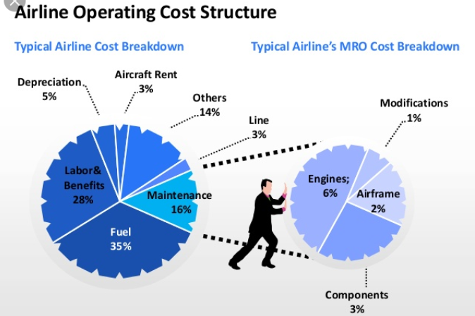
Fuel and labor costs have the largest share
https://www.slideshare.net/reyyandemir/aviation-industry-and-mro-sector-trends

Slide 49
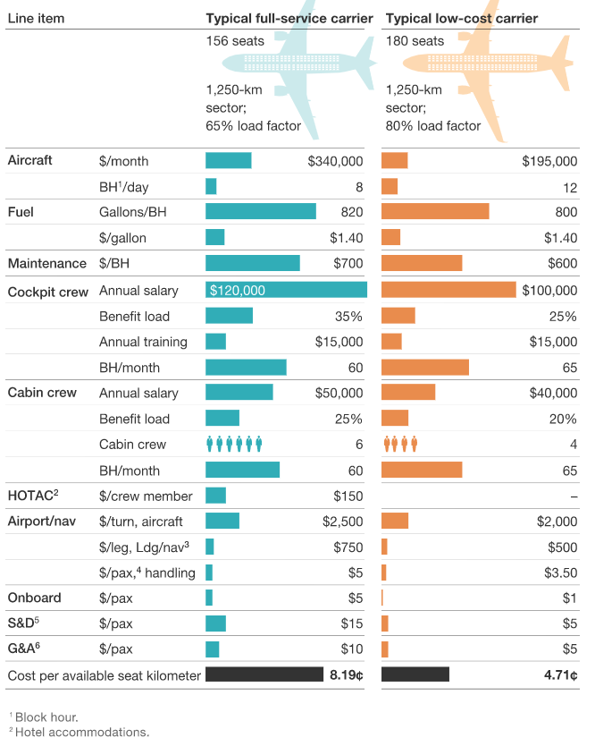
LCC are estimated to have large cost advantages in almost all cost components: aircraft, cockpit crew, cabin crew, HOTAC, airport.
https://www.mckinsey.com/industries/travel-transport-and-logistics/our-insights/a-better-approach-to-airline-costs

Slide 50
Air transport volumes and competition between airline companies

Slide 51
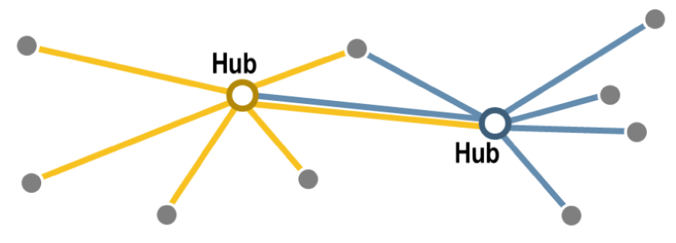
The elaboration and consolidation of hub-and-spoke systems combined with fiercer competition have been among the factors propelling load factors (the percentage of seats filled) higher, both in the United States and around the world. While the average load factor was around 65% in the 1990s, better scheduling and yield management have enabled American airlines to substantially increase the load factor of their fleets above the 80% landmark by 2010 (this threshold was reached at the global level in 2013). In light of increasing competition, airlines have been able to improve the utilization level of their assets. This has also involved reducing capacity on some segments of the network with the dual intent of increasing fares as well as asset utilization. However, while high load factors imply higher profit levels for airlines, they also involve lower levels of flexibility to accommodate demand fluctuations and disruptions. For instance, if a flight is cancelled, an airline may have difficulties rebooking passengers on alternative flights within a reasonable timeframe since there are few extra seats available. It may therefore be difficult to have load factors above 85%, since it could create a context where small disruptions (a few cancelled flights) could have substantial system wide impacts.

Slide 52
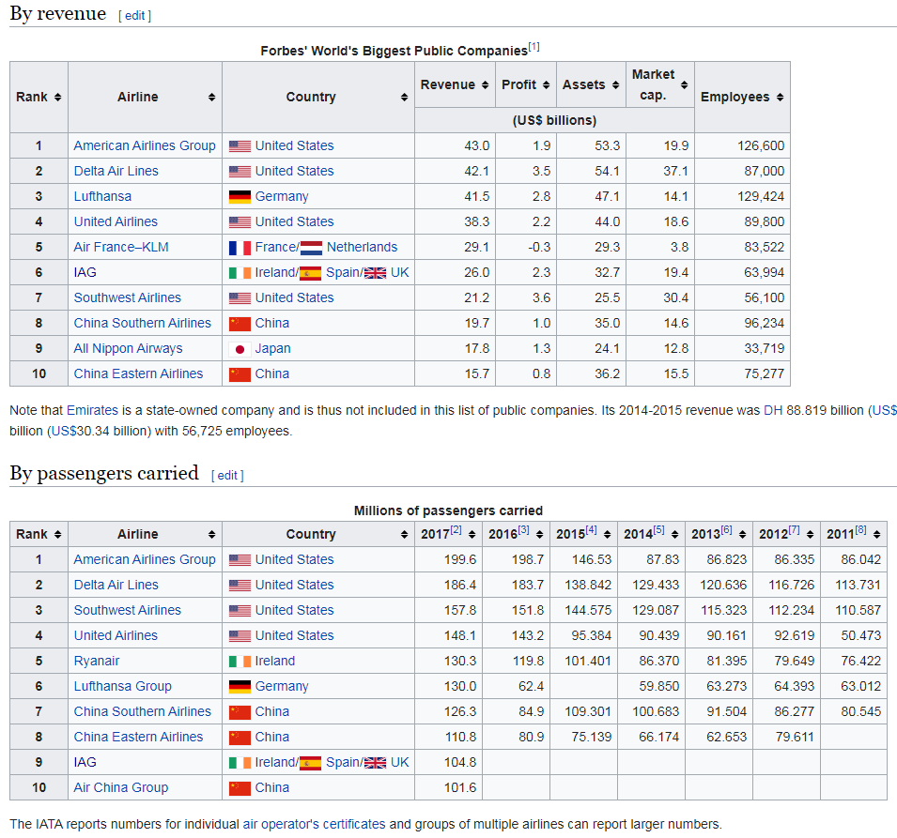
World's largest airlines

Slide 53
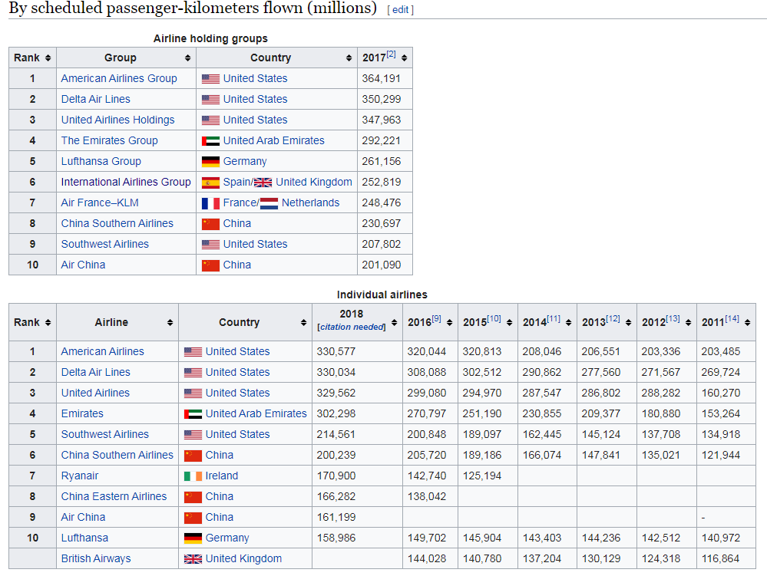

Slide 54
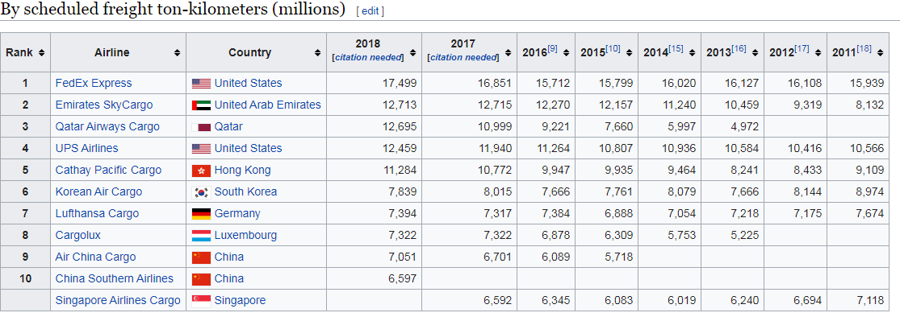

Slide 55
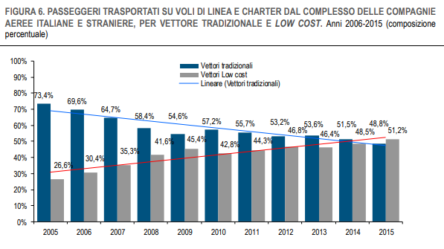
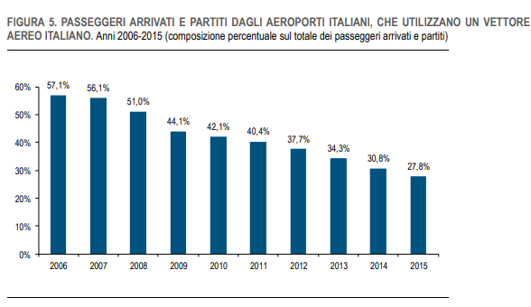
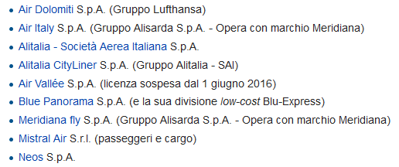
Alitalia vs. LCC in Italy
Compagnie aeree italiane: Fonte Enac
https://www.istat.it/it/files//2017/02/trasporto-aereo-2015.pdf

Slide 56
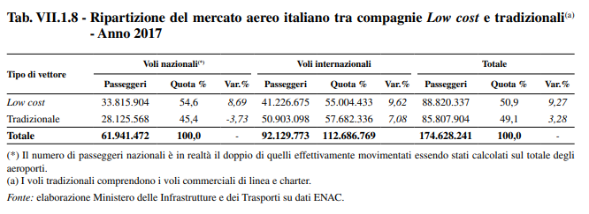

Slide 57
LCC Market share
By 2017, low-cost carriers had achieved market share of 57.2% in South Asia and 52.6% in Southeast Asia. Market share remained somewhat lower in Europe at 37.9% and North America at 32.7%.
For the European Commission, the LCCs market share (44.8%) exceeded legacy carriers (42.4%) in 2012: between 2002 and 2017, LCC share of international seat capacity rose from 23% to 57% in the UK, from 10% to 55% in Italy and from 9% to 56% in Spain but have still room for growth in domestic seat-capacity In France with 19% and in Germany with 25% in 2017, compared with 66% in the UK, 48% in Spain and 47% in Italy.
By early 2019, there were more than 100 LCCs operating 6,000 aircraft, doubled from 2,900 aircraft at the end of 2009, while seat capacity reached nearly 1.7 billion in 2018. LCCs accounted for 33% of intra-regional seat capacity in 2018 with 1.564 billion, up from 25% in 2008 with 753 million, and 13% of seat capacity between regions with 101 million, up from 6% in 2009 with 26 million. In 2018, penetration rate was 41% of seats within Europe, 36% within Latin America, 32% within North America, 29% within Asia Pacific, 17% within the Middle East and 12% within Africa

Slide 58
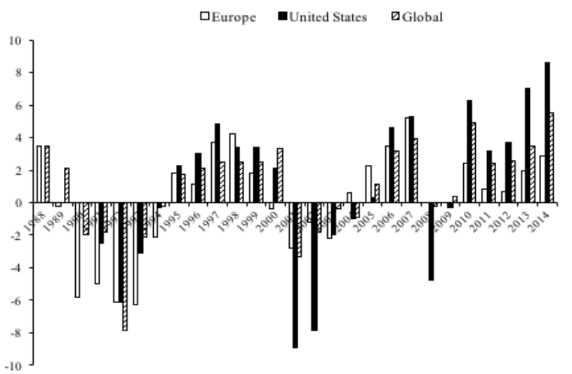
Unstable operating margins
The margins are low (max 8%) because
Price of oil (main cost component)
Financial crises (2008)
Terrorisms and wars (9/11/2001, Iraq war 2003)
Low cost competition
Covid-19 (2020)

Slide 59
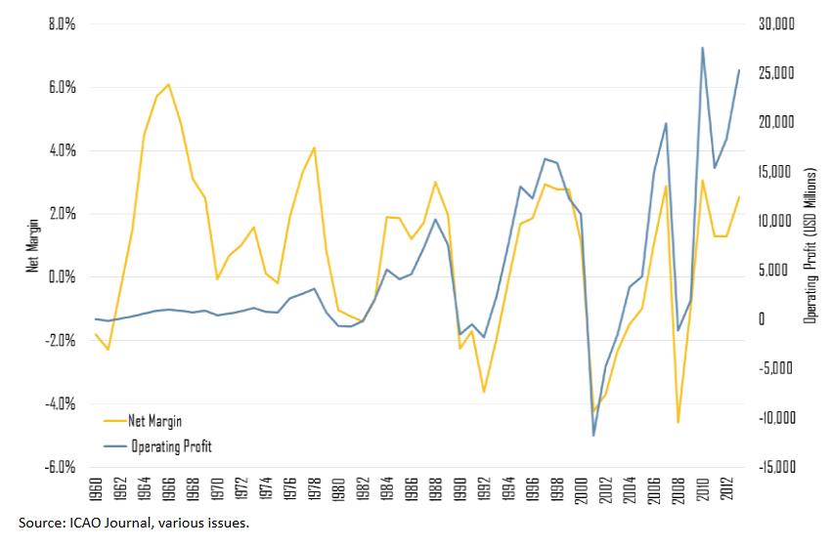
Low net margins
Although the airline industry is characterized by boom-and-bust cycles, the long-term rate of profit in the industry is not impressive, with peak profit margins around 2%. Under such circumstances, the airline industry has developed additional sources of revenues relying on fees such as priority boarding, seating choice, luggage and rebooking.

Slide 60
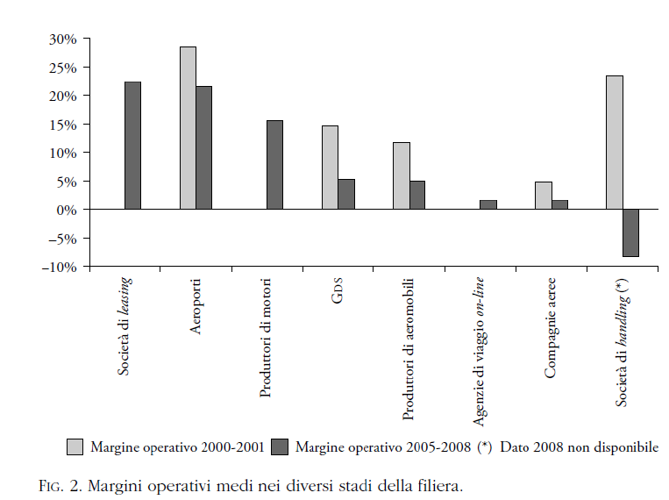
Profit margins in the supply chain
…but other parts of the supply chain enjoy higher margins due to less intense competition (monopoly, duopoly)

Slide 61
Market instability
Alitalia crisis - It was restructured again in 2014, when Etihad Airways, the flag carrier of the United Arab Emirates, bought a 49% stake. But Etihad said in May that it was "not prepared to continue to invest." The cash-strapped Italian government has ruled out nationalizing the airline.
Malev Hungarian Airlines: The flag carrier of Hungary, this airline went out of business in 2012 and abruptly stopped its flights. Low-cost competitor Ryanair -- known for its aggressive, cut-throat prices -- immediately capitalized on the situation and opened a new base in Budapest.
Czech Airlines: Korean Air is credited with saving Czech Airlines by purchasing a 44% stake in the business from the national government in 2013.
Olympic Airlines: The Greek government sold off its flag carrier Olympic Airlines in 2009 to the Greek conglomerate Marfin Investment Group. It was sold again to Greece's publicly-traded Aegean Airlines in 2012.

Slide 62
Market instability
TAP Air Portugal: The Portuguese government sold its majority stake in flag carrier TAP Air Portugal in 2015 to the private firm Gateway, which was backed by JetBlue founder David Neeleman. Months later the government bought back a portion of TAP Air Portugal to retain at 50% controlling stake in the airline. The company reported a small operating profit for 2016 after losing more than $120 million the previous year.
Iberia, Aer Lingus: U.K.-based International Airlines Group -- the parent company of British Airways -- bought Spain's struggling Iberia airline in 2011. It had to overhaul the company and slash thousands of jobs to keep it in business. Iberia's chief executive warned in 2012 that Iberia was unprofitable in all its markets and needed the painful restructuring. International Airlines Group also acquired Ireland's Aer Lingus in 2015.
Swissair, Austrian Airlines: German carrier Lufthansa has gobbled up a number of smaller national airlines, including Swiss International Air Lines in 2005 and Austrian Airlines in 2009.

Slide 63
Latest news
Ryanair faces legal action from regulator over cancelled flights - The Irish no-frills carrier could be hit with "enforcement action" from the CAA, which claimed it had failed to give passengers necessary and accurate information about their rights after their flights were cancelled, specifically on rerouting and refund expenses.
Ryanair in retreat: Cancels more flights, drops Alitalia bid - The airline also announced it would withdraw from bidding for Alitalia, the bankrupt Italian airline, to "eliminate all management distractions."

Slide 64
Narrowing margins
Based on current trends, the operating margin for US airlines is expected to narrow to between five and six percent in 2019 — a margin that is less than 40 percent of the industry’s peak of 15 percent in 2015. Ironically, this margin squeeze began during a period of falling oil and jet fuel prices: In January 2016, oil prices per barrel slid to around $35 from a high of more than $110 in 2014. Although prices quickly recovered to above $50, they have not returned to the $80-plus levels they had maintained between mid-2009 and October 2014. Still, the outlook is mixed, and the Energy Information Agency projects prices trending upward in the second half of the year. Jet fuel remains the industry’s second biggest operating expense.
https://www.planestats.com/aea1_2019apr

Slide 65
Conclusions
From national monopolies to liberalization
Growing volumes, decreasing prices, satisfying service
Price discrimination practices: yield management
Low and unstable profit margins
Unstable markets

Slide 66
Have a nice day!

