Slide 1
IL REVENUE MANAGEMENT
« Provide the right service to the right customer at the right time for the right price »
(Robert G. Cross, 1997)

Slide 2
Definition of revenue (yield) management
Business practise to set prices when there is perishable inventory (e.g., fruit vendor)
Intuition:
Limited inventory, raise prices
Excess inventory, lower prices
or
Prices too high, left over inventory (low revenue)
Prices too low, inventory sold too soon (low revenue)
Demand forecasting is the pre-requisite in oder to maxime revenue
Different levels of sophistication: fruit vendor vs. airline networks

Slide 3
Inventory control in Revenue Management
Main question: how much to sell at a given price and whom to sell to?!
Optimizing models used for inventory control:
Littlewood’s rule
Booking limits, Protection levels
Expected marginal seat revenue (EMSR)
Virtual Nesting
Bid prices
Overbooking
Task: Calculate the protection levels (inventory control) and apply them to the reservation systems!

Slide 4
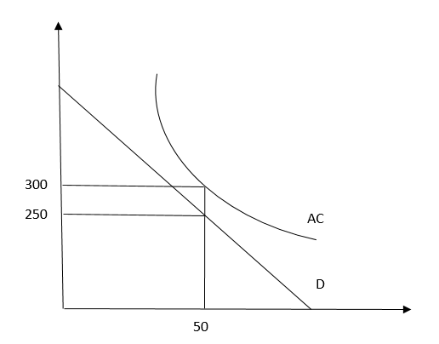
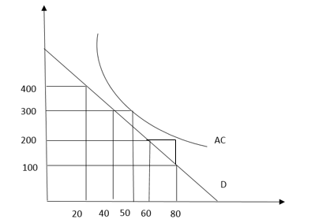
Uniform vs differentiated prices: price discrimination increases profits and, if the quantity increases, also social welfare
Price | Quantity sold | Revenue
400 | 20 | 8000
300 | 20 | 6000
200 | 20 | 4000
100 | 20 | 2000
Total quantity sold | 80 | 20000
Average cost at 80 |  | 200
Total cost |  | 16000
Profit |  | 4000
Uniform price | 250
Quantity sold | 50
Total revenue | 12.500
Average cost at 50 | 300
Total cost | 15.000
Profit | -2.500

Slide 5
Determine the fare structure to discriminate among travellers: possible segmentations
Main goal: distinguish among Leisure and Business Customers: how?
Examples:
Advance purchase (AP): AP7 (at least 7 days in advance), AP15 (15 days in advance)
Minimum stay (MS): MS 3 day
Include Saturday and Sunday
Non refundable (NR)
Mandatory return trip (RT)
Discounted (walk up): special offer
Unrestricted (walk up): just board the plane
Luggage
Fast boarding lines

Slide 6
Link the fare to the travel restrictions: nesting structure
Fare |  | Travel restrictions | Protection Level | Booking Limit
500$ | Y | no restriction | 0 | 100
400$ | M | Advance purchase: 7 day – no reimbursement | 40 | 60
350$ | H | Advance purchase: 7 day – no reimbursement – 3 day Min. Stay – Round Trip | 50 | 50
300$ | K | Advance purchase: 14 day - no reimbursement – 3 day Min. Stay – Round Trip | 65 | 35
Capacity: 100 seats
BOOKING LIMITS = CAPACITY – PROTECTION LEVEL
Customers willing to pay less ask for the service earlier than the customers willing to pay more
The tariff structure must be tested: it is necessary to see how customers and competitors react
The tariff structure rarely changes, more often the levels of protection are modified

Slide 7
How to determine the protection levels: inventory control

Slide 8
Example
Only 1 seat is still available on the airplane. 2 possible fares: F_{L}: 100$, F_{H}: 200$
Two possibilities:
If a customer willing to pay a high fare shows up first, sell him the seat (no problem!).
If a customer willing to pay a low fare shows up first, should I sell him the seat? (Problem!) What if an high-fare customer shows up soon afterwards? How should I decide?
Littlewood’s Rule: compare the revenue that you would get for sure with the expected revenue!!
F_{L} ≥ F_{H} · Pr (probability that a higher-fare customer F_{H} would show up before the airplane take-off)

Slide 9
Find the probability needed to sell the seat at the lower fare (critical probability)
If F_{H}=200, F_{L}=100
Prob =F_{L} / F_{H} ≥ Pr (D_{H} ≥ c) =100/200=0.5 (critical probability)
If the probability than a high-fare customers F_{H} would arrive is greater than 0.5, then do not sell the seat for 100
If the probability than a high-fare customers F_{H} would arrive is lower than 0.5, then do sell the seat for 100
Test of the rule:
If Prob= 0.6, expected marginal revenue = 200*0.6=120, that is higher the F_{L}
If Prob= 0.4, expected marginal revenue = 200*0.4=80, that is lower than F_{L}

Slide 10
Littlewood’s rule
Determine the optimal protection level (inventory control) for a single-leg flight with 2 fares
F_{L} ≥ F_{H} · Pr (X_{H} ≥ θ_{H})
F_{L}: low fare, F_{H}: high fare
X_{H}: demand for the high fare H
θ_{H}: protection level
Pr (X_{H} ≥ θ_{H}): probability that more than θ_{H} clients show up
F_{H} · Pr (X_{H} ≥ θ_{H}) expected marginal revenue deriving from a seat if sold at a high fare

Slide 11
How many seats should we protect?
F_{L}(100$) ≥ F_{H} (200$) · Prob [x > Θ_{H}]
Pr (X_{H} ≥ θ_{H}): probability that more than θ_{H} clients show up
Θ_{H} = protection level | Prob (x_{H} ≥ Θ_{H}) | Expected marginal revenue at Θ_{H} | Inequality satisfied? | comments
2 | 80% | 200*0.8=160$ | No: 100$ ≤ (200*0,8)= 160$ | Protect at least 3 seats
3 | 60% | 200*0.6=120$ | No: 100$ ≤ (200*0,6)= 120$ | Protect at least 4 seats
4 | 40% | 200*0.4=80$ | Yes: 100$ ≥ (200*0,4)= 80$ | Do not protect 5 seats
5 | 30% | 200*0.3=60$ | Yes: 100$ ≥ (200*0,3)= 60$ | Do not protect 6 seats
6 | 20% | 200*0.2=40$ | Yes: 100$ ≥(200*0,2)= 40$ | Do not protect 7 seats
Solution: Protect 4 seats for the higher-fare customers and sell the remaining seats to the lower-fare customers

Slide 12
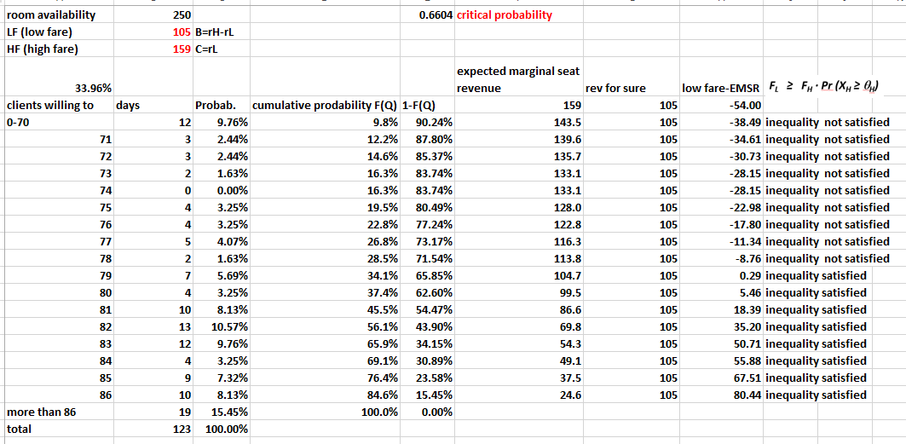
Calculate the protection levels (booking limits)

Slide 13
Determine how many rooms to reserve for the high fare customers on the basis of the demand observed in the last 123 days
Simulate with lower fares
FH times the probability that more than 78 clients willing to pay the FH show up is higher than FL. That is EMSR (78) is higher than FL. Therefore, I protect 79 rooms for the high fare customers.
Since 210 are available, 131 rooms would be available for the low fare customers!
Expected marginal revenue = FH* Prob(x>Theta H)
Certain vs. uncertain
Rooms sold at the higher fare H
Probability that exactly X rooms would be sold at the higher fare H
Probability that at least X rooms would be sold at the higher fare H
Revenue that I would make with certainty
Probability that more than X rooms would be sold at the higher fare H

Slide 14
Two important requirements for RM
Accurate demand forecasting (demand probability function): it is necessary to have as much quantitative and qualitative information as possible (by season, by type of ticket, by age group, etc.)
Optimization (in the case of a network): it is necessary to have a good and easy way to apply decision rules (control mechanism such as the protection level or the bid price)

Slide 15
EMSR (Expected Marginal Seat Revenue): with 4 fares
(EMSR (Expected Marginal Seat Revenue) – a): Extension of the Littlewood’s rule from 2 to 4 fares. (We want to protect the seats for the clients who are willing to pay more…) : Peter Belobaba (MIT, USA)
EMSR = F_{H} · Pr (X_{H} ≥ θ_{H})
There are 150 seats available:
(Prot. Level 4,j): How may sets to protect for the customers willing to pay the $290 fare and not only the $125 fare, for the customers willing to pay the $420 fare and not only the $125 fare, for the customers willing to pay the $500 fare and not only the $125 fare.
(Prot. Level 3,j): How may sets to protect for the customers willing to pay the $420 fare and not only the $290 fare, for the customers willing to pay the $500 fare and not only the $290 fare.
(Prot. Level 2,1): How may sets to protect for the customers willing to pay the $500 fare and not only the $420 fare.
Class | Fare | Mean* | St.Dev.* | Prot. Level 4, j | Prot. Level 3, j | Prot. Level 2, 1
1 | 500$ | 16,5 | 5,6 | 20 | 15 | 11
2 | 420$ | 44,2 | 15,0 | 52 | 37
3 | 290$ | 35,1 | 11,2 | 37
4 | 125$ | -- | --
Total |  |  |  | 109 | 52 | 11
*Assuming a normal distribution

Slide 16
calcoli
How many seats to protect vs. class 4
125>=290· Pr (X_{H} ≥ θ_{H}), θ_{H}=37
125>=420· Pr (X_{H} ≥ θ_{H}), θ_{H}=52
125>=500· Pr (X_{H} ≥ θ_{H}), θ_{H}=20
How many seats to protect vs. class 3
290>=420· Pr (X_{H} ≥ θ_{H}), θ_{H}=15
290>=500· Pr (X_{H} ≥ θ_{H}), θ_{H}=37
How many seats to protect vs. class 2
420>=500· Pr (X_{H} ≥ θ_{H}), θ_{H}=11
Sum along the classes (column)
Calculate the booking limits (how many seats to reserve to each class)
The level of protection does not correspond to the expected demand (11 compared to 16.5) for two reasons:
It depends not only from the mean but also the standard deviation
The level of protection reflects the marginal revenue of a fare compared to another fare (the difference is important)

Slide 17
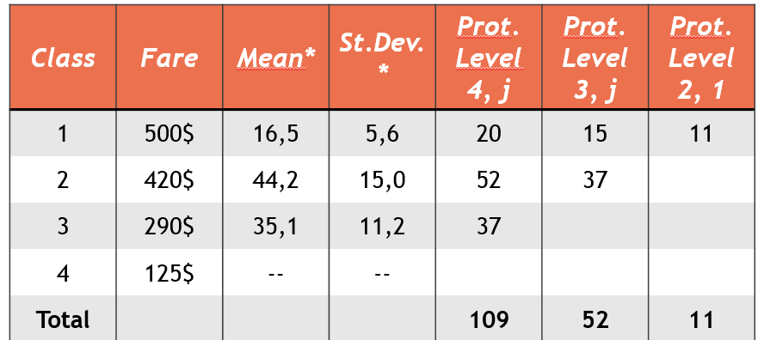
Total capacity (inventory): 150 seats
Booking Limits = Inventory – Protection Level
Fare | $125 | $290 | $420 | $500
Protection Level: not available seats | 109 | 52 | 11 | --
Booking Limits: available seats | 41 | 98 | 139 | 150
Prescriptions:
If someone is willing to pay $ 500 for a seat, sell it to him;
If someone is willing to pay $ 420 for a seat, sell it up to 139 seats;
If someone is willing to pay $ 290 for the seat, sell it up to 98 seats;
If someone is willing to pay $ 125 for the place, sell it up to 41 seats;

Slide 18
The issue is much more complex if you sell a service organized in a network…

Slide 19
Virtual nesting
Example of a network. Two issues:
Very many fares in a network
Leg vs. network control
BOS→JFK→MIA
Y: 375$
B: 325$
M: 275$
BOS
LAX
JFK
LAX→JFK→MIA
Y: 600$
B: 500$
M: 400$
JFK→MIA
Y: 500$
B: 450$
M: 400$
MIA
.. having only one free seat on the JFK→MIA flight, whom passenger should I sell it to?! Would it be more convenient to sell it to the one who buys the LAX→MIA flight for $ 600 or to the passenger who buys the JFK→MIA single leg for $ 500? The LAX→MIA passenger pays a higher fare but he occupies 2 seats ...

Slide 20
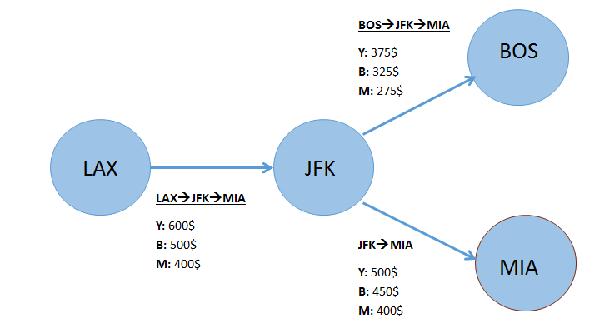
The issue of the very many fares in a network was solved by VIRTUAL NESTING. American Airlines developed the concept of virtual buckets identified by fare ranges. The protection levels are calculated for the buckets instead of by single fares. But it is still a leg level control!
VIRTUAL NESTING | VALUE RANGE | ITINERARIES
1 | 450$ - 600$ | LAX→JFK→MIA (Y), LAX→JFK→MIA (B), JFK→MIA (Y), JFK→MIA (B)
2 | 350$ - 449$ | BOS→JFK→MIA (Y), LAX→JFK→MIA (M),JFK→MIA (M)
3 | 200$ - 349$ | BOS→JFK→MIA (B), BOS→JFK→MIA (M)

Slide 21
Leg-level control vs. network control
Leg level control: it considers flights as indipendent
Origin-destination control: it considers the entire network
.. having only one free seat on the JFK→MIA flight, whom passenger should I sell it to?
Would it be more convenient to sell it to the one who buys the LAX→MIA flight for $ 600?
or to the passenger who buys the JFK→MIA single leg for $ 500?
Pay attention that the LAX→MIA passenger pays a higher fare but occupies 2 seats ...

Slide 22
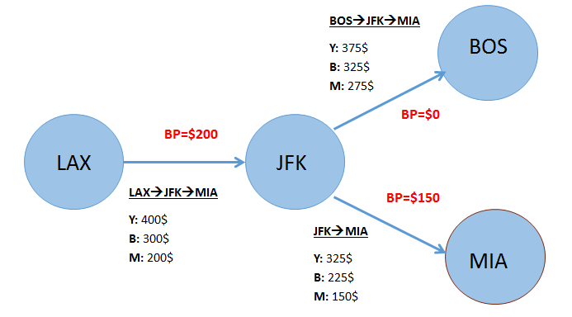
Leg-level control vs. network control. The Bid price (BP) solution
The issue is solved by calculating the BID PRICES.
Since an airplane's capacity is fixed, there is an opportunity cost to allocate a seat, equal to the expected gain that one believes one can get with that seat (the same logic as the Littlewood rule: certain value vs. expected value). Such opportunity cost (shadow price) is called BID PRICE.
Instead of loading on the computer system the booking limits (protection levels), one loads the bid prices for each leg.

Slide 23
How to use the bid prices (in red)
Rule: compare the fare to the Bid Price (opportunity cost of that seat)
LAX-MIA uses two seats: the BPs are summed up (200 + 150 = 350): fare Y is accepted, fare B is not
BOS-MIA uses two seats: the BPs are summed up (0 + 150 = 150): Fares Y, B, M are all accepted
JFK-MIA: Fares Y, B, M are all accepted
Two difficulties: 1) Shared networks, 2) Dynamic BP update

Slide 24
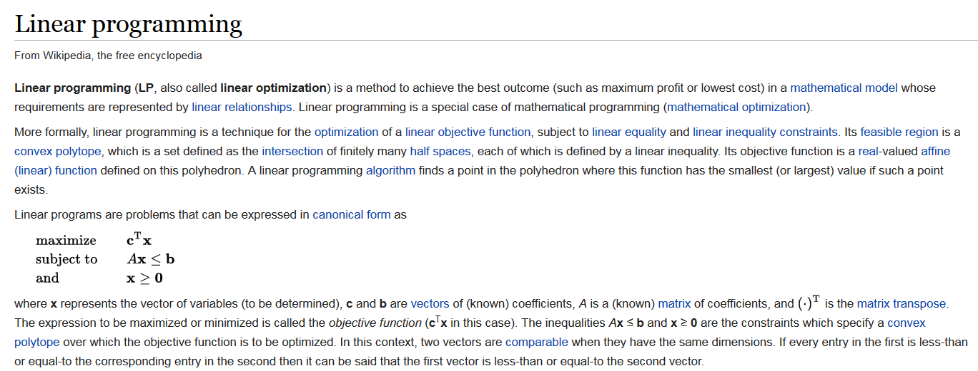
How to calculate Bid Prices
Bid Prices are determined at leg level via linear (non linear, stochastic) programming optimization models at network level.
Bid Prices are estimated periodically

Slide 25
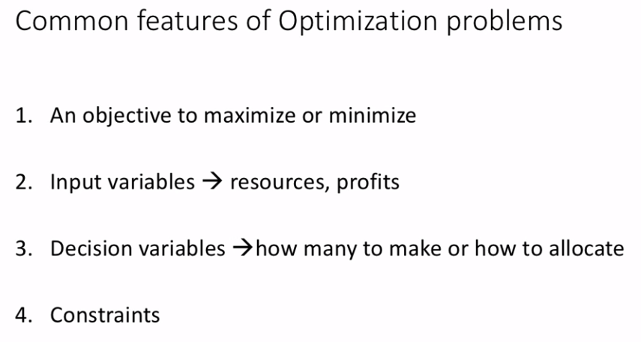

Slide 26
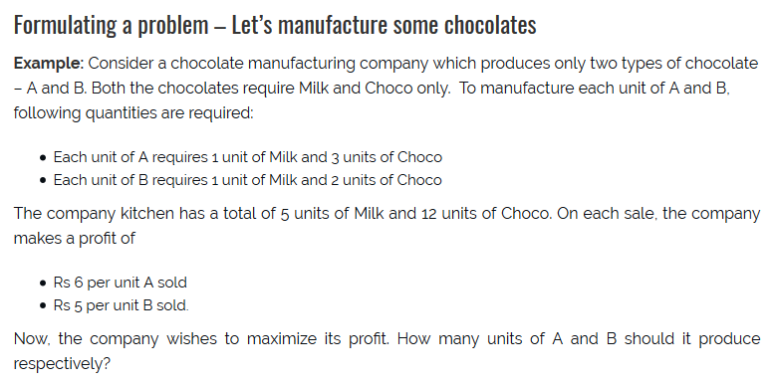
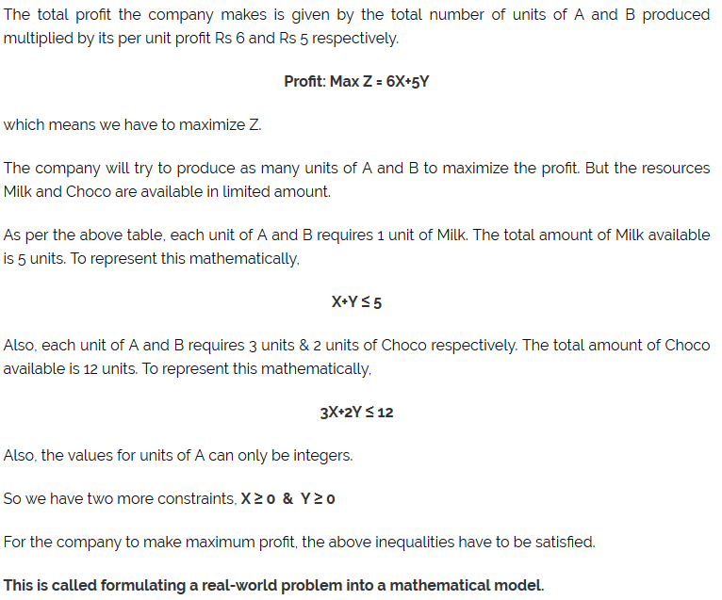
A simple example of linear programming

Slide 27
Objective function!
Constraint on machine A time in minutes
Constraint on machine B time in minutes
X >= demand (75) - initial stock (30), which ensures we meet demand
Y >= demand (95) - initial stock (90), which ensures we meet demand

Slide 28
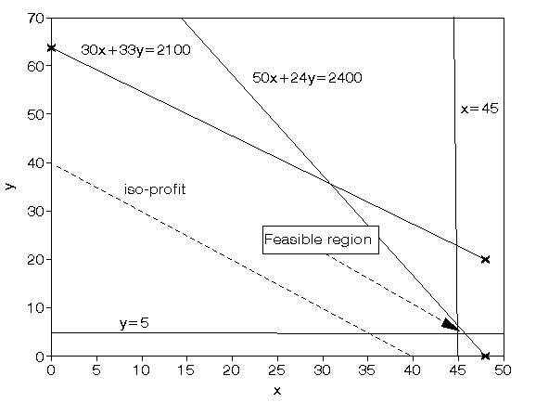
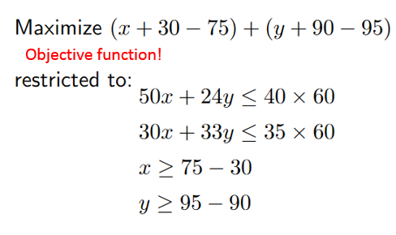
Solution of the linear programming example
Finding the combination of X and Y that generate the higher profits while at the same time respecting the constraint. The solution is x=45 and y=6.25 with the value of the objective function being 1.25
Suppose that the working hour on X are reduced from 40 to 38, that would be the opportunity cost (foregone profit) of an hour of X. The bid prices for a seat on a leg are similarly calculated!
the maximum occurs at the intersection of x=45 and 50x + 24y = 2400

Slide 29
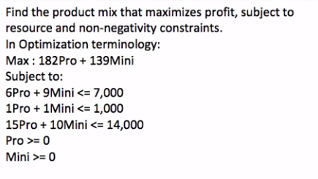
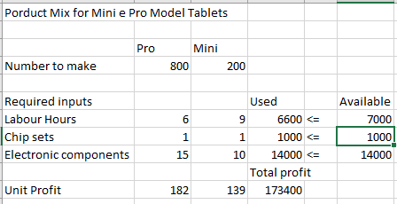
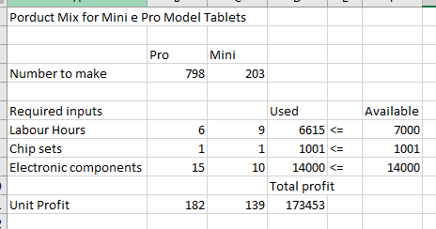
LP with Excel Solver
What is the optimal mix of the two types of Tablet Models?
https://www.youtube.com/watch?v=6xa1x_Iqjzg&t=48s

Slide 30
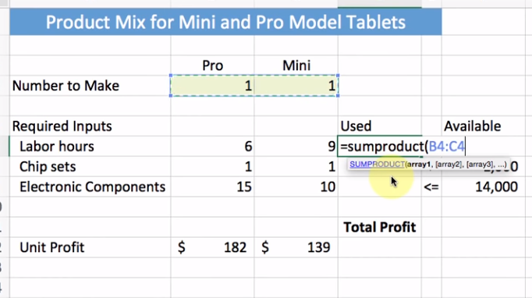
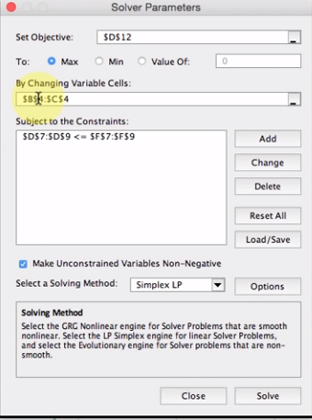
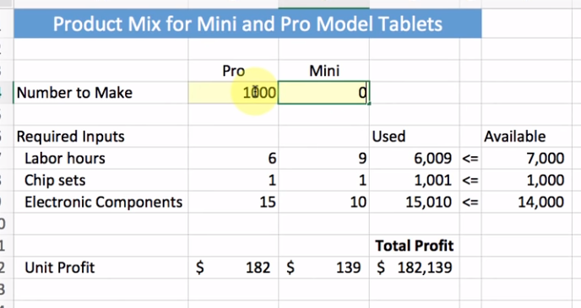
Explanatory steps

Slide 31
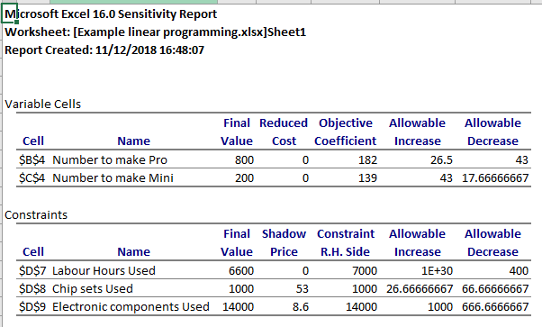
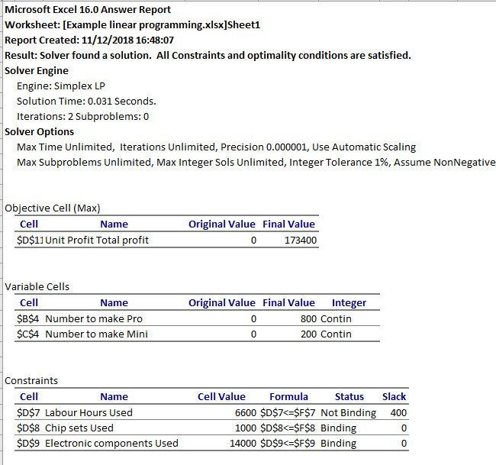
LP with Excel Solver
Shadow price: any unit increase\decrease in the resource availabe increase profits by the shadow price:
53 for Chips sets
8.6 for Electronic components
0 for Labour hours (not binding)
Shadow price= bid price, cost of a used resource at the margin

Slide 32
Overbooking
Commercial technique consisting in the sale of a higher number of tickets than the actual seats available on the aircraft to take into account the possibility that some travelers do not show up.
It consists in balancing out the marginal revenue to sell more seats with marginal cost to compensate for the traveler who did not find a place on the plane
Hotels, rental car agencies, some restaurants, and even some non-emergency health-care providers overbook.

Slide 33
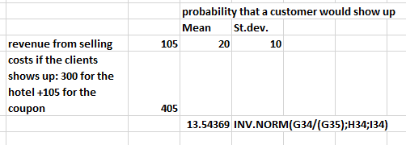
200 rooms available in the hotel
f_{H}: 159$, f_{L}: 105$
the number of customers who book a room but fail to show up on the night in question is Normally distributed with mean 20 and standard deviation 10
Costs: 300$ the cost of alternative accommodation + 105$ a gift certificate for a one-night stay
Revenue for sure vs. uncertain loss
·
14 seats could be overbook. The total number of booking allowed is 214.

Slide 34
Summary on revenue management
Aim: Optimal management of a perishable good\service.
Method: Price discrimination! It increases revenue (profit) and might increase the quantity sold and the social well-being (private profit + consumer surplus)
Procedure:
Segment the service;
Forecast the demand;
Provide the right service to the right customer (inventory control) at the right time calculating the protection levels, the booking limits, the bid prices, and the overbooking levels.
The improvement over uniform pricing is so much higher:
the better we forecast demand,
the more the demand is differentiated among customers, and
the more sophisticated is the technique used to evaluate the optimal prices.

Slide 35
Have a nice day!

