Slide 1
Course of Geodynamics
Dr. Magdala Tesauro
Course Outline:
Thermo-physical structure of the continental and oceanic crust
Thermo-physical structure of the continental lithosphere
Thermo-physical structure of the oceanic lithosphere and oceanic ridges
Rheology and mechanics of the lithosphere
Plate tectonics and boundary forces
Hot spots, plumes, and convection
Subduction zones systems
Orogens formation and evolution
Sedimentary basins formation and evolution

Slide 2

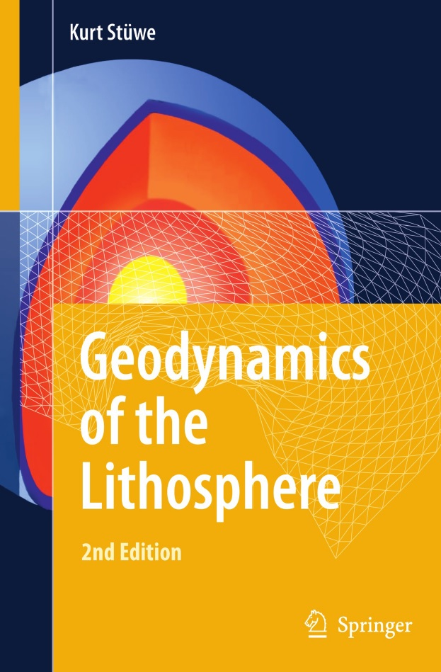
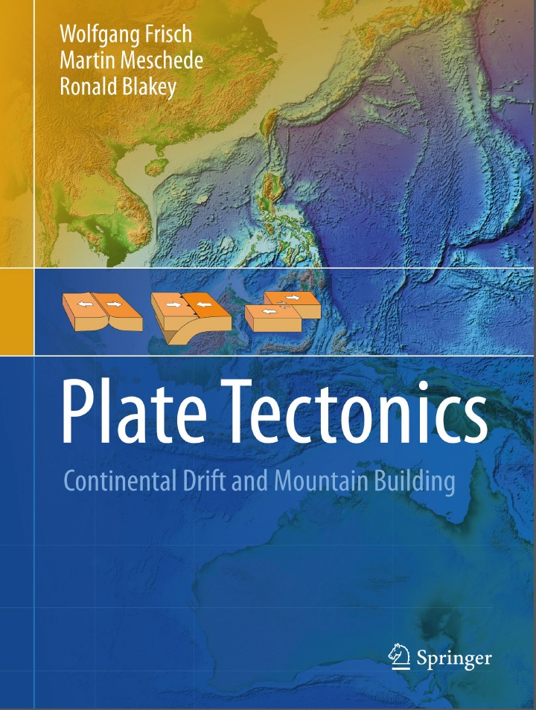
Books Suggested
1)
2)
3)
4) Treatise on Geophysics, volume 6
5) Basin Analysis, P.A. Allen, J.R. Allen

Slide 3









How Should I Study???
The contents of the lectures will be released on moodle platform (https://moodle2.units.it/) as slides, chapters of books, and articles at the end of each topic discussed during the course.
The exam (oral) will consist of questions about all the topics presented in the course and comprehensive of a Power Point presentation illustrating a thematic research.
Reading only the slides is not sufficient to pass the exam. You need to study using all the material released.
The slides released are useful to review the lessons and find the topics discussed in books and articles suggested.
Recording the lessons is allowed, but not recommended.
You will save a lot of time paying attention to the lectures and taking notes instead of recording.
Good Luck!!!

