Slide 1
STORIA GLOBALE
Guido Abbattista
Laurea Magistrale Interateneo in Studi Storici dal Medioevo all’età contemporanea Anno accademico 2022-2023
Moodle enrolment key: GLOBHIST

Slide 2
Premessa
La malaria: una malattia globale

Slide 3
L’unificazione microbica
Emmanuel Le Roy Ladurie
« Un concept: L'unification microbienne du monde (XVIe-XVIIe siècles) », in Schweizerische Zeitschrift für Geschichte = Revue suisse d'histoire = Rivista storica svizzera, Band (Jahr): 23 (1973), Heft 4

Slide 4
“quand je parle de l'unification microbienne du monde, entre le XIVe et le XVIe siecle […] je ne pretends pas que le processus ait commenee le 1er janvier 1300, ä zero heure! En fait, les grandes epidemies voltigeaient ou voyageaient dejä, bien avant cette date, meme si leur rayon d'action etait generalement moins etendu qu'il ne le sera dans la suite des temps: sans remonter jusqu'ä la peste d'Athenes, il suffirait de rappeler, en deux mots, la pandemie du VTe siecle, teile que Font etudiee le docteur Biraben et Jacques Le Goff1. II n'est pas question non plus d'affirmer que le processus «d'unification» se termine vers 1600, ou meme 1700: la diffusion du cholera, au XIXe siecle, suffirait ä refuter cette absurdite. Je voudrais simplement, dans cet expose, souligner l'existence d'un paroxysme: en bref, l'unification microbienne du monde, ou encore, la creation, ä Fechelle de FEurasie, puis de FAtlantique, d'un marche commun des microbes, est passee, entre 1300 et 1600 (dates rondes) par une phase specialement intense, rapide, dramatique, et pourquoi ne pas le dire, apocalyptique.

Slide 5
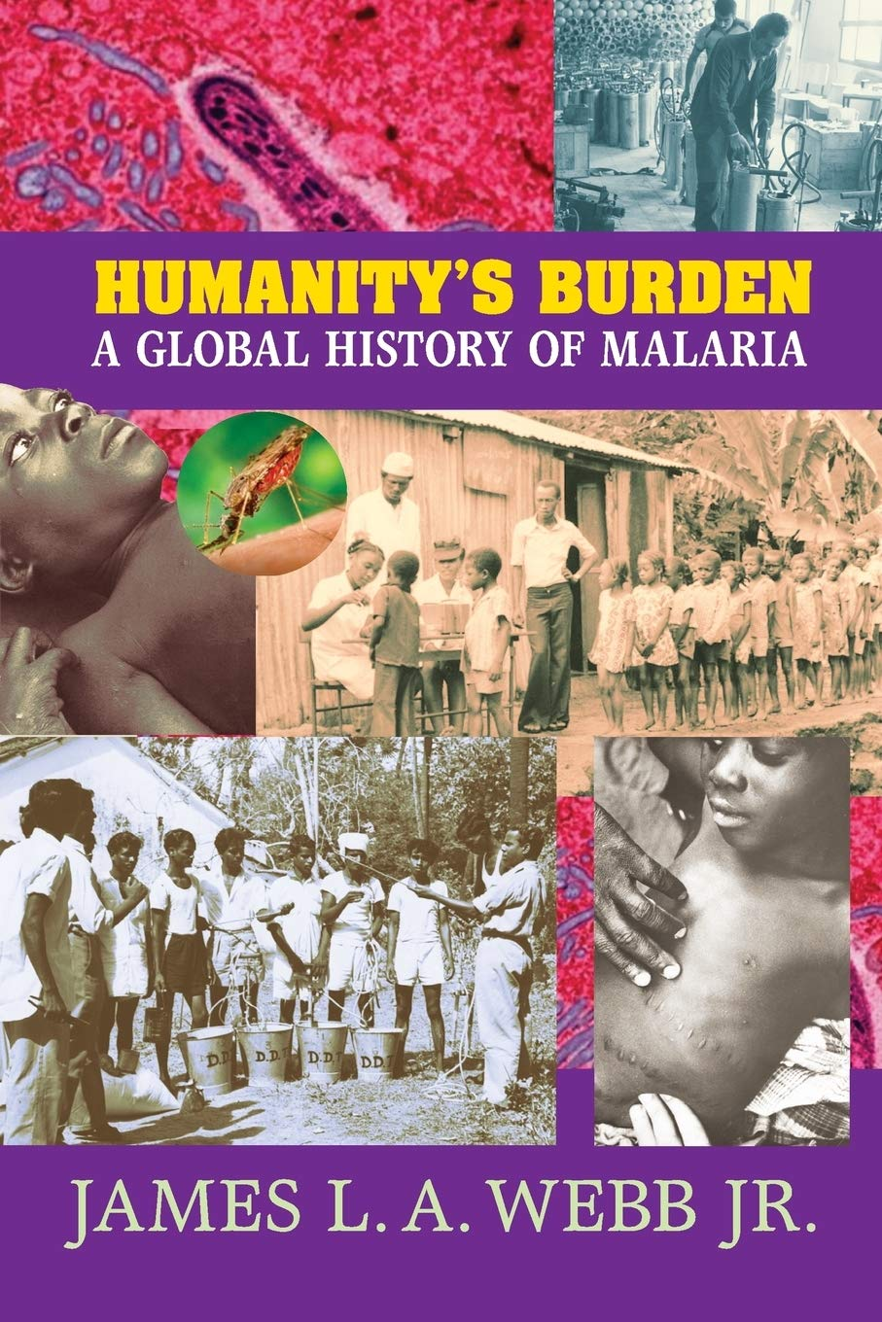
“Where malaria prospers most, human societies have prospered least. The global distribution of per-capita gross domestic product shows a striking correlation between malaria and poverty, and malaria-endemic countries also have lower rates of economic growth. There are multiple channels by which malaria impedes development, including effects on fertility, population growth, saving and investment, worker productivity, absenteeism, premature mortality and medical costs.”
2009

Slide 6
Malaria nel mondo intorno al 1920

Slide 7
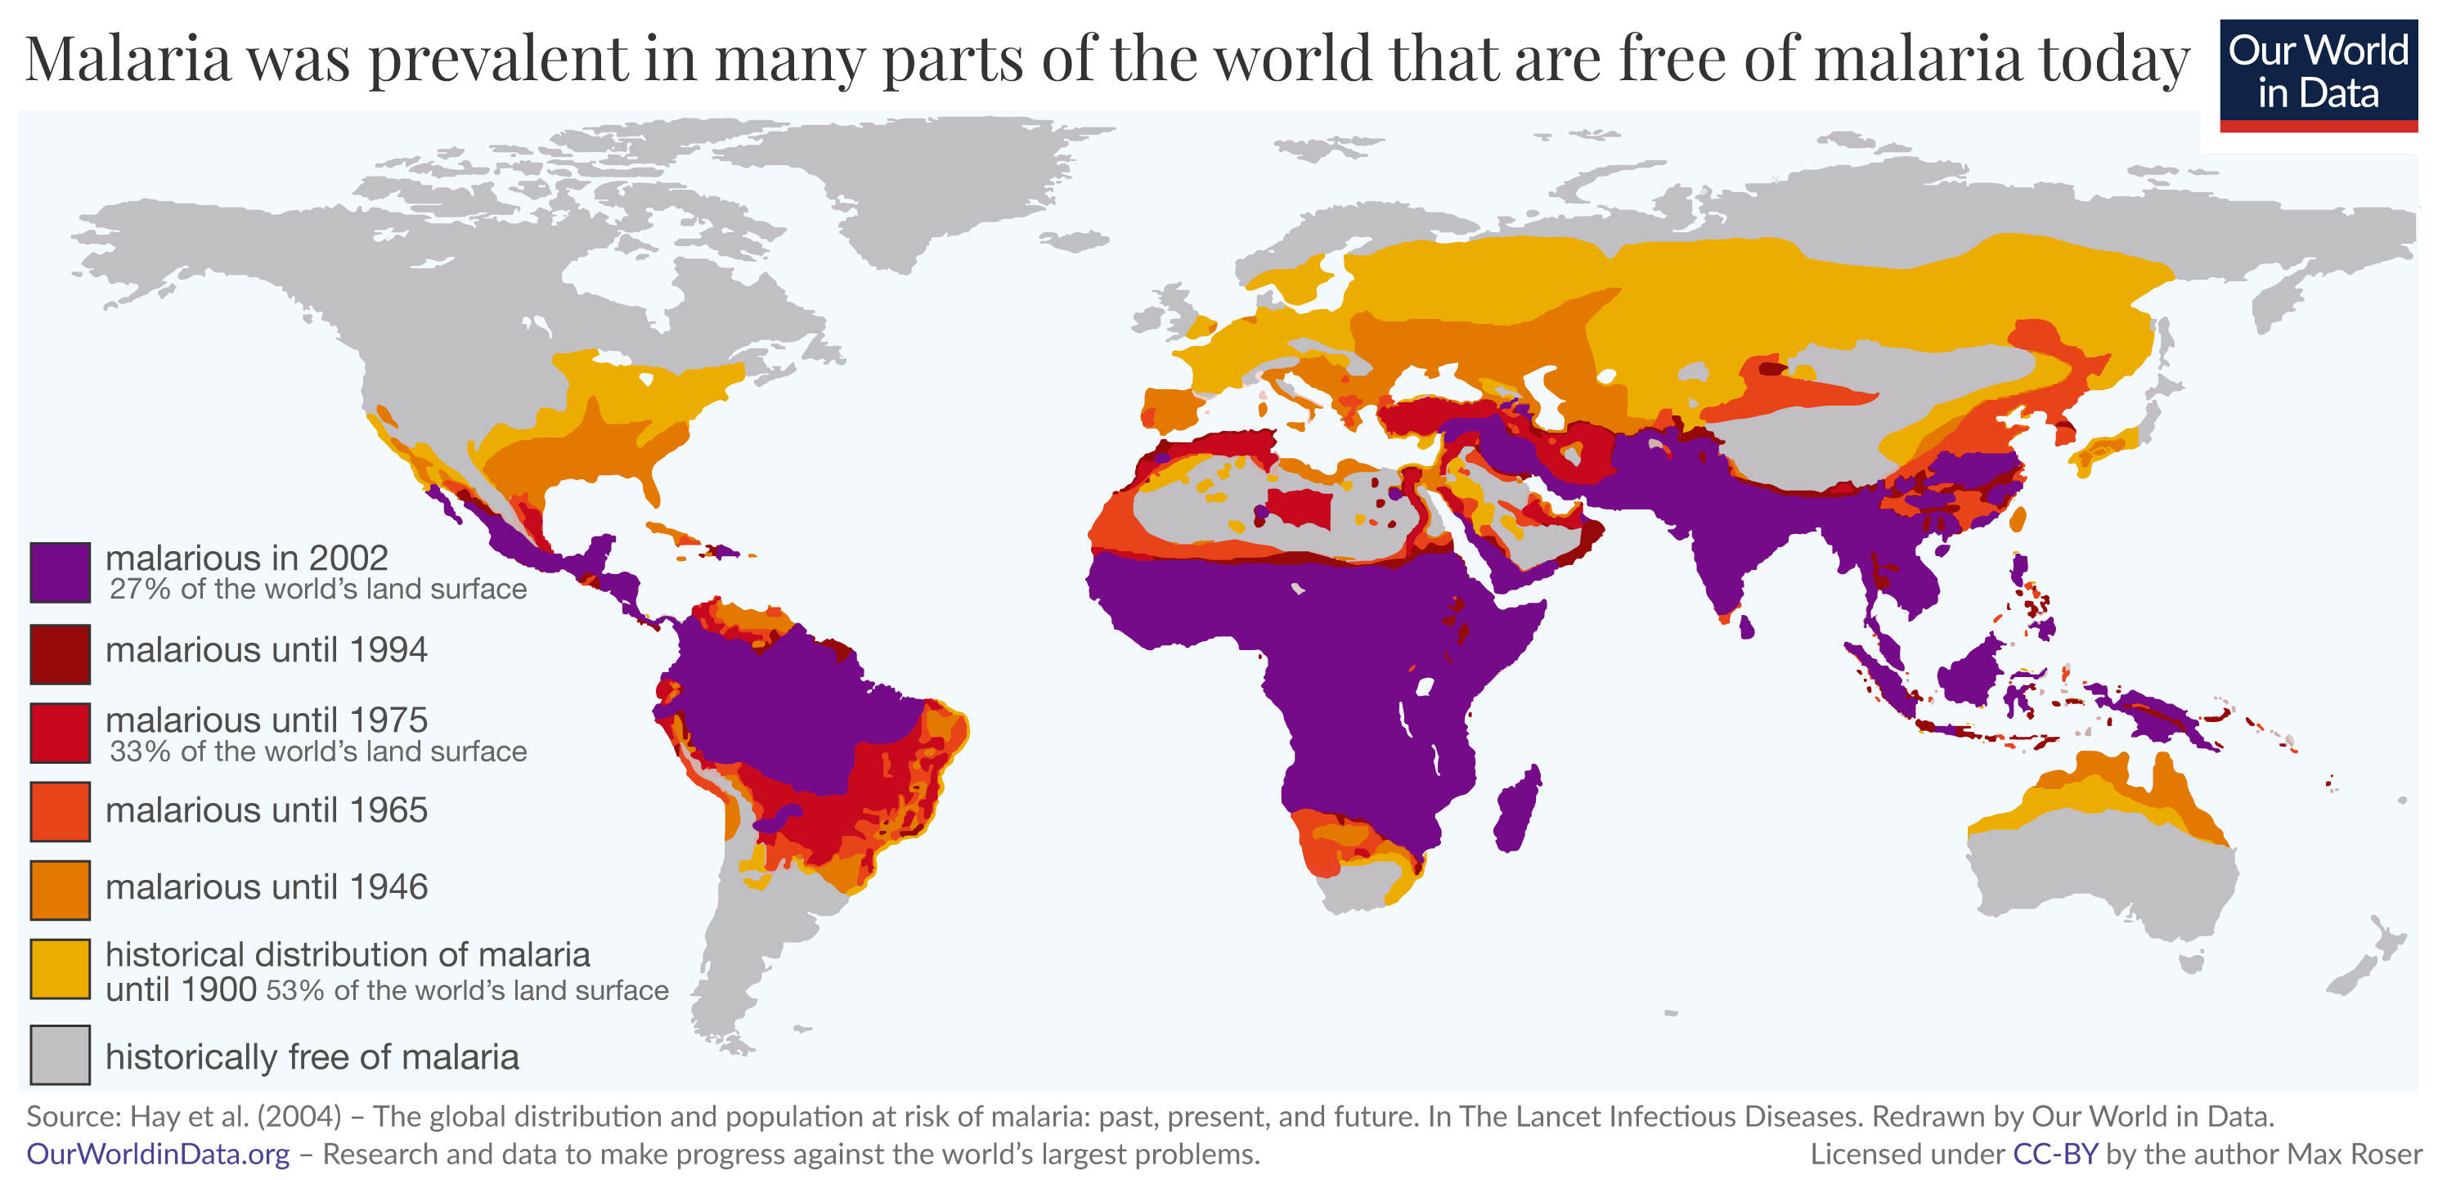
Malaria is a disease that is transmitted from person to person by infected mosquitoes. The bite of an infected Anopheles mosquito transmits a parasite that enters the victim’s blood system and travels into the person’s liver where the parasite reproduces. There the parasite causes a high fever that involves shaking chills and pain. In the worst cases malaria leads to coma and death.
The parasites are single-celled microorganisms of the Plasmodium group. Plasmodium falciparum is by far the most lethal in humans and responsible for most deaths.
The annual death toll is certainly in the hundreds of thousands, but estimates differ between different global health organizations: The World Health Organization (WHO) estimates that 558,000 people died because of malaria in 2019; the Institute of Health Metrics and Evaluation (IHME) puts this estimate at 643,000.
Most victims are children. It is one of the leading causes of child mortality. Every twelfth child that died in 2017, died because of malaria.1

Slide 8
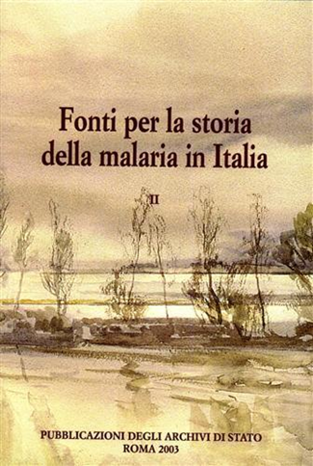

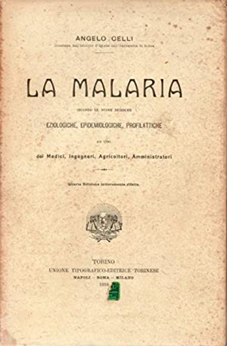

Italia

