Slide 1
Wave particle duality:
When a quantum entity is detected by some kind of interaction, it acts like a particle in the sense that it is localized;
When it is moving it acts like a wave in the sense that interference phenomena are observed and of course a wave is extended, not localized.
Bohr summarized the situation in his principle of complementarity.
If a measurement proves the wave character of radiation or matter, then it is impossible to prove the particle character in the same measurement.
The link between wave model and particle model is provided by a probability interpretation of the wave-particle duality.
In the case of radiation it was Einstein who united the wave and particle theories;
Born applied a similar argument to unite wave and particle theories.

Slide 2
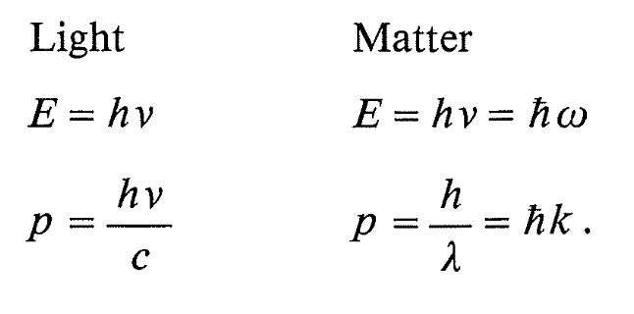
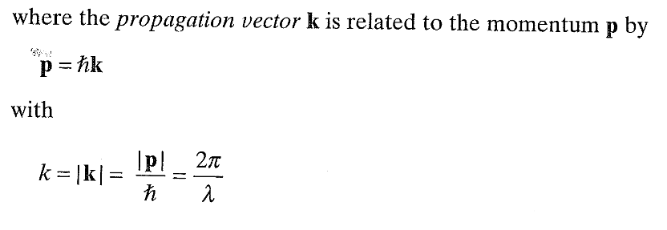
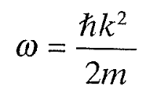
How to unify the wave and particle description?
wave function of a plane wave: it represents particles having definite momentum

Slide 3
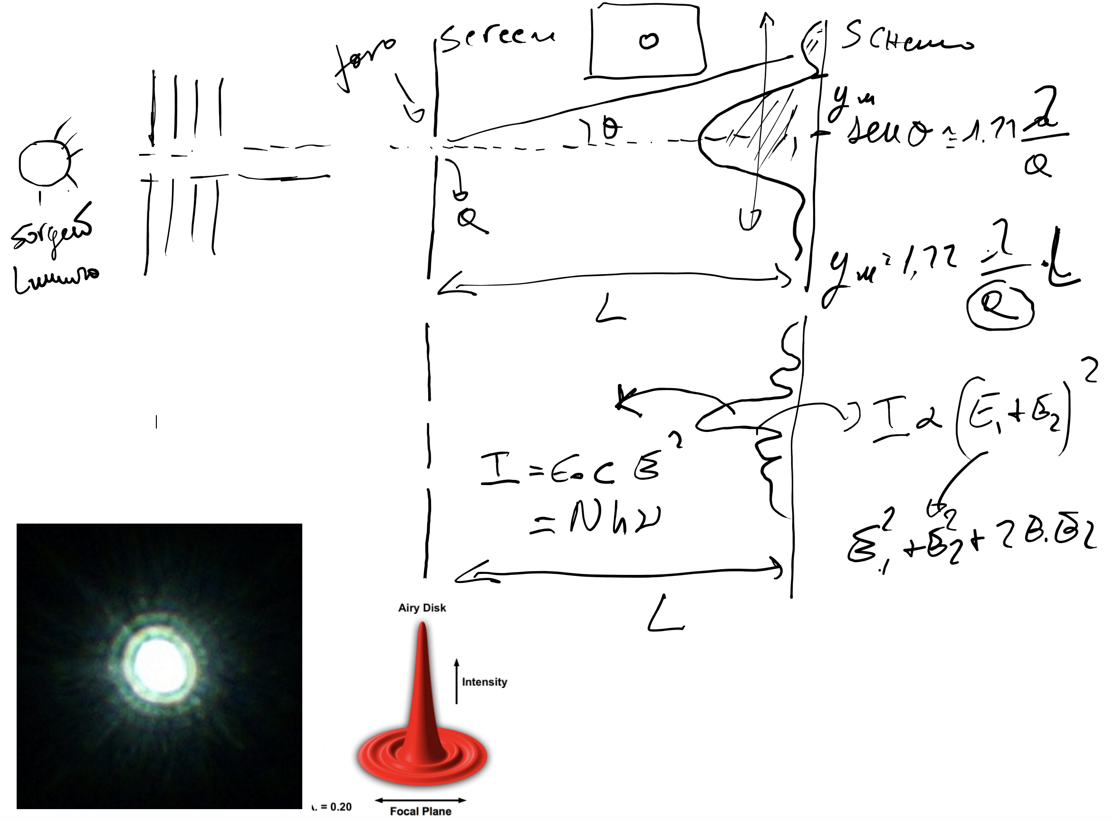

Slide 4
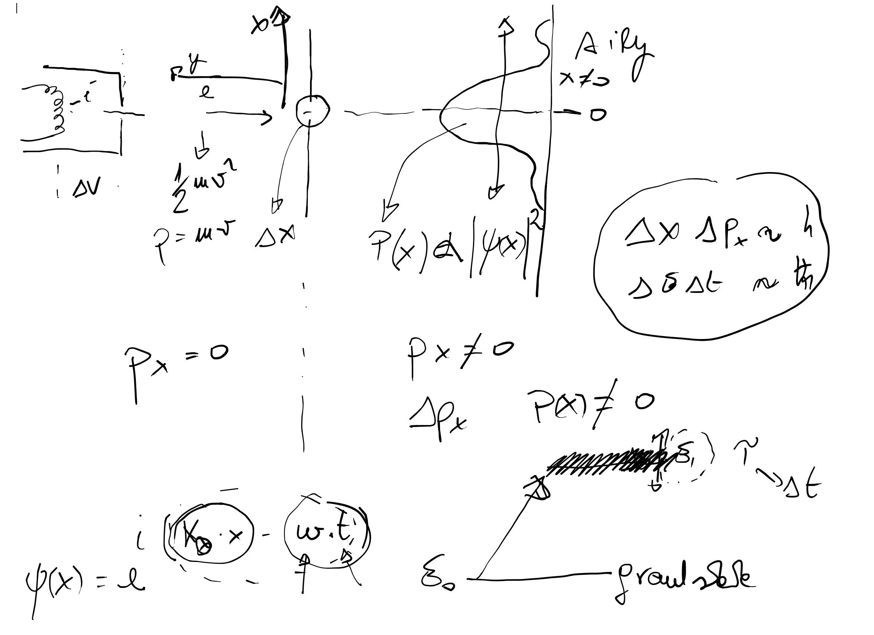

Slide 5
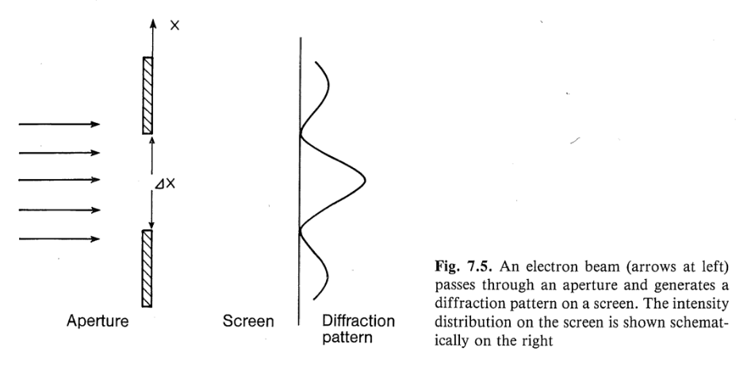
Probabilistic interpretation
Born’s postulate
normalised

Slide 6
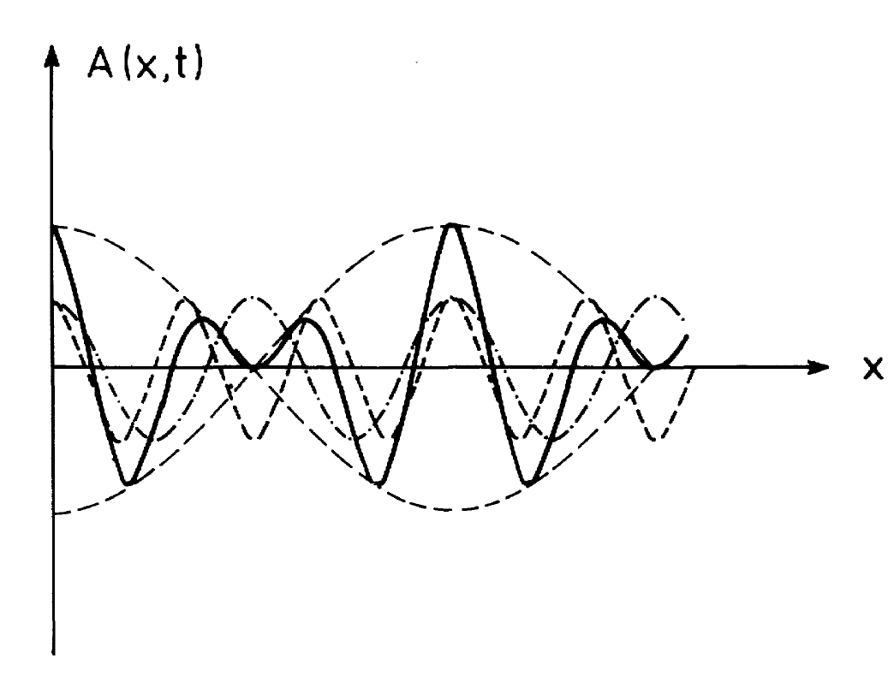
Two waves

Slide 7
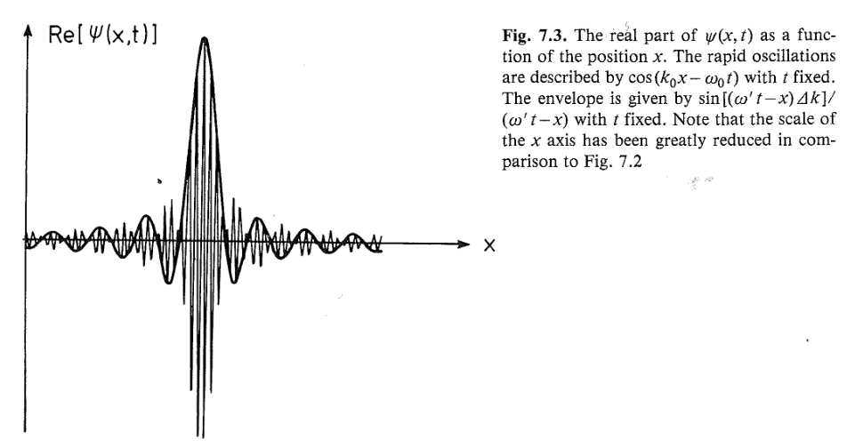
The wave packet is strongly localized and the particle velocity= group velocity
Δx=2π/Δk

Slide 8
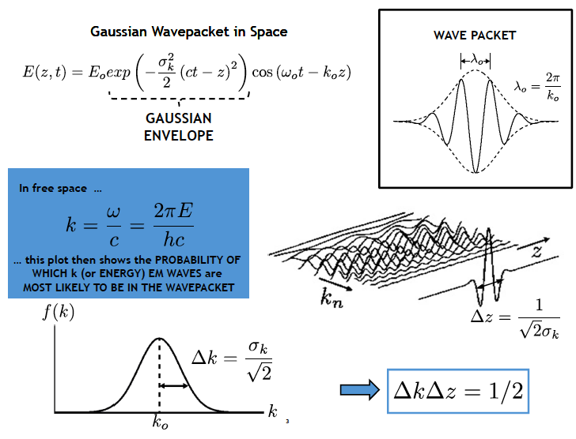

Slide 9
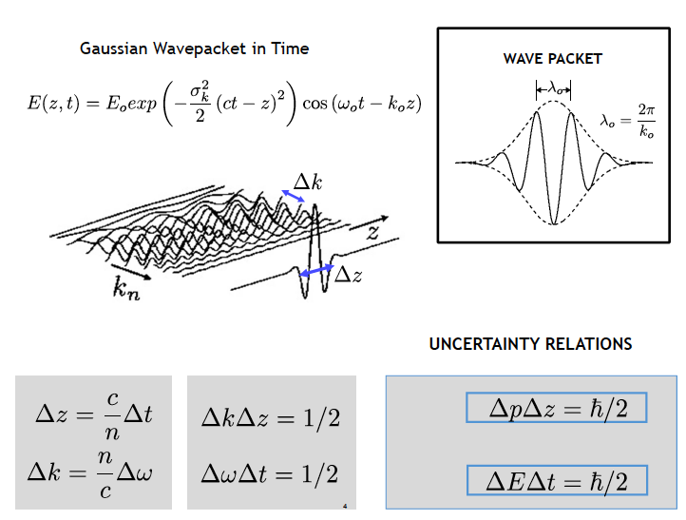

Slide 10
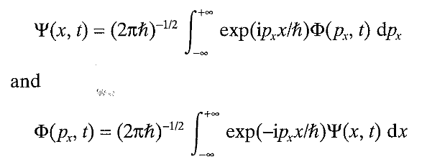
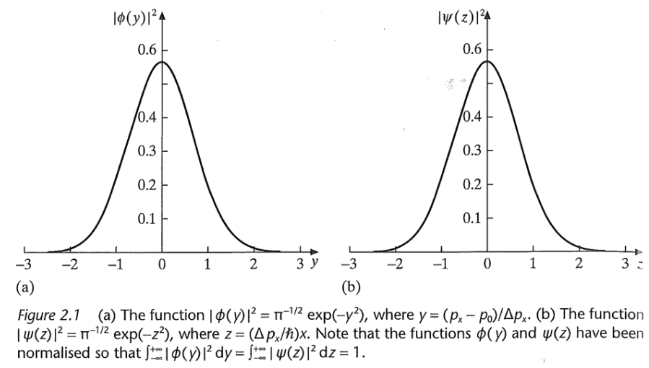
wave packet: to describe a particle which is confined in a certain spatial region, a wave packet can be formed by superimposing plane waves of different wave numbers.
Mutual Fourier transform
We could be tempted to unify the wave and particle picture by using wave packets to describe the motion of particles. This is not possible, because in general, wave packets change their shapes and flow apart.

