Slide 11
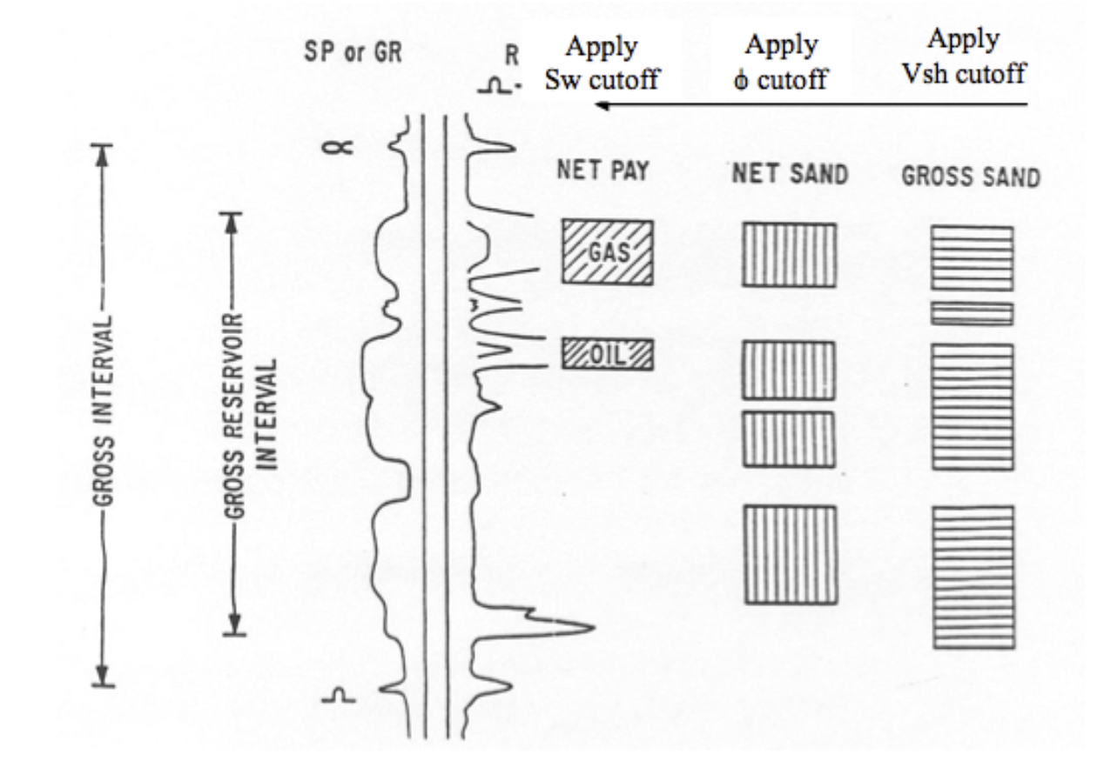

Slide 12
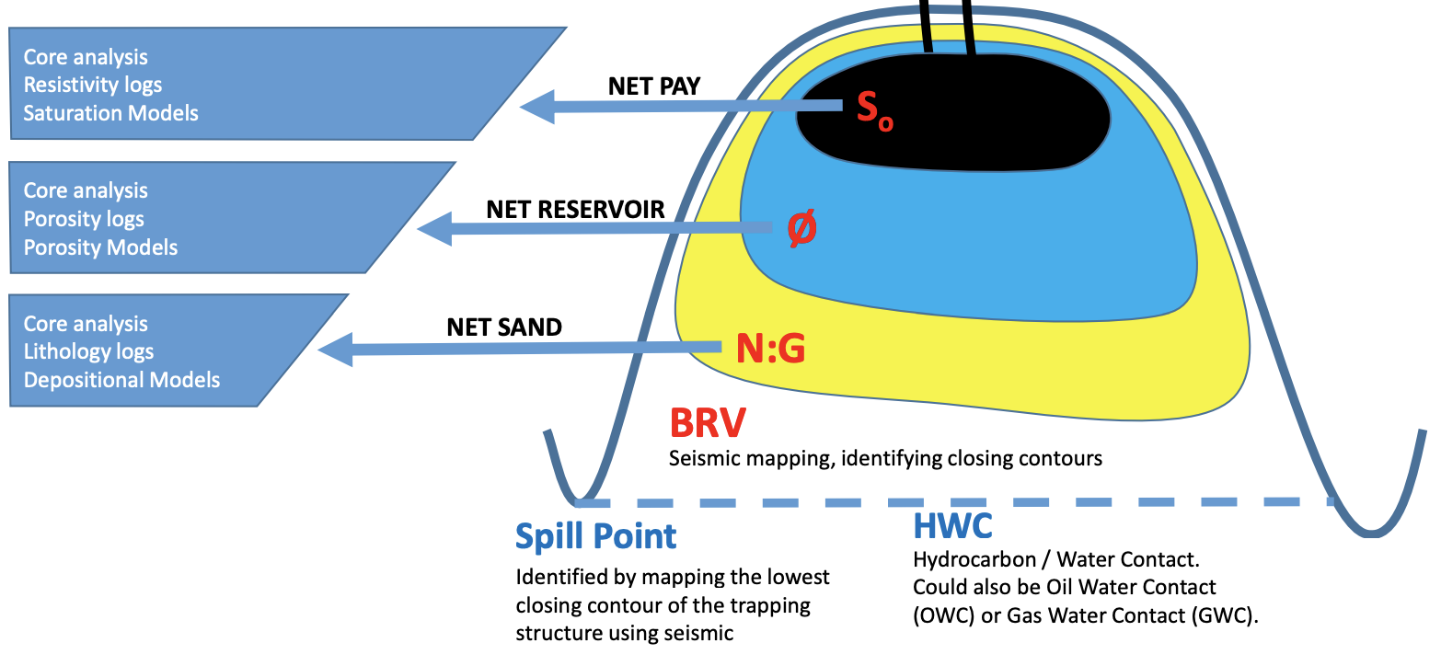

Slide 13
BRV = Bulk Rock Volume ===> from reflection seismics
N:G = lithological make-up of BRV ===> from wells, well-logs
(in case of well-logs: Neutron density and Gamma ray)
= Porosity ===> from Neutron, Density and Sonic Logs
S₀ = Oil Saturation ===> from well-logs

Slide 17
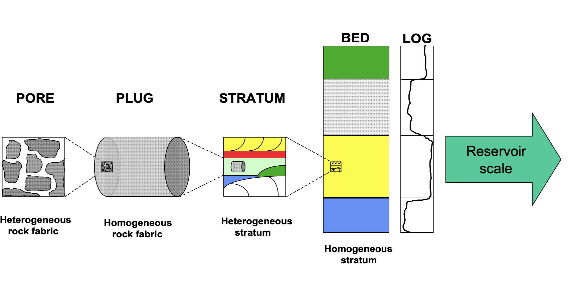

Slide 28
