Slide 1
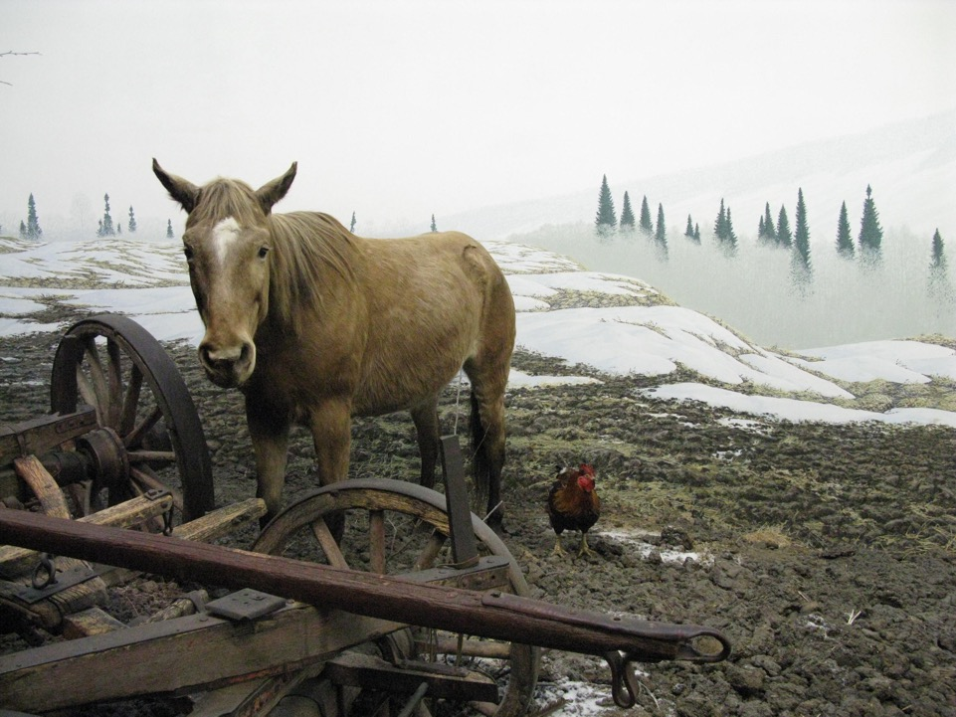
Il ‘problema’ della MEMORIA

Slide 2
PATRIMONIO CULTURALE
burocrati
associazioni
NUOVE FORME DI MEMORIA
materiale/immateriale
ATTIVITA' MEMORIALI
ossessione e raccolta
governi
paesaggi
oggetti, siti
patrimonio assente
distruzione & violenza
Necessità di PATRIMONIO
come Produzione ATTIVA del passato NEL PRESENTE
Selezione, non solo conservazione del PASSATO.

Slide 3
Patrimonializzazione
Accumulo eterogeneo di tracce e memorie di molti passati differenti che affiorano e mediano il presente
Patrimonio come assenza presente
Nostalgia dell’Est
Patrimonio problematico e dark tourism
Memoria e oblio stanno insieme. Entrambi servono per usare a pieno il tempo… Occorre dimenticare per rimanere presenti, dimenticare per non morire, dimenticare per restare fedeli (M. Augè, 2000)

Slide 4
Museo etnografico
Come interfaccia tra la memoria culturale tattica e frammentaria e quella strategica e ufficiale promossa dalle istitutuzioni
Rappresentare il passato, la tradizione, l’identitià locale è qualcosa che la gente FA assieme, producendo e alimentando al tempo stesso RELAZIONI SOCIALI
Dono come pratica di cultura popolare
(F. Dei, 2018: 228)

Slide 5
Conflicts, memory & identity
History case: Trieste, border area
Multi-ethnic context with minorities
Civil war with traumatic events and division
Exile, abandonment and memorialization
Interdisciplinary approach & references
Memory complex as process of construction for identity

Slide 6
Istrian exodus 1943-57
After 2WW (London Memorandum 1954) 200,000-350,000 italians displaced (Esodo)
Cruel conflicts between fascists/communist - Italians/”Slavs”
Traumatic “ethnic cleaning” (Foibe)
Claims for the abandonment of land and properties
Political patronage (Mediterranean anthropology)
Memory and identity in relation to both political and symbolic boundaries.

Slide 7
Divided memory in urban space of Trieste
Divided: mutual recriminations and competing, often exclusive (Italy/Yugoslavia-Fascist/Communist)
Operation of memory, rather than an “objective” history:
The Museum of Civilization of Fiume, Istria and Dalmatia, 2015
A theatrical musical, Warehouse18 (S. Cristicchi)
Sites of memory and celebration of trauma
A fiction-movie (Red Land)

Slide 8
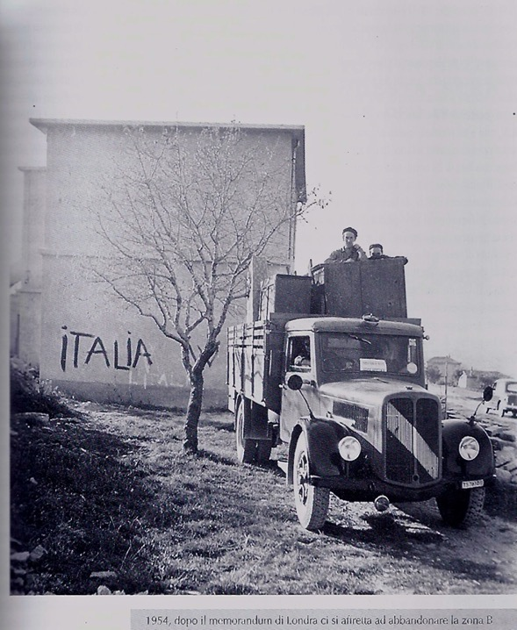
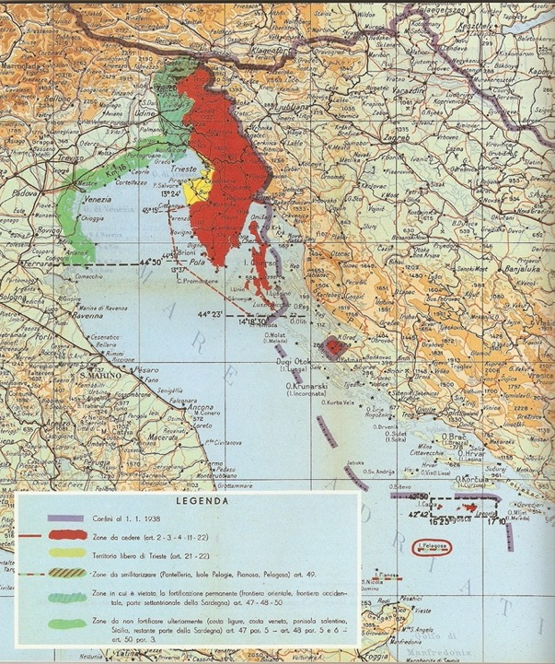

Slide 9
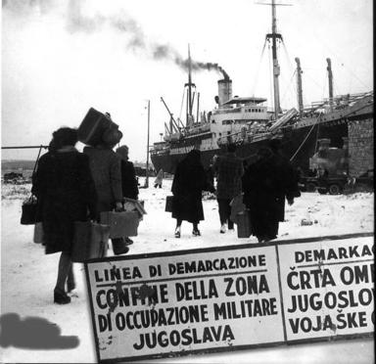
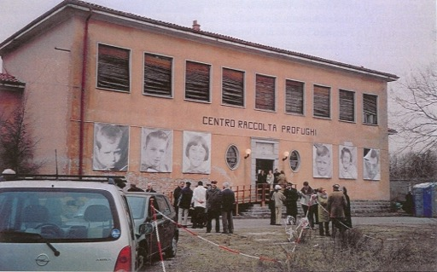
Departure
Arrival

Slide 10
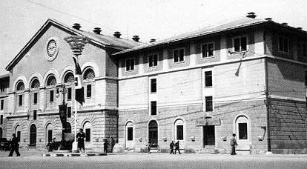
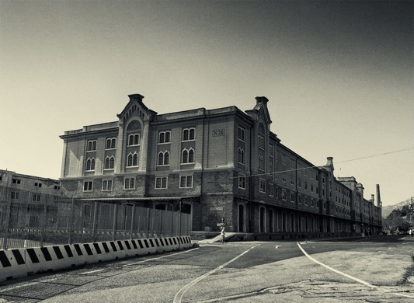
CPR
Silos
Refugees Collection
Centre
250,000
Italian exiles
from Istria,
Dalmatia

Slide 11
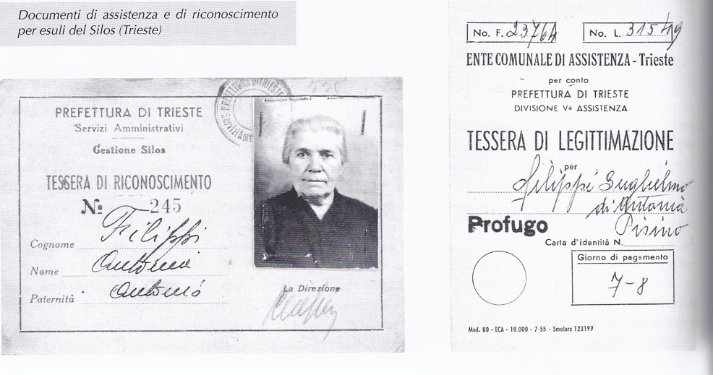
Identification Card as Refugee, SILOS 1943-1956

Slide 12
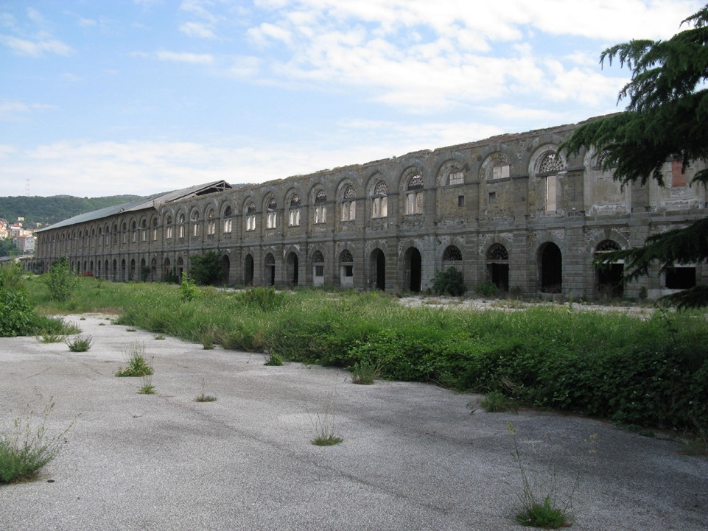

Slide 13
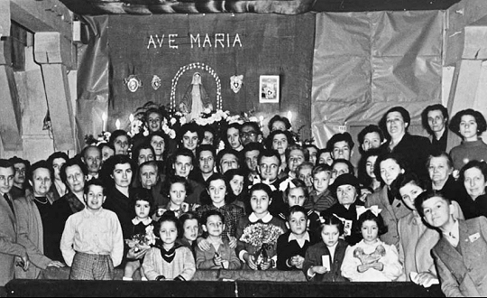
Silos’ community

Slide 14
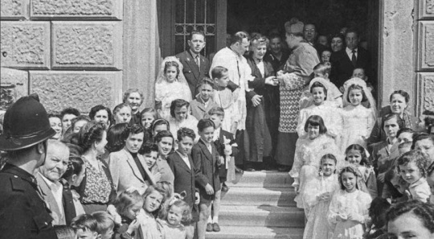
Catholic Mass in Silos

Slide 15
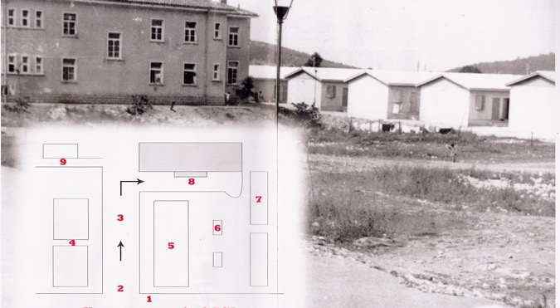
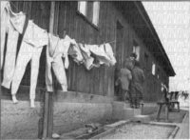
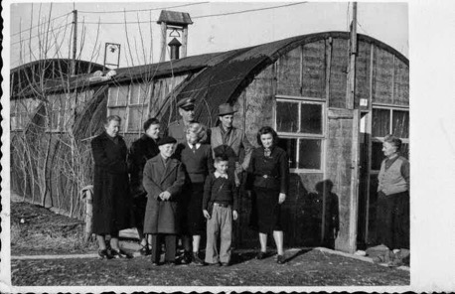
After Silos: camps in karst plateau near the border

Slide 16
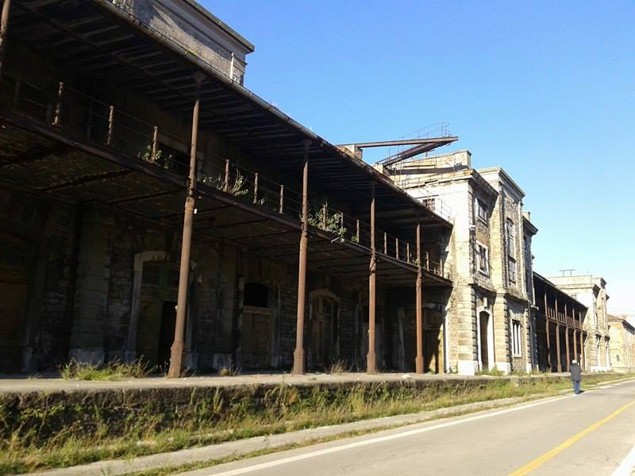

Slide 17
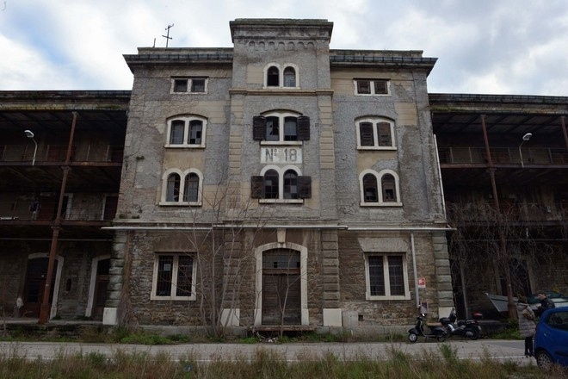
Warehouse 18: deposit of abandoned goods

Slide 18
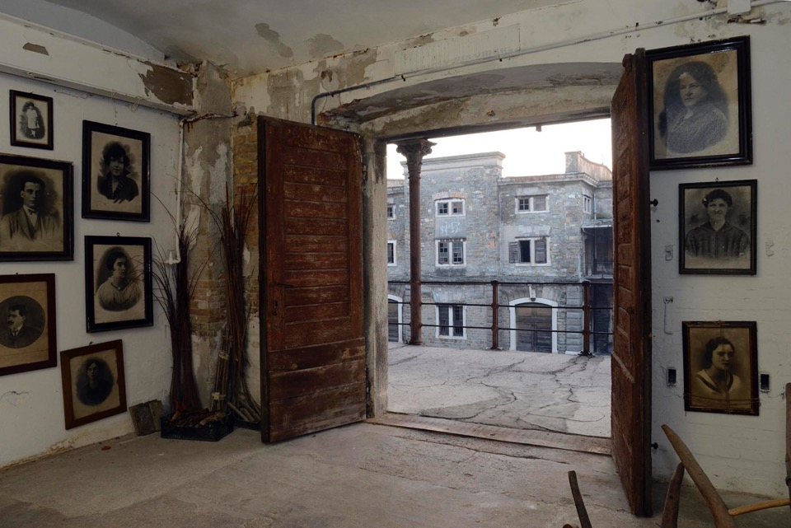
Makeshift exhibition: exile as founding event for collective memory

Slide 19
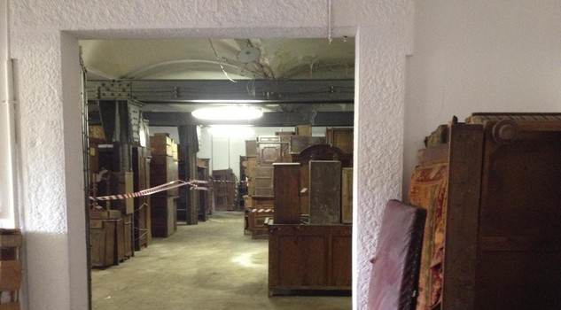
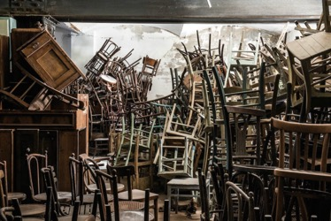
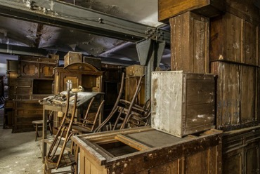

Slide 20

Past interrupted by escape, “culture of survivors”
symbolic death = exile = identity

Slide 21
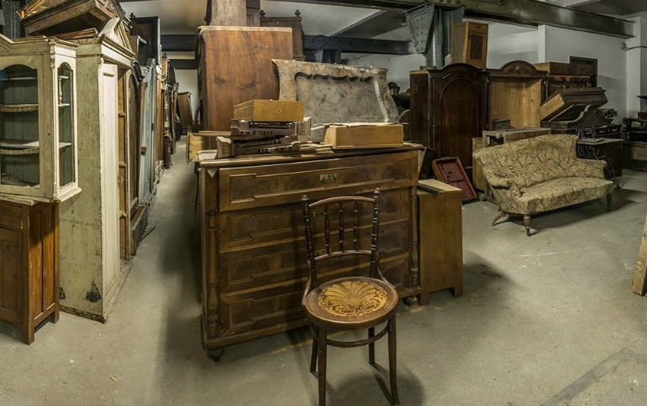
Trauma: past that never passes,
past crucial to the way of living the present and the future

Slide 22
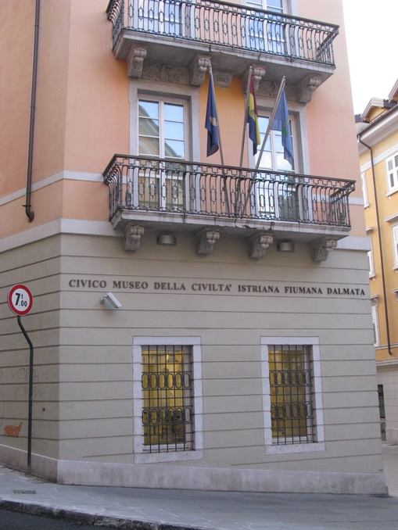
Trieste 2015
The museum of civilization of Istria, Dalmatia and Fiume (Rijeka)

Slide 23
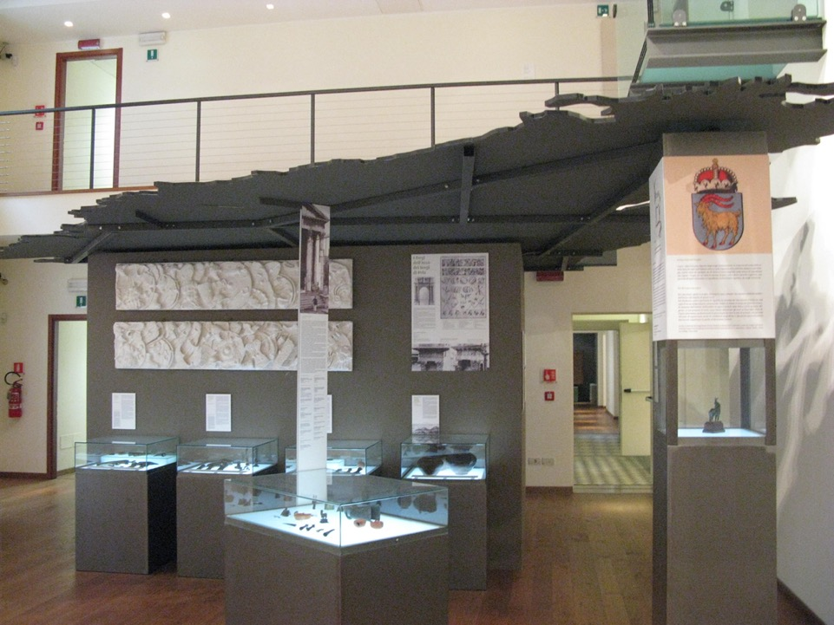
Documentary on Istria tricolour:
red, white and green

Slide 24
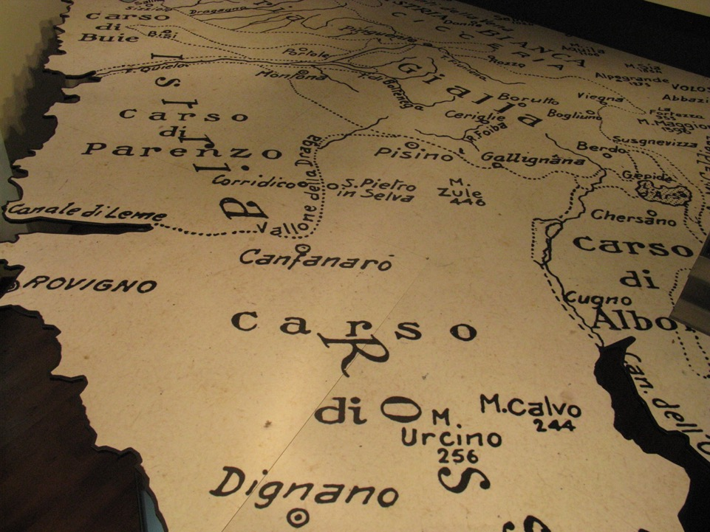

Slide 25
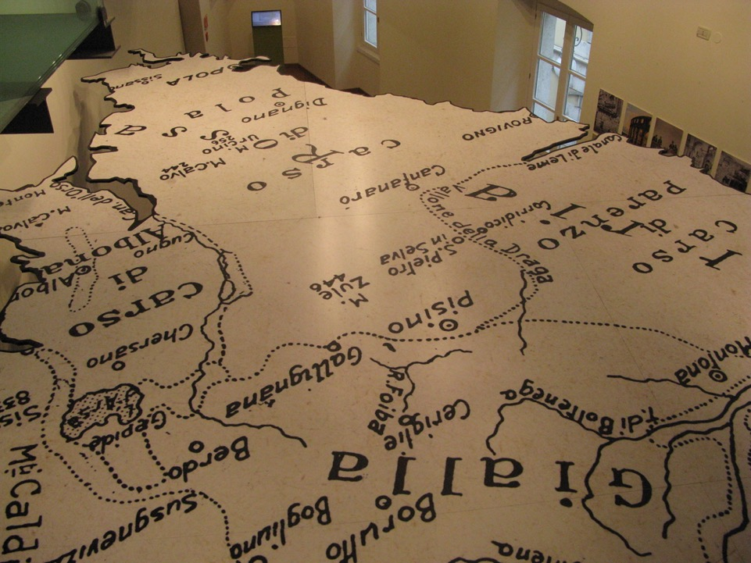

Slide 26
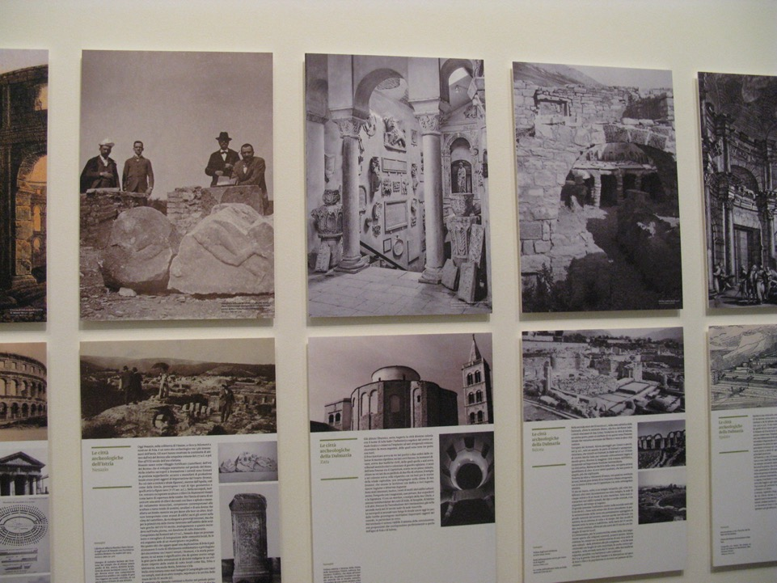
Italian Civilization against “Slavic barbarity”
Urban / rural culture

Slide 27
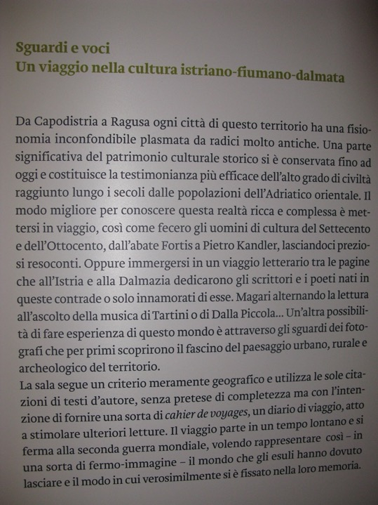
The question of which culture is most “authentic” and autochthonous
or “indigenous” to the Adriatic littoral lies at the heart of the contest over territory that form the backdrop to the exodus of Italians from Istria.
(Ballinger, History in Exile, 2004)

Slide 28
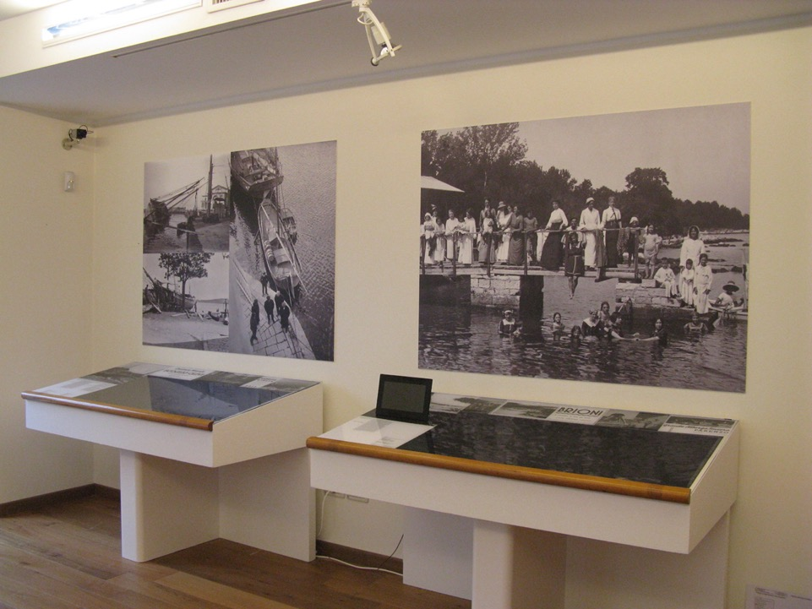

Slide 29
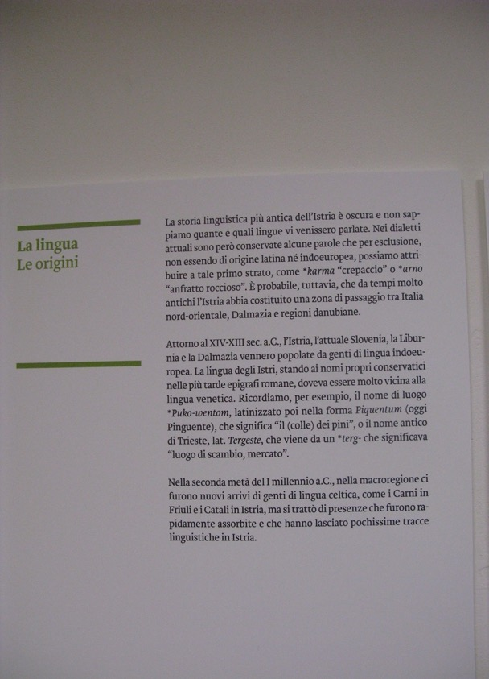
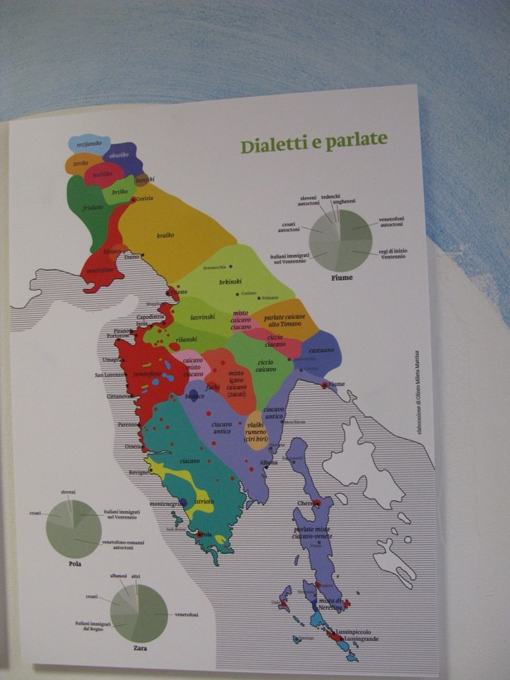

Slide 30
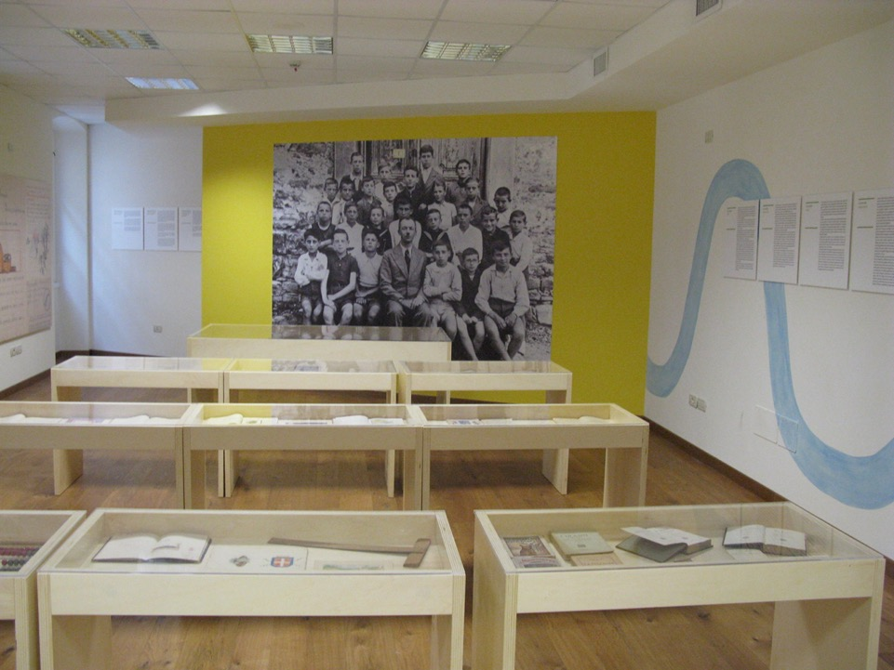

Slide 31
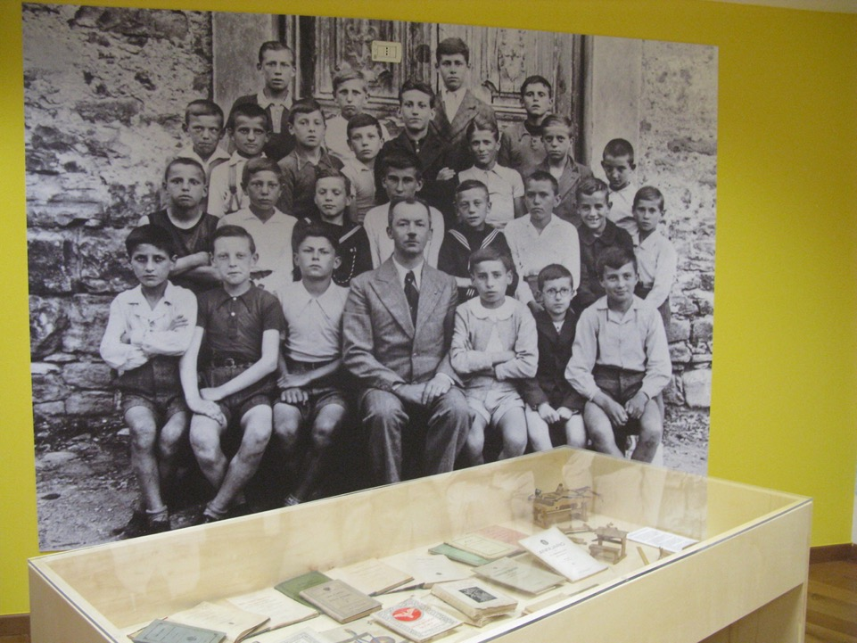

Slide 32
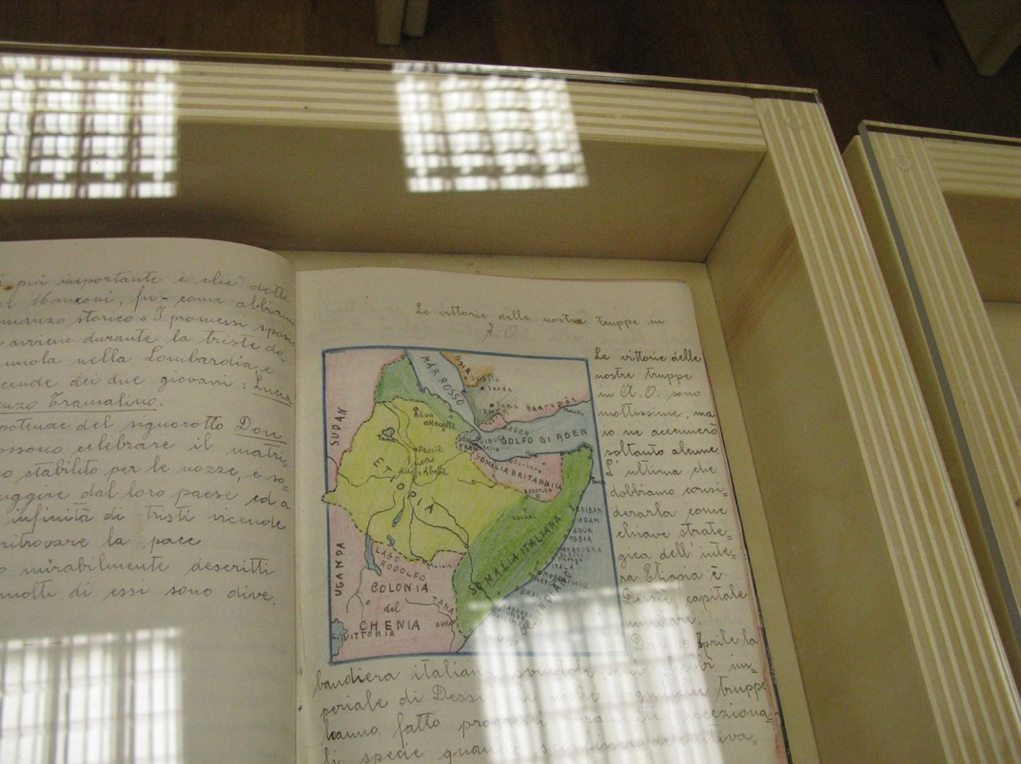

Slide 33
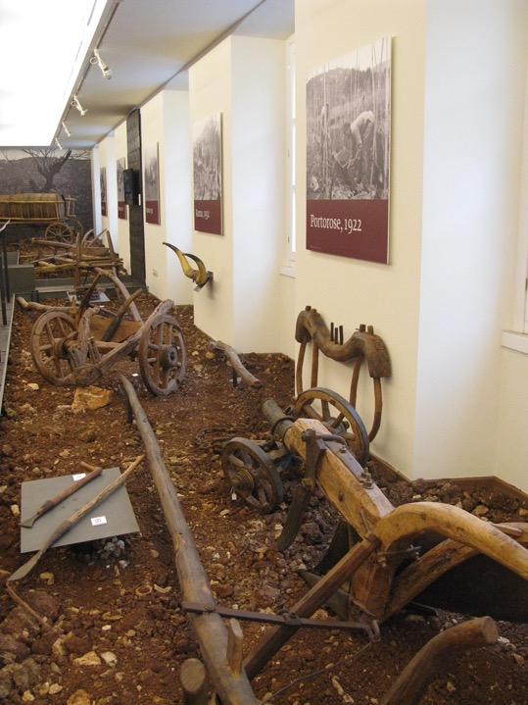
Symbolic
red land

Slide 34
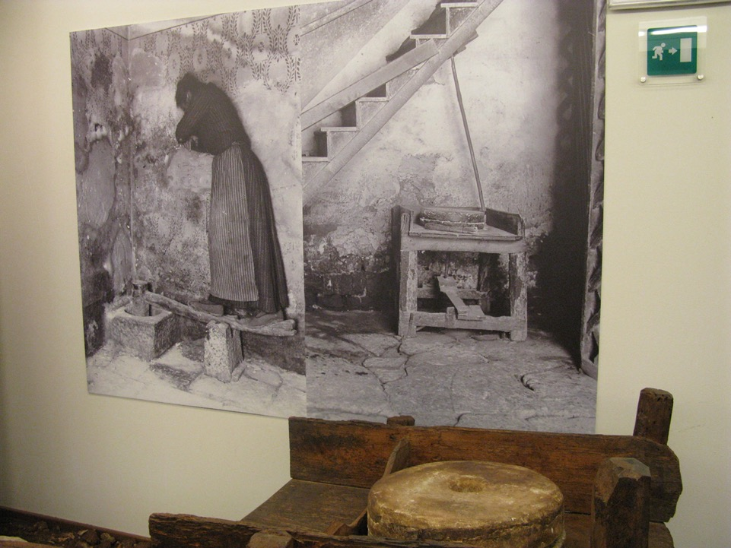
Structural
nostalgia
Clifford,
Herzfeld

Slide 35
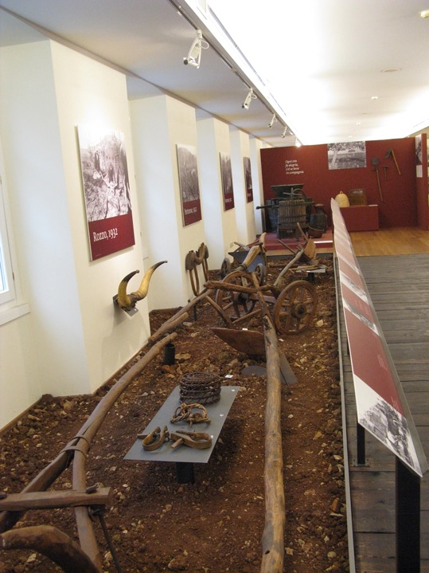
“Authentic” traditional
Istrian culture
Pastoral idyll
(J. Clifford, G. Marcus, Writing Cultures, 1986)

Slide 36
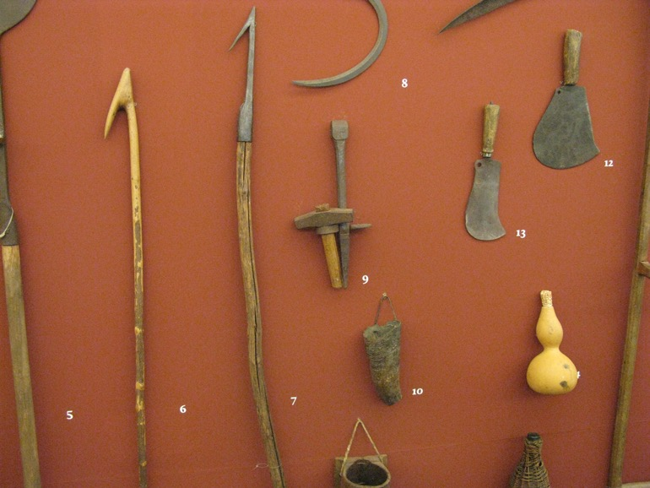
Idealization of the past and former life

Slide 37
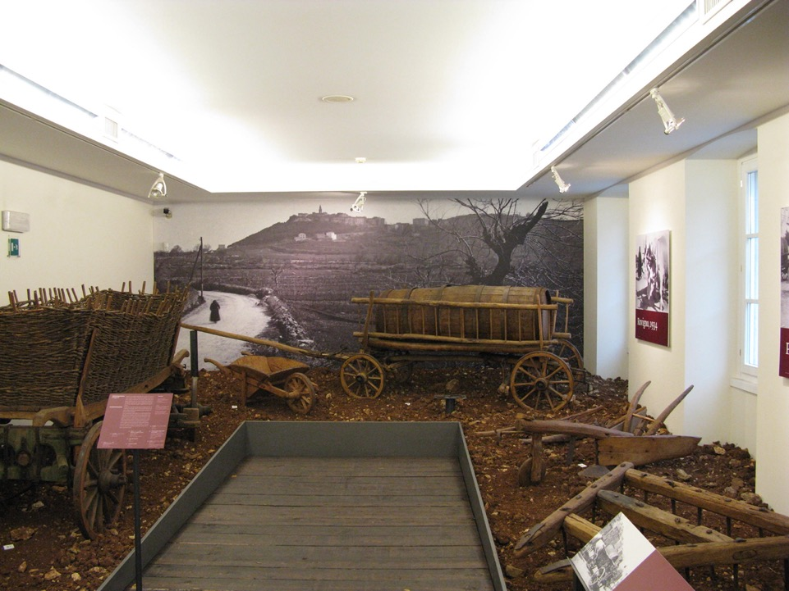
Space & time fixed and pristine, lost in time

Slide 38
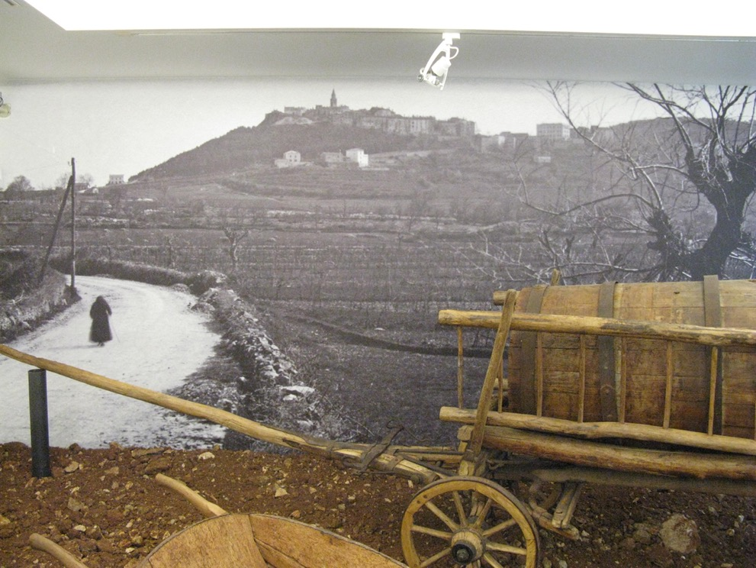

Slide 39
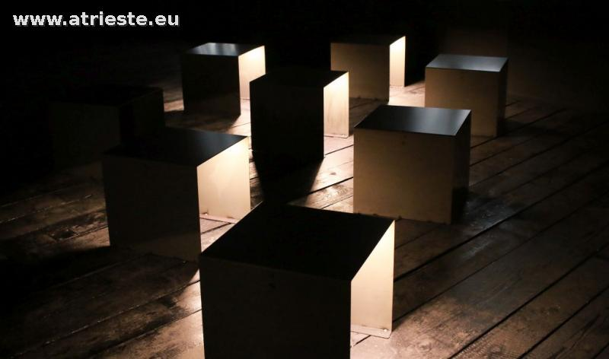
The black hole (foibe): oral interviews in a dark room
Narrative space that feeds “wounded culture”

Slide 40
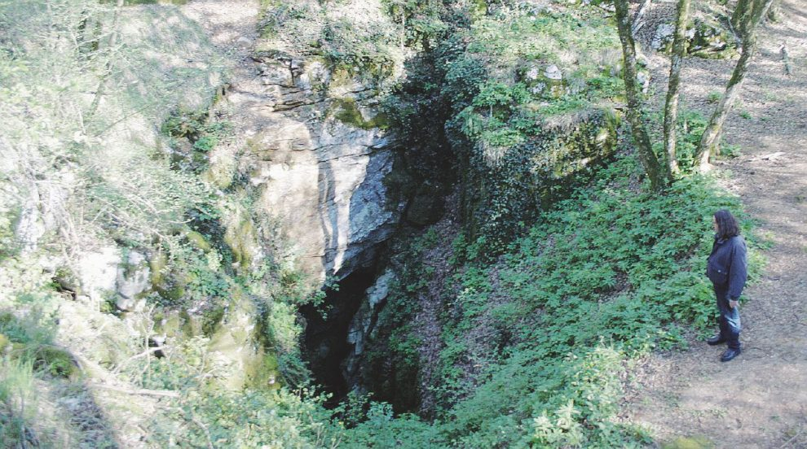
Karstic sinkholes, foibe, as political submersion and ‘archeological’ trauma (Ballinger 2004; Beneduce 2011)

Slide 41
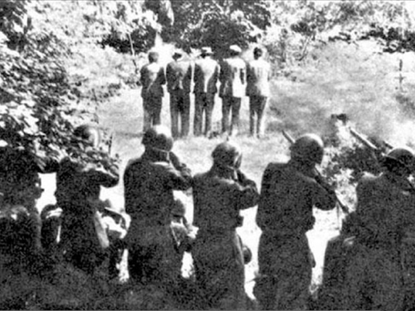
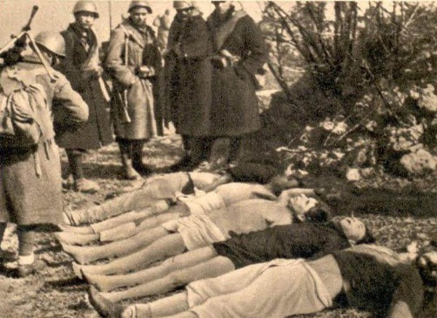
“Microphysics” of violence refracted
through individual and family narratives.

Slide 42
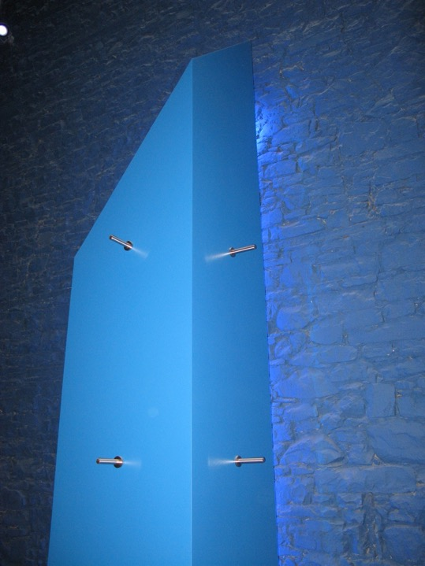
“Regardless of
who the witness is
—the villain, the surviving victim, or you and I—
the violent event persists like crushed glass in one’s eyes.
The light it generates, rather than
helping us see,
is blinding”
E. Valentine Daniel,
Anthropology of violence, 1996.

Slide 43
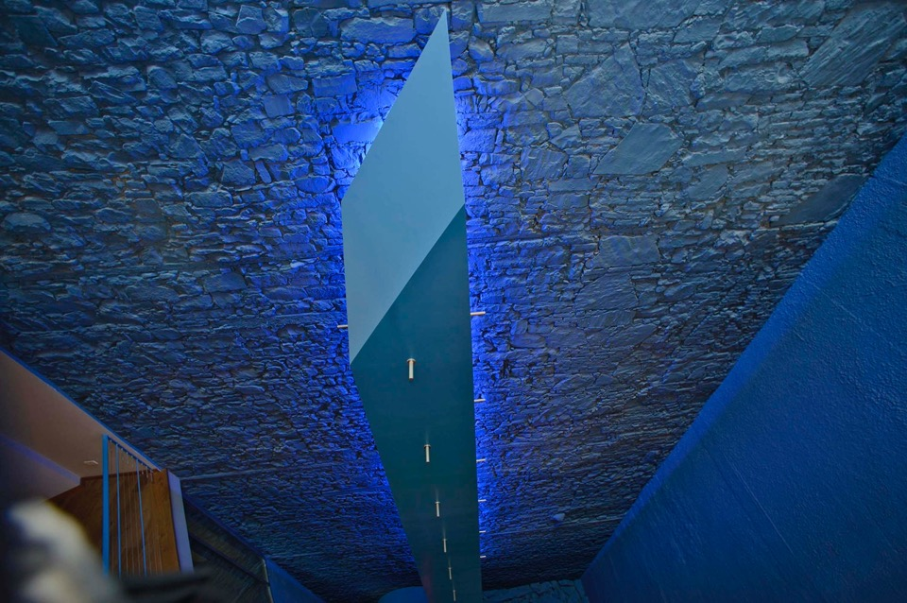
Art and ritual of violence or memory?

Slide 44
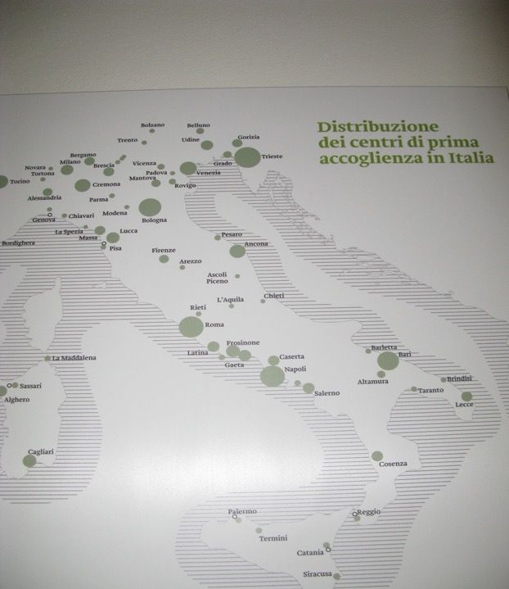
Identity based on displacement and unknown exiles
Italian-ness: often manipulative public use of history
Victimhood

Slide 45
Amnesty, memory … and then?
Modern legacies of violence and victimhood generated by the “dual traumas” of fascism and communism (Ballinger 1998)
Interior displacement and exile (Malkki 1995)
Identity based on trauma & absence (Audenino)
Space: nostalgia for an imaginary homeland
Time: frozen and then thawed at the end of the Cold War
Breakup of Yugoslavia, seeking to reposition their group histories: humanitarism & absolute victims

Slide 46
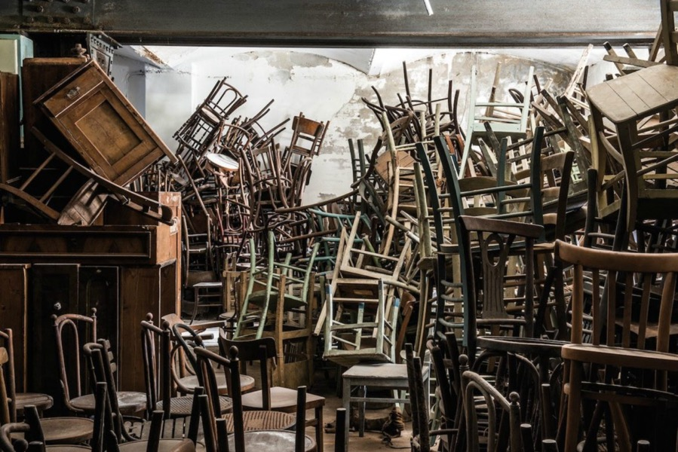
Aesthetic of Holocaust

Slide 47
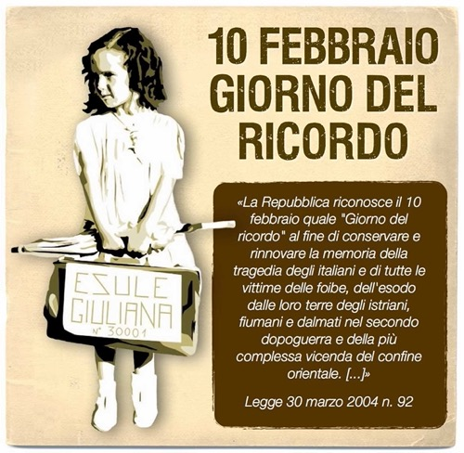

Slide 48
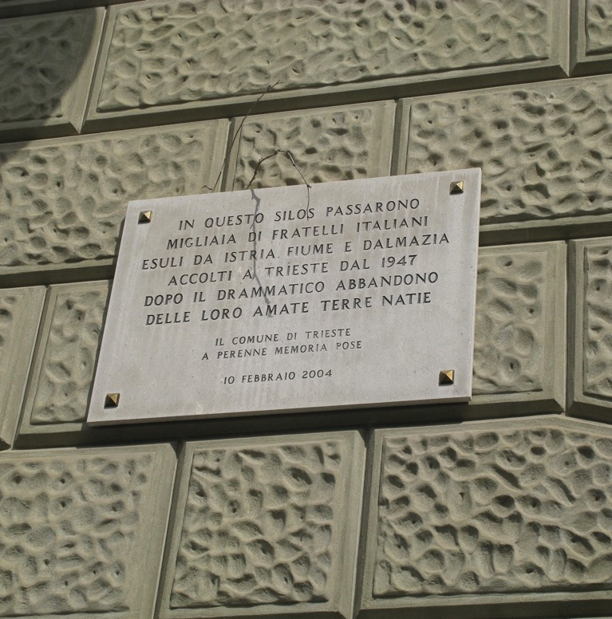
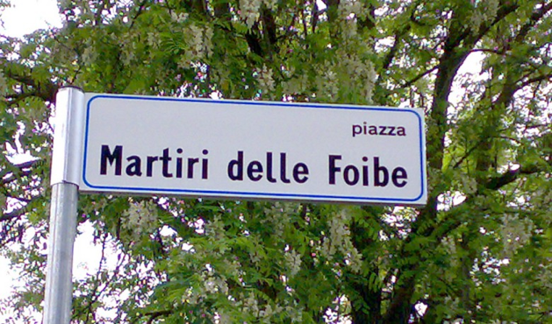

Slide 49




Slide 50


Slide 51
2013: Musical by Simone Cristicchi
“Shared memory”: wishes to “teach how to remember without partisanships or ideological prejudices
Song
Into the hole
Strong emotions and disturbing representation of tragedy:
rhetoric of reconciliation?

Slide 52
Inside the hole
How many secrets inside the hole.
We comrades, we communists, we partisans or poor wretches.
We are deleted from consciousness,
because silence is like a bomb,
It will forever be our grave.
Inside the hole, inside the hole, all inside the hole.
What are you hiding inside the hole?
Inside the hole ?? The world inside the hole.
Violence ?? inside the hole!
There is no escape route here,
only that shot behind the back of the head.

Slide 53


Slide 54



Slide 55




Slide 56


Slide 57


Slide 58


Slide 59
Memory complex
Border (incorporated) for a sense of belonging and ethnic simplification
Enemy = unheimlich, ambiguity of violent relationship
“Compassion automatically attributes all the victims to the dominant culture”.
Complex set of entanglements with the past and present- day politics

Slide 60
Memory and history
The difference between real memory - social and unviolated - …. and history, which is how our forgetful modern societies, propelled by change, organize the past ... Memory is life.... History, on the other hand, is the reconstruction, always problematic and incomplete,
of what is no longer.
P. Nora, Between memory and history, 1989

