Slide 1
Flow Chemistry

Slide 2
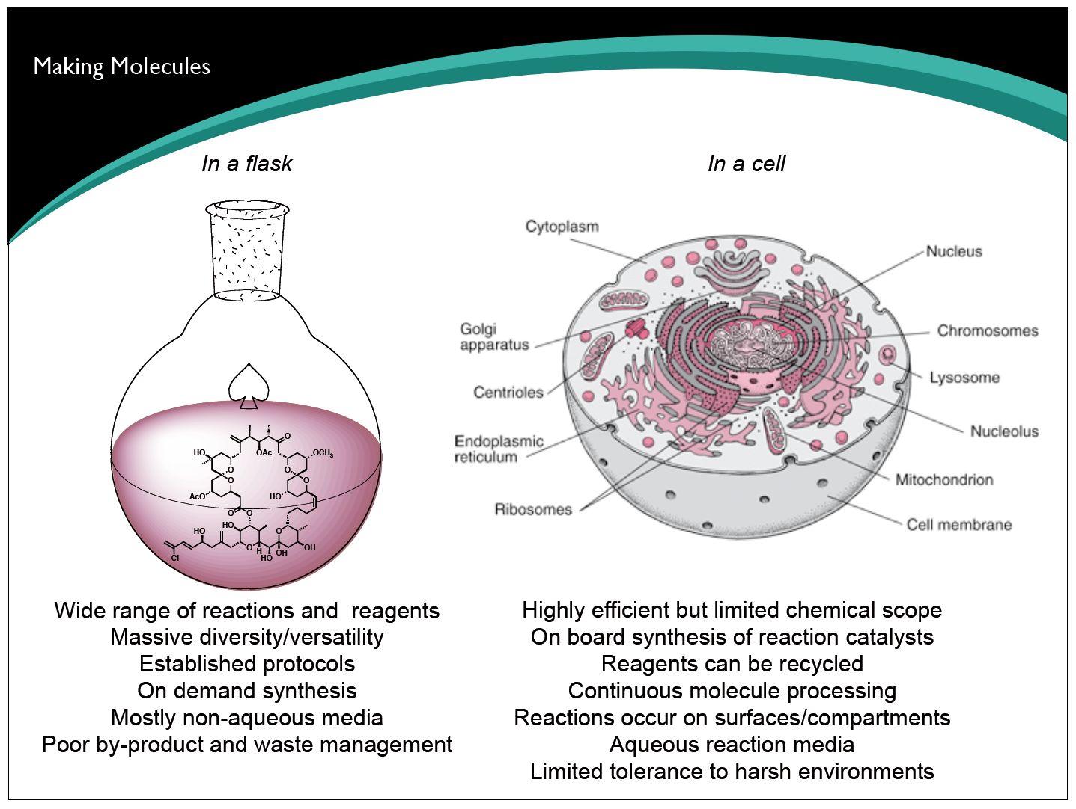
Flow Chemistry

Slide 3
Flow Chemistry

Slide 4
Flow Chemistry

Slide 5
Flow Chemistry

Slide 6
Flow Chemistry

Slide 7
Flow Chemistry

Slide 8
Flow Chemistry

Slide 9
Flow Chemistry

Slide 10
Flow Chemistry

Slide 11
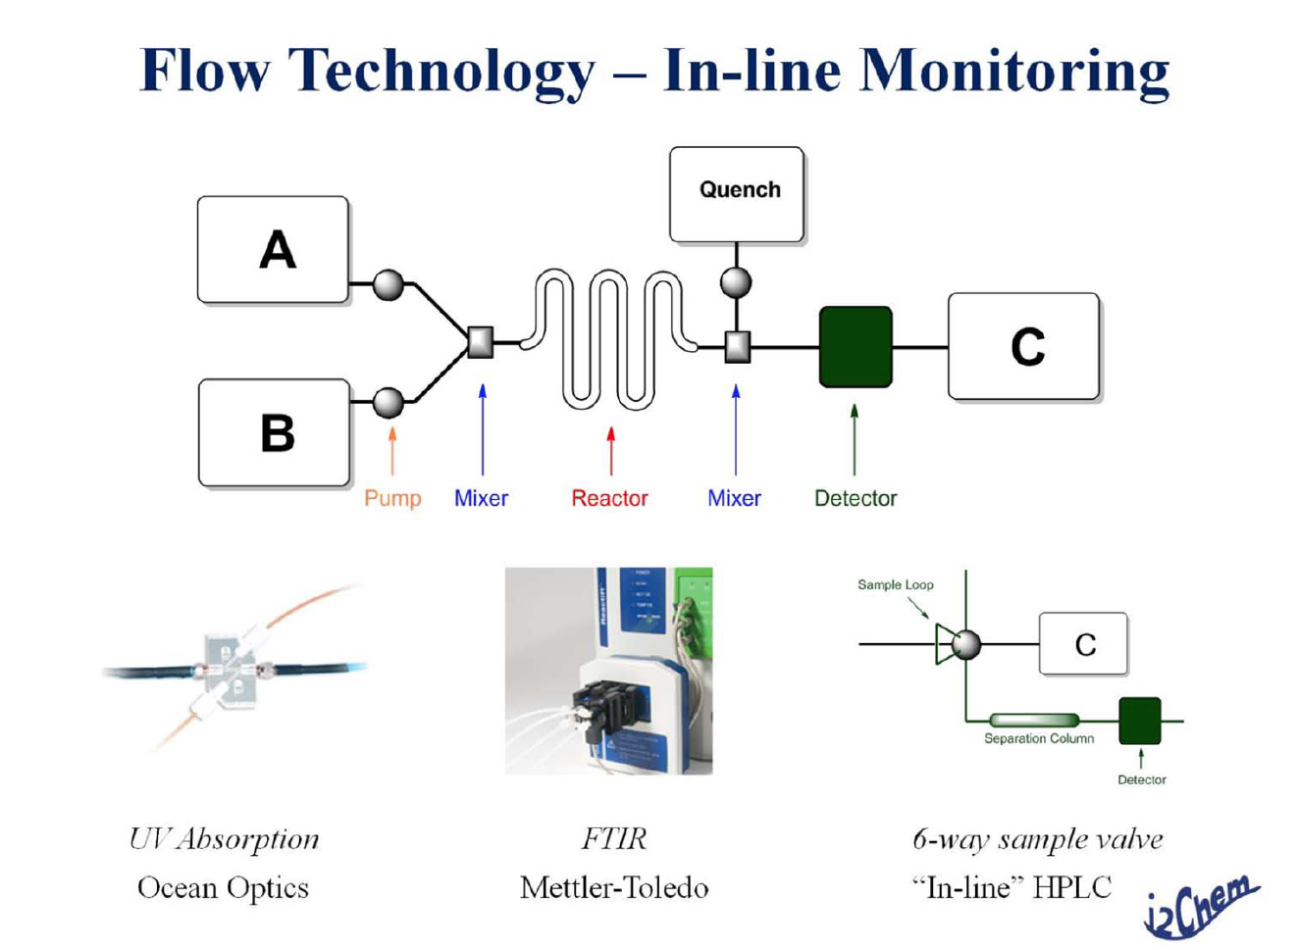
Flow Chemistry

Slide 12
Flow Chemistry

Slide 13
Flow Chemistry

Slide 14
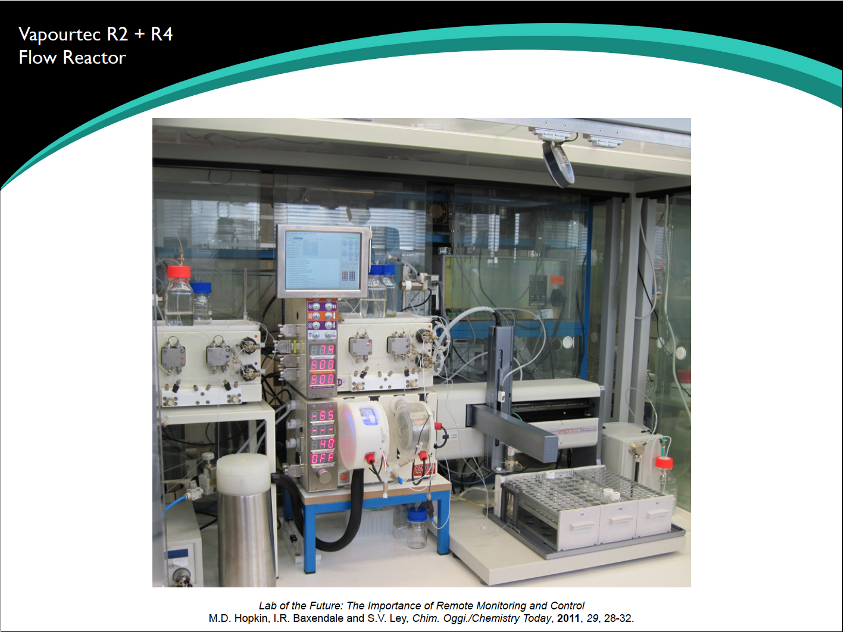
Flow Chemistry

Slide 15
Flow Chemistry

Slide 16
Flow Chemistry

Slide 17
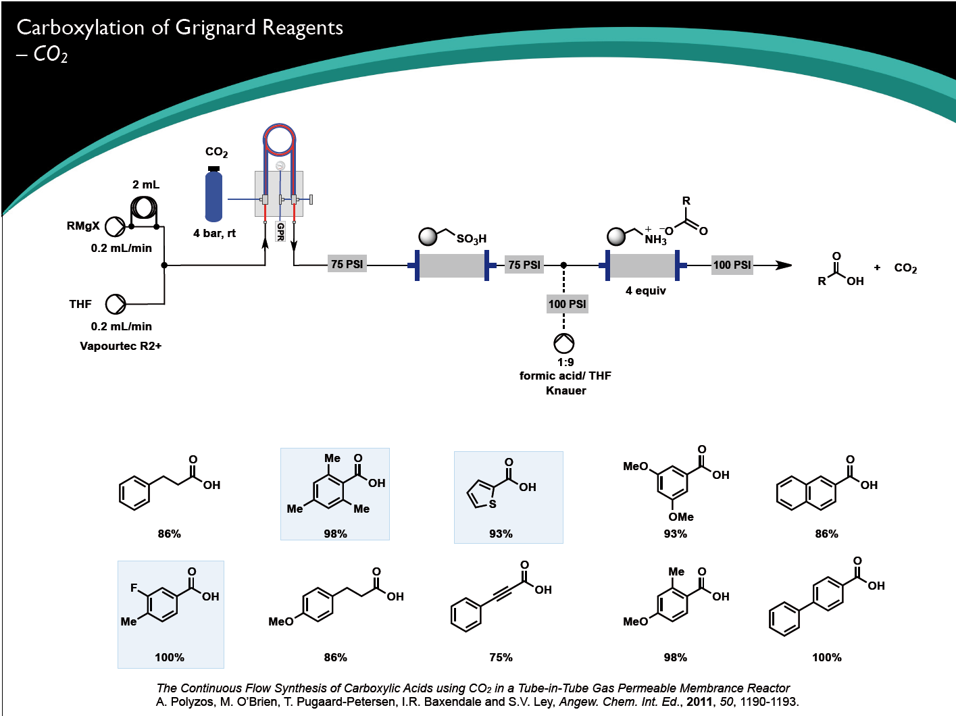
Flow Chemistry

Slide 18
Flow Chemistry

Slide 19
Flow Chemistry

Slide 20
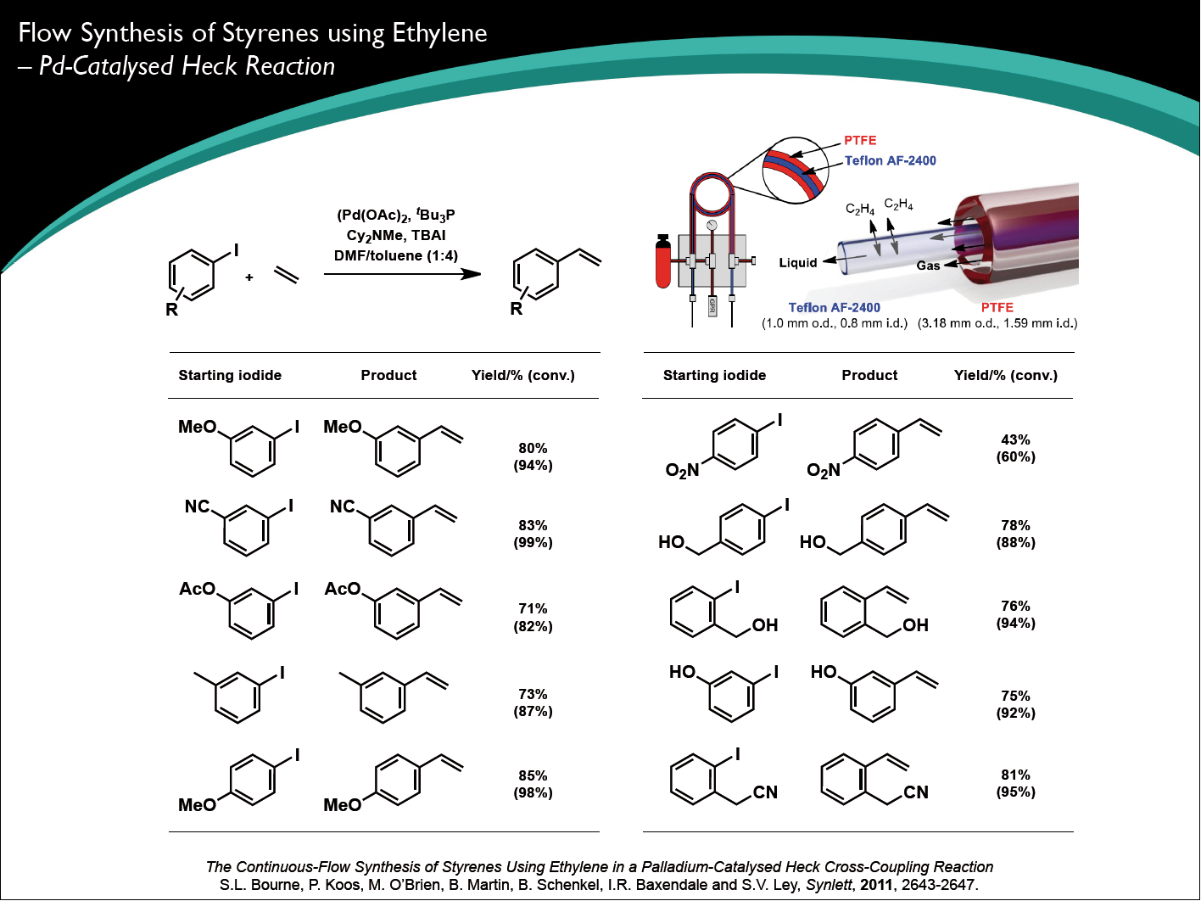
Flow Chemistry

Slide 21
Flow Chemistry

Slide 22
Flow Chemistry

Slide 23
Flow Chemistry

Slide 24
Flow Chemistry

Slide 25
Flow Chemistry

