Slide 1


CRISI
PERICOLO
OPPORTUNITÀ

Slide 2
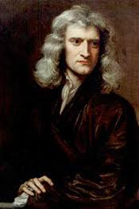
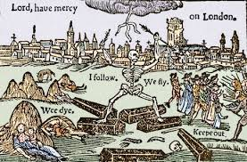
nanorods
nanorods
Peste a Londra 1665-66
Isaac Newton nato nel 1642 Newton approfittò dell’interruzione delle lezioni dovuta alla peste per proseguire gli studi per conto suo; durante questo periodo di isolamento quasi assoluto, e a soli 22 anni, scoprì le Identità di Newton, il metodo di Newton, approssimò la serie armonica tramite i logaritmi e cominciò a sviluppare il calcolo infinitesimale.

Slide 3
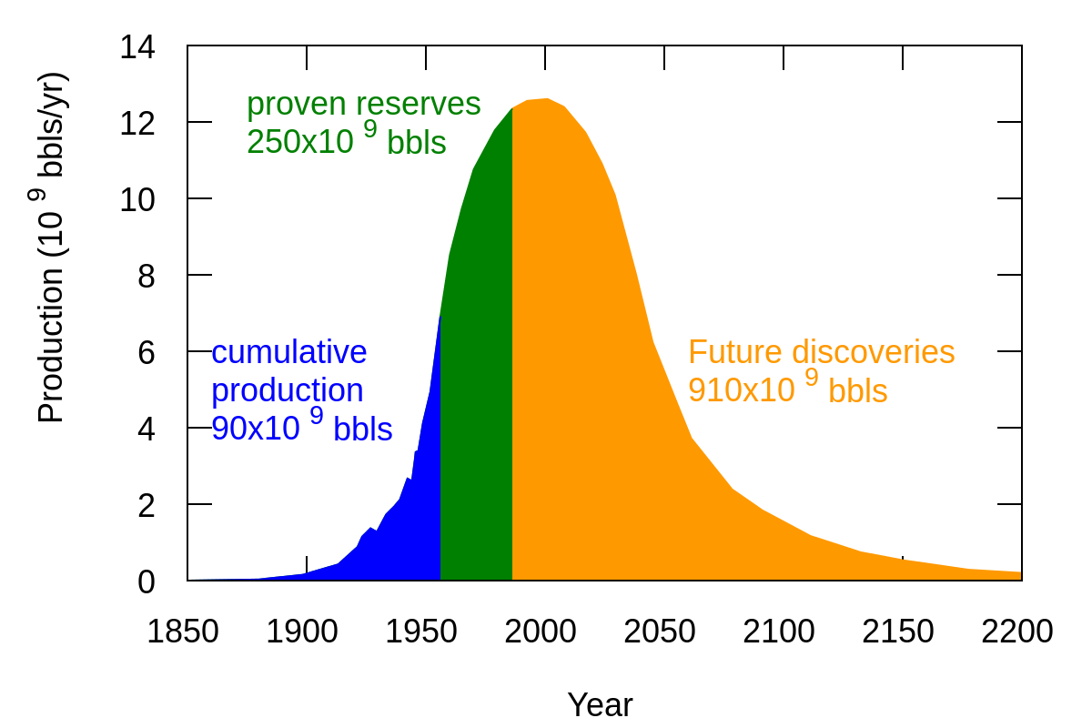
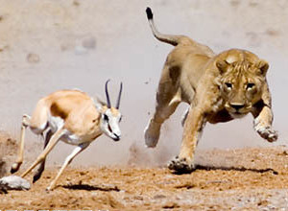
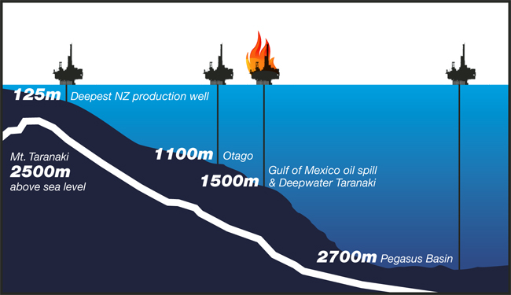
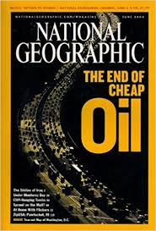
Depletion:
EROEI = Energy Delivered / Energy Required to Deliver that Energy

Slide 4
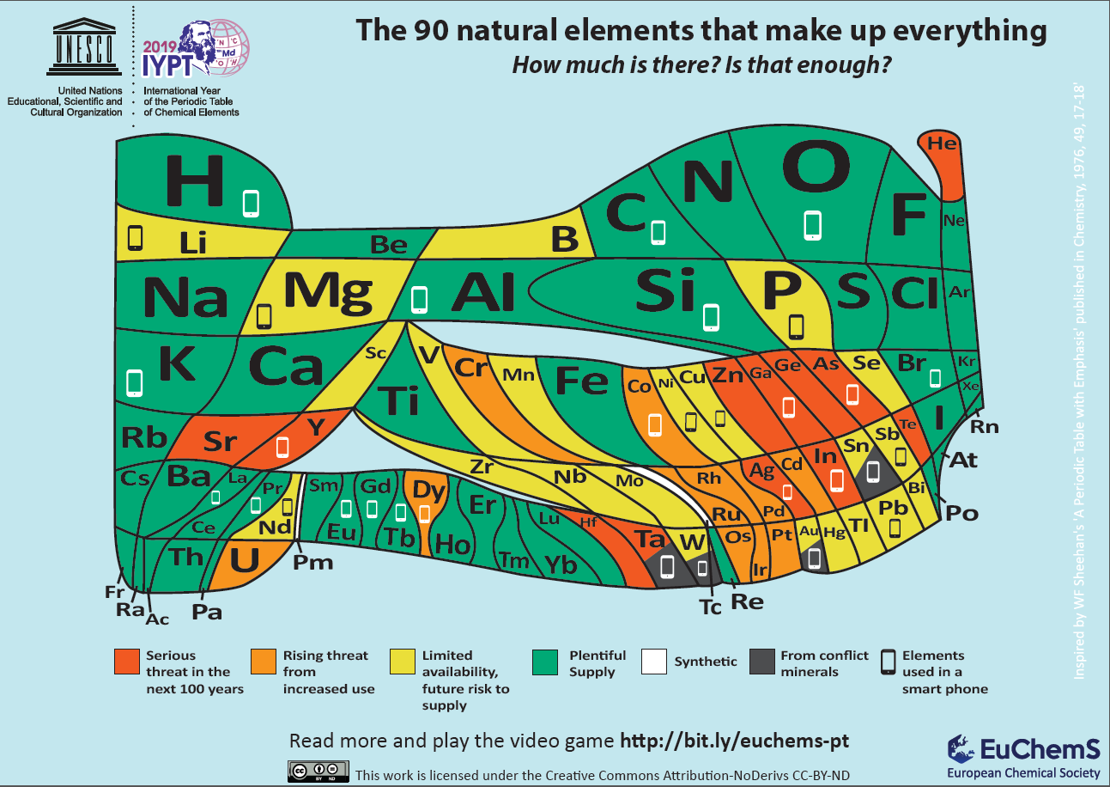

Slide 6
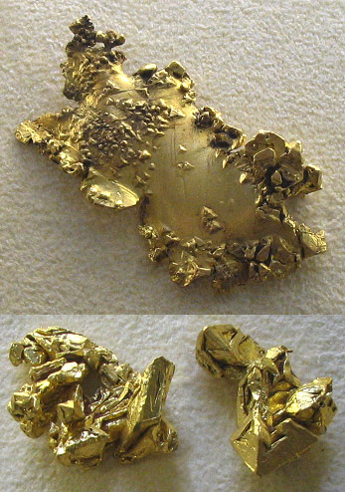
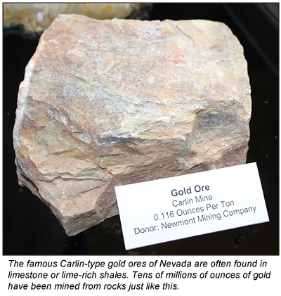
Depletion:
As you eat the cake, it becomes less and less tasty

Slide 7
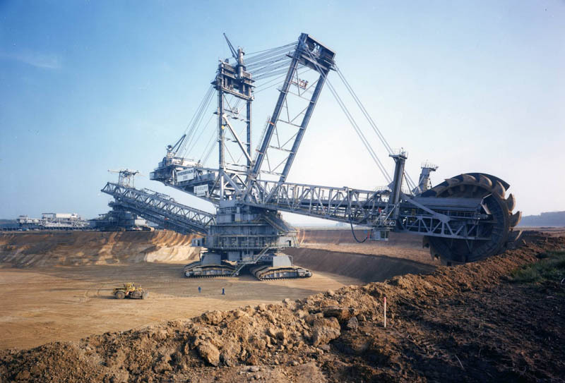
Mining requires energy

Slide 8
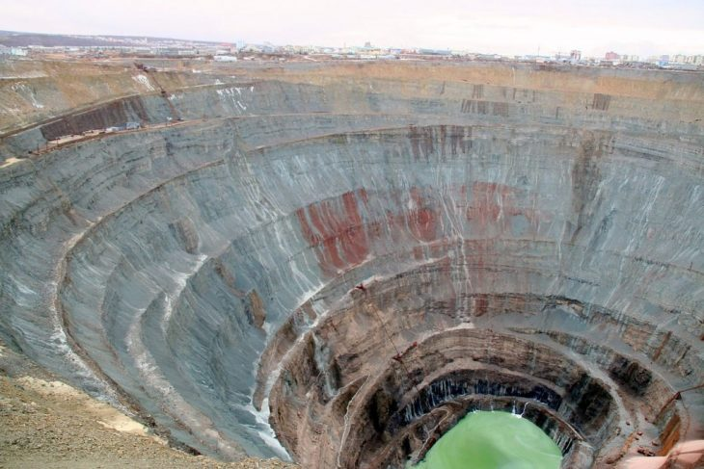
Incredible Open-Pit Mines
Mirny Mine, Russia

Slide 9
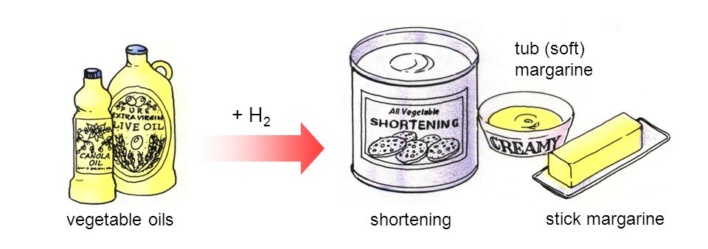

Toxicity: scientific facts and more….
Ni hydrogenation catalysts have been replaced by Ru/C catalyst
More Asbestos! More Asbestos! More Asbestos!
President Trump’s long-time love affair with asbestos is making its way into federal policy

Slide 10
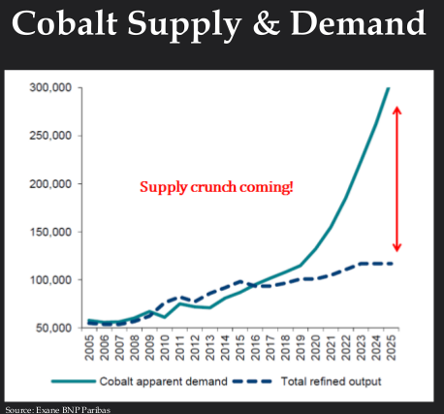
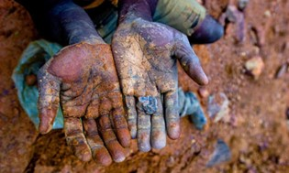
Ethical Cobalt extraction
Replacing noble metals with base metal

Slide 11
Lesson Overview
Purpose : To provide students with introductory information about nanotechnology and nanomaterials
Topics
  How small is a nanometer?
  Definitions and commonly used terms
  How is the nanoscale different from the macroscale or the atomic scale?
  Major classes of nanomaterials and their benefits
Notes:
Trainer Notes:
Explain that this is intended to be an introduction to a very broad and diverse area. This module can in no way cover all of nanotechnology and nanomaterials but will provide a basic understanding of what they are, some of the types of materials workers may encounter and some of the features that warrant focused health and safety training. Some of this material may be well understood by those who have a background in chemical safety. These students should be encouraged to share their knowledge with their peers and provide examples for discussion.

Slide 12
Learning Objectives
At the end of this module you should be able to
Contrast objects at the nanoscale with larger and smaller forms of matter
Define key terms in nanotechnology
Explain some of the ways nanomaterial properties differ from molecules and microscale particles
Describe some of the physical and chemical characteristics that can change at the nanoscale
Describe some of the major classes of nanomaterials produced today and their properties and potential benefits
Notes:
Trainer Notes:
Review these objectives with the class and explain that you will return to them at the end of the module to see if the learning objectives have been achieved. You can also post them on a flipchart or repeat this slide as you move between Topics to indicate where you are in the timeline of the module if desired.

Slide 13
How small is a nanometer?

Slide 14
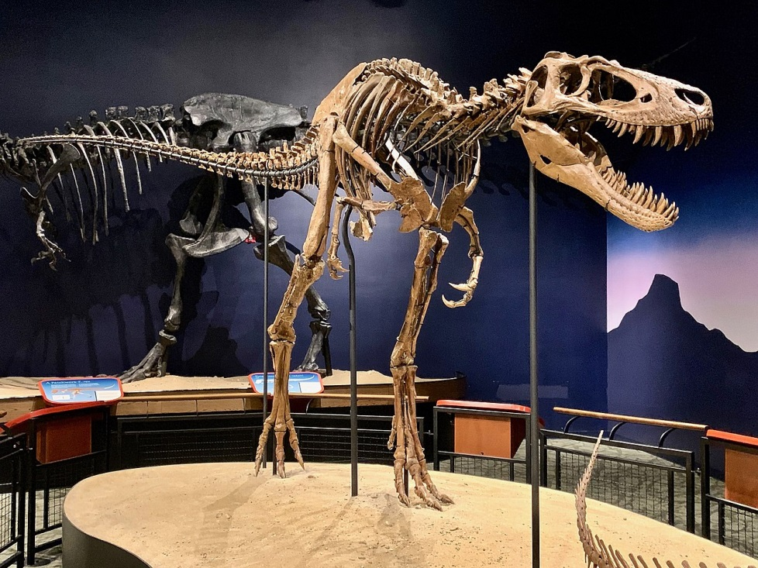
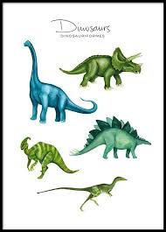
Topic 1: How small is a nano?
Dinosaur
Nanotyrannus lancensis
nano dinosaur

Slide 15

Topic 1: How small is a nano?
Nanodates for single busy workers
One session of multiple 5 minutes date!!

Slide 16
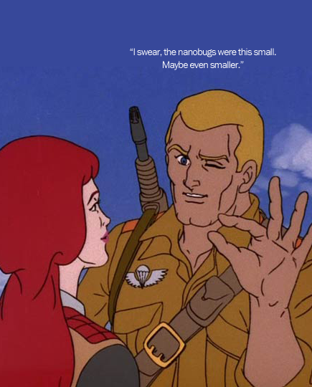
Topic 1: How small is a nanometer?
1 nm = 0.000000001 m
= 10⁻⁹ m
= one billionth meter
http://www.sniffcode.com/view.php?id=8
Notes:
Trainer Notes:
If desired, ask the class to point out the fallacy in the cartoon. (Or you could just let them laugh.) The size of any object worthy of the name “nanobug” cannot be estimated by squeezing together one’s fingers nor seen by squinting one’s eyes! The nanoscale is much too small for us to experience directly with our senses.
IMPLICATION FOR WORKERS: As with chemical substances, nanoscale objects may be present in the working environment with little to alert the worker of a possible exposure. Just because you can’t see it, feel it, smell it or taste it doesn’t mean it’s not there.

Slide 17
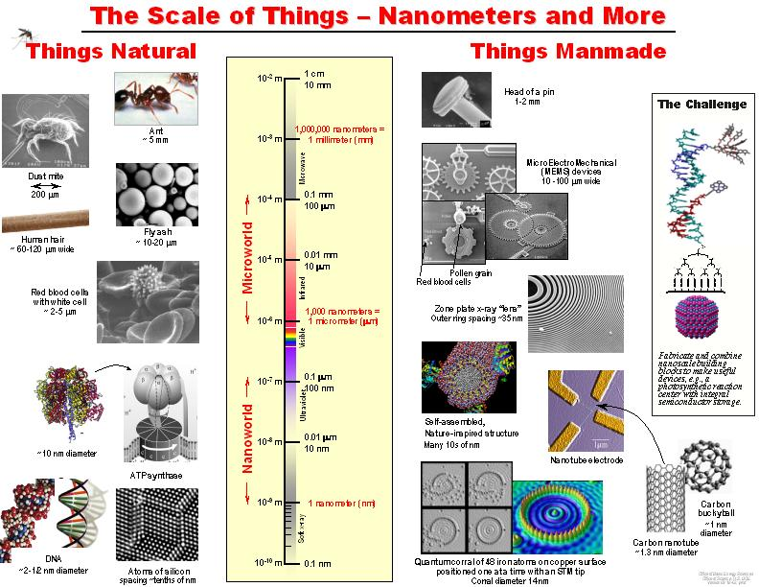
Handout 1
VIRUS
Courtesy Office of Basic Energy Sciences, Office of Science, U.S. DOE
Notes:
Trainer Notes:
The nanometer is difficult to conceptualize because we cannot experience it directly with our senses. Be sure to emphasize that “nano” does not simply mean “very small” and that there are many forms of matter much smaller than a nanometer, including electrons, atoms and most molecules. Rather, the nanoscale is in between the very small atomic regime and the larger regime of microparticles and colloids.
On the left of the diagram are naturally occurring objects of various sizes. On the right are human-designed objects of various sizes.
Note that there are plenty of natural objects that fall within the nanoscale, notably DNA and some larger proteins. Whether these can be called “nanotechnology” will be addressed in Topic 2.

Slide 18
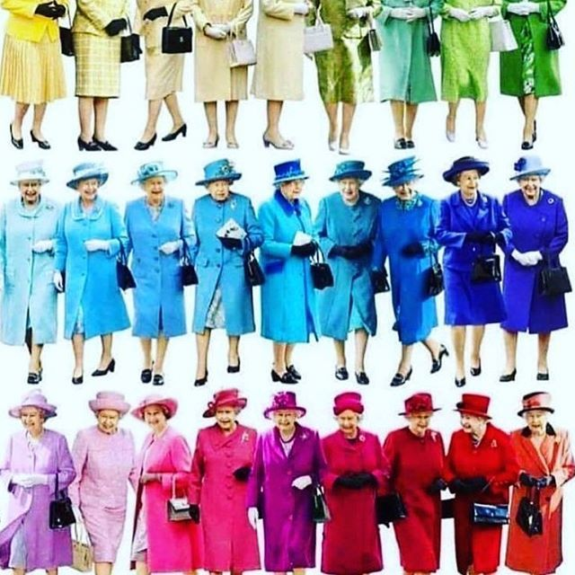
Quantum Effects
Band gap depends on particle size
(number of atoms in the particle)

Slide 19
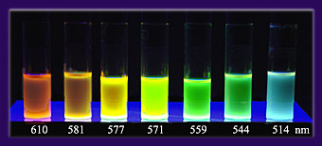
Quantum Effects
Band gap depends on particle size
(number of atoms in the particle)
4 nm
2 nm
Fluorescence of cadmium selenide nanoparticles

Slide 20
How is the nanoscale different from the macroscale or the atomic scale?

Slide 21

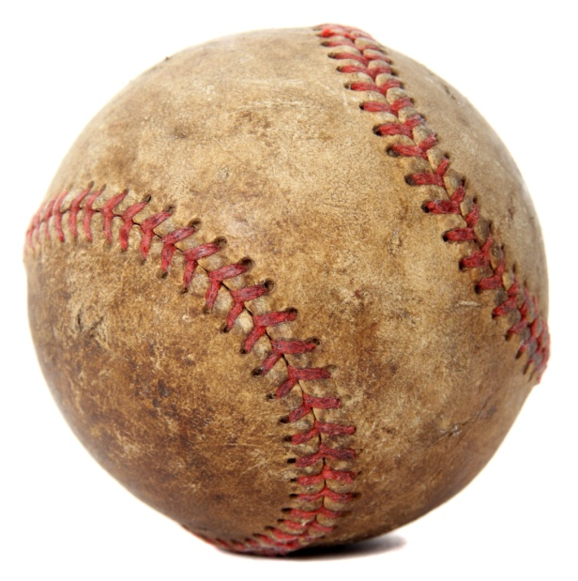
Topic 3: How is the nanoscale different from the macroscale or the atomic scale?
Baseball: ~2.8 inches in diameter
Softball: ~3.8 inches in diameter
Notes:
Trainer Notes (OPTIONAL):
Ask the students how different a baseball is from a softball. Prompt the students to respond that baseballs and softballs are different in size but not really different in terms of their properties or their composition. Changing the size of the ball has only a modest impact on how it behaves. When either ball is hit, it is fairly easy to figure out where it’s going to end up. This is how big objects behave and we’re all familiar with this from our everyday experience.
But the same is not true for objects at the nanoscale. The reason is that nanoscale objects resemble atoms a lot more than they resemble baseball.
IMAGE CREDIT softball: en.wikipedia.org; baseball is microsoft clipart

Slide 22
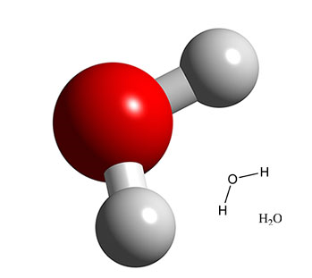

Nanomaterial Properties Can Change with Size
The nanoworld
At the nanometer scale, fundamental physical and chemical properties depend on the size of the object.
Notes:
Trainer Notes:
Explain that very small forms of matter such as atoms and molecules have their own set of rules and don’t behave the same way as larger objects. In other words, a water molecule is not just a very, very small water drop. They are made of the same chemical substance, H₂O, but they behave very differently. In order to understand the nanoscale it’s helpful to consider how gaseous water vapor in the atmosphere becomes a water drop that falls to Earth.
Start with an individual water molecule. We can’t see or feel individual water molecules but when conditions are right the individual molecules start to cluster together into tiny droplets. The droplet may start off as a cluster of 5 or 6 molecules, at which point it’s not much different than a single molecule. However, the bigger the cluster gets, the more it begins to resemble a raindrop. As more and more molecules cluster together, the droplet gets heavier and heavier until eventually it falls from the sky, getting some unlucky person below all wet. In other words, there is a point at which the cluster of water molecules stops resembling an individual gas-phase molecule and starts resembling a liquid-phase raindrop. The water undergoes a smooth transition from gas to liquid simply as a result of its change in size.
This is an important concept for nanomaterials. The nanoscale world lies between the realms of molecules (such as H₂O) and larger objects we can perceive with our senses (such as a raindrop). A nanoparticle’s properties can change with its size because it is transitioning from the atomic world to the macroscopic world. Unlike water, though, the changes some substances go as they transit through the nanoscale can include properties we wouldn’t expect to change. This will be explored with specific examples on the next slides.

Slide 23
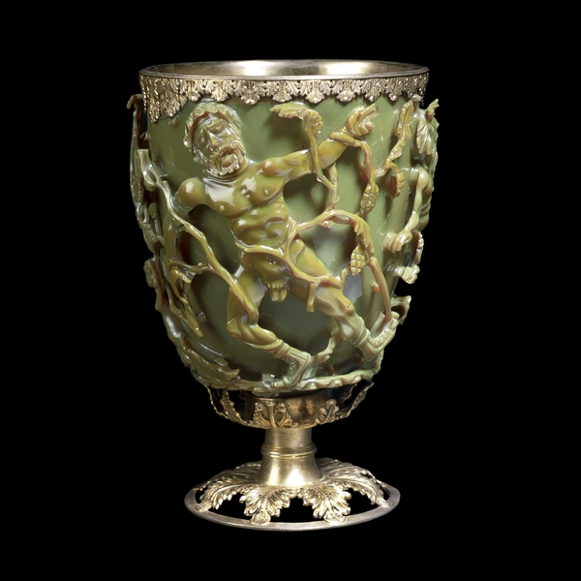
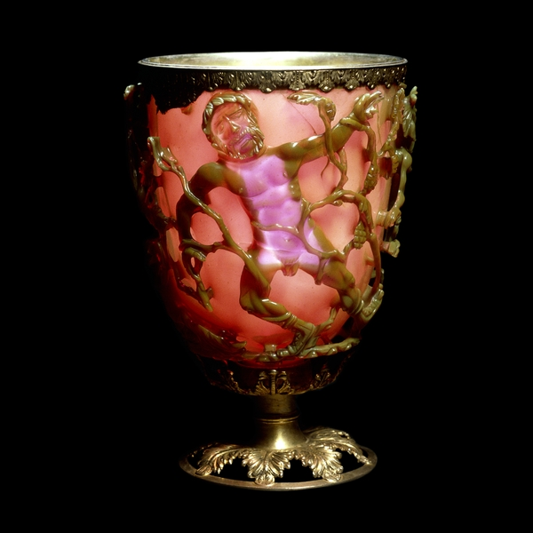
Early Nanotechnologists
Lycurgus Cup
http://www.britishmuseum.org/explore/highlights/highlight_objects/pe_mla/t/the_lycurgus_cup.aspx
Notes:
Trainer Notes: (OPTIONAL EXTRA SLIDE)
Explain that while the term nanotechnology is new, in fact artisans have been making and working with nanoparticles for millenia.
The Lycurgus [lie∙KUR∙guss] cup is a stunning example of dichroic (“two colors”) glass from the late Roman period (4th century AD). The cup appears green in reflected light and red when lit from behind. Modern analysis revealed the glass contains 50-100 nm particles of a silver-gold alloy. These small size of these particles is responsible for the dichroic effect.
There are many other examples of the shape-shifting nature of nanomaterials.
The cup depicts the triumph of Dionysus over King Lycurgus who attacked one of Dionysus’s maenads, Ambrosia. She transforms herself into a vine and holds him captive while Dionysus sets his followers to kill him.

Slide 24

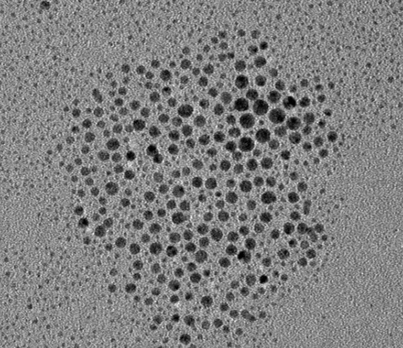
Would you buy this gold?
Gold (~ 10 nm)
Bulk Gold (Au) = Yellow
Conductive
Nonmagnetic
Chemically inert
Nano Gold = Red
Loses conductivity at ~ 1-3 nm
Becomes magnetic ~ 3 nm
Explosive and catalytic!
Notes:
Trainer Notes:
Prompt the audience to list some of the properties of bulk gold: lustrous (shiny), ductile (can be drawn into wires), malleable (can be pounded into sheets), yellow color, inert (doesn’t easily react chemically, especially with atmospheric oxygen) and nonmagnetic. These qualities make gold extremely valuable because it can be shaped into various forms, doesn’t corrode and is pleasing to the eye.
But what about nanogold?
Well if you take gold down to the nanoscale it becomes red (10 nm)! Or green or blue, depending on the size.
It also
Melts at a lower temperature (830°C for a 5-nm particle and 350°C at 2 nm vs. 1064°C for bulk gold);
Ceases to be metallic between 1-3 nm but becomes magnetic at that size AND
Becomes an excellent catalyst!
IMPLICATION FOR WORKERS: You cannot assume that you understand the behavior of a nanomaterial just because you understand the same material at the atomic/molecular or macroscopic levels.

Slide 25
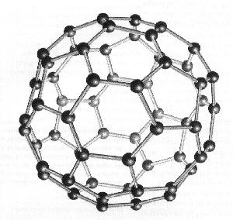

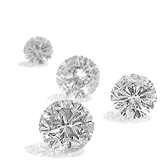

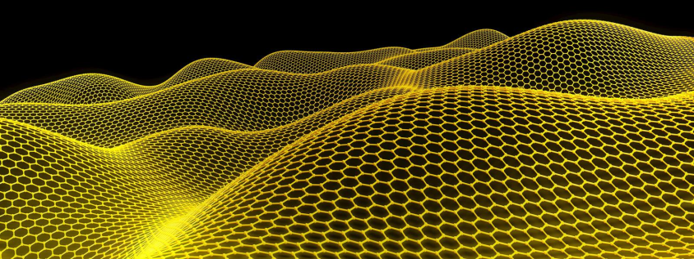
Effects of Nanoscale
Nanoscale Carbon
Structural differences:
Bulk Carbon
C₆₀ (Buckeyball)
1996 Nobel Prize
Carbon Nanotubes
Sumio Iijima - 1991
Graphite
Diamond
Graphene 2010 Nobel Prize

Slide 26
Definitions and commonly used terms

Slide 27
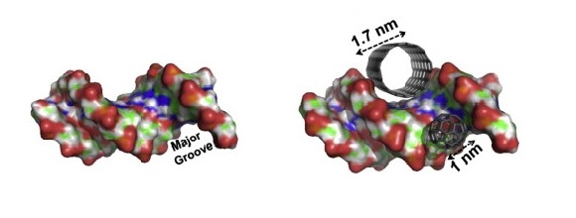
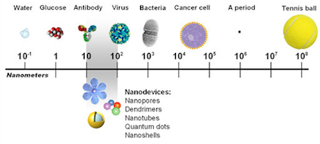
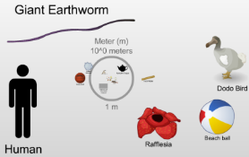
What is nano?
  Nanotechnology is science, engineering, and technology conducted at the nanoscale (about 1 to 100 nanometers)
  Nano can refer to technologies, materials, particles, objects – we are focusing on nanomaterials as these are already being used in workplaces more widely
  A sheet of paper is about 100,000 nanometers thick, a human hair is around 80,000- 100,000 nanometers wide
Human hair and a sheet of paper
The Scale of the Universe video
References:
http://www.cancer.gov/researchandfunding/snapshots/nanotechnology
http://www.nano.gov/nanotech-101
Yanamala N, Kagan VG and Shvedova AA (2013), Adv. Drug Del. Rev. 65, 2070-2077. "Molecular modeling in structural nano-toxicology: Interactions of nano-particles with nano-machinery of cells".
http://htwins.net/scale2/

Slide 28
Different Types of Nanomaterials
Naturally Occurring | Human Origin (Incidental) | Human Origin (Engineered)
Forest fires | Cooking smoke | Metals
Sea spray | Diesel exhaust | Quantum dots
Mineral composites | Welding fumes | Buckyballs/Nanotubes
Volcanic ash | Industrial effluents | Sunscreen pigments
Viruses | Sandblasting | Nanocapsules
Nanotechnology
Notes:
Trainer Notes:
The items in the table are just some examples. There are others.
Another important distinction to make is whether the particle is naturally occurring, of human origin but unintentionally produced or intentionally engineered for a specific purpose.
Naturally occurring: There are many examples of materials that satisfy the size requirements of the nanoscale but that are produced naturally rather than in a factory or research lab. Combustion products (e.g., from a forest fire) and volcanic ash are both composed of a range of substances and particle sizes, some of which are on the nanoscale. Viruses could even be considered nanoscale particles.
Human Origin (incidental): Humans engage in many activities that produce nanoscale particles as an unintentional waste product of the process. Workers may be familiar with examples from welding, sandblasting or other industrial processes. Some of these particles have been implicated in unwanted public or occupational health outcomes.
Human Origin (Engineered): When we speak in this course about nanomaterials we will be talking about the third class shown in the table, the particles that have been intentionally designed to be in the nanoscale and are being studied or used commercially because of their novel properties. Some examples, about which more will be presented later, include nanoscale metals such as nanosilver, semiconducting nanoparticles known colloquially as quantum dots, carbon-based nanomaterials such as nanotubes, ceramic (metal oxide) nanoparticles such as titanium dioxide which is found in sunscreens, and polymeric hydrocarbon-based nanoparticles such as capsules used for drug delivery.
The main differences between Incidental and Engineered nanomaterials are that Engineered nanomaterials are intentionally designed to exploit a novel feature that accompanies the small size and are typically more well-controlled than randomly produced Incidental nanomaterials.

Slide 29
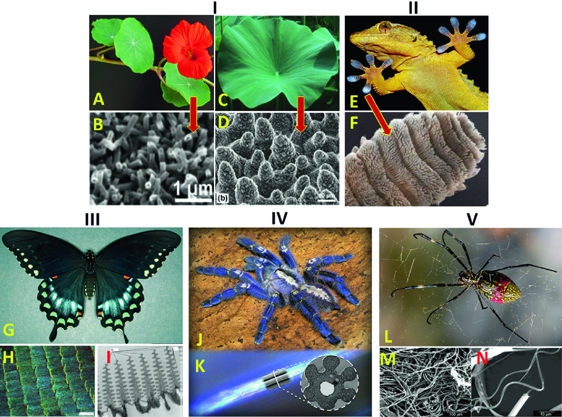
Natural sources of nanomaterials

Slide 30


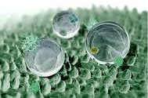
Natural sources of nanomaterials
Biological systems often feature functional nanomaterials.
Lotus effect, hydrophobic effect
with self-cleaning ability
vetri autopulenti
lenti antigraffio
finestre autopulenti
parabrezza e schermi più robusti
vestiti smart
Grafene based films

Slide 31

Self-Cleaning Glass
What is it?
Thin film of TiO₂ bonded to glass
Advantages
Reduces energy usage
Self-cleaning glass
Reduces cost and effort of cleaning glass
Why Nano?
Film doesn’t change glass color
Nano-size enhances the photocatalytic effect
PPG Industries
Notes:
Trainer Notes:
In self-cleaning glass, a thin film of titanium dioxide (TiO₂ or titania) is bonded to glass. Upon exposure to UV from sunlight, the titania catalyzes breakdown of dirt. Rainwater then washes dirt away. The film also creates a hydrophobic surface which causes water to flow in sheets rather than beading up. As a result, little to no streaking occurs after water evaporates.
This coating can also be made to reflect UV light which can result in greater energy efficiency for the building due to reduced air-conditioning costs.

Slide 32

Small Change, Big Savings
What is it?
Thin film of polymer bonded to paint
Advantages
Reduces friction-causing debris build-up on plane surface
Reduces fuel consumption 1-2%  ~$22 million
Why Nano?
Film adds a mere 4 oz to weight of the jet (compared to 176 pounds of paint)
https://www.bbc.com/news/business-12428667
Notes:
Trainer Notes:
UK-based airline Easy Jet is testing a new nanotechnology coating on 8 of its jets in hopes that it can reduce fuel consumption by as much as 2% per jet per year. The coating fills in all the tiny crevices in the surface of the paint, creating an ultra-smooth, low-friction surface that repels debris and reduces drag. For an airline that spends nearly $1.2 billion in fuel per year, the coating could save them 10’s of millions of dollars.
If you have time and Internet access, click on the image to open the website and play a one-minute video
Credit: http://www.bbc.co.uk/news/business-12428667

Slide 33
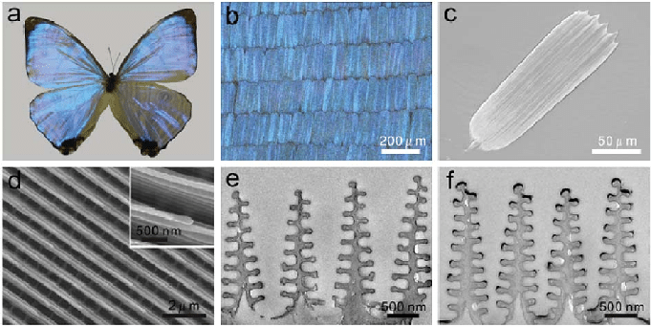
Natural sources of nanomaterials
Biological systems often feature functional nanomaterials.

Slide 34
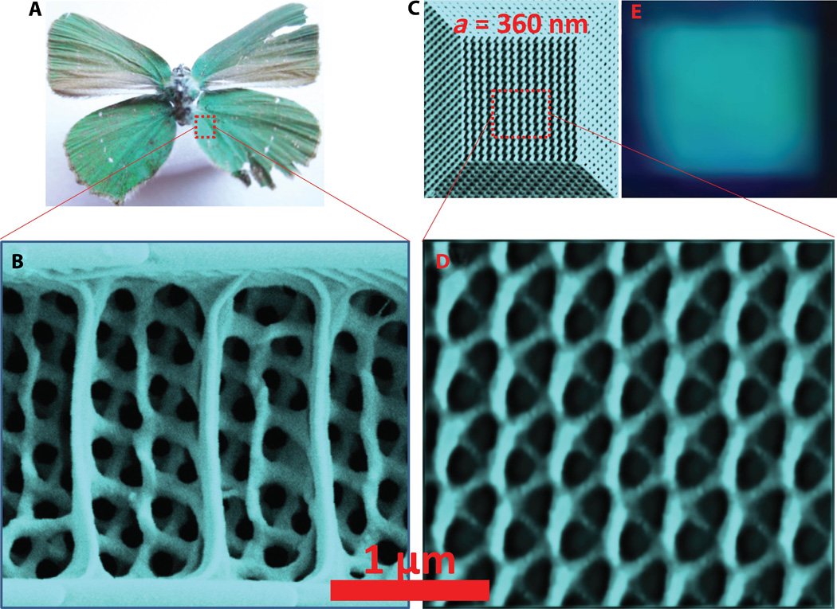
Natural sources of nanomaterials
Sensors, textile, photoapplications….

Slide 35
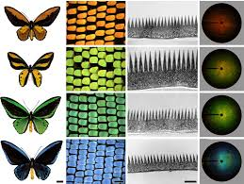
Natural sources of nanomaterials
Biological systems often feature functional nanomaterials.

Slide 36
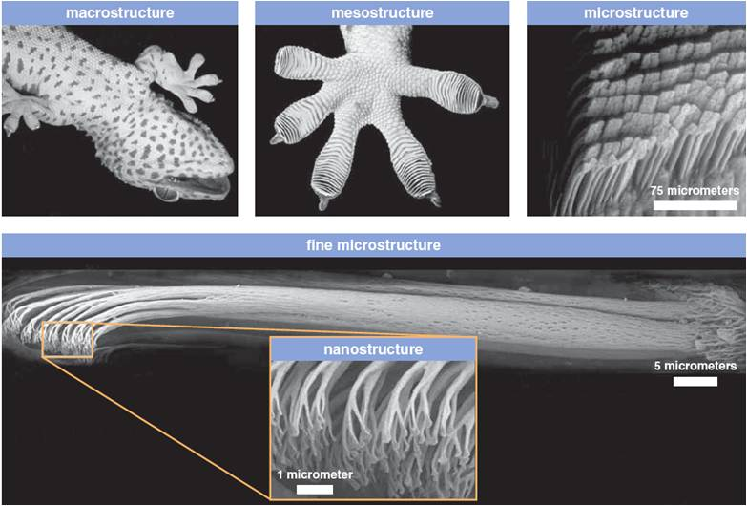
Natural sources of nanomaterials
The "spatulae" on the bottom of gecko feet

Slide 37
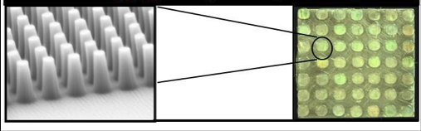
Natural sources of nanomaterials
The "spatulae" on the bottom of gecko feet
Artificial replica

Slide 38
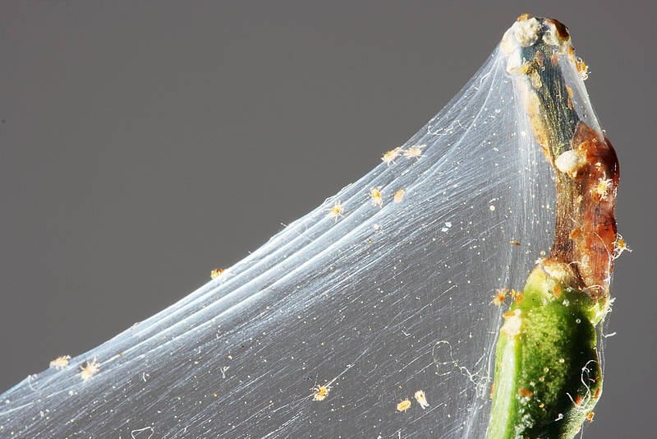
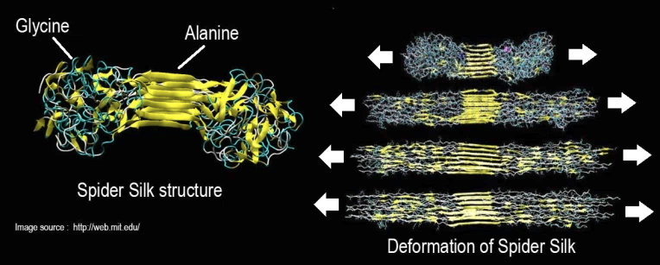
Sources of nanomaterials
Spider silk: nanomaterial that can stop a jumbo jet in the midflight

Slide 39
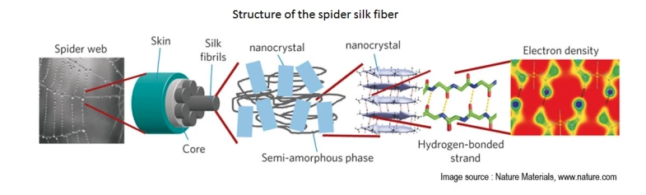
Sources of nanomaterials

Slide 40
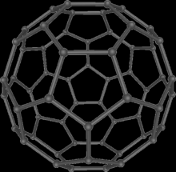
Sources of nanomaterials
Incidental
Nanomaterials may be incidentally produced as a byproduct of mechanical or industrial processes.
vehicle engine exhausts, welding fumes, combustion processes from domestic solid fuel heating and cooking.
VEHICLES
Soot from fuel combustion
Attrition of tires (cars 70 mg/Km, trucks 1 g/Km
Attrition of clutches (3 mg/Km)
Attrition of brakes (20 mg/Km)
Engine wear
Catalyst (0.0005 mg/km of metal oxides)
Fiber-particles from silencers

Slide 41
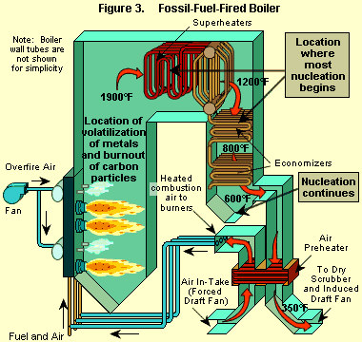
Particulate formation: Combustion particles burnout
Fossil-Fuel-Fired Boiler
Injection of fuel particles
Volatile organic compounds are vaporized and oxidized
ash and char formation

Slide 42
Particulate formation hypothesis of radicals
Formation of aromatic rings
PAH
(Polycycle Aromatic Hydrocarbons)
CH₄
Methane fuel
Desorption
Pyrolise
Chemical condensation
Pyrens
Reactive small molecules and radicals
Graphitisation
• CH₃
Methylradical
H
C
C
H
Acetylene
Corones
Desorption
• C₃H₃
Propargylradical
• C₆H₅
Phenylradical
Ovalenes

Slide 43
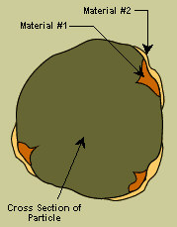
Particulate formation: Homogeneous and heterogeneous nucleation
Homogeneous nucleation is the formation of new particles composed almost entirely of the vapor phase material (one compound).
Heterogeneous nucleation is the accumulation of material on the surfaces of existing particles (more than one compound).

Slide 44
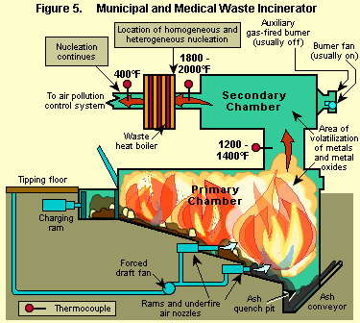
Particulate formation: Homogeneous and heterogeneous nucleation
Municipal and medical waste Incinerator
Condensation of
1. metal/metal oxides like Hg, Pb, Cd; As…
2. Organic compounds

Slide 45
Nanotechnology and Nanoscience:
There are many definitions of these terms. (Home work – find some!)
We will define it as science and technology of structures
made of materials or composites of inorganic and organic materials where at least one dimension is
less than 100 nm, and in addition new phenomena are observed which result from such a small size.
ISO/TS 80004 defines nanomaterial as the "material with any external dimension in the nanoscale or having internal structure or surface structure in the nanoscale", with nanoscale defined as the "length range approximately from 1 nm to 100 nm". This includes both nano-objects, which are discrete pieces of material, and nanostructured materials, which have internal or surface structure on the nanoscale.

Slide 46
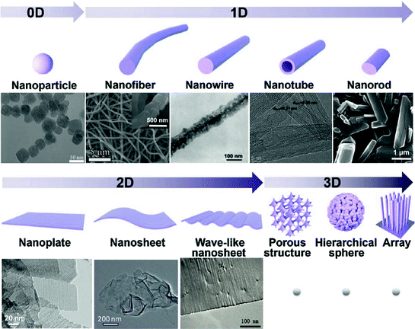
Nanomaterials

Slide 47
Zero-dimensional
A material with all three external dimensions in the nanoscale.
One-dimensional nanostructures
The smallest possible crystalline wires with cross-section as small as a single atom can be engineered in cylindrical confinement.
Two-dimensional nanostructures
2D nanomaterials are materials consisting of a two-dimensional single layer of atoms. The most important representative graphene was discovered in 2004. Thin films with nanoscale thicknesses are considered nanostructures, but are sometimes not considered nanomaterials because they do not exist separately from the substrate.
3D nanostructured materials
Bulk materials that contain features on the nanoscale, including nanocomposites, nanocrystalline materials, nanostructured films, and nanotextured surfaces.

Slide 48
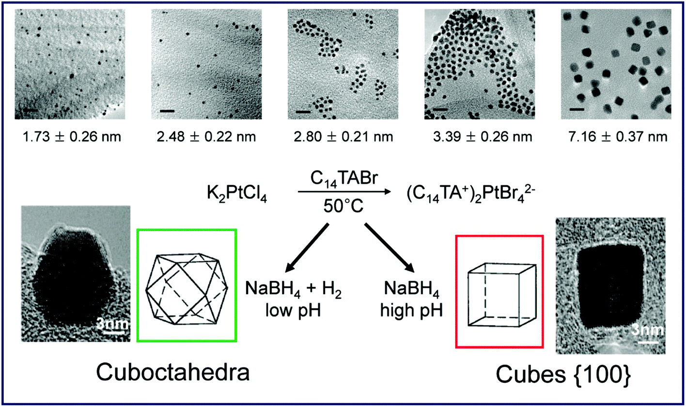
Nanomaterials: Nanoparticle
A nanoparticle is defined a nano-object with all three external dimensions in the nanoscale, whose longest and the shortest axes do not differ significantly.

Slide 49
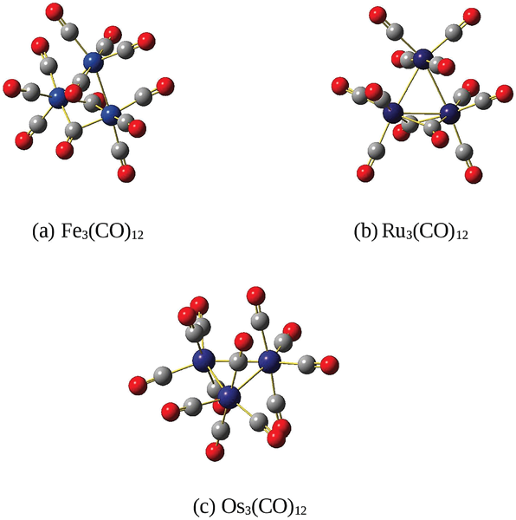
Nanomaterials: Nano and sub nanoparticle
Nanoparticles are smaller than "fine particles“ 100 and 2500 nm.
They are a subclass of the colloidal particles: 1 to 1000 nm.
Metal particles smaller than 1 nm are usually called atom clusters instead (sometimes subnanometer particles).

Slide 50
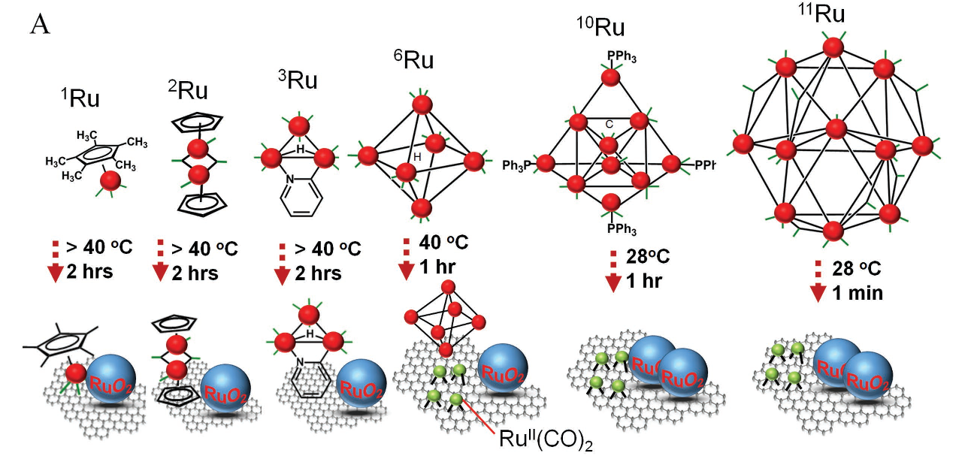
Nanomaterials: Nanoparticle
Metal clusters precursors for nanoparticles and model of surfaces.
Stability, effect of ligands removal,….

Slide 51
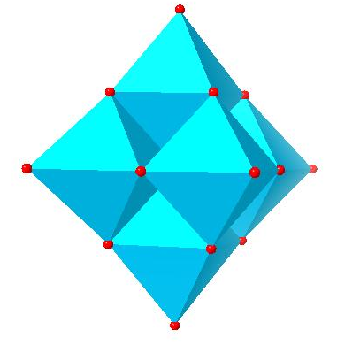


Nanomaterials: Polyoxometalates
POM is a polyatomic ion, usually an anion, that consists of three or more transition metal oxyanions linked together by shared oxygen atoms to form closed 3-dimensional frameworks.
The metal atoms are usually group 6 (Mo, W) or less commonly group 5 (V, Nb, Ta) transition metals in their high oxidation states.
Isopolymetalates are composed of only one kind of metal and oxide
Hexamolybdate, Mo₆O²⁻₁₉
Sodium decavanadate Na₆[V₁₀O₂₈]
Mo₃₆-polymolybdate, Mo₃₆O₁₁₂(H₂O)₁₆⁸⁻

Slide 52

Nanomaterials: Polyoxometalates
Heteropolymetalates are composed of one metal oxide, and a main group oxyanion (phosphate, silicate, etc.).
The phosphotungstate anion
PW₁₂O₄₀³⁻ consists of a framework of twelve octahedral tungsten oxyanions surrounding a central phosphate group.

Slide 53



Being much smaller than the wavelengths of visible light (400-700 nm), nanoparticles cannot be seen with ordinary optical microscopes, requiring the use of transmission electron microscopy.
http://www.rsc.org/suppdata/c9/nr/c9nr02731a/c9nr02731a1.gif
Dispersions of nanoparticles in transparent media can be transparent, whereas suspensions of larger particles usually scatter some or all visible light incident on them.
Nanoparticles also easily pass through common filters, such as common ceramic devices, so that separation from liquids requires special nanofiltration techniques.

Slide 54

Nanomaterials:
A nanofiber has two external dimensions in the nanoscale.
Filtration
Catalysis
Tissue engineering
Drug delivery
batteries
Inorganic or polimeric

Slide 55



Nanomaterials:
Nanotubes are hollow nanofibers.
C nanotubes
TiO₂ nanotubes

Slide 56


Nanomaterials:
Nanorods are solid nanofibers.
Gold nanoroads
TiO₂ nanoroads

Slide 57


Nanomaterials: Nanoplates
A nanoplate has one external dimension in the nanoscale, and if the two larger dimensions are significantly different it is called nanoribbon.
Gold nanoplate
ZnO nanoplate

Slide 58

Nanomaterials: Nanoribbons
If the two larger dimensions are significantly different it is called nanoribbon.

Slide 59
Nanomaterials: Nanoribbons
(a)Intercalation-exfoliation of MWCNTs, involving treatments in liquid NH₃ and Li, and subsequent exfoliation using HCl and heat treatments,
(b) a chemical route involving acid reactions that start to break carbon-carbon bonds (e.g. using H₂SO₄ and KMnO₄ as oxidizing agents),
(c) a catalytic approach, in which metal nanoparticles 'cut' the nanotube longitudinally like a pair of scissors, (d) an electrical method by passing an electric current through a nanotube
(e) a physicochemical method by embedding the tubes in a polymer matrix followed by Ar plasma treatment.
(f ) The resulting structures are either GNRs or graphene sheets

