Slide 1
Energie Rinnovabili
Laurea Magistrale in Chimica
Trieste, Marzo 2023
Prof. Federico ROSEI
Dipartimento di Scienze Chimiche e Farmaceutiche federico.rosei@units.it
C11, Aula 9

Slide 2
n.1:
Sustainable development: UN definition
The 17 Sustainable Development Goals (SDGs): these include n.7 (affordable and clean energy) and n.13 (climate action).
Can we develop a model for sustainability?

Slide 3
United Nations Definition of Sustainable Development
“Meeting the needs of the present without compromising the ability of future generations to meet their own needs.”
Soddisfare i bisogni della presente generazione senza compromettere le possibilità delle future generazioni di soddisfare i loro
An Oxymoron?

Slide 4
Sustainable Development
Requires the integration of environmental, economic & social priorities into policies & programs

Slide 5
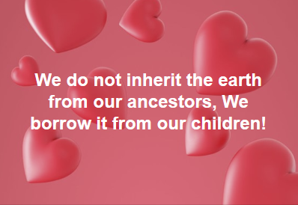

Slide 6
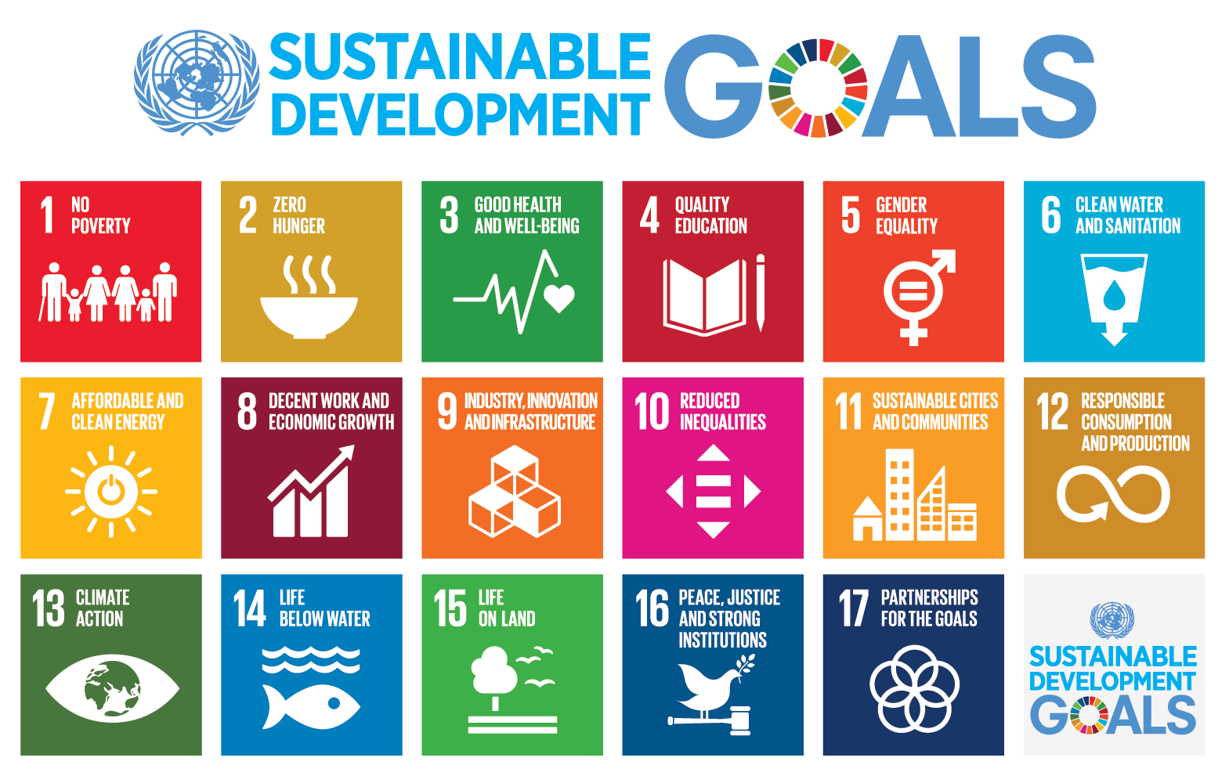

Slide 7
‘Simplified SDGs’
Energy (Renewable)
Education
(Training, knowledge transfer)
Food
Health
Environment
(Water)
Sustainable Consumption
and Production

Slide 9
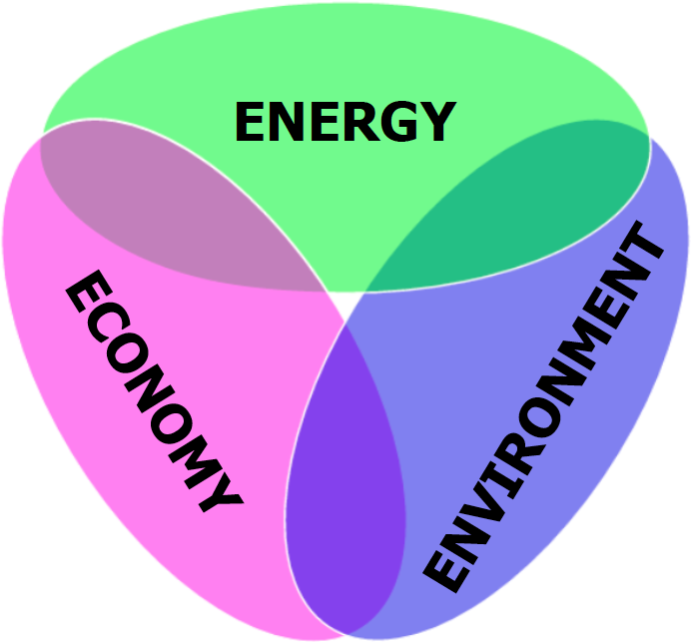
The Energy Trilemma

Slide 11
Worldwide Societal Challenges
(Broad, General => affect everybody)
Clean and sustainable energy
Preserving and protecting the environment
Improving our health and quality of life
“Our generation will ultimately be defined by how we live up to the energy challenge”
The Future of Energy Supply: Challenges and Opportunities; N. Armaroli, V. Balzani, Angew. Chem. Int. Ed. 2007, 46, 52.

Slide 12
Energy: an essential need
Energy: what is it for?
We take it for granted. (Not so in the past… may not be so in the future!)
What happens when there’s none
World Energy consumption vs. present sources
Environmental Consequences

Slide 13

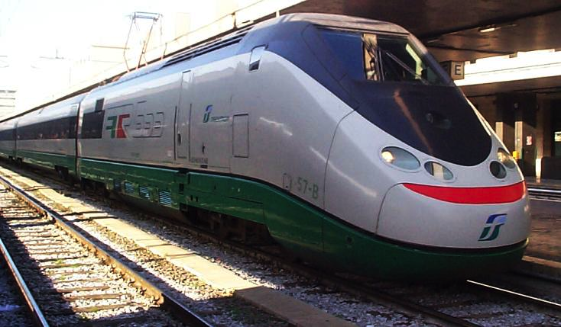
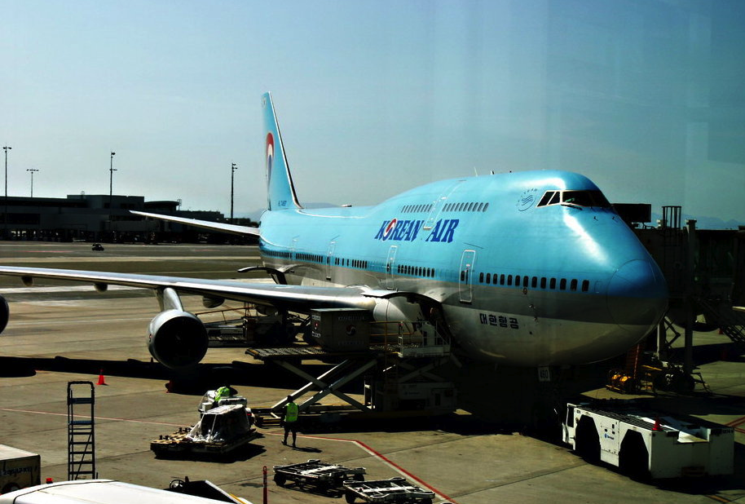
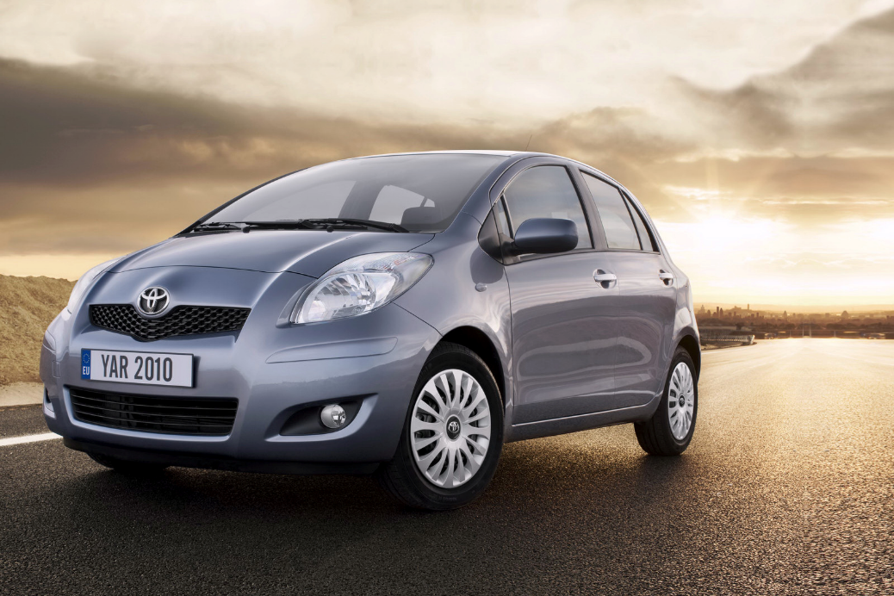
Energy for Transport

Slide 14
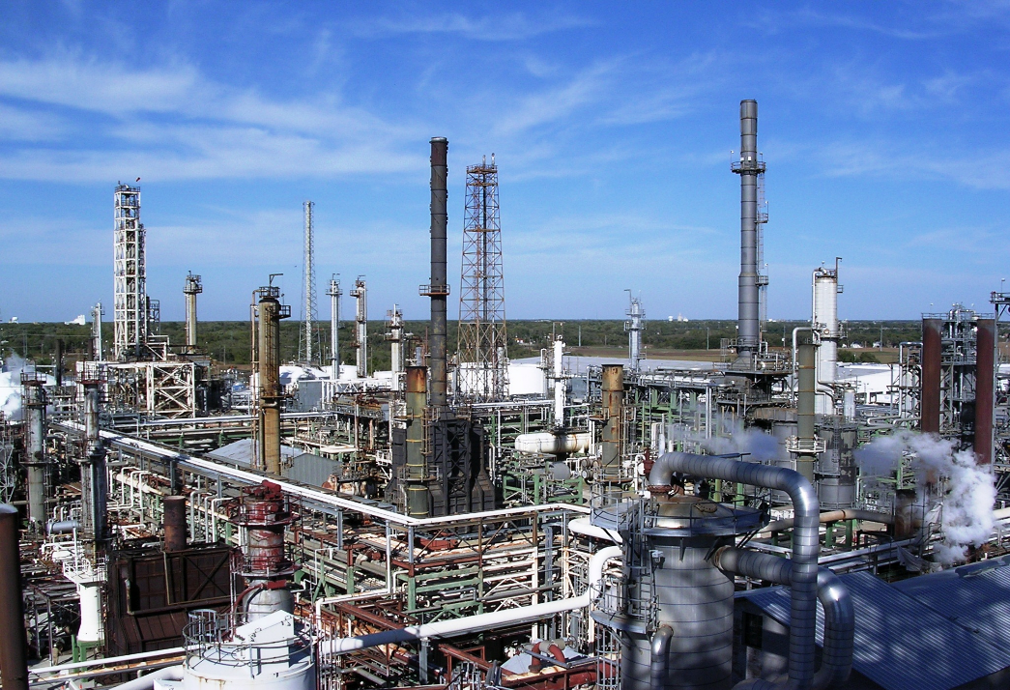
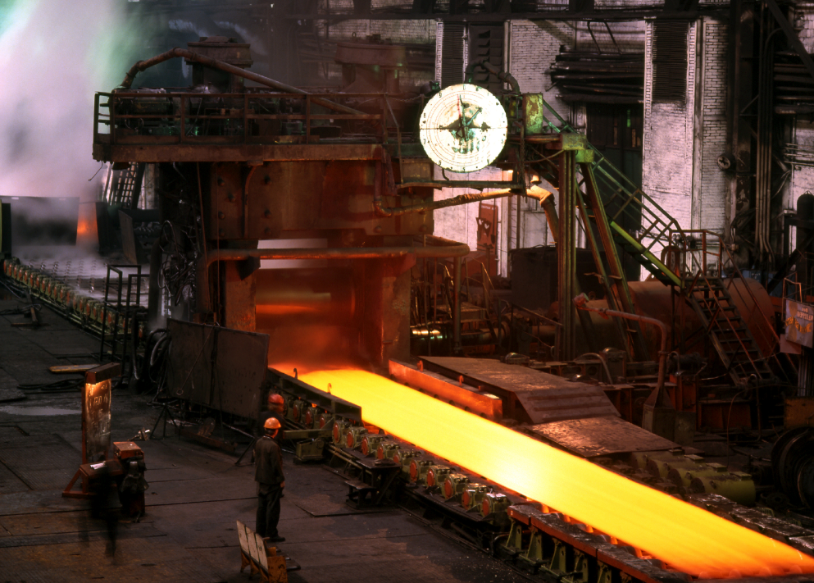
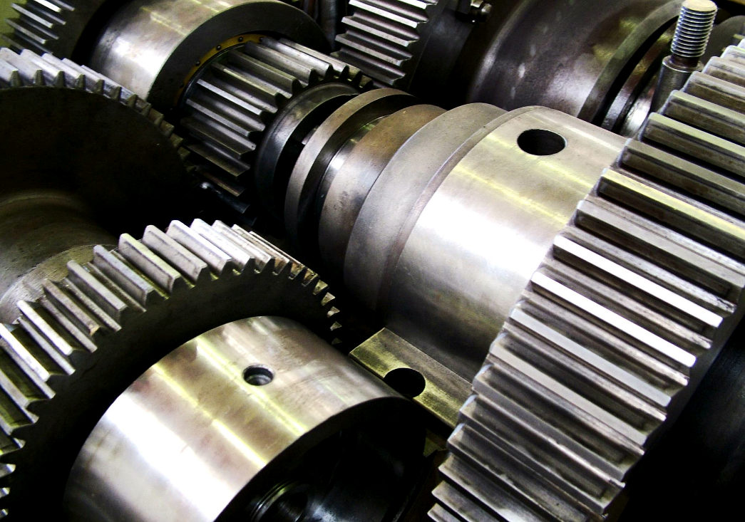
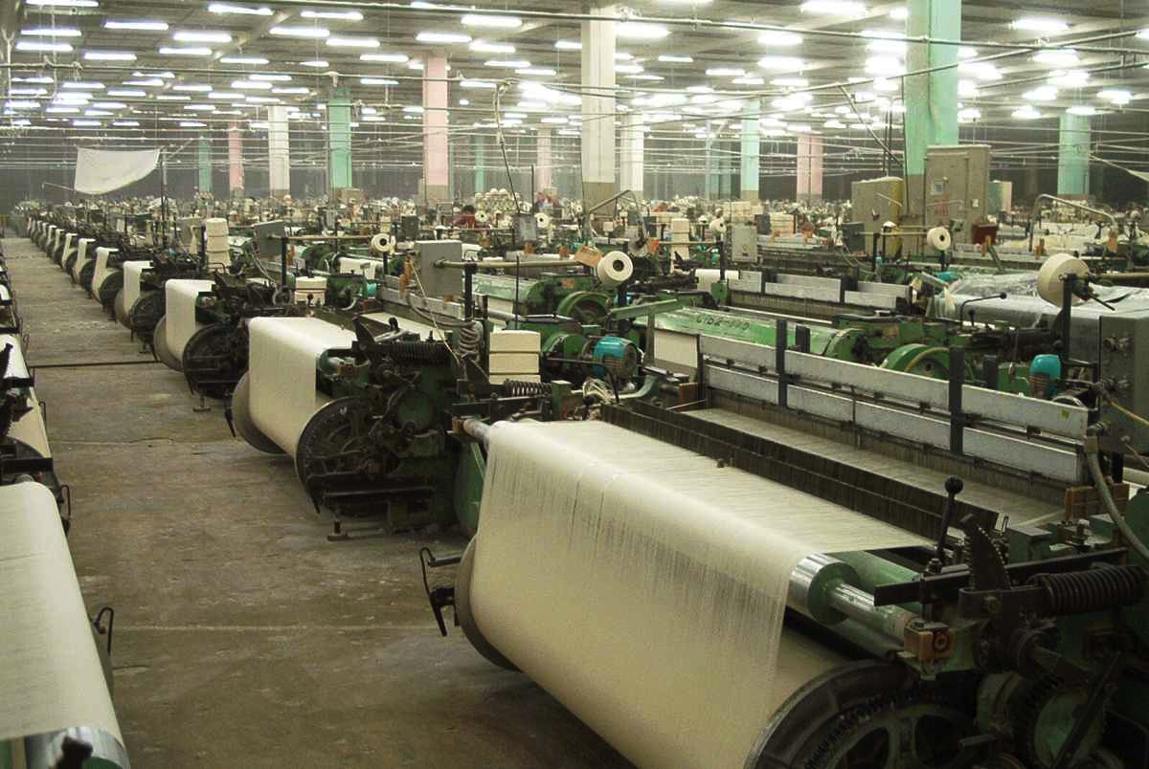
Energy for Industry

Slide 15
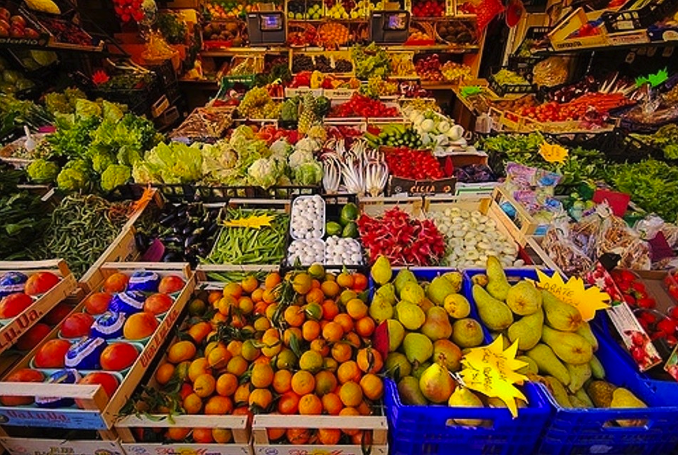
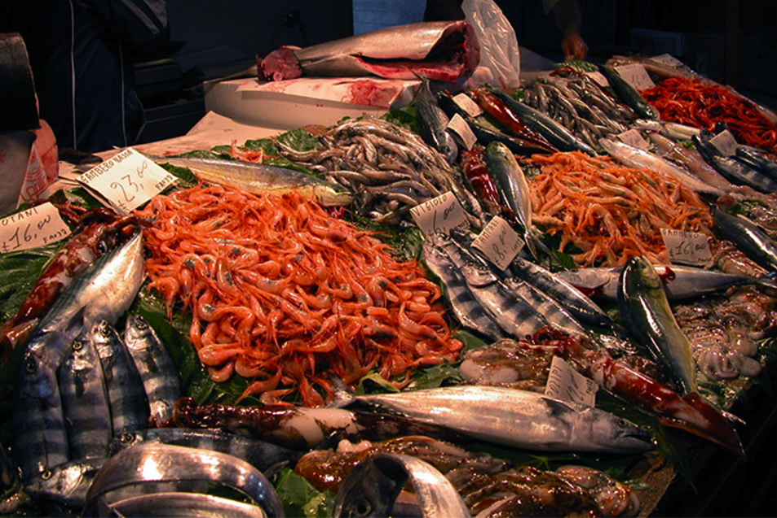
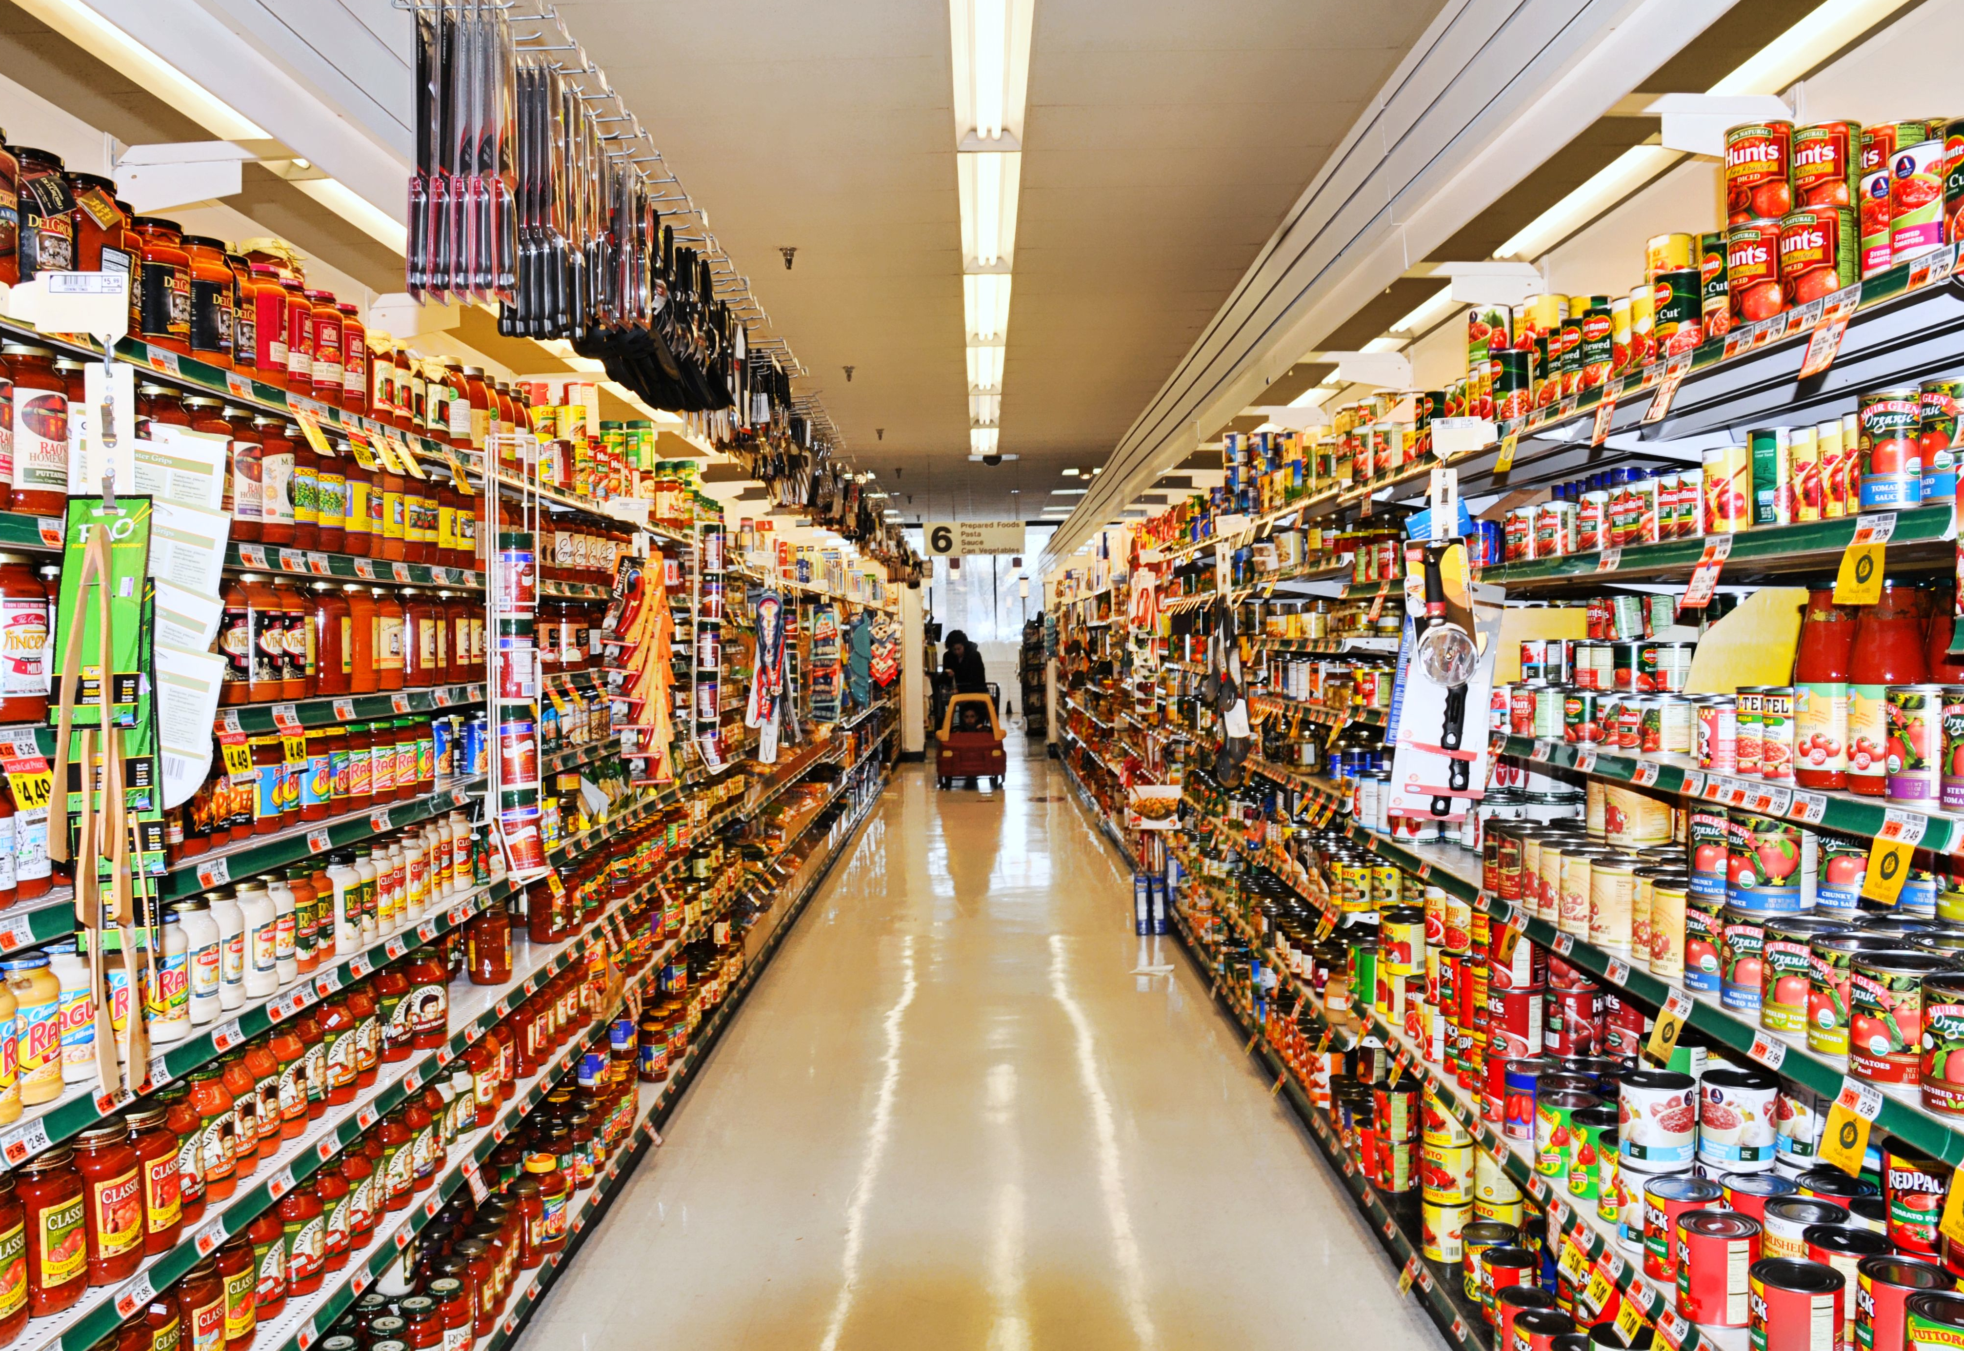
Energy for Food

Slide 16
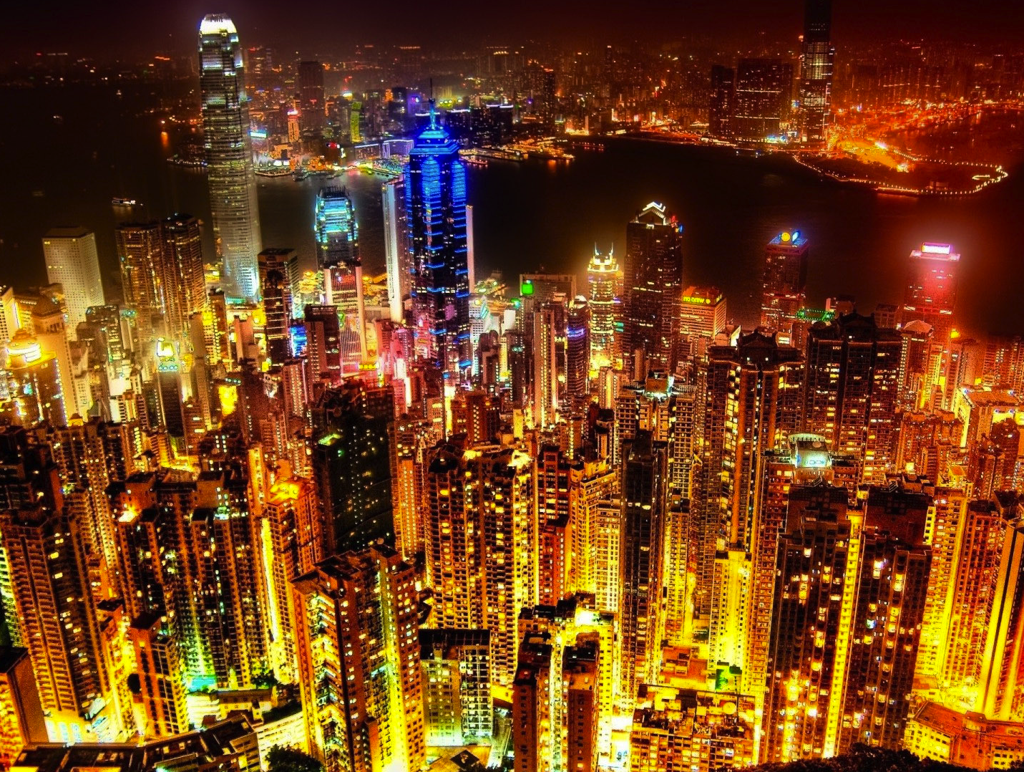
Energy for illumination

Slide 17
What is it, Charlie Brown?
I believe it is an old
washing machine…
Really!? And.. where
is the plug???

Slide 18
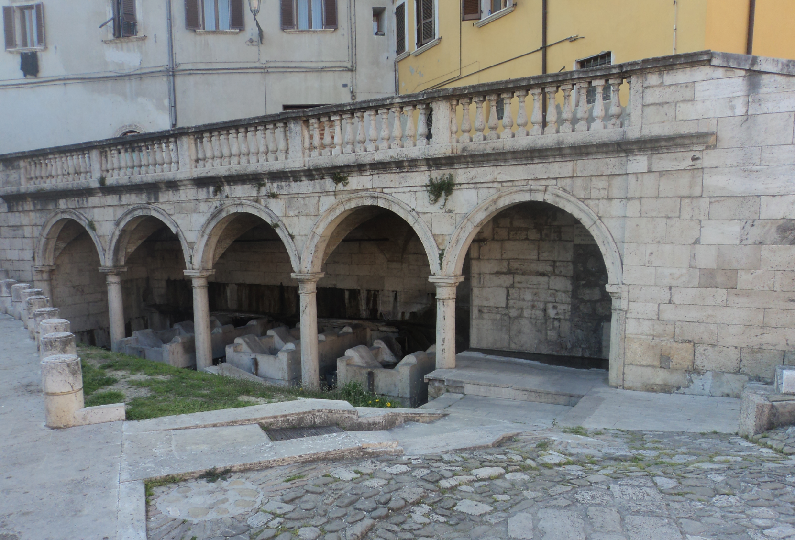
Ascoli Piceno, Italy. Public laundry

Slide 19
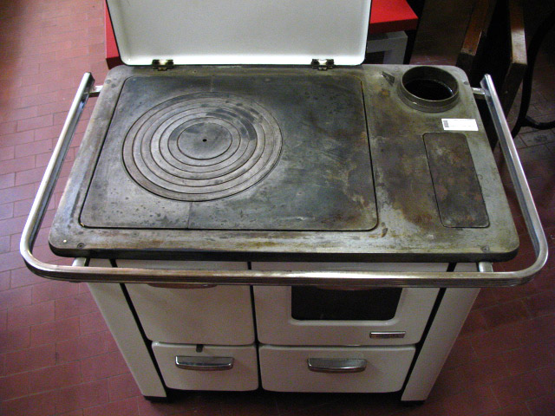
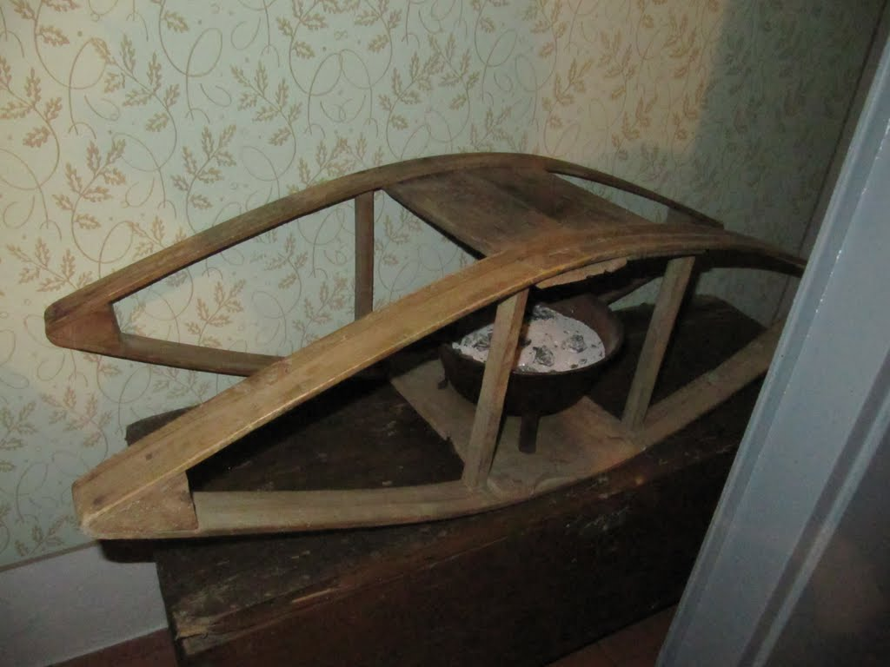
Wood heater
Embers bed preheater
“Yesterday” it was often the only heating element in the house
People had to wake up early to fire it
Place embers in hand-heater, then the entire contraption inside the bed half an hour before going to sleep

Slide 20

Transportation
yesterday
today
One of my great grandfathers owned a carriage & horse
Power (literally) 1 HP
I own a Toyota Yaris
Power about 100 HP

Slide 21
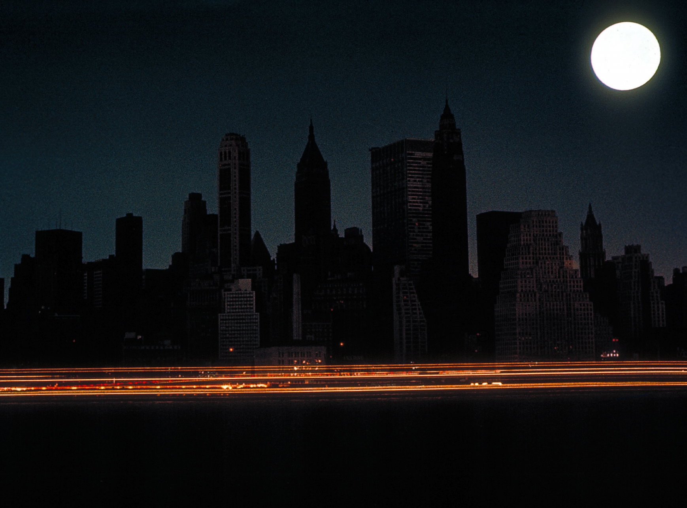
New York City Blackout 2003
Energy is like health… We sorely miss it when it is gone!

Slide 22
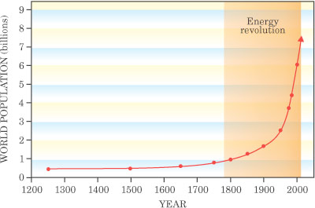
World energy consumption increases continuously
Oil (in general: *non-renewable* fossil fuels) is still the most widely used Fuel of modern society
World population increases at a rate of ~200.000 inhabitants per day
(70 million per year)
Source: Physics Today

Slide 23
Population
Population is the key towards attaining sustainability,
Or failing
More people:
Need more energy, more food, more clean water, more jobs, will pollute more, increase carbon emissions, produce more waste…

Slide 24
Can we develop a model for sustainability?
What would be the variables in the model?
Population; Energy (renewable vs. non-renewable); Food; Land; CO₂ emissions; …
Predator/Pray model

Slide 25
The Hadza: sustainable living
About 1000 Hadza live in their traditional homeland, a broad plain encompassing shallow, salty Lake Eyasi, sheltered by the Great Rift Valley.
About 25% Hadza are true hunter-gatherers.
They maintained their lifestyle so long because their homeland has never been an inviting place. The soil is briny; fresh water is scarce; the bugs intolerable.
For tens of thousands of years no one else wanted to live here, so they were left alone.

Slide 26
The Hadza: sustainable living
Recent escalating population pressures brought a flood of people into Hadza lands.
The fact that the Hadza are such gentle stewards of the land has hurt them—the region has generally been viewed by outsiders as empty and unused, in need of development.
The Hadza, who by nature are not a combative people, almost always moved away rather than fight. Now there is nowhere to retreat.

Slide 27
The Hadza: sustainable living
They have no crops, no livestock, no permanent shelters. They live just south of the valley in which the oldest fossils of early humans were found.
Gene­tic testing indicates they represent one of the primary roots of the human family tree—more than 100,000 years old.
They offer a glimpse of what life was like before the birth of agriculture 10,000 years ago.
They maintained their foraging lifestyle despite long exposure to surrounding agriculturalist groups.
Their lives changed very little over the ages.

Slide 28
The Hadza: sustainable living
For >99% of the time since the genus Homo arose two million years ago, humans lived as hunter-gatherers.
Domestication of plants and animals => complete reorganization of the globe.
Food production => greater population densities => farm-based societies displaced or destroyed hunter-gatherer groups.
Villages were formed, then cities, then nations. In a brief period, the hunter-gatherer lifestyle was almost extinguished.

Slide 29
The Hadza: sustainable living
Today only a handful of scattered peoples—in the Amazon, the Arctic, Papua New Guinea, and a few African groups—maintain a primarily hunter-gatherer existence.
Agriculture’s sudden rise came with a price:
Introduced infectious-disease epidemics, social stratification, intermittent famines, and large-scale war.
UCLA professor J. Diamond called the adoption of agriculture "the worst mistake in human history“, from which we never recovered.

Slide 30
The Hadza: sustainable living
The Hadza do not engage in warfare. They never lived densely enough to be seriously threatened by an infectious outbreak.
They have no known history of famine. Their diet remains even today more stable and varied than that of most of the world’s citizens.
They enjoy an extraordinary amount of leisure time: they “work”—actively pursue food—four to six hours a day.
And over all these thousands of years, they left hardly more than a footprint on the land.

Slide 31
Sustainable / Development
A contradiction in terms?

