Slide 1
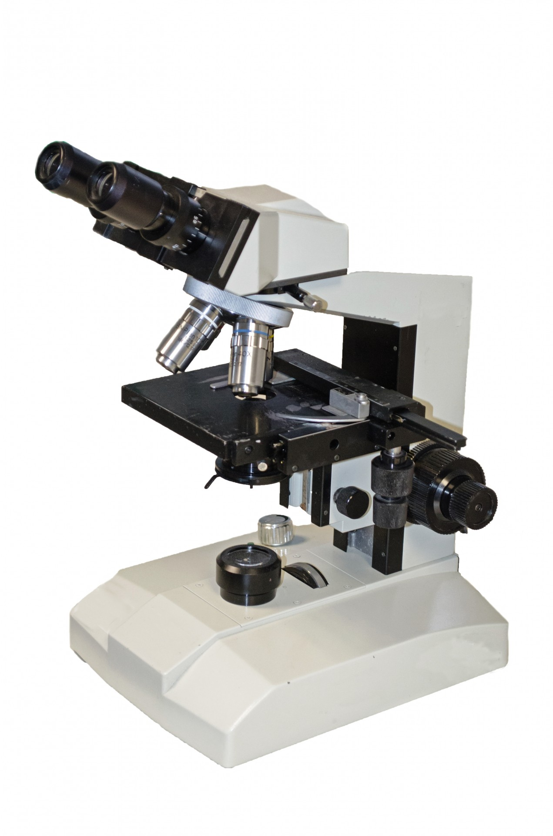
MICROSCOPIA OTTICA IN BIOLOGIA CELLULARE [675SM]
MICROSCOPY IN CELL BIOLOGY –
aa 2022/2023, 2nd semester
Aula 5A, edificio H2bis 14-17 15-18
Agnes Thalhammer
agnes.thalhammer@units.it

Slide 2
MICROSCOPIA OTTICA IN BIOLOGIA CELLULARE [675SM]
date | lesson/lab | aula | time
01/03/23 | intro | aula5A, H2bis | 14-15 (GF and BT), 16-17 (NS)
08/03/23 | lesson1 | aula5A, H2bis | 15-18
15/03/23 | lab1 | sala microscopia F2, C1 | 15-18
22/03/23 | lesson2 | aula5A, H2bis | 15-18
29/03/23 | lab2 | sala microscopia F2, C1 | 15-18
05/04/23 | lesson3 | aula5A, H2bis | 15-18
19/04/23 | lesson4 | aula5A, H2bis | 15-18
tbn | lesson5 | aula5A, H2bis | tbn
tbn | lab3 | sala microscopia F2, C1 | tbn
tbn | lab4 | CIMA center | tbn
12 h lab + 16 h lessons

Slide 3
Lesson 1 - How a microscope works
1.1. Image formation
1.2. Magnification vs resolution
1.3. Numerical aperture and working distance
1.4. Objectives
1.5. Point-spread function and Airy disk
1.6. Optical abberations
2. Lab1 – Contrasting techniques
2.1. Brightfield
2.2. Darkfield
2.3. Phase Contrast
2.4. Polarization Contrast
2.5. Differential Interference Contrast (DIC)

Slide 4
3. Lesson 2 - Flourescence microscopy
3.1. Flourescence principle
3.2. Absorption and Emission spectra - Stoke’s shift
3.3. The flourescence microscope –
light sources, filter, dicroic mirror
3.4. Fluorophores
3.5. Staining with flourophores
3.6. Problems with flourescence imaging
3.7. Multichannel imaging
4. Lab2 - Flourescence microscopy

Slide 5
5. Lesson 3 – Confocal, super-resolution and 2-photon microscopy
5.1. TIRF microscopy
5.2. Confocal microscopy
5.3. 2-photon microscopy
5.4. Superresolution microscopy
5.4.1. SIM microscopy
5.4.2. STED microscopy
5.4.3. PALM microscopy
5.4.4. STORM microscopy
5.5. FRET microscopy
5.6. FRAP microscopy
lab4

Slide 6
6. Lesson4- Live-imaging techniques
6.1. Incubation
6.2. The life-imaging microscope
6.3. Contrasting techniques
6.4. Flourescent labelling of live cells
6.5. Resolution – Speed – Sensitivity
6.6. Examples

Slide 7
7. Lesson5 - Quantitative microscopy –
Imaging processing and analysis
7.1. Digital images
7.2. Resolution
7.3. Signal-to-noise
7.4. Sampling
7.5. Quantization
8. Lab3 – Image processing and analysis using ImageJ
8.1. Histogram and LUTs
8.2. Noise, Filters and Background
8.4. ROIs and measurements
8.5. Threshold, watershed and particle analysis
8.6. Live imaging analysis

