Slide 1
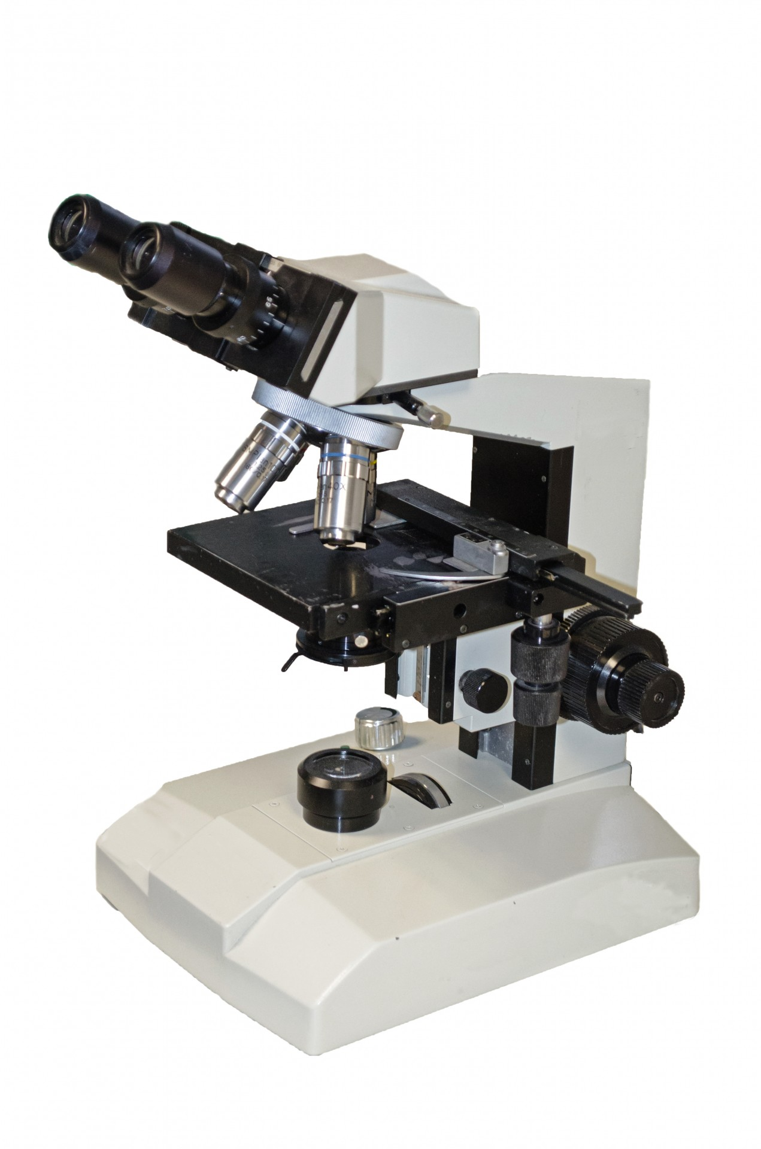
MICROSCOPIA OTTICA IN BIOLOGIA CELLULARE [675SM]
MICROSCOPY IN CELL BIOLOGY –
aa 2022/2023, 2nd semester
Aula 5A, edificio H2bis 15-18
Agnes Thalhammer
agnes.thalhammer@units.it

Slide 2
MICROSCOPIA OTTICA IN BIOLOGIA CELLULARE [675SM]
date | lesson/lab | aula | time
01/03/23 | intro | aula5A, H2bis | 14-15 (GF and BT), 16-17 (NS)
08/03/23 | lesson1 | aula5A, H2bis | 15-18
15/03/23 | lab1 | sala microscopia F2, C1 | 15-18
22/03/23 | lesson2 | aula5A, H2bis | 15-18
29/03/23 | lab2 | sala microscopia F2, C1 | 15-18
05/04/23 | lesson3 | aula5A, H2bis | 15-18
19/04/23 | lesson4 | aula5A, H2bis | 15-18
26/04/23 | lesson5 | aula5A, H2bis | 15-18
tbn | lab3 | sala microscopia F2, C1 | tbn
tbn | lab4 | CIMA center | tbn
12 h lab + 16 h lessons

Slide 3
OPTICAL MICROSCOPY
How a microscope works
2. Magnification vs resolution
Numerical aperture and working distance
Objectives
Point-spread function and Airy disk
Optical abberations

Slide 4
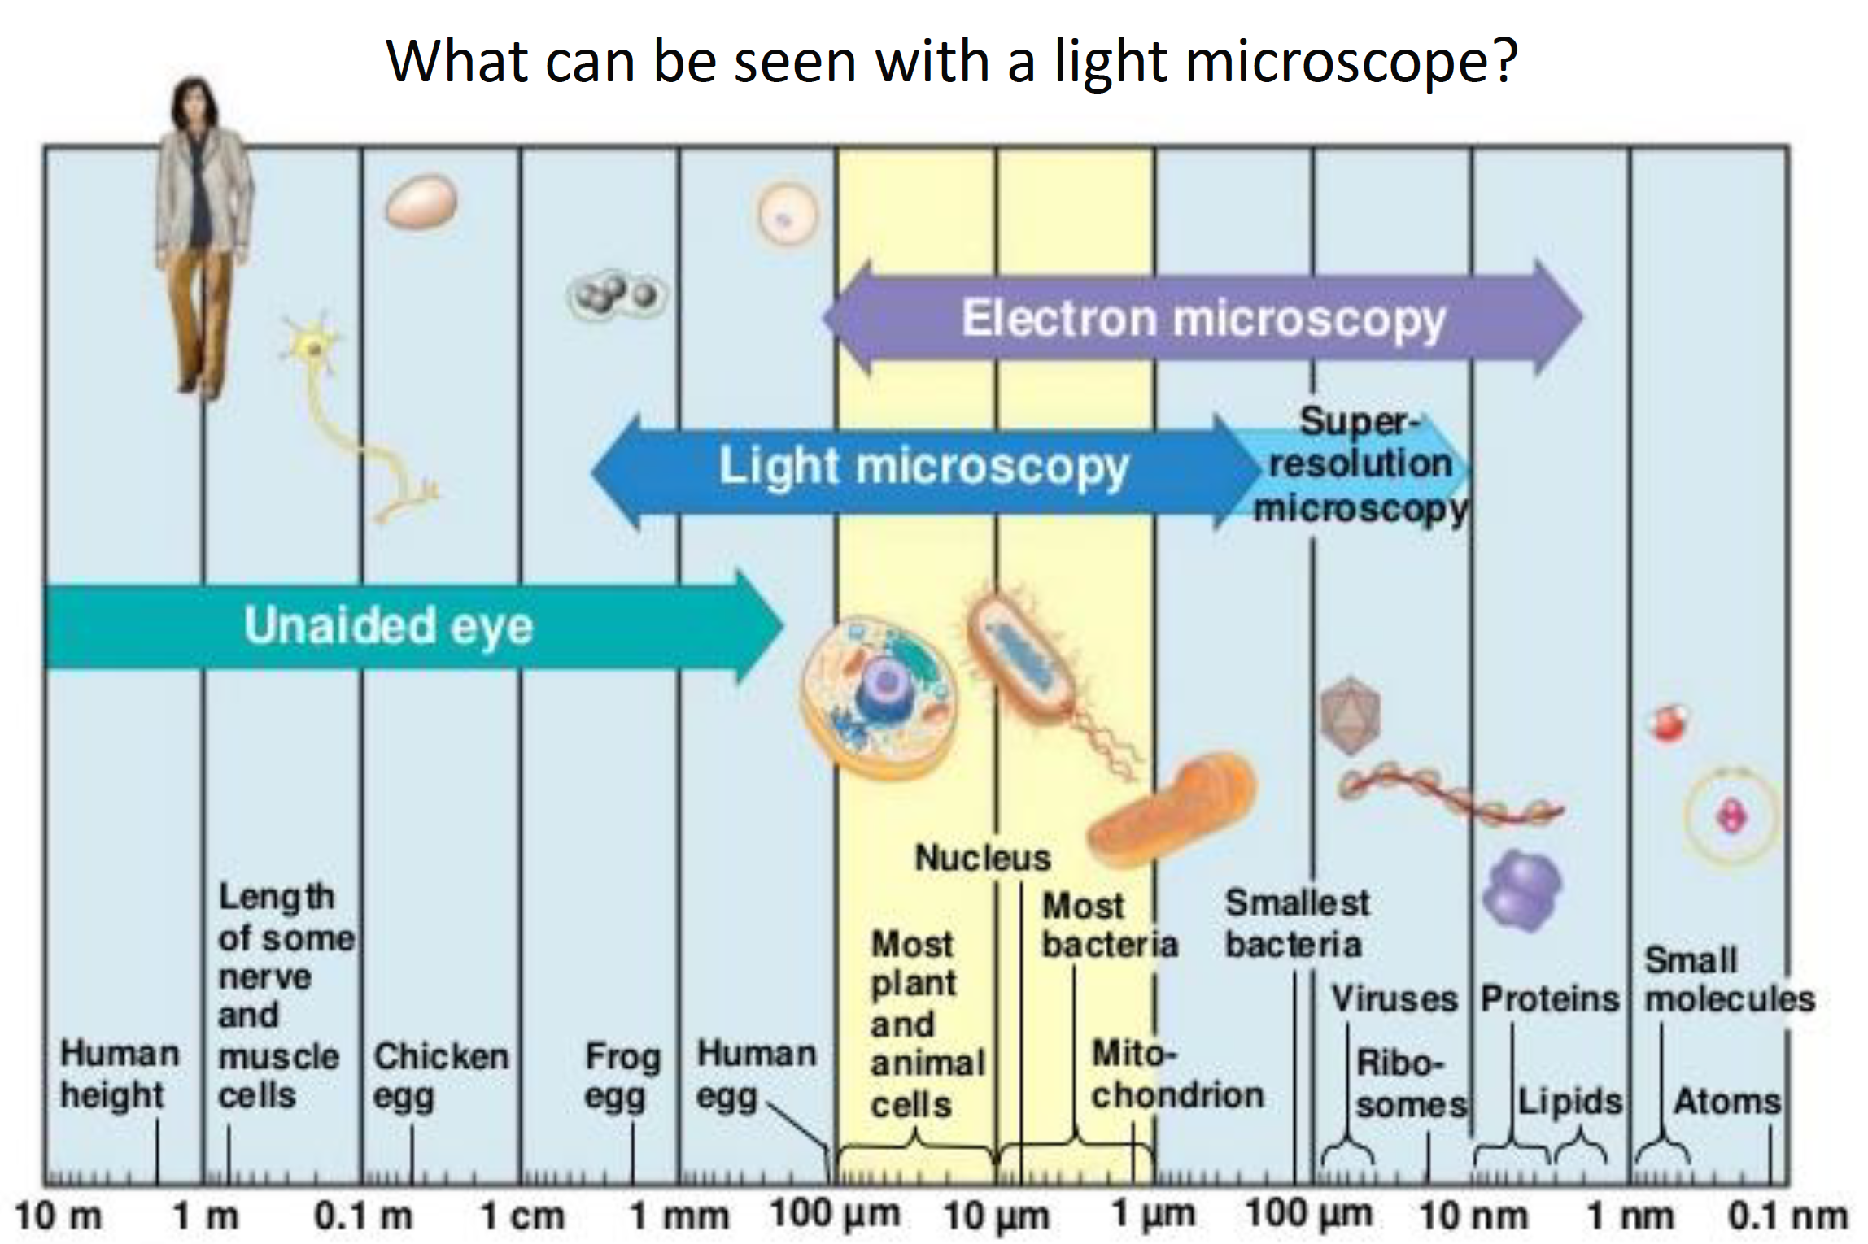

Slide 6
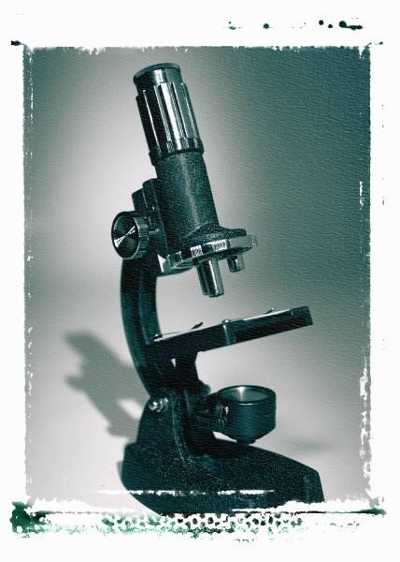
HOW A MICROSCOPE WORKS
Ocular Lens
(magnifies image)
Objective Lens
(gathers light; magnifies
and focuses image inside body tube)
Body Tube
(focuses image)
Bending Light: The convex lens of the objective magnifies and focuses (bends) the image inside the body tube and the convex lens of the ocular magnifies it (again).

Slide 7
HOW A MICROSCOPE WORKS
Convex Lenses are curved glass pieces used to make microscopes
(and glasses etc.)
Convex Lenses bend light and focus it in one spot.

Slide 8
HOW A MICROSCOPE WORKS
Convex Lenses bend light and focus it in one spot.
Optical imaging tecniques in cell biology

Slide 9
HOW A MICROSCOPE WORKS
Convex Lenses bend light and focus it in one spot.

Slide 10
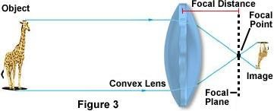
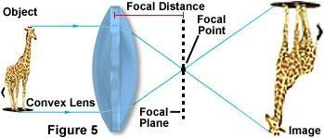
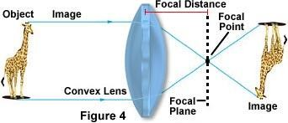
Image Formation

Slide 11
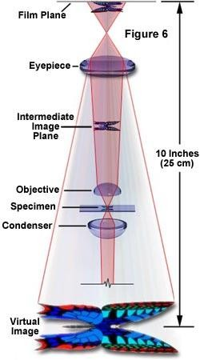
Lenses and Image Formation

Slide 12
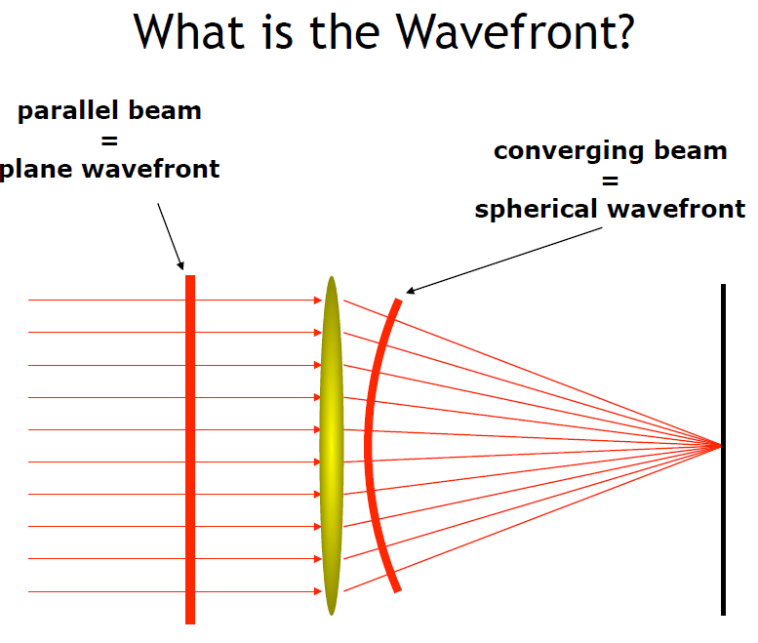
Lenses and Image Formation

Slide 13
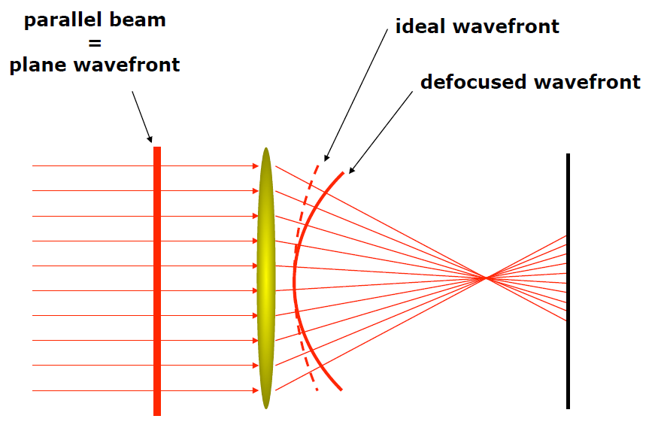
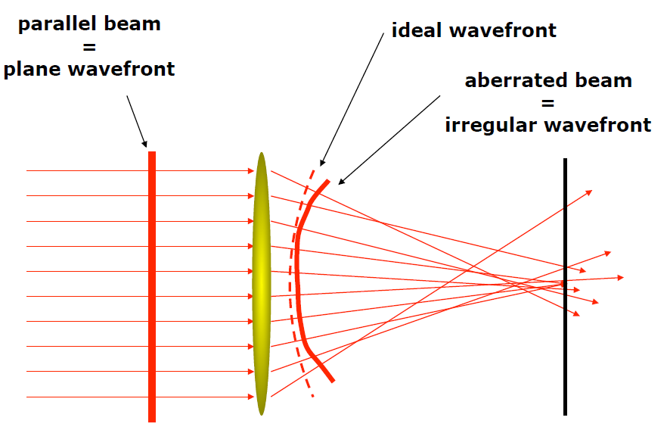
Lenses and Image Formation
OUT of focus
Aberrations

Slide 14
Microscope Imaging
http://zeiss-campus.magnet.fsu.edu/tutorials/index.html
http://zeiss- campus.magnet.fsu.edu/tutorials/basics/transmittedlightoptic alpathway/indexflash.html

Slide 15
Absorption
When light passes through an object the intensity is reduced depending upon the color absorbed. Thus the selective absorption of white light produces colored light.
Refraction
Direction change of a ray of light passing from one transparent medium to another with different optical density. A ray from less to more dense medium is bent perpendicular to the surface, with greater deviation for shorter wavelengths
Diffraction
Light rays bend around edges - new wavefronts are generated at sharp edges - the smaller the aperture the lower the definition
Dispersion
Separation of light into its constituent wavelengths when entering a transparent medium - the change of refractive index with wavelength, such as the spectrum produced by a prism or a rainbow

Slide 16
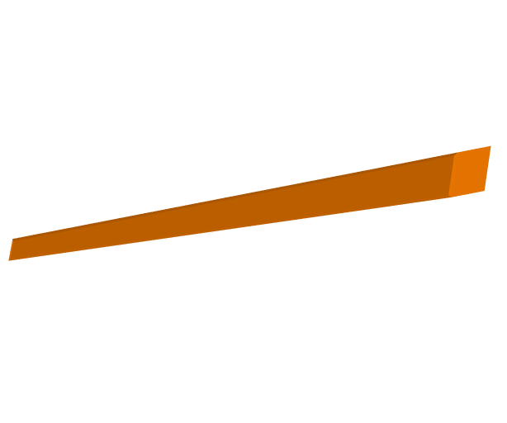
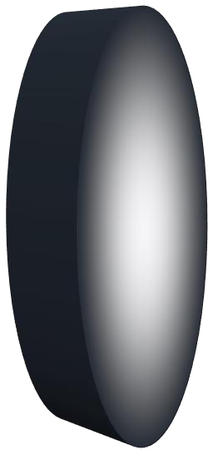
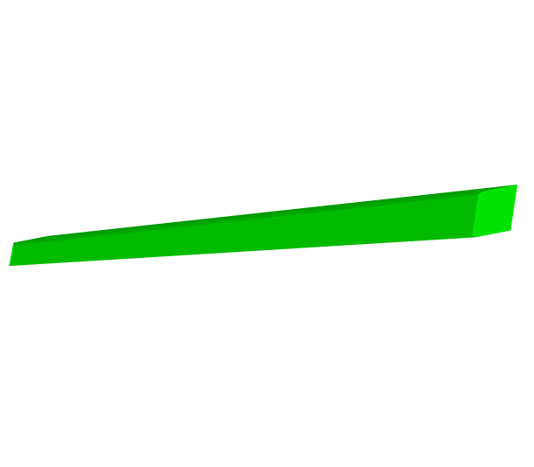
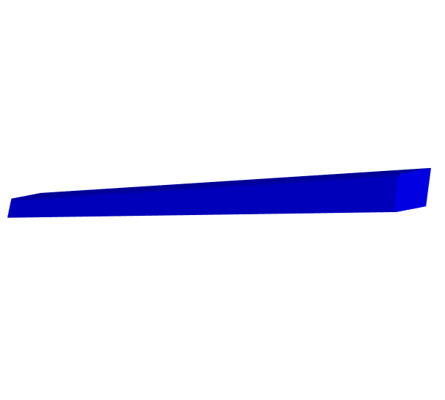
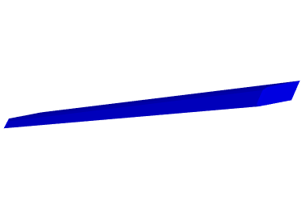
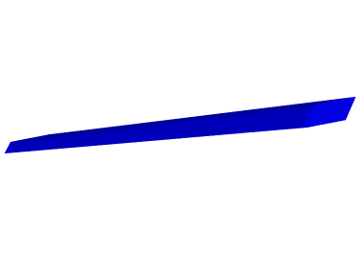
ABSORPTION
Control
Absorption
No blue/green light
red filter

Slide 17
REFRACTION & DISPERSION
Short wavelengths are “bent” more than long wavelengths
Light is “bent” and the resultant colors separate (dispersion). Red is least refracted, violet most refracted.

Slide 18
He sees the fish here….
But it is really here!!

Slide 19
DIFFRACTION

Slide 20
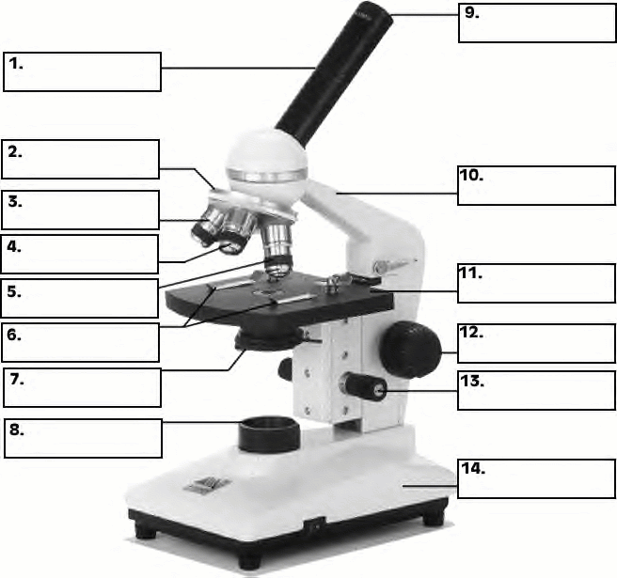
MICROSCOPE
Ocular Lens
Body Tube
Nose Piece
Arm
Objective
Lenses
Stage
Stage
Clips
Coarse
Adjustment
Diaphragm (Iris)
Fine
Adjustment
Light Source
Base

Slide 21
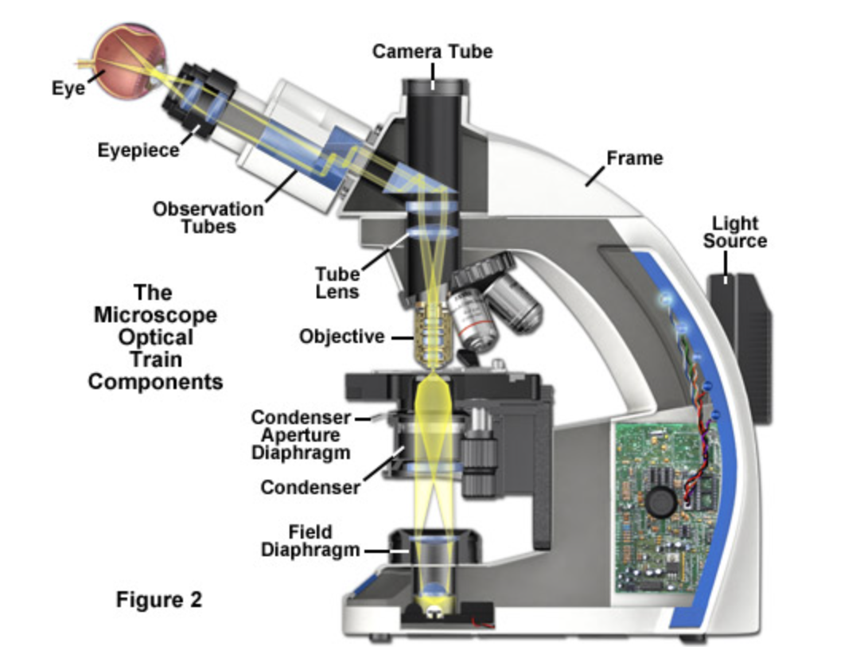
MICROSCOPE – upright, transmitted light

Slide 22
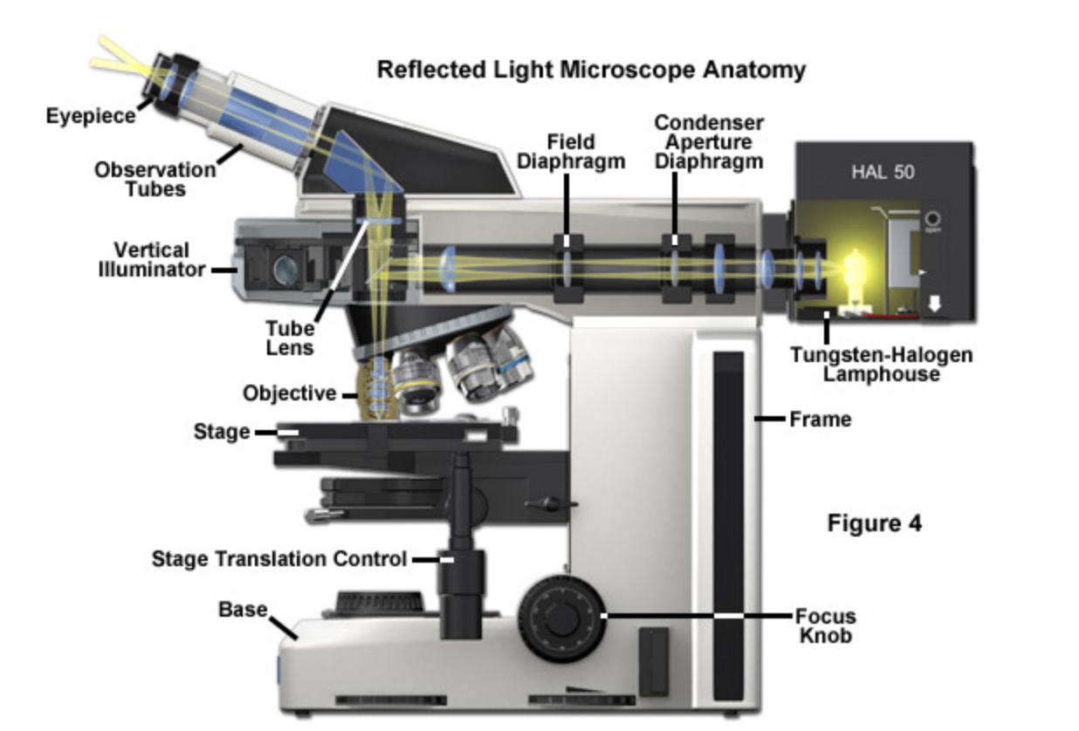
MICROSCOPE – upright, reflected light
Fluorescent microscopy
Opaque, thicker sample

Slide 23
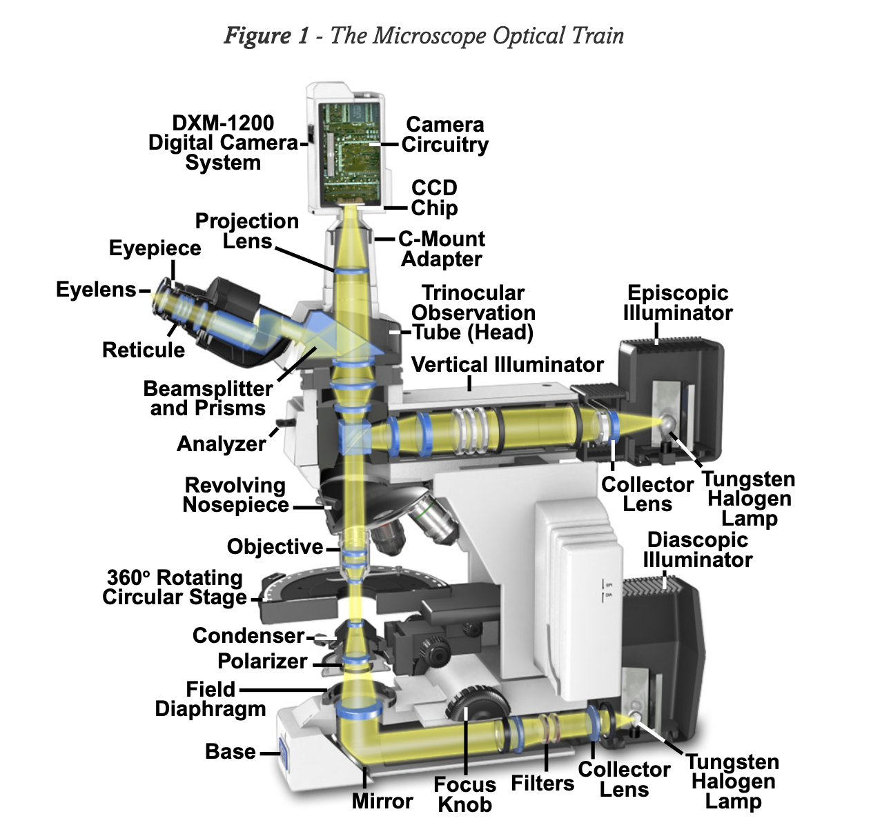
MICROSCOPE

Slide 24
MAGNIFICATION vs. RESOLUTION
Magnification: increase of an object’s apparent size
Resolution: power to show details clearly
Both are needed to see a clear image

Slide 25
MAGNIFICATION

Slide 26
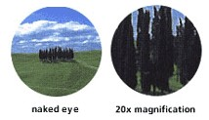
MAGNIFICATION
Magnification is NOT ALWAYS
related with resolution

Slide 27
RESOLUTION

Slide 28
RESOLUTION of two points

Slide 29
RESOLUTION CRITERION

Slide 30
NUMERICAL APERTURE & WORKING DISTANCE
n = refractive index
α = angle of incident illumination

Slide 31
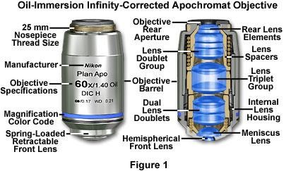
OBJECTIVES

Slide 32
OBJECTIVE SPECIFICATIONS

Slide 33
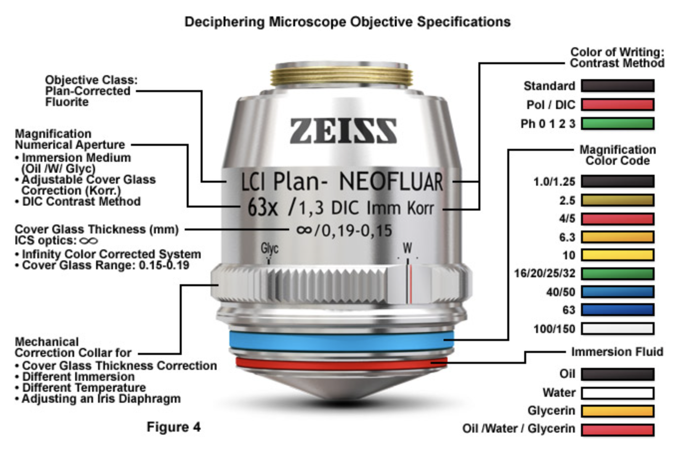
OBJECTIVE SPECIFICATIONS
magnification
immersion

Slide 34
OBJECTIVE TYPES
CP-Achromat
Good colour correction – exactly for two wavelengths. Field flatness in the image center, refocusing also covers the peripheral areas. For fields of view up to ⌀ 18 mm. Versions for phase contrast.
Achroplan
Improved Achromat objectives with good image flatness for fields of view with ⌀ 20 or even 23 mm. Achroplan for transmitted light and Achroplan Ph for phase contrast.
Plan-Neofluar
Excellent colour correction for at least three wavelengths. Field flattening for the field of view with ⌀ 25 mm. Highly transmitting for UV excitation at 365 nm in fluorescence. All methods possible, special high-quality variants are available for Pol and DIC.
Plan-Apochromat
Perfect colour rendition (correction for four wavelengths!). Flawless image flatness for fields of view with ⌀ 25 mm. Highest NAs for a resolving power at the very limits of the physically possible.

Slide 35
OBJECTIVES
http://zeiss- campus.magnet.fsu.edu/tutorials/basics/transmittedlightopticalpathway/indexflash.ht ml
http://www.microscopyu.com/tutorials/java/objectives/nuaperture/index.html http://www.microscopyu.com/tutorials/java/objectives/immersion/index.html http://www.microscopyu.com/tutorials/java/aberrations/slipcorrection/index.html http://www.microscopyu.com/articles/optics/index.html

Slide 36
POINT SPREAD FUNCTION

Slide 37
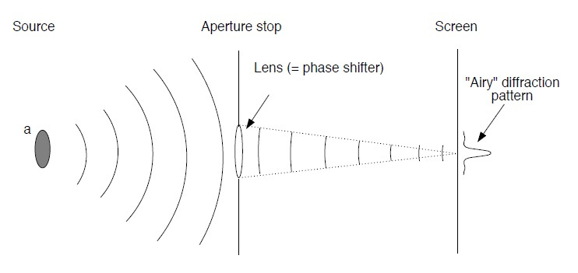
POINT SPREAD FUNCTION

Slide 38
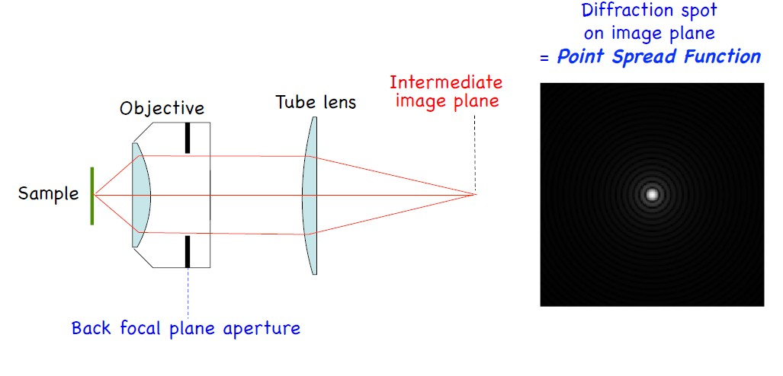
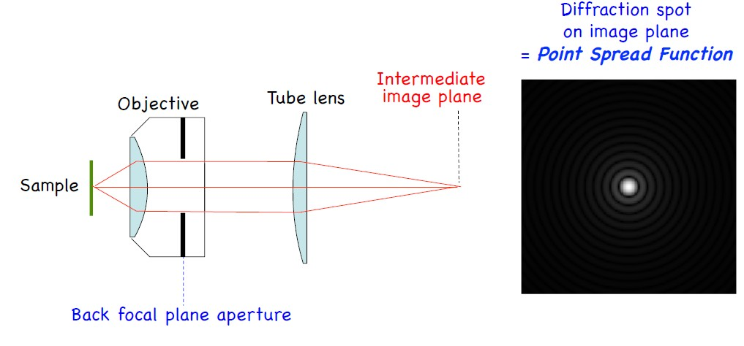
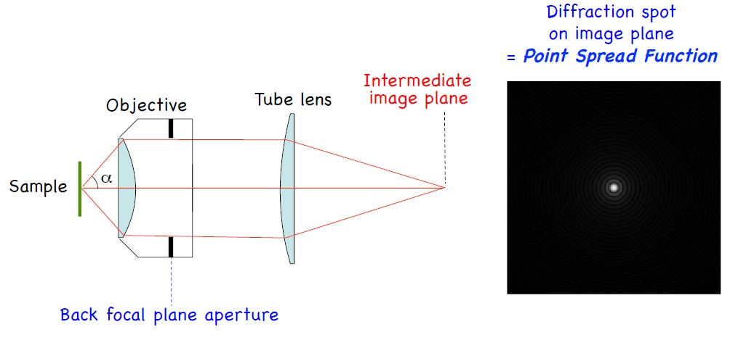
POINT SPREAD FUNCTION

Slide 39
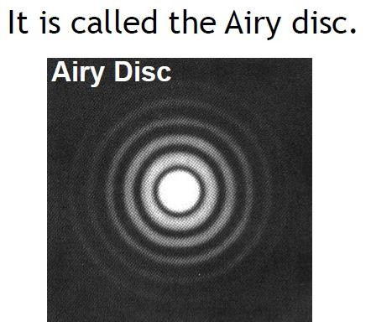
POINT SPREAD FUNCTION

Slide 40
RESOLUTION CRITERION

Slide 41
POINT SPREAD FUNCTION (PSF)
The size of the airy disk depends on the size of the objective lens

Slide 42
NUMERICAL APERTURE AND IMAGE RESOLUTION

Slide 43
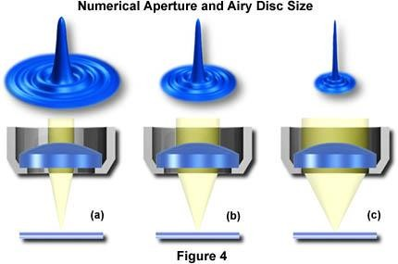
Numerical aperture, NOT magnification determines resolution!
Resolution of 0.175µ Bead Pair
1.1
1.0
0.9
0.8
0.7
0.6
0.5
0.4
0.3
0.2
0.1
0.0
1.4 NA
0.7 NA
-1.10
-0.96
-0.81
-0.66
-0.51
-0.37
-0.22
-0.07
0.07
0.22
0.37
0.51
0.66
0.81
0.96
1.10
Microns
Increasing NA
A lens with a larger NA will be able to visualize finer details and will also collect more light and give a brighter image than a lens with lower NA.

Slide 44
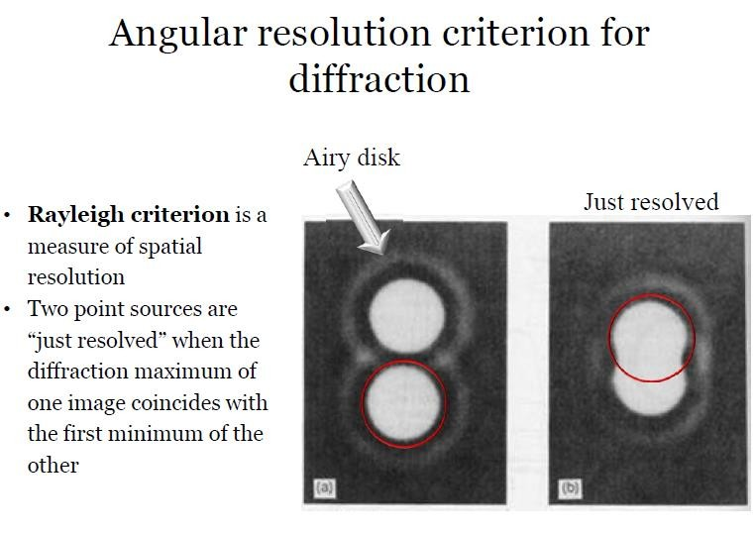

Slide 45
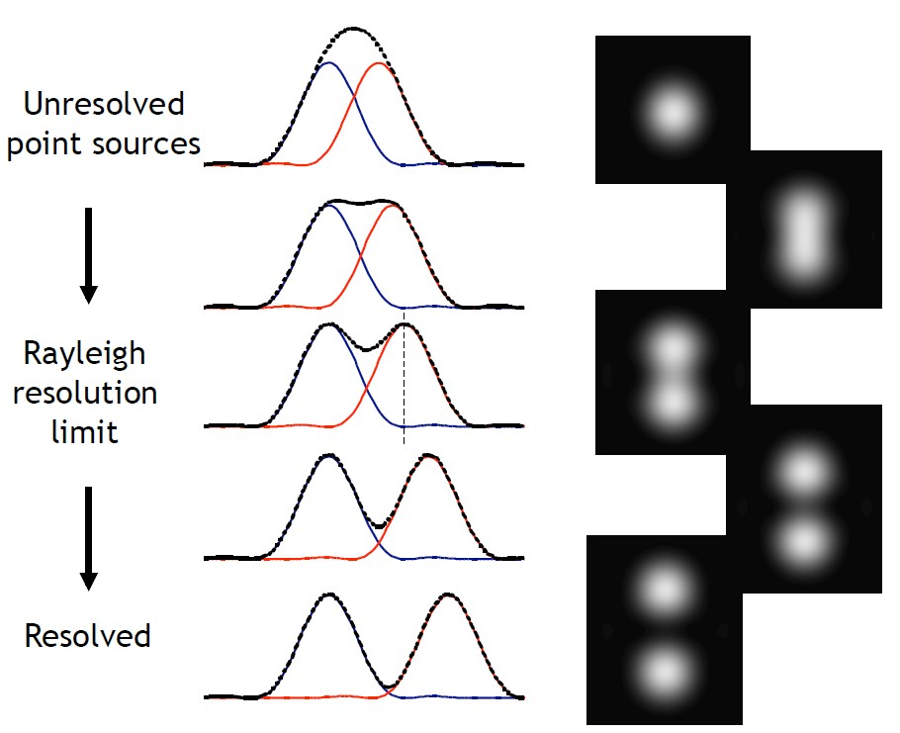
NUMERICAL APERTURE AND IMAGE RESOLUTION

Slide 46
RESOLVING POWER
Is the ability to distinguish two adjacent points as distinct and separate
Mere increase in size without the ability to distinguish structural details is not beneficial. The largest magnification produced by a microscope may not be the most useful because the image obtained may be unclear or fuzzy.
The more lines or dots per unit area that can be seen separately, the greater is the resolving power.
It is a function of the wavelengths of lights used & the numerical aperture of the lens system.

Slide 47
NUMERICAL APERTURE
In optics, the numerical aperture (NA) of an optical system is a dimensionless number that characterizes the range of angles over which the system can accept or emit light.
The sine value of half-aperture angle multiplied by the refractive index n of the medium gives the numerical aperture (NA)
Thus,
NA= n sin θ

Slide 48
MAGNIFICATION
Magnification beyond the resolving power is of no value since the larger image will be less distinct in detail & fuzzy in appearance.
The situation is analogous to the of a movie screen: If we move closer to the screen the image is larger but is also less sharp than when viewed from distance.
Most laboratory microscopes are equipped with three objectives, each capable of a different degree of magnification.
The total magnification of the system is determined by magnification of the objective and by that of eyepiece.

Slide 49
THE LIMIT OF RESOLUTION
is the smallest distance by which two objects can be separated and still be distinguished as two separate objects.
The greatest resolution in optical microscopy can be obtained with the shortest wavelength of visible light and an objective with maximum NA.
The relationship between NA and the limit of resolution can be expressed as follows:
d= λ / 2NA
d= Resolution
λ= Wavelength of light
Here,

Slide 50
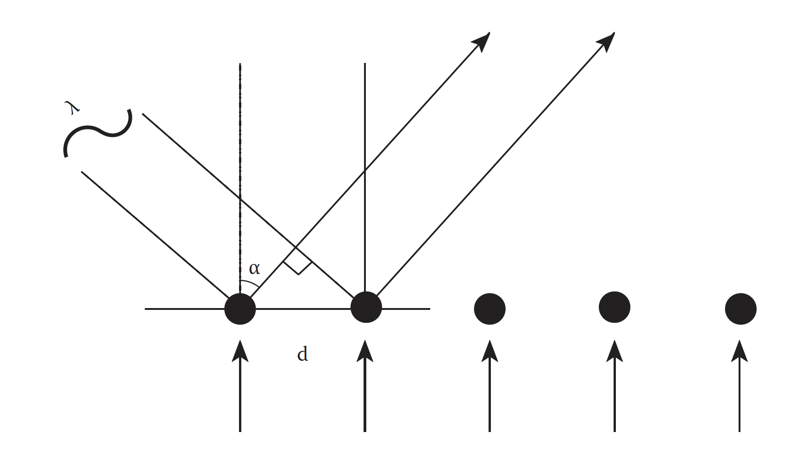
ABBE’s LAW
Optical imaging tecniques in cell biology
“minimum resolving distance (d) is related to the wavelength of light (lambda) divided by the Numeric Aperture, which is proportional to the angle of the light cone (theta) formed by a point on the object, to the objective”.

Slide 51
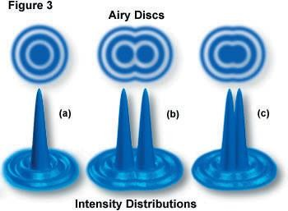
RESOLUTION CRITERION
Abbe’s Criterion

Slide 52
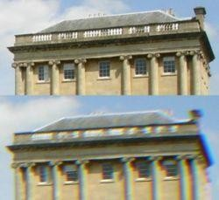
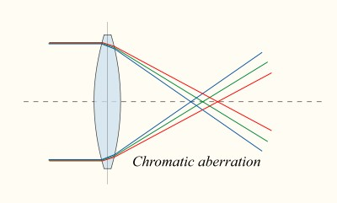
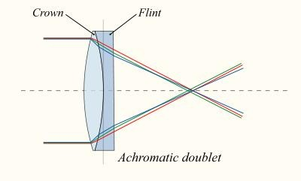
CHROMATIC ABERRATION
Chromatic aberration is caused by a lens having different refractive indexes for different wavelengths.
Since the focal length of a lens is dependent on the refractive index, different wavelengths will be focused on different positions in the focal plane.
Chromatic aberration is seen as fringes of colour around the image.
It can be minimised by using an achromatic doublet (=achromat) in which two materials with differing dispersion are bonded together to form a single lens.

Slide 53
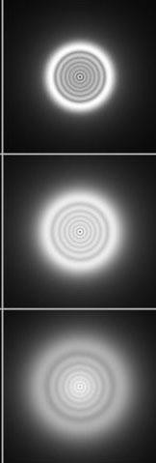
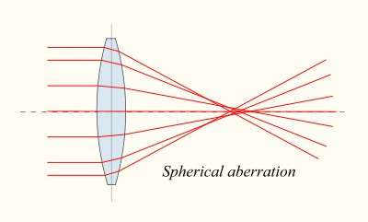
SPHERICAL ABERRATION
Spherical aberration causes beams parallel to but away from the lens axis to be focussed in a slightly different place than beams close to the axis. This manifests itself as a blurring of the image.

Slide 54
OBJECTIVE TYPES
CP-Achromat
Good colour correction – exactly for two wavelengths. Field flatness in the image center, refocusing also covers the peripheral areas. For fields of view up to ⌀ 18 mm. Versions for phase contrast.
Achroplan
Improved Achromat objectives with good image flatness for fields of view with ⌀ 20 or even 23 mm. Achroplan for transmitted light and Achroplan Ph for phase contrast.
Plan-Neofluar
Excellent colour correction for at least three wavelengths. Field flattening for the field of view with ⌀ 25 mm. Highly transmitting for UV excitation at 365 nm in fluorescence. All methods possible, special high-quality variants are available for Pol and DIC.
Plan-Apochromat
Perfect colour rendition (correction for four wavelengths!). Flawless image flatness for fields of view with ⌀ 25 mm. Highest NAs for a resolving power at the very limits of the physically possible.

