Slide 1
Energie Rinnovabili
Laurea Magistrale in Chimica
Trieste, Marzo 2023
Prof. Federico ROSEI
Dipartimento di Scienze Chimiche e Farmaceutiche federico.rosei@units.it
C11, Aula 9

Slide 2
Laws of Thermodynamics
Heat does not flow between objects at the same temperature (heat flows from a body at higher temperature to a body at lower temperature)
Energy is conserved
Entropy always increases

Slide 3
Ludwig Boltzmann, who spent much of his life studying statistical mechanics, died in 1906, by his own hand.
Paul Ehrenfest, carrying on the work, died similarly in 1933.
Now it is our turn to study statistical mechanics.
Perhaps it will be wise to approach the subject cautiously. (Opening lines of "States of Matter", by D.L. Goodstein).

Slide 4
n.6
Combustion of fossil fuels.
Why do fossil fuels still dominate the global energy landscape?
Greenhouse gases, carbon emissions, climate change and global warming (already discussed)
Other uses of fossil fuels

Slide 5
“Questions are never indiscreet, answers sometimes are” Oscar Wilde
Each generation is confronted with new challenges and opportunities
1970 picture: average American family surrounded by the barrels of oil they consume annually. Now this consumption is 40% higher
“Currently the world’s growing thirst for oil amounts to 1000 barrels a second.”
The Future of Energy Supply: Challenges and Opportunities; N. Armaroli, V. Balzani, Angew. Chem. Int. Ed. 2007, 46, 52.

Slide 6

The world burns
> a cubic mile (4.3 km³) of oil / year
1 mile
Eiffel Tower

Slide 7
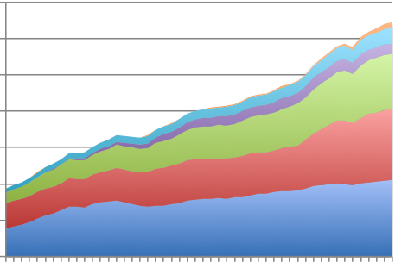
World primary energy consumption
Continuously
growing…
Renewables
12
Hydroelectric
Nuclear
24%
8
Billion tons of Oil (Equivalent)
Natural Gas
30%
Coal
4
Oil
33%
0
1970 1980 1990 2000 2010
2015 BP Energy Review
Time (years) Total fossil >80%

Slide 8
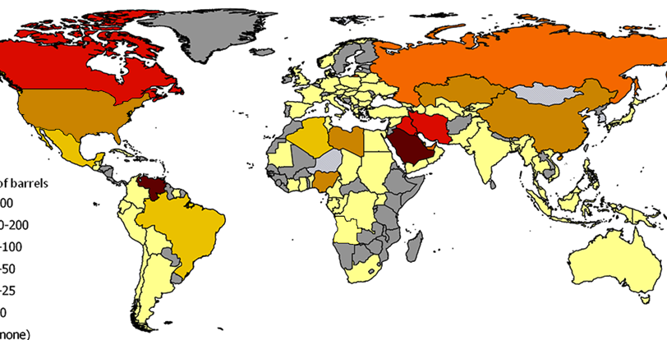


Known crude oil reserves in 2014
200
100-200
50-100
25-50
10-25
U.S. Energy Information
Administration
Billions of barrels

Slide 9


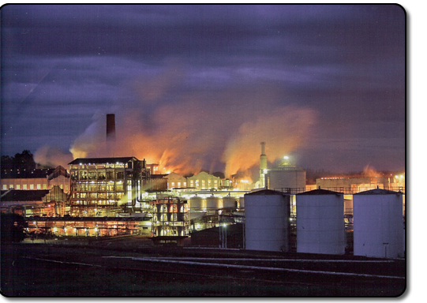
Concept of EROI
Success in niche markets: Brazil
EROI = Energy Return On Energy Investment
40 years ago, you could ‘invest’ the equivalent (in Energy) of one barrel of oil when drilling a new oil field, and would retrieve 200 barrels
EROEI examples:
  Ethanol from corn: 1 to 1.3
  Ethanol from sugar cane: 1 to 8 (acceptable)
  Alberta tar sands: 2 to 3 (barely acceptable)
corn
Sugar cane
Usina Sao Martinho 300 ML ethanol/yr (from sugar cane)

Slide 10
EROI of our major source of energy (fossil fuels) => decreasing
=> Major repercussions on
world economy

Slide 11
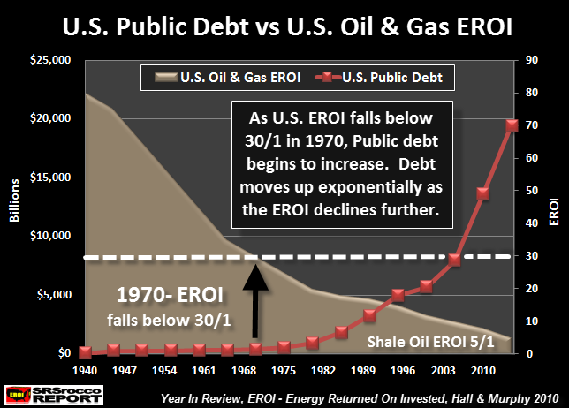

Slide 12
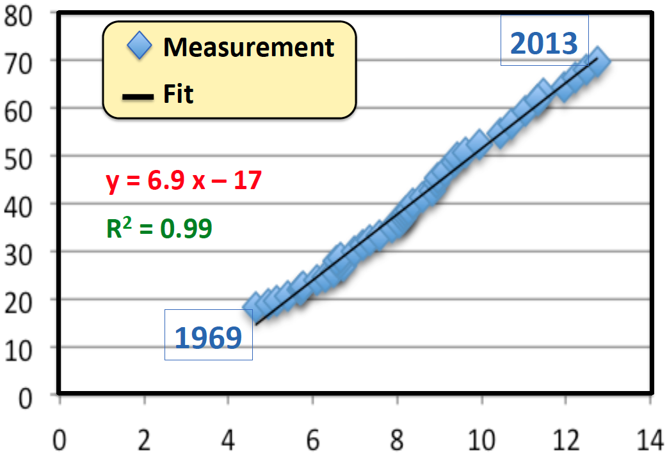
World GNP & Energy Consumption Correlation
$ (Trillions)
Billions of (equivalent) Tons of Oil

Slide 13
Energy use: very strongly coupled with economy & environment
Decreasing energy use => damages the economy
Maintaining energy use => damages the environment
The Energy «Trilemma»

Slide 14
Oil extraction: much more expensive & demanding ⬄ lower EROI
Deepwater Pathfinder Offshore Platform

Slide 15
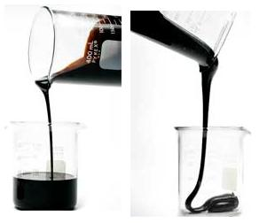
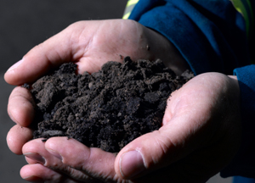
Not all oils were created equal…
Light sweet Oil: Fluid & rich in light molecules; Almost no sulphur
Heavy sour Oil: Dense & rich of long sticky molecules;
Contains sulphur
Tar Sands: sand drenched in bitumen; Extracting & refining ‘oil’ is expensive & energy intensive
High EROI Medium EROI Very low EROI

Slide 16
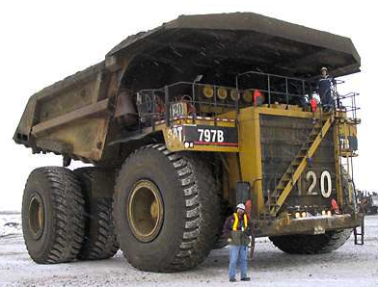
Tar sands mining

Slide 17
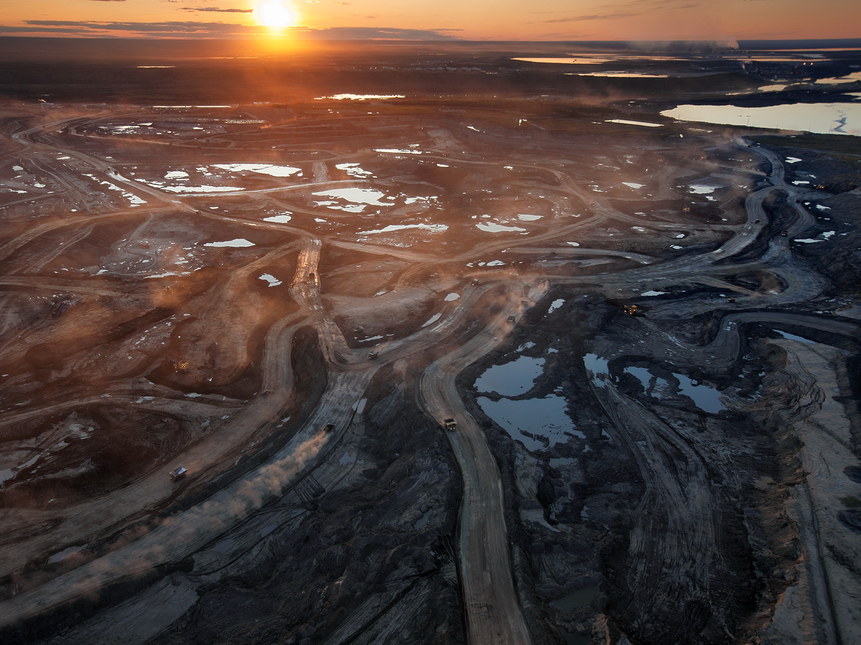
Tar sands mining
=> Environmentally disastrous

Slide 18
Combustion of Fossil Fuels
Energy can be extracted (converted) from exothermic combustion reaction of fossil fuels
Hydrocarbons + Oxygen => CO₂ + H₂0 + Heat
Heat used for heating dwellings, cooking
For evaporating water into steam => operate mechanical systems (e.g. turbines)

Slide 19
Combustion of Fossil Fuels

Slide 20
Combustion of Fossil Fuels
Fossil fuel fed into combustion chamber
Intense heat from the burning fuel heats the water introduced through the pump => turns it into steam
=> steam transferred to turbine at high speed & pressure
The pressuring flow causes turbine blades to spin
Turbine is connected to a synchronous generator that creates flow of electrons which produces electricity

Slide 21
Efficiency of power generating plants
Can be measured with the heat rate ⬄ the amount of energy used by a power plant to generate 1 kWh of electricity (Btu/kWh)
The efficiency can be expressed as a percentage by dividing 3412 Btu (the equivalent Btu content of a kWh of electricity) by the heat rate
Average efficiency of fossil fuel generating plants published by the U.S. Energy Information Administration (EIA) in 2012 was 9800 Btu/kWh (about 35%)

Slide 22
Comparative efficiency
For example,
Coal 2012: 3412 / 10,498 = 32.5%

Slide 23
Combustion Engines
Combustion engine: machine that converts thermal energy released by fuel into mechanical energy.
Two types of combustion engines:
  External combustion engine: heat engine => ignition occurs outside the chamber in which heat is converted into mechanical energy
  Internal combustion engine: heat engine => ignition or burning of a fuel-air occurs within the engine cylinder

Slide 24
Advantages of fossil fuels
Availability: abundant; with technological advances the extraction has improved in terms of efficiency & health concerns.
Energy Efficiency: easily combustible; very high calorific value / energy density => a small amount of fuel can generate a lot of power [airplanes]
Storage & Transportation: The molecular composition of fossil fuels is very stable which makes them easy to store & transport under normal conditions
Economy: Abundant availability means power plants can be constructed anywhere; The facilities & energy extraction methods are relatively simple / low cost

Slide 25
Disadvantages of fossil fuels
Combustion by-products
CO₂: emission of CO₂ contributes to pollution, climate change & global warming
SO₂: emission of SO₂ can be transformed into acidic pollutants such as sulphuric acid H₂SO₄. These particles are then removed from the atmosphere in acid rain, snow, sleet or hail which can affect human health & quality of water and soils.
NO_{x}: Nitrogen oxides are also primary GHG & have similar greenhouse effects as CO₂; NO_{x} emissions can be transformed into acidic pollutants such as nitric acid HNO₃ => similar acid rain effects as SO₂

Slide 26
Radioactive waste from coal burning

Slide 27
Disadvantages of fossil fuels
Risk of accidents: leaks and explosions
2010 gulf of Mexico BP oil spill: one of the worst environmental disasters in U.S. history
2013 Lac-Mégantic derailment: one of the deadliest rail accidents in Canadian history

Slide 28
Disadvantages of fossil fuels
Coal Mining
Ecosystem:
  Reshape & destroy land vegetation & fertility
  Release methane
  Pollute water due to coal sludge
Human health & security:
  Chronic lung & respiratory diseases from dust / other particles
  Noise pollution (trucks, explosions, etc.)
Security risk from explosives

Slide 29
Other uses of oil: production of plastics
SDGn.12: Responsible Consumption and Production

Slide 30
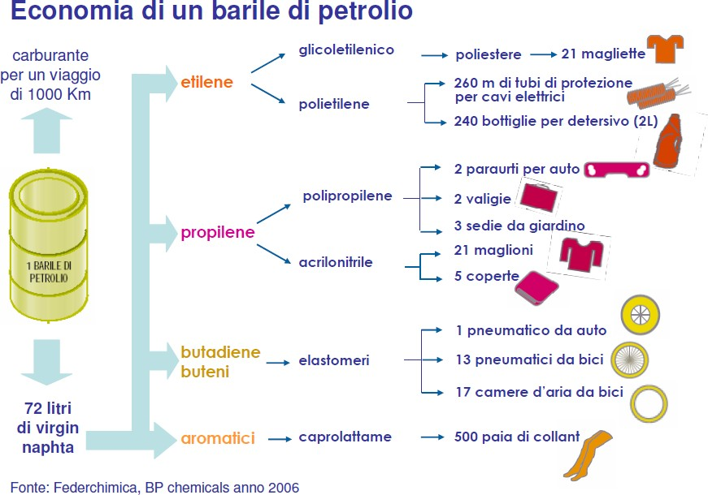
158,99 litri
circa 140 kg

Slide 31

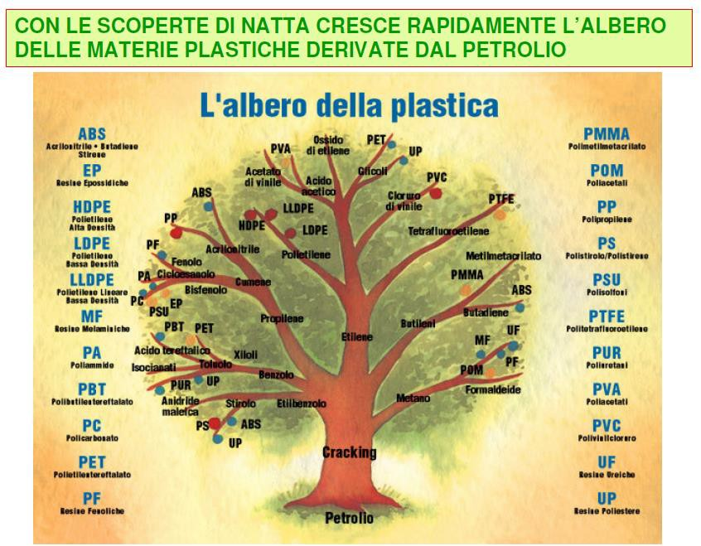

Slide 32
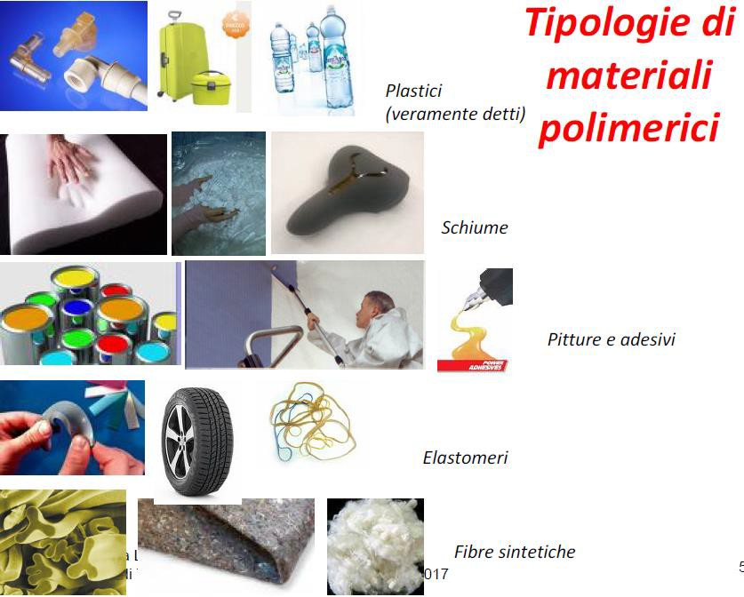

Slide 33
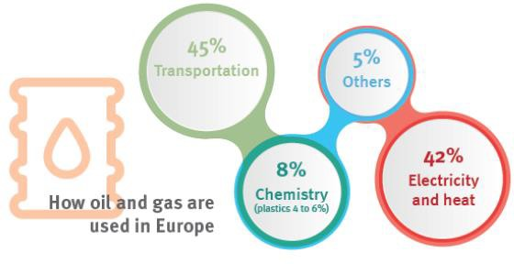

Slide 34
One 42-gallon barrel of oil creates 19.4 gallons of gasoline. The rest (over half) is used to make things like: Solvents Diesel fuel Motor Oil Bearing Grease Ink Floor Wax Ballpoint Pens Football Cleats Upholstery Sweaters Boats Insecticides Bicycle Tires Sports Car Bodies Nail Polish Fishing lures Dresses Tires Golf Bags Perfumes Cassettes Dishwasher parts Tool Boxes Shoe Polish Motorcycle Helmet Caulking Petroleum Jelly Transparent Tape CD Player Faucet Washers Antiseptics Clothesline Curtains Food Preservatives Basketballs Soap Vitamin Capsules Antihistamines Purses Shoes Dashboards Cortisone Deodorant Shoelace Aglets Putty Dyes Panty Hose Refrigerant Percolators Life Jackets Rubbing Alcohol Linings Skis TV Cabinets Shag Rugs Electrician’s Tape Tool Racks Car Battery Cases Epoxy Paint Mops Slacks Insect Repellent Oil Filters Umbrellas Yarn Fertilizers Hair Coloring Roofing Toilet Seats Fishing Rods Lipstick Denture Adhesive Linoleum Ice Cube Trays Synthetic Rubber Speakers Plastic Wood Electric Blankets Glycerin Tennis Rackets Rubber Cement Fishing Boots Dice Nylon Rope Candles Trash Bags House Paint Water Pipes Hand Lotion Roller Skates Surf Boards Shampoo Wheels Paint Rollers Shower Curtains Guitar Strings Luggage Aspirin Safety Glasses Antifreeze Football Helmets Awnings Eyeglasses Clothes Toothbrushes Ice Chests Footballs Combs CD’s & DVD’s Paint Brushes Detergents Vaporizers Balloons Sun Glasses Tents Heart Valves Crayons Parachutes Telephones Enamel Pillows Dishes Cameras Anesthetics Artificial Turf Artificial limbs Bandages Dentures Model Cars Folding Doors Hair Curlers Cold cream Movie film Contact lenses Drinking Cups Fan Belts Car Enamel Shaving Cream Ammonia Refrigerators Golf Balls Toothpaste Gasoline

Slide 35
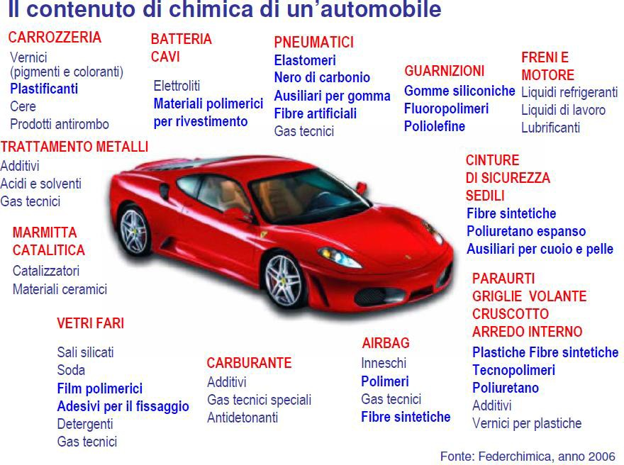
Contenuto di materiale polimerico di un’automobile

Slide 36


