Slide 1
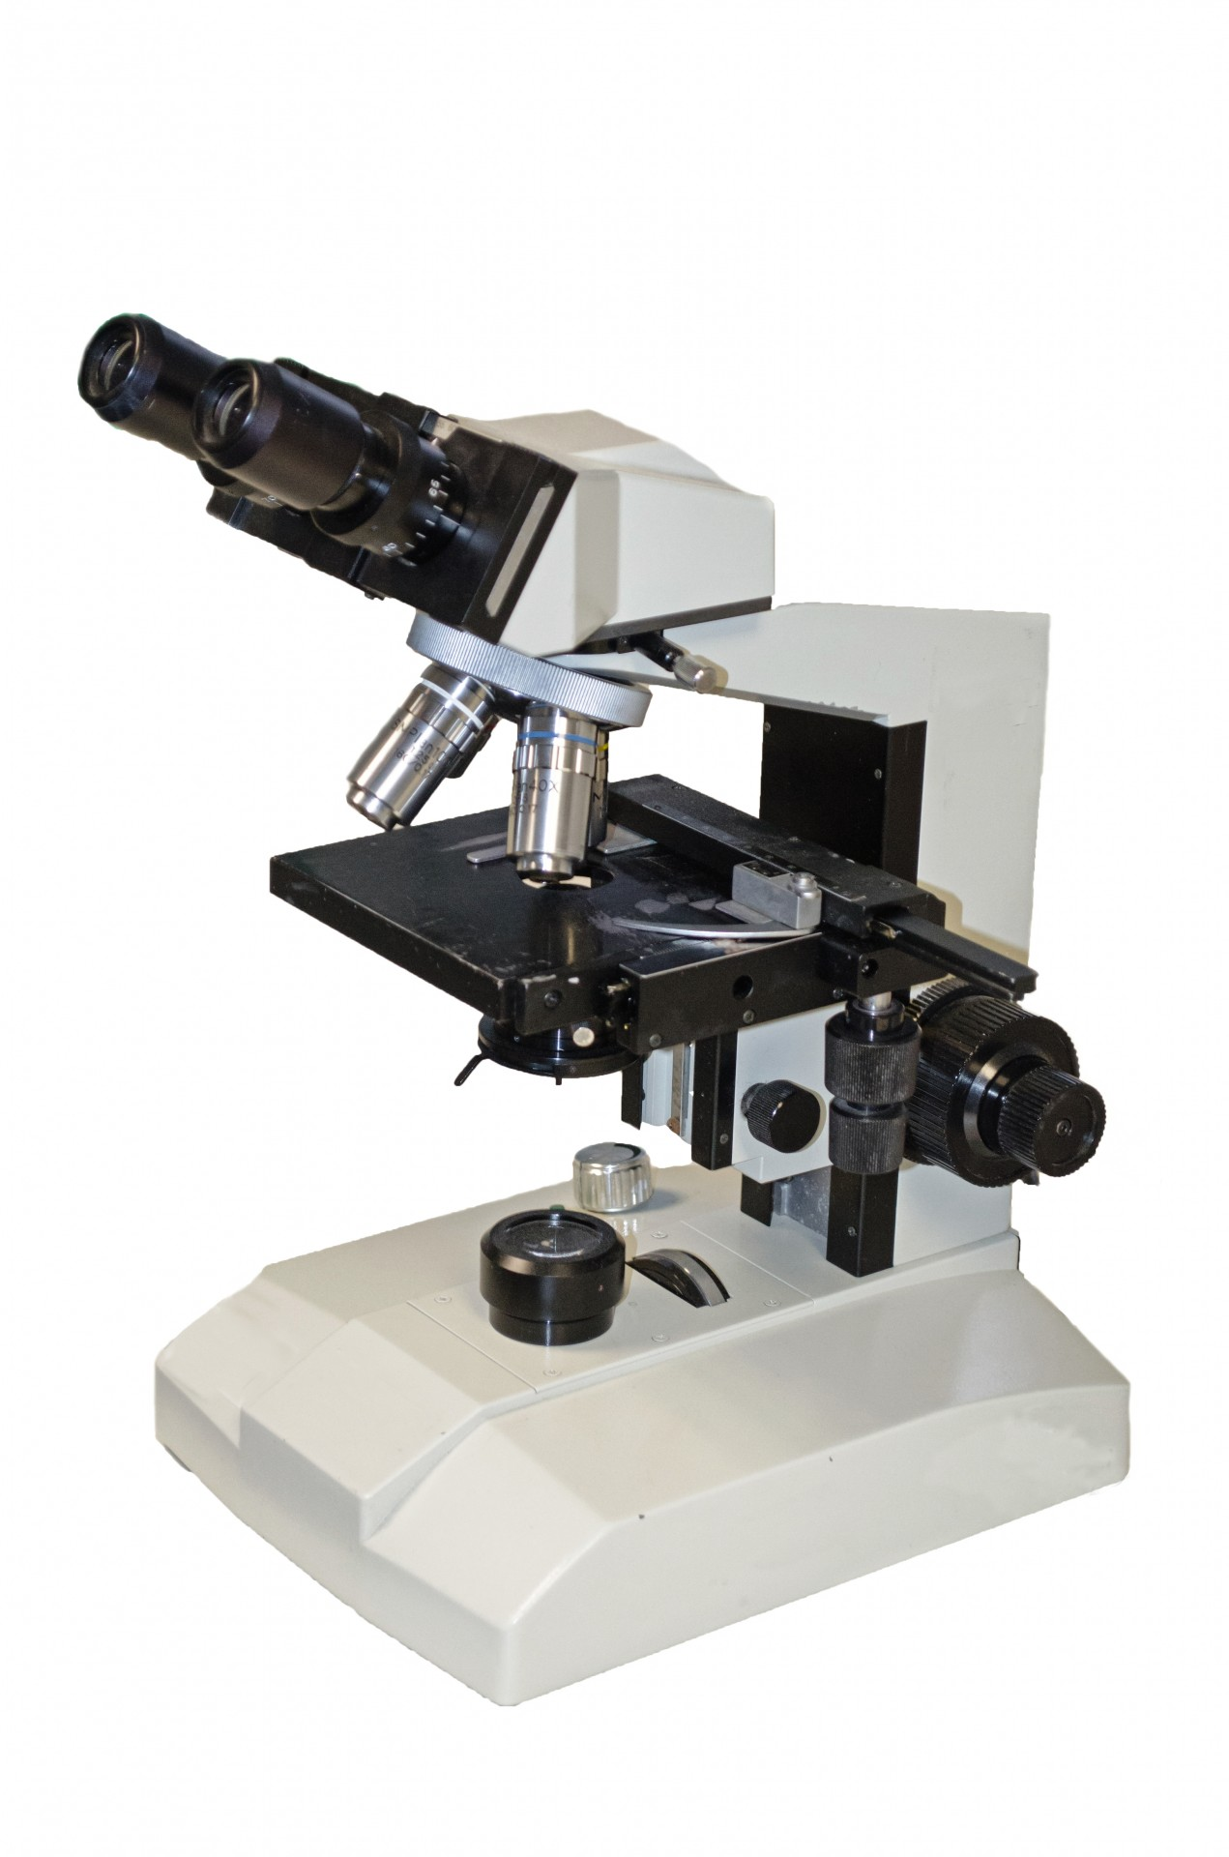
MICROSCOPIA OTTICA IN BIOLOGIA CELLULARE [675SM]
15th March 2023:
Contrasting techniques with laboratory
Agnes Thalhammer
agnes.thalhammer@units.it

Slide 2
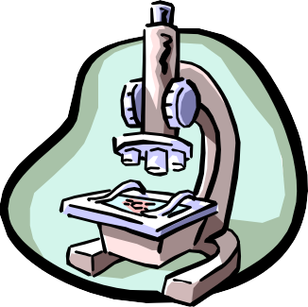
CONTRASTING TECHNIQUES
Brightfield
Darkfield
Phase Contrast
Polarization Contrast
Differential Interference Contrast (DIC)
Fluorescence Contrast

Slide 3
CONTRAST GENERATION FOR TRANSMITTED LIGHT
Brightfield | >>> | absorbance
Darkfield | >>> | diffraction
Phase Contrast | >>> | Phase shift
Differential Interference Contrast (DIC) Microscopy
>>> Phase shift / Polarization / Interference

Slide 4
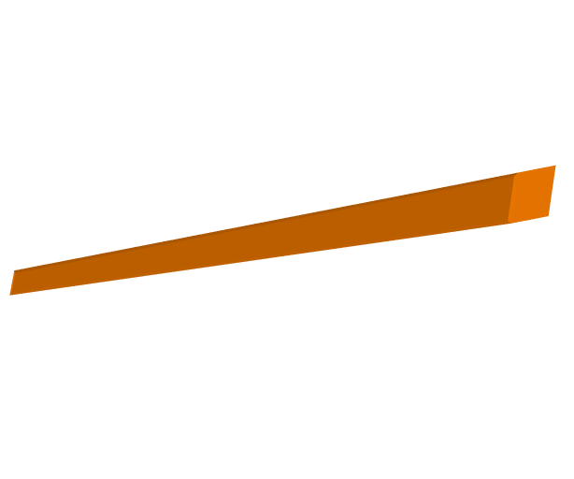
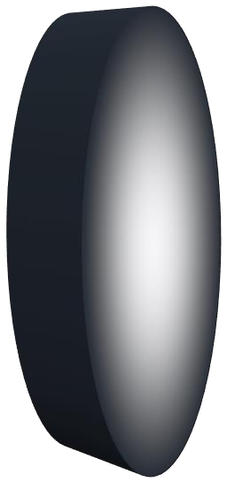
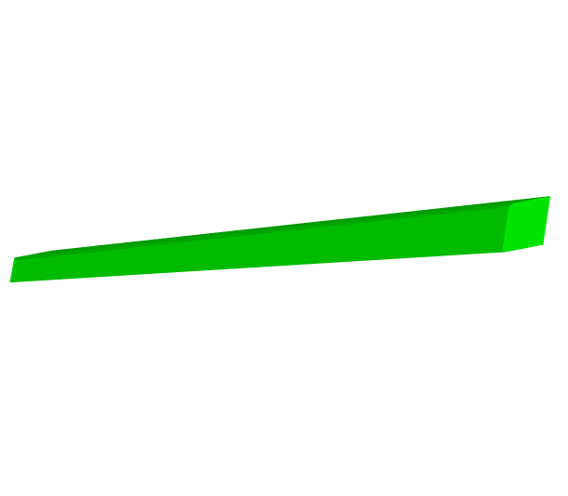
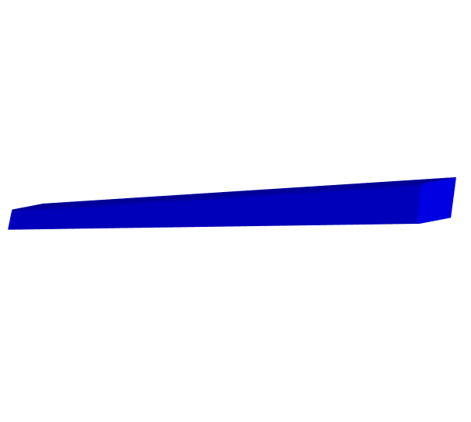
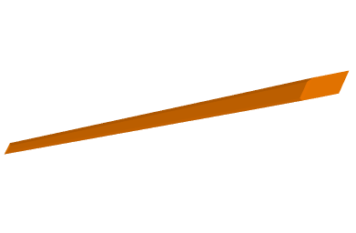
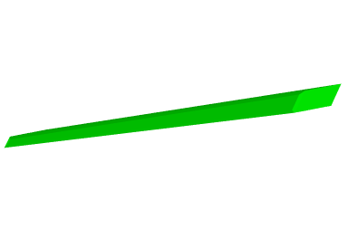
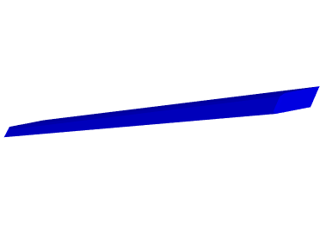
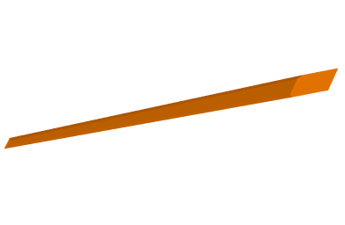
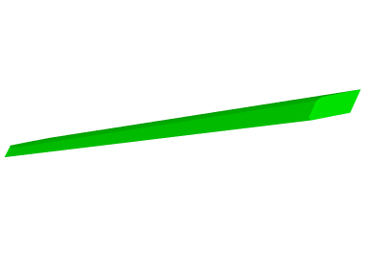
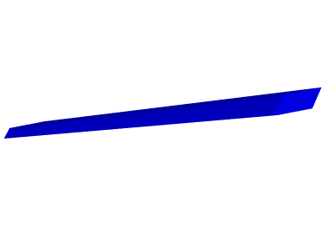
ABSORPTION
Control
Absorption
No blue/green light
red filter

Slide 5
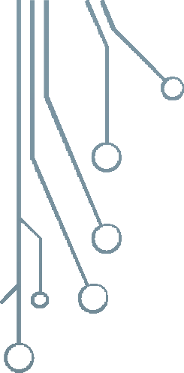
DIFFRACTION

Slide 6
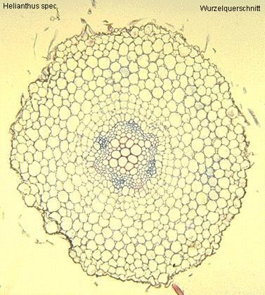
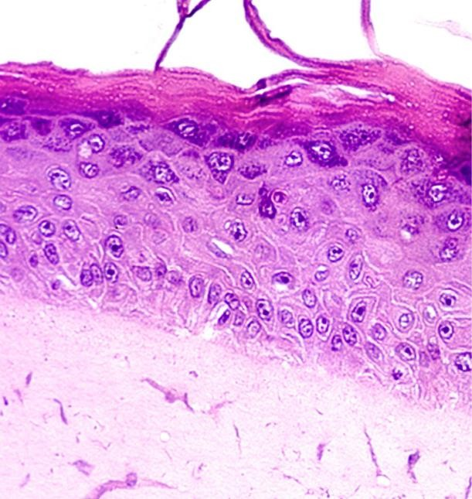
BRIGHTFIELD
Principle:
Light is transmitted through the sample and absorbed by it.
Application:
Only useful for specimens that can be contrasted via dyes
Very little contrast in unstained specimens
With a bright background, the human eye requires local intensity fluctuations of at least 10 to 20% to be able to recognize objects.
Cross section of sunflower root
(http://www.zum.de/Faecher/Materialien/beck/12/bs12-5.htm)
Piece of artificially grown skin
(www.igb.fhg.de/.../dt/PI_BioTechnica2001.dt.html )

Slide 7
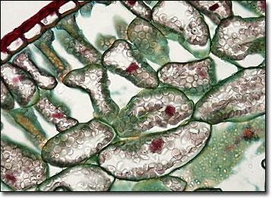
BRIGHTFIELD
Bright Field is the most universal technique used in light microscope.
Usually used in samples with colorimetric staining or good contrast; dark sample absorbing light on bright background
Particularily useful on samples with intrinsic colour (e.g. chloroplasts)
AI programs using mashine-learning techniques on stained samples to be able to identify cells/organelles etc.. without staining in Bright Field.

Slide 8
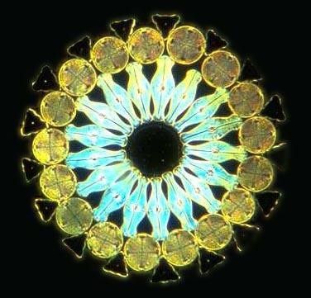
DARKFIELD
Principle:
The illuminating rays of light are directed through the sample from the side by putting a dark disk into the condenser that hinders the main light beam to enter the objective. Only light that is scattered by structures in the sample enters the objective.
Application:
Diatoms and other unstained or colourless specimens
Darkfield
Symbiotic Diatom colony
(www1.tip.nl/~t936927/making.html)
Brightfield

Slide 9
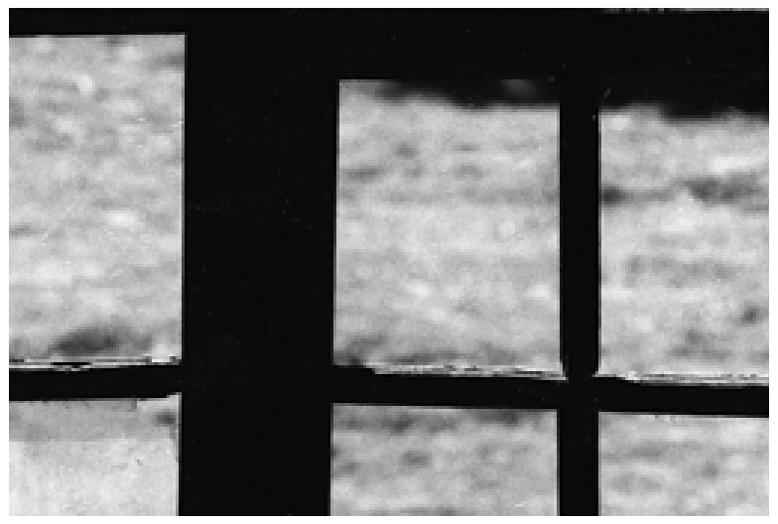
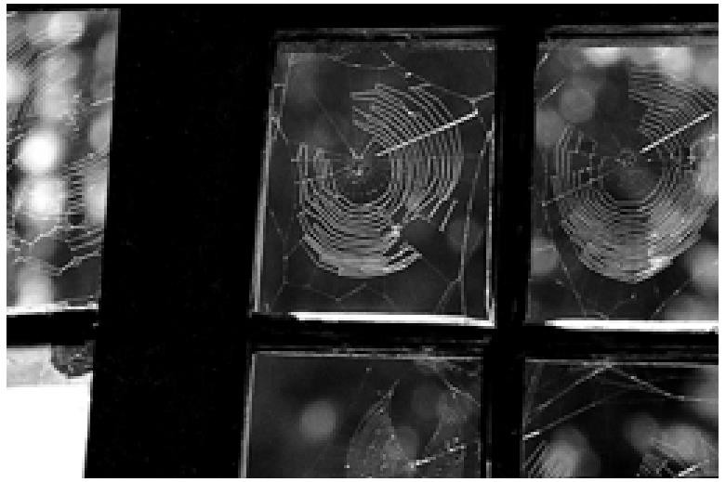
DARKFIELD
Fine structures can often not be seen in front of a bright background.

Slide 10
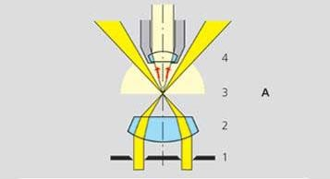
DARKFIELD
Dark background against which objects are brilliantly illuminated.
This is accomplished by a special condenser that transmits a hollow cone of light.
Most of the light directed through the condenser does not enter the objective, the field is dark.
However, some of the light rays will be scattered if the medium contains objects.
The diffracted light will enter the objective & reach the eye, thus the object will appear bright in an dark background.
Best for observing pale objects, unstained cells

Slide 11
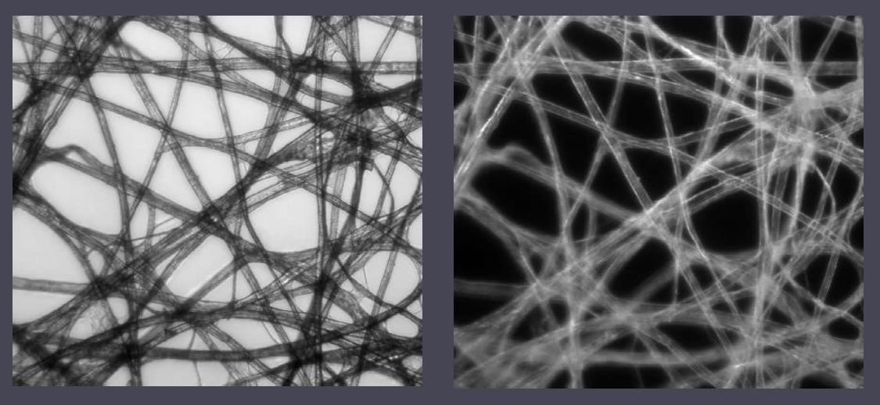
DARKFIELD

Slide 12
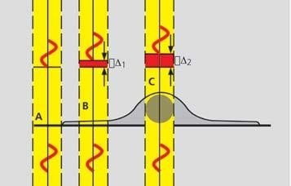
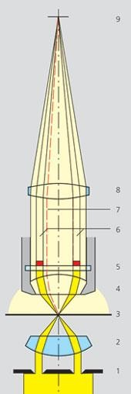
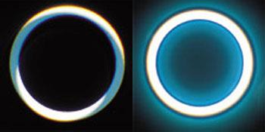
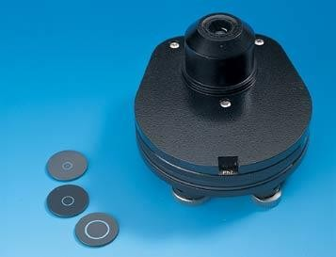
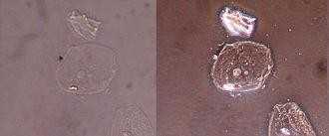
PHASE CONTRAST
Principle:
Incident light is out of phase with transmitted light as it was slowed down
while passing through different parts of the sample. when the phases of the light are synchronized by an interference lens, a new image with greater contrast is seen.
I0
not aligned
aligned
I
Phase stops

Slide 13
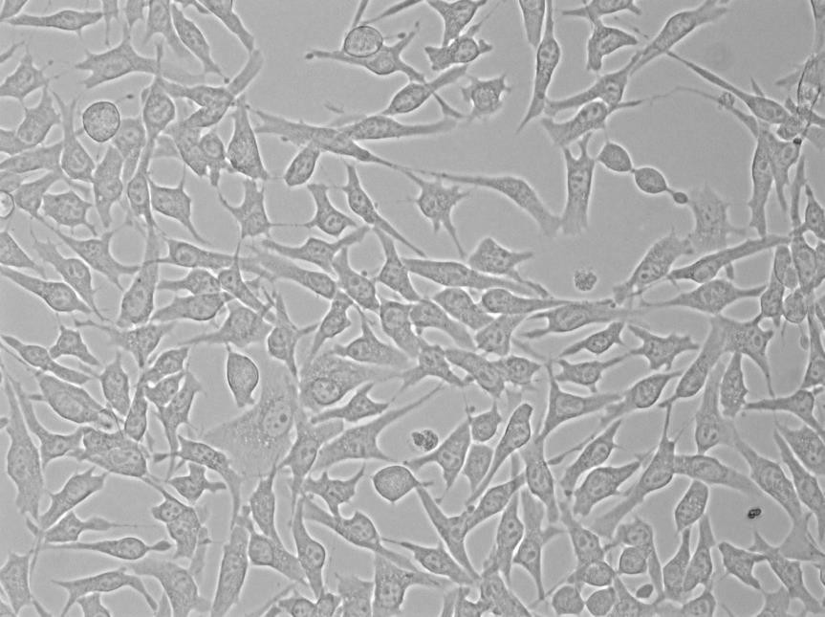
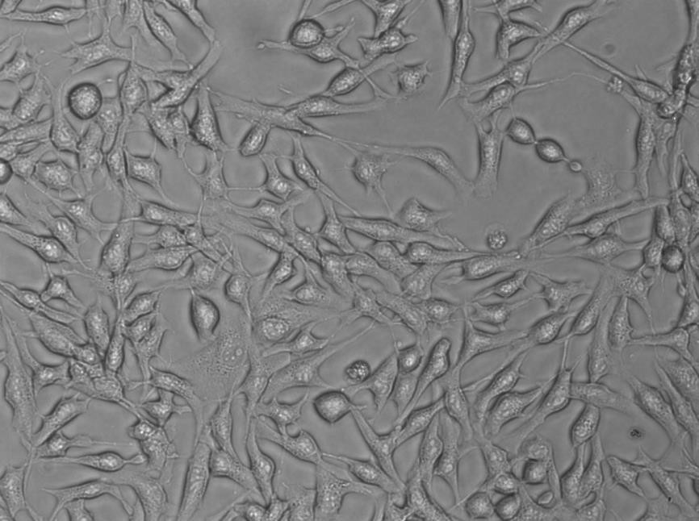
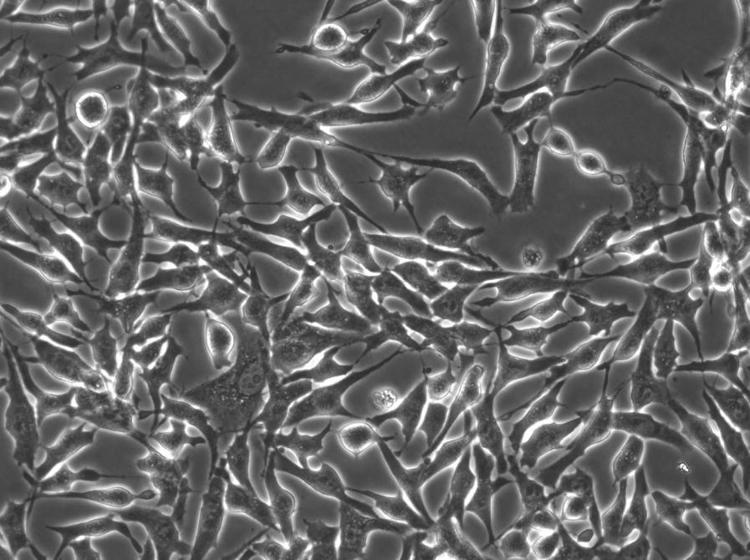
PHASE CONTRAST
Phase contrast in practice
Application: Phase contrast is the most commonly used contrasting technique All tissue culture microscopes and many time-lapse microscopes are set up for phase contrast.
I0
not aligned
aligned
I
Phase stops
brightfield
wrong phase stop
right phase stop

Slide 14
PHASE CONTRAST
I0
not aligned
aligned
I
Phase stops

Slide 15
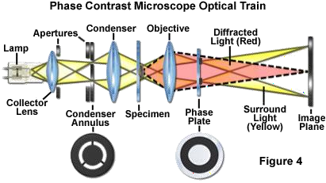
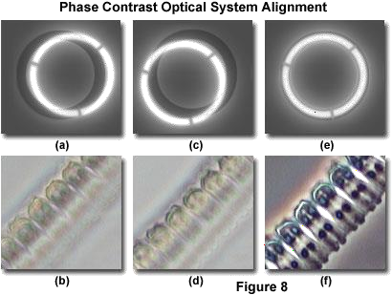
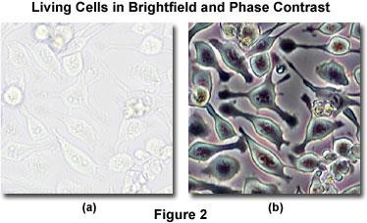
PHASE CONTRAST
I0
not aligned
aligned
I
Phase stops
THEORY & APPL. LIGHT MICROSCOPY

Slide 16
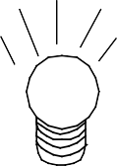
POLARISATION
propagation
direction
plane of vibration
light vibrates in
all planes that contain the light ray
(i.e., all planes perpendicular to the propagation direction
I0
not aligned
aligned
vibration direction
I
Phase stops
© Jane Selverstone, University of New Mexico, 2003

Slide 17
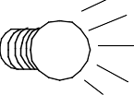
POLARISATION
1) Light passes through the lower polarizer
west (left)
Unpolarized light
Plane polarized light
east
(right)
Only the component of light vibrating in E-W direction can pass through lower polarizer –
light intensity decreases
Though polarized, still white light!
© Jane Selverstone, University of New Mexico, 2003

Slide 18
POLARISATION
2) Insert the upper polarizer
west (left)
north
(back)
south
(front)
east (right)
Black!! (“extinct”)
Now what happens? What reaches your eye?
Why would anyone design a microscope that
prevents light from reaching your eye???
© Jane Selverstone, University of New Mexico, 2003

Slide 19
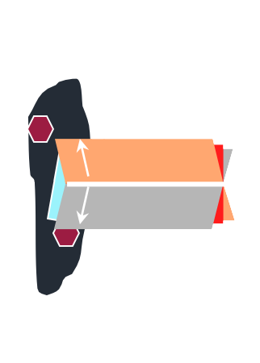
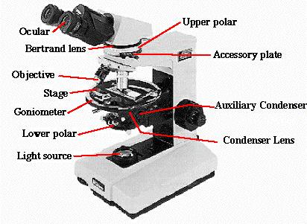
POLARISATION
3) Now insert a thin section
west (left)
Unpolarized light
east (right)
Light and colors reach eye!
Light vibrating E-W
Light vibrating in many planes and with many wavelengths
How does this work??
© Jane Selverstone, University of New Mexico, 2003

Slide 20
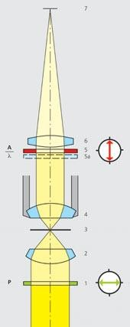
POLARISATION CONTRAST
Principle:
Polarized light is used for illumination. Only when the vibration direction of the polarized light is altered by a sample placed into the light path, light can pass through the analyzer. The sample appears light against a black background. A lambda plate can be used to convert this contrast into colours.
Application:
Polarization contrast is used to look at materials with birefringent properties, in which the refractive index depends on the vibration direction of the incident light, e.g. crystals or polymers.
Analyzer
Lambda plate
Polarizer

Slide 21
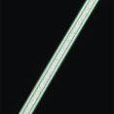
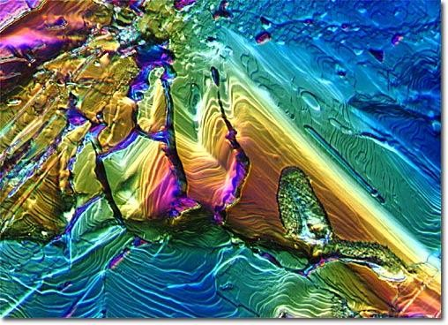
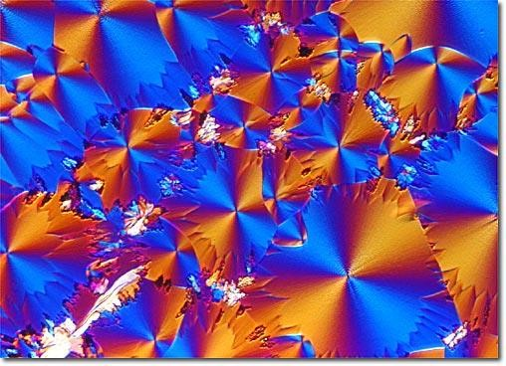
Brightfield
Polarization contrast
Polarization contrast with Lambda plate
Glutaric Acid Crystallites
Dinosaur Bone

Slide 22
NOMARSKI IMAGE
Result is extinction (shadow) on one side of specimen and reinforcement (bright) on the other
Shear of image
False relief 3D image
Consider wavefront diagrams

Slide 23
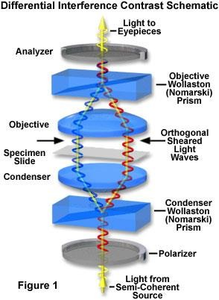

Slide 24
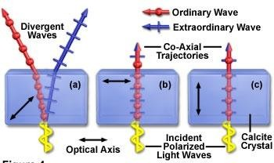
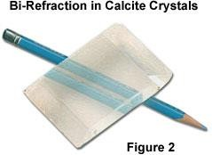
BIREFRINGENCE
Birefringent materials have different indices of refraction for light polarized parallel or perpendicular to the optical axis.
Two beams with orthogonal polarization are produced if illumination is at an angle to optical axis

Slide 25
Differential Interference Contrast (DIC)
ΔOPL
The idea:
Use two beams and interference to measure the path length difference between adjacent points in the sample
n_{m}
n_{s}

Slide 26
WOLLASTON / NOMARSKI PRISMS
Two pieces of cemented calcite/quartz
Produce orthogonally polarized beams propagating at different angles
f
.
Placed at a back focal plane, this produces the two beams that will probe the OPL difference of our sample

Slide 27
THE DIFFERENTIAL INTERFERENCE CONTRAST (DIC) MICROSCOPE
Camera
Projection Eyepiece
Imaging path
Tube lens
Polarizer (analyzer)
Wollaston
Objective
Sample
Condenser lens Aperture iris
Wollaston Polarizer
Illumination
path
Field lens
Field iris
Collector
Light source

Slide 28
HOW DIC GENERATES CONTRAST
X
Both beams see same OPL
Emerge in phase
Regenerate initial polarization
No light makes it through analyzer
© Jane Selverstone, University of New Mexico, 2003

Slide 29
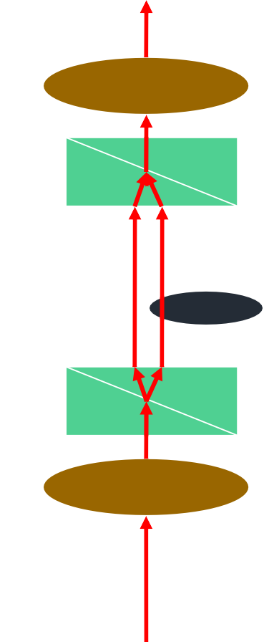
HOW DIC GENERATES CONTRAST
Beams see different OPL
Right beam is phase retarded
Generate elliptical
polarization
Light makes it through analyzer
© Jane Selverstone, University of New Mexico, 2003

Slide 30
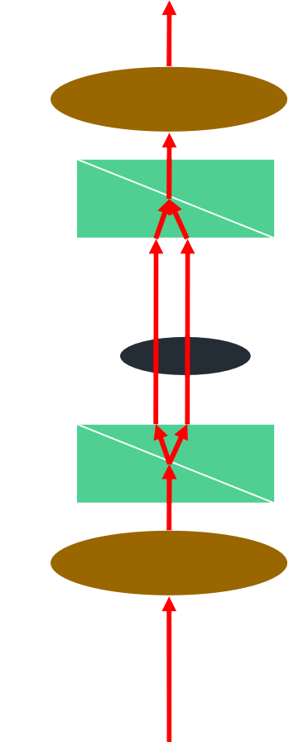
HOW DIC GENERATES CONTRAST
X
Both beams see same OPL
Emerge in phase
Regenerate initial polarization
No light makes it through analyzer

Slide 31
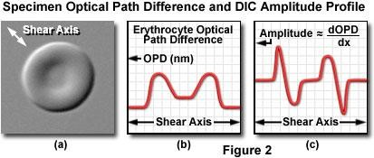
THEORY & APPL. LIGHT MICROSCOPY

Slide 32
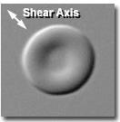
Contrast is directional
Contrast highlights edges
One end brighter, other is dimmer
giving a pseudo – 3D image

Slide 33
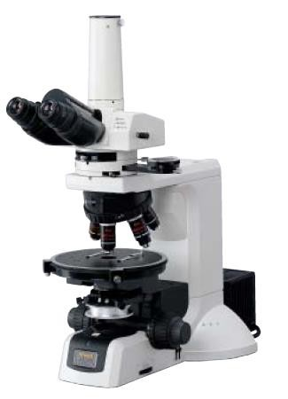
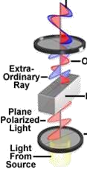
THE DIFFERENTIAL INTERFERENCE CONTRAST (DIC) MICROSCOPE
Analyzer
Polarizer

Slide 34
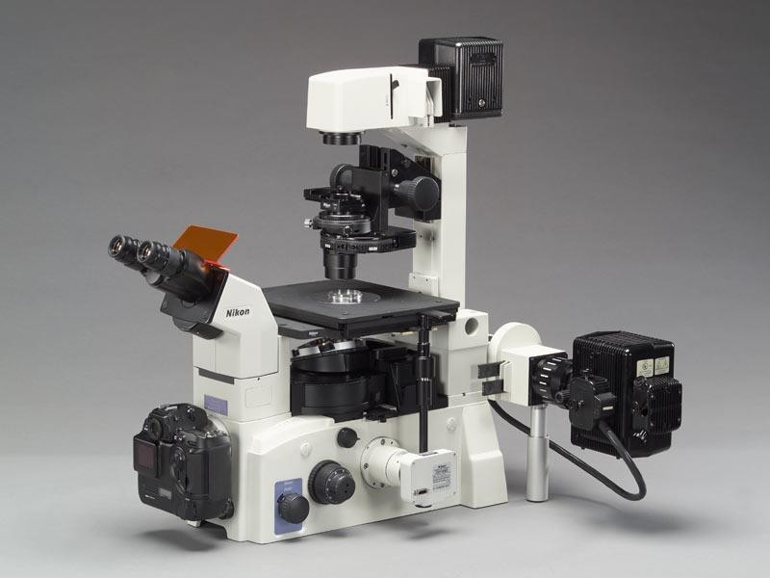
THE DIFFERENTIAL INTERFERENCE CONTRAST (DIC) MICROSCOPE
Analyzer
Condenser Nomarski prism
Polarizer

Slide 35
SHEAR IN IMAGE
Degree of shear is set by wollaston combination
Bias of shear adjustable by shifting upper wollaston position to retard one beam more or less relative to other
Cannot be used for quantitative measurements of dry mass
But extremely useful for observing living cells

Slide 36
THEORY & APPL. LIGHT MICROSCOPY

Slide 37
THEORY & APPL. LIGHT MICROSCOPY

Slide 38
THEORY & APPL. LIGHT MICROSCOPY

Slide 39
COMPARISON OF NOMARSKI AND PHASE CONTRAST OPTICS
Phase Contrast | Nomarski
Cheaper | More expensive
Easier to set up | Fussy alignment
Uses less than full aperture of objective | Uses full aperture — closest to theoretical limit
Phase Halo — surrounds specimen and other changes | Shadow Effect — contrast greatest at shear direction maximum

Slide 40
COMPARISON OF NOMARSKI AND PHASE CONTRAST OPTICS
Phase Contrast | Nomarski
Insensitive to birefringence in specimen or slides | Optics disrupted by birefringence
Extremely large depth of field — sensitive to artifacts far out of plane of specimen | Extremely shallow depth of field — useful for optical sectioning of specimen
Doesn’t work well with stained specimens | Works well with stained specimens; optics can be adjusted to enhance contrast

Slide 41
DIC IS HIGHER RESOLUTION THAN PHASE CONTRAST
DIC
Phase
THEORY & APPL. LIGHT MICROSCOPY

Slide 42
THEORY & APPL. LIGHT MICROSCOPY

Slide 43
THEORY & APPL. LIGHT MICROSCOPY

Slide 44
THEORY & APPL. LIGHT MICROSCOPY

Slide 45
HeLa Cell Culture
Heliozoans
(Actinophrys sol)
THEORY & APPL. LIGHT MICROSCOPY

Slide 46
https://en.wikipedia.org/wiki/Polarized_light_microscopy#/me dia/File:Paper_Micrograph_Bright.png
THEORY & APPL. LIGHT MICROSCOPY

Slide 47
CONTRASTING TECHNIQUES - A SUMMARY
Brightfield - absorption
Light transmitted through sample. Only useful for colored samples. Very little contrast in unstained ones
Darkfield - scattering
Light directed from the side - only scattered light enters the microscope lenses -> sample appears as an illuminated object
Phase Contrast - phase interference
Incident light is out of phase with transmitted light. phases of the light are synchronized by an interference lens -> new image with greater contrast
Polarization Contrast – polarization
Polarized light for illumination. vibration direction of the polarized light is altered by a sample - light can pass through analyzer. The sample appears light against a black background.
Differential Interference Contrast (DIC) – polarization + phase interference
Also known as Nomarski microscopy. Synchronizing of the different phases of incident and transmitted light is done by a set of special condenser lens mounted below the stage of a microscope
Fluorescence Contrast

