Slide 1


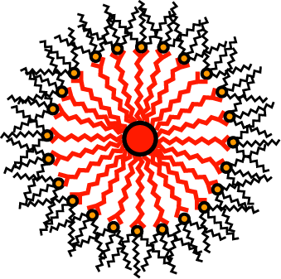
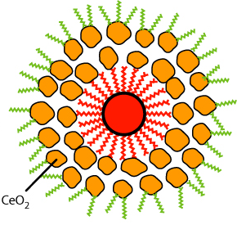
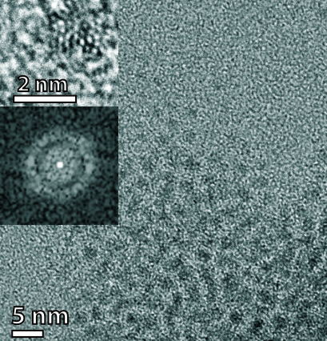
Pd@CeO₂ HIERARCHICAL STRUCTURES
Ce(IV) tetrakis(decyloxide)
Hydrolysis conditions:
THF + 30 eq H₂O
(120 mol vs Ce) in 4 h
THF
MUA-Pd NPs
MUA: 11-Mercapto
Undecanoic Acid
Controlled Hydrolysis
Pd core size:
1.8 ± 0.2 nm
Dispersible in CH₂Cl₂, toluene, hexane
J. Am. Chem. Soc. 132 (2010), 1402-1409.

Slide 2
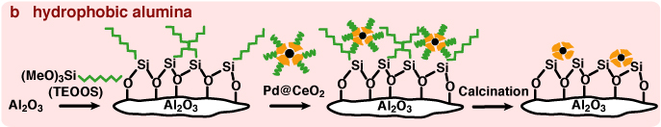
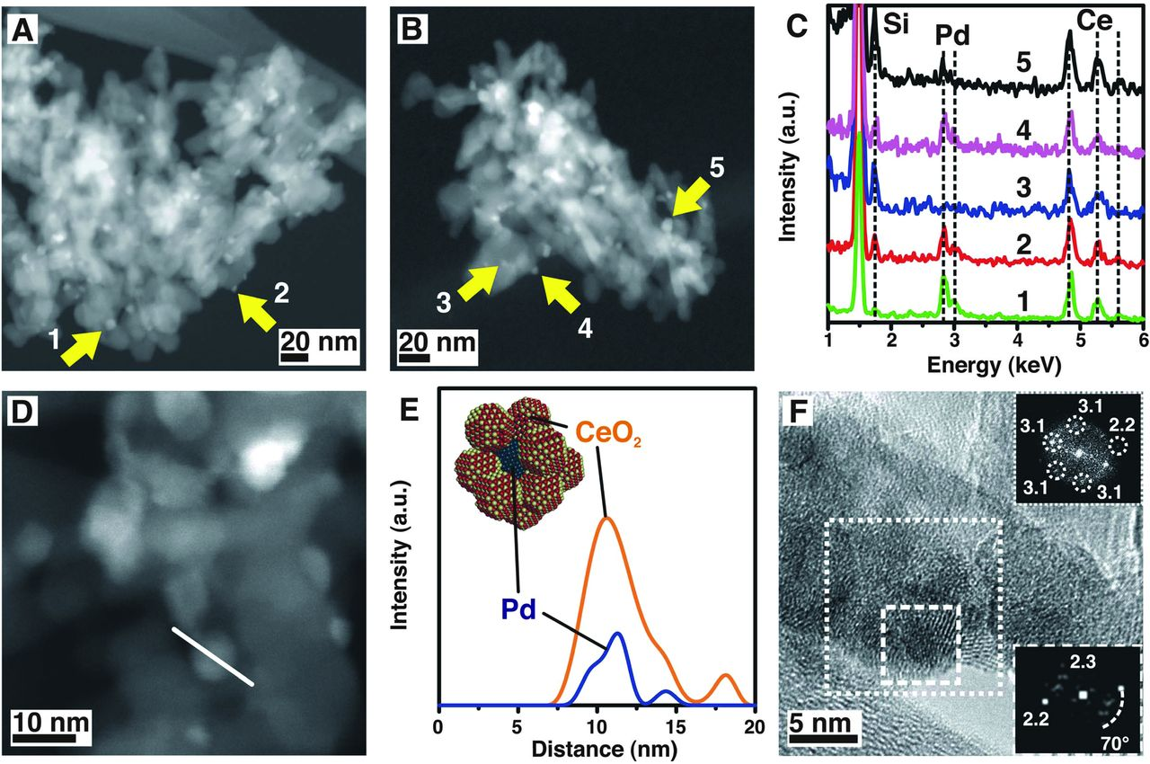
Pd@CeO₂ FOR CH₄ combustion
HAADF-STEM
Science 337 (2012), 713-717.

Slide 3
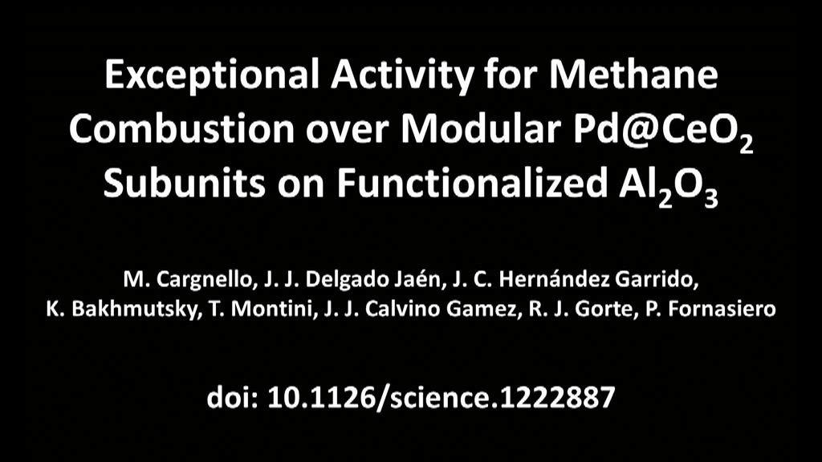
Pd@CeO₂/Al₂O₃ materials

