Slide 1

Economics of Monetary Union 14e
Paul De Grauwe
Introduction

Slide 2
Outline of this module
The theory of optimal currency areas (OCA)
The costs of a monetary union
The benefits of a monetary union
Costs and benefits compared
Monetary union
The fragility of incomplete monetary unions
Transition towards a monetary union
How to complete a monetary union
The European Central Bank: institutional features

Slide 3
Paul De Grauwe
Chapter 1: The costs of a common currency

Slide 4
Introduction
When joining a monetary union, a country loses monetary policy instrument
This is costly when asymmetric shocks occur

Slide 5
1 Shifts in demand (Mundell)
Analysis is based on celebrated contribution of Robert Mundell (1961)
Assume two countries, France and Germany
Asymmetric shock in demand

Slide 6
1 Shifts in demand (Mundell)
Asymmetric shock in demand
Decline in aggregate demand in France
Increase in aggregate demand in Germany
Need to distinguish between permanent and temporary shock
We will analyse this shock in two regimes
Monetary union
Monetary independence

Slide 7
Figure 1.1 Aggregate demand and supply in France and Germany
France
Germany
P_{F}
P_{G}
S_{G}
S_{F}
D_{G}
D_{F}
Y_{F}
Y_{G}

Slide 8
First regime: monetary union
Definition of monetary union
Common currency
Common central bank setting one interest rate
How can France and Germany deal with this shock if they form a monetary union?
Thus France cannot stimulate demand using monetary policy; nor can Germany restrict aggregate demand using monetary policy
Do there exist alternative adjustment mechanisms in monetary union?

Slide 9
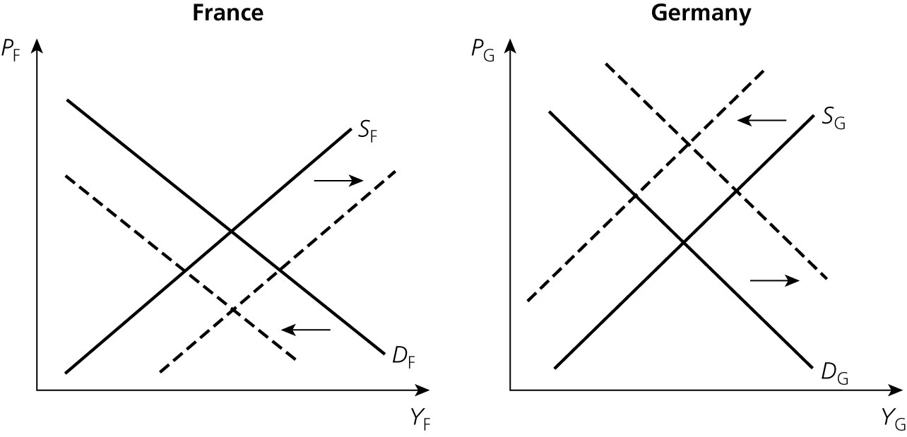
Wage flexibility
Aggregate supply in France shifts downwards
Aggregate supply in Germany shifts upwards
Figure 1.2 The automatic adjustment process
3
2
1
1
2
3

Slide 10
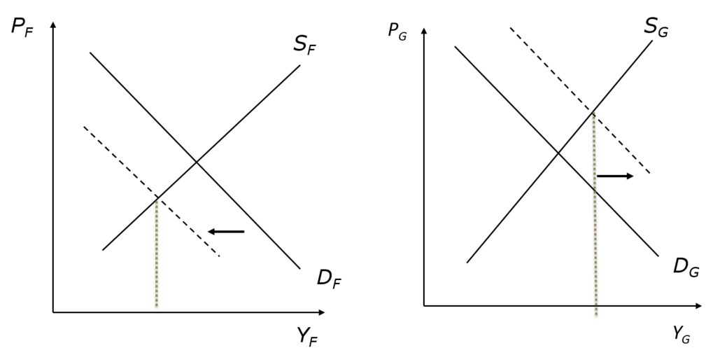
Labour mobility
Is very limited in Europe
Especially for low-skilled workers

Slide 11
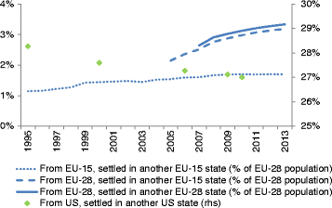
Labour mobility and labour market adjustment in the EU
Share of EU working-age population born in other EU countries and share of US population born in a different US state
Source: Arpaia et al. 2016

Slide 12
Monetary union will be costly, if
wages and prices are not flexible
if labour is not mobile
France and Germany may then regret being in a union

Slide 14
Second regime: monetary independence
What if France and Germany had maintained their own currency and national central bank?
Then national interest rate and/or exchange rate can be used.
flexible exchange rates
peg exchange rates to another currency

Slide 15
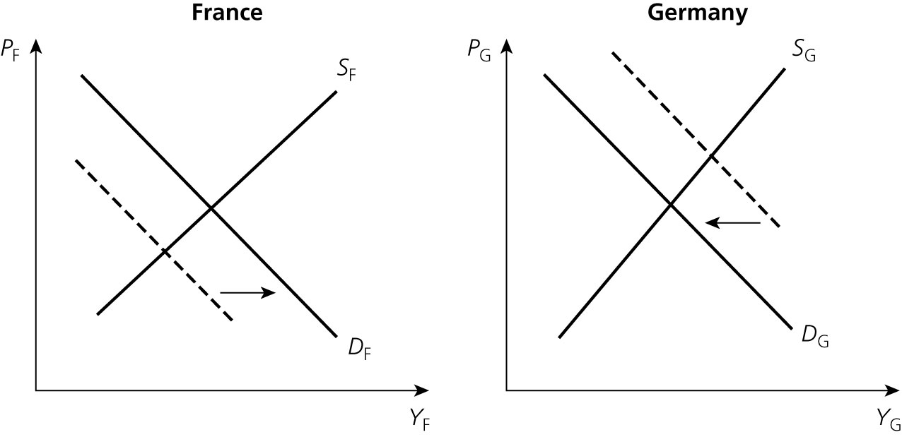
Figure 1.3 Effects of monetary expansion in France and monetary restriction in Germany

Slide 16
Thus when asymmetric shocks occur and when there are a lot of rigidities monetary union may be more costly than not being in a monetary union.

Slide 17
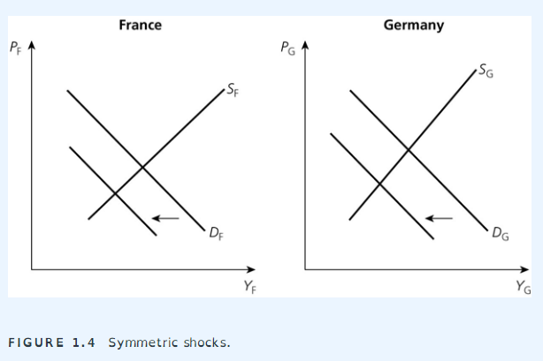
What about symmetric shocks?

Slide 18
1.2 Monetary independence and government budgets
When countries join a monetary union they lose their monetary independence.
That affects their capacity to deal with asymmetric shocks.
The loss of monetary independence has another major implication:
it fundamentally changes the capacity of governments to finance their budget deficits.
Let us develop this point further.

Slide 19
Members of monetary union issue debt in currency over which they have no control.
It follows that financial markets acquire power to force default on these countries.
Not so in countries that are not part of monetary union, and have kept control over the currency in which they issue debt.
Consider case of UK (‘stand-alone’ country) and Spain (member of monetary union).

Slide 20
UK Case
Suppose investors fear default of UK government:
they sell UK govt. bonds (yields increase)
proceeds of sales are presented in forex market
Sterling drops
UK money stock remains unchanged, maintaining pool of liquidity that will be reinvested in UK govt. securities
if not, Bank of England can be forced to buy UK govt. bonds.
Investors cannot trigger liquidity crisis for UK government and thus cannot force default (Bank of England is superior force).
Investors know this; thus, they will not try to force default.

Slide 21
Spanish case
Suppose investors fear default of Spanish government:
they sell Spanish govt. bonds (yields increase)
proceeds of these sales are used to invest in other eurozone assets
Spanish money stock declines;
no Spanish central bank that can be forced to buy Spanish government bonds
liquidity crisis possible
Spanish government can be forced to default
investors know this and will be tempted to try.

Slide 22
Monetary union is fragile
a forced budgetary austerity is politically costly and may lead the government to stop servicing the debt and to declare a default.
By entering a monetary union member countries become vulnerable to movements of distrust by investors.
Self-fulfilling prophecy
This dynamic is absent in countries that have kept their monetary independence.

Slide 23
1.3 Asymmetric shocks and debt dynamics
There is an important interaction between asymmetric shocks and debt dynamics:
negative shock:→ GDP →tax receipts
Unemployment →government expenditures
→ budget deficit increases

Slide 24
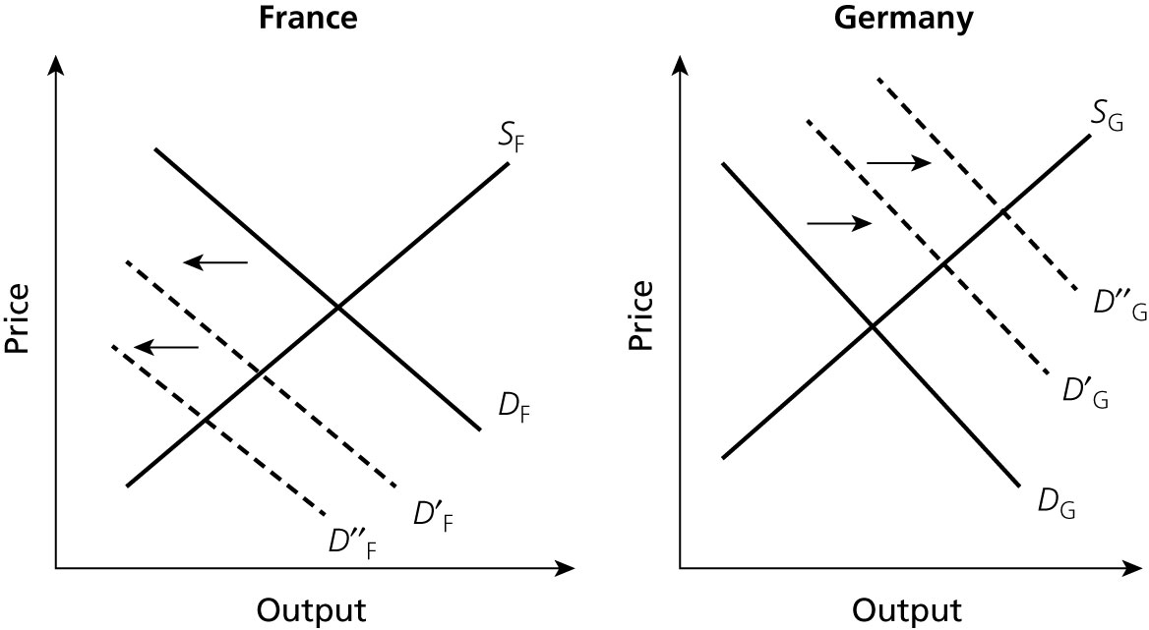
Figure 1.5 Amplification of asymmetric shocks

Slide 25
Consequences
Negative amplification in France and positive amplification in Germany
(long term) Interest rate changes: instead of stabilizing the system, it tends to destabilize it.
All this intensifies the adjustment problems of both countries.

Slide 26
Non permanent shocks
Periods of optimism and pessimism alternate, creating booms and busts in economic activity
Problem is when shocks are not synchronized.
Two scenarios
the union can live with the desynchronized business cycle (if investors keep their trust in the French government’s capacity to service its debt)
Budget deficit in France and Budget surplus in Germany
automatic stabilisers
Liquidity flow to the country experiencing a boom→ increase in the interest rate in the country experiencing a recession (and decrease in the interest rate in the country experiencing a boom)

Slide 27
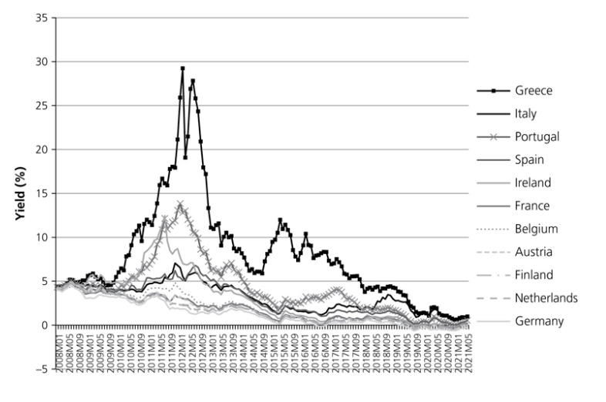
Figure 1.9 Ten-year government bond yields
Source: European Commission, AMECO databank

Slide 28
Covid-19 shock of 2020: asymmetric effects of symmetric shock
Covid-19 shock hit all countries at same time
It appears to be a symmetric shock.
However, its effects on different EMU-countries was very asymmetric
Large differences in effct on GDP (see next figure)
Therefore also large differences in effects on budget deficits and debts (following figures)
Potential for renewed sovereign debt crisis was created
And avoided
We ask the question later Why?

Slide 29
Large differences impact of Covid-19 on GDP
Source: Eurostat

Slide 30
Large differences impact of Covid-19 on budgets
Source: Eurostat

Slide 31
High correlation GDP-growth and budget balance
Source: calculations using Eurostat data

Slide 32
1.4 Monetary union and budgetary union
Monetary union can be very fragile.
Can one design a mechanism that will alleviate these problems and thereby reduce the costs of a monetary union?

Slide 33
There is such a mechanism: budgetary union
This consists of centralizing a significant part of the national budgets into a common union budget.
This is a monetary union with a budgetary union.
Such a budgetary union achieves two things:
It creates an insurance mechanism
It allows consolidation of part of national government debts and deficits.

Slide 34
A budgetary union as an insurance mechanism
Centralized budget allows for automatic transfers between countries of monetary union:
can offset asymmetric shocks
is largely absent at European level (European budget only 1% of EU GDP)
exists at national level
creates problems of moral hazard.

Slide 35
A budgetary union as a protection mechanism
In a budgetary union, national government debts are centralized into a union government debt (or at least a significant part).
There is little prospect for centralization of national budgets at the European level.
Such a centralization would require a far-reaching degree of political unification.
Small step was taken with NextGeneration-EU programme

Slide 36
Private insurance systems
Integrated capital markets allow for automatic insurance against shocks.
Example: stock market.
Insurance mainly for the wealthy.

Slide 37
Other sources of asymmetry
Different labour market institutions.
Centralized versus non-centralized wage bargaining.
Symmetric shocks (e.g. oil shocks) are transmitted differently when institutions differ across countries.
Different legal systems
These lead to different transmission of symmetric shocks (e.g. interest rate change).
Anglo-Saxon versus continental European financial markets.

Slide 38
Symmetric and asymmetric shocks compared
When shocks are asymmetric:
monetary union creates costs compared to monetary independence
common central bank cannot deal with these shocks.
When shocks are symmetric:
monetary union becomes more attractive than monetary independence
common central bank can deal with these shocks
monetary independence can then lead to conflicts and‘beggar-my-neighbour’policies.

Slide 39
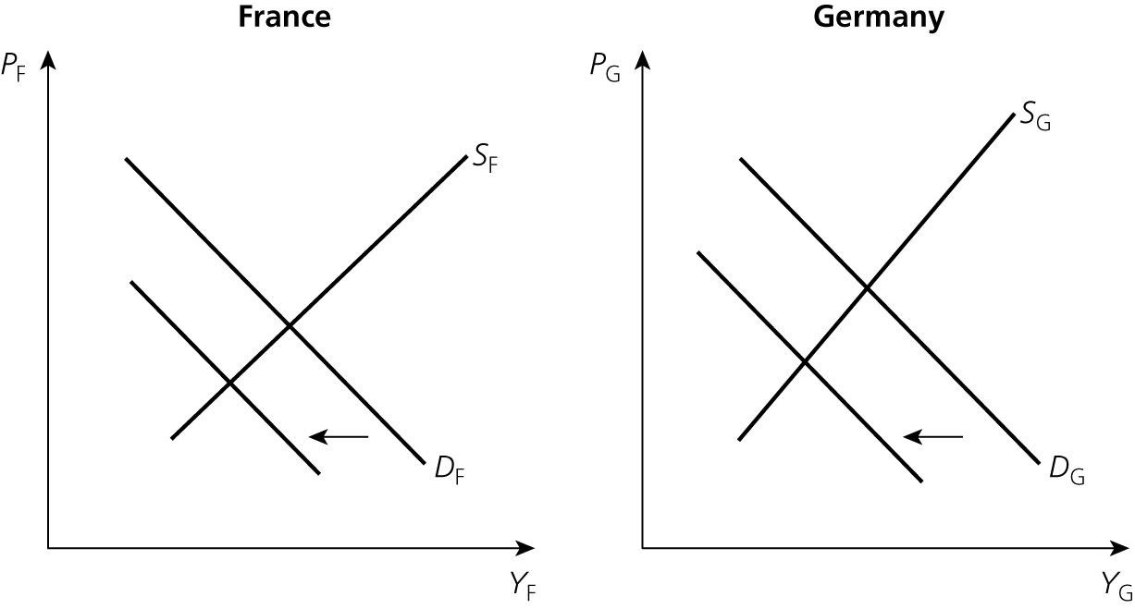
Figure 1.4 Symmetric shocks

