Slide 1
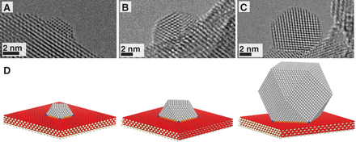
Nanomaterials: Nanocomposites
A nanocomposite is a solid containing at least one physically or chemically distinct region, or collection of regions, having at least one dimension in the nanoscale.
The use of nano building blocks can allow to design and create new materials with unprecedented flexibility and improvement in their physical properties. In the broadest sense this definition can include porous media, colloids, gels and copolymers, but is more usually taken to mean the solid combination of a bulk matrix and nano-dimensional phase(s) differing in properties due to dissimilarities in structure and chemistry.
The mechanical, electrical, thermal, optical, electrochemical, catalytic properties of the nanocomposite will differ markedly from that of the component materials. SINERGIC EFFECT

Slide 2
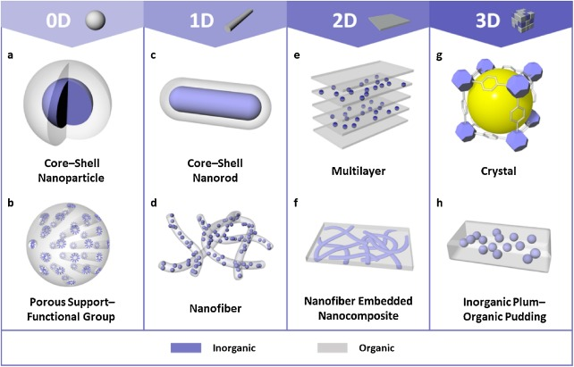
https://www.sciencedirect.com/science/article/pii/S1748013218304225

Slide 3
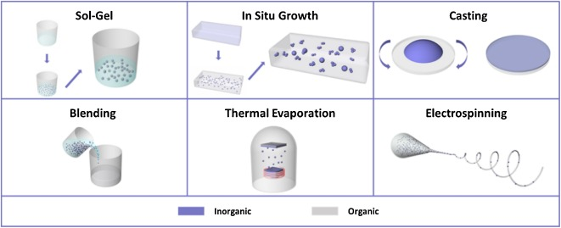

Slide 4
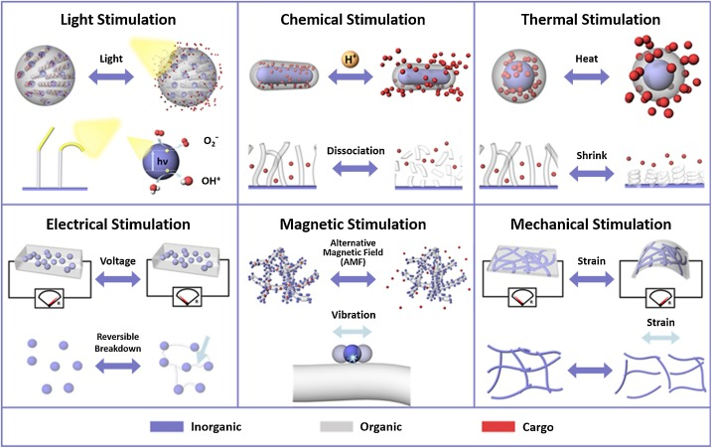

Slide 5
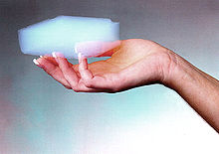
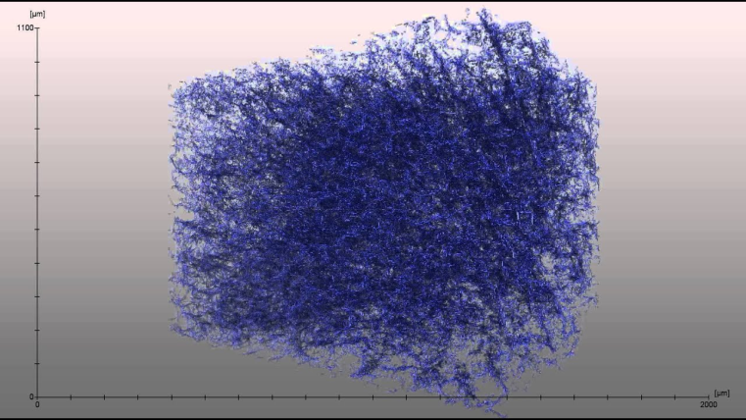
A nanofoam has a liquid or solid matrix, filled with a gaseous phase, where one of the two phases has dimensions on the nanoscale.
Foam is an object formed by trapping pockets of gas in a liquid or solid.
Aerogel is a synthetic porous ultralight material derived from a gel, in which the liquid component for the gel has been replaced with a gas
Insulating materials
Catalysis
Gas storage
Separation / filtration
Carbon nanofoam

Slide 6
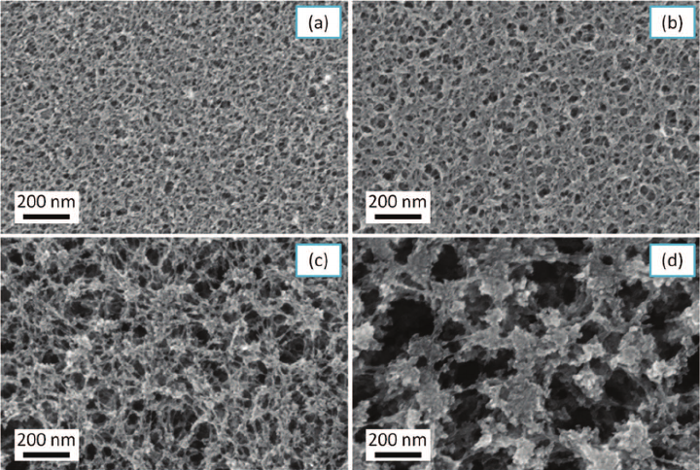
A nanoporous material is a solid material containing nanopores, cavities with dimensions on the nanoscale.
The skeletal portion of the material is often called the "matrix" or "frame".
Activated carbon and zeolites are two examples of bulk nanoporous materials.
The pores are typically filled with a fluid (liquid or gas).
A nanoporous material with consistently sized pores has the property of letting only certain substances pass through, while blocking others. Chromatography, catalysis, filtration,…

Slide 7
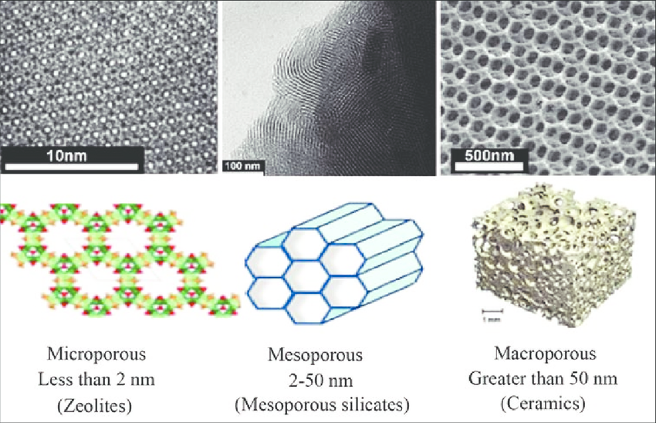
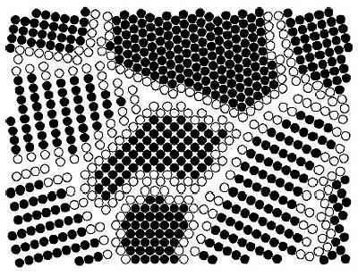
Nanoporous materials and nanofoam are sometimes considered nanostructures but not nanomaterials because only the voids and not the materials themselves are nanoscale.
A nanocrystalline material has a significant fraction of crystal grains in the nanoscale.
Although the ISO definition only considers round nano-objects to be nanoparticles, other sources use the term nanoparticle for all shapes

Slide 8
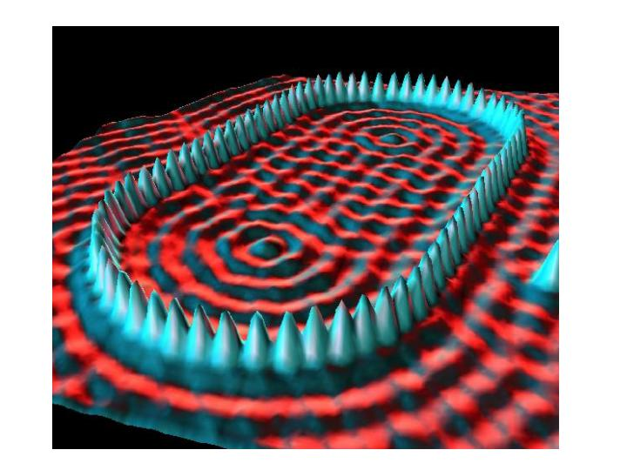
Instrumentation / Imaging
“Quantum Corral”
48 Fe atoms positioned by the STM used
to image them
http://www.nano.gov/html/facts/home_facts.html

Slide 9
Physical and Chemical Properties that can Change at the Nanoscale
Color
Melting temperature
Crystal structure
Chemical reactivity
Electrical conductivity
Magnetism
Mechanical strength
…
Notes:
Trainer Notes:
This is a partial list of some of the physical and chemical properties that can change for a given nanomaterial. Not all of these changes will be relevant for every nanoparticle; each will have its own set of variable properties.

Slide 10
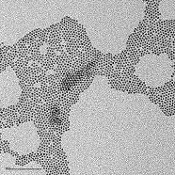
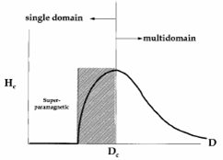
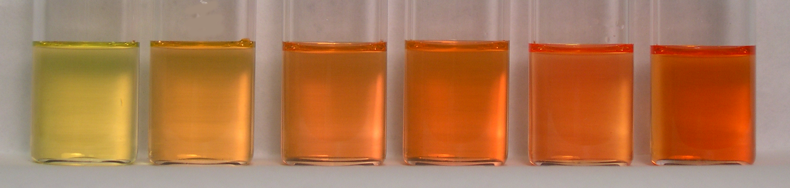
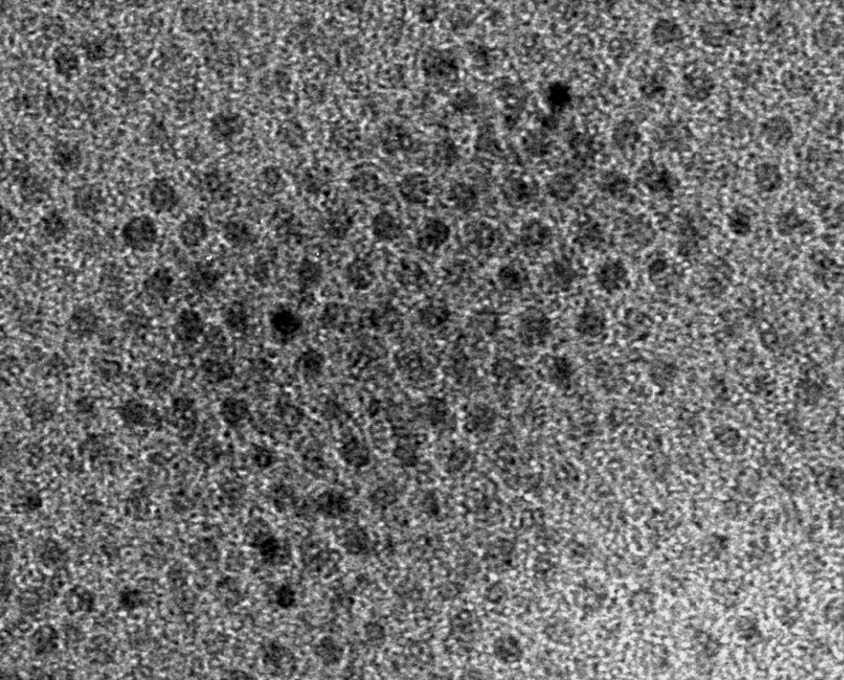
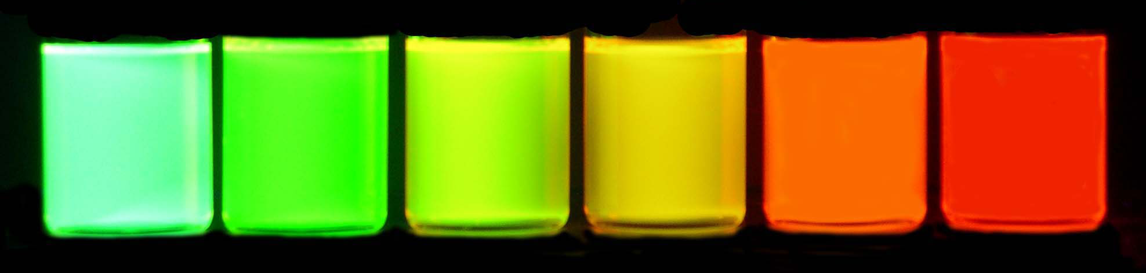
Some Other Size-Dependent Properties
Fe₃O₄, Magnetite (4 nm)
CdSe (8 nm)
Magnetism
Emission
Notes:
Trainer Notes:
Optional additional examples of properties that change as a result of the nanoscale size of the object.
LEFT: The form of iron oxide known as magnetite exhibits size-dependent magnetism. The magnetic strength of a permanent magnet does not change with the magnet’s size at the macroscale. But tiny magnets can actually exhibit larger magnetic fields than bigger magnets. The figure shows a parameter associated with magnetic field strength H plotted against particle diameter D. Note that as the magnet gets smaller the field strength goes up until it reaches a maximum.
[This is called superparamagnetism and can be explained by the fact that at a certain size, within the nanoscale, the material can form a single crystal (or domain) in which all the magnetic moments are aligned in the same direction. In larger magnets, multiple “domains” are present with slightly misaligned magnetic fields, which weakens the overall field strength. An analogy is the difference in power between a tug-of-war team that is all pulling straight back vs. one in which some of the members are pulling the rope off to one side or the other. The overall pulling power of the team is weakened if all members are not pulling in the same direction.]

Slide 11
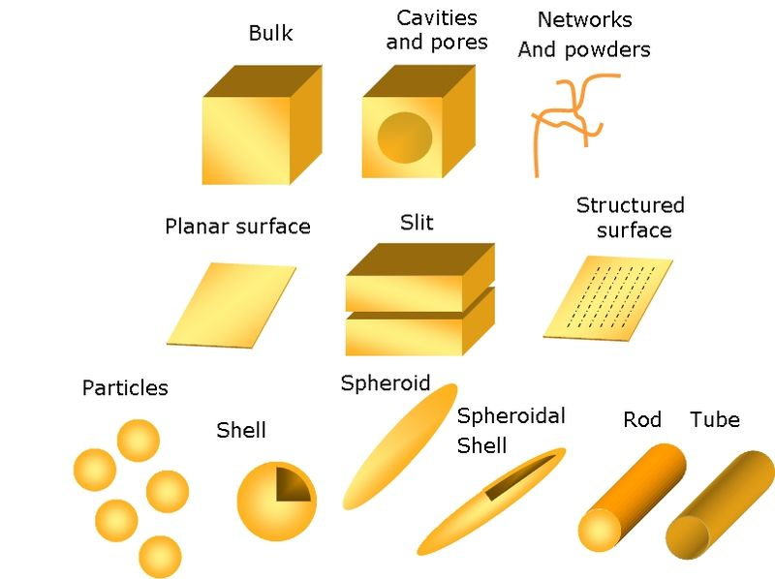

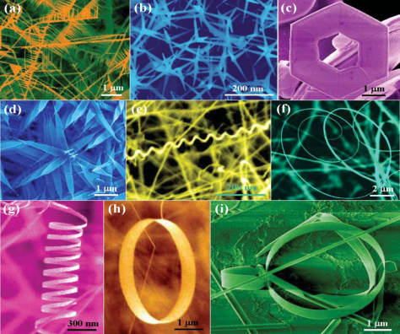
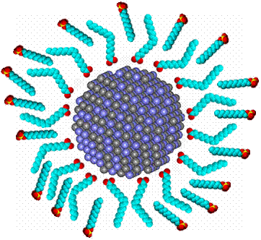
Nanomaterials Exhibit Diversity in…
Chemical composition
Form or shape
Surface treatments
Notes:
Trainer Notes:
TOP: Novel materials can be made just by taking elements in the periodic table and combining them to form objects within the nanoscale range. There is incredible chemical diversity among nanomaterials.
MIDDLE: Note the wide variety of different shapes of the objects shown in the middle image (and that the color was added to the microscope images for visual appeal). Now reveal that each one of those objects has exactly the same chemical formula: ZnO. Nanoscientists and engineers can take the same substance and shape it into many different types of nanoscale objects. There is great structural diversity among nanomaterials.
BOTTOM: Manufacturers often change the surface of a nanoparticle during product formulation to achieve the desired dispersability, stability or activity. These surface modifications may impact the properties to such an extent that the surface-treated particle is, for all purposes, an entirely different substance than the non-treated particle.
Image credits: (top) http://facstaff.gpc.edu; (middle left) K. Molhave, Opensource Handbook of Nanoscience and Nanotechnology, (middle right) Zhong Lin Wang, (bottom) CBEN, Rice University

Slide 12
Major classes of nanomaterials and their benefits

Slide 13
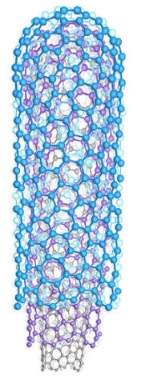
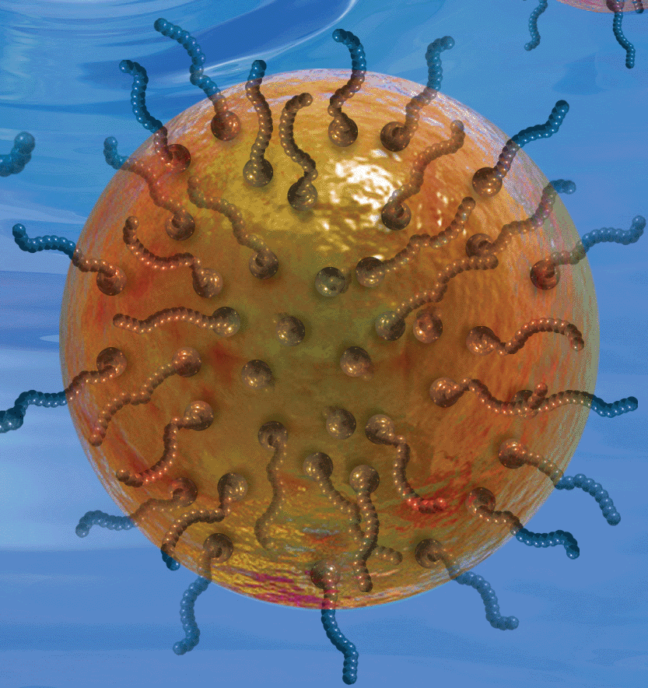
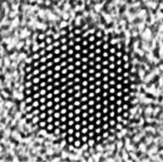
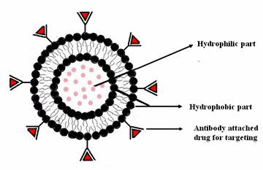
Major Classes of Nanomaterials and Sample Applications
Category | Chemical Composition | Product example
Fullerenes, Nanotubes; Nanowires | carbon, boron nitrides | Anti-static fabrics
Metals | silver, gold, iron, copper | Anti-microbial wound dressings
Ceramics (metal oxides) | titanium dioxide, zinc oxide, cerium oxide | Sunscreen filters, self-cleaning glass
Semiconductors (Quantum dots) | cadmium selenide, cadmium telluride | Medical imaging agents
Polymeric | hydrocarbon polymers | Drug delivery devices
Notes:
Trainer Notes:
One way to categorize nanomaterials is by their chemical composition. Many of the most commercially important nanomaterials can be categorized into one of the five classes listed here.
Fullerenes, Nanotubes; Nanowires: Most materials in this class are made from carbon. These include the family of compounds derived from the C₆₀ molecule known as buckminsterfullerene or buckyball, as well as the class of materials known as nanotubes. Nanotubes are simply elongated versions of the buckyball and can exist in single-walled, double-walled or multi-walled configurations.
Metals: There are many examples of nanometals in use today. The most commercially relevant is likely to be nanosilver, which is prized for its potent and broad-spectrum antimicrobial properties. Nanosilver is used in a number of consumer products ranging from spray disinfectants to toothpaste and teddy bears, as well as in many medical applications such as wound dressings and catheters. Nanosilver is even being researched for use in animal feed to reduce the need for conventional antibiotics
Ceramics: Another very broad class of materials that includes titanium dioxide, which is used in sunscreens and to coat so-called “self-cleaning glass”, as well as cerium oxide, which is a fuel additive that promotes greater fuel efficiency.
Semiconductors (Quantum Dots): These exhibit very bright photoluminescence and can be used as medical imaging agents. Unlike conventional dyes, quantum dots do not degrade quickly and have much brighter luminescence, thus enhancing the signal in a medical image. Their surfaces can be modified to direct them to specific cells in the body, including cancer cells which can aid in disease detection.
Polymeric: Polymeric nanoparticles are small beads made from polymeric hydrocarbons. They can serve as containers for drug molecules and can be designed to deliver the drug to the precise location via surface modification with biomarkers that target a certain type of cell, for example. Polymeric nanoparticles are also used in the cosmetics industry to encapsulate active ingredients and potentially deliver them beneath the epidermis.

Slide 14
Balancing the Benefits and Risks
Nanomaterials’ special physical and chemical properties may lead to unexpected interactions with biological and environmental systems.
Notes:
Trainer Notes:
The novelty of certain nanomaterials may be a double-edged sword. Society supports the development of novel nanoscale materials because of their different physical and chemical properties. But this novelty could result in unwanted impacts on humans or the natural environment. As we’re developing technologies to solve one problem we should ensure we are not contributing to another.
There is a growing body of information about nanomaterial toxicity that must be considered in designing and implementing a safe workplace. That’s where we’re going next.
Image Credit: Scale-Microsoft Clipart

Slide 15
100 Kg H₂O
V = 100 L
V = a³ = 100 dm³ a = 4.64 dm
Surface 6 x a² = 129 dm²
1 cube
100 Kg H₂O
V_{i} = 1 L
V_{i} = a_{i} ³ = 1 dm³ a = 1 dm
Total surface 100 x 6 x a_{i} ²
= 600 dm²
100 cubes

Slide 16
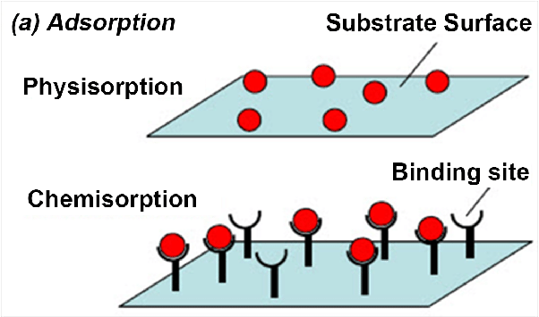
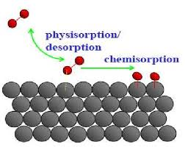
Physisorption and chemisorption

Slide 17
Adsorption and Reaction at Surfaces
PHYSISORPTION | CHEMISORPTION
WEAK, LONG RANGE BONDING Van der Waals interactions (e.g. London dispersion, dipole-dipole).. | STRONG, SHORT RANGE BONDING Chemical bonding involving orbital overlap and charge transfer.
NOT SURFACE SPECIFIC Physisorption takes place between all molecules on any surface providing the temperature is low enough. | SURFACE SPECIFIC Marked variation between crystal planes E.g. Chemisorption of hydrogen takes place on transition metals but not on gold or mercury.
ΔΗ_{ads} = 5 ….. 50 kJ mol⁻¹ Related to factors like molecular mass and polarity (i.e. ~ heat of liquefaction) | ΔΗ_{ads} = 50 ….. 500 kJ mol⁻¹ Wide range (related to the chemical bond strength)
Non activated with equilibrium achieved relatively quickly. Increasing temperature always reduces surface coverage. | Can be activated, in which case equilibrium can be slow and increasing temperature can favour adsorption.
No surface reactions. | Surface reactions may take place:- Dissociation, reconstruction, catalysis.
MULTILAYER ADSORPTION BET Isotherm used to model adsorption equilibrium. | MONOLAYER ADSORPTION Langmuir Isotherm used to model adsorption equilibrium..

Slide 18
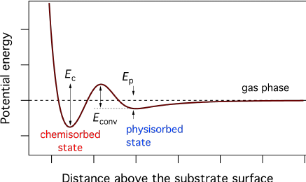

Slide 19
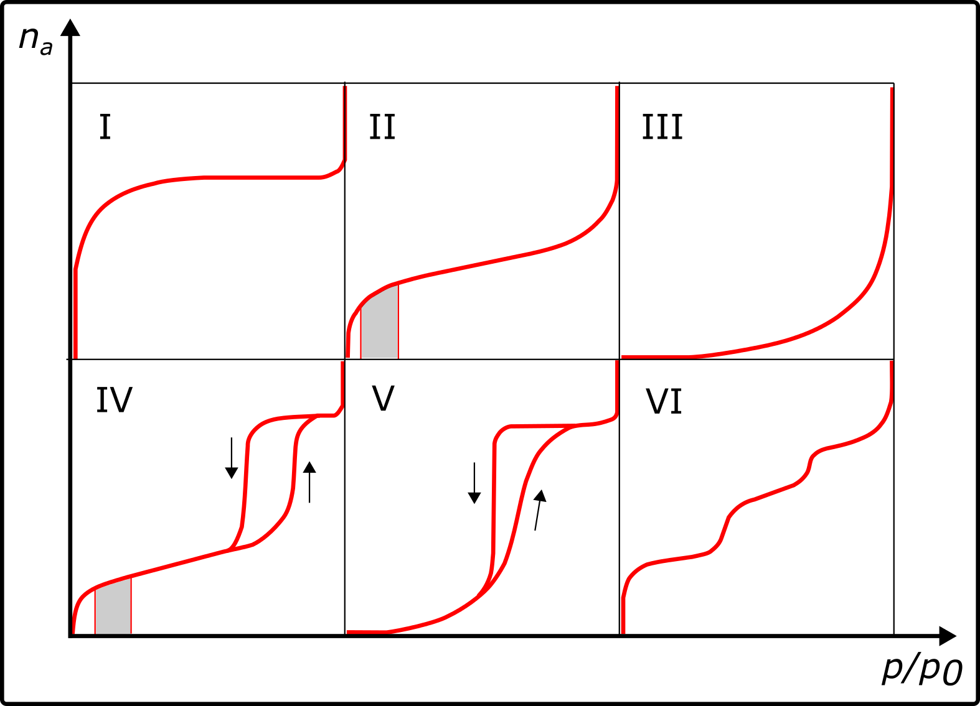

Slide 20
Type I Pores are typically microporus with the exposed surface residing almost exclusively inside the microspores, which once filled with adsorbate, leave little or no external surface for further adsorption.
Type II Most frequently found when adsorption occurs on nonporous powders or powders with diameters exceeding micropores. Inflection point occurs near the completion of the first adsorbed monolayer.
Type III Characterised by heats of adsorption less than the adsorbate heat of liquification, adsorption proceeds as the adsorbate interaction with an adsorbed layer is greater than the interaction with the adsorbent surface.
Type IV Occur on porous adsorbents with pores in the range of 1.5 – 100nm. At higher pressures the slope shows increased uptake of adsorbate as pores become filled, inflection point typically occurs near completion of the first monolayer.
Type V Are observed where there is small adsorbate-absorbent interaction potentials (similar to type III), and are also associated with pores in the 1.5 –100 nm range.
Type VI The reversible stepwise Type VI isotherm is representative of layer-by-layer adsorption on a highly uniform nonporous surface.

Slide 21
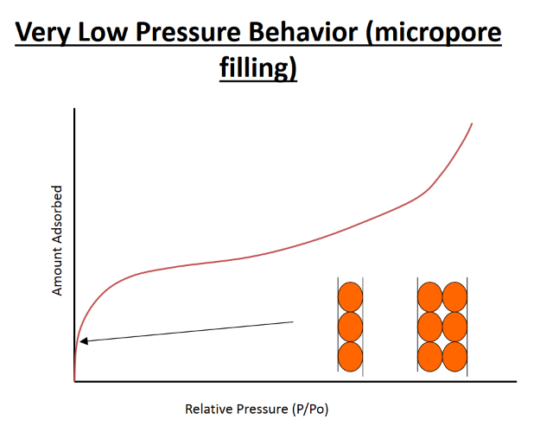

Slide 22
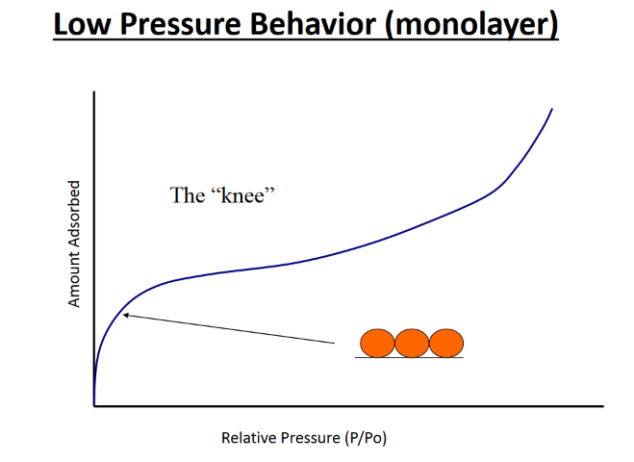

Slide 23
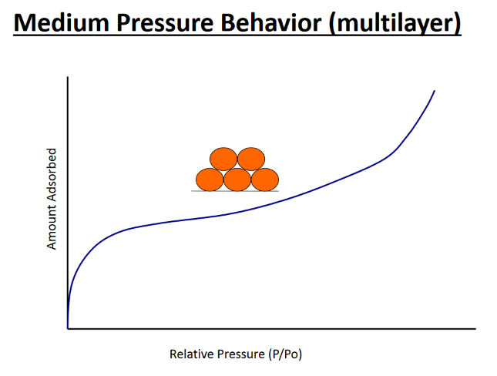

Slide 24
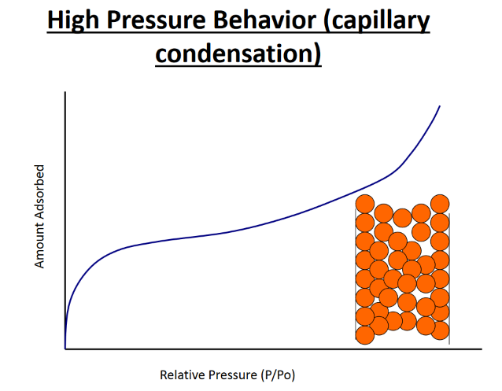

Slide 25
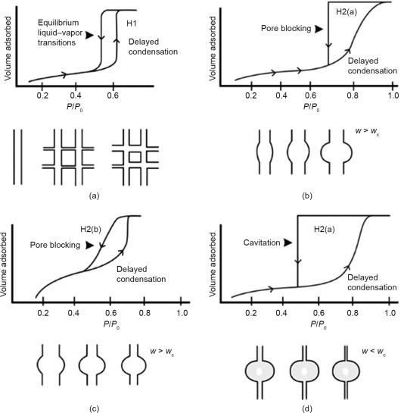
IUPAC
Classification
Macroporous
> 50nm
Mesoporus
2-50 nm
Microporus
< 2nm

Slide 26
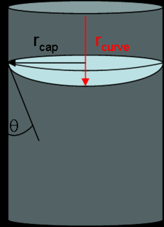
Where...
P_{v} = equilibrium vapor pressure
P_{sat} = saturation vapor pressure
H = mean curvature of meniscus
γ = liquid/vapor surface tension
V_{l} = liquid molar volume
R = ideal gas constant
T = temperature

Slide 27
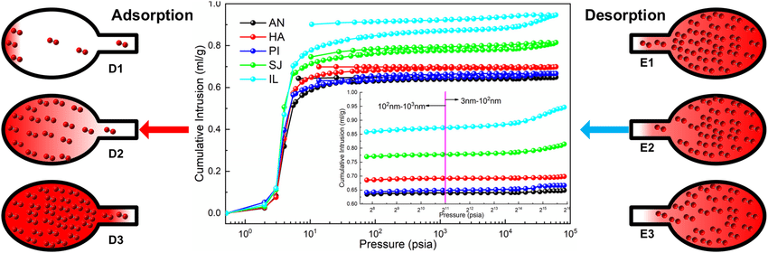
Hysteresis

Slide 28
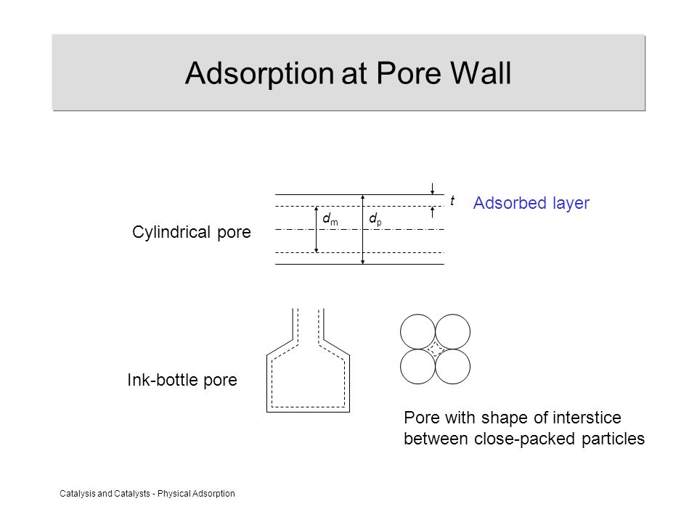
Heterogeneity of pores

Slide 29
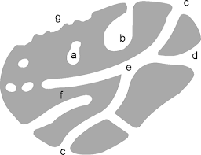
Heterogeneity of pores

Slide 30
Adsorption
Kinetic behavior of the adsorption process
Rate of arrival of adsorption is equal to the rate of desorption
Heat of adsorption was taken to be constant and unchanging with the degree of coverage, θ

Slide 31
Langmuir Assumption
Gas molecules behave ideally
Only 1 monolayer forms
All sites on the surface are equal
No adsorbate-adsorbate interaction
Adsorbate molecule is immobile

Slide 32
Langmuir Isotherm
An isotherm describes the dependence of volume, concentration , or in the case of a surface, coverage θ, on pressure P at constant temperature T at equilibrium.
θ = [ƒ(P)]^{T}
In the equilibrium between the gas phase and the adsorbed phase, LeChatelier's Principle predicts that at constant temperature an increase in pressure will increase the number of molecules adsorbed on the surface since the volume occupied by the molecules at the surface (per mole) is smaller.
This can, however, reach a limiting value. The number of molecules adsorbed at any pressure P will also depend on the strength of the adsorbate bond to the surface.
P
θ

Slide 33
Langmuir Isotherm
Langmuir’s “checkerboard” model of adsorption assumes that a surface is composed of a finite number of equivalent adsorption sites.
So the maximum coverage is obtained when all sites are filled. The coverage θ is expressed in terms of the number of molecules adsorbed in relation to the number of available sites. i.e. When all sites are filled, θ = 1.
Consider the equilibrium:
A_{gas} A_{adsorbed}
p
k_{ads}
θ
The Rate of adsorption is proportional to:
The number of surface collisions n from the gas phase
per second, which is proportional to the pressure P .
2) area of bare surface available for adsorption (1 - θ).
ie. rate of adsorption = k_{ads} P (1 - θ)

Slide 34
Langmuir Isotherm
Consider the equilibrium:
A_{gas} A_{adsorbed}
p
k_{des}
θ
Rate of desorption proportional to:
1) the fraction of surface covered by adsorbate θ.
i.e rate of desorption = k_{des} θ

Slide 35
At equilibrium
Rate of adsorption = Rate of desorption
θ = 1
b = 100
k_{ads} p (1 - θ) = k_{des} θ
b = 50
θ
b = 10
If we write b = k_{ads} / k_{des}
p
θ = bp / (1+bp) ……….. The Langmuir Isotherm
Since b = k_{ads} / k_{des} , this is the same as an equilibrium constant K
And since ln K = -ΔG/RT one can write:
b = exp (-ΔG/RT ), i.e b reflects the strength of the adsorbate bond to the surface.
Since θ = n_{ads} / n_{max}
p / n_{ads} = 1 / b n_{max} + p / n_{max}

Slide 36
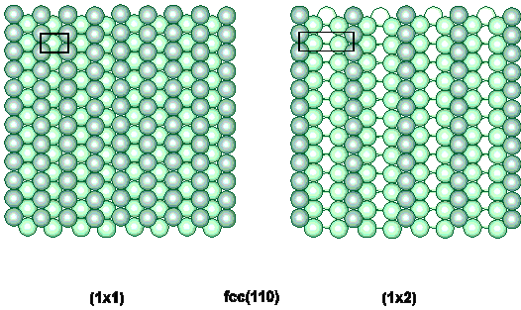
Langmuir Isotherm
Limitations and approximations
“finite number of equivalent adsorption sites”
different surface adsorbate structures
surface reconstruction

Slide 37
Langmuir Isotherm
Limitations and approximations
“finite number of equivalent adsorption sites”
lateral interactions between adsorbates
Enthalpy of adsorption ΔH_{ads}
depends on site/coverage

Slide 38
Langmuir Isotherm
Limitations and approximations
rate of adsorption = k_{ads} p (1 - θ)
X
assumes collision at a vacant site is required for adsorption
precursor kinetics
rate of adsorption i.e. sticking probability (S)
S α (1 - θ)
θ

Slide 39
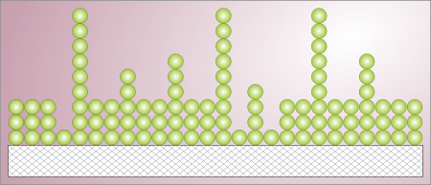
The concept of the B.E.T. theory is an extension of the Langmuir theory, which is a theory for monolayer molecular adsorption, to multilayer adsorption with the following hypotheses
1. gas molecules physically adsorb
on a solid in layers infinitely;
2. gas molecules only interact
with adjacent layers; and
3. the Langmuir theory can be applied to each layer.
4. the enthalpy of adsorption for the first layer is constant and greater than the second (and higher).
5. the enthalpy of adsorption for the second (and higher) layers is the same as the enthalpy of liquefaction.

Slide 40
Physisorption
Brunauer, Emmett and Teller – BET Theory
* Multilayer adsorption
* Dynamic equilibrium
q_{o} Fraction of surface unoccupied
A₁ condensation coefficient (adsorption probability)
N_{m} n° of molecules in a monolayer
E₁ Energy of adsorption
n₁ adsorbate’s vibrational frequency
1.
2.
3.
First layer
4.
Second layer

Slide 41
5.
n^{th} layer
Assuming ν, E and A constant for 2nd, 3rd,…n^{th} layer (liquid state)
L heat of liquefaction
6.
7.

Slide 42
7.
11.
12.
8.
13.
9.
14.
10.

Slide 43
The total number of molecules adsorbed at equilibrium is
15.
Substituting for θ₁, θ₂ , …
from 11-14.
16.
Since a and b are constant
17.
18.
from 7-10.

Slide 44
Substituting in 16.
19.
20.
21.
1 = θ₀ + θ₁ + θ₂ +.....θ_{n}
22.
Substituting 22 into 20
23.

Slide 45
Replacing q_{n} in 23. with ab^{n-1}θ_{o} from 14.
24.
Replacing a in 24. with Cb from 17.
25.
Since
26.
27.

Slide 46
From 20.
28.
Substituting 28 in 27.
29.
30.
Introducing θ_{o} from 30. into 20
= 1 when
N/N_{m} = infinite
31.
Condensation on the surface or P/P₀ = 1

Slide 47
Considering Eq. 10 for P/P₀ = 1 , β= 1 when
33.
32.
Introducing b into 31.
34.
Recalling that N/N_{m} = n/n_{m}

Slide 48
Brunauer Emmett and Teller (BET equation):
n amount of adsorbate (g) at the pressure P
n_{m} amount of adsorbate corresponding to the formation of a monolayer
C BET constant
P₀ saturation pressure
M_{w} è Molecular weight of the adsorbate N_{a} Avogadro Number a_{m} “cross section area” of the adsorbate.

