Slide 1

Economics of Monetary Union 14e
Paul De Grauwe
Chapter 2: The theory of optimum currency areas: a critique

Slide 2
Critique of OCA theory can be formulated at three different levels:
  How relevant are the differences between countries? Should we worry?
  Is national monetary policy (including exchange rate policy) effective?
  How credible are national monetary policies?

Slide 3
How relevant are the differences between countries?
Should we worry?
Let’s analyse these differences.

Slide 4
How likely are asymmetric demand shocks when integration increases?
There exist two views.
  Optimistic view (European Commission):
    intra-industry trade leads to similar specialization patterns
    integration leads to more equal economic structures and less asymmetric shocks.
  Pessimistic view (Krugman):
    economies of scale lead to agglomeration effects and clustering
    integration leads to more asymmetric shocks.

Slide 5
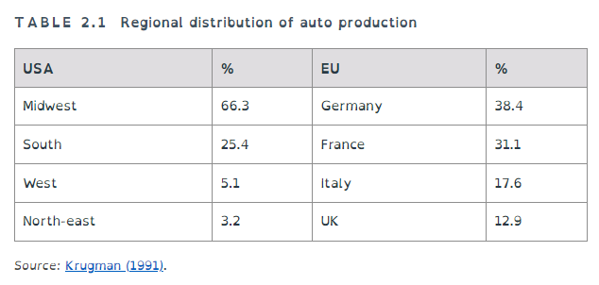

Slide 6
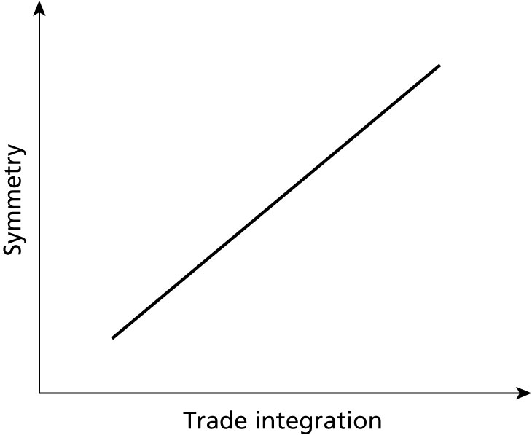
Figure 2.1 The European Commission view

Slide 7
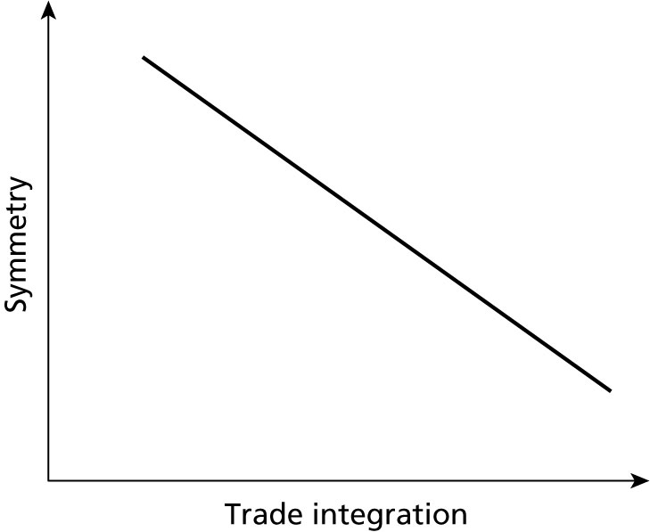
Figure 2.2 The Krugman view

Slide 8
Which view is likely to prevail?
  A little bit of both.
  But even if pessimistic view prevails, agglomeration effect will be blind to national borders.
  Then asymmetric shocks cannot be dealt with by national monetary policies.
  Empirical evidence of Frankel and Rose favours optimistic view.
  Role of services: they are increasingly important, and less subject to economies of scale.

Slide 9
Institutional differences in the labour market
Institutional differences in labour markets create asymmetries in the transmission of shocks.
Some of these differences disappear in the monetary union:
  monetary union puts pressure on trade unions.
Other differences will remain in place.

Slide 10
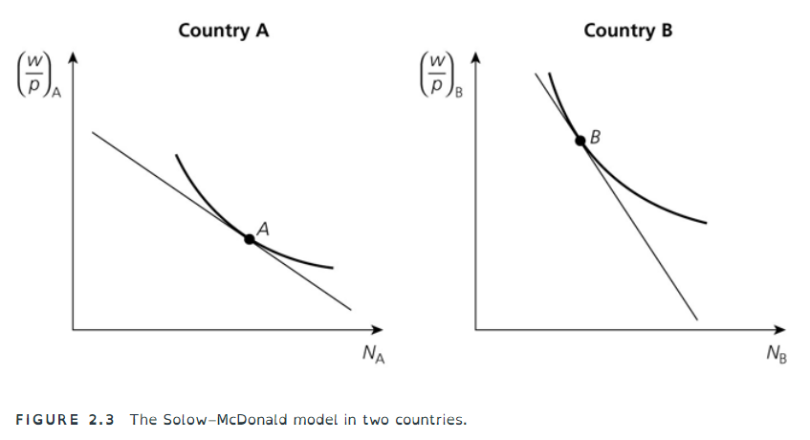

Slide 11
w/p ²
w/p ¹
N²
N¹

Slide 13
Different legal systems and financial markets
The reduction of inflation differentials in monetary union leads to institutional convergence:
  e.g. maturity structure in bond markets converges.
However, not all institutional differences will disappear.

Slide 14
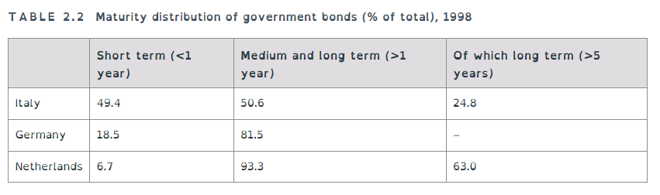

Slide 15
Booms and busts and the nation-state
Previous discussion focused on exogenous asymmetric shocks.
Some shocks are the result of endogenous booms and busts.
These have continued to work and to lead to divergences in economic trends.

Slide 16
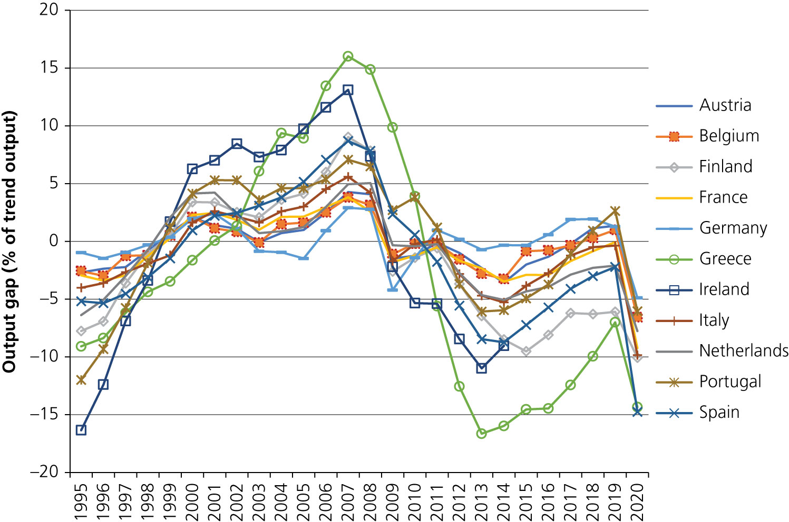


Slide 17
Business cycles have been synchronized.
Asymmetries have been in the amplitude of these business cycles.
Periphery countries experienced strong booms followed by deep recessions.
This is less pronounced in core countries.
Effects of these asymmetries:
periphery countries experienced strong increases in wages during boom
and losses of competitiveness.

Slide 18
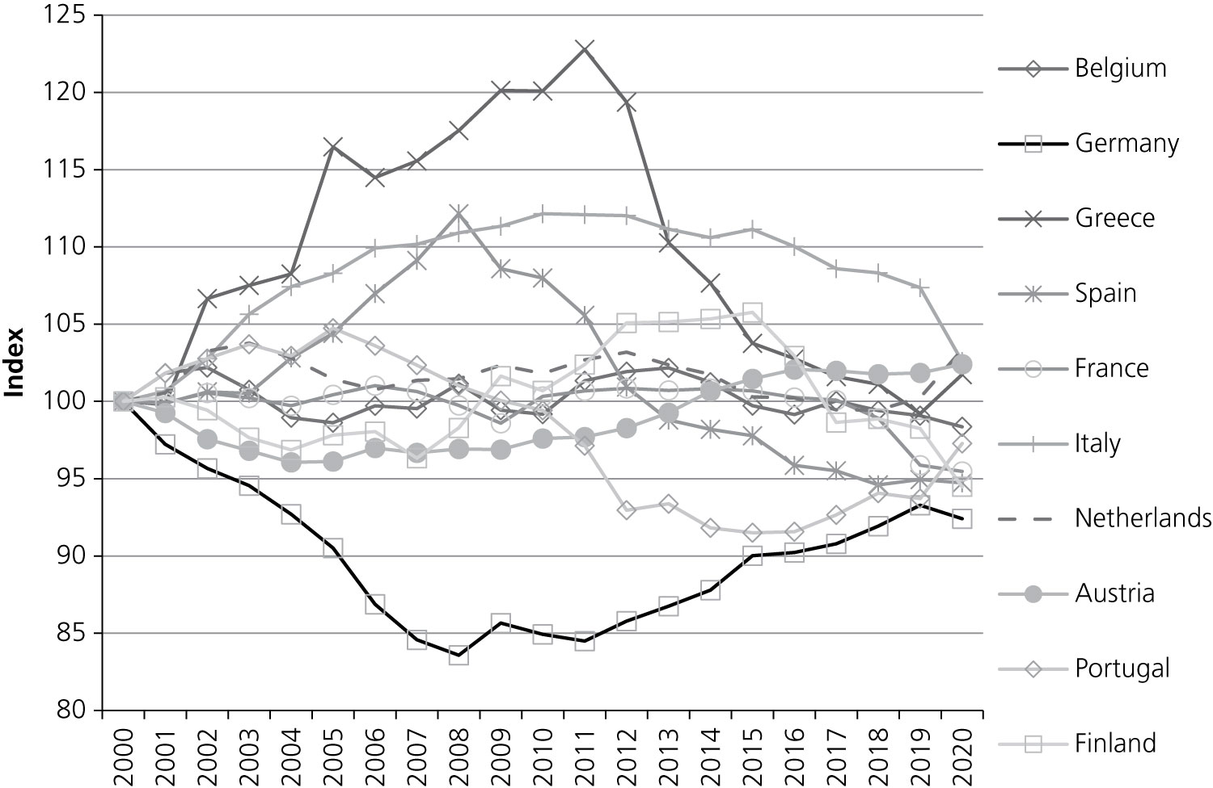
These lead to divergences in competitive positions
Figure 2.5 Relative unit labour costs in the Eurozone countries (2000–18).
Source: European Commission, AMECO databank.

Slide 19
Conclusion on effect of integration
Economic integration can produce economic structures that lead to more convergence.
However, the continued existence of the nation states can set in motion macroeconomic dynamics in monetary unions that lead to strong divergences.
Thus, despite the fact that at the microeconomic level trade integration may lead to less asymmetric shocks, the absence of a political union may set in motion macroeconomic dynamics leading to large asymmetric shocks.
There is therefore a need to embed a monetary union in a stronger political union.

Slide 20
How effective are
national monetary policies?

Slide 21
The question we analyse here is whether national monetary policies are effective instruments to correct for asymmetric disturbances.

Slide 22
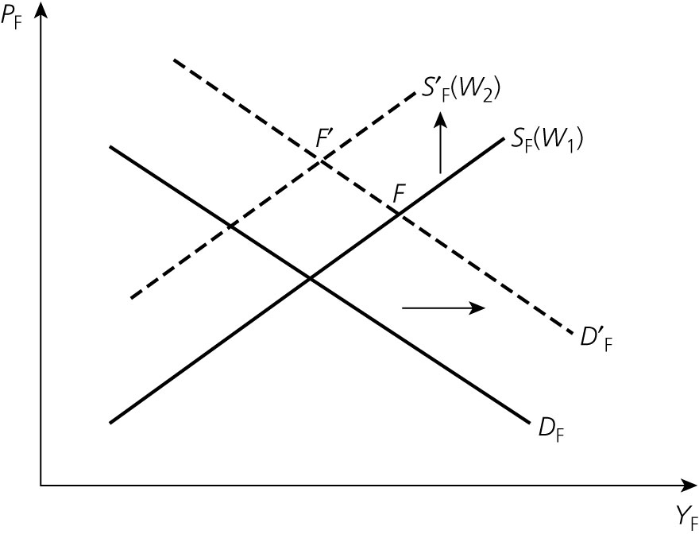
Figure 2.6 Price and cost effects of a national monetary policy
After monetary expansion real wage declines.
Workers will want to be compensated by higher nominal wage.
Supply shifts upwards, thereby reducing output effect of monetary expansion.
Effectiveness of monetary policy is reduced.
It does not make a difference whether country is in a MU.
P_{F}
S’_{F}(W₂)
F’
S_{F}(W₁)
F
D’_{F}
D_{F}

Slide 23
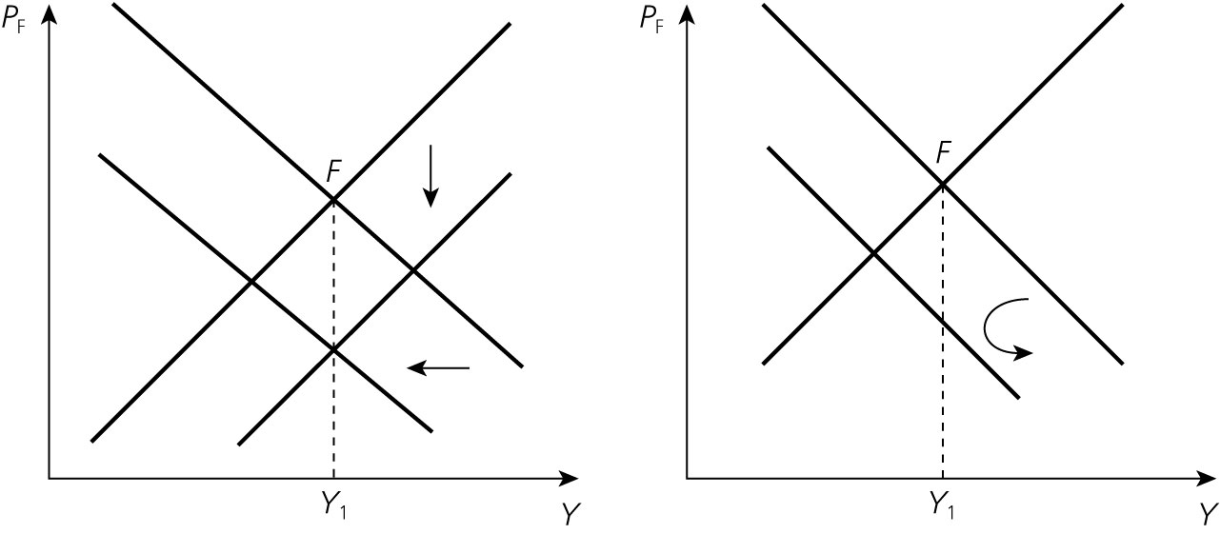
Figure 2.7 Currency depreciation and deflationary policies compared
In a monetary union
No monetary union

Slide 24
Budgetary implications of the two adjustment mechanisms
When in a monetary union a country has to reduce wages and prices, the ensuing decline in output leads to an increasing budget deficit and a surge in the government debt levels.
Members of monetary union have no control over the money in which they have issued their debt.
This makes them vulnerable to self-fulfilling speculative attacks that can lead to a liquidity crisis, which in turn can degenerate into a solvency crisis.

Slide 25
The contrast with a country that is not in a monetary union and therefore has full control over the money in which it issues its debt is important here.
Such a country will be able to devalue, thereby avoiding the deflationary process and the ensuing increase in budget deficit and debt level.

Slide 26
National monetary policies
to stabilize business cycles
France
Germany
P_{F}
P_{G}
S_{G}
S_{F}
D_{G}
D_{F}
Y_{F}
Y_{G}

Slide 27
Conclusion:
  in a monetary union there is little scope for stabilization policies at the national level
  monetary policies cannot be used to stabilize nationally driven business cycles
  these business cycle movements are likely to be exacerbated as the government budgets lose their automatic stabilizing capacities.

Slide 28
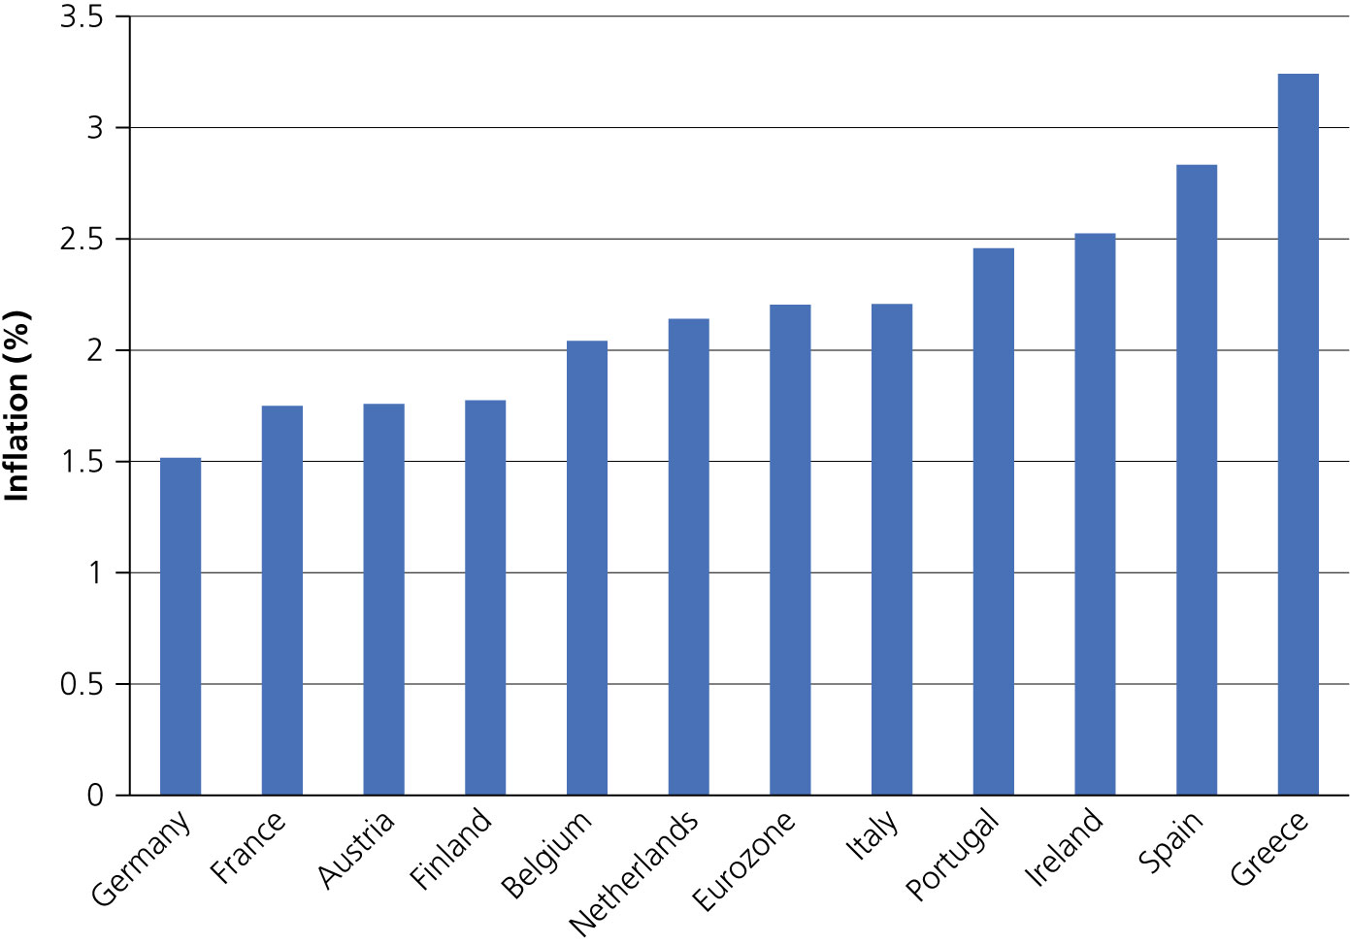
An aside: productivity and inflation in monetary union
The Balassa–Samuelson effect
Inflation differentials in monetary union can be significant
Figure 2.8 Average yearly inflation in Eurozone countries, 1999–2010 (%)

Slide 29
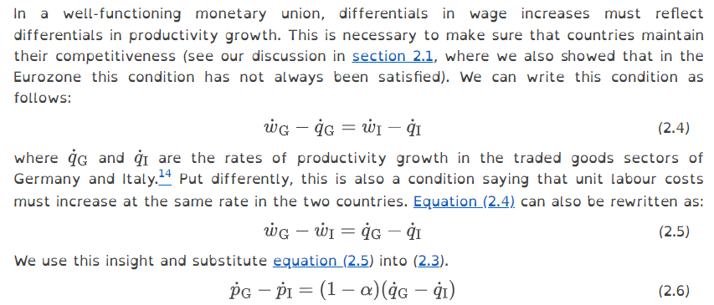
Balassa–Samuelson model
Inflation in Germany
Inflation in Italy
(we assume that inflation in non-tradables is equal to wage inflation)
Inflation rates in tradable goods sectors are equal
This leads to
Assuming that differences in wage increases reflect differences in productivity growth :
(
)
Inflation in Italy exceeds inflation in Germany if Italian productivity increases faster than German productivity

Slide 30
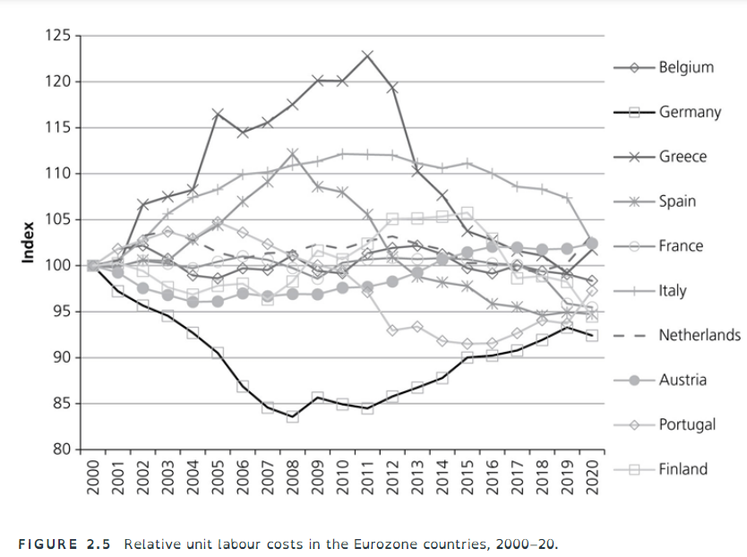

Slide 31
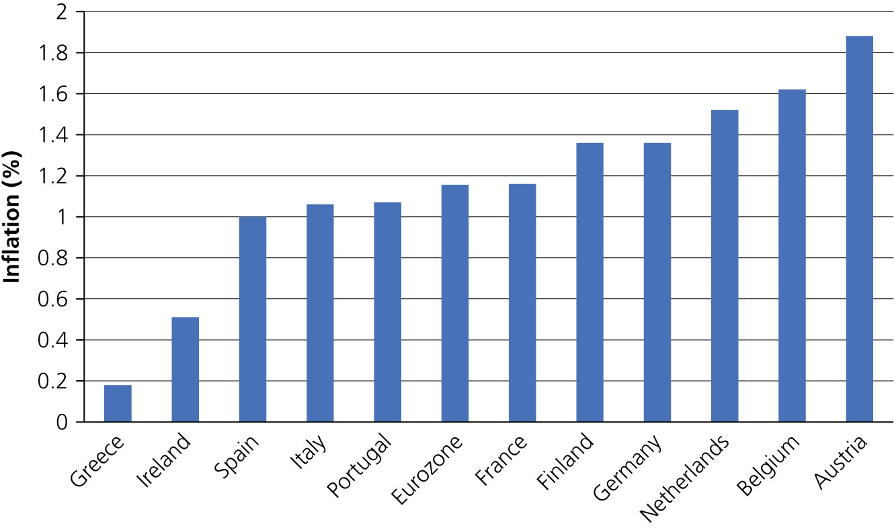
Inflation after sovereign debt crisis: correcting for previous excesses
Figure 2.8 Average yearly inflation in Eurozone countries, 1999–2010 (%)
Figure 2.9 Average inflation in Eurozone countries , 2011-2021
Source: Eurostat

Slide 32
  How credible are national monetary policies?

Slide 33
National monetary policies, time consistency, and credibility
Credibility affects the effectiveness of policies.
We use Barro-Gordon model.
We first develop the closed-economy version.
Then we develop the two-country version.

Slide 34

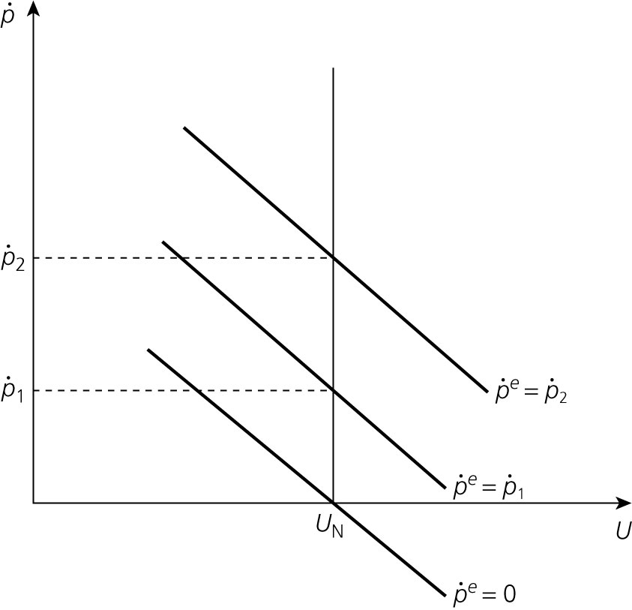
Barro–Gordon model
There is a short-term trade-off between inflation and unemployment for every level of expected inflation.
The vertical line represents the ‘long-term’ vertical Phillips curve. It is the collection of all points for which
This vertical line defines the natural rate of unemployment U_{N}

Slide 35
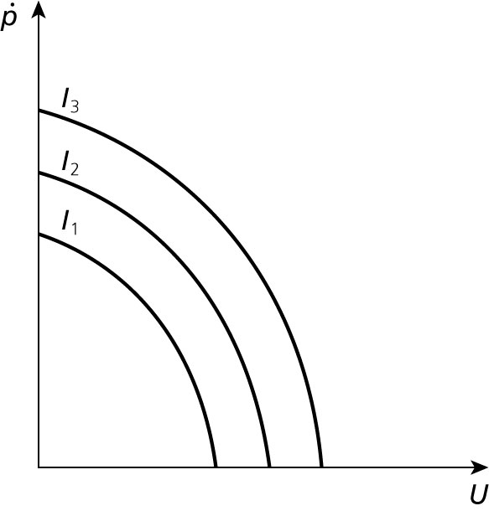
Figure 2.11 The preferences of the authorities

Slide 36
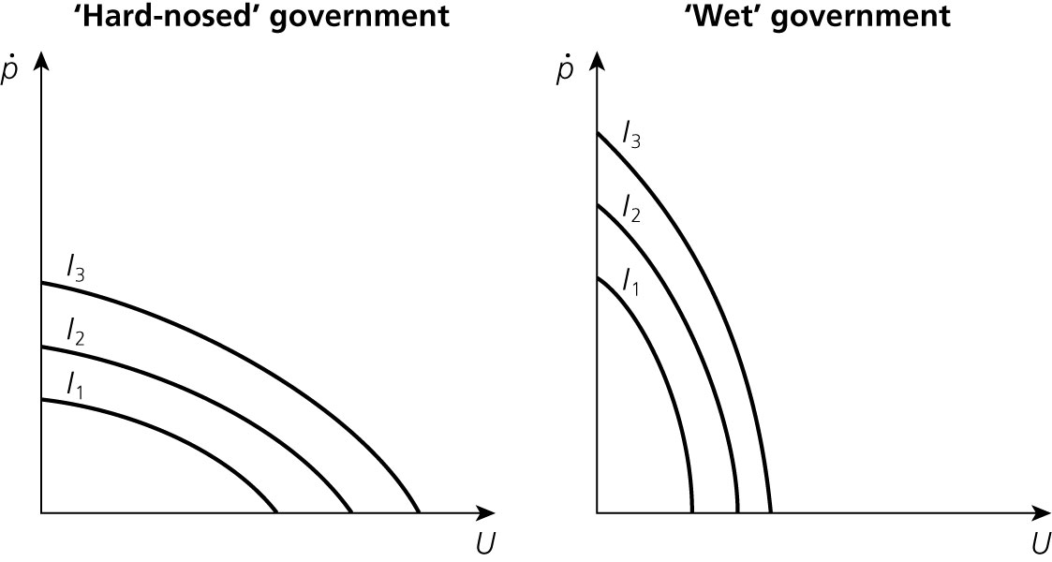
Figure 2.12 The preferences of the authorities
Pc
Pd
Pc
Pd
Ub
Ua
Ub
Ua

Slide 37
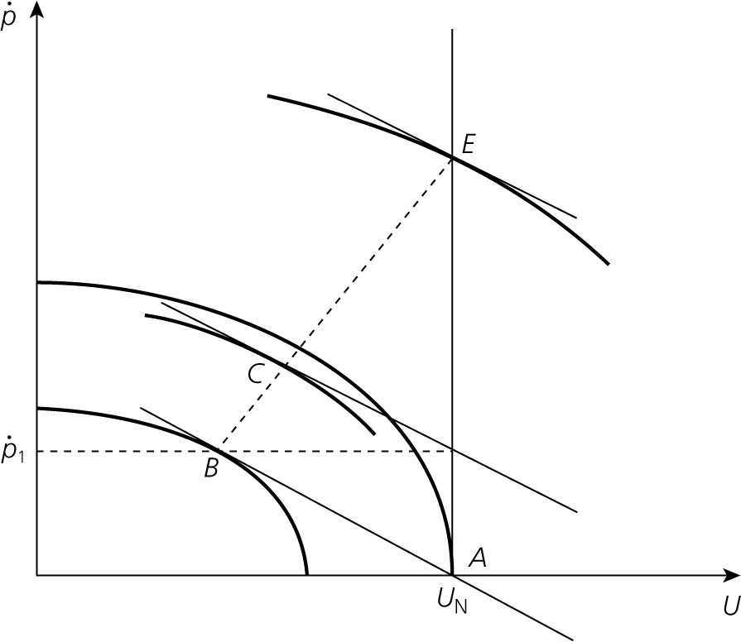
Figure 2.13 The equilibrium inflation rate

Slide 38
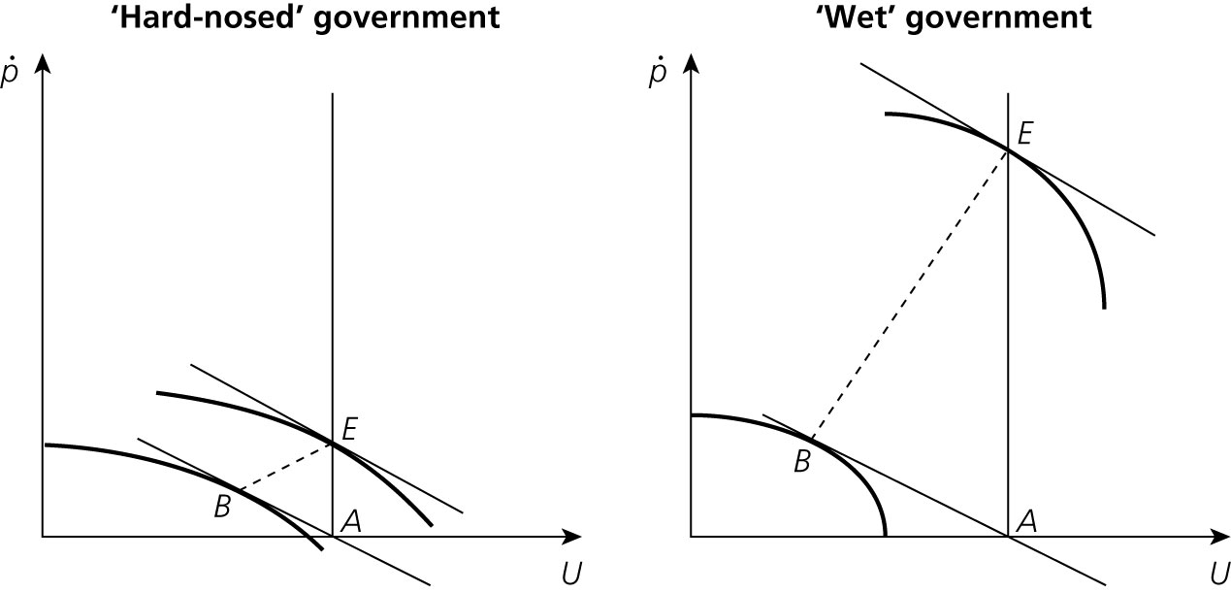
Figure 2.14 Equilibrium with ‘hard-nosed’ and ‘wet’ governments
‘Hard-nosed’ government achieves lower inflation than ‘wet’ government without imposing more unemployment in the long run.

Slide 39
The Barro–Gordon model in an open economy
We add the purchasing power parity condition to link the inflation rates of two countries, called Germany and Italy, i.e.

Slide 40
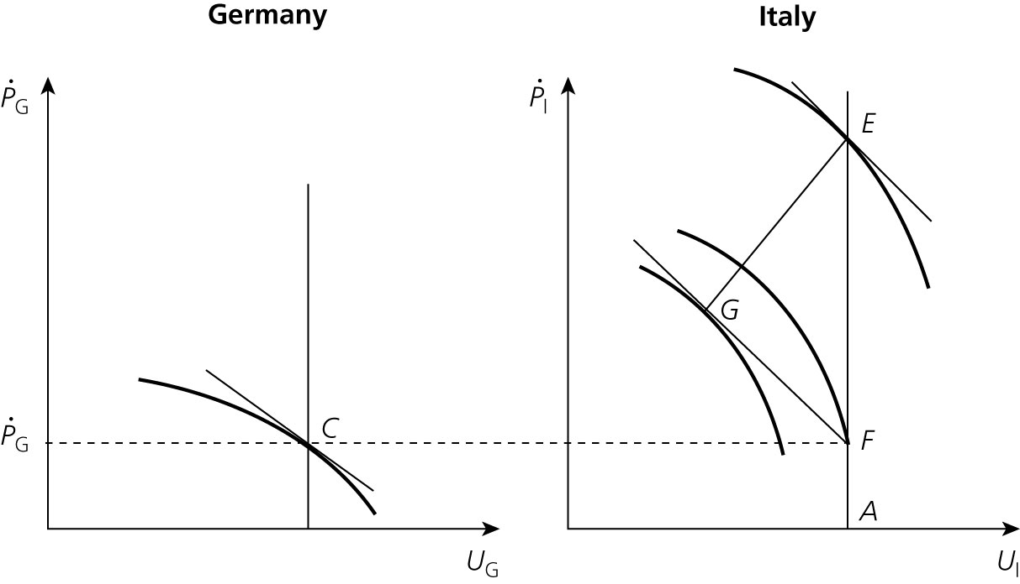

A graph for hard-nosed government plots P versus U. A is at the center of the X axis and a vertical line goes up from it. There are two arcs near each other. The center point of the two arcs are B and E respectively. A graph for wet government plots P versus U. A is at the center of the X axis and a vertical line goes up from it. There are two arcs far away from each other. The center point of the two arcs are B and E respectively.
How can Italy reach a more attractive (lower) inflation equilibrium?
Fixing the exchange rate of the lira with the mark is not credible, because Italian authorities have an incentive to create surprise inflation (devaluation).

Slide 41
Only by abolishing the Italian central bank and adopting the mark can Italy escape from high inflation equilibrium.
This is also what countries that decide to ‘dollarize’ or to ‘euro-ize’ hope to achieve.
Monetary union is more complicated because in a monetary union both central banks decide jointly and a new currency is created.
This leads to problem in that new central bank may not have the same reputation as the German Bundesbank.
The latter is reluctant to join.

Slide 42
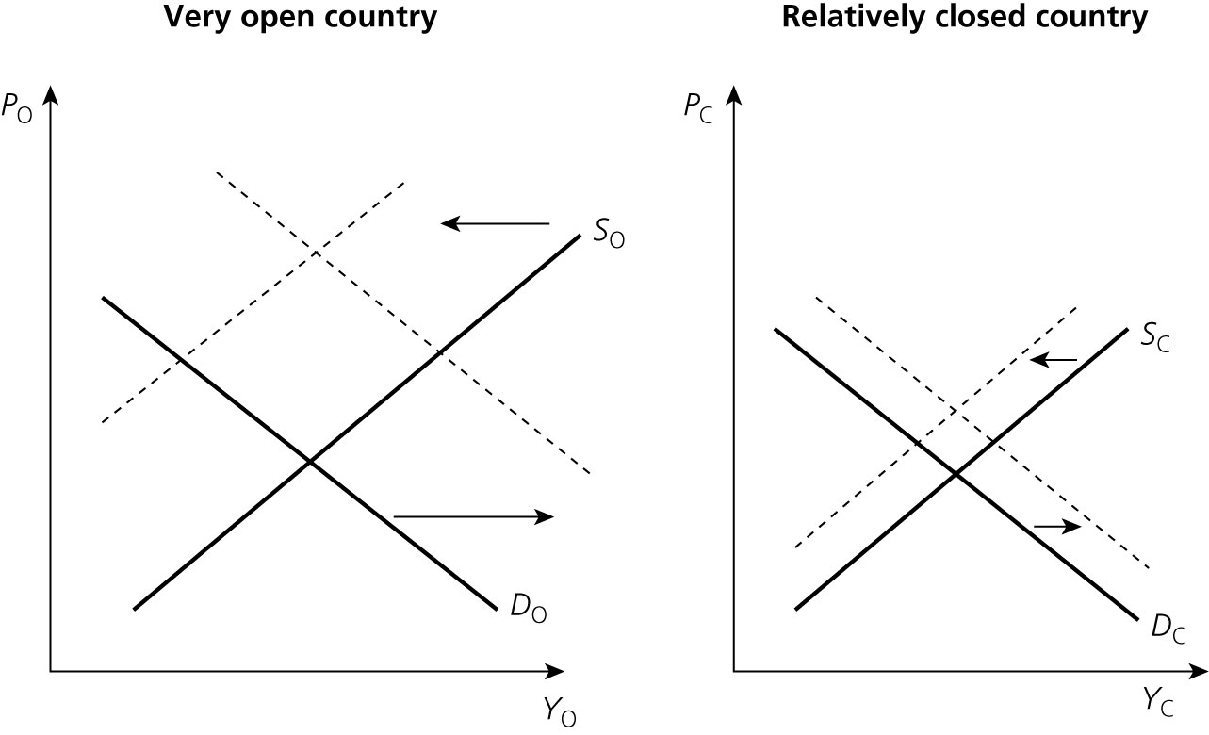
Cost of monetary union and openness
Figure 2.16 Effectiveness of currency depreciation as a function of openness.

Slide 43
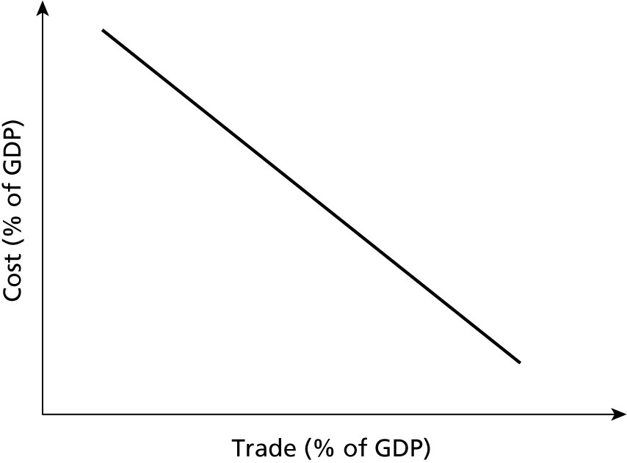

Figure 2.17 The cost of a monetary union and the openness of a country.
The graph for very open country plots P 0 versus Y 0. A straight line S 0 from bottom-left to top-right. A straight line D 0 goes from top-left to bottom-right. An arrow goes from D 0 to the right. An arrow goes from S 0 to the left. The graph for relatively closed country plots P C versus Y C. A straight line S C from bottom-left to top-right. A straight line D C goes from top-left to bottom-right. An arrow goes from D C to the right. An arrow goes from S C to the left.
The graph for very open country plots P 0 versus Y 0. A straight line S 0 from bottom-left to top-right. A straight line D 0 goes from top-left to bottom-right. An arrow goes from D 0 to the right. An arrow goes from S 0 to the left. The graph for relatively closed country plots P C versus Y C. A straight line S C from bottom-left to top-right. A straight line D C goes from top-left to bottom-right. An arrow goes from D C to the right. An arrow goes from S C to the left.
Cost
(% of GDP)
Trade (% of GDP)

