Slide 1
Energie Rinnovabili Laurea Magistrale in Chimica Lezione n.11
Federico Rosei
Trieste, Marzo 2023

Slide 2
n.11
Tidal energy

Slide 3
What kind of “landscape” is needed for tidal energy?
Suitable locations for capturing tidal energy include those with large differences in tidal range, which is the difference between high tide and low tides, and where tidal channels and waterways become smaller and tidal currents become stronger.

Slide 4
Tidal Energy
Harnessed by converting energy from tides into useful forms of power, mainly electricity using various methods. The turbines are likened to wind turbines, except they are positioned underwater.
Although not yet widely used, tidal energy has the potential for future electricity generation.
Tides are more predictable than wind & sun.
Traditionally suffered from relatively high cost & limited availability of sites with sufficiently high tidal ranges => constricting total availability.
Recent technological developments & improvements
in design (e.g. dynamic tidal power, tidal lagoons)
turbine technology (e.g. new axial turbines, cross flow turbines)
=> total availability of tidal power may be much higher than previously assumed & economic & environmental costs may be brought down to competitive levels.

Slide 5
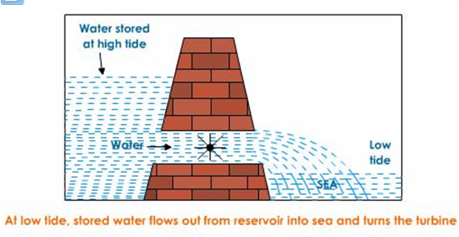

Slide 6
Advantages
What are the advantages of tidal energy?
Predictable energy output – tides are predictable and constant, thanks to gravitational forces. Only needing to assess the low or high tide, makes it easier for engineers to design efficient systems.
As technology advances for tidal, it will get increasingly cheaper and efficient.
Protects coastal flooding due to the stability of the rock armour under different design conditions. Tidal lagoons can withstand 1 in 500 storm surges and waves a year.
Equipment and facilities of tidal power can last a lot longer and be more cost-competitive than other renewable technologies. With an asset life of 120 years, developments are made for future increases in sea-level.

Slide 7
Challenges
What is stopping us from making the most of tidal energy?
It is currently expensive to construct tidal power plants as they require high capital investments.
Environmental issues such as habitat change, particularly with tidal barrages.
Maintaining and repairing equipment can be a challenge.
Limited energy demand. Powerful tides only happen normally 10 hours out of each day, this means the tidal energy storage capacity must be developed.
Difficult to provide tidal energy to coastal communities, as the energy produced by the tides is often a long distance from where the electricity will be used inland.

Slide 8
What are the dangers of tidal energy?
Tidal power can damage marine life, as tidal turbines with their rotating blades may lead to deaths of living creatures in a sea. Noise from the rotation of the turbines may also impact fish habitations in tidal power locations. Tidal energy can also impact the quality of water and sediment processes.

Slide 9
Large-scale tidal power
Currently, the Sihwa Lake project remains the world’s largest tidal power station in operation, located on the west coast of South Korea. The 254 MW Sihwa project, consisting of 10 water turbine generators, has enough power to support the domestic needs of a city with a population of 500,000 people. “The 552.7 GWh of electricity generated from Sihwa tidal power plant is equivalent to 862,000 barrels of oil, or 315,000 tons of CO₂ – the amount produced by 100,000 cars annually.” Around 160 million tonnes of water flows in and out of the floodgate and waterwheel, which is responsible for half of the total water quantity in Sihwa Lake. The ongoing circulation of water between the lake and the outer sea during the energy generation process has improved the water quality. With limited energy resources, South Korea is looking to transition to tidal power, to provide an alternative to fossil fuels and develop emission-free clean energy.

