Slide 1
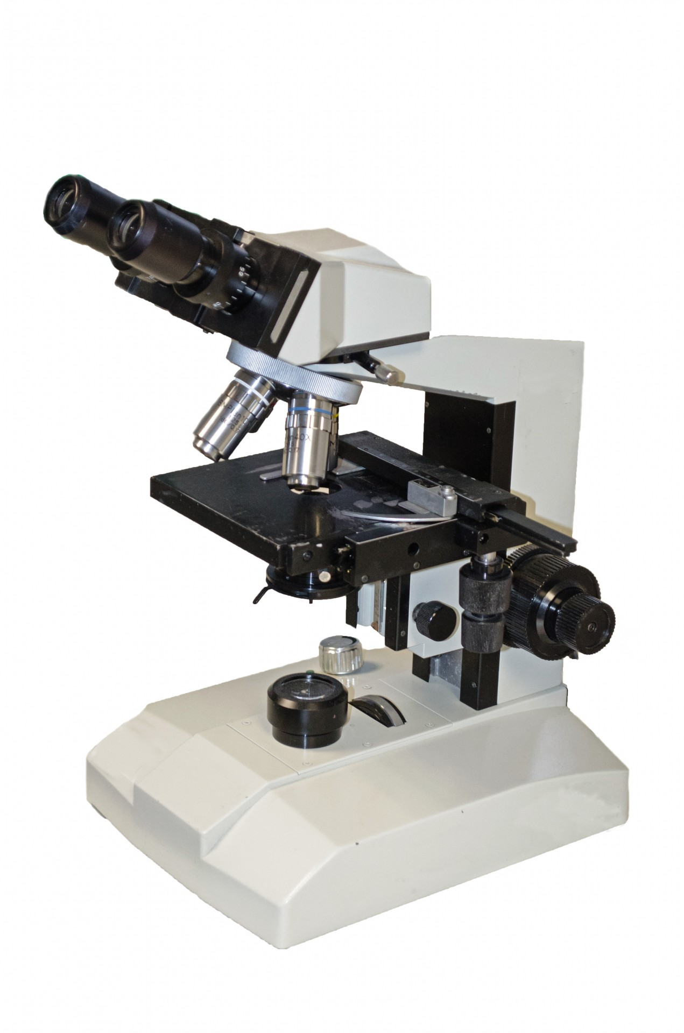


MICROSCOPIA OTTICA IN BIOLOGIA CELLULARE [675SM]
MICROSCOPY IN CELL BIOLOGY –
aa 2022/2023, 2nd semester
Aula 5A, edificio H2bis 15-18
Agnes Thalhammer
agnes.thalhammer@units.it

Slide 2

Fluorescence Microscopy
part1

Slide 3
CONTRASTING TECHNIQUES – A REMINDER…
Brightfield: absorption
Darkfield: scattering
Phase Contrast: phase interference
Differential Interference Contrast (DIC):
polarization + phase interference
Fluorescence Contrast

Slide 4
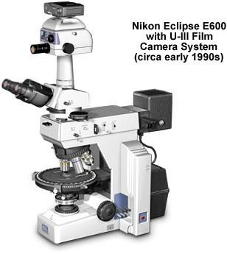
UPRIGHT MICROSCOPE
Epi- illumination Source
Transmitted and reflected light: transmission for bright field and reflection for flourescent light
Brightfield Source

Slide 5
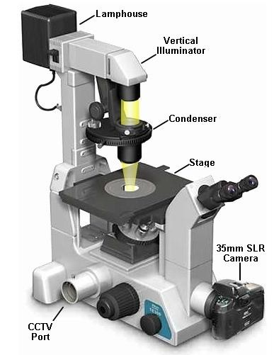
INVERTED MICROSCOPE
Brightfield Source
Epi- illumination Source

Slide 6
WHY FLUORESCENCE MICROSCOPY?
In all types of microscopes, cell constituents are generally not distinguishable.
In fluorescent microscopy, various fluorescent dyes are used which gives property of fluorescence to only specific part of the cell and hence it can be focused.
Fluorescent microscopy depends upon illumination of a substance with a specific wavelength which then emits light at a longer wavelength.

Slide 7
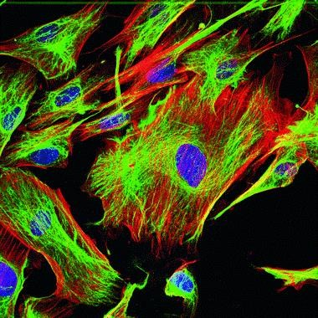
WHY FLUORESCENCE MICROSCOPY?
High resolution
High contrast High specificity Quantitative
Live Cell Imaging

Slide 8
FLUORESCENCE PRINCIPLE
When certain compounds are illuminated with high energy light, they then emit light of a different, lower frequency. This effect is known as fluorescence.
Often specimens show their own characteristic autofluorescence image, based on their chemical makeup.
The key feature of fluorescence microscopy is that it employs reflected rather than transmitted light, which means transmitted light techniques such as phase contrast and DIC can be combined with fluorescence microscopy.

Slide 9
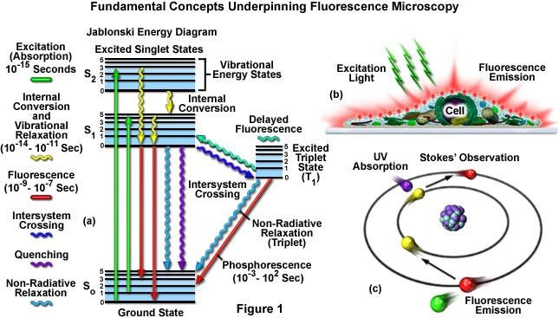
FLUORESCENCE PRINCIPLE

Slide 10
FLUORESCENCE PRINCIPLE
Fluorescence and phosphorescence are both types of luminescence.
In fluorescence the emission of light occurs extremely rapidly after the absorption of excitation light.
Phosphorescence emission continues for milliseconds to minutes after the energy source has been removed.

Slide 11
FLUORESCENCE vs. PHOSPHORESCENCE
If the luminescence is caused by absorption of some form of radiant energy, such as ultraviolet radiation or X rays (or by some other form of energy, such as mechanical pressure), and ceases as soon as (or very shortly after) the radiation causing it ceases, then it is known as fluorescence.
If the luminescence continues after the radiation causing it has stopped, then it is known as phosphorescence.
NB: The term phosphorescence is often incorrectly considered synonymous with luminescence

Slide 12
FUNCTIONING
A component of interest in the specimen is specifically labeled with a fluorescent molecule called a fluorophore.
The specimen is illuminated with light of a specific wavelength (or wavelengths) which is absorbed by the fluorophores, causing them to emit longer wavelengths of light (of a different color than the absorbed light).

Slide 13
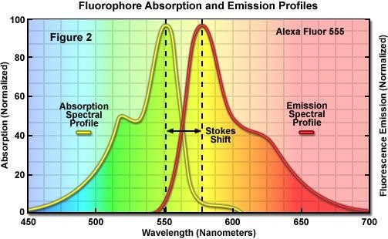
Molecules absorbing the energy of electromagnetic radiation will jump to a higher energy level. When certain excited molecules return to the ground state they emit radiation. This phenomenon is known as fluorescence. Fluorescent molecules are known as fluorochromes or fluorophores.

Slide 14
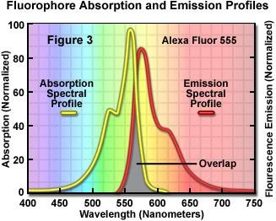

STOKE’S SHIFT
As Stokes' shift values increase, it becomes easier to separate excitation from emission light through the use of fluorescence filter combinations.

Slide 15
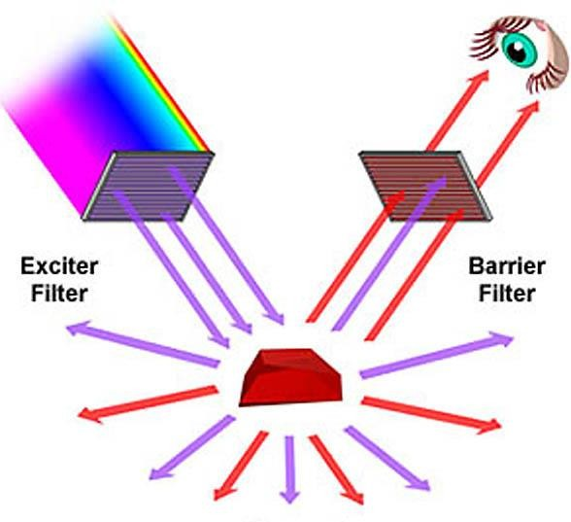

Slide 16
COMPONENTS OF A FLUORESCENT MICROSCOPE
light source
  (xenon arc lamp / mercury-vapor lamp / metal halide lamp / LED )
excitation filter,
dichroic mirror
emission filter
A fluorescence microscope is basically a conventional light microscope with added features and components that extend its capabilities.

Slide 17
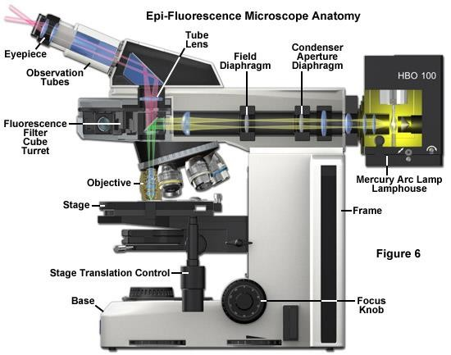
Molecules absorbing the energy of electromagnetic radiation
will jump to a higher energy level. When certain excited molecules return to the ground state they emit radiation. This phenomenon
is known as fluorescence. Fluorescent molecules are known as
fluorochromes or fluorophores.

Slide 18
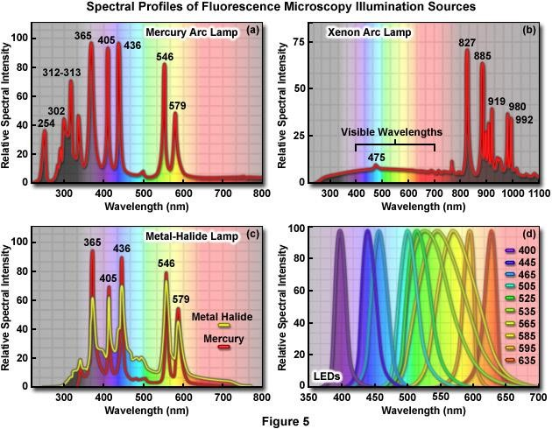

Slide 19
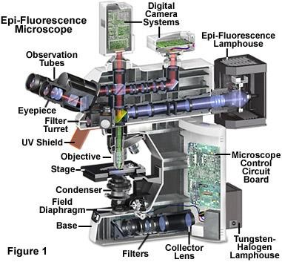
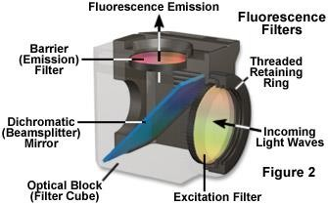

Slide 20
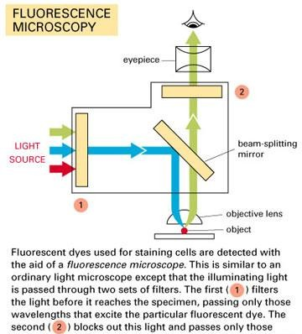

Slide 21
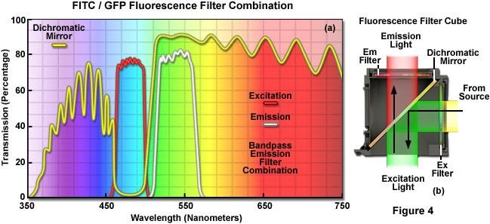

Slide 22
THE DICROIC MIRROR – dichroic: two color
Each dichroic mirror has a set wavelength value - the transition wavelength value - which is the wavelength of 50% transmission.
wavelengths below the transition wavelength value are reflected (90%)
wavelengths above this value are transmitted (90%)
Ideally, the wavelength of the dichroic mirror is chosen to be between the wavelengths used for excitation and emission.

Slide 23
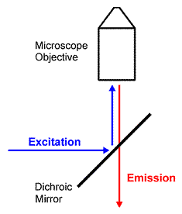
THE DICROIC MIRROR – dichroic: two color
The excitation light reflects off the surface of the dichroic mirror into the objective.
The fluorescence emission passes through the dichroic to the eyepiece or detection system.

Slide 24
THE FILTERS
Excitation Filter | Emission Filters
to select excitation wavelength | to select emission wavelength
 | to remove traces of excitation light
placed in the excitation path just prior to the dichroic mirror | placed between sample and ocular/camera/ detector

Slide 25
BASIC CONCEPTS
excitation light radiates specimen
weaker emitted light to make up the image is separated
use fact that the emitted light is of lower energy and has a longer wavelength
The fluorescent areas can be observed in the microscope and shine out against a dark background with high contrast

Slide 26
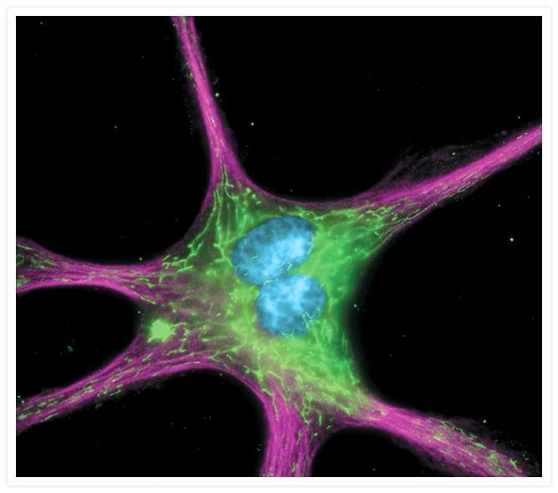
The cytoskeleton of a fixed and permeabilized bovine pulmonary artery endothelial cell detected using mouse monoclonal anti– -tubulin antibody (A11126), visualized with Alexa Fluor 647 goat anti–mouse IgG antibody (A21235) and pseudocolored magenta. Endogenous biotin in the mitochondria was labeled with green-fluorescent Alexa Fluor 488 streptavidin (S11223) and DNA was stained with blue-fluorescent DAPI (D1306, D3571, D21490).

Slide 27
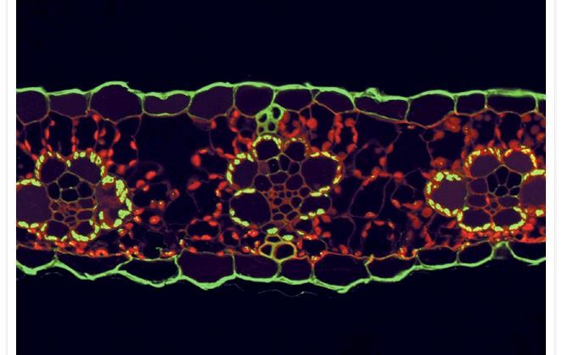
A 2.0 µm maize leaf section illustrating the immunolocalization of the enzyme ribulose bisphosphate carboxylase (rubisco) in the chloroplasts of the bundle sheath cells surrounding the vascular bundles. Maize is a C4 plant and, as a result, spatially segregates components of the photosynthetic process between the leaf mesophyll and the bundle sheath. Rubisco was localized using a rabbit anti-rubisco antibody and visualized using the highly cross-adsorbed Alexa Fluor 488 goat anti–rabbit IgG antibody (A11034). The remaining fluorescence is due to the autofluorescence of chlorophyll, which appears red and is localized to the mesophyll plastids; lignin, which appears dull green and is localized to the xylem of the vascular bundle; and cutin, which appears bright green and is localized to the cuticle outside the epidermis.
Image contributed by Todd Jones, DuPont.

Slide 28
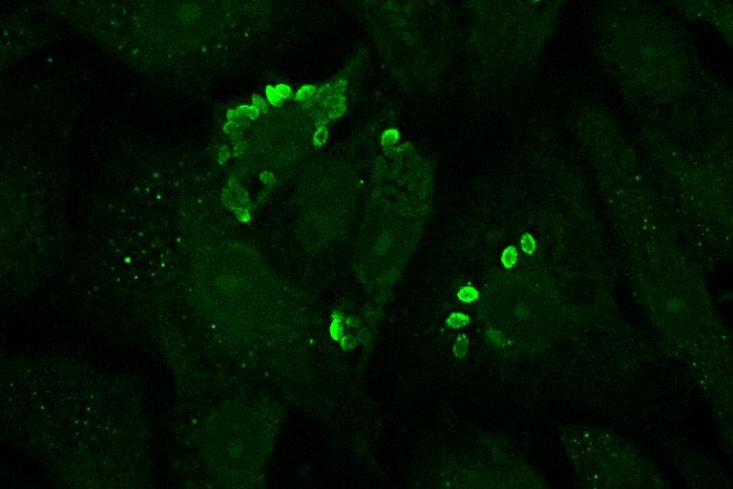
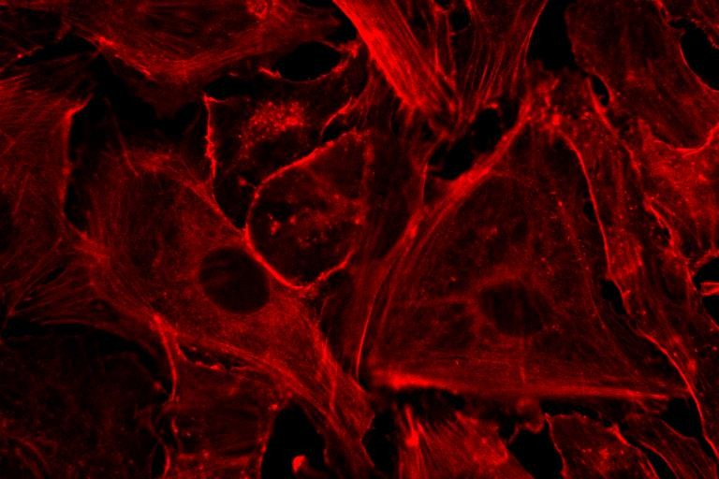
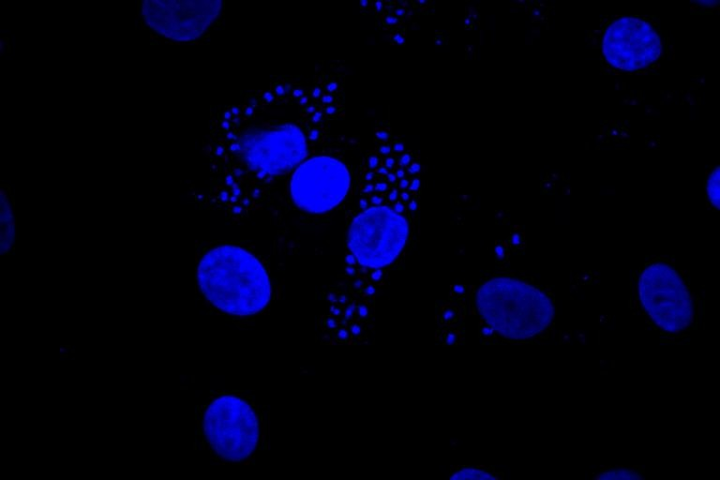
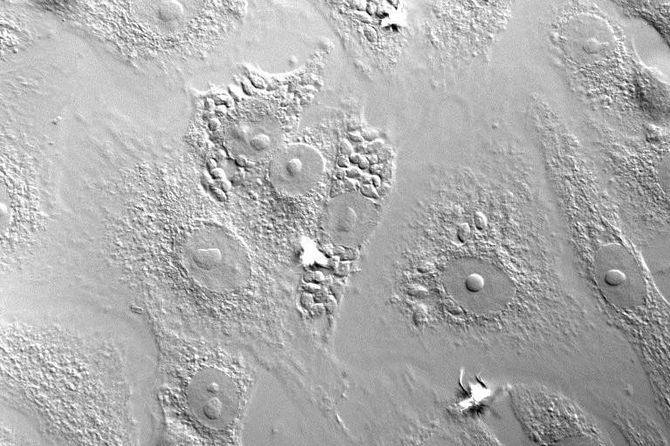
Actin - Rhodamine-phalloidin (red), Antibody to T.cruzi – FITC (green),
DNA – Dapi (blue)

Slide 29
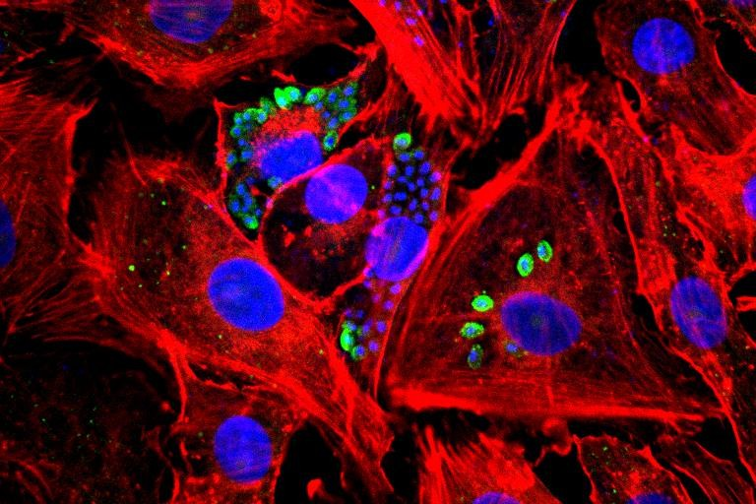
2021/2022 - Light microscopy in Cellula Biology
r
Actin - Rhodamine-phalloidin (red), Antibody to T.cruzi – FITC (green),
DNA – Dapi (blue)

Slide 30
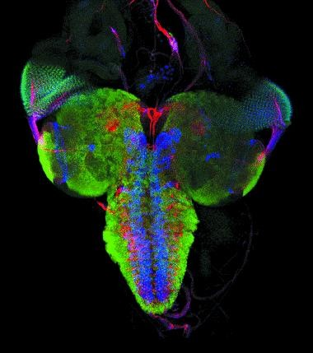
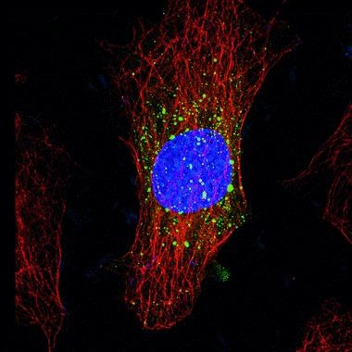
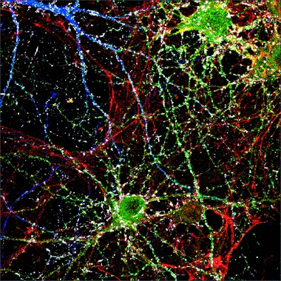
r
The “cube”
Actin - Rhodamine-phalloidin ^{Imaged using an MRC 1000}
Confocal Microscope, 40 x 1.3 NA Fluor

Slide 31
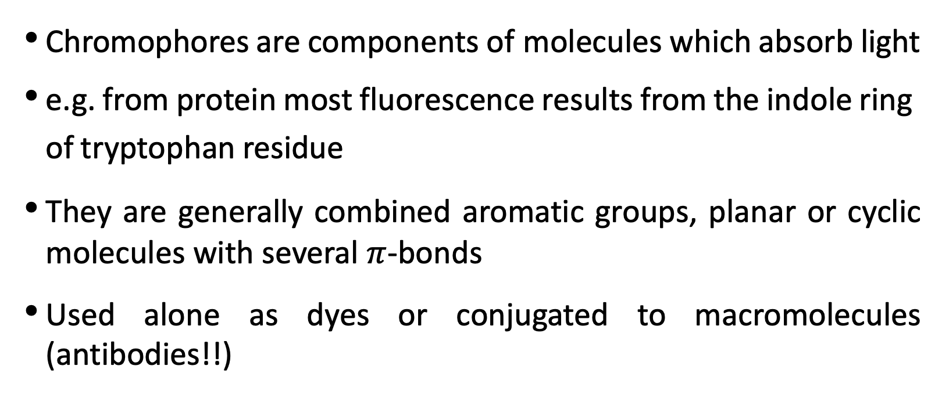
r
CHROMOPHORES
Chromophores are components of molecules which absorb light
e.g. from protein most fluorescence results from the indole ring of tryptophan residue
They are generally combined aromatic groups, planar or cyclic molecules with several $π$-bonds
Used alone as dyes or conjugated to macromolecules (antibodies!!)
The “cube”
Actin - Rhodamine-phalloidin ^{Imaged using an MRC 1000}
Confocal Microscope, 40 x 1.3 NA Fluor

Slide 32
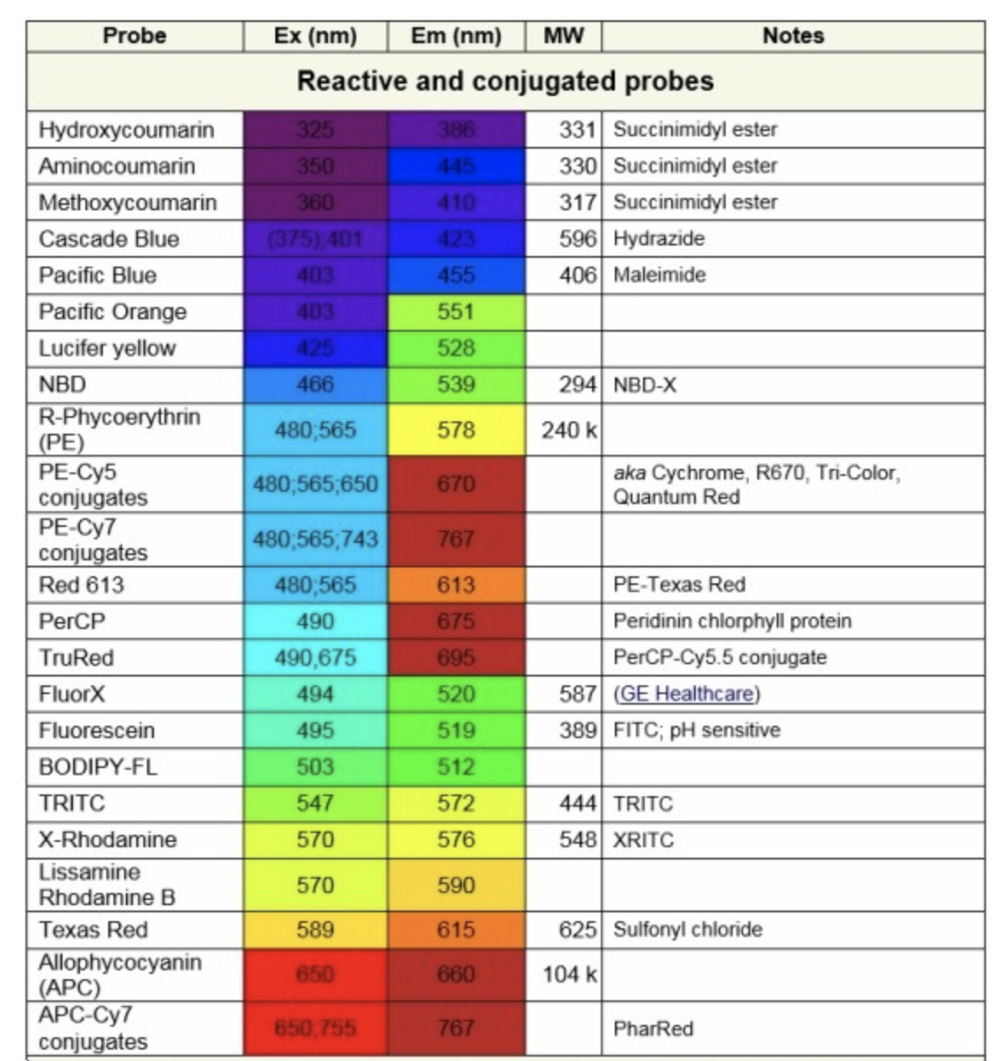
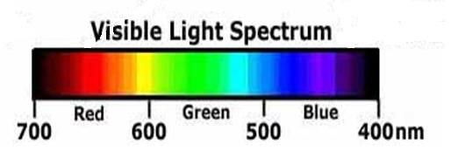
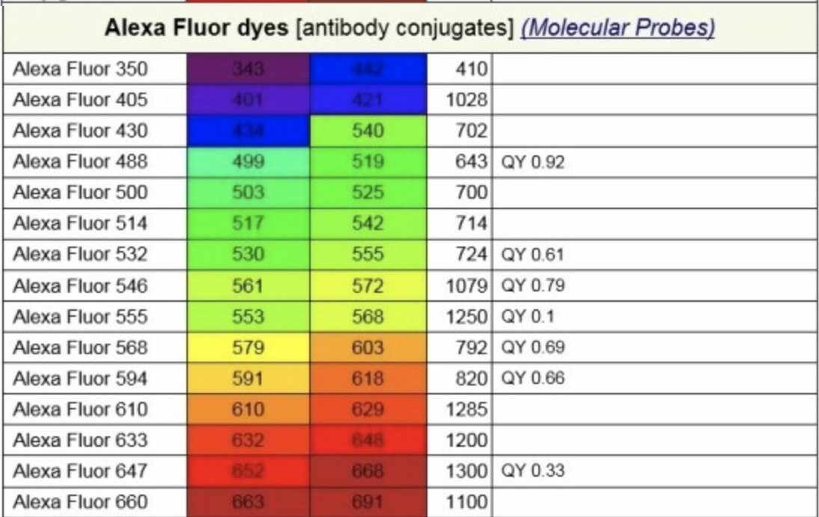
FLUOROPHORES (Fluorochromes, chromophores)

Slide 33
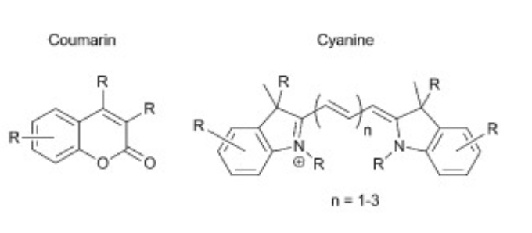
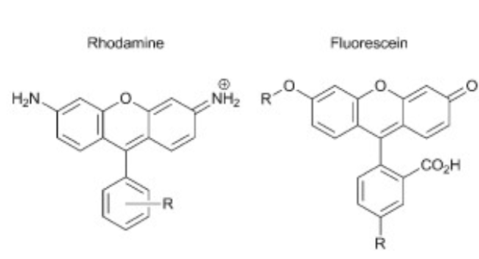
FLUOROPHORES (Fluorochromes, chromophores)

Slide 34
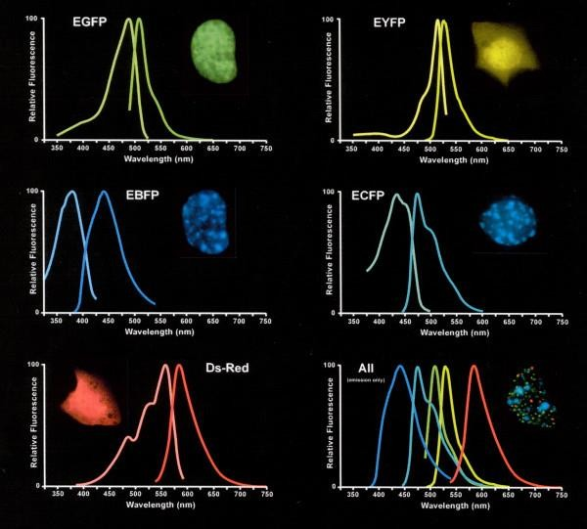
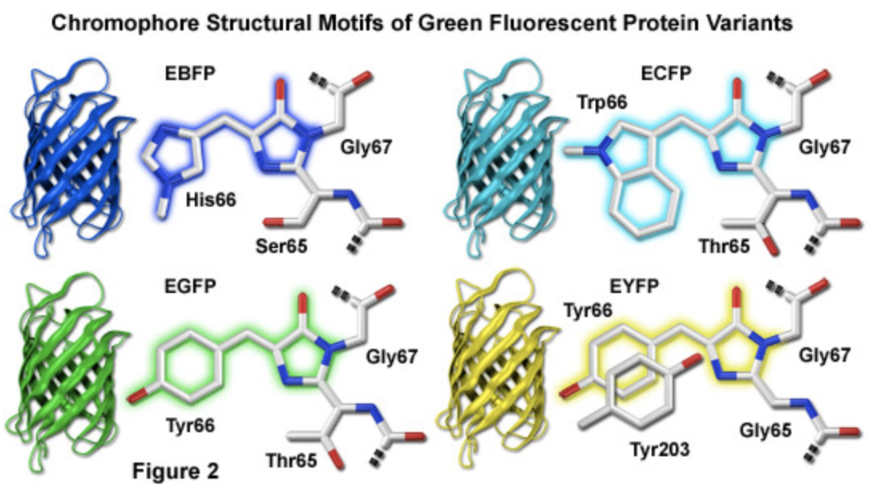
FLUORESCENT PROTEINS

Slide 35
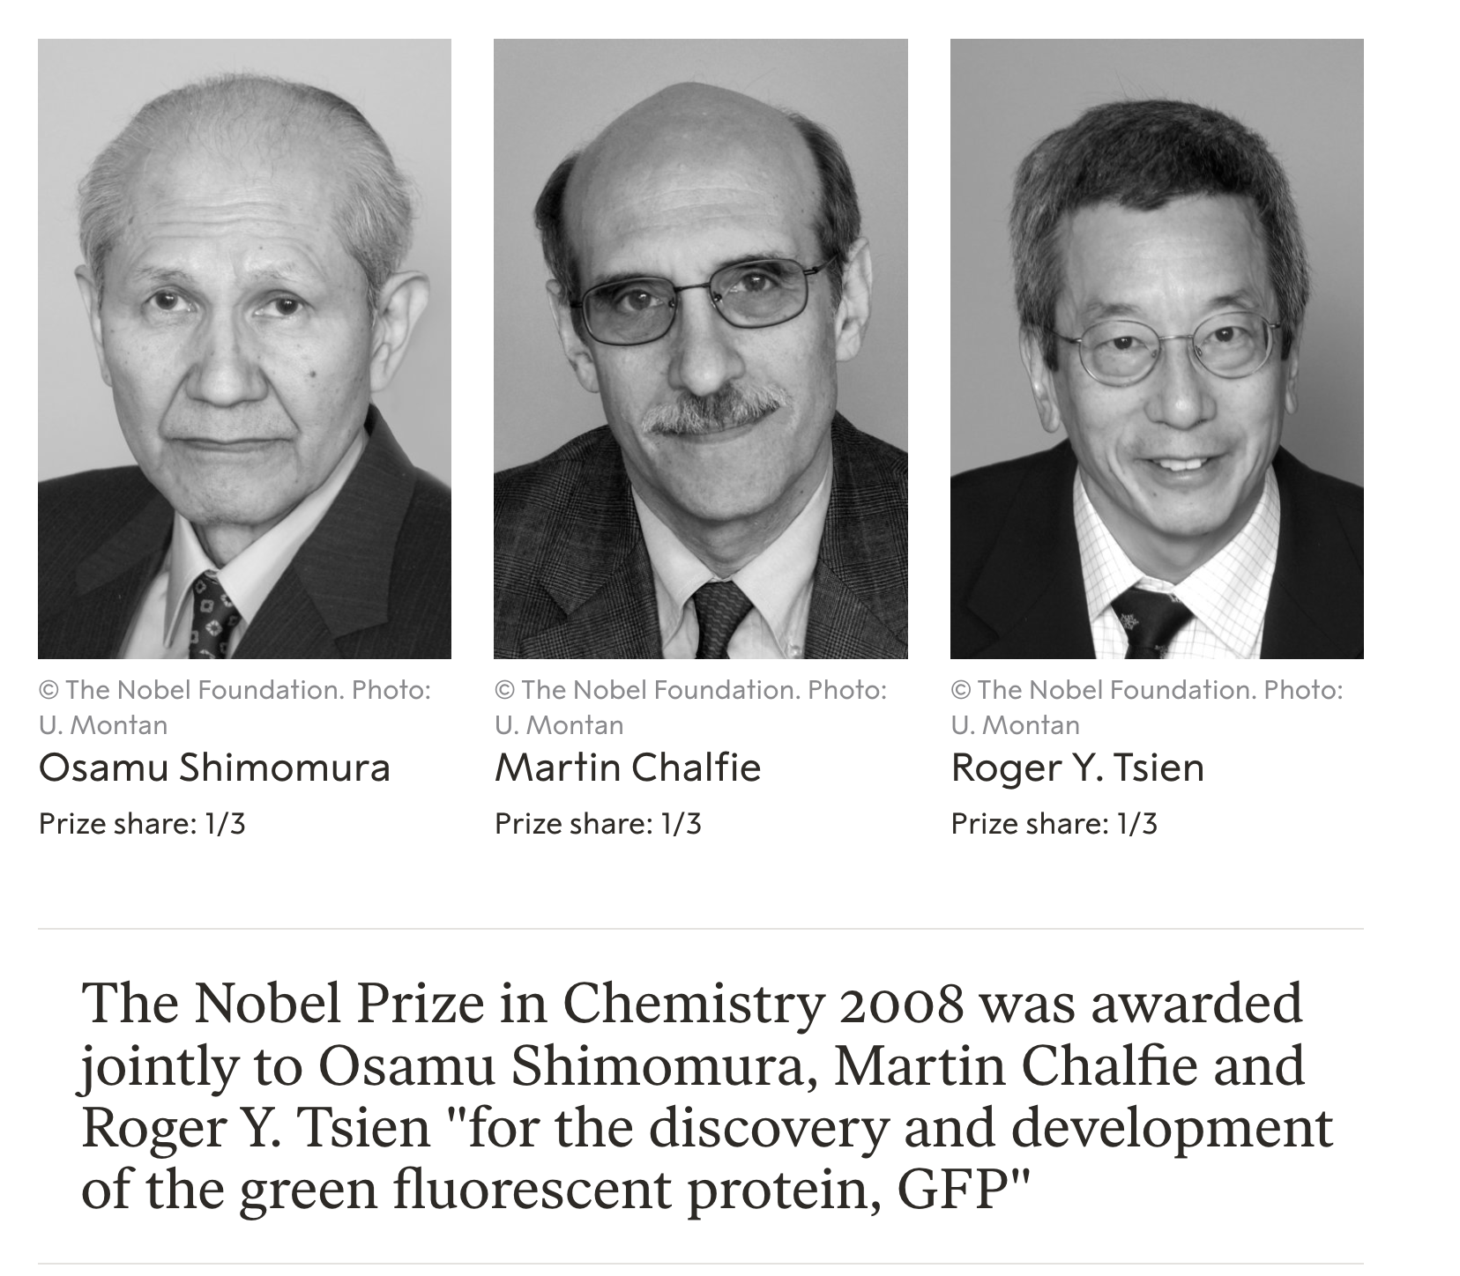
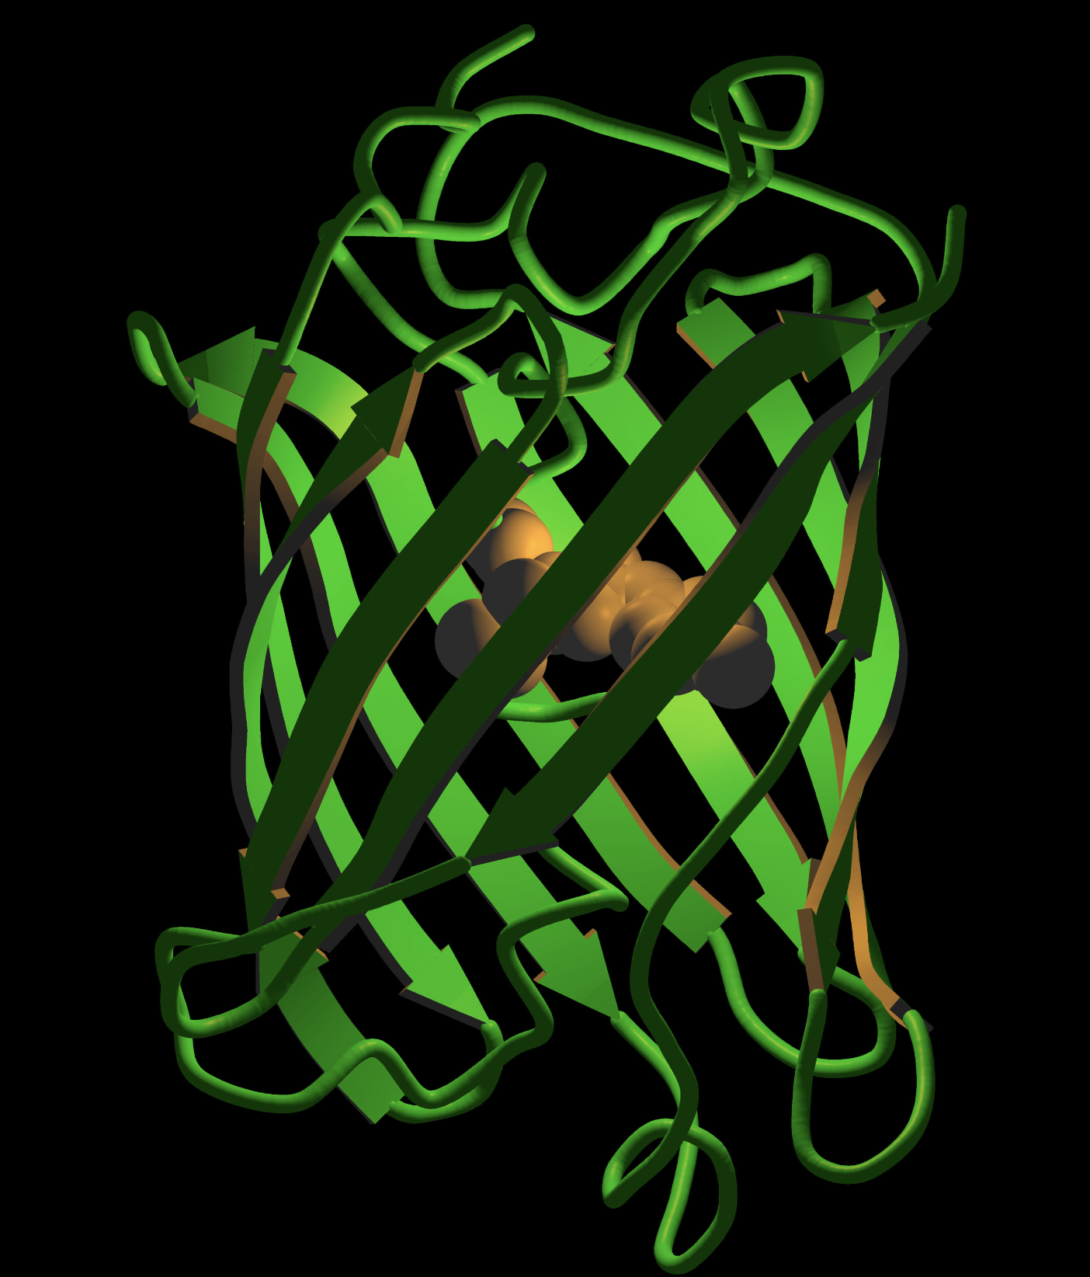

Slide 36
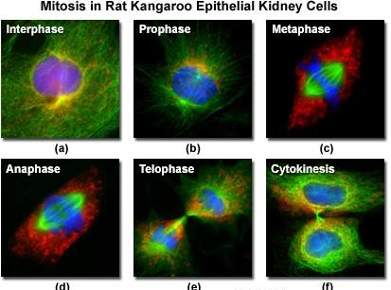

Slide 37
CONSIDERATIONS
The intensity
is related to the probability of the event
Wavelength relates to the energy of the light absorbed or
emitted
the longer the wavelength the lower the energy
the shorter the wavelength the higher the energy

Slide 38
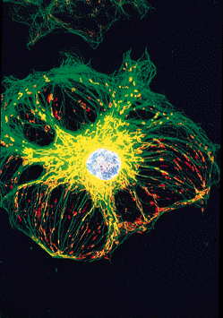
MULTICHANNEL FLUORESCENCE
Direct coupling to macromolecules
Fluorescent dyes and substrates
Fluorescent fusion proteins
Fluorescent Antibodies
Arterial edothelial cell Ch1(Green) FITC Tubulin Ch2(Red) mitotracker Ch3(Blue) DAPI

Slide 39
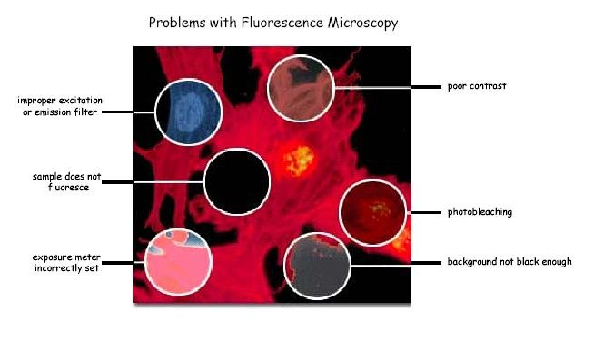

Slide 40
PHOTOBLEACHING
Defined as the irreversible destruction of an excited fluorophore (discussed in later lecture)
Methods for countering photobleaching
  Scan for shorter times
  Use high magnification, high NA objective
  Use wide emission filters
  Reduce excitation intensity
  Use “antifade” reagents (not compatible with viable cells)

Slide 41
QUENCHING
Not a chemical process
Dynamic quenching:
Collisional process usually controlled by mutual diffusion
Typical quenchers: oxygen, aliphatic and aromatic amines
(IK, NO2, CHCl3)
Static Quenching:
Formation of ground state complex between the fluorophores and quencher with a non-fluorescent complex (temperature dependent – if you have higher quencher ground state complex is less likely and therefore less quenching

Slide 42
ANTIFADE AGENTS
Many quenchers act by reducing oxygen concentration to prevent formation of singlet oxygen
Satisfactory for fixed samples but not live cells!
Antioxidants such as propyl gallate, hydroquinone, p- phenylenediamine are used
Reduce O₂ concentration or use singlet oxygen quenchers such as carotenoids (50 mM crocetin or etretinate in cell cultures); ascorbate, imidazole, histidine, cysteamine, reduced glutathione, uric acid, trolox (vitamin E analogue)

Slide 43
STAINING
 | Fluorescent dyes | Coupled fluorophore
Fixed sample | Most DNA dyes | to proteins: Antibodies, lectins, streptavidin to other molecules (nucleic acids,..) Fluorescent protein coupling (usually genetically encoded)
Live sample | Some DNA stains Organelle stains (mitotracker, lysotracker, ER tracker) | Ready access only for surface targeting coupled fluorophores Main application for genetically encoded fluorescent proteins

Slide 44
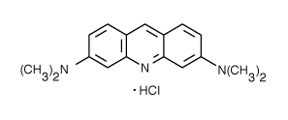
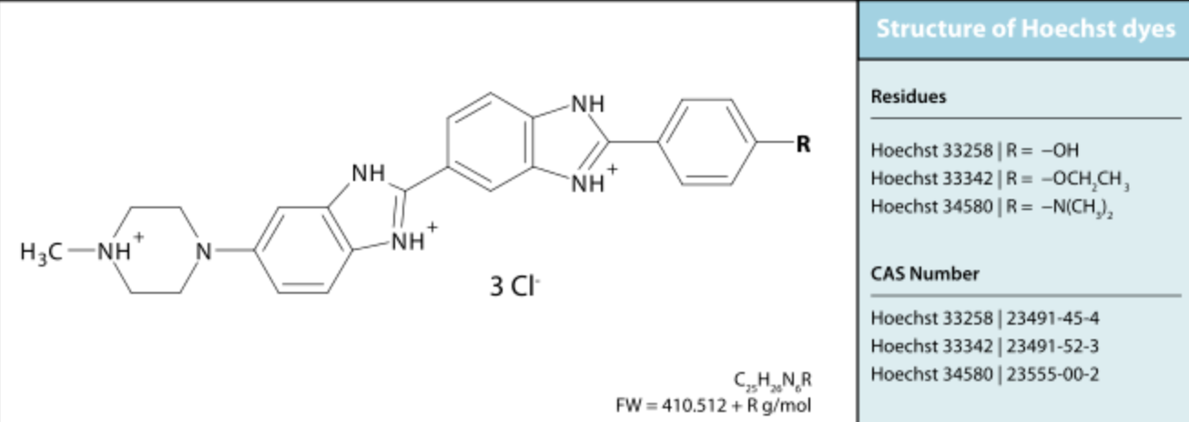
DNA PROBES
Acridine Orange
  Metachromatic dye
    concentration dependent emission
    double stranded NA - Green
    single stranded NA - Red
AT/GC binding dyes
  AT rich: DAPI, Hoechst, quinacrine
  GC rich: antibiotics bleomycin, chromamycin olivomycin, rhodamine 800

Slide 45
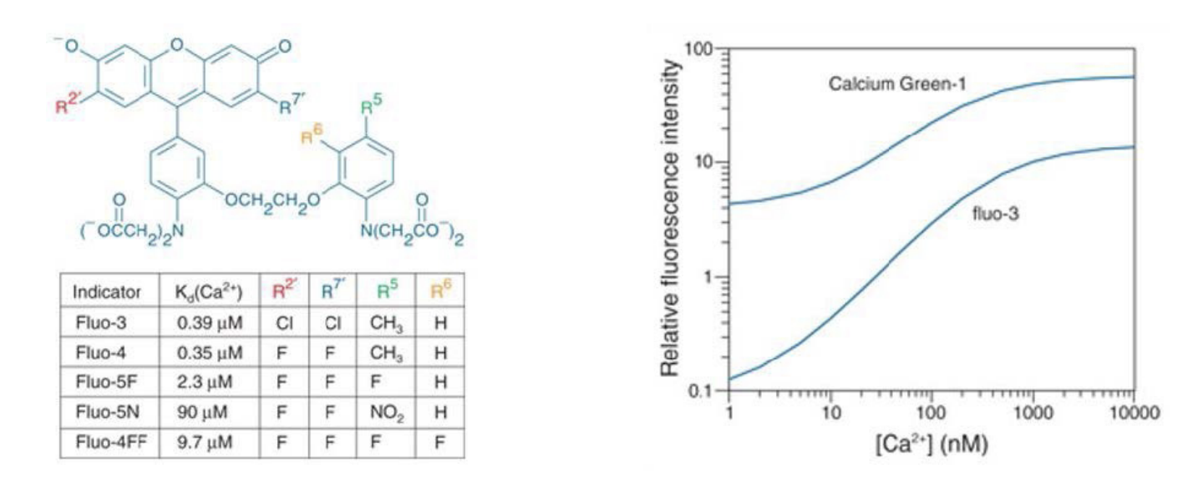
PROBES FOR IONS
INDO-1
QUIN-2
Fluo-3
Fura -2
E_{x}350 E_{x}350 E_{x}488 E_{x}330/360
E_{m}405/480 E_{m}490 E_{m}525 E_{m}510

Slide 46
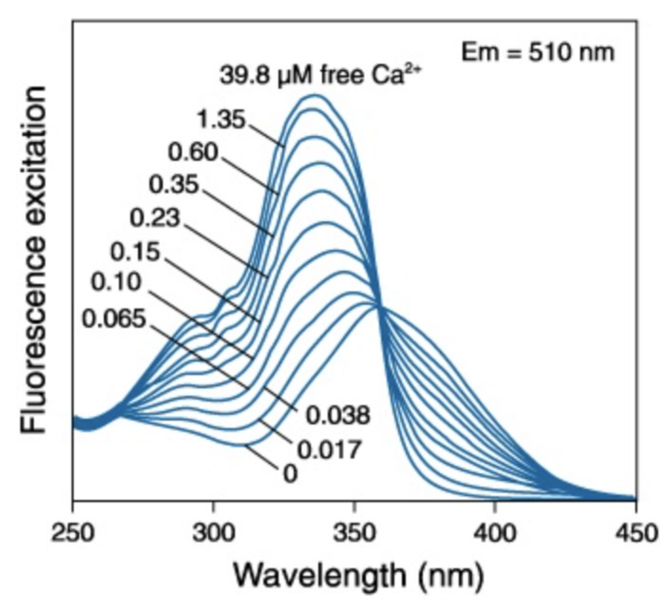
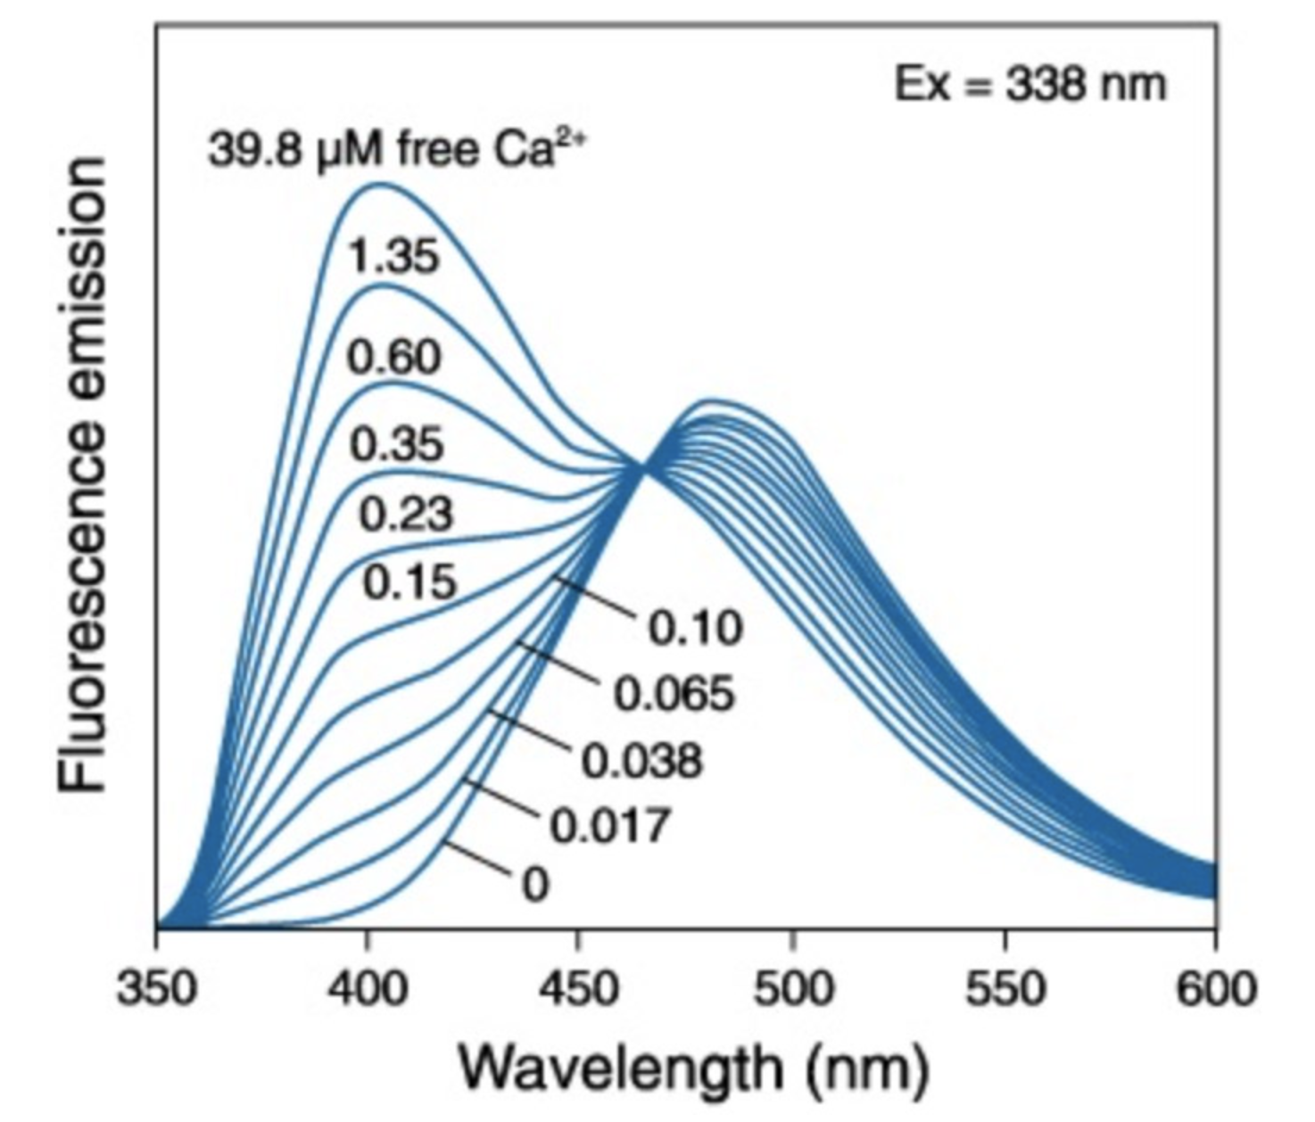
PROBES FOR IONS
INDO-1
QUIN-2
Fluo-3
Fura -2
E_{x}350 E_{x}350 E_{x}488 E_{x}330/360
E_{m}405/480 E_{m}490 E_{m}525 E_{m}510
Fura2
Indo1

Slide 47
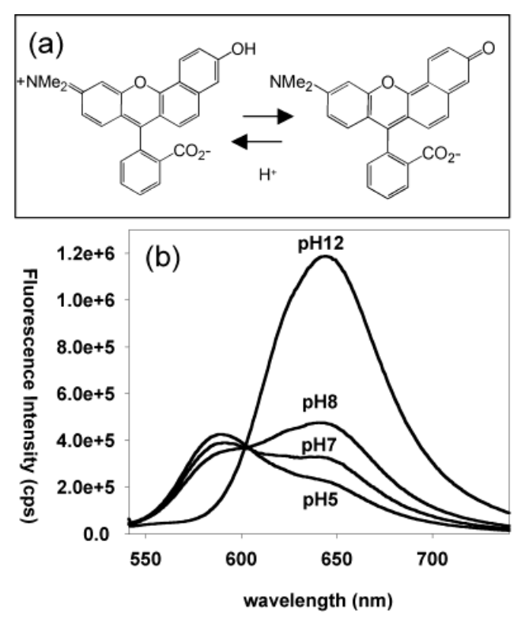
PH SENSITIVE INDICATORS
SNARF-1

Slide 48
SPECIFIC ORGANELLE PROBES
Probe
Site Excitation Emission
GOLGI 505
GOLGI 488
LIPID 350
LIPID 350
MITOCHONDRIA 488
LIPID 488
LIPID 550
LIPID 488
BODIPY NBD DPH
TMA-DPH RHODAMINE 123 DIO
DII-CN-(5)
DIO-CN-(3)
511
525
420
420
525
500
565
500
BODIPY - borate-dipyrromethene complexes DPH – diphenylhexatriene
NBD - nitrobenzoxadiazole TMA - trimethylammonium

Slide 49
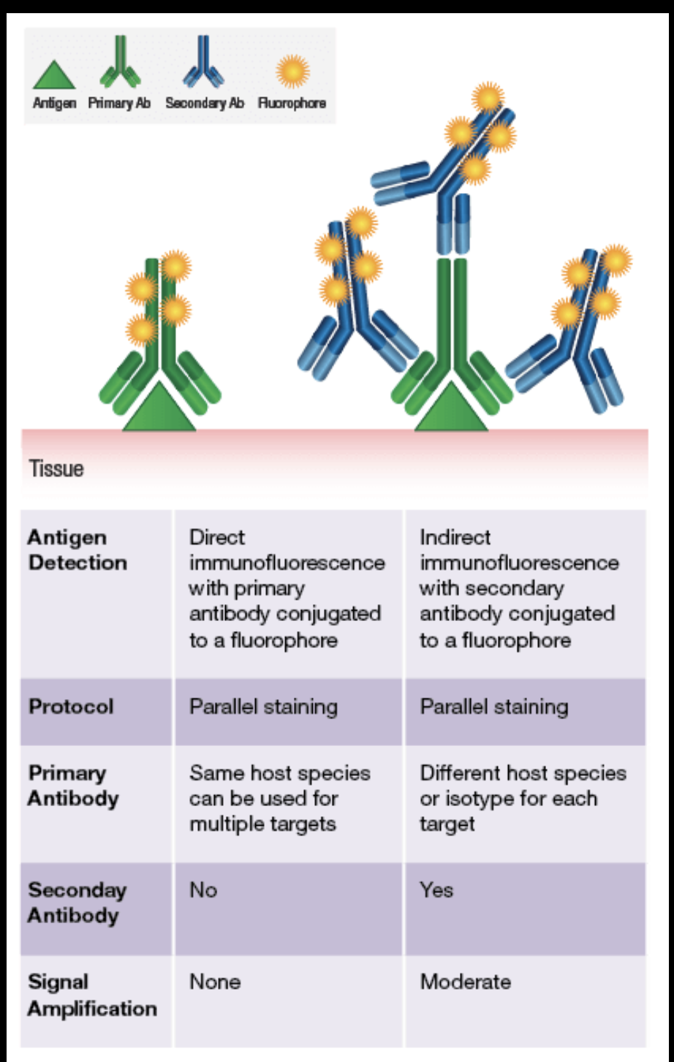
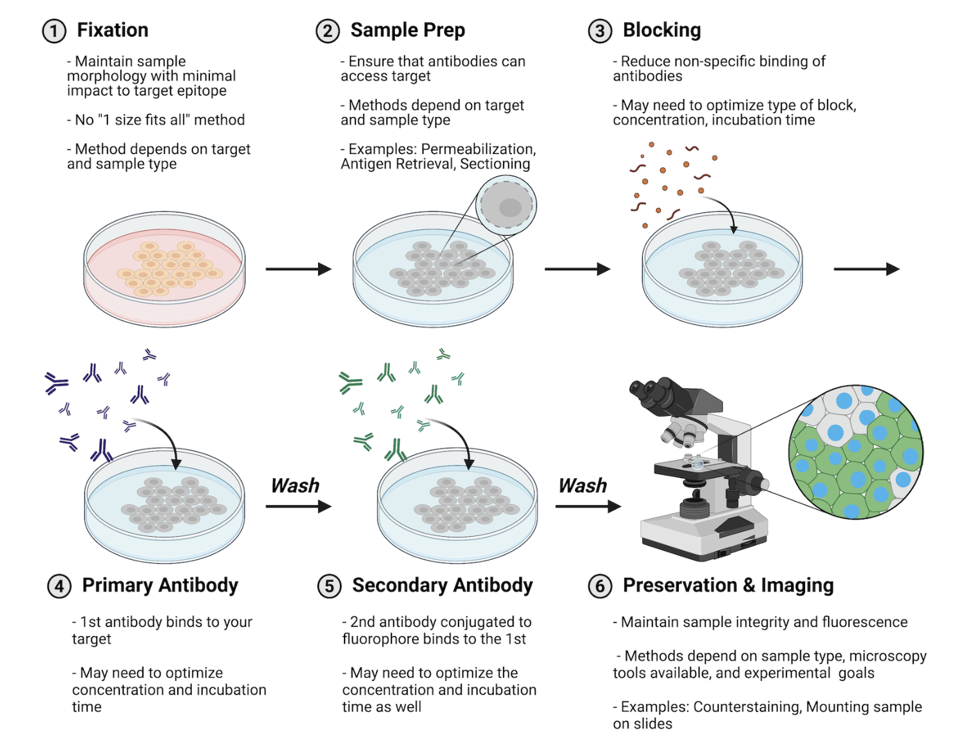
Fluorophore-conjugated ANTIBODIES

Slide 50
Fluorophore-conjugated ANTIBODIES
Which target protein? -> Selection for specificity
Accessability of target (cell surface, intracellular)
    Permeabilisation after fixation
Blocking of unspecific sites
Controls for specificity of antibody
Mounting

Slide 51
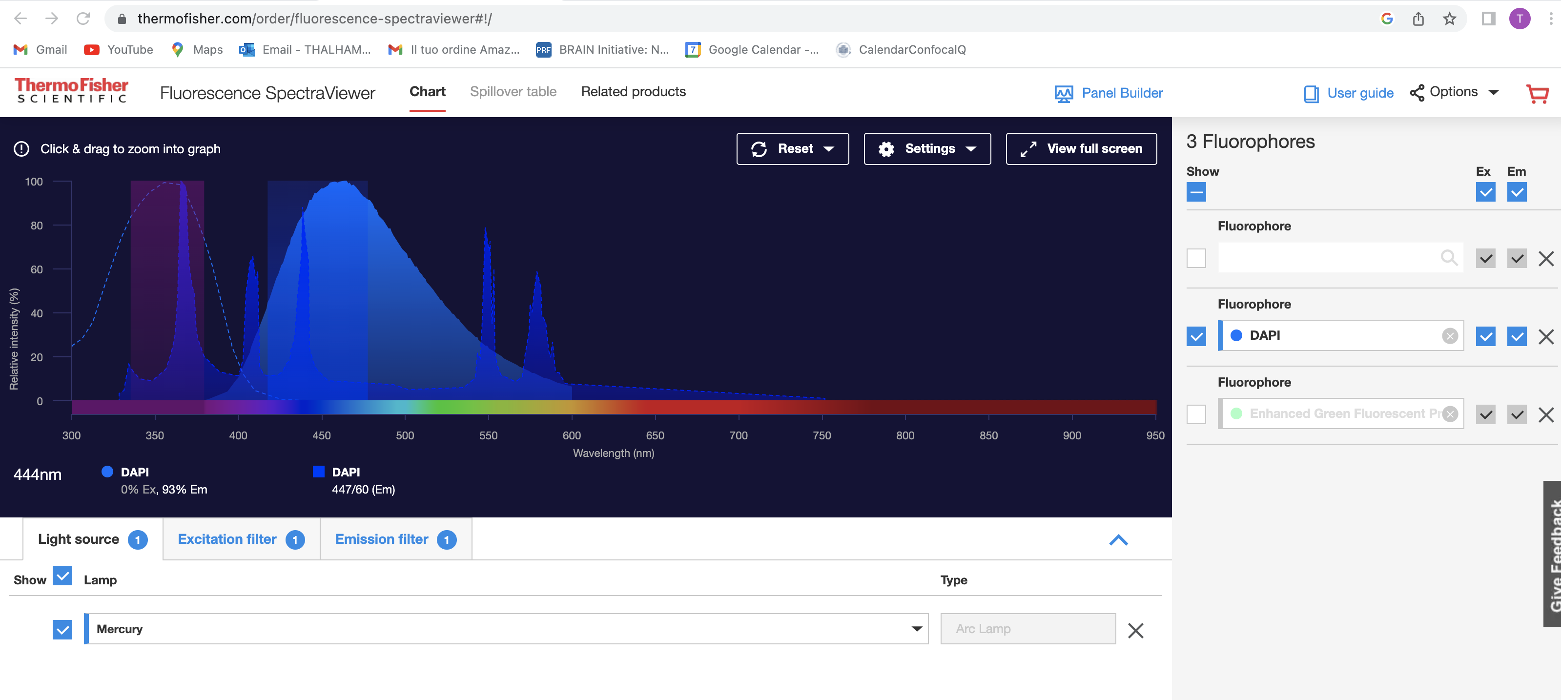
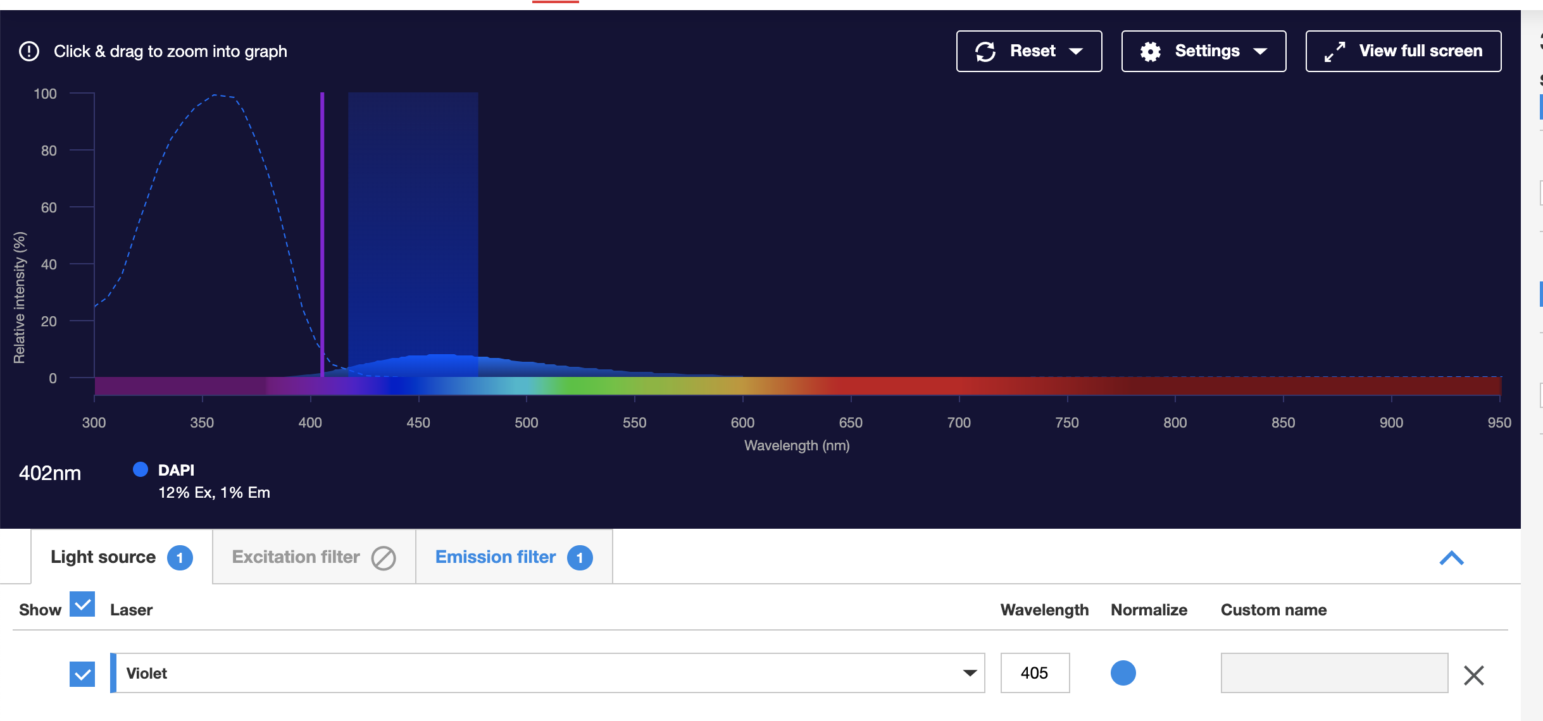
FILTER COMBINATIONS
https://www.thermofisher.com/order/fluorescence-spectraviewer#!/
Beware of light source!!

Slide 52
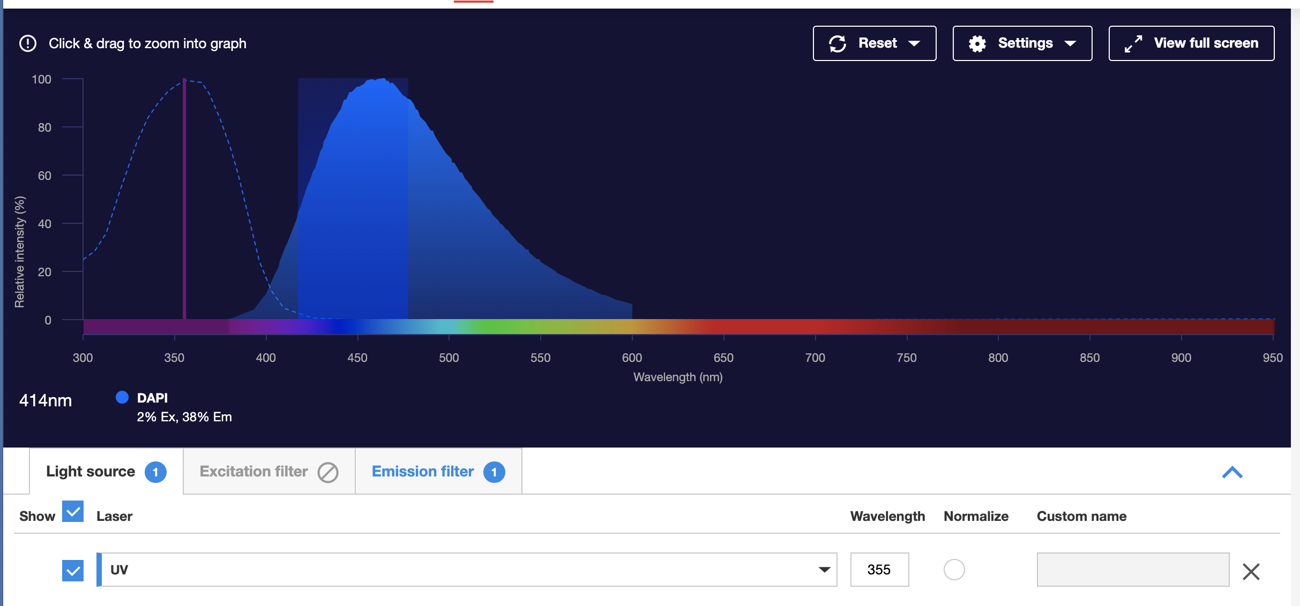
FILTER COMBINATIONS
https://www.thermofisher.com/order/fluorescence-spectraviewer#!/
Beware of light source!!

Slide 53
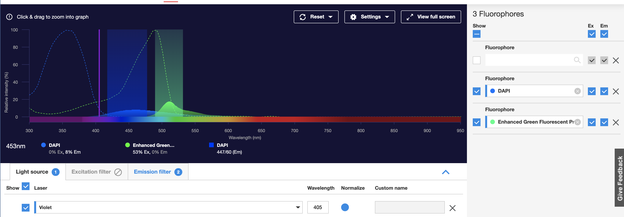

FILTER COMBINATIONS
https://www.thermofisher.com/order/fluorescence-spectraviewer#!/
Beware of light source!!

Slide 54

FILTER COMBINATIONS
https://www.thermofisher.com/order/fluorescence-spectraviewer#!/
Beware of light source!!

Slide 55

FILTER COMBINATIONS
https://www.thermofisher.com/order/fluorescence-spectraviewer#!/
Check for crosstalk!!

Slide 56

FILTER COMBINATIONS
https://www.thermofisher.com/order/fluorescence-spectraviewer#!/
Check for cross-talk!!

Slide 57


FILTER COMBINATIONS
https://www.thermofisher.com/order/fluorescence-spectraviewer#!/
Beware of filter!!

Slide 58

FILTER COMBINATIONS
https://www.thermofisher.com/order/fluorescence-spectraviewer#!/
Beware of crosstalk!!

Slide 59


FILTER COMBINATIONS
https://www.thermofisher.com/order/fluorescence-spectraviewer#!/
Beware of fluorophore!!

Slide 60


FILTER COMBINATIONS
https://www.thermofisher.com/order/fluorescence-spectraviewer#!/
Beware of fluorophore!!

Slide 61


FILTER COMBINATIONS
https://www.thermofisher.com/order/fluorescence-spectraviewer#!/
Beware of filter cube!!

Slide 62


FILTER COMBINATIONS
https://www.thermofisher.com/order/fluorescence-spectraviewer#!/
Farred is not visible to eye!!

Slide 63
FLUORESCENCE OVERLAP
Band pass filter
575 nm
488 nm
Fluorescence Intensity
Fluorescein
molecule
PE
molecule
450
500
550 600 650
Wavelength (nm)
Overlap of FITC fluorescence in PE PMT Overlap of PE fluorescence in FITC PMT

Slide 64

FLUORESCENCE OVERLAP

Slide 65


FLUORESCENCE OVERLAP
Overlap!!

