Slide 1
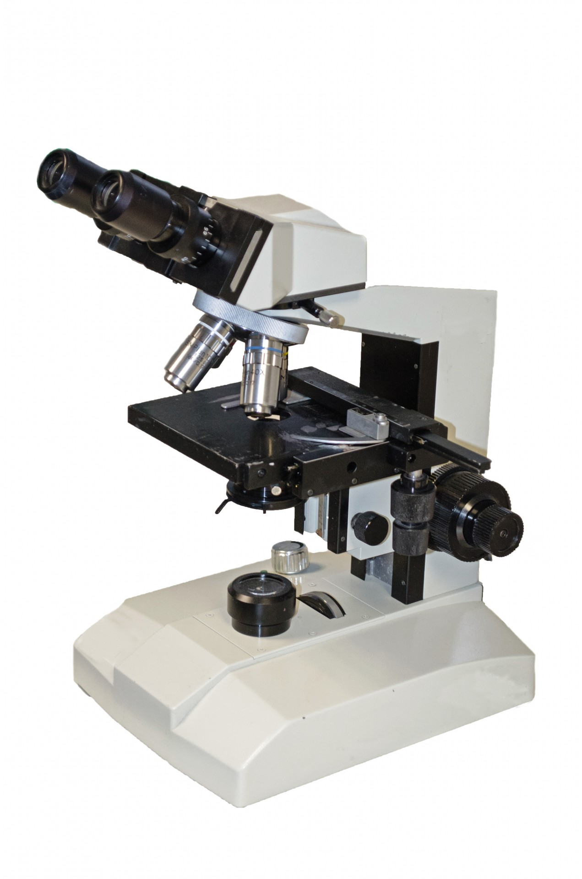


MICROSCOPIA OTTICA IN BIOLOGIA CELLULARE [675SM]
MICROSCOPY IN CELL BIOLOGY –
aa 2022/2023, 2nd semester
Aula 5A, edificio H2bis 15-18
Agnes Thalhammer
agnes.thalhammer@units.it

Slide 2

Fluorescence Microscopy
part1

Slide 3
CONTRASTING TECHNIQUES – A REMINDER…
Brightfield: absorption
Darkfield: scattering
Phase Contrast: phase interference
Differential Interference Contrast (DIC):
polarization + phase interference
Fluorescence Contrast

Slide 4
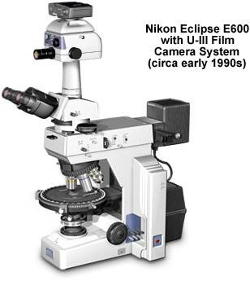
UPRIGHT MICROSCOPE
Epi- illumination Source
Transmitted and reflected light: transmission for bright field and reflection for flourescent light
Brightfield Source

Slide 5
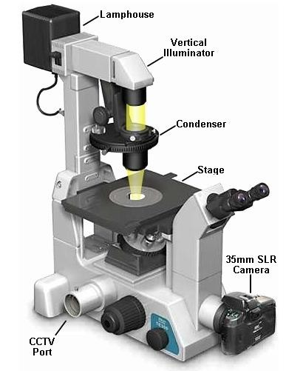
INVERTED MICROSCOPE
Brightfield Source
Epi- illumination Source

Slide 6
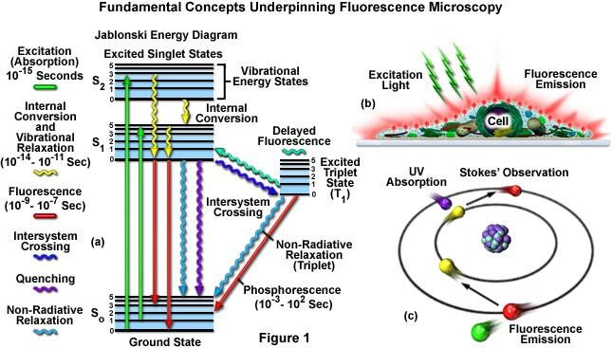
FLUORESCENCE PRINCIPLE

Slide 7
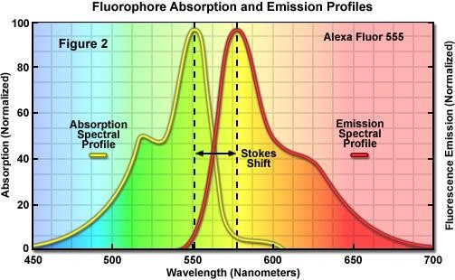
Molecules absorbing the energy of electromagnetic radiation will jump to a higher energy level. When certain excited molecules return to the ground state they emit radiation. This phenomenon is known as fluorescence. Fluorescent molecules are known as fluorochromes or fluorophores.

Slide 8
COMPONENTS OF A FLUORESCENT MICROSCOPE
light source
  (xenon arc lamp / mercury-vapor lamp / metal halide lamp / LED )
excitation filter,
dichroic mirror
emission filter
A fluorescence microscope is basically a conventional light microscope with added features and components that extend its capabilities.

Slide 9
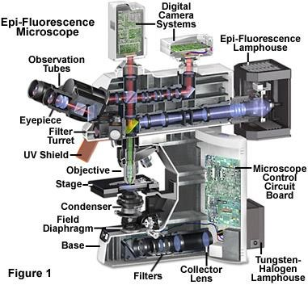
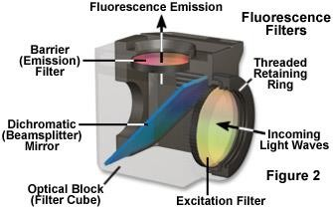

Slide 10
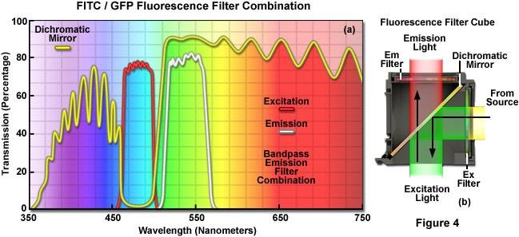

Slide 11
THE FILTERS
Excitation Filter | Emission Filters
to select excitation wavelength | to select emission wavelength
 | to remove traces of excitation light
placed in the excitation path just prior to the dichroic mirror | placed between sample and ocular/camera/ detector

Slide 12
BASIC CONCEPTS
excitation light radiates specimen
weaker emitted light to make up the image is separated
use fact that the emitted light is of lower energy and has a longer wavelength
The fluorescent areas can be observed in the microscope and shine out against a dark background with high contrast

Slide 13
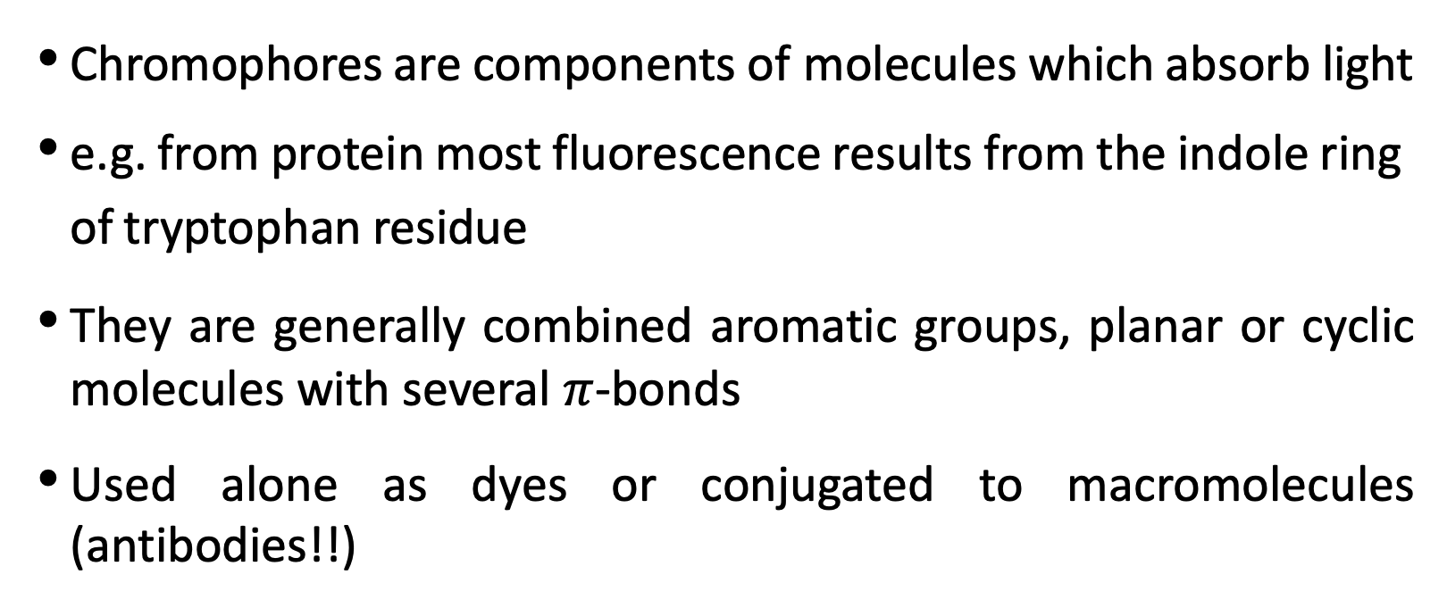
r
CHROMOPHORES
Chromophores are components of molecules which absorb light
e.g. from protein most fluorescence results from the indole ring of tryptophan residue
They are generally combined aromatic groups, planar or cyclic molecules with several $π$-bonds
Used alone as dyes or conjugated to macromolecules (antibodies!!)
The “cube”
Actin - Rhodamine-phalloidin ^{Imaged using an MRC 1000}
Confocal Microscope, 40 x 1.3 NA Fluor

Slide 14
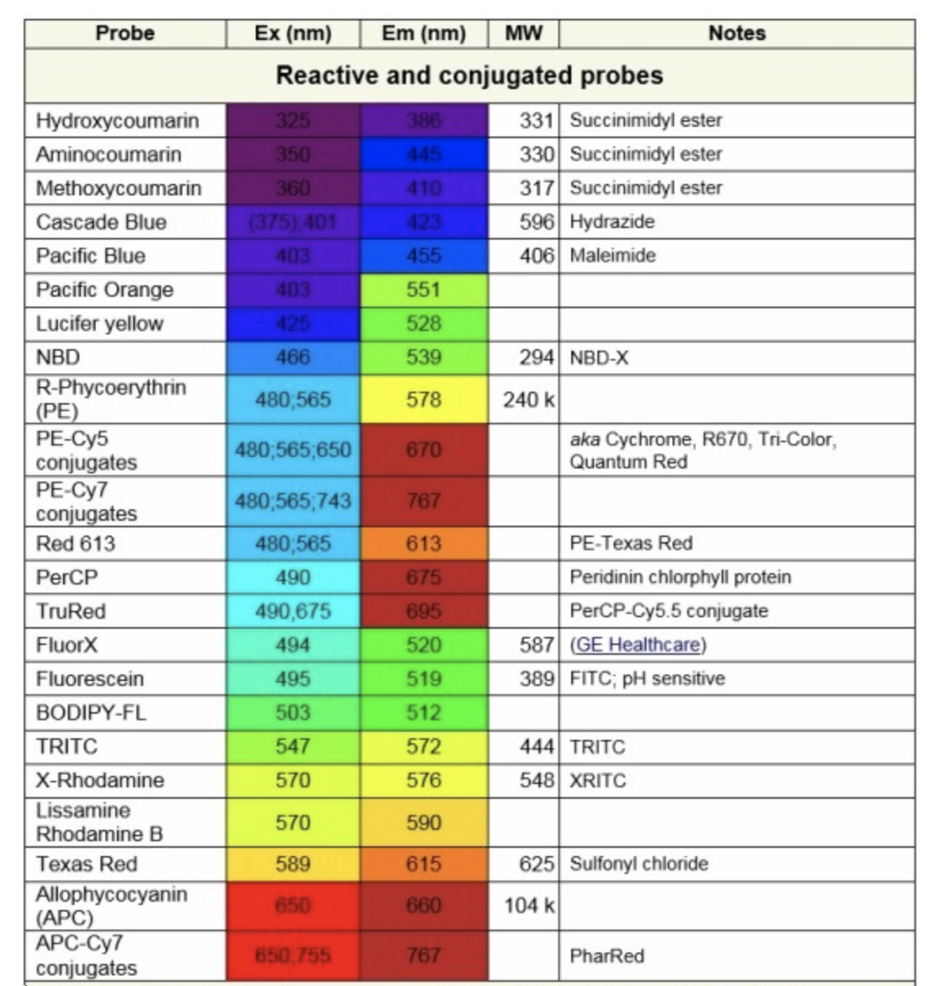
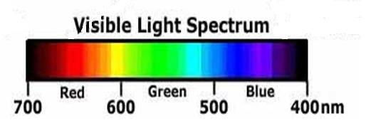
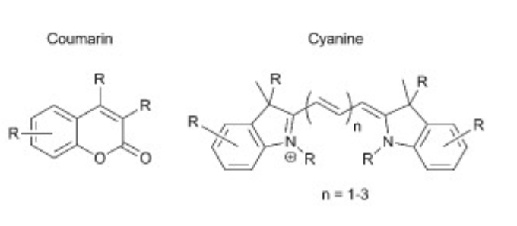
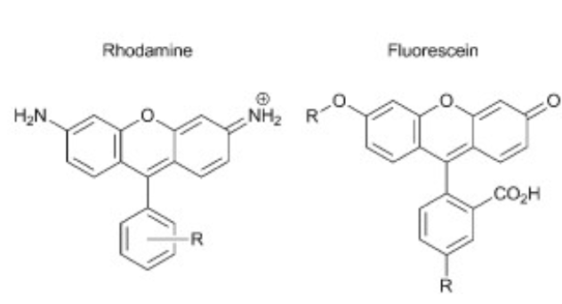
FLUOROPHORES (Fluorochromes, chromophores)

Slide 15
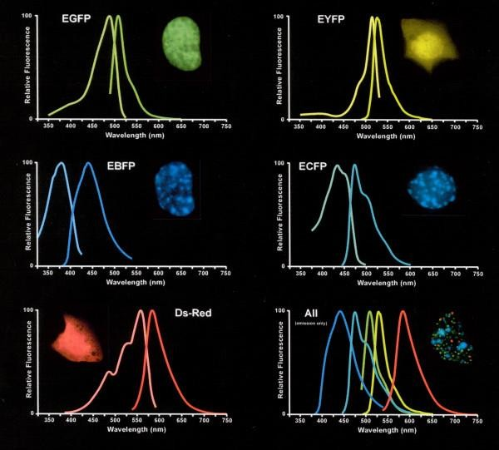
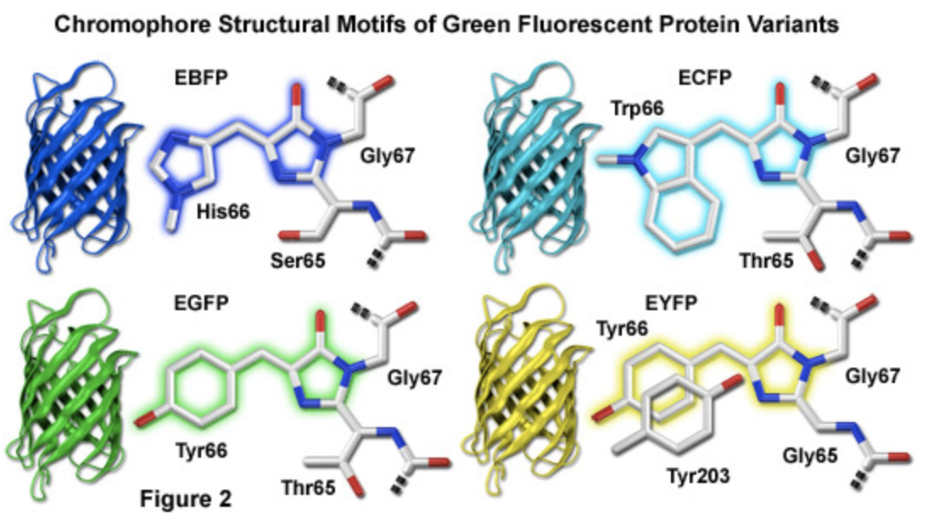
FLUORESCENT PROTEINS

Slide 16
CONSIDERATIONS
The intensity
is related to the probability of the event
Wavelength relates to the energy of the light absorbed or
emitted
the longer the wavelength the lower the energy
the shorter the wavelength the higher the energy

Slide 17
STAINING
 | Fluorescent dyes | Coupled fluorophore
Fixed sample | Most DNA dyes | to proteins: Antibodies, lectins, streptavidin to other molecules (nucleic acids,..) Fluorescent protein coupling (usually genetically encoded)
Live sample | Some DNA stains Organelle stains (mitotracker, lysotracker, ER tracker) | Ready access only for surface targeting coupled fluorophores Main application for genetically encoded fluorescent proteins

Slide 18
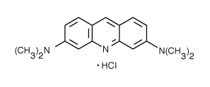
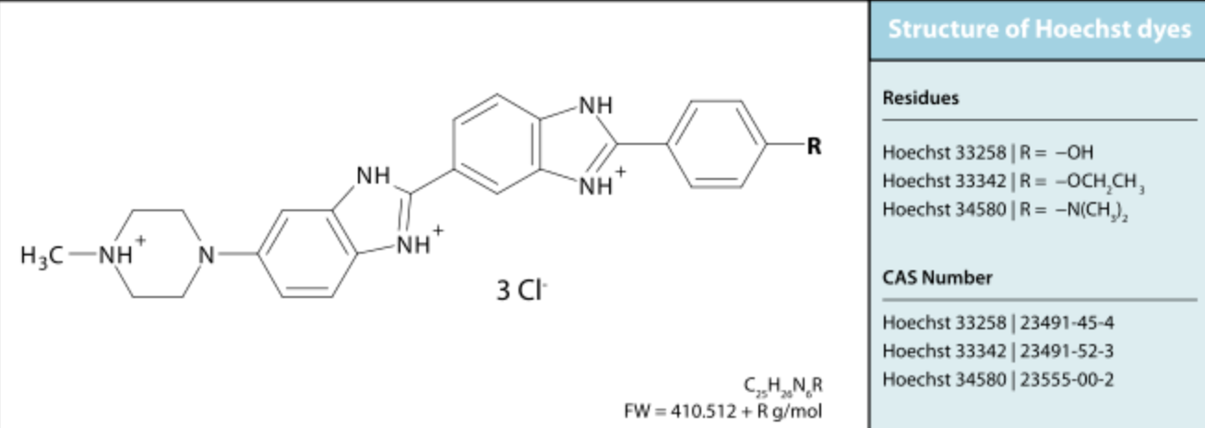
DNA PROBES
Acridine Orange
  Metachromatic dye
    concentration dependent emission
    double stranded NA - Green
    single stranded NA - Red
AT/GC binding dyes
  AT rich: DAPI, Hoechst, quinacrine
  GC rich: antibiotics bleomycin, chromamycin olivomycin, rhodamine 800

Slide 19
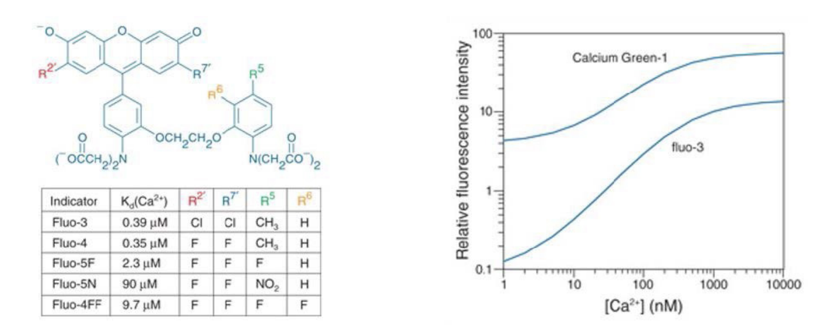
PROBES FOR IONS
INDO-1
QUIN-2
Fluo-3
Fura -2
E_{x}350 E_{x}350 E_{x}488 E_{x}330/360
E_{m}405/480 E_{m}490 E_{m}525 E_{m}510

Slide 20
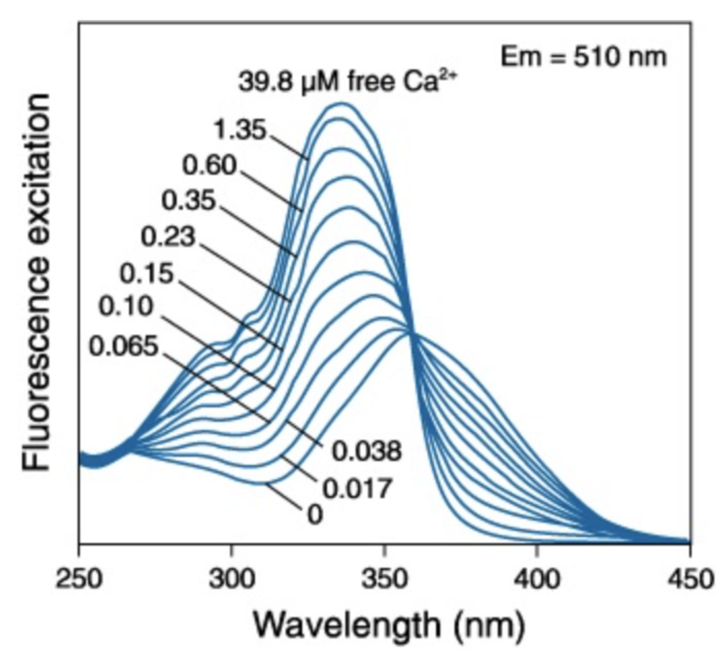
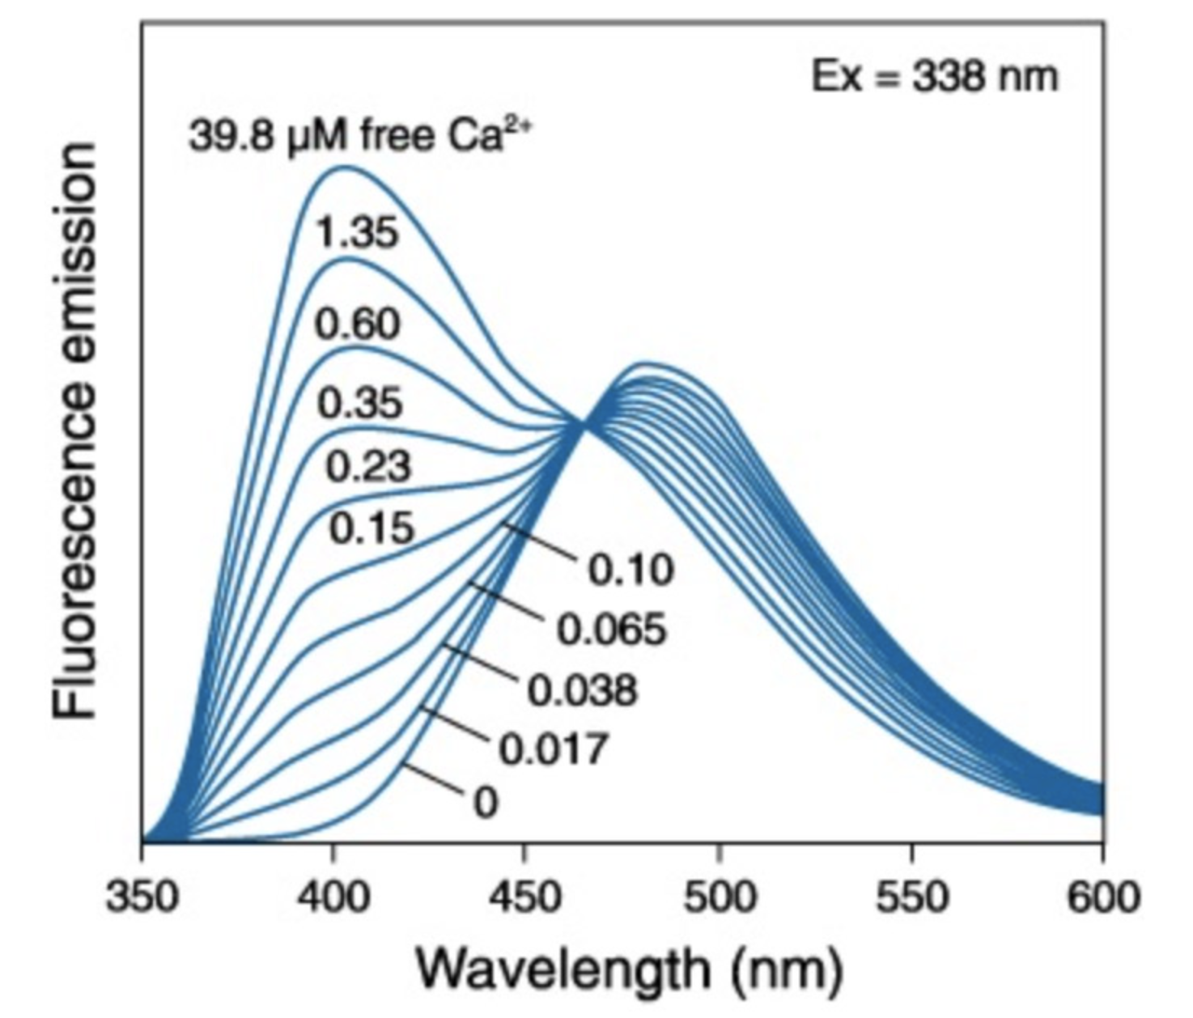
PROBES FOR IONS
INDO-1
QUIN-2
Fluo-3
Fura -2
E_{x}350 E_{x}350 E_{x}488 E_{x}330/360
E_{m}405/480 E_{m}490 E_{m}525 E_{m}510
Fura2
Indo1

Slide 21
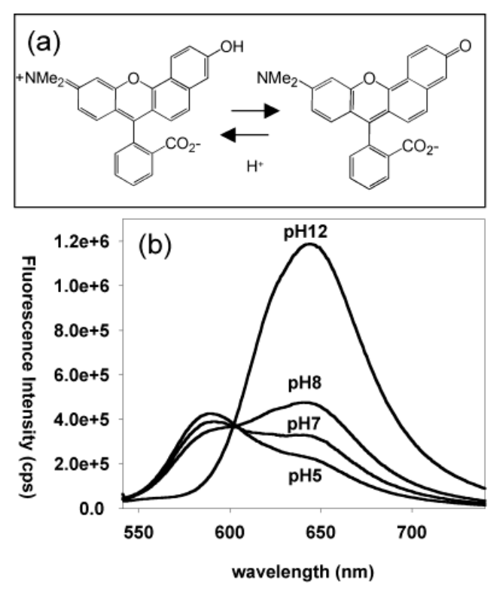
PH SENSITIVE INDICATORS
SNARF-1

Slide 22
SPECIFIC ORGANELLE PROBES
Probe
Site Excitation Emission
GOLGI 505
GOLGI 488
LIPID 350
LIPID 350
MITOCHONDRIA 488
LIPID 488
LIPID 550
LIPID 488
BODIPY NBD DPH
TMA-DPH RHODAMINE 123 DIO
DII-CN-(5)
DIO-CN-(3)
511
525
420
420
525
500
565
500
BODIPY - borate-dipyrromethene complexes DPH – diphenylhexatriene
NBD - nitrobenzoxadiazole TMA - trimethylammonium

Slide 23
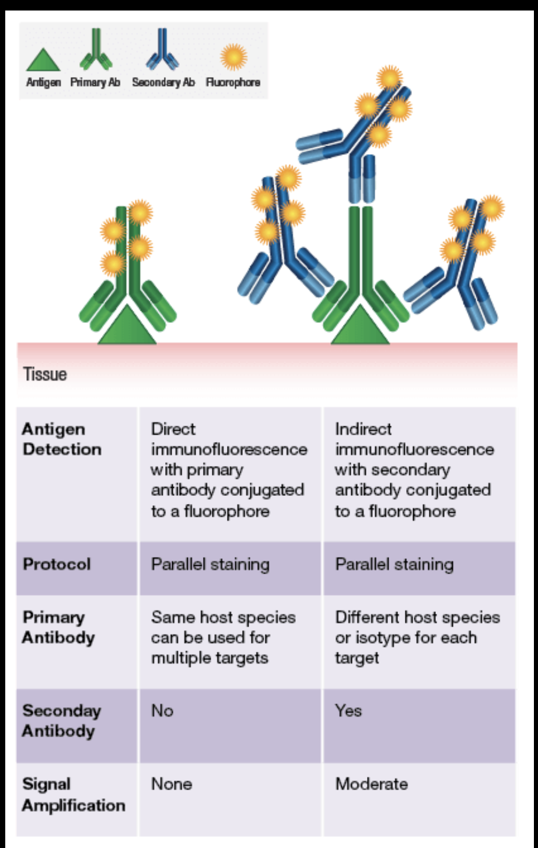
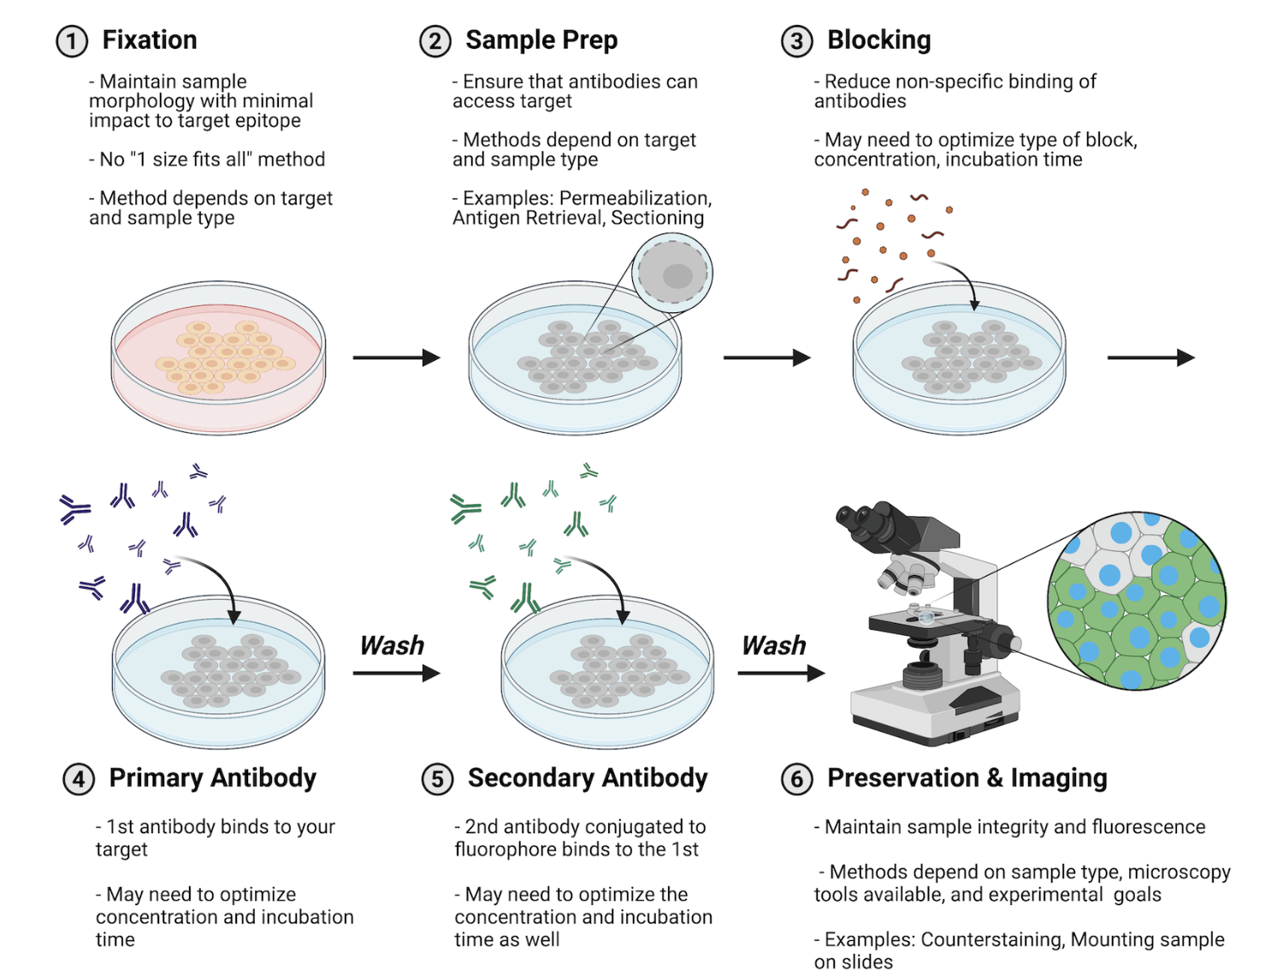
Fluorophore-conjugated ANTIBODIES

Slide 24
Fluorophore-conjugated ANTIBODIES
Which target protein? -> Selection for specificity
Accessability of target (cell surface, intracellular)
    Permeabilisation after fixation
Blocking of unspecific sites
Controls for specificity of antibody
Mounting

Slide 25
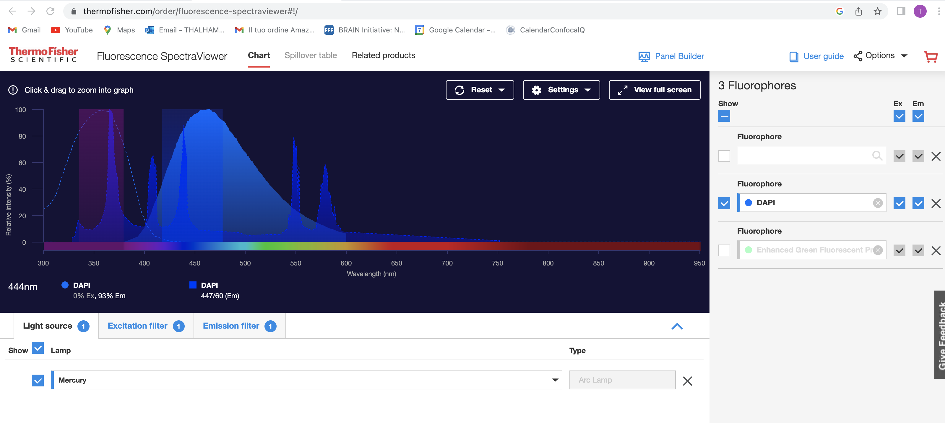
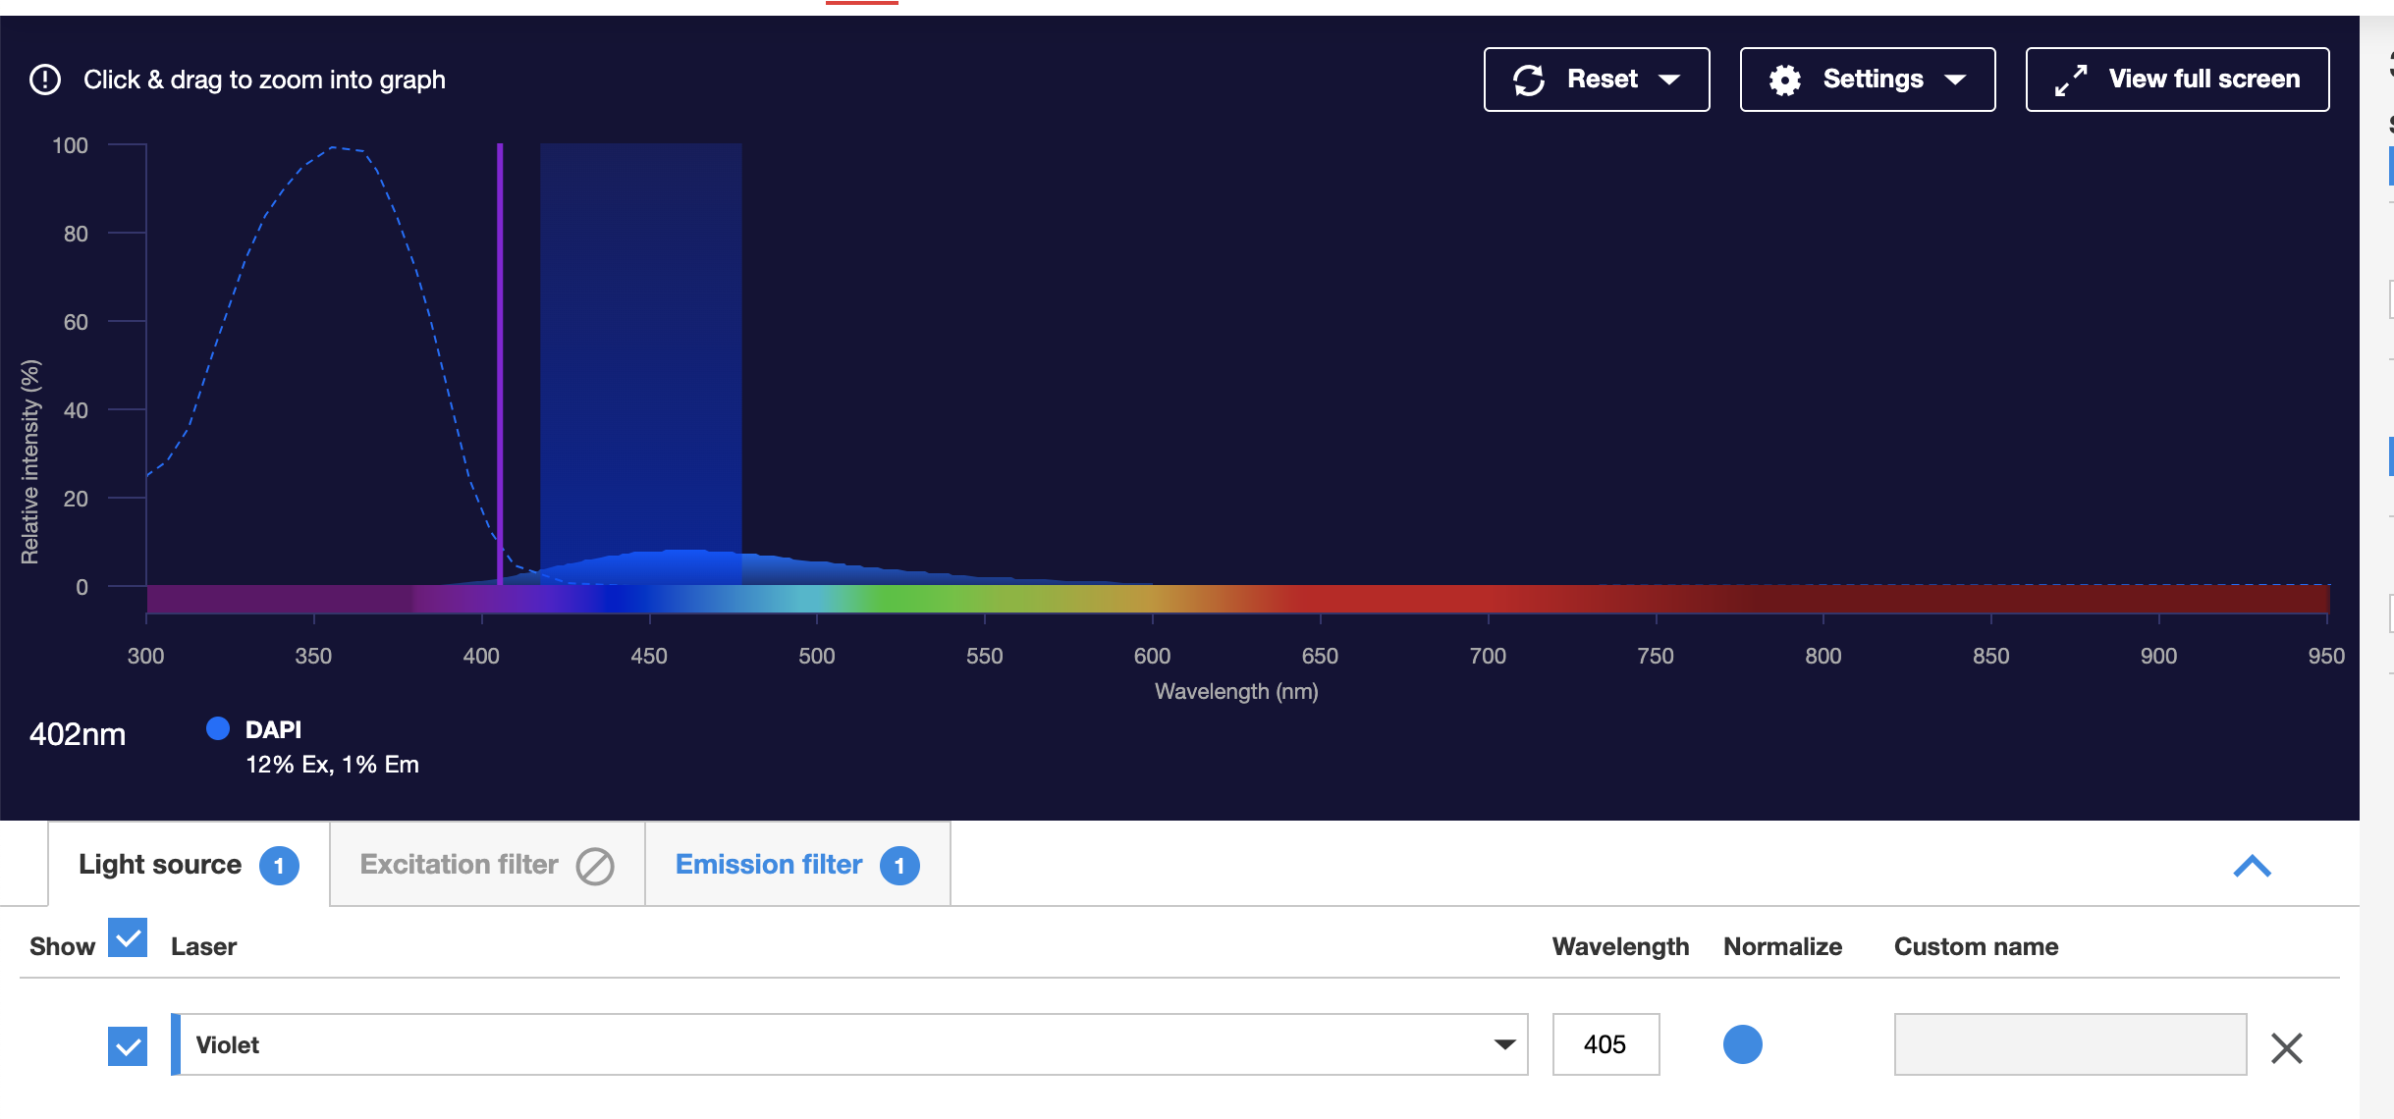
FILTER COMBINATIONS
https://www.thermofisher.com/order/fluorescence-spectraviewer#!/
Beware of light source!!

Slide 26
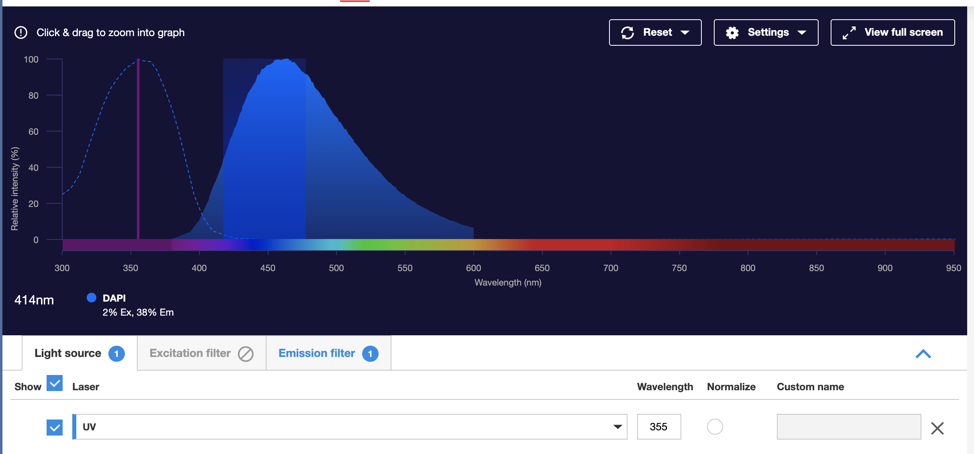
FILTER COMBINATIONS
https://www.thermofisher.com/order/fluorescence-spectraviewer#!/
Beware of light source!!

Slide 27
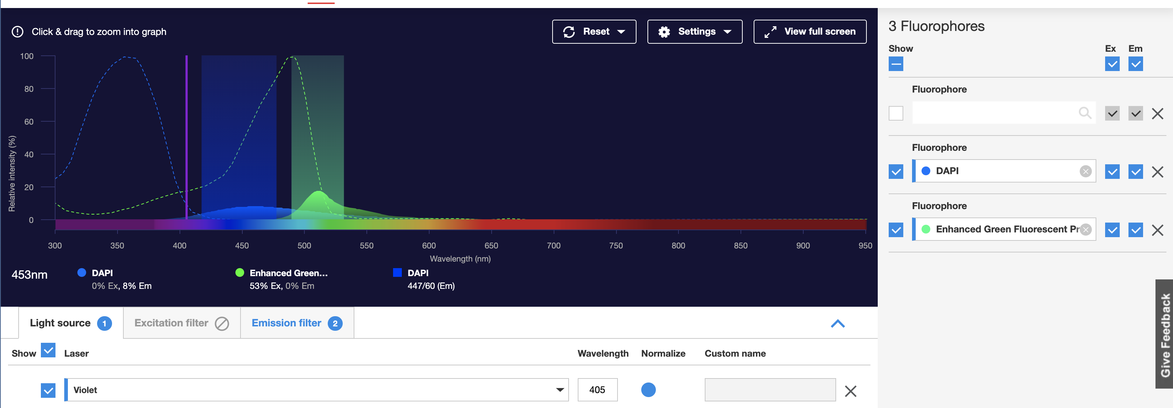
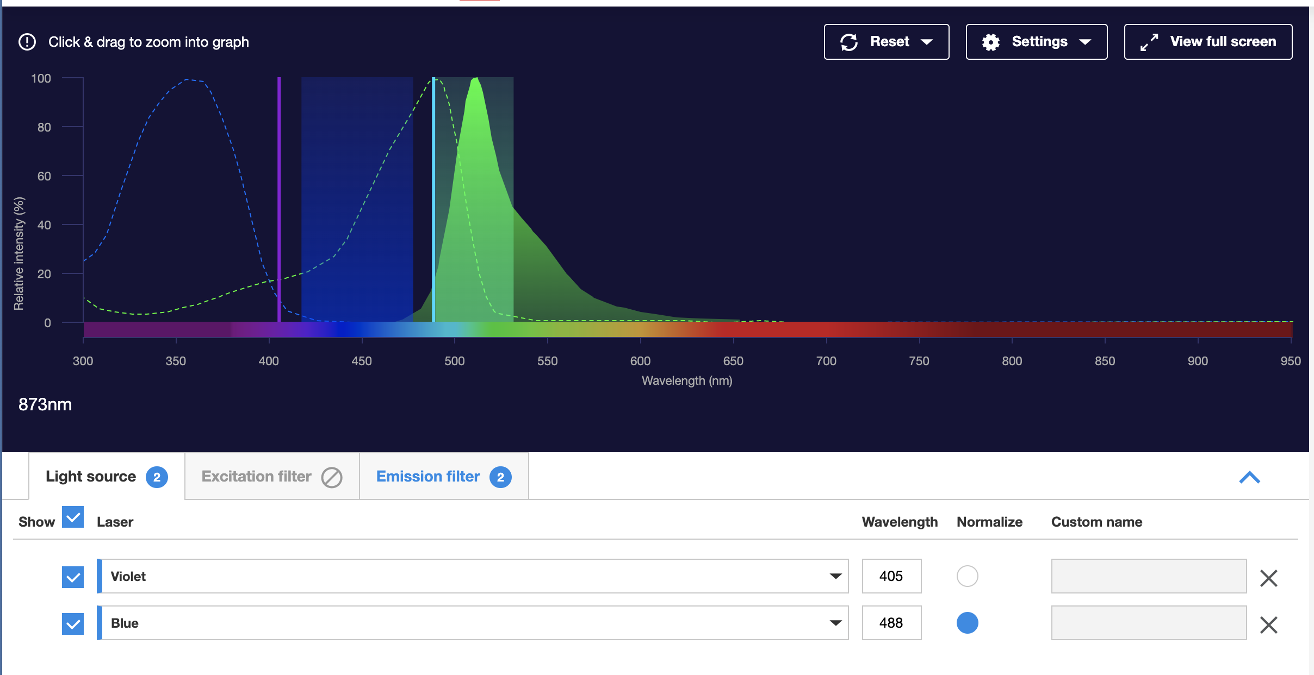
FILTER COMBINATIONS
https://www.thermofisher.com/order/fluorescence-spectraviewer#!/
Beware of light source!!

Slide 28
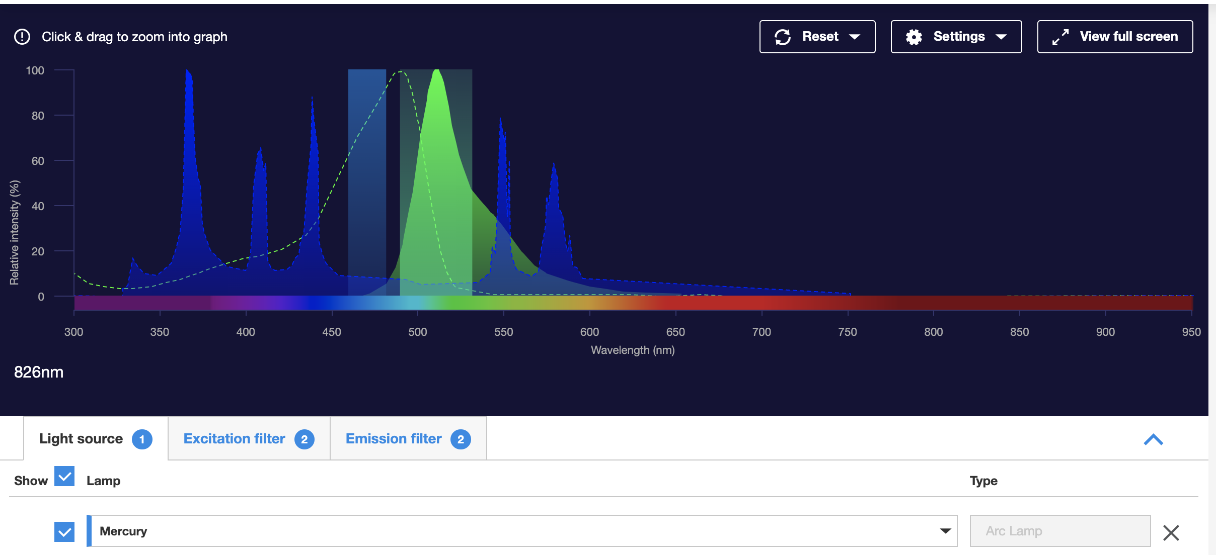
FILTER COMBINATIONS
https://www.thermofisher.com/order/fluorescence-spectraviewer#!/
Beware of light source!!

Slide 29
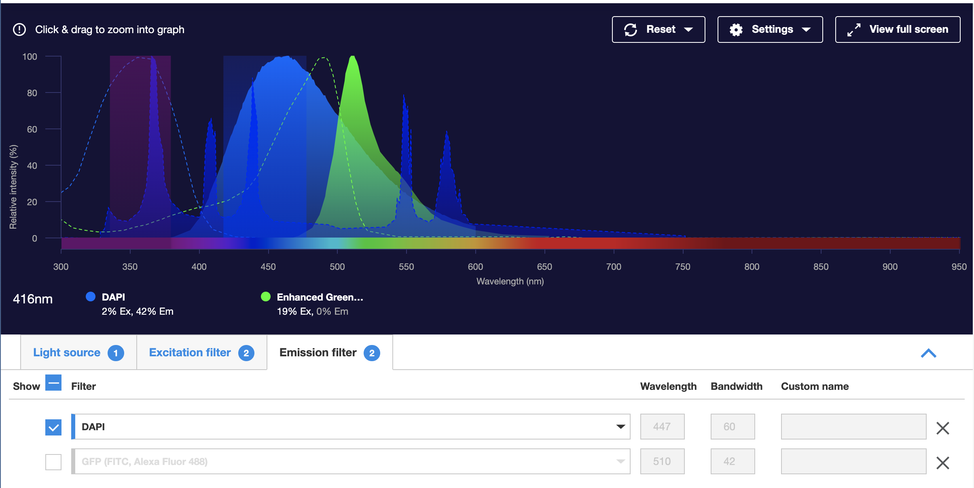
FILTER COMBINATIONS
https://www.thermofisher.com/order/fluorescence-spectraviewer#!/
Check for crosstalk!!

Slide 30
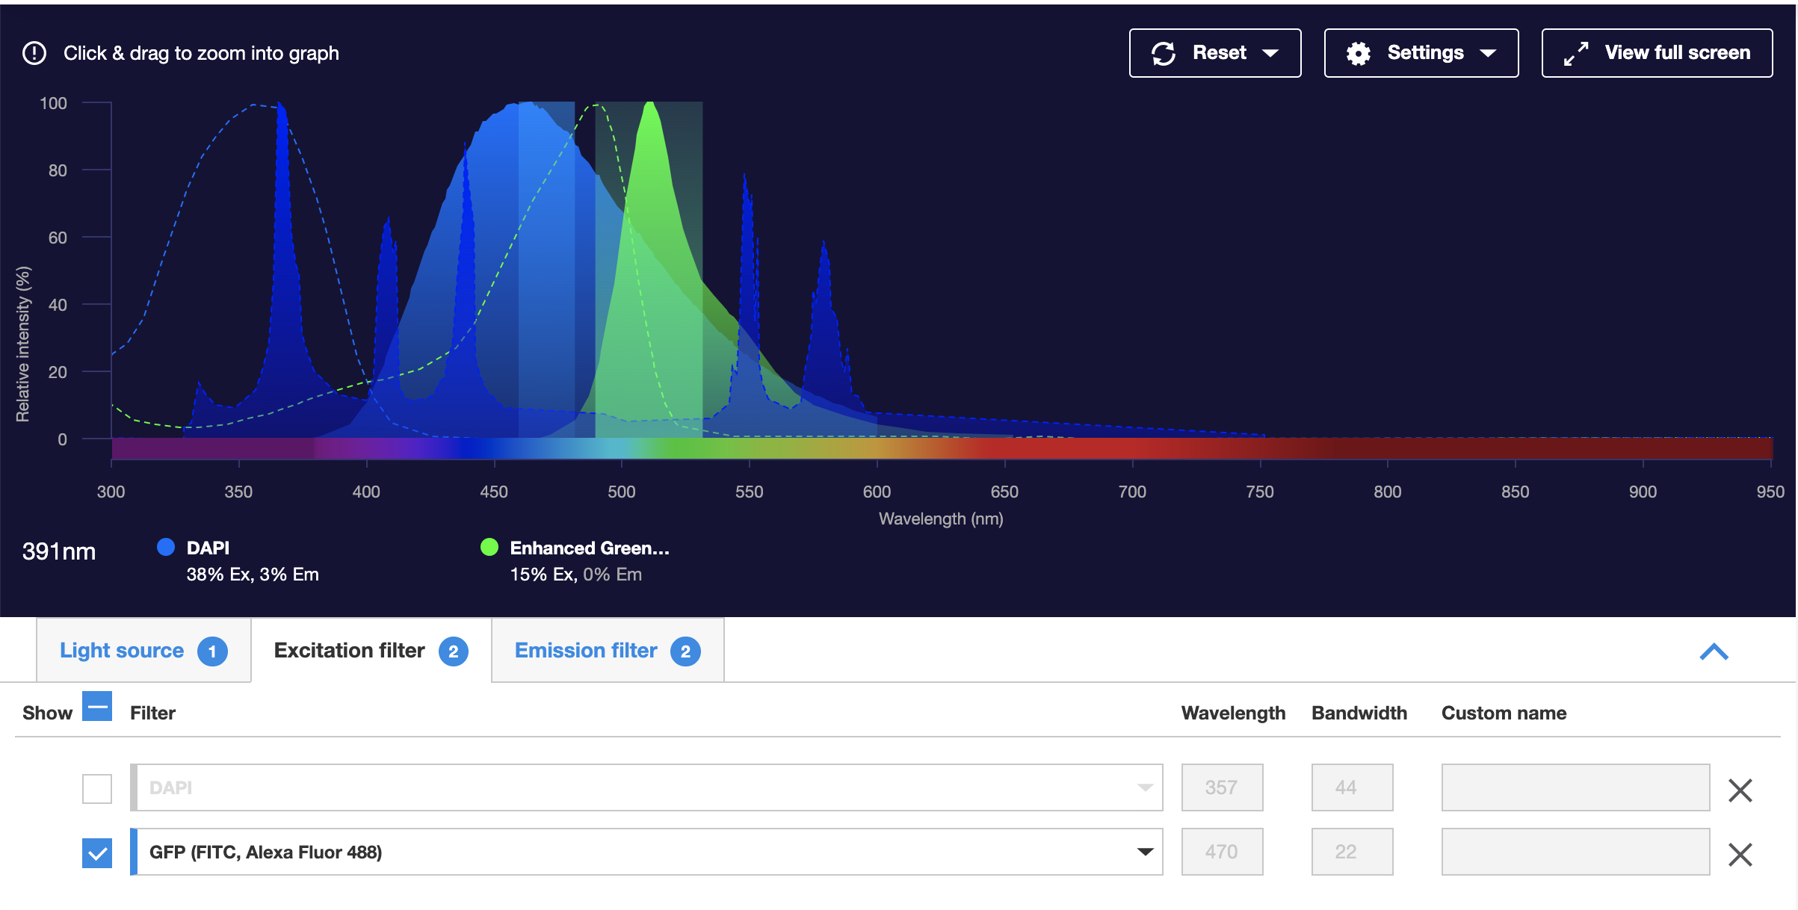
FILTER COMBINATIONS
https://www.thermofisher.com/order/fluorescence-spectraviewer#!/
Check for cross-talk!!

Slide 31
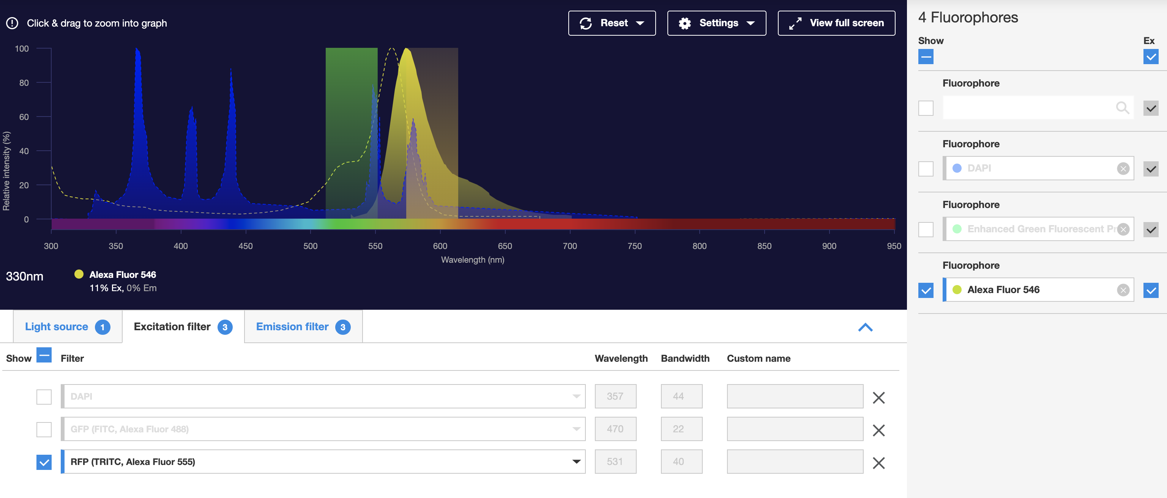
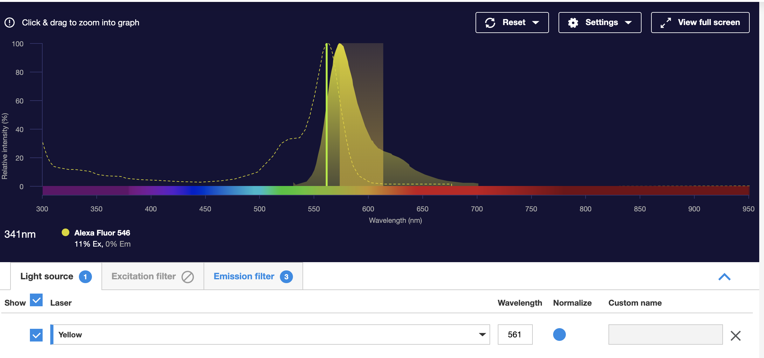
FILTER COMBINATIONS
https://www.thermofisher.com/order/fluorescence-spectraviewer#!/
Beware of filter!!

Slide 32
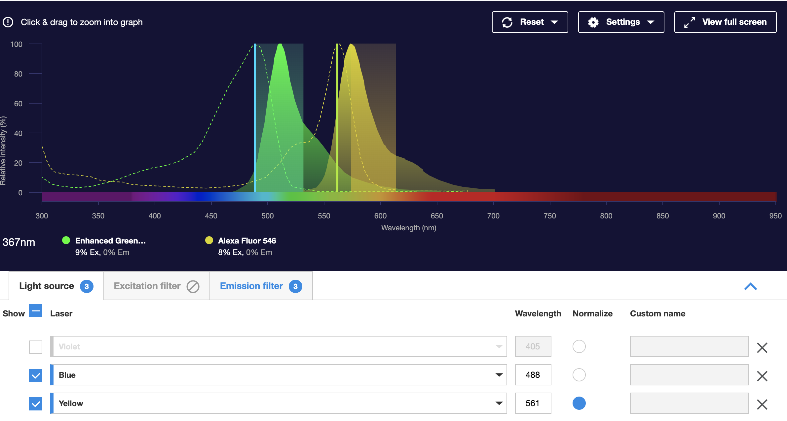
FILTER COMBINATIONS
https://www.thermofisher.com/order/fluorescence-spectraviewer#!/
Beware of crosstalk!!

Slide 33
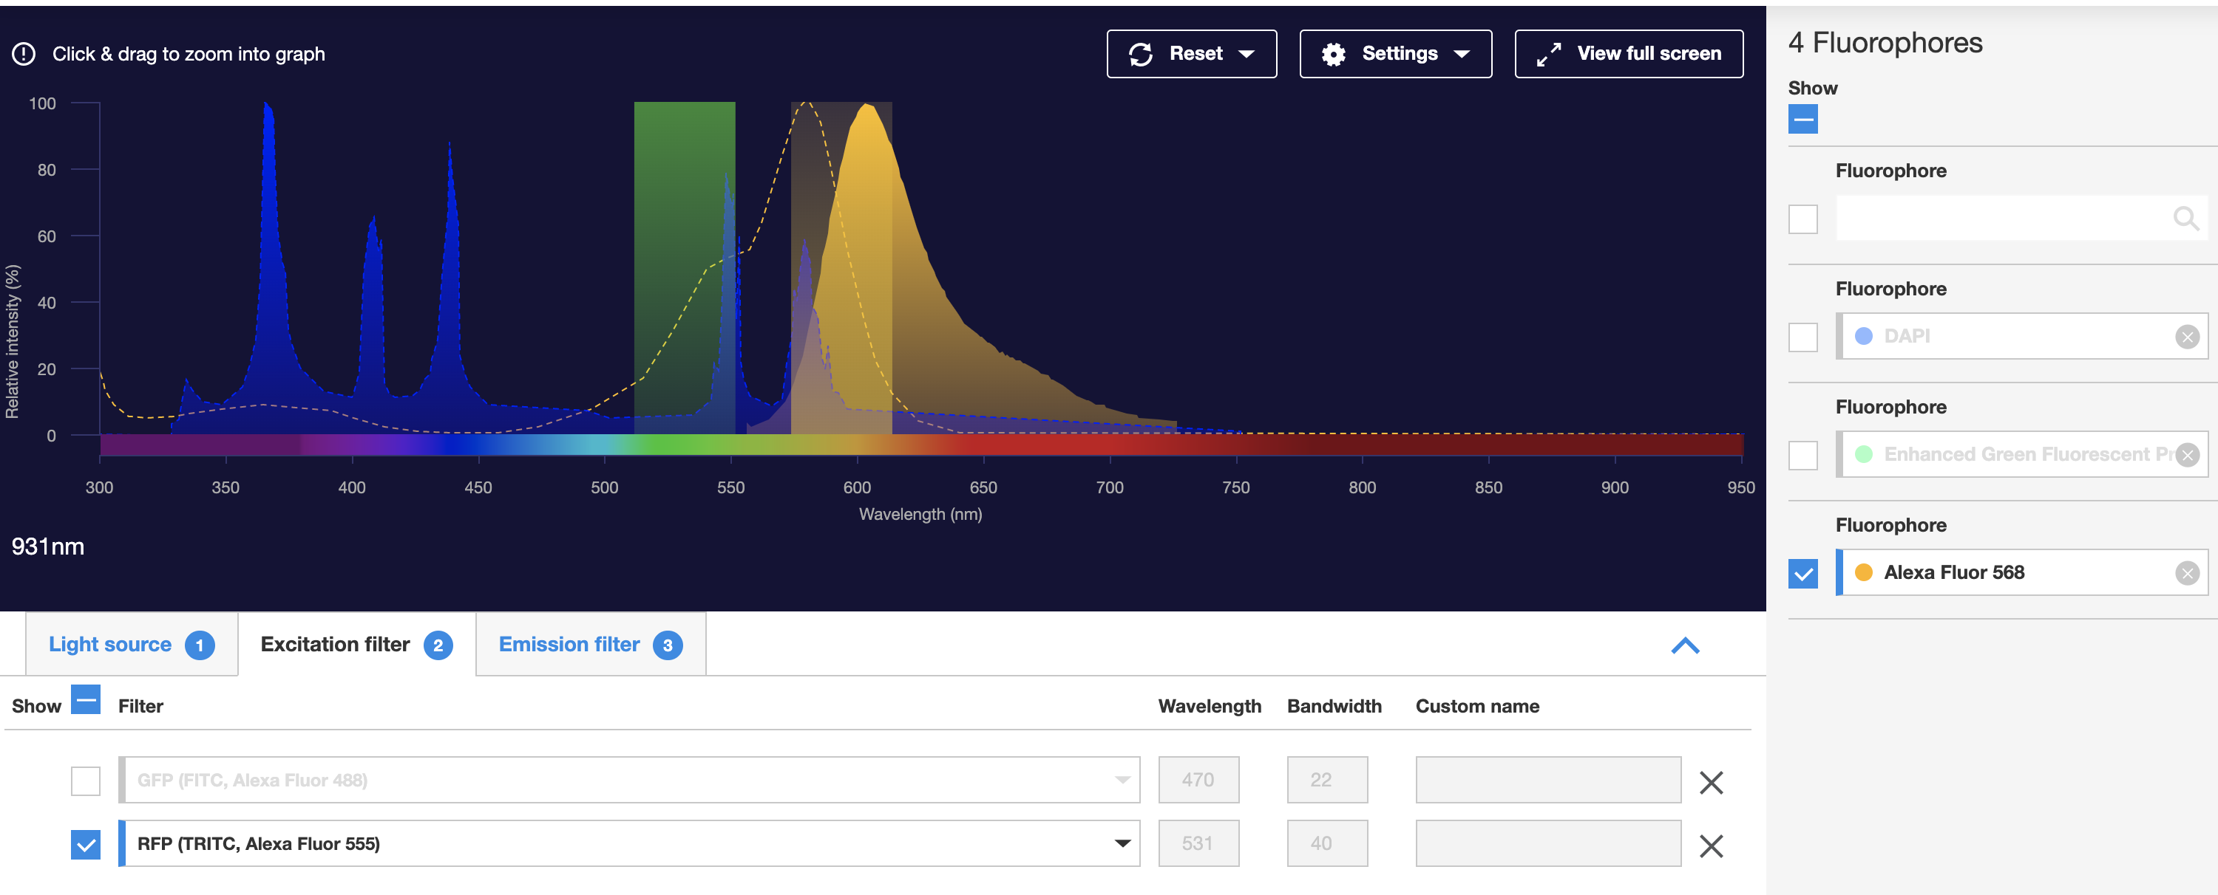
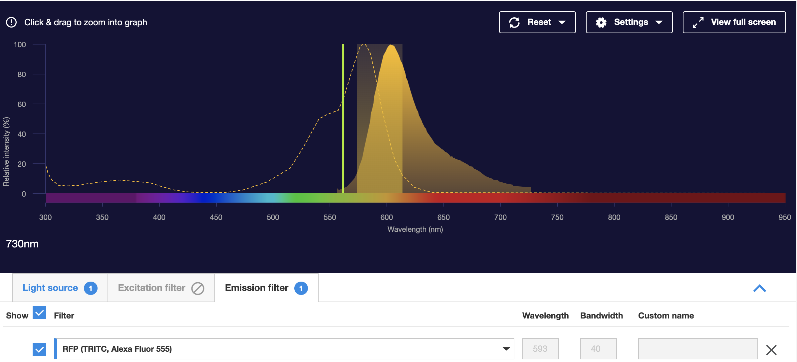
FILTER COMBINATIONS
https://www.thermofisher.com/order/fluorescence-spectraviewer#!/
Beware of fluorophore!!

Slide 34
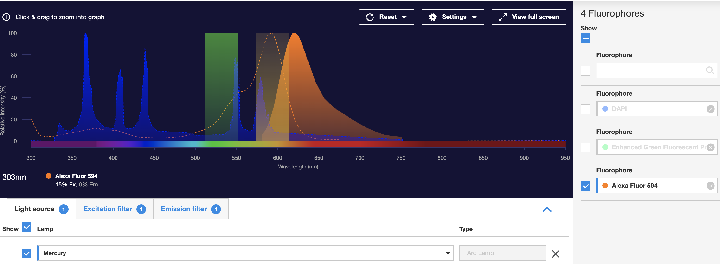
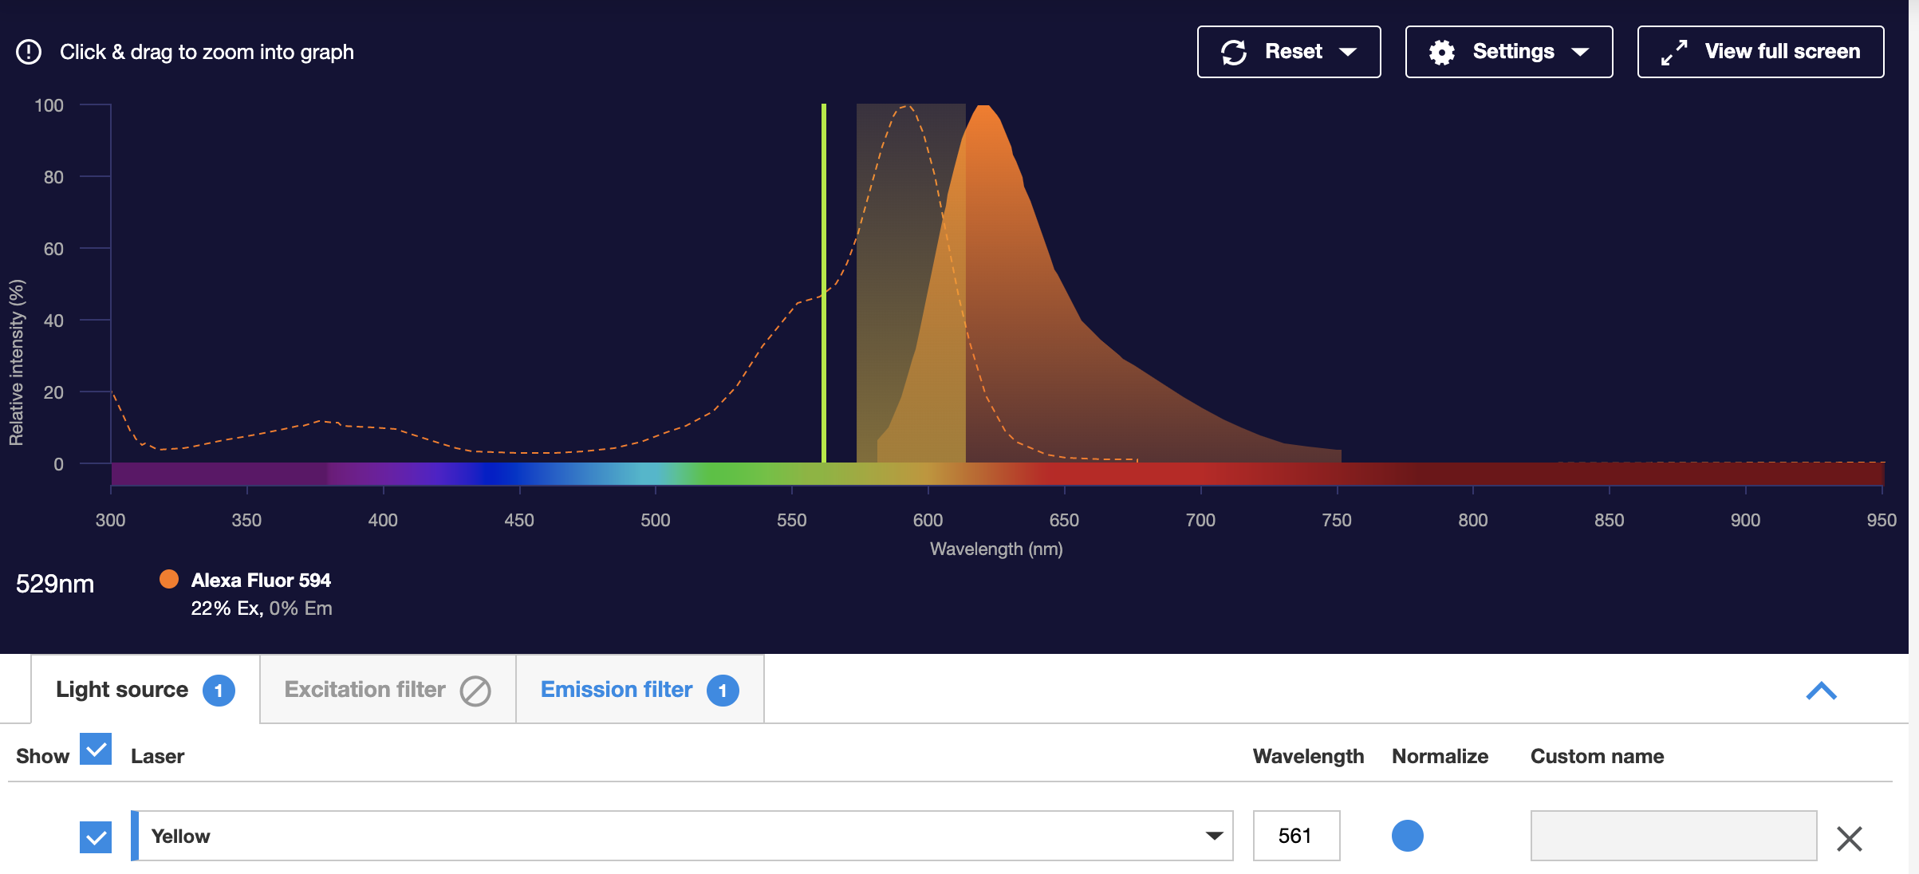
FILTER COMBINATIONS
https://www.thermofisher.com/order/fluorescence-spectraviewer#!/
Beware of fluorophore!!

Slide 35
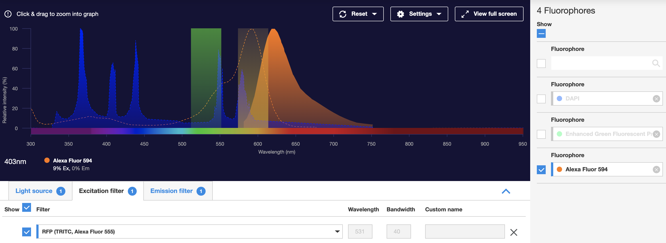
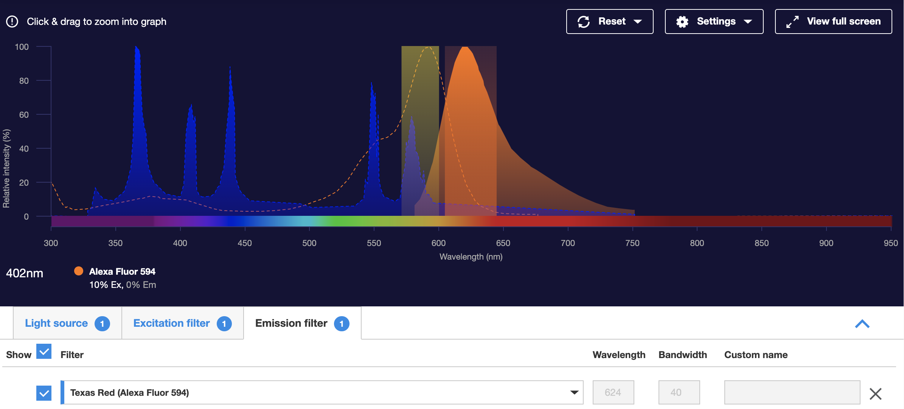
FILTER COMBINATIONS
https://www.thermofisher.com/order/fluorescence-spectraviewer#!/
Beware of filter cube!!

Slide 36
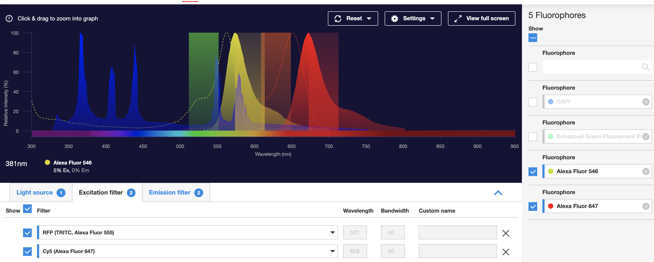
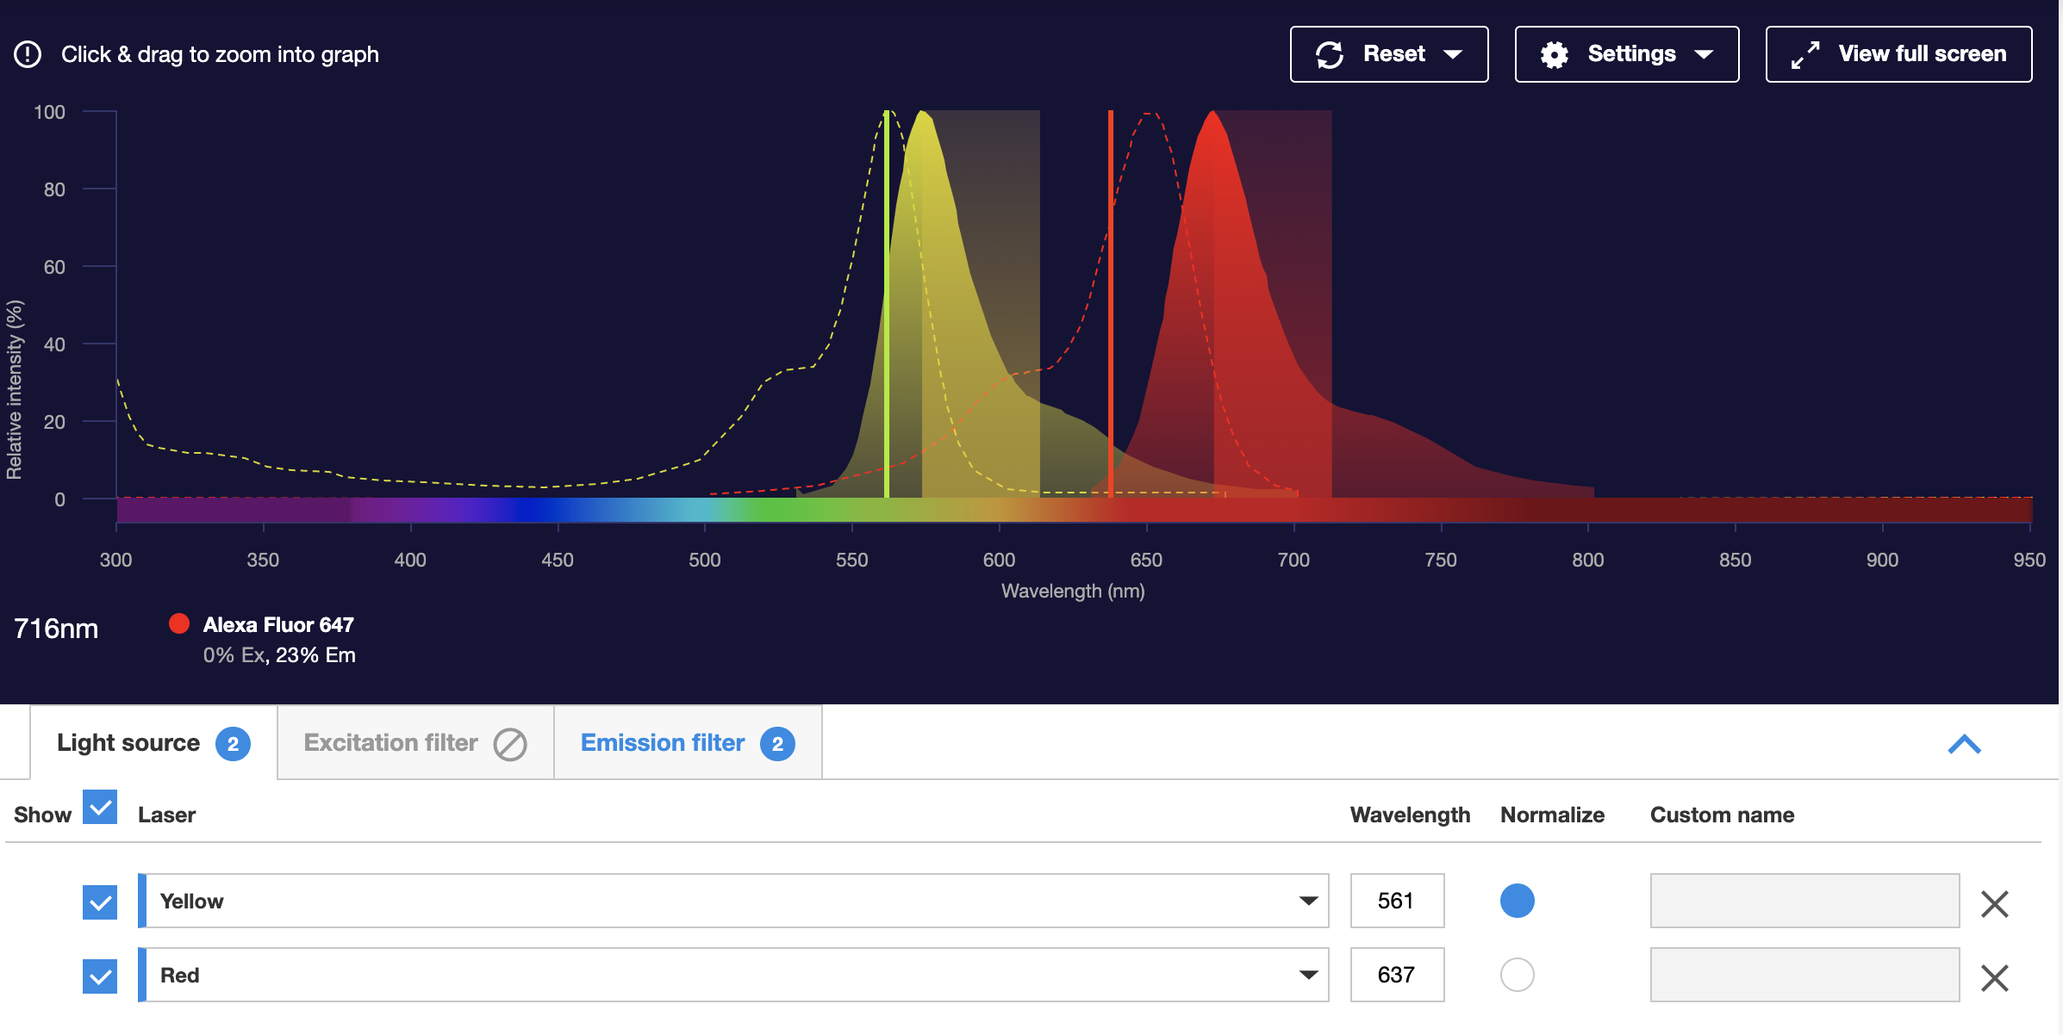
FILTER COMBINATIONS
https://www.thermofisher.com/order/fluorescence-spectraviewer#!/
Farred is not visible to eye!!

Slide 37
FLUORESCENCE OVERLAP
Band pass filter
575 nm
488 nm
Fluorescence Intensity
Fluorescein
molecule
PE
molecule
450
500
550 600 650
Wavelength (nm)
Overlap of FITC fluorescence in PE PMT Overlap of PE fluorescence in FITC PMT

Slide 38
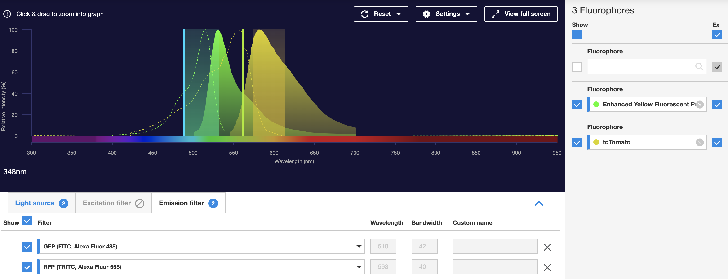
FLUORESCENCE OVERLAP

Slide 39
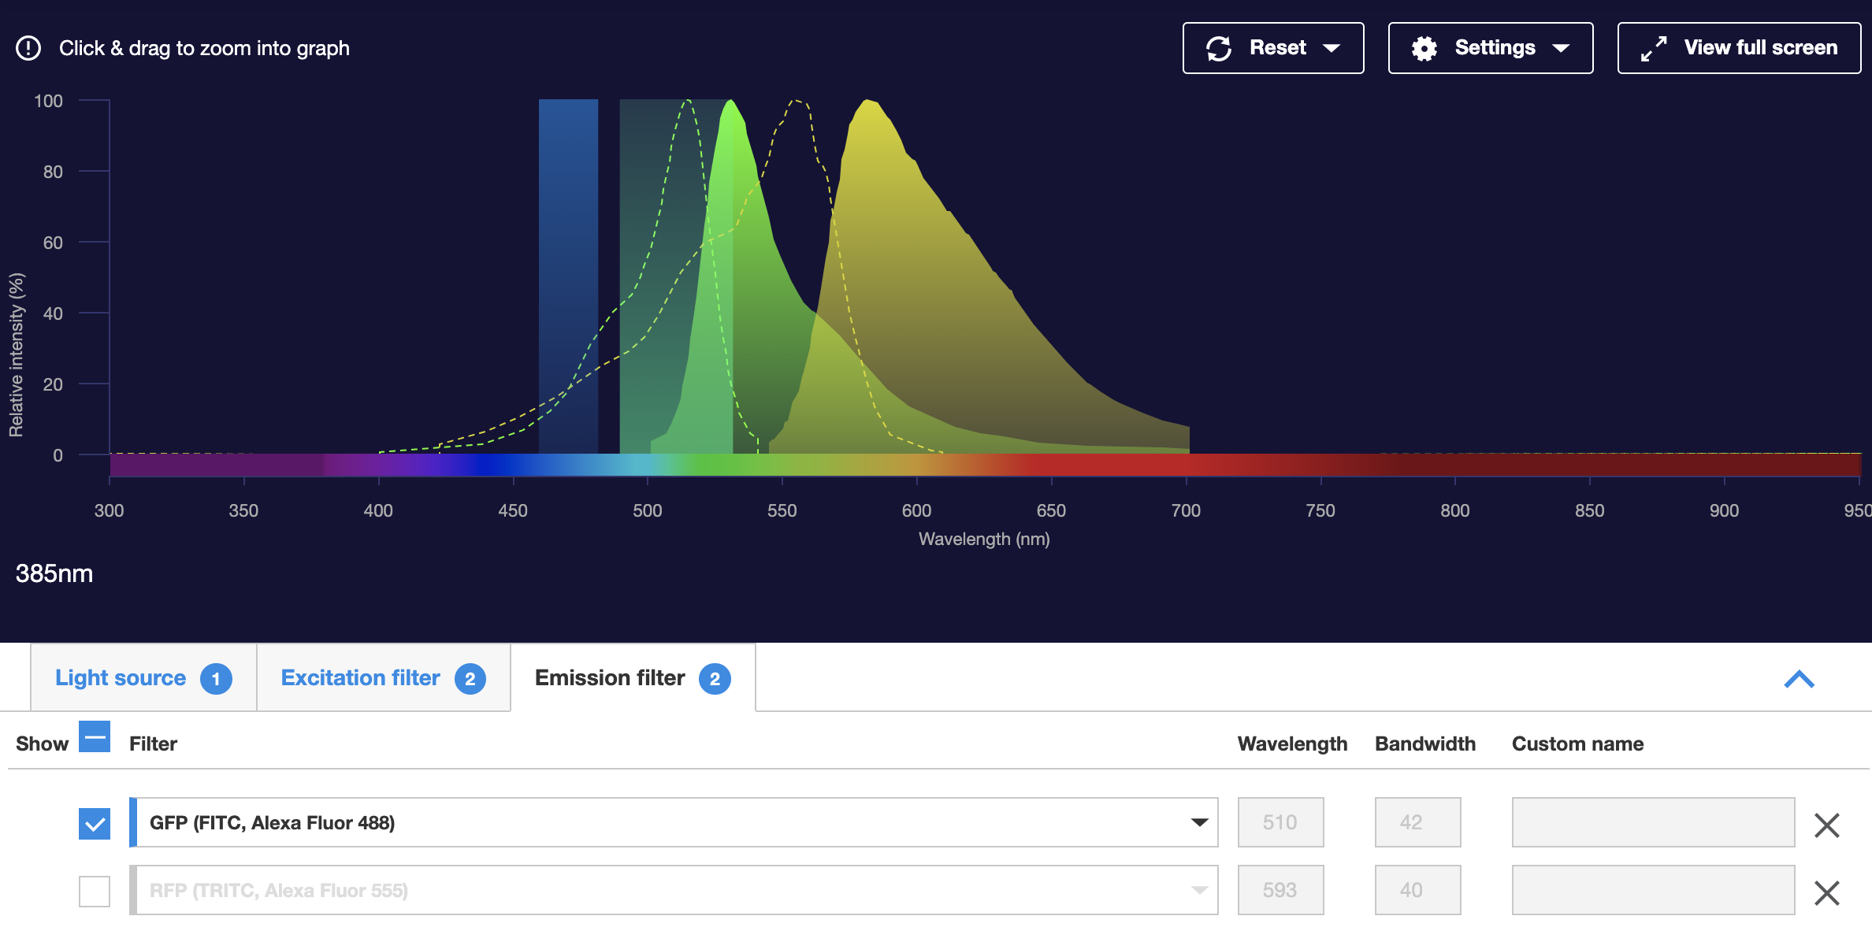
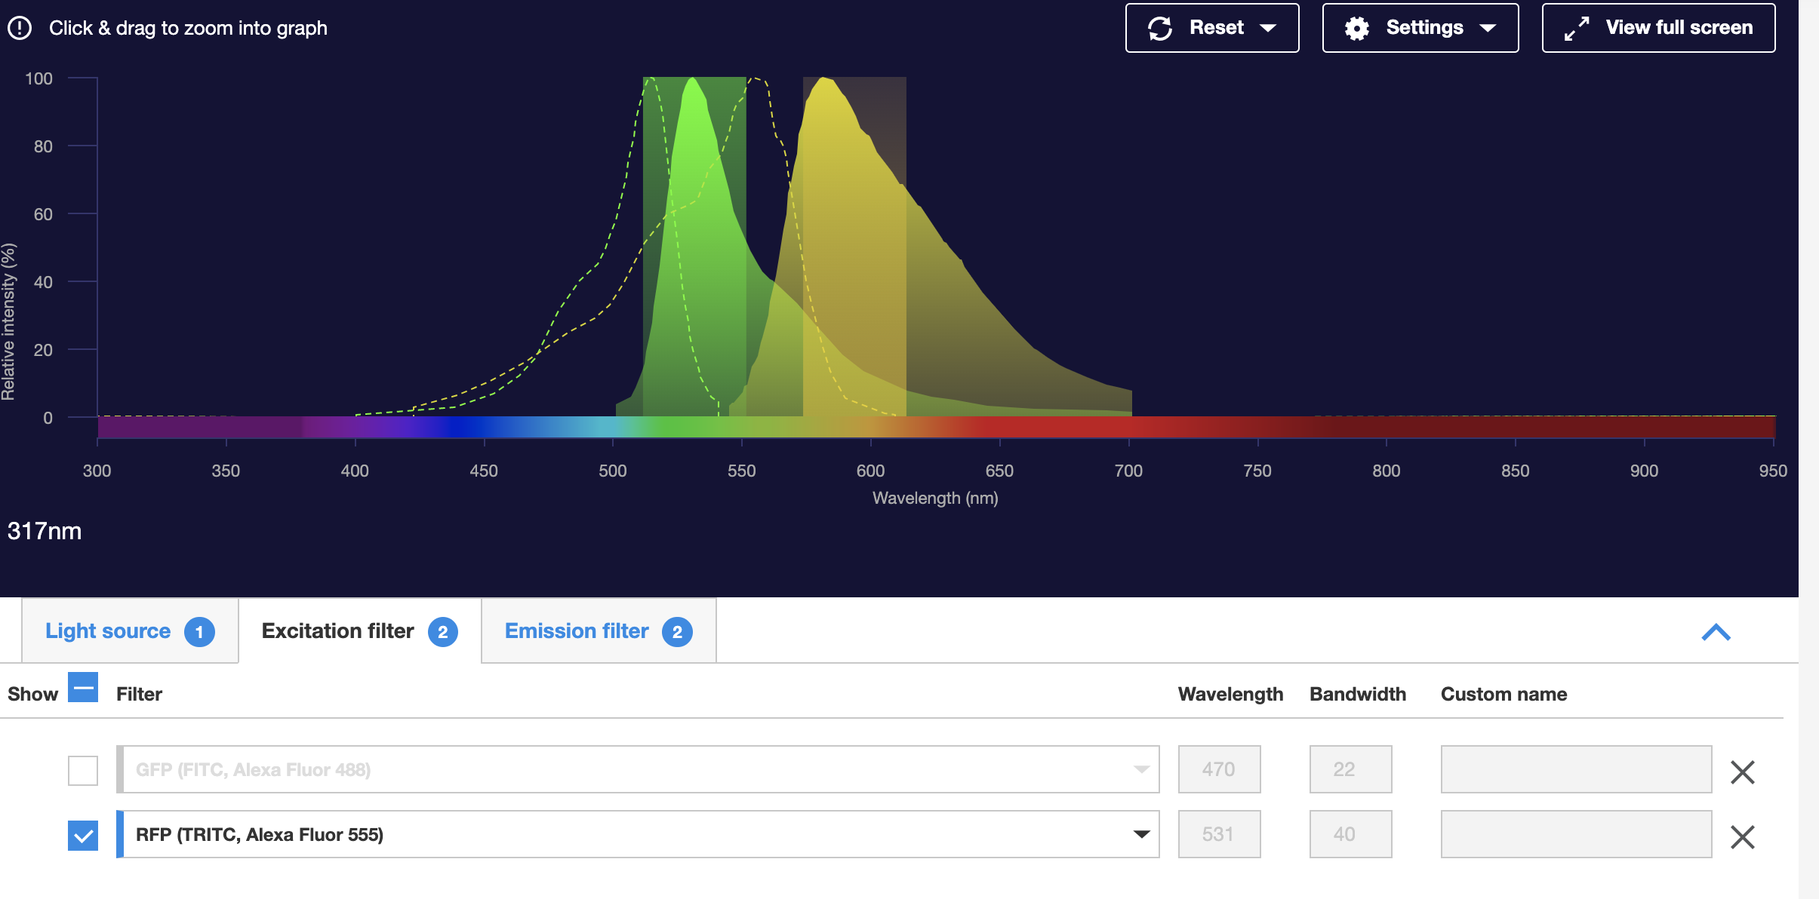
FLUORESCENCE OVERLAP
Overlap!!

