Slide 1

Economics of Monetary Union 14e
Paul De Grauwe

Slide 2
The benefits of a common currency

Slide 3
Introduction
The costs of EMU have mostly to do with macroeconomic management.
The benefits are mostly microeconomic in nature:
Less transaction costs and price transparency
Less uncertainty

Slide 4
Less transactions cost and price transparency
Less transaction costs:
Elimination of foreign exchange markets within the union eliminates the cost of exchanging one currency into another.
Cost reductions amount to 0.25–0.5% of GDP (according to European Commission)
Price transparency:
One common unit of account facilitates price comparisons
Competition increases.
Prices decline and consumers gain.
Does euro increase price transparency in a significant way?

Slide 5
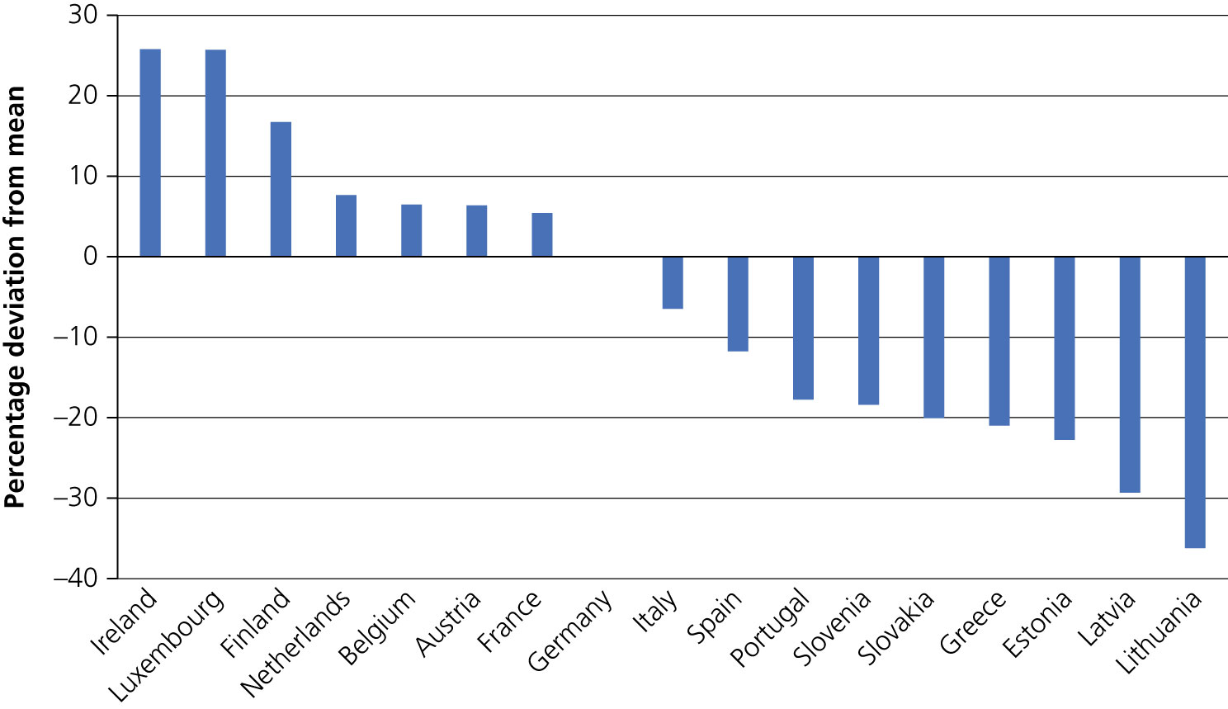

Large price differentials of identical products in Eurozone (2020)
Source: Eurostat

Slide 6
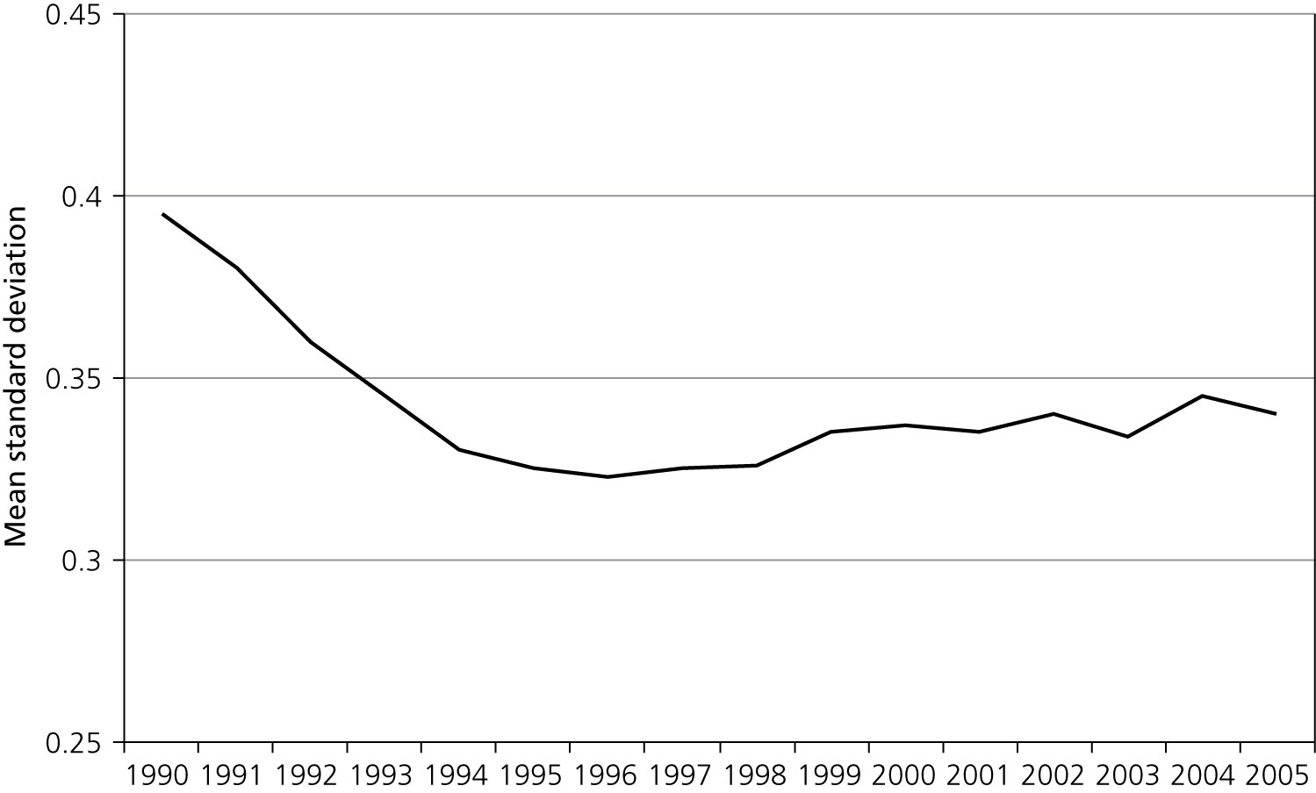

Eurozone has not increased price convergence
Figure 3.2 Evolution of price dispersion in the Eurozone, 1990–2005
Source:Wolszczak-Derlacz (2006)

Slide 7
Less uncertainty
Euro eliminates exchange risk. Two issues:
Does the decline in exchange risk increase welfare?
Does the decline in exchange risk reduce systemic risk?

Slide 8
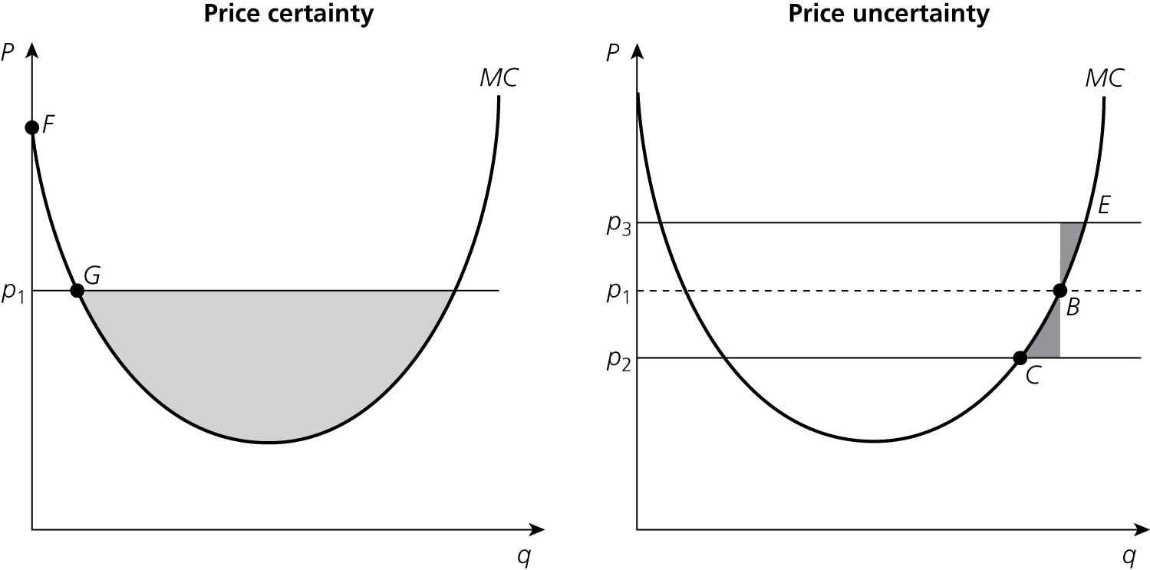
Less exchange risk and welfare
Figure 3.3 Profits of the firm under price certainty and uncertainty

Slide 9
Less exchange risk and welfare
Figure 3.3 Profits of the firm under price certainty and uncertainty

Slide 10
Less exchange risk and welfare
Figure 3.3 Profits of the firm under price certainty and uncertainty

Slide 11
Profits are higher on average when there is price uncertainty.
Welfare will then depend on degree of risk aversion.
If risk aversion sufficiently high price certainty is preferred by firms.
Moreover: Exchange rate changes are not normally distributed.

Slide 12
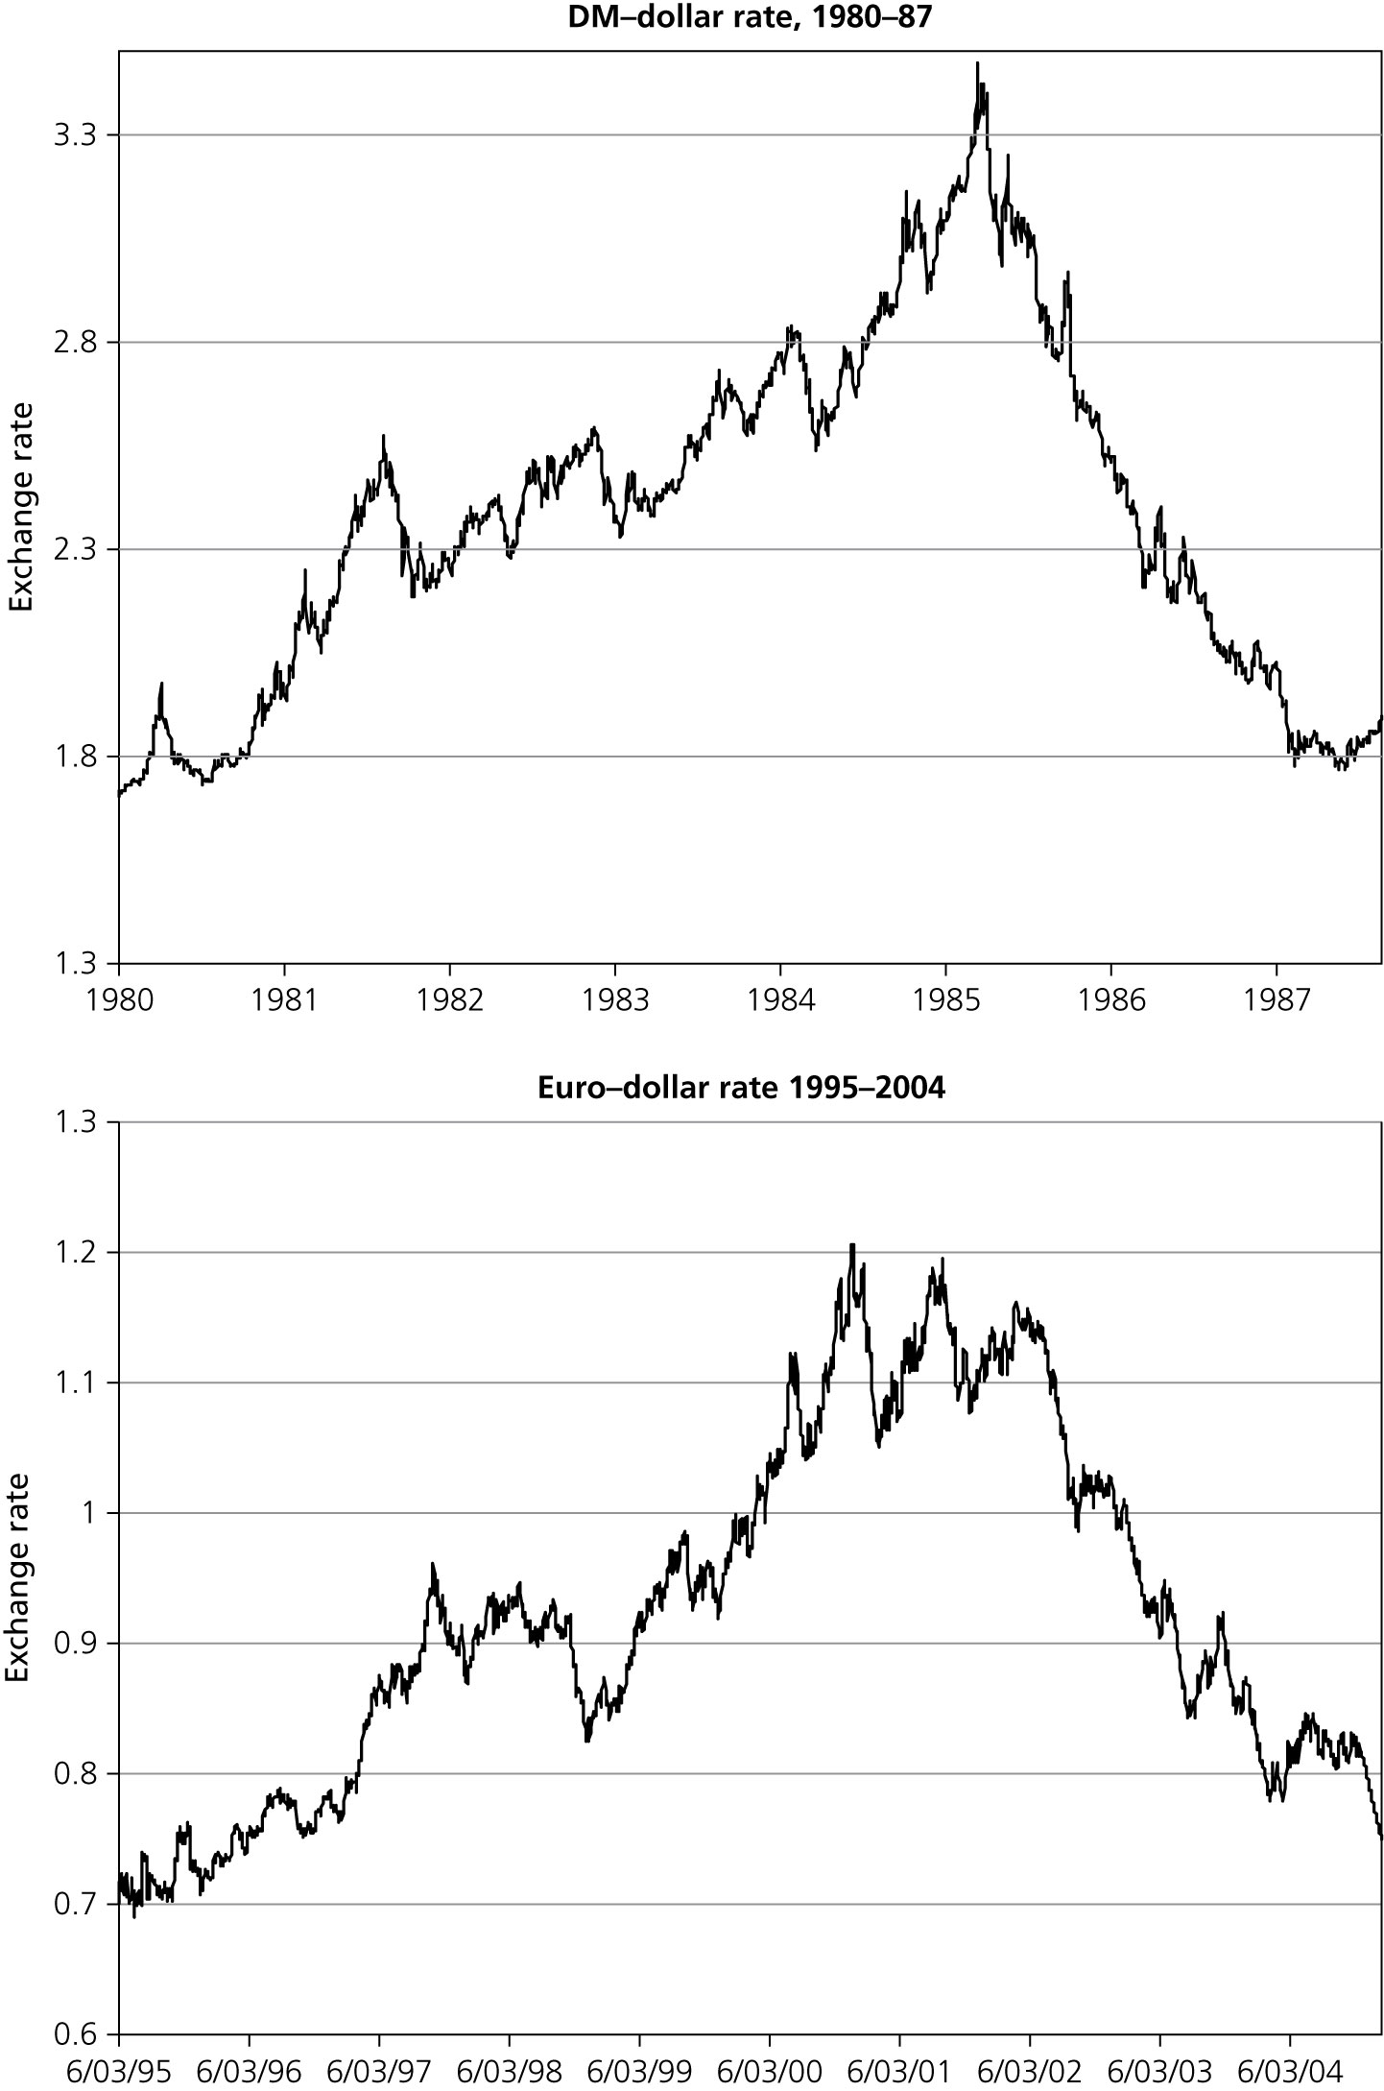
Two bubbles and two crashes
Figure 3.4 Bubbles and crashes in foreign exchange markets: two examples.

Slide 13
Large exchange rate movements are a recurrent problem with freely floating exchange rates
creating large adjustment costs
they occurred massively during the early 1990s within EU when some currencies (e.g. the Italian Lira and the Spanish peseta) depreciated by 20–30%, creating large adjustment costs in countries like Germany and the Benelux.
These large exchange rate movements between the currencies of highly integrated countries became sources of asymmetric shocks
…and convinced many leaders of EU countries to move into a monetary union.

Slide 14
Monetary union and economic growth
main theoretical argument of why monetary union would boost economic growth:
In a monetary union exchange rate uncertainty is eliminated (at least for the internal trade).
Systemic risk declines.
This leads to lowering the real interest rate.

Slide 15
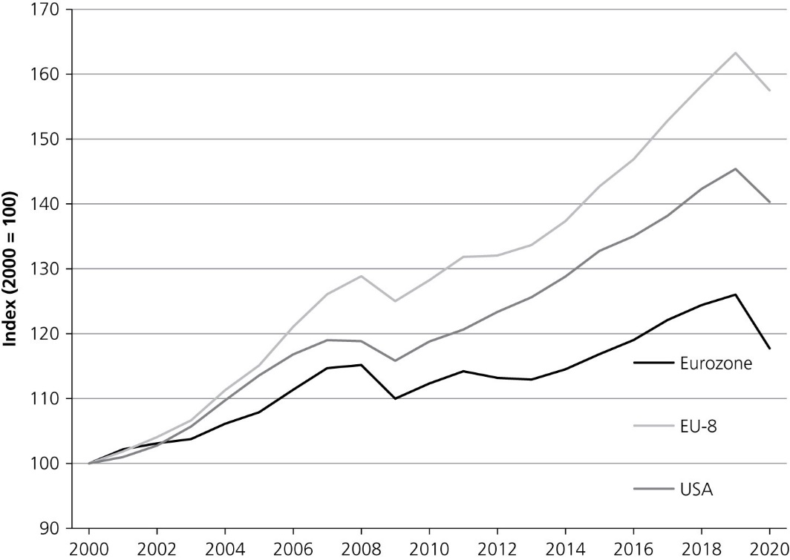
How much of this growth promise has come through?
Figure 3.5 Real GDP in Eurozone, EU-8, and USA (2000 = 100, 2010 prices).
Source: European Commission, Ameco

Slide 16
Why has monetary union not boosted growth?
Main reason: reduced exchange rate uncertainty within the union did not lead to a significant decline on the real interest rate in the Eurozone.

Slide 17
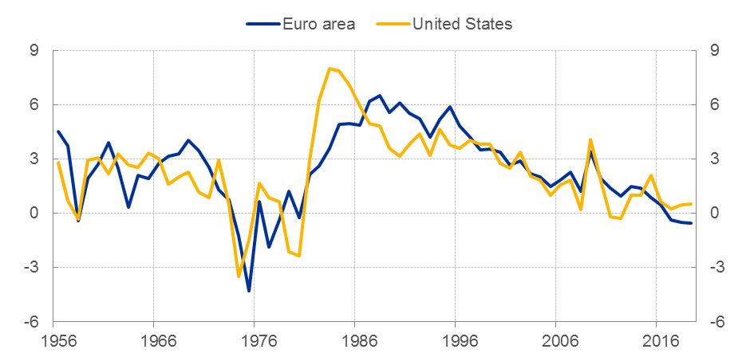
Real ten-year sovereign bond yields
(percentages per annum)
Source: ECB

Slide 18
Why has monetary union not boosted growth?
Main reason: reduced exchange rate uncertainty within the union did not lead to a significant decline on the real interest rate in the Eurozone.
The reduction in exchange rate uncertainty does not necessarily reduce the systemic risk.
Less exchange rate uncertainty may be compensated by greater uncertainty elsewhere, e.g. output and employment uncertainty.
As a result, firms that operate in a greater monetary zone may not, on average, operate in a less risky environment.

Slide 19
Empirical evidence about monetary union and trade
First-generation empirical studies found little relation between exchange rate volatility and trade.
Using cross-section evidence Andy Rose recently found strong effect of monetary union on trade:
a monetary union doubles trade among members of union, on average
more recent econometric evidence has reduced these effects to 10–20%

Slide 20
Benefits of an international currency
International use of the dollar creates seigniorage gains for the US.
These gains, however, remain relatively small
Easy government finance (foreign central banks hold dollars as reserves)
foreign holders bear the exchange risk.

Slide 21
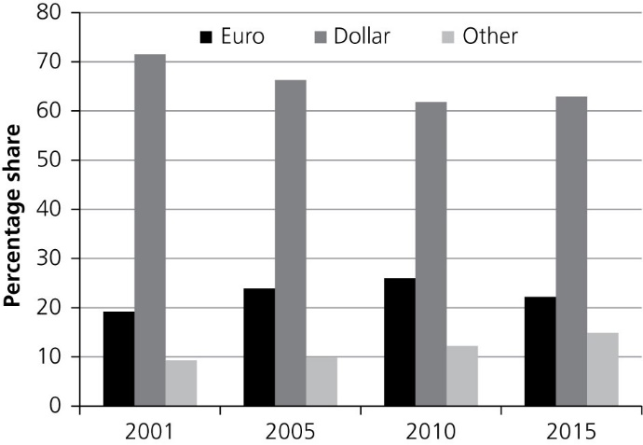
Figure 3.8 Share of euro and dollar as reserve currencies
Source: International Monetary Fund

Slide 22
Benefits of an international currency
International use of the dollar creates seigniorage gains for the US.
These gains, however, remain relatively small
Easy government finance (foreign central banks hold dollars as reserves)
foreign holders bear the exchange risk.
Boosting activity for domestic financial markets
However, an international currency not necessarilly a necessary condition for this!
World currency as a political weapon (large part of the international payment system is dollar-based.)

Slide 23
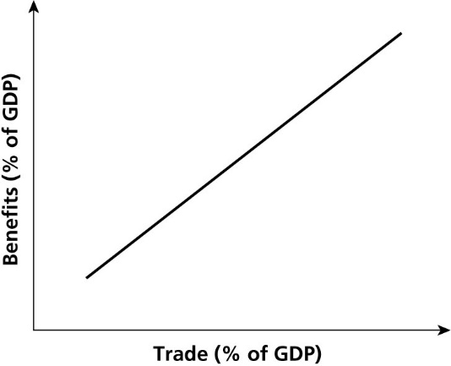
Benefits of monetary union and openness
Figure 3.9 Benefits of a monetary union and openness of the country.

Slide 24
Costs and benefits compared

Slide 25
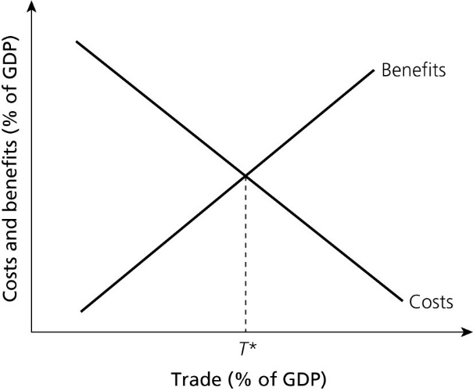
Costs and benefits of a monetary union
Figure 4.1 Costs and benefits of a monetary union.

Slide 26
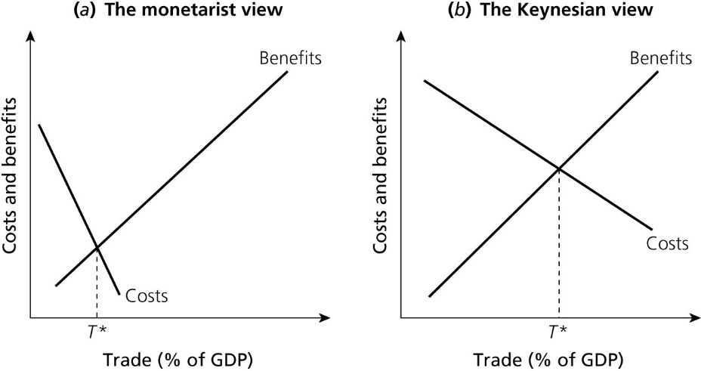
Two views about costs and benefits of MU
Figure 4.2 Costs and benefits of a monetary union: two views.

Slide 27
Is EMU an optimal currency area?
In order to answer to this question there are different parameters to evaluate:
intra-EU trade
degree of rigidities
degree of asymmetry of shocks.

Slide 28
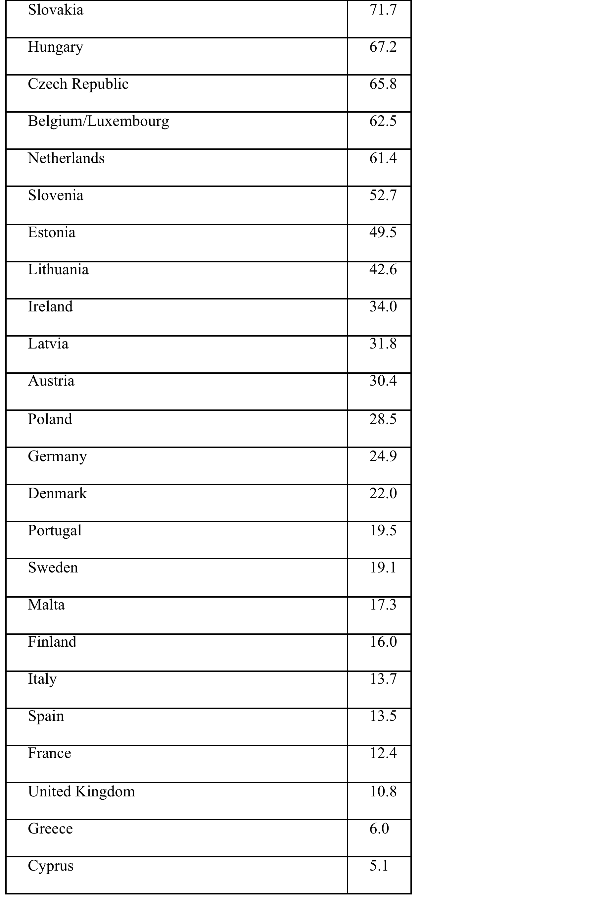
Table 4.1 Intra-union exports of EU countries (% of GDP) in 2012.
Source: European Commission, European Economy, Statistical Appendix.

Slide 29
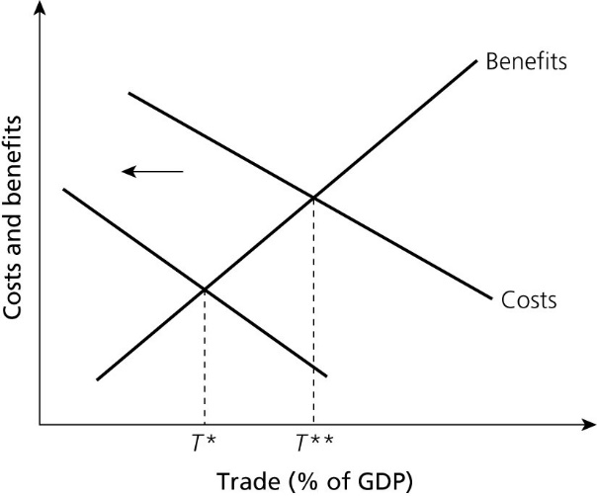
Figure 4.3 Costs and benefits with decreasing rigidities.

Slide 30
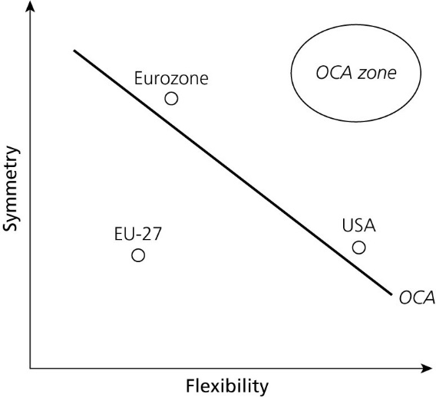
Figure 4.4 Symmetry and labour market flexibility in monetary unions.

Slide 31
The challenging task for the EU-27 is to move to the other side of the OCA-line, i.e. to make a monetary union less costly.
How can this be achieved? There are essentially two strategies.
reduce the degree of real divergence (political union)
increase the degree of flexibility of labour markets.

Slide 32
The degree of completeness of a monetary union
In an incomplete monetary union: great fragility of the government bond markets.
asymmetric shocks intensified by disruptions in the government bond markets
In monetary unions that are embedded in a budgetary union: the cost of a monetary union is likely to be lower.

Slide 33
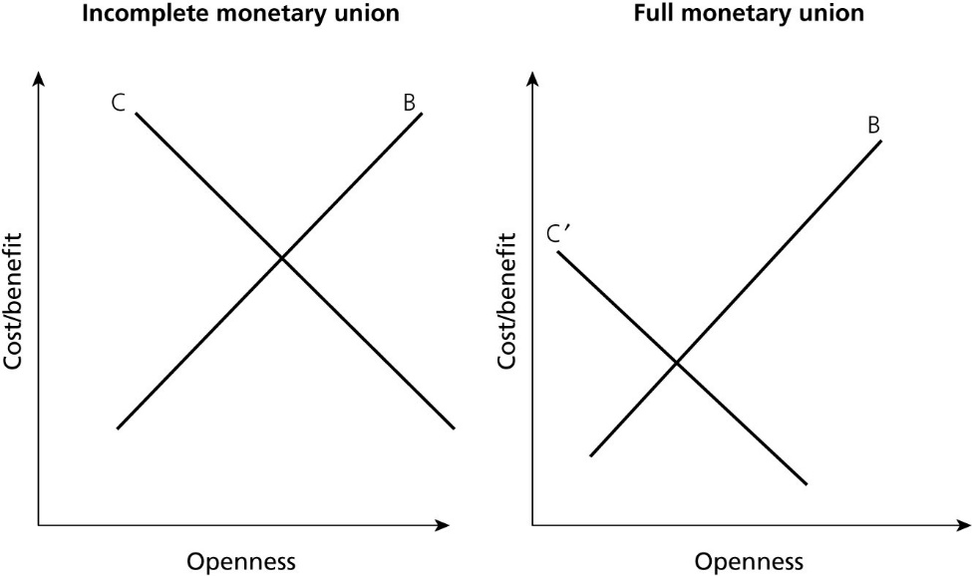
Figure 4.6 Costs and benefits and degree of completeness of monetary union.

Slide 34
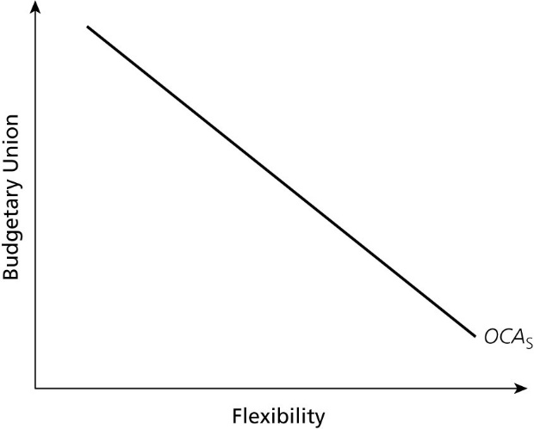
Trade-off budgetary union and flexibility
Figure 4.7 Trade-off between budgetary union and flexibility.

Slide 35
Nature of shocks
Two types of asymmetric shocks.
Exogenous asymmetric shocks: permanent shocks like productivity shock; mostly supply shocks.
Endogenous shocks: result of unsynchronized business cycle movements.
Driving force: animal spirits that lead to booms and busts.

Slide 36
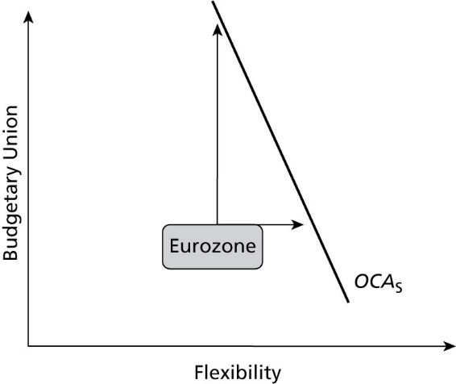
Figure 4.8 How to move the Eurozone towards the OCA zone when permanent shocks dominate.

Slide 37
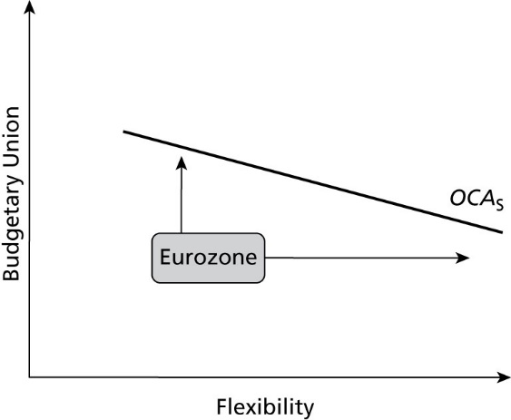
Figure 4.9 How to move the Eurozone towards the OCA zone when business cycle movements dominate.

Slide 38
Additional insight
Hysteresis
Flexibility in labour markets is something national governments can do.
Budgetary union, however, is of a different nature. It requires political integration.
Ideally:
permanent shocks - dealt with at the national level,
temporary shocks - dealt with at the Eurozone level,

Slide 39
Mean trend growth and mean (absolute) business cycle change in GDP (in percent) during 1999–2020
 | Mean cycle | Mean trend | ratio
Germany | 1,47% | 1,19% | 1,24
Belgium | 1,70% | 1,36% | 1,25
Austria | 1,84% | 1,44% | 1,28
France | 2,34% | 1,26% | 1,85
Netherlands | 3,10% | 1,59% | 1,94
Spain | 4,82% | 1,79% | 2,69
Ireland | 6,19% | 2,23% | 2,77
Finland | 5,05% | 1,70% | 2,97
Portugal | 4,59% | 0,73% | 6,26
Italy | 2,88% | 0,28% | 10,26
Greece | 9,25% | 0,30% | 31,11

Slide 40
Correlation coefficients cyclical components GDP
 | Austria | Belgium | Finland | France | Germany | Greece | Ireland | Italy | Netherl | Port
Austria
Belgium | 0,97
Finland | 0,97 | 0,98
France | 0,93 | 0,95 | 0,97
Germany | 0,69 | 0,57 | 0,55 | 0,59
Greece | 0,73 | 0,82 | 0,84 | 0,74 | 0,09
Ireland | 0,85 | 0,89 | 0,92 | 0,95 | 0,41 | 0,81
Italy | 0,91 | 0,96 | 0,98 | 0,96 | 0,50 | 0,86 | 0,93
Netherlands | 0,93 | 0,94 | 0,93 | 0,91 | 0,60 | 0,75 | 0,86 | 0,90
Portugal | 0,98 | 0,89 | 0,89 | 0,87 | 0,37 | 0,82 | 0,87 | 0,90 | 0,94
Spain | 0,85 | 0,91 | 0,94 | 0,87 | 0,27 | 0,97 | 0,90 | 0,95 | 0,86 | 0,90

Slide 41
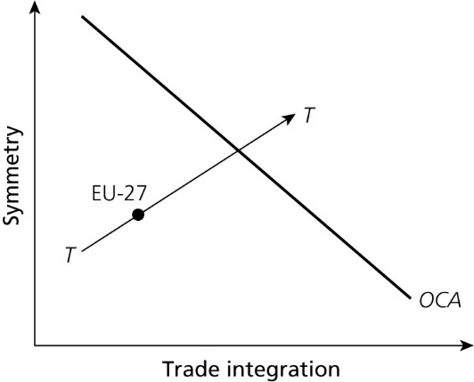
Costs and benefits in the long run
Figure 4.10 The European Commission view of monetary integration
Upward sloping line (TT): as trade integration increases the degree of symmetry between the countries involved increases.
Downward sloping line (OCA):
points on OCA line are minimal combinations of symmetry and integration for which monetary union has zero net gain.

Slide 42
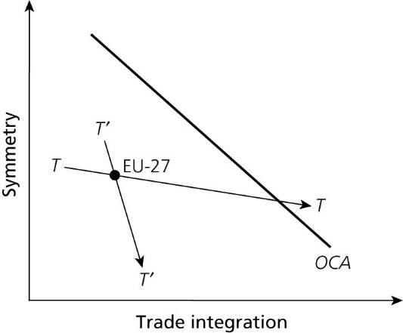
Costs and benefits in the long run
Figure 4.11 The Krugman view of monetary integration.

Slide 43
Two possibilities for the long-term prospects of monetary union.
One is represented by the TT line.
In this case, although today the EU-28 may not be an optimum currency area, it will move into the OCA zone over time (right side of OCA).
The second case is represented by the steep T’T’ line.
Integration brings us increasingly farther away from the OCA zone. The net gains of a monetary union do not increase fast enough with the degree of integration.
The costs of asymmetry overwhelm all the other benefits a monetary union may have.
Second case is implausible.

Slide 44
Endogeneity of monetary union
A decision by an individual country to join EMU, even if it does not satisfy the OCA criteria, can have a self-fulfilling character.
Process of integration is sped up by the very decision to join the monetary union, so that this new country grouping moves faster into the OCA zone.
OCA becomes endogenous.

Slide 45
Is there evidence for endogeneity?
Three OCA criteria are potentially affected by endogeneity:
Trade integration
econometric evidence suggests that the euro may have increased intra-trade by 10–20%.
Symmetry
Campos et al. (2017)’s meta-analysis: symmetry increased in Eurozone (and in non-Euro countries)
Flexibility
has increased but much of it before 1999; and very unequal between countries.
Thus there is mitigated support for endogeneity.

Slide 46
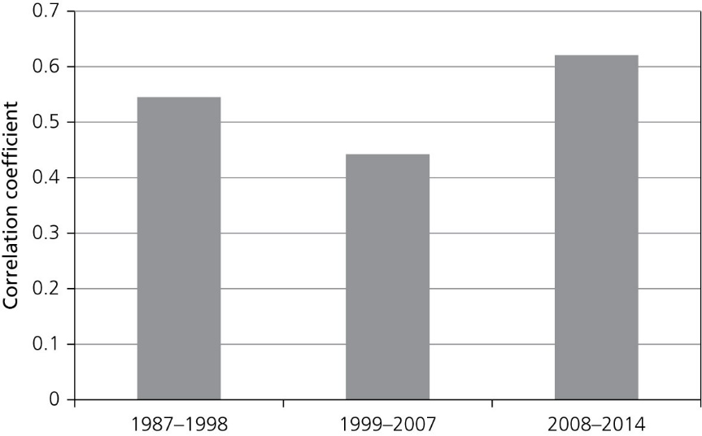
Figure 4.12 Mean Eurozone correlation of
cyclical component of industrial production.

Slide 47
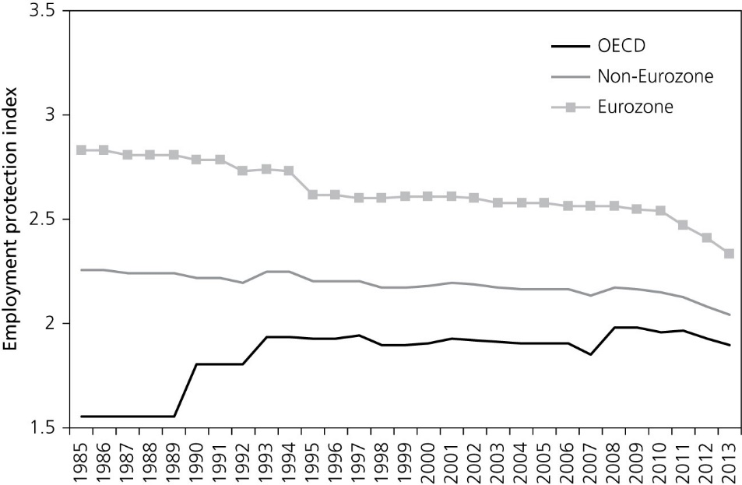
Increased flexibility?
Figure 4.13 Employment protection legislation index, 1985–2013.
Source: OECD

Slide 48
Is Latin America an optimal currency area?
Monetary instability has made the idea of forming a monetary union in Latin America popular.
Costs of monetary union in Latin America.
Latin American countries have very low levels of trade with the rest of Latin America.

Slide 49
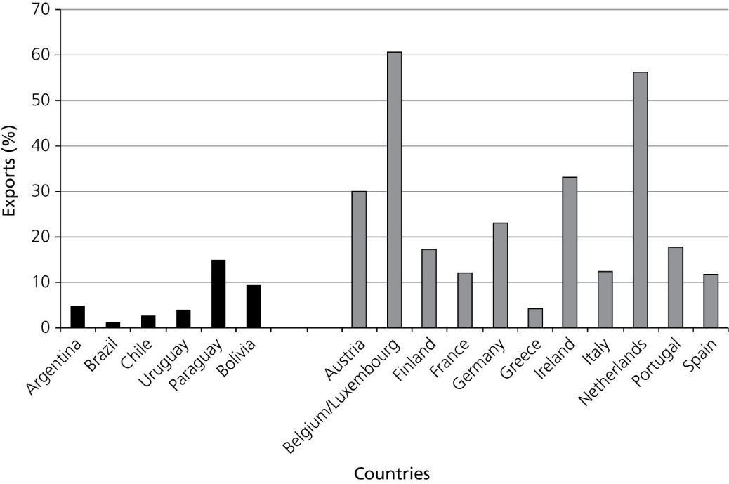
Figure 4.14 Intraregional exports of goods and services, EU and Latin America as a percentage of GDP (2010)

Slide 50
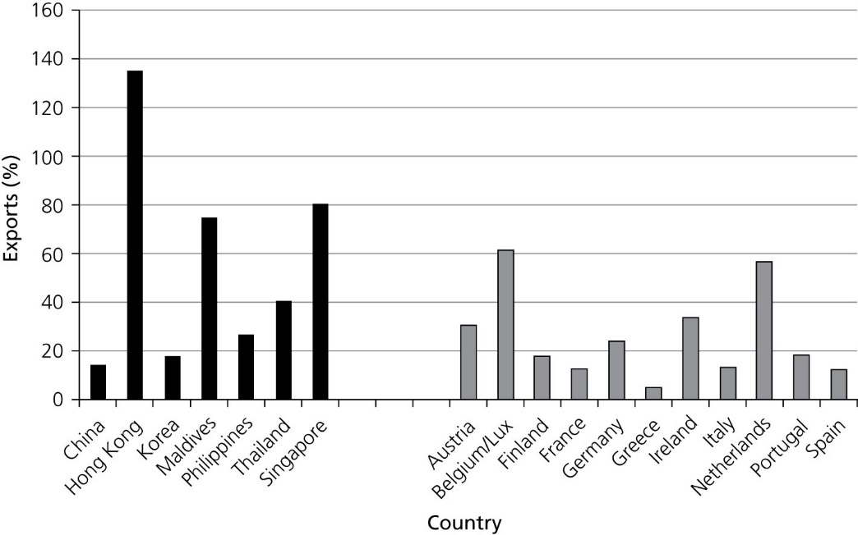
Is East Asia an optimal currency area?
Figure 4.15 Intra-regional exports of goods and services, East Asia and the EU, as a percentage of GDP, 2010.
Source: IMF, IFS and Xu Ning(2004)
Note: the exports of the East-Asian countries is to ASEAN plus China, Korea and Japan. The data for China relate to 2001.

Slide 51
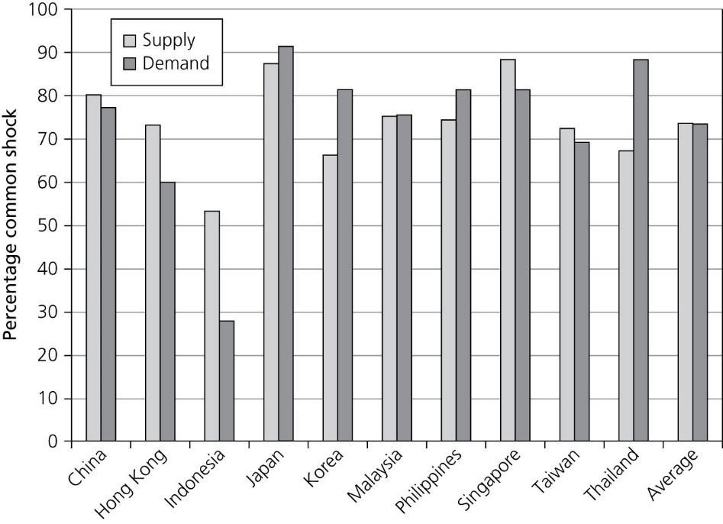
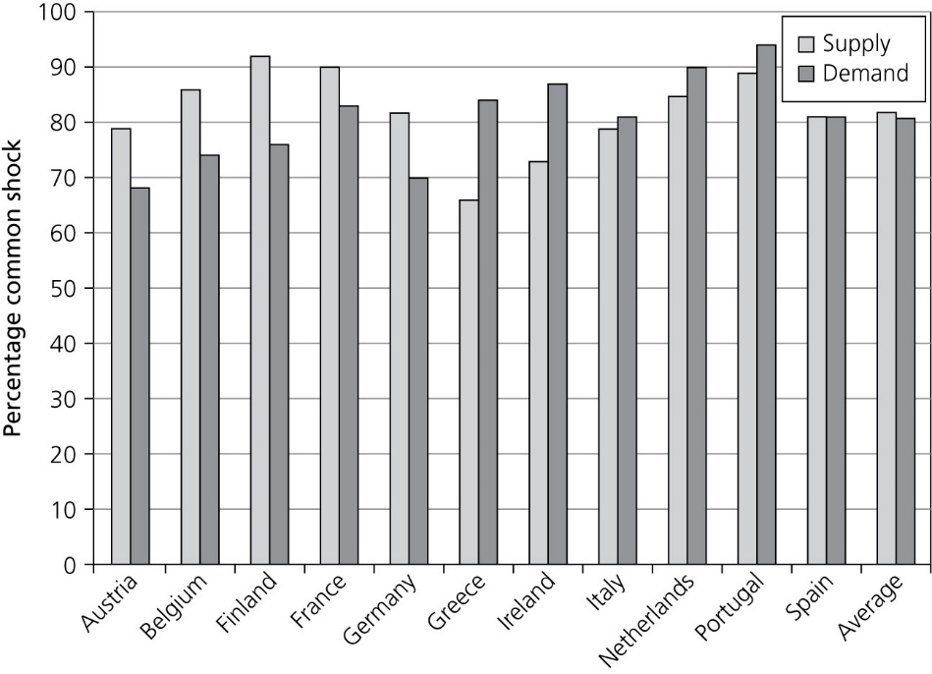
Shocks are not more asymmetric in Asia than in Eurozone
Figure 4.16 Percentage of demand and supply changes explained by common shock in East Asia.
Figure 4.17 Percentage of demand and supply changes explained by common shock in the Eurozone.

Slide 52
Monetary Unions in Africa
There is a history of monetary union in West and Central Africa.
New initiative to extend existing monetary unions: The Economic Community of West-African States (ECOWAS).
This is a grouping of 15 states.
Do these form an OCA?

Slide 53
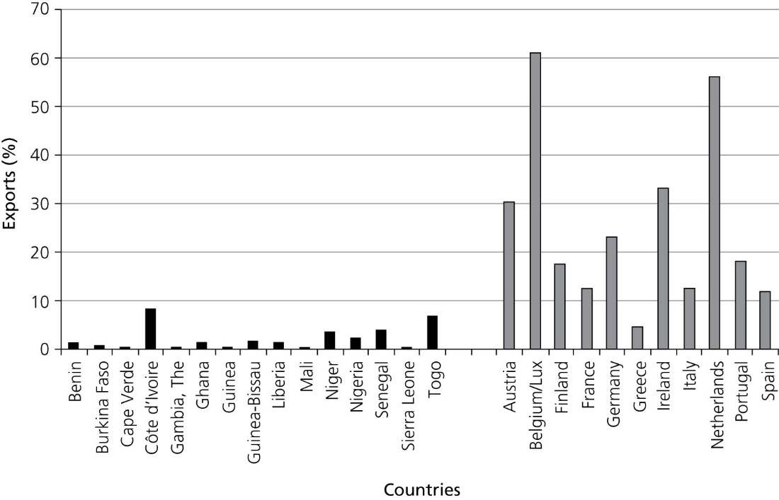
Figure 4.18 Intra-regional exports of goods and services in West Africa (2003) and the Eurozone (2010).

Slide 54
Conclusion
It is unlikely that the EU as a whole constitutes an optimal monetary union.
Even the countries that are net gainers from a monetary union take a risk by joining the union.
The nature of the asymmetric shocks matters
It is unlikely that Latin America and East Asia will come to monetary union soon, although reasons are different. Evidence about West Africa as an OCA is mixed.

