Slide 1
REPORTED SPEECH

Slide 2
GRAMMAR
In reported speech, the introductory word (say, tell, think, explain, wonder, etc) is normally in the past tense, and the verbs in the direct speech are moved back one tense.

Slide 3
Quoted Speech | Reported Speech
He said, "I live in Trieste." | He said (that) he lived in Trieste.
He said, "I am prepping for surgery." | He said he was prepping for surgery.
He said, "I have checked the patient twice." | He said he had checked the patient twice.
He said, "I wrote my CV last week." | He said he had written his CV the week before. BUT also he wrote
He said, "I had already eaten." | He said he had already eaten.
He said, "I am going to find a new job here." | He said he was going to find a new job there.
He said, "I am starting a new course next week." | He said that he was starting a new course the following week.
He said, "I will give Dr Bronwin a call tomorrow." | He said he would give Dr Bronwin a call the next day.
He said, "I have been working on this project for over two weeks." | He said he had been working on that project for over two weeks.
He said, "I can come tonight." | He said he could come that night.
He said, "I may buy a new car." | He said he might buy a new car.
He said, "I might go to Denver." | He said he might go to Denver.
He said, "I must give Ken a call." | He said he had to give Ken a call.
He said, "I have to give Ken a call." | He said he had to give Ken a call.
He said, "You should see your doctor" | He said I should see my doctor.

Slide 4
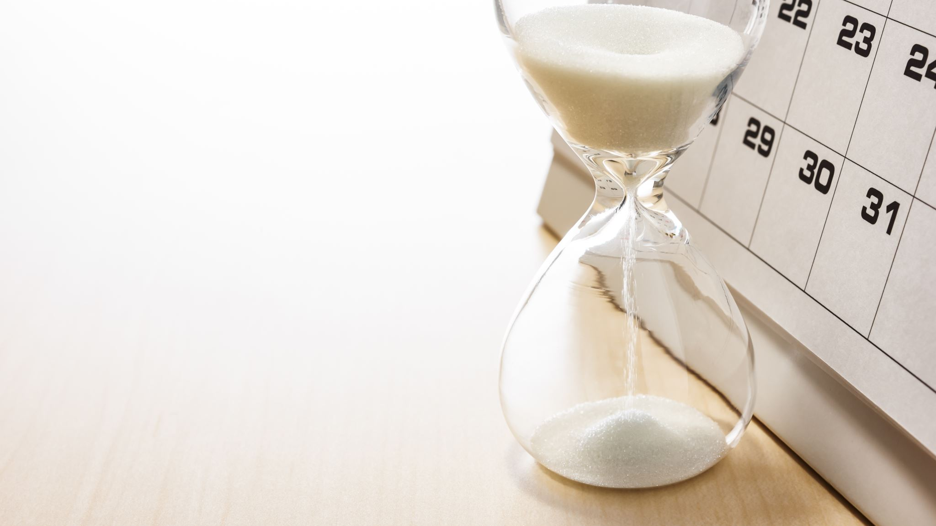
Time and place

Slide 5
You need to change the pronouns and expressions of time and place accordingly:
My mother – her mother
Your doctor – my doctor
Tomorrow – the day after / the following day / the next day
Yesterday – the day before / the previous day
Next week – the following week / the next week
Last week – the week before
Now – then
Here – there

Slide 6
Reported questions

Slide 7
When you report a question, the verb changes tense and is put in the affirmative form.
What time is it?
“What music do you like?
“Is it sunny outside?”
She asked what time it was.
He asked what music I liked.
He asked if it was sunny outside.

Slide 8
She asked me, “What is your name?” _____________________________
She asked me, “What do you want?” ______________________________
She asked me, “Where do you live?” _____________________________
I asked her, “Why do you want to know?” _________________________
She asked me, “Why don’t you answer my questions? ______________
I asked her, “Is your father at home?” _____________________________
She asked me, “Are you a friend of his?” __________________________
I asked her, “Do you remember me?” _____________________________
She asked me, “Do you know what day it is?” ______________________
I asked myself, “What is she talking about?” _______________________

Slide 9
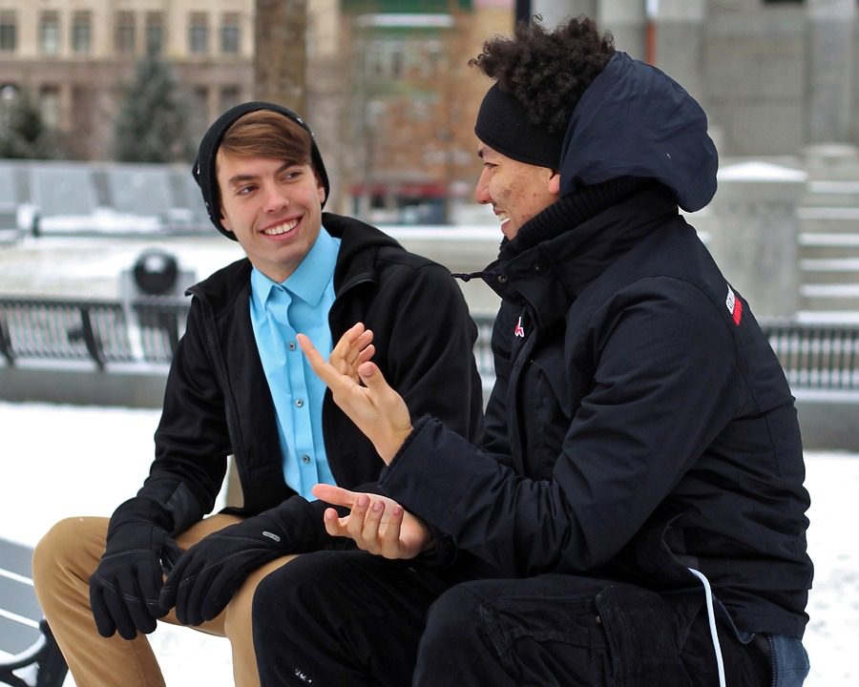
A month ago you met your friend Charlie, and these are some things he told you. Today you tell your friend what he said.
1. I’m living in London now.
2.My father isn’t very well
3.Sharon and Paul are getting married next month.
4. Margaret has had a baby.
5. I don’t know what Fred is doing.
6. I saw Helen at a party last week and she seemed fine.
7. I haven’t seen Diane recently.
8. I’m not enjoying my job much.
9. You can come and stay at my flat if you are ever in London.
10. My cat was stolen a few days ago.
11. I want to go to Greece but I can’t afford it.
12. What have you been up to?
13. Where do you work now?
14. I’ll tell Anne I saw you.

