Slide 1

Economics of Monetary Union 14e
Paul De Grauwe

Slide 2
The fragility of incomplete monetary unions

Slide 3
Introduction
Summing up from previous lectures:
  Complete monetary union: a monetary union together with budgetary union.
  Incomplete monetary union: a monetary union where each member country maintains its own independent budgetary policy.
In this lecture we analyse the fragility of incomplete monetary unions more formally.

Slide 4
Many gradations of incompleteness
The Eurozone is one type of incomplete monetary union.
In the real world, there exist many monetary arrangements between nations
One such arrangement is a fixed exchange rate system.

Slide 5
Fixed exchange rate regime as an incomplete monetary union
A fixed exchange rate regime is arrangement whereby the monetary authorities peg their exchange rates.
  Examples: the Bretton Woods system; European Monetary System
  Over time most of these arrangements tend to disintegrate after some crisis:
  the Bretton Woods system collapsed in 1973
  the South-East Asian currencies were hit by speculative attacks in 1997–98

Slide 6
An aside: The Asian Financial Crisis 1997-1998
Events of 1997-98: Massive devaluations in Thailand, Korea, Indonesia, Malaysia, Philippines;
Countries not directly affected: China, Taiwan, Hong Kong;
Sharp contraction and return to growth thereafter;
Deeper causes:
  Investment exceeding savings (capital inflows!)
  Currency and maturity mismatch
  Lack of financial regulation
  Poorly implemented capital account liberalization;
  Problematic exchange rate policy
  Neglect of ‚Impossible Trinity‘
Actual Triggers of crisis:
  Speculative real estate bubble in Thailand
  Overvalued currencies
  Increasingly short-term capital inflows
  Early draw-down of reserves (Thailand and Korea)

Slide 7
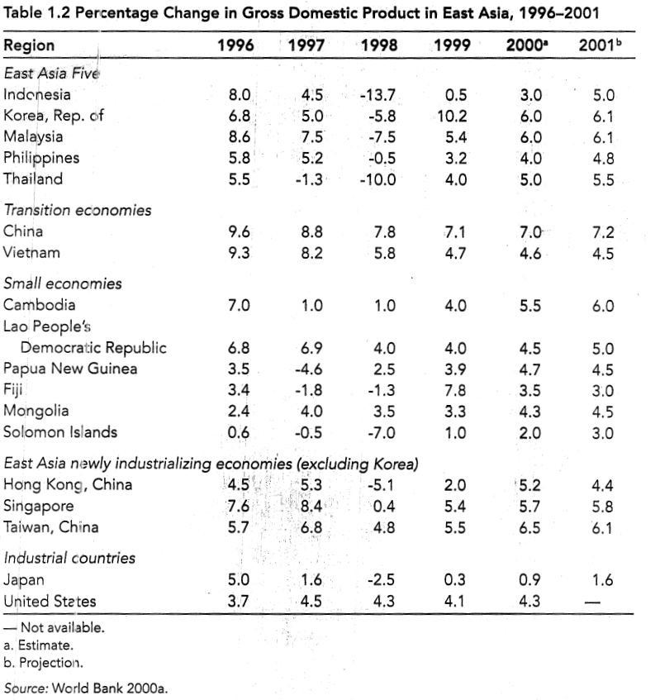

Slide 8
An aside: The Asian Financial Crisis 1997-1998
Events of 1997-98: Massive devaluations in Thailand, Korea, Indonesia, Malaysia, Philippines;
Countries not directly affected: China, Taiwan, Hong Kong;
Sharp contraction and return to growth thereafter;
Deeper causes:
  Investment exceeding savings (capital inflows!)
  Currency and maturity mismatch
  Lack of financial regulation
  Poorly implemented capital account liberalization;
  Problematic exchange rate policy
  Neglect of ‚Impossible Trinity‘
Actual Triggers of crisis:
  Speculative real estate bubble in Thailand
  Overvalued currencies
  Increasingly short-term capital inflows
  Early draw-down of reserves (Thailand and Korea)

Slide 9
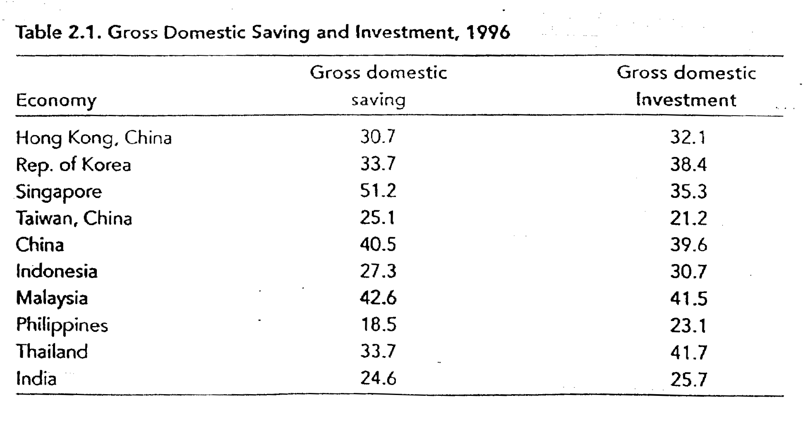
Notes:
4/36

Slide 10
An aside: The Asian Financial Crisis 1997-1998
Events of 1997-98: Massive devaluations in Thailand, Korea, Indonesia, Malaysia, Philippines;
Countries not directly affected: China, Taiwan, Hong Kong;
Sharp contraction and return to growth thereafter;
Deeper causes:
  Investment exceeding savings (capital inflows!)
  Currency and maturity mismatch
  Lack of financial regulation
  Poorly implemented capital account liberalization;
  Problematic exchange rate policy
  Neglect of ‚Impossible Trinity‘
Actual Triggers of crisis:
  Speculative real estate bubble in Thailand
  Overvalued currencies
  Increasingly short-term capital inflows
  Early draw-down of reserves (Thailand and Korea)

Slide 11
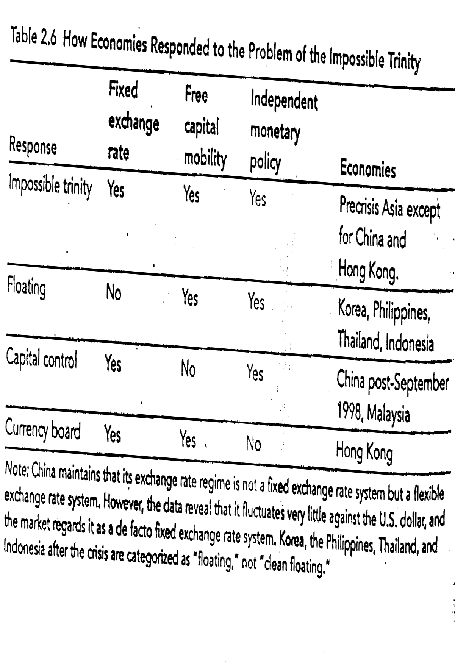
Notes:
4/41

Slide 12
An aside: The Asian Financial Crisis 1997-1998
Events of 1997-98: Massive devaluations in Thailand, Korea, Indonesia, Malaysia, Philippines;
Countries not directly affected: China, Taiwan, Hong Kong;
Sharp contraction and return to growth thereafter;
Deeper causes:
  Investment exceeding savings (capital inflows!)
  Currency and maturity mismatch
  Lack of financial regulation
  Poorly implemented capital account liberalization;
  Problematic exchange rate policy
  Neglect of ‚Impossible Trinity‘
Actual Triggers of crisis:
  Speculative real estate bubble in Thailand
  Overvalued currencies
  Increasingly short-term capital inflows
  Early draw-down of reserves (Thailand and Korea)

Slide 13
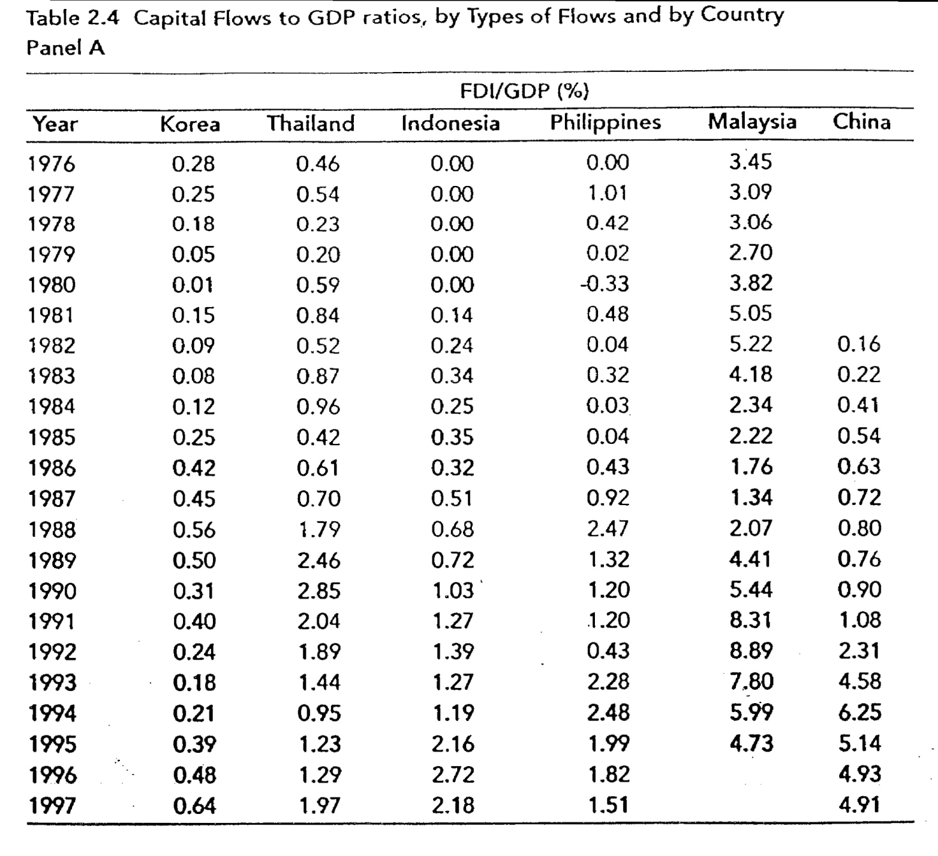
Notes:
4/37

Slide 14
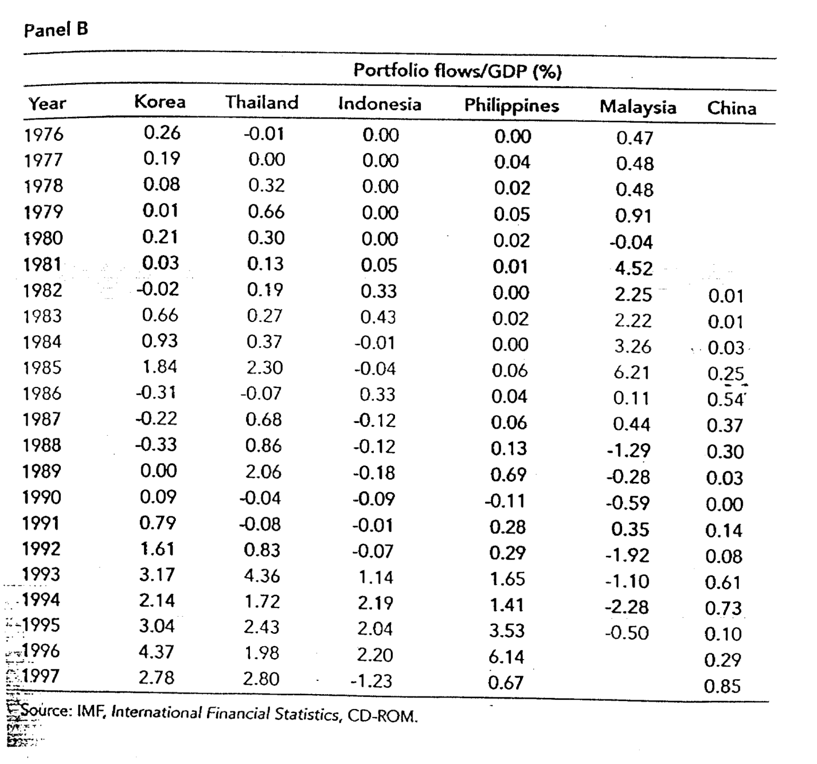
Notes:
4/38

Slide 15
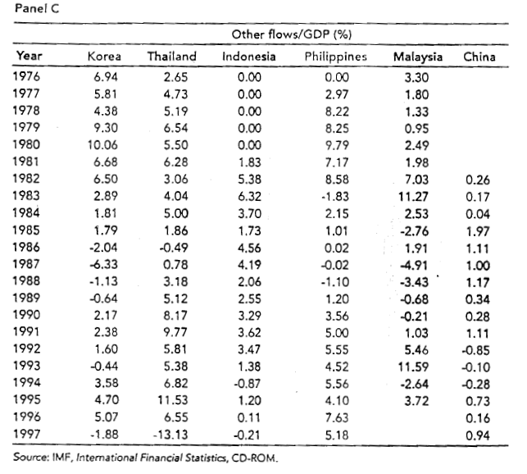
Notes:
4/39

Slide 16
Crisis and Aftermath
Role of contagion (trade, finance, investor sentiment)
Which countries not affected? Why?
Aftermath:
  Addressing impossible trinity
  More regulation and supervision of financial sector;
  Reversing liberalization;
  Substantial political reforms (esp. South Korea, Indonesia);
Lessons for other countries?
  Little benefits, high costs of short-term capital inflows;
  External financial liberalization extremely dangerous (and may have few benefits anyways);
  Regulation of financial system crucial;

Slide 17
Why are pegged exchange rate regimes so fragile?
The fragility of a fixed exchange rate system arises for two reasons:
there is a credibility problem
and a liquidity problem.

Slide 18
Simple model
We assume country on fixed exchange rate.
Experiencing a current account shock: a sudden increase in current account deficit.
If current account deficit is not corrected foreign debt becomes unsustainable and country will default.
Country can solve this problem in two ways:
  expenditure reducing policies (less spending more taxation)
    but this is politically costly
  devaluing the currency
    we assume this is politically less costly.

Slide 19
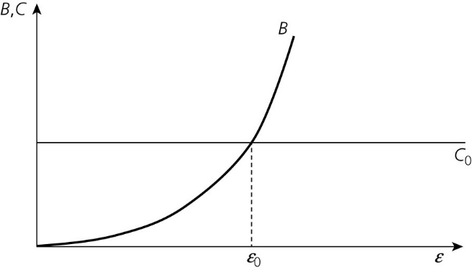
Costs and benefits of devaluation: first-generation model
Figure 5.1 Benefits (B) and costs (C) of a devaluation.

Slide 20
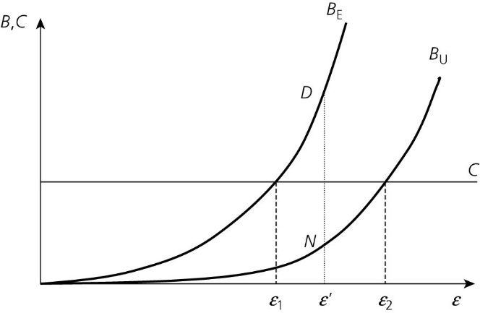
Second-generation model: multiple equilibria
Figure 5.2 Multiple equilibria in foreign exchange markets.

Slide 21
B_{U} curve: benefit of devaluation when devaluation is not expected.
B_{E} curve: benefit of devaluation when devaluation is expected (=speculative attack)
B_{E} > B_{U} because when devaluation is expected the defence of the fixed exchange rate is very costly (central bank has to raise interest rate with negative effect on economy)

Slide 22
Important note
The existence of two equilibria depends on the fact that the central bank has a limited stock of international reserves.

Slide 23
Second-generation model: multiple equilibria
Figure 5.2 Multiple equilibria in foreign exchange markets.

Slide 24
A monetary union without a budgetary union
The Eurozone is another type of incomplete monetary union.
The incompleteness arises because it is a monetary union without a budgetary union.
It will be seen that this leads to a similar fragility as the fixed exchange rate system.

Slide 25
Simple model of incomplete monetary union: the Eurozone
Starting point is: there is a cost and a benefit of defaulting on the debt.
Investors take this calculus of the sovereign into account.
It is assumed that the country involved is subject to a shock, which takes the form of a decline in government revenues.
  The latter may be caused by a recession, or a loss of competitiveness.
Call this a solvency shock.

Slide 26
Benefits of default
Figure 5.3 The benefits of default after a solvency shock.
Benefits
Benefit of default:
government reduces interest burden;
cost of taxation reduced
benefit increases with size of solvency shock
and size of govt. debt.
Solvency shock

Slide 27
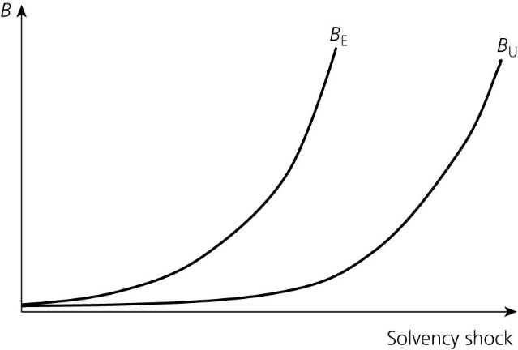
Two benefit curves
Figure 5.3 The benefits of default after a solvency shock.
B_{U} = Benefit when default is not expected.
B_{E} = Benefit when default is expected.

Slide 28
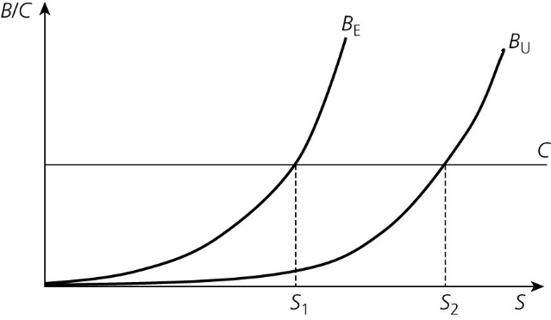
Cost and benefit of default
Figure 5.4 Cost and benefits of default after a solvency shock

Slide 29
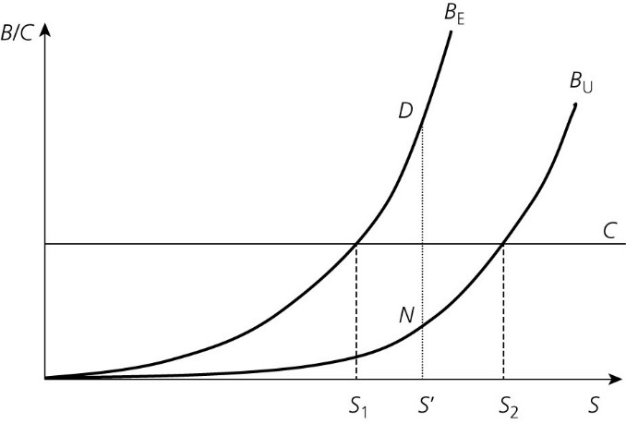
Three types of shocks
Figure 5.5 Good and bad equilibria.
Small shock: S < S₁
There will be no default because cost exceeds benefits, consistent with expectations.
Large shock: S > S₂.
Default is certain because benefits exceed costs; consistent with expectations
Intermediate shock:
S₁ < S < S₂
Two equilibria: N and D, both consistent with expectations.

Slide 30
The bad news about a bad equilibrium
Banking crisis (‘deadly embrace’)
Automatic stabilizers switched off.

Slide 31
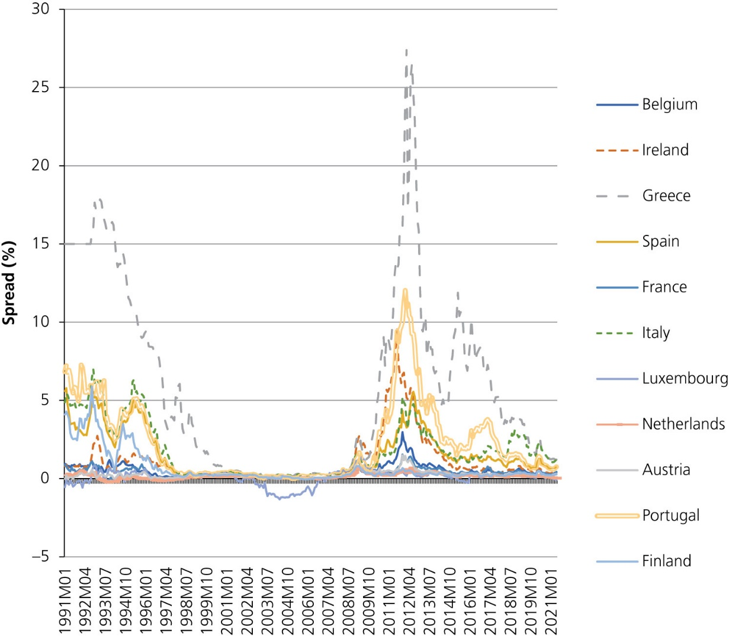
Figure 5.11 Spreads of 10-year government bond rates (%) vis-à-vis Germany (1991–2021)
Source: Eurostat

Slide 32
The transition to a monetary union

Slide 33
Short History of monetary unification in Europe
Latin Monetary Union (1865-1927)
  Loose arrangement: each central bank decides about currency supply
  Bimetallic standard leading to Greshnam’s Law
  Union ends de facto at the start of WWI

Slide 34
Post WWII period
European Payments Union (1950-1959)
  Complicated system
  But helped trade to recover
From 1959: convertibility of national currencies
  Bretton Woods system becomes effective
  Fixed exchange rates vis-à-vis dollar
  Dollar convertible in gold

Slide 35
Problems with Bretton-Woods system
  Fixed exchange rates not credible
  Frequent speculative crises and devaluations
  Collapse in 1971-73
From 1973: floating exchange rate
  Exchange rate volatility
  Becomes a problem for well-functioning of EEC, especially agricultural policies
First attempt at fixing exchange rates within the EEC: snake in the tunnel

Slide 36
Snake in the tunnel comes under pressure with frequent speculative crises
Werner report of 1970
  Road map for monetary union by 1980
  From then on irrevocably fixed exchange rates
  Weak point: it remained vague about how the system of central bank would function
  Was not implemented

Slide 37
European Monetary System (EMS) in 1979
Two features
  Exchange Rate Mechanism (ERM): adjustable peg system
  European Currency Unit (ECU): precursor of euro
ERM quickly came under pressure
  Speculative crises
  Frequent realignments
  Collapse in 1993.

Slide 38
The Maastricht Treaty
The Maastricht Treaty was signed in 1991.
It is the blueprint for progress towards monetary unification in Europe.
It is based on two principles:
  gradualism: the transition towards monetary union in Europe is seen as a gradual one
  convergence criteria: entry into the union is made conditional on satisfying convergence criteria.

Slide 39
‘Convergence criteria'
(1) Inflation rate ≤ average of three lowest inflation rates in the group of candidate countries + 1.5%
(2) Long-term interest rate ≤ average observed in the three low-inflation countries + 2%
(3) Joined the exchange rate mechanism of the EMS and did not experience a devaluation during the two years preceding the entrance into EMU
(4) Government budget deficit ≤ 3% of its GDP
(5) Government debt ≤ 60%of GDP

Slide 40
Why convergence requirements?
The OCA theory stresses microeconomic conditions for a successful monetary union:
  symmetry of shocks
  labour market flexibility
  labour mobility.
The Treaty stresses macroeconomic convergence:
  inflation
  interest rates
  budgetary policies.

Slide 41
1. Inflation convergence
Future monetary union could have an inflationary bias.
The analysis is embedded in the Barro–Gordon model.

Slide 42
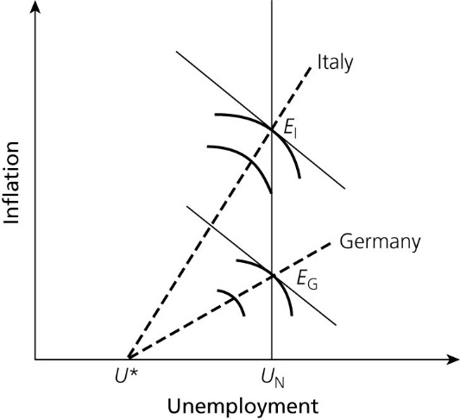
The inflation bias in a monetary union
Figure 6.1 The inflation bias in a monetary union.

Slide 43
2. Budgetary convergence
Deficit and debt criteria can be rationalized in a similar way:
  a country with a high debt-to-GDP ratio has an incentive to create surprise inflation
  the low-debt country stands to lose and will insist that the debt-to-GDP ratio of the highly indebted country be reduced prior to entry into the monetary union
  the high-debt country must also reduce its government budget deficit.

Slide 44
In addition, countries with a large debt face a higher default risk.
Once in the union, this will increase the pressure for a bailout in the event of a default crisis.
No bailout clause was incorporated into the Maastricht Treaty.
But is this clause credible?

Slide 45
Numerical precision of budgetary requirements is difficult to rationalize
3% and 60% budgetary norms have been derived from formula determining budget deficit needed to stabilize government debt:
d = gb
  b = (steady state) level at which the government debt is to be stabilized (in per cent of GDP),
  g = growth rate of nominal GDP, and
  d = government budget deficit (in per cent of GDP).
  In order to stabilize the government debt at 60% of GDP the budget deficit must be brought to 3% of GDP if and only if the nominal growth rate of GDP is 5% (0.03 = 0.05 x 0.6).

Slide 46
Arbitrary nature of the rule
The rule is quite arbitrary on two counts.
  Why should the debt be stabilized at 60%?
    The only reason was that at the time of the Maastricht Treaty negotiation this was the average debt-to-GDP ratio in the European Union.
  The rule is conditioned on the future nominal growth rate of GDP.

Slide 47
3. Exchange rate convergence
(no-devaluation requirement)
It prevents countries from manipulating their exchange rates
Note:
  according to the Treaty, countries should maintain their exchange rates within the ‘normal’ band of fluctuation (without changing that band) during the two years preceding their entry into the EMU
  since August 1993, the ‘normal’ band within the EMS was 2 x 15%.

Slide 48
4. Interest rate convergence
Excessively large differences in the interest rates prior to entry could lead to large capital gains and losses at the moment of entry into EMU .
These gains and losses are likely to occur prior to entry
  because the market will automatically lead to a convergence of long-term interest rates as soon as the political decision is made to allow entry of the candidate member country.

Slide 49
How to organize relations between the ‘ins’ and the ‘outs’
Main principles decided in ECOFIN meeting in June 1996:
  a new exchange rate mechanism (the so-called ERM-II) replaced the old exchange rate mechanism (ERM) since 1 January 1999
  adherence to the mechanism is voluntary
  its operating procedures are determined in agreement between the ECB and the central banks of the ‘outs’.
  ERM-II is based on central rates around which relatively wide margins of fluctuations are set. Countries may choose different margins.
  The anchor of the system is the euro

Slide 50
Conclusion
The transition towards EMU was based on two principles
  gradualism
  macroeconomic convergence.
These principles will continue to be important for the new and older member countries when/if these countries decide to join the Eurozone.

Slide 51
Maastricht convergence criteria have little to do with OCA criteria
They were invented to solve a political problem:
  the reluctance of Germany to enter into a monetary union with countries that had a history of high inflation and high government debts and deficits.

