Slide 1
Physisorption, surface area and porosity

Slide 2
Brunauer Emmett and Teller (BET equation):
n amount of adsorbate (g) at the pressure P
n_{m} amount of adsorbate corresponding to the formation of a monolayer
C BET constant
P₀ saturation pressure
M_{w} è Molecular weight of the adsorbate N_{a} Avogadro Number a_{m} “cross section area” of the adsorbate.

Slide 3
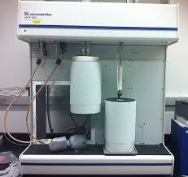

Slide 4
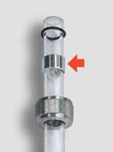
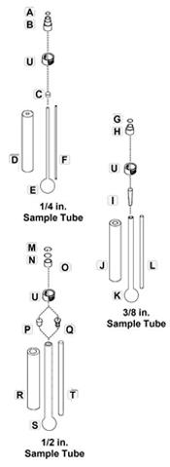
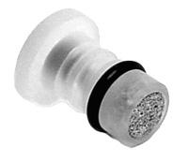

Slide 5
What is a Gas Sorption Analyzer?
Does it actually measure surface area and pore size?
NO!! It simply records various pressures of gas in the sample cell due to adsorption and desorption. The instrument then calculates the amount (as STP volume) of gas adsorbed/desorbed.
Surface area, pore size are calculated by PC software
Pressure measurements are critical!

Slide 6
Low Surface Area Materials
Vapour pressure at 77 K
Kr = 267 Pa N₂ = 101325 Pa
The gas adsorption amount in the volumetric method is calculated from the difference between the number of dosed molecules and number of unadsorbed gas molecules at equilibrium pressure.
In other words, by assuming both molecular sizes equal and adsorption pressure equal to 50 Pa, it is necessary to measure the pressure change of 0.16% (=50/30400) for N₂ and 63% (=50/80) for Kr at the same relative pressure (P/Po=0.3, N₂=30400Pa, Kr = 80Pa).
Obviously, it is easier to measure larger pressure change, and therefore, the accuracy of the measurement is better. For this reason, the lower the saturation vapour pressure at the adsorption measurement temperature, the more accurate the measurement of low surface areas and so Xe, with vapour pressure equal to 0.23 Pa at 77 K, is still a better gas to measure low surface areas. Unfortunately, Xe is much more expensive than Kr.
Nitrogen 0.162 nm²
Krypton 0.210 nm²
https://www.microtrac.it/it/applicazioni/conoscenza-base/method-of-small-surface/

Slide 7
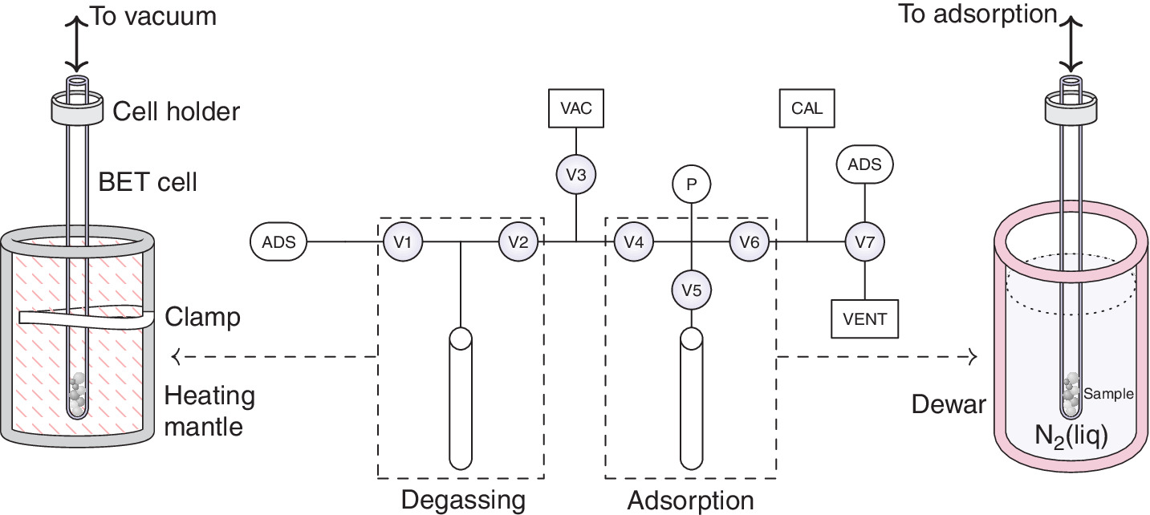
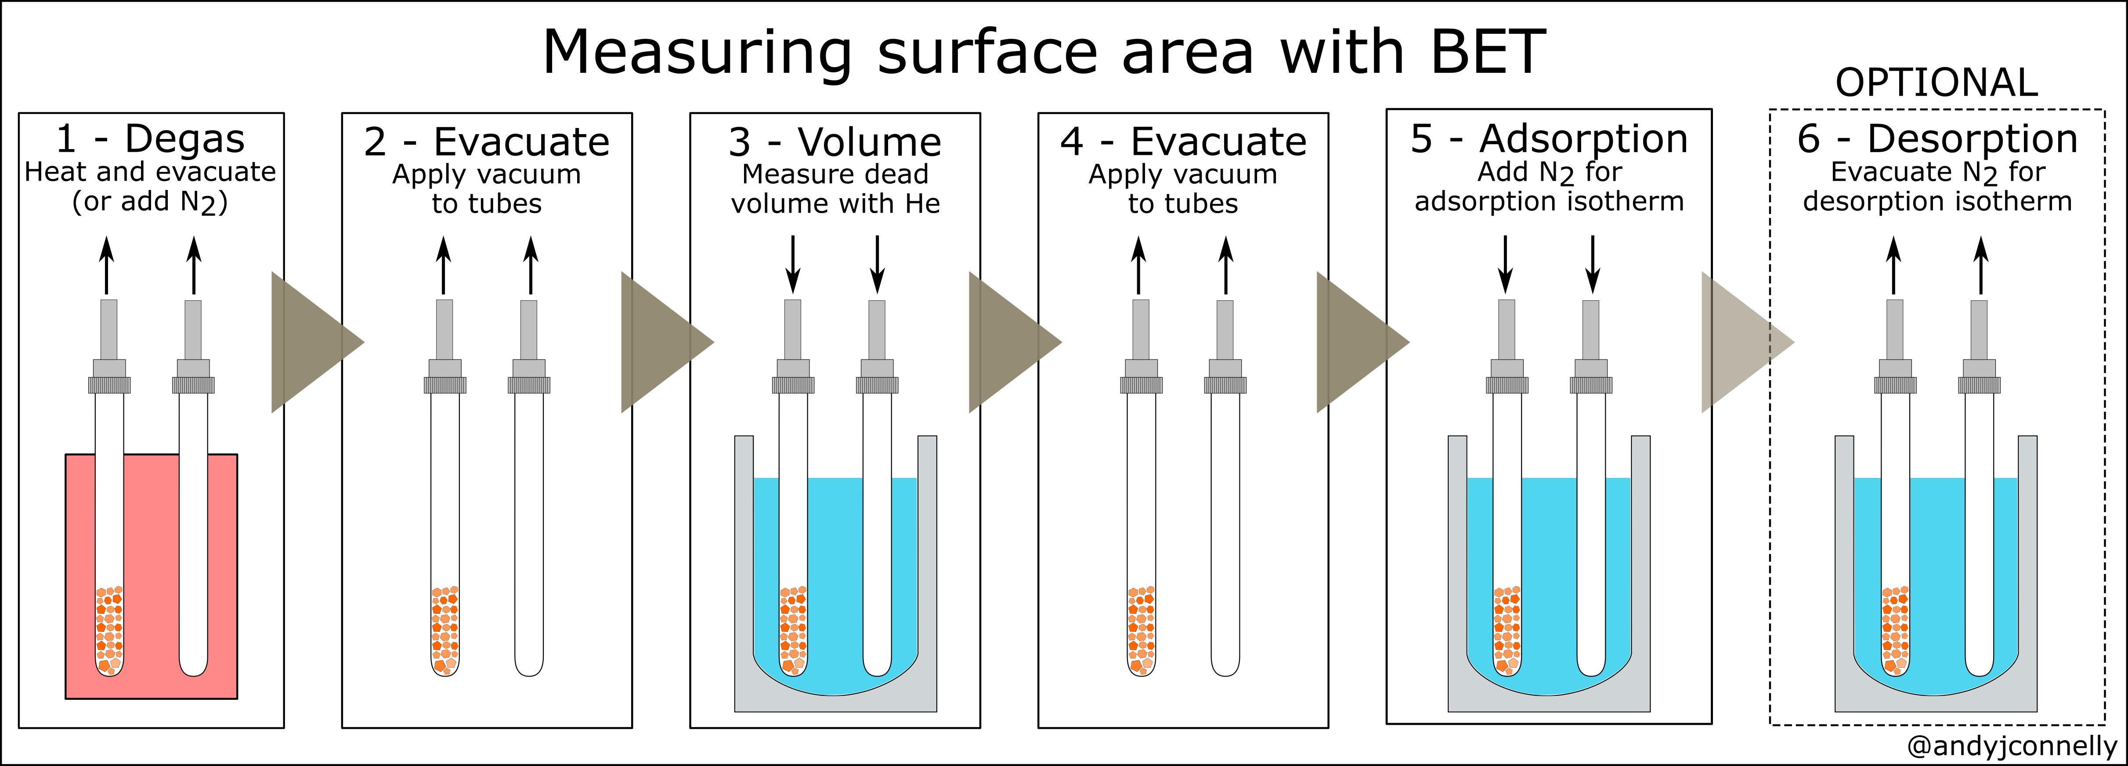
https://andyjconnelly.wordpress.com/2017/03/13/bet-surface-area/

Slide 8
Degas
Important step before measurement of surface area or pore size/volume
Surfaces armust be ‘cleaned’ of water/organic vapours in two ways:
With heating under a vacuum
Under a flow of dry, inert gas.
No modification must be induced

Slide 9
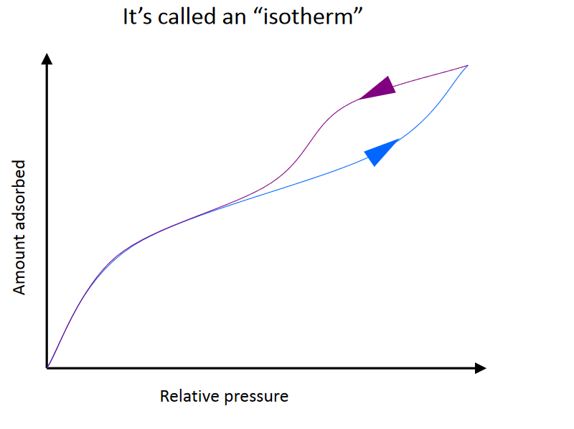
What is the result?
Desorption curve may overlay on,
or appear to left of,
the adsorption curve
The values on the y-axis are calculated from pressure measurements (and temperature values)

Slide 10
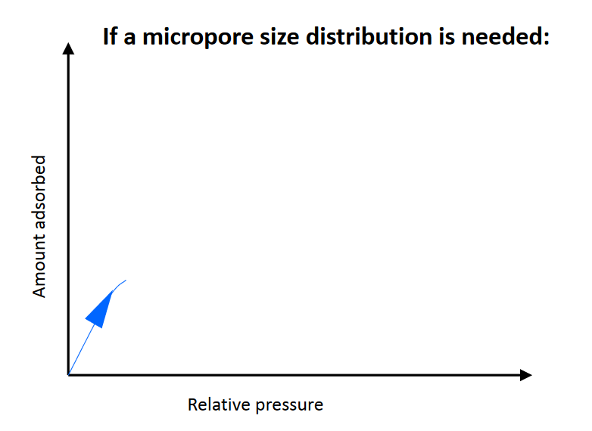
What to Analize?

Slide 11
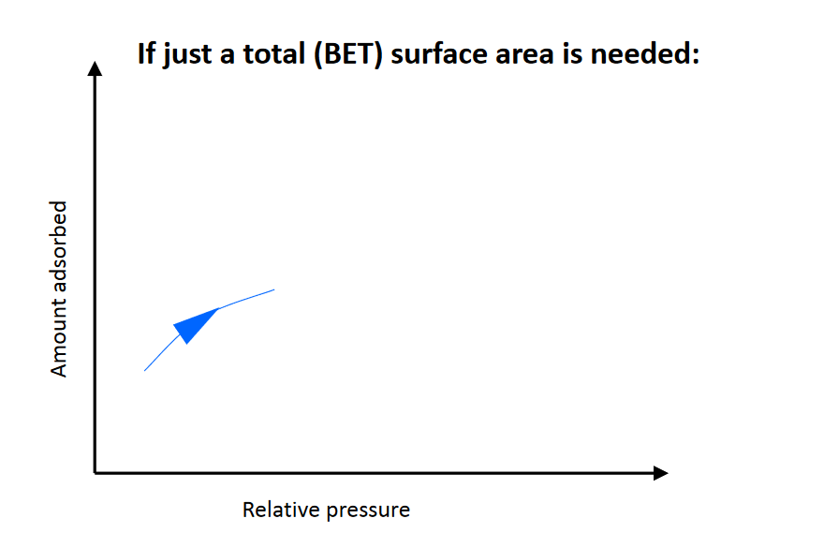
What to Analize?

Slide 12
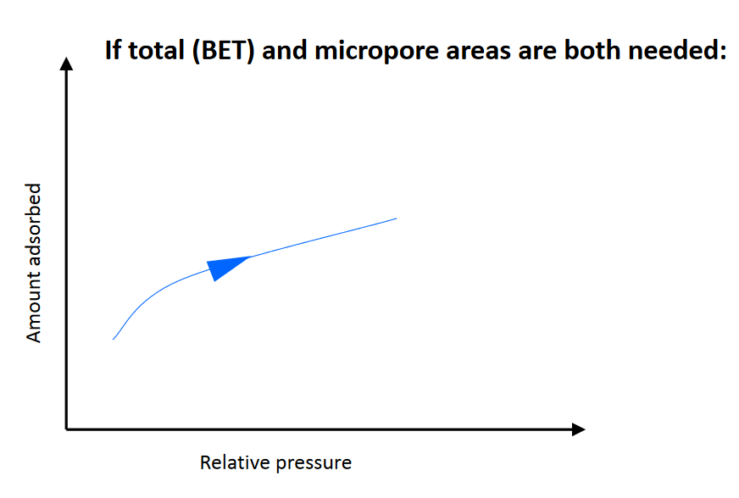
What to Analize?

Slide 13
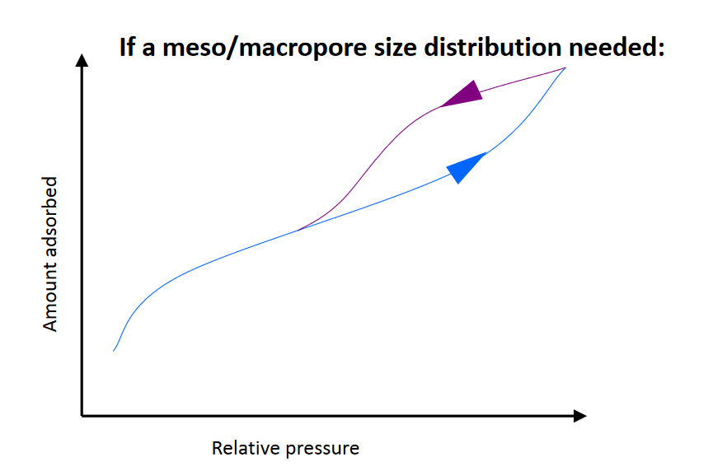
What to Analize?

Slide 14
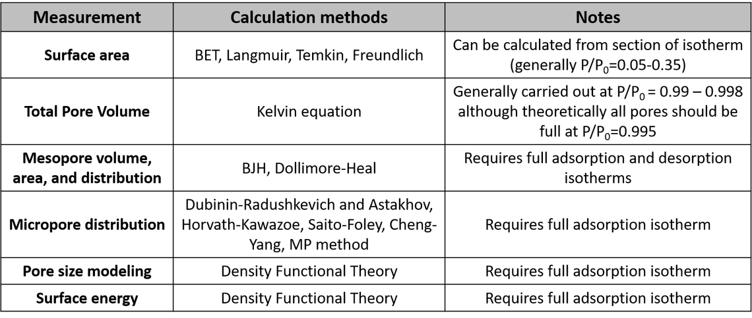

Slide 15
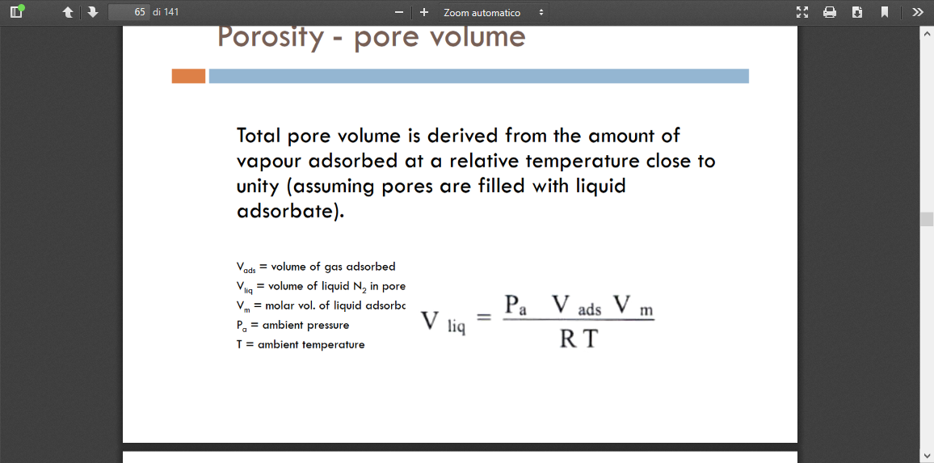
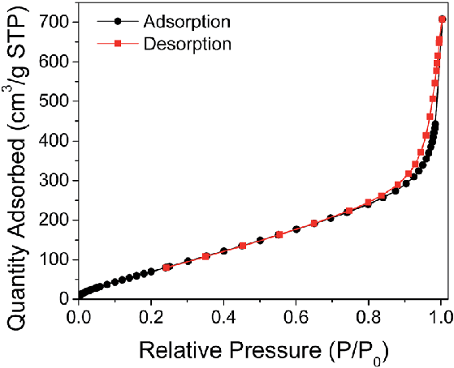
Total Pore Volume

Slide 16
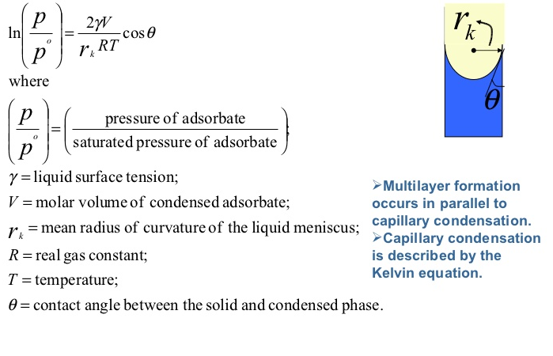
Pore Size: Kelvin Equation

Slide 17
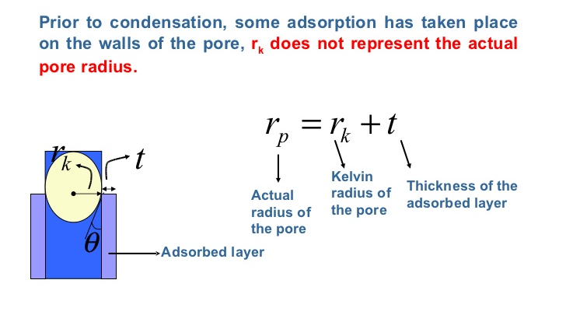
Pore Size: Kelvin Equation

Slide 18
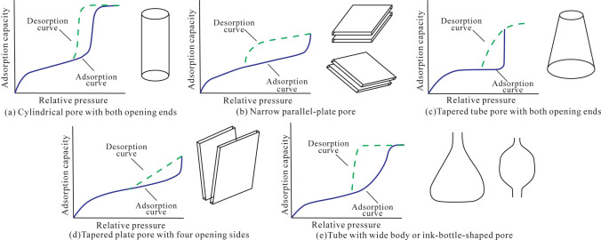

Slide 19
ADSORPTION PLOT for Ce_{0.5}Zr_{0.5}O₂

Slide 20
Chemisorption, surface area and metal dispersion

Slide 21
Chemisorption for probing metal surface areas
Objective
determine number of accessible metal sites
Exploit high reactivity of metal surface atoms
- let them react with small molecules (H₂, O₂, CO, etc.)
- count the number of molecules that have reacted
- knowing the stoichiometry of the reaction you obtain the number of metal surface atoms
Choice of the probe molecule
- must be selective for reaction with metal vs. support
- must be selective for reaction with surface atoms (not with bulk)
- reaction must be «irreversible»

Slide 22
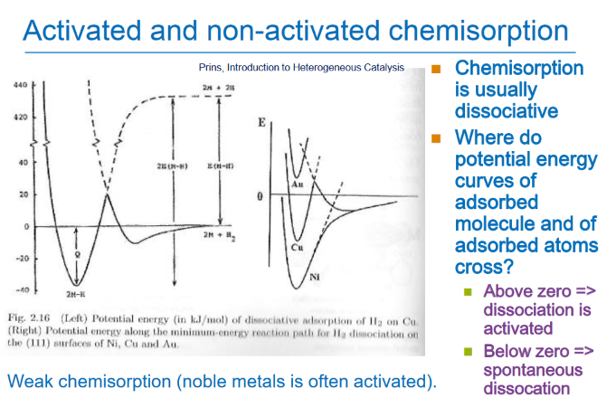

Slide 23
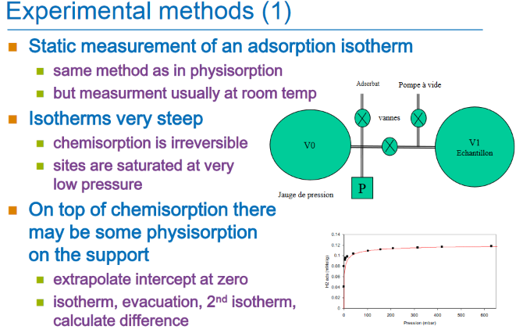

Slide 24
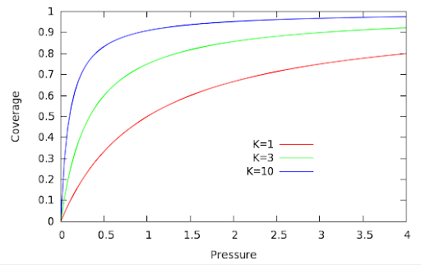

Slide 25
Metal surface atoms (N_{(s)M}) and metal surface area (S_{M})
n = number of surface metal atoms that are occupied by the chemisorption of a gas molecule.
ex : H₂ on Pt : n = 2 because of dissociative adsorption: 1 molecule H₂ dissociates to 2 H atoms adsorbed on 2 Pt atoms
v adsorbed gas volume
V_{m} volume of a mole of metal atom
N_{a} Avogadro’s number
S surface of one metal atom

Slide 26
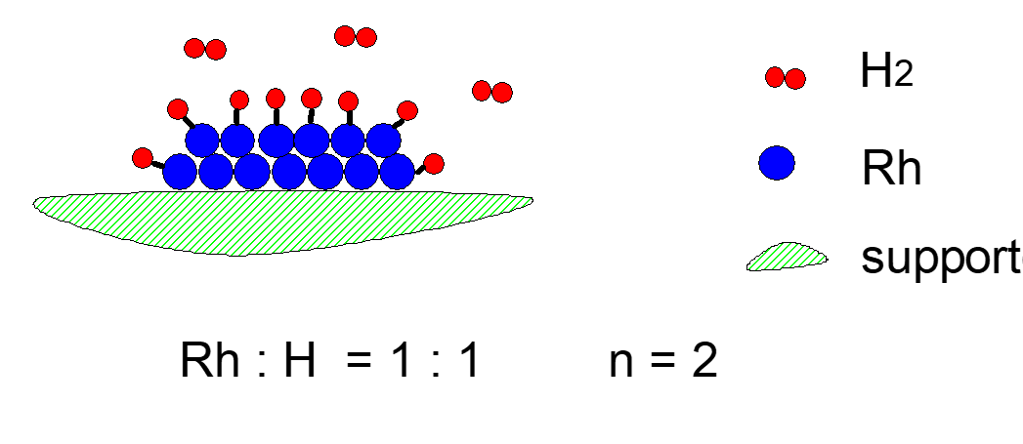
Chemisorption stoichiometry
corner atoms are usually more active than atoms on the flat surfaces
stoichiometry of chemisorption may also change
Nanoparticle < 1nm → n < 2

Slide 27
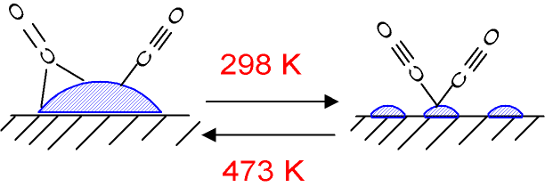
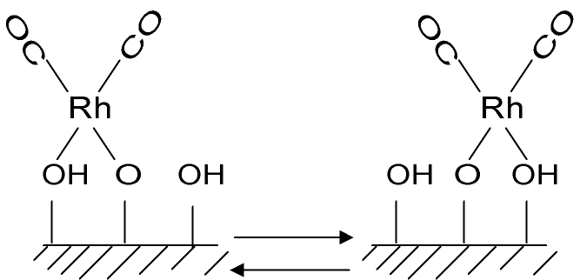
Rh/Al₂O₃

Slide 28
Chemisorption and Physisortion: the role of support in nanocomposites
Gas adsorption
Pressure
Physisorption is investigated at 77 K but occurs at higher temperature

Slide 29
Chemisorption and Physisortion: the role of support in nanocomposites
Adsorption
Pressure

Slide 30
1.1% Pt/γ-Al₂O₃
Adsorbimento a 573 K di H₂. Curva (a) adsorbimento su 2.031 g di catalizzatore, (c) adsorbimento su 1.00 g di Al₂O₃, (d) adsorbimento su quantità di supporto corrispondente a quella del campione (2.00 g) ed espressa nella stessa scala della curva (a), (b) differenza tra la curva a e d.

