Slide 1
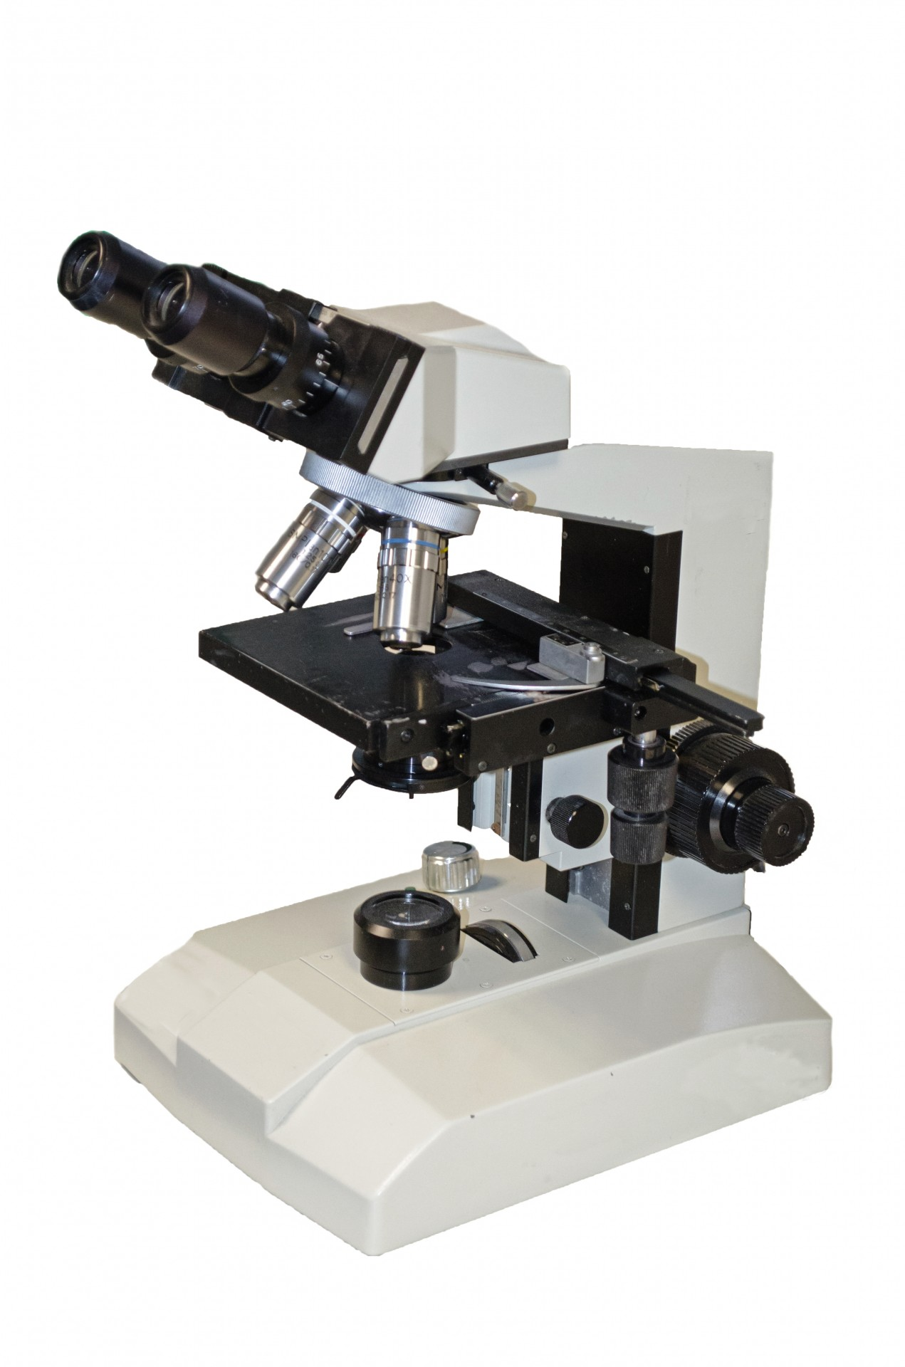
MICROSCOPIA OTTICA IN BIOLOGIA CELLULARE [675SM]
MICROSCOPY IN CELL BIOLOGY –
aa 2022/2023, 2nd semester
Aula 5A, edificio H2bis 15-18
Agnes Thalhammer
agnes.thalhammer@units.it

Slide 2
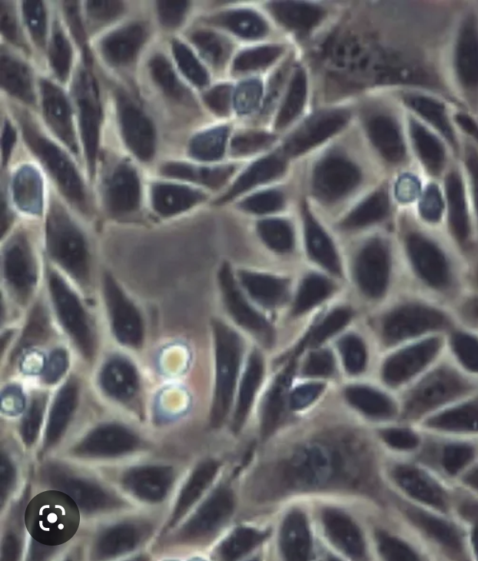
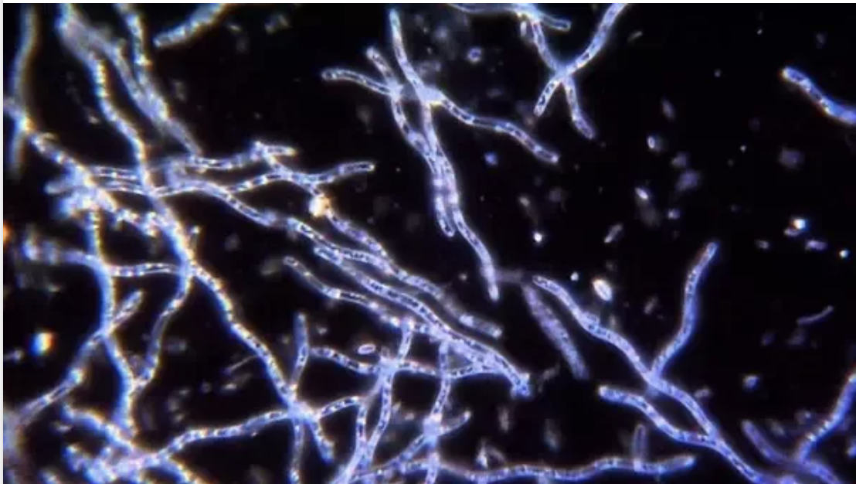
Which contrasting technique?

Slide 3
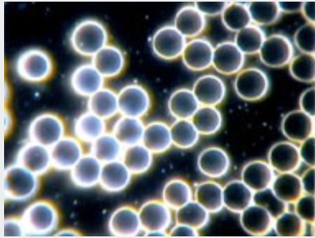
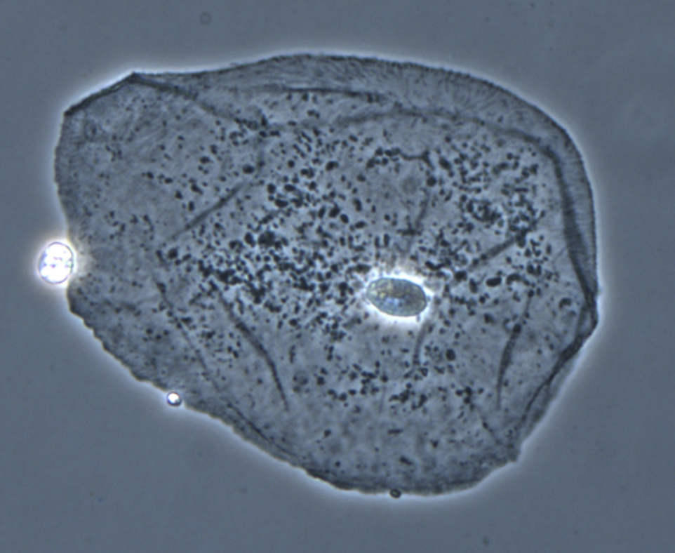
Which contrasting technique?

Slide 4
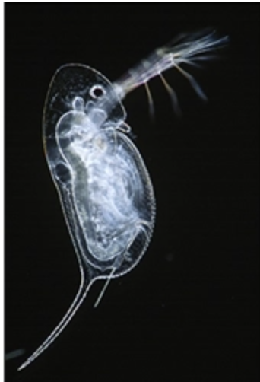
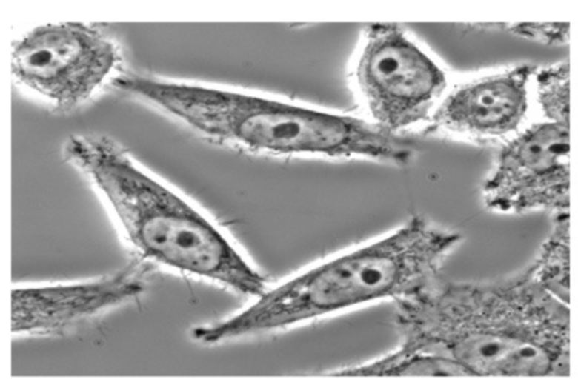
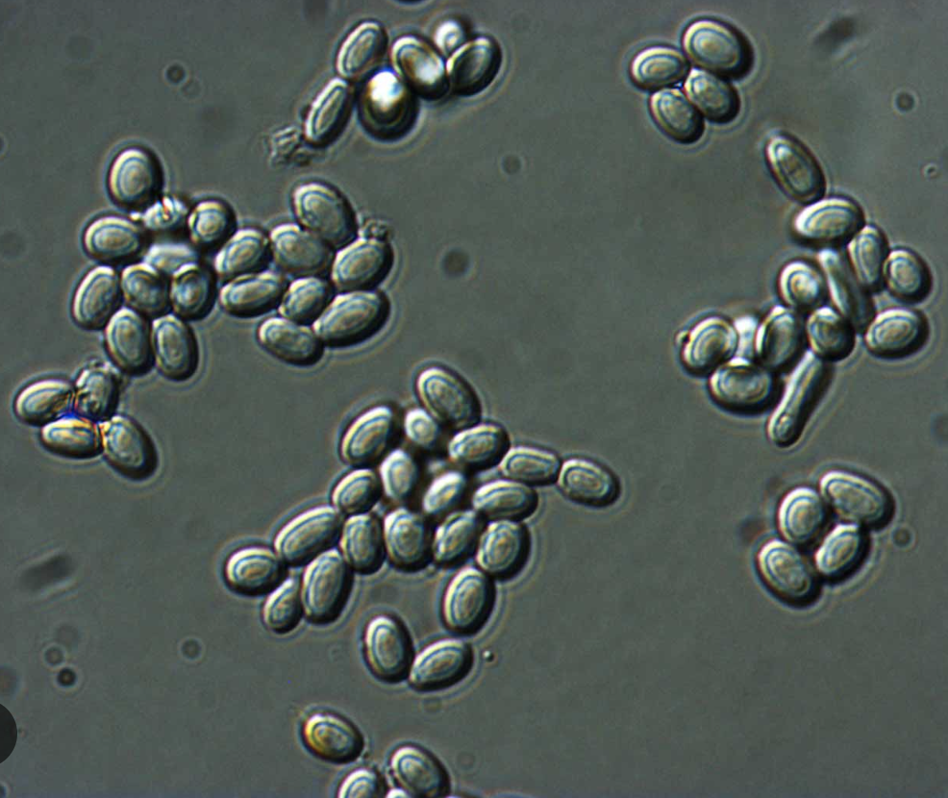
Which contrasting technique?

Slide 5
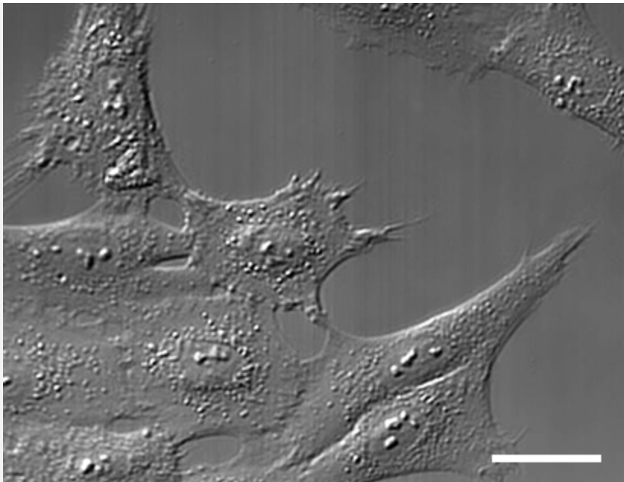
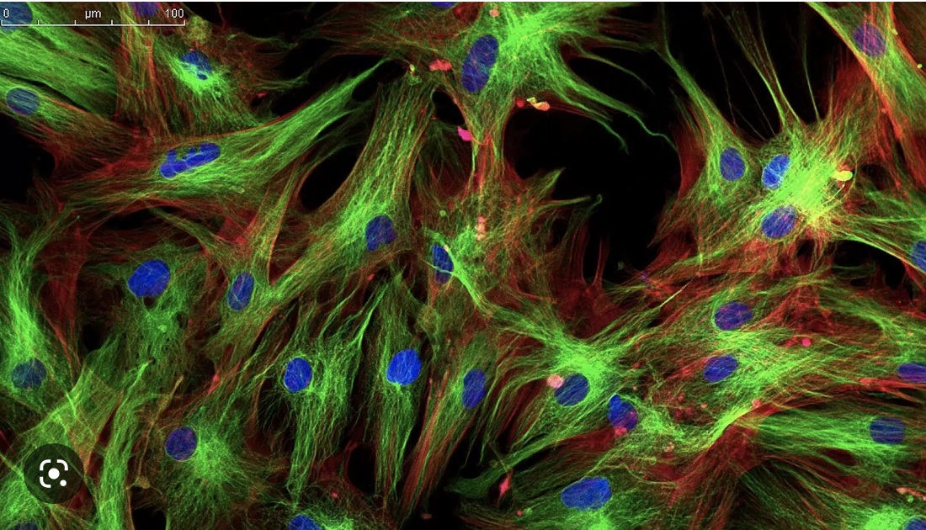
Which contrasting technique?

Slide 6
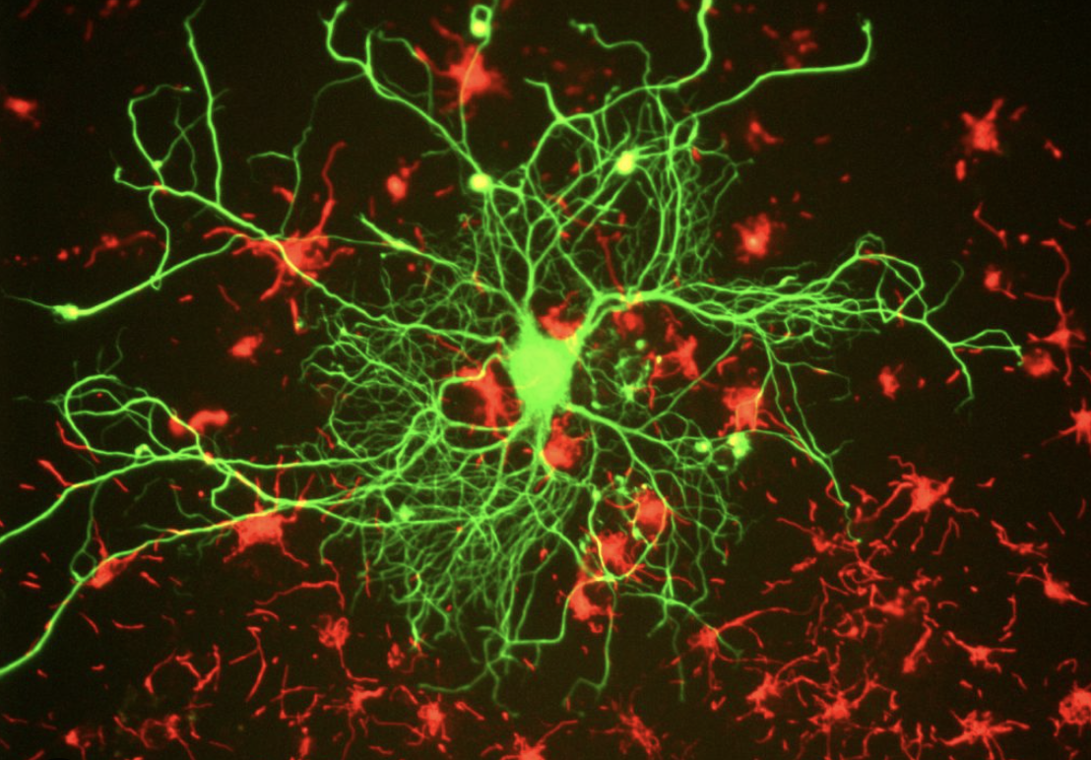
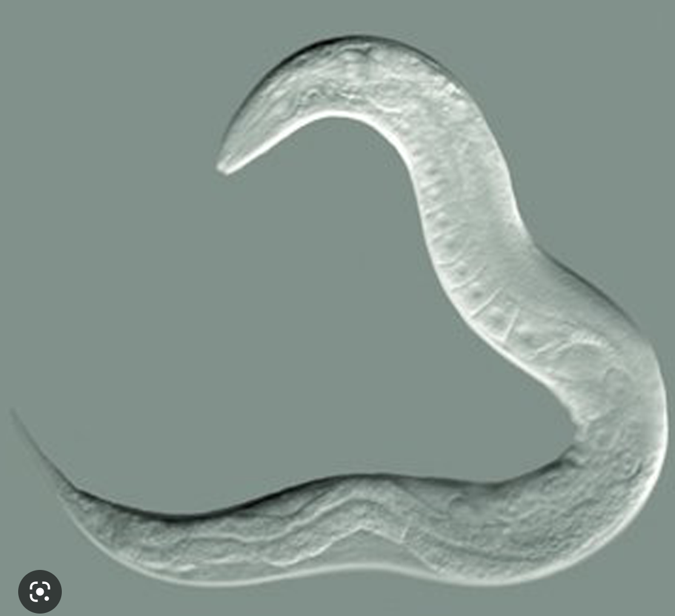
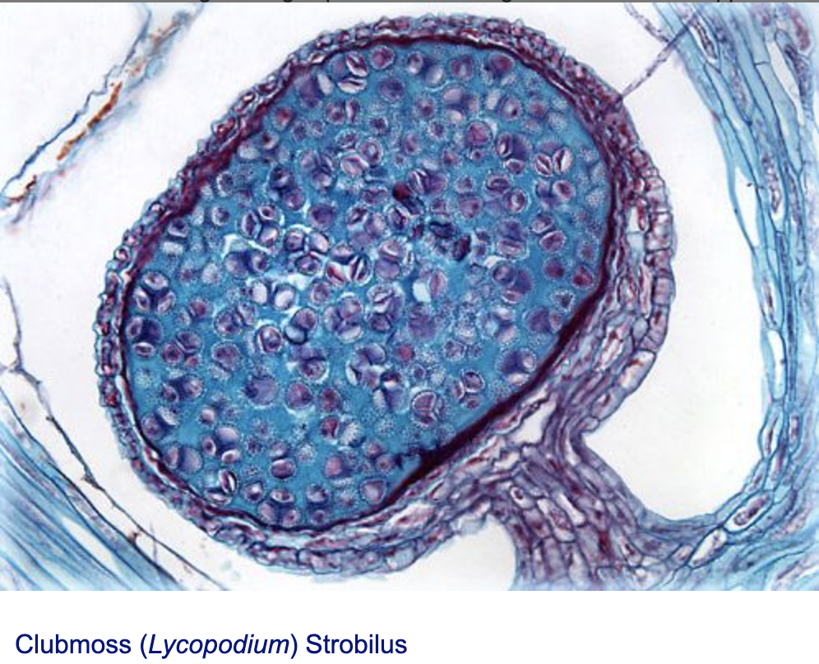
Which contrasting technique?

Slide 7
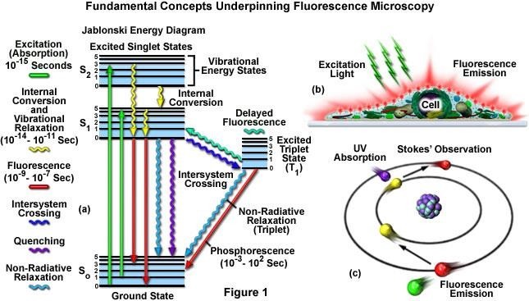
FLUORESCENCE PRINCIPLE

Slide 8
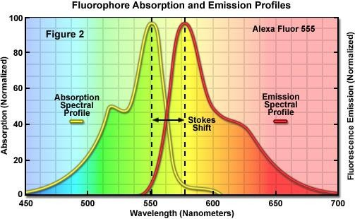
Molecules absorbing the energy of electromagnetic radiation will jump to a higher energy level. When certain excited molecules return to the ground state they emit radiation. This phenomenon is known as fluorescence. Fluorescent molecules are known as fluorochromes or fluorophores.

Slide 9
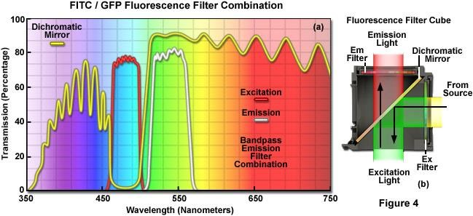

Slide 10
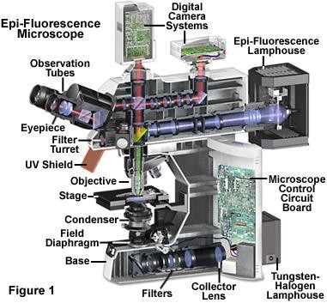
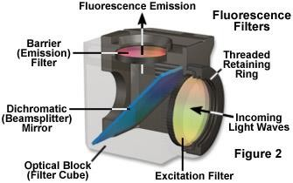

Slide 11
Advanced Microscopy Techniques
Lesson 3

Slide 12
WHICH IMAGING TECHNIQUE SHOULD I USE?
1-5 μm
TIRF (for samples at the coverslip)
Wide-field (+deconvolution)
1-20 μm
Spinning Disk Confocal
Fast
Sample Thickness
Sensitivity
10-100 μm
Line-scanning confocal
>20 μm
Point scanning Confocal
Slow
>50-100 μm
2-photon confocal

Slide 13
NEAR FIELD IMAGING (NSOM)
-place microscope distance less than 1 wavelength from sample
-20-50 nm resolution
problem: cannot image into sample because of wavelength restriction

Slide 14
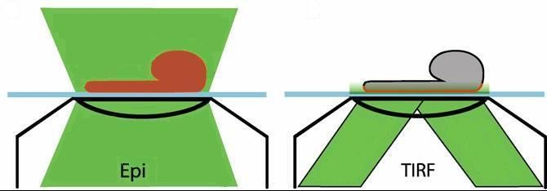
You need:
TIRF objectives with high NA
TIRF condensor, where you are able to change the angle of illumination
Glass coverslips

Slide 15
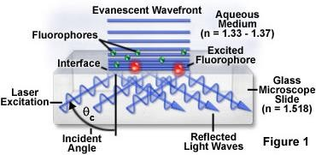
TIRF
micro.magnet.fsu.edu
Result: very thin section at the bottom of the sample 150-200nm
Use: to study membrane dynamics (endocytosis, focal adhesions, receptor binding) Nikon TE 2000

Slide 16
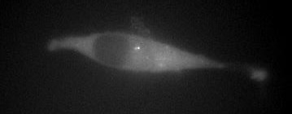
TIRF vs EPI
FAK-lasp in epi mode (wide field)
FAK-lasp in tirf mode (wide field)
Heather Spence, R10

Slide 17
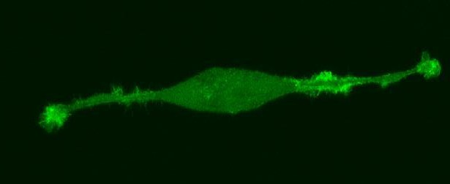
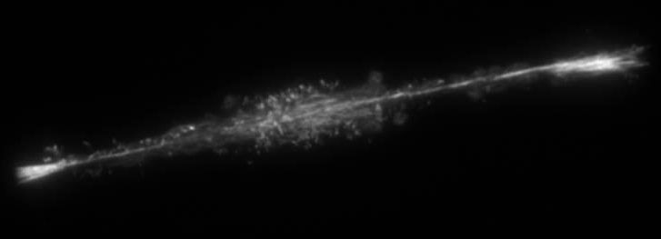
TIRF vs EPI
Lasp in confocal sectioning
Lasp in TIRF mode
Heather Spence, R10

Slide 18
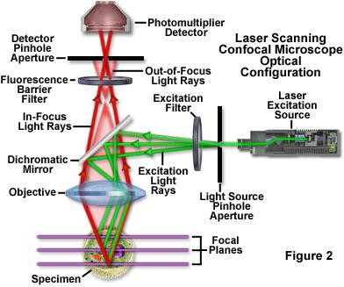
PRINCIPLE OF CONFOCAL MICROSCOPY
two pinholes are used:
One pinhole is placed in front
of the illumination source to allow
transmission only through a small area
only a point of the specimen is illuminated at one time
Fluorescence excited at the focal plane is imaged onto a confocal pinhole placed right in front of the detector
Only fluorescence excited within the focal plane of the specimen will go through the detector pinhole
Need to scan point onto the sample
OUT-OF-FOCUS PLANE
IN-FOCUS (OBJECT) PLANE
CONTAINING ILLUMINATED SPOT OUT-OF-FOCUS PLANE
"POINT" SOURCE OF LIGHT
"POINT" DETECTOR APERTURE
CONDENSER
OBJECTIVE
LENS
BIOLOGICAL SAMPLE
LENS

Slide 19
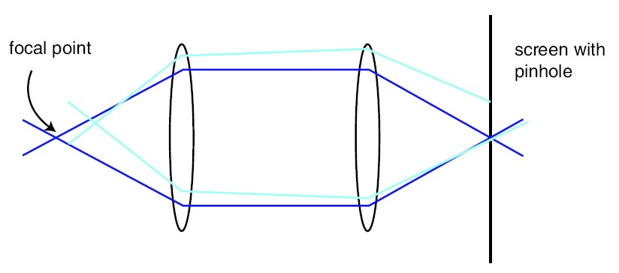
CONFOCAL DETECTION
Sample 3D -> Detector 2D
A pinhole allows only in-focus light through
3D sample
Focused Light creates fluorescence which gets to detector
Light mostly
gets rejected
Smaller the pinhole, better out-of-focus discrimination but lose more signal.
Scan sample in x, y, z and reconstruct entire image

Slide 20
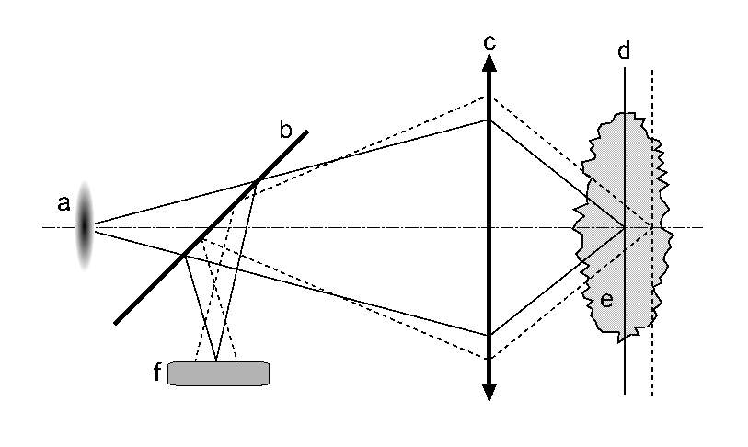
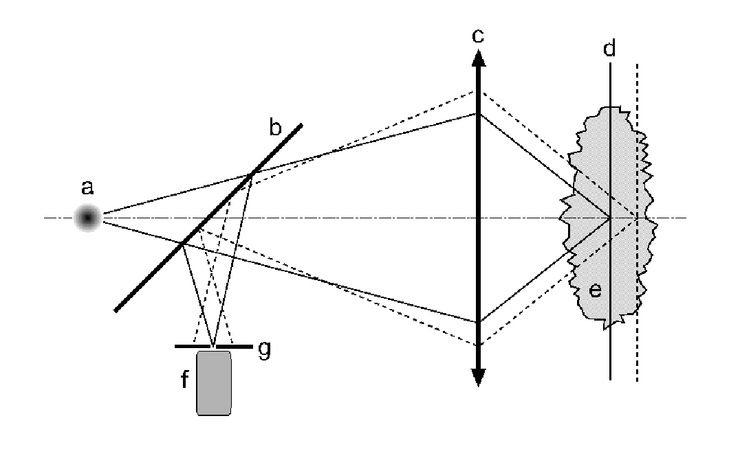
WIDE-FIELD vs CONFOCAL MICROSCOPY
a – light source
b – dichroic filter
c – objective lens
d – focal plane
e – specimen
f – light detector
g – confocal aperture

Slide 21
Fluorescence Microscope
Confocal Fluorescence Microscope
Arc Lamp
Laser
Excitation Diaphragm
Excitation Pinhole
Excitation Filter
Excitation Filter
Ocular
PMT
Objective
Objective
Emission Filter
Emission Filter
Emission Pinhole
29-Mar-22

Slide 22
WHEN TO USE CONFOCAL?
Confocal is not a magic bullet
It is extremely wasteful of photons
Laser-scanning confocal is 100 – 200-fold less sensitive than widefield

Slide 23
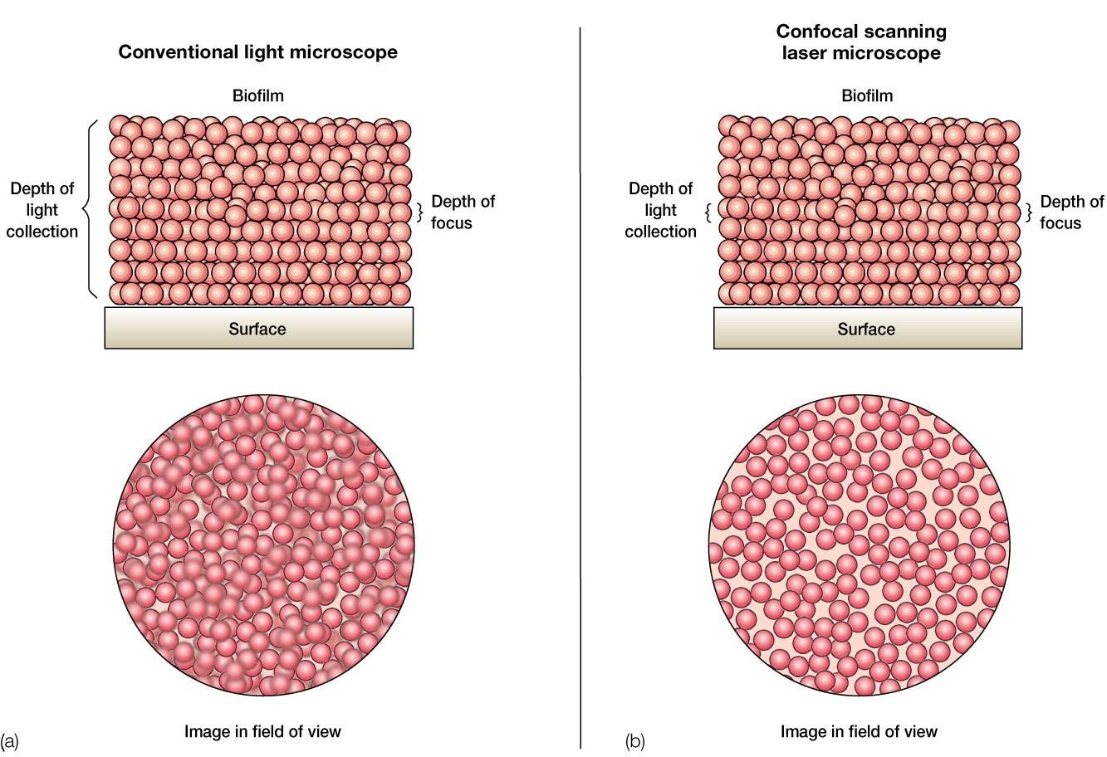

Slide 24
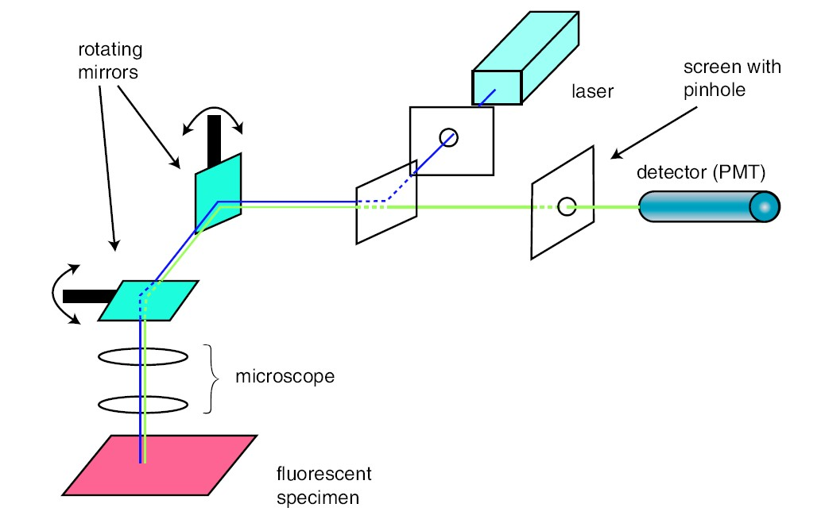
CONFOCAL MICROSCOPY
Fast imaging via moveable mirrors

Slide 25
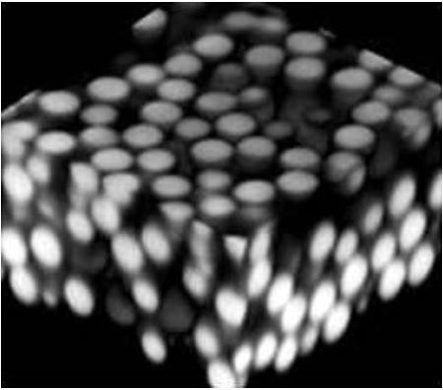
3-D SECTIONING WITH CONFOCAL
3D-dimensional reconstruction of a series of 2D images of PMMA spheres

Slide 26
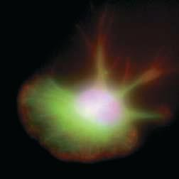
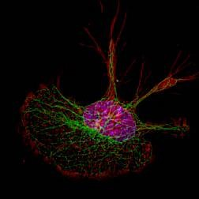
A macrophage cell was stained with fluorochrome-labeled reagents specific for DNA (blue), microtubules (green), and actin microfilaments (red). The series of fluorescent images obtained at consecutive focal planes (optical sections) through the cell were recombined in three dimensions.
(a) In this three-dimensional reconstruction of the raw images, the DNA, microtubules, and actin appear as diffuse zones in the cell. (b) After application of the deconvolution algorithm to the
images, the fibrillar organization of microtubules and the localization of actin to adhesions become readily visible in the
reconstruction.

Slide 27
2-PHOTON EXCITATION
excited state
Two-photon excitation occurs through the absorption of two lower energy
excitatio n
emission
emission
excitatio n
excitatio n
ground state
One-photon excitation
Two-photon excitation
21

Slide 28
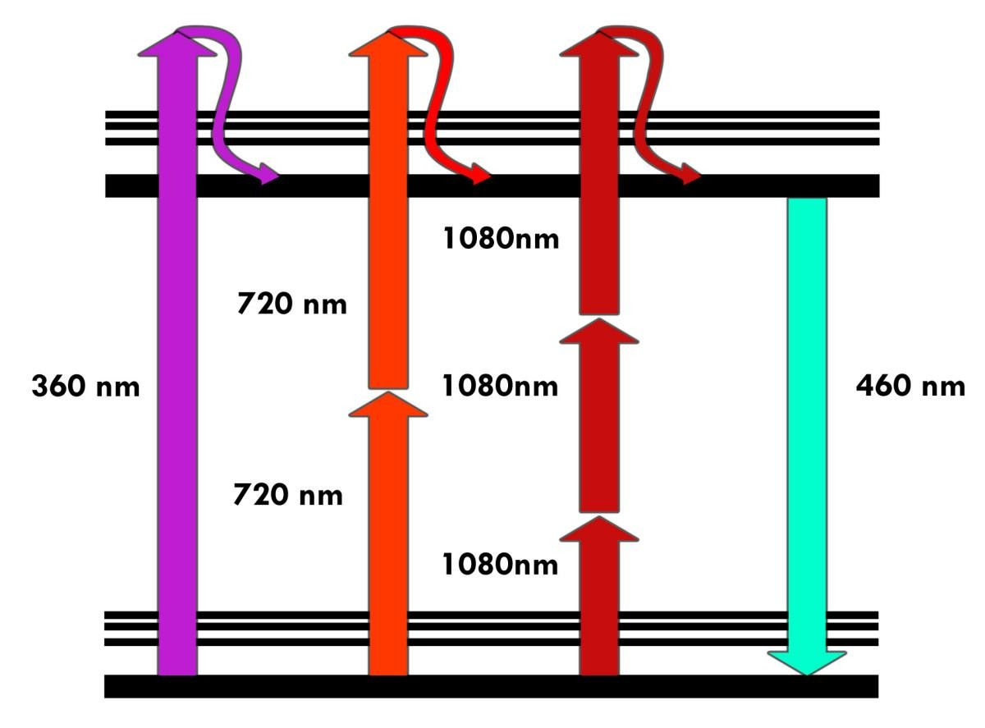
FROM 2-PHOTON TO MULTIPHOTON…

Slide 29
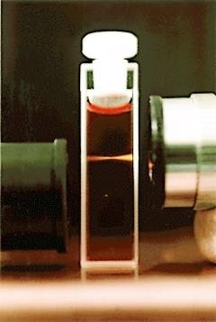
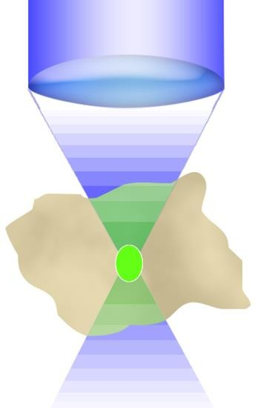
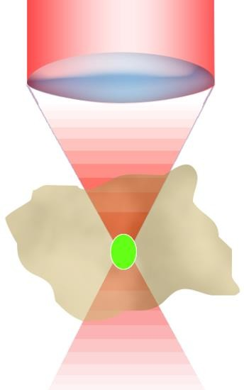
SINGLE- vs TWO-PHOTON EXCITATION
The cuvette is filled with a solution of a dye, safranin O, which normally requires green light for excitation. Green light (543 nm) from a continuous-wave helium-neon laser is focused into the cuvette by the lens at upper right. It shows the expected pattern of a continuous cone, brightest near the focus and attenuated to the left. The lens at the lower left focuses an invisible 1046-nm infrared beam from a mode-locked Nd-doped yttrium lanthanum fluoride laser into the cuvette. Because of the two-photon absorption, excitation is confined to a tiny bright spot in the middle of the cuvette.
2·hν excitation
Image source: Current Protocols in Cytometry Online Copyright © 1999 John Wiley & Sons, Inc. All rights reserved.
Slide credit: Brad Amos, MRC Laboratory of Molecular Biology, Cambridge, United Kingdom
24

Slide 30
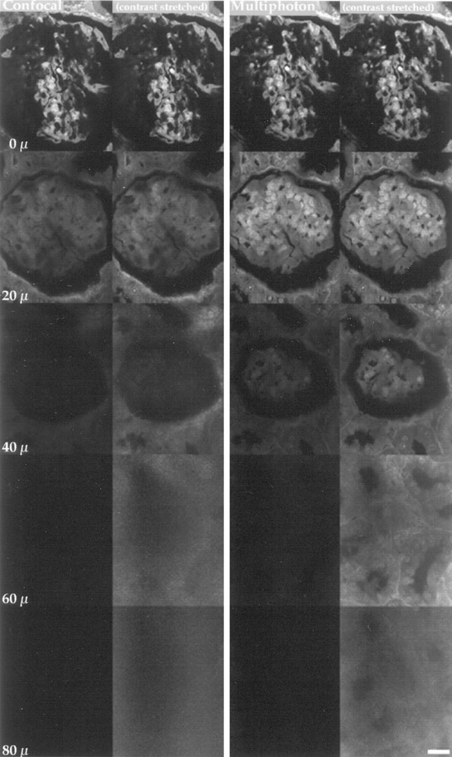
PENETRATION DEPTH
Comparison of imaging penetration depth between confocal and multiphoton microscopy. Optical sections through a glomerulus from an acid-fucsin- stained monkey kidney pathology sample imaged by confocal microscopy with 2 µW of 532-nm light (left, columns 1 and 2) and multiphoton microscopy with 4.3 mW of 1047-nm light (descanned; right, columns 3 and 4) were compared. At the surface, the image quality and signal intensity are similar; however, at increasing depth into the sample, signal intensity and quality of the confocal image falls off more rapidly than the multiphoton image. Images were collected at a pixel resolution of 0.27 µm with a Kalman
3 collection filter. Scale bar, 20 µm.
Centonze VE, White JG. Multiphoton excitation provides optical sections from deeper within scattering specimens than confocal imaging. Biophys J. 19²98⁵ Oct;75(4):2015-24.

