Slide 1
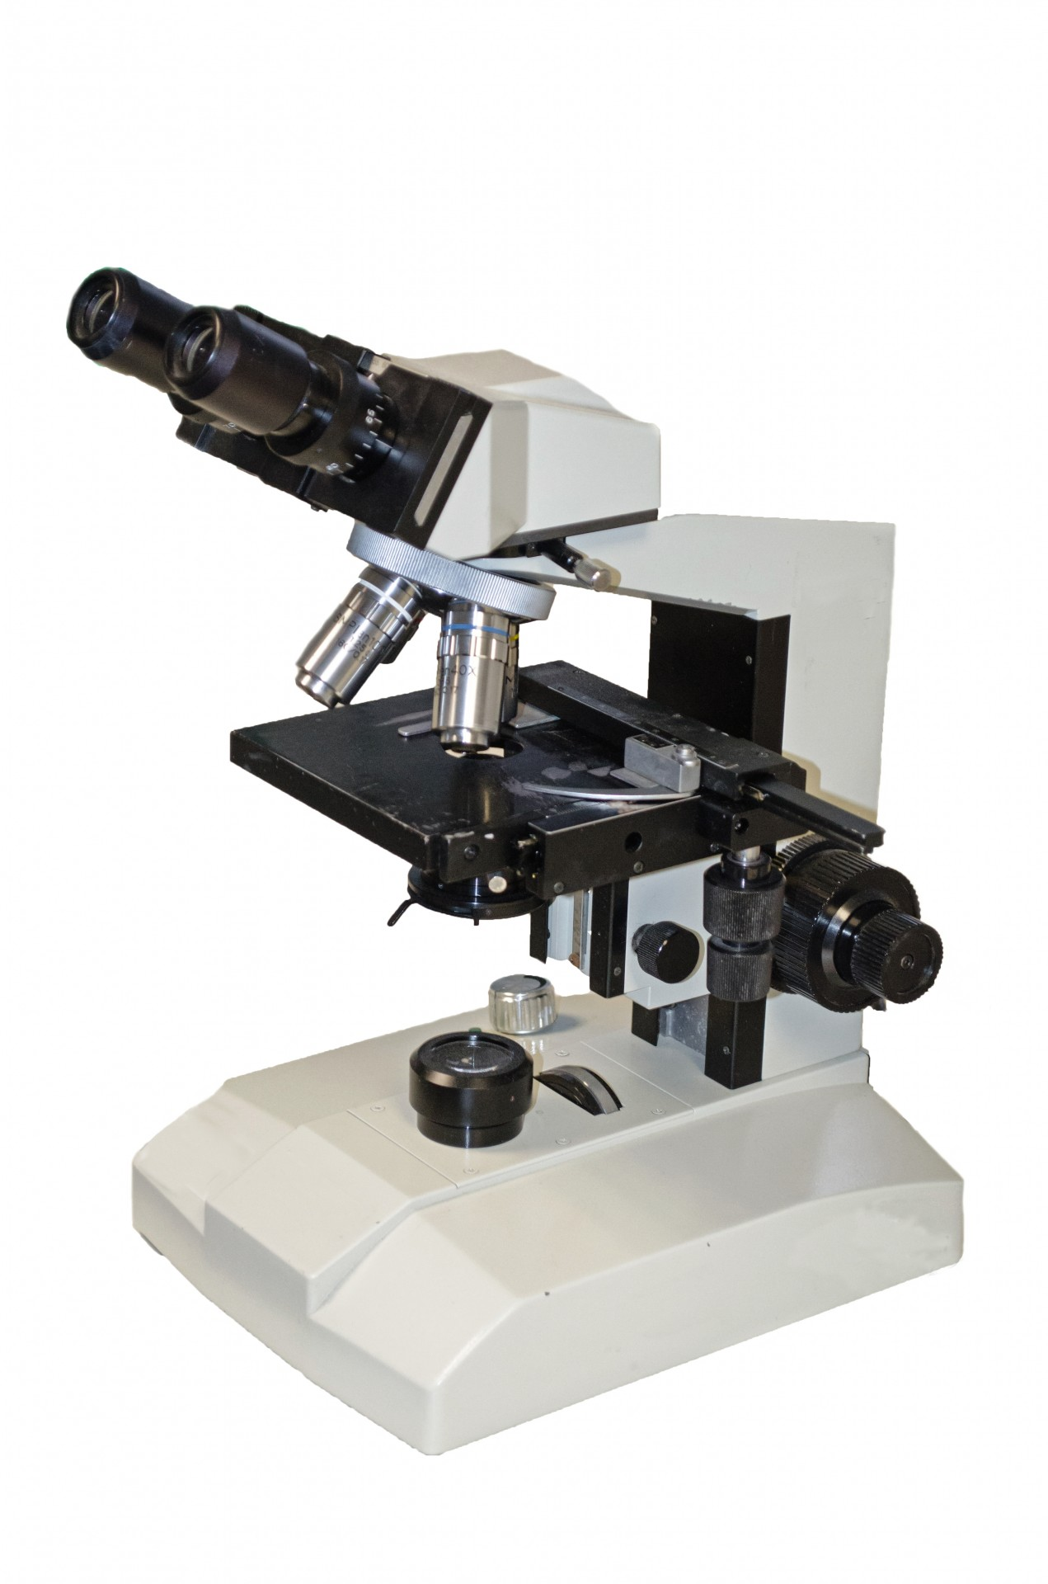
MICROSCOPIA OTTICA IN BIOLOGIA CELLULARE [675SM]
MICROSCOPY IN CELL BIOLOGY –
aa 2022/2023, 2nd semester
Aula 5A, edificio H2bis 15-18
Agnes Thalhammer
agnes.thalhammer@units.it

Slide 2
CONCLUSIONS
methods (TIRF, cofocal, SIM and 2 photon) use common dyes (good)
confocal is easiest, most widely used
best resolution obtainable only 100 nm (SIM)
single molecule is problematic
Consider sample thickness!
28
29

Slide 3
Advanced microscopy techniques
CIMA SIM superresolution vs MP vs confocal
cima.services@units.it
 | confocal | SIM | MP
Fixed sample | yes | yes | yes
Live sample | not ideal | yes dedicated incubation chamber with temperature, CO₂ and humidity regulation | yes to be set up customized to needs
Sample thickness | tens of μm | tens of μm preferably monolayer of cells | up to 2 mm
Wavelengths (nm) | 405/488/561/640 | 405/488/561/640 | tuneable, range 700-1000 nm
strength | Multichannel imaging for colocalisation | Structural resolution and time series (1 fps) | Penetration depth, time series (> 1 fps)

Slide 4
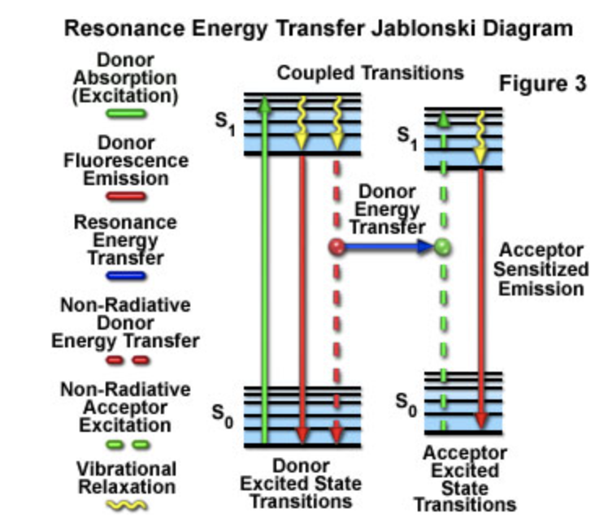
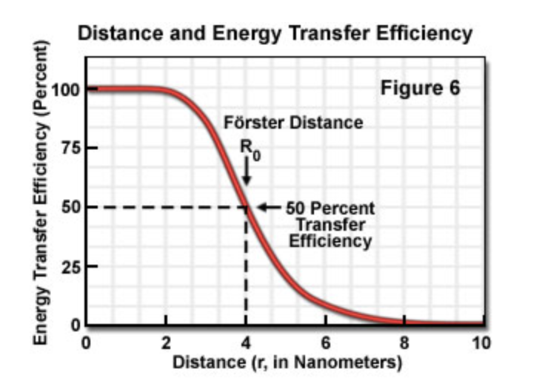
Fluorescence Resonance Energy Transfer (FRET) Microscopy
33

Slide 5
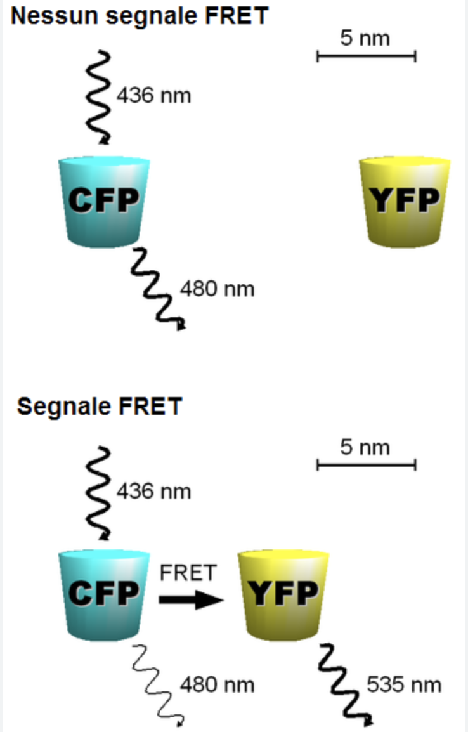
Fluorescence Resonance Energy Transfer (FRET) Microscopy
33

Slide 6
Fluorescence Resonance Energy Transfer (FRET) Microscopy
33

Slide 7
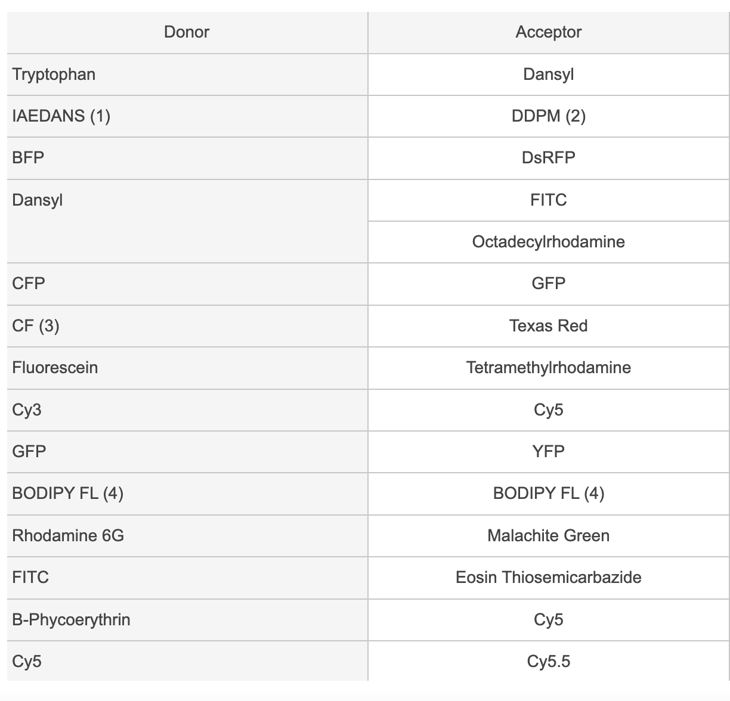
Fluorescence Resonance Energy Transfer (FRET) Microscopy
33

Slide 8
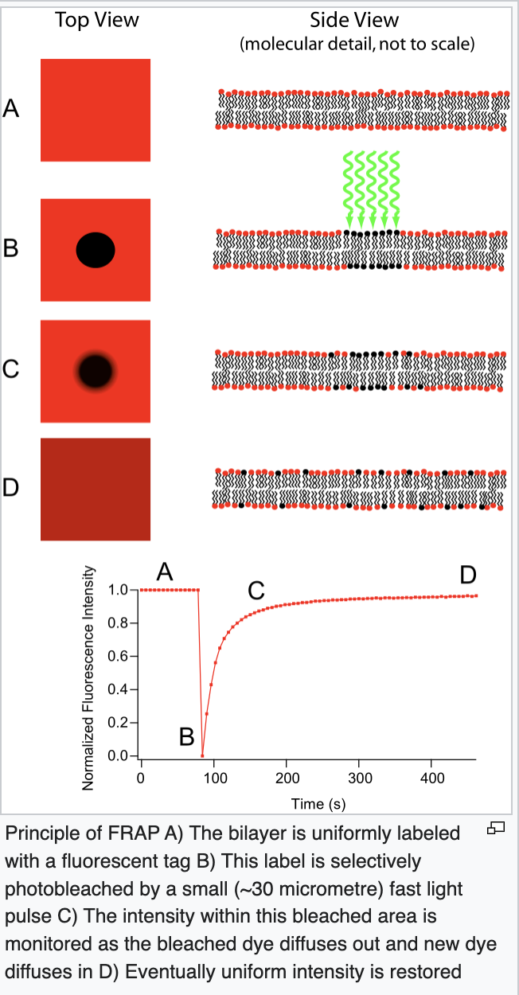
Fluorescence recovery after photobleaching
33

Slide 9
Fluorescence recovery after photobleaching
Laser for photobleaching can be used on an epifluorescence or confocal microscope, usually with CCD camera, not PMT
GFP dyes or photoconvertable dyes used
33

Slide 10
COMPARISON
method | excitation | detection | sectioning | use
Wide field | Whole sample | Whole sample | No sectioning | Simple fluorescence samples
confocal | Whole sample | One z-plane | 350-500nm | High contrast images, optical sectioning
2-Photon | One z-plane | One z-plane | 500-700nm | Deep tissue imaging, optical sectioning
FRET |  |  |  | Protein interactions
FRAP + photoactivation | 405 laser (UV) |  |  | dynamics/mobility
TIRF | Only bottom plane | Only bottom plane | 150-200nm | Membrane dynamics

Slide 11
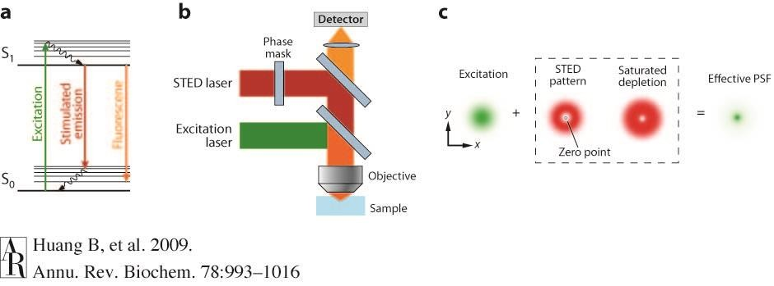
STIMULATED EMISSION DEPLETION (STED) MICROSCOPY
(a) The process of stimulated emission. A ground state (S₀) fluorophore can absorb a photon from the excitation light and jump to the excited state (S₁). Spontaneous fluorescence emission brings the fluorophore back to the ground state. Stimulated emission happens when the excited-state fluorophore encounters another photon with a wavelength comparable to the energy difference between the ground and excited state. (b) The excitation laser and STED laser are combined and focused into the sample through the objective. A phase mask is placed in the light path of the STED laser to create a specific pattern at the objective focal point. (c) In the xy mode, a donut-shaped STED laser is applied with the zero point overlapped with the maximum of the excitation laser focus. With saturated depletion, fluorescence from regions near the zero point is suppressed, leading to a decreased size of the effective point spread function (PSF).
33

Slide 12
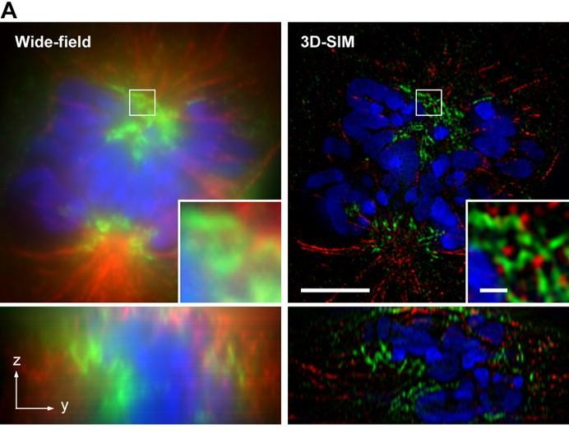
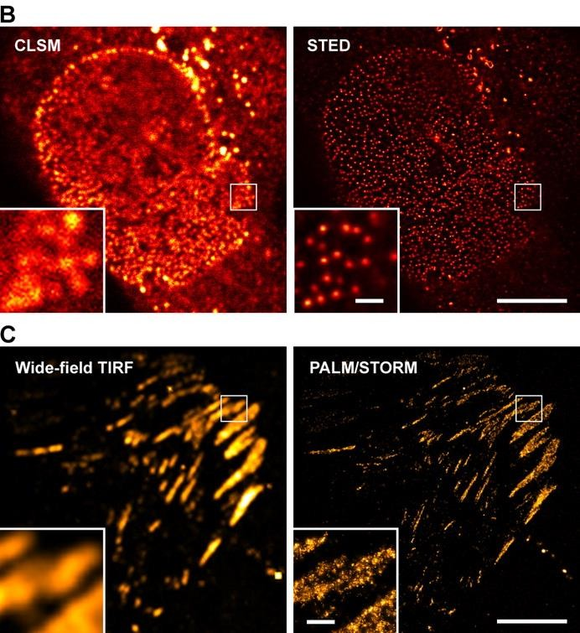
SUPER-RESOLUTION MICROSCOPY OF BIOLOGICAL SAMPLES.
Schermelleh, Lothar, Rainer Heintzmann, and Heinrich Leonhardt. 2010. “A guide to super-resolution fluorescence microscopy.” The Journal of Cell Biology 190 (2) (July 26): 165 -
175. doi:10.1083/jcb.201002021.
33

Slide 13
SINGLE MOLECULE LOCALISATION MICROSCOPY (SMLM)
Induction of fluorescence emission of only a subset of molecules at a given time in order to localize each of them individually. By repeating this process, you can accumulate enough localizations to reconstruct a final super-resolved image.
STORM and PALM are based on SMLM principle. The only difference is the way to induce the stochastic emission of the fluorophores:
In STORM, fluorescent organic dyes (cyanines, rhodamines, …etc.) together with a specific imaging buffer (abbelight’s buffer) are used to allow blinking of the fluorescent molecules;
In PALM, photoactivatable, photoconvertible or photoswitchable proteins are used (ex: PA-GFP, PA-mCherry, mEOS, mMAPLE, …etc.);
33

Slide 14
PALM-Photoactivated localization microscopy
invented by E Betzig and H Hess (2014 Nobel Prize for Chemistry)
uses photoactivatable fluorophores to resolve spatial details of tightly packed molecules
The laser stochastically activates fluorophores until all have emitted. Fluorophores emit for a short period but eventually bleach -> a more accurate view of positions can be obtained.
33

Slide 15
PALM-Photoactivated localization microscopy
Signals from each fluorophore are still subject to the 300 nm diffraction of light limit. However, because each has been activated separately, the centre of mass can be calculated accurately
The point spread function (PSF) is used to determine the location down to a resolution of 20 nm
By mapping each of the more accurately defined points together, a complete super-resolution microscopy image can be compiled.
33

Slide 16
PALM-Photoactivated localization microscopy
Three commonly used types of fluorophores are:
Photoactivatable Fluorophores, e.g.: PAmCherry, PA-GFP, which emit light upon activation with UV.
Photoconvertible Fluorophores, which change their emission spectrum upon activation with UV light (e.g.: mEOS proteins).
Photoswitchable Fluorophores: Typically chemical dyes (e.g. Alexa Fluor 647, DyLight555) which can switch between dark, non-fluorescent and bright, fluorescent states repeatedly.
33

Slide 17
STORM-Stochastic Optical Reconstruction Microscopy
https://downloads.microscope.healthcare.nikon.com/phase4/literature/Brochures/Super-Resolution_2CE-SCJK-3.pdf
33

Slide 18
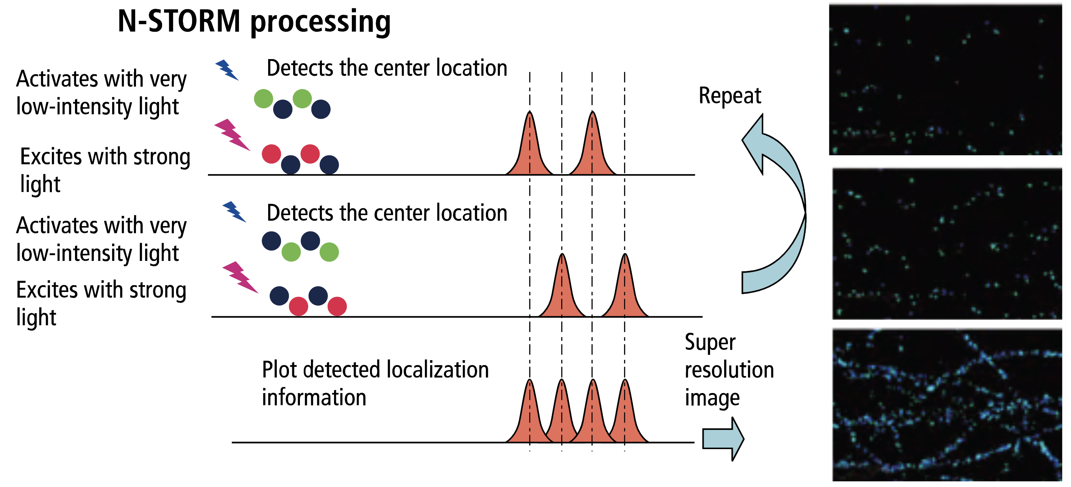
STORM-Stochastic Optical Reconstruction Microscopy
reconstructs a super-resolution image by combining the high-accuracy localization information of individual fluorophores
https://downloads.microscope.healthcare.nikon.com/phase4/literature/Brochures/Super-Resolution_2CE-SCJK-3.pdf
33

Slide 19
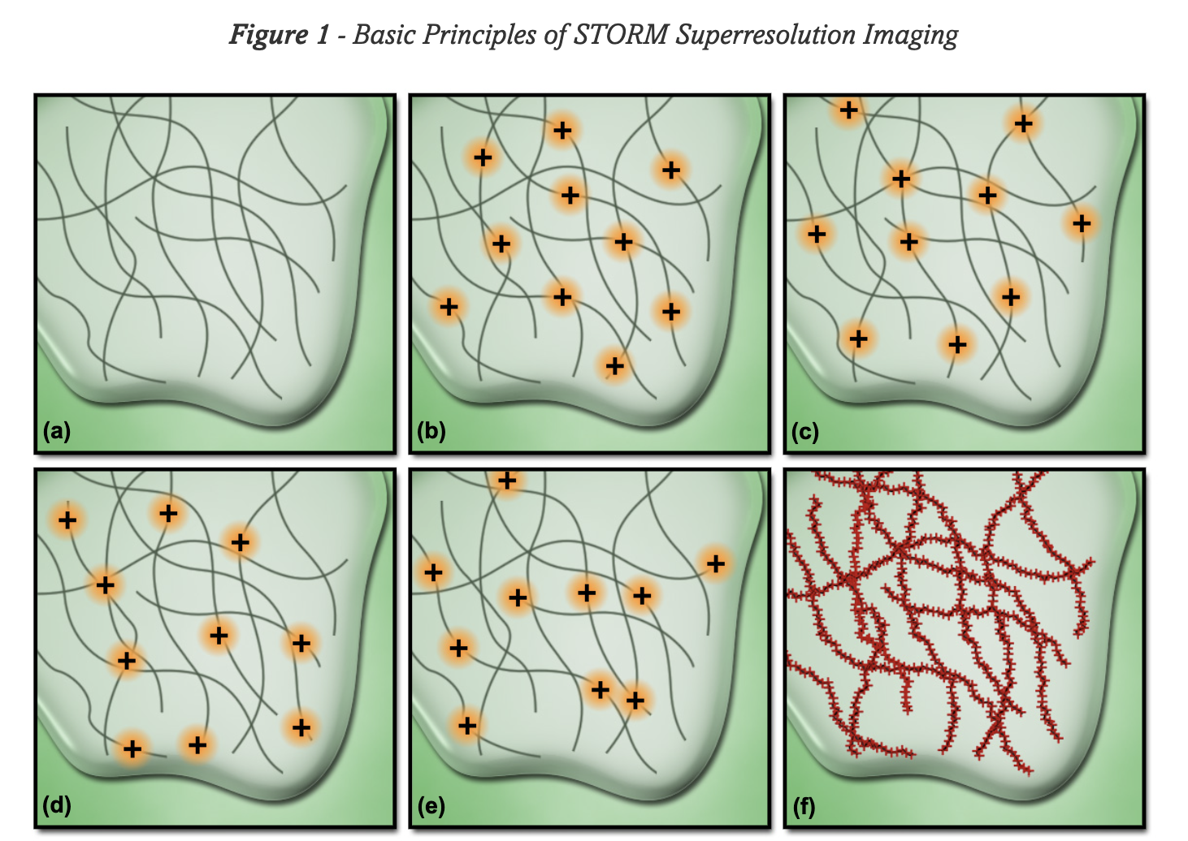
STORM-Stochastic Optical Reconstruction Microscopy
https://www.microscopyu.com/tutorials/stochastic-optical-reconstruction-microscopy-storm-imaging
33

Slide 20
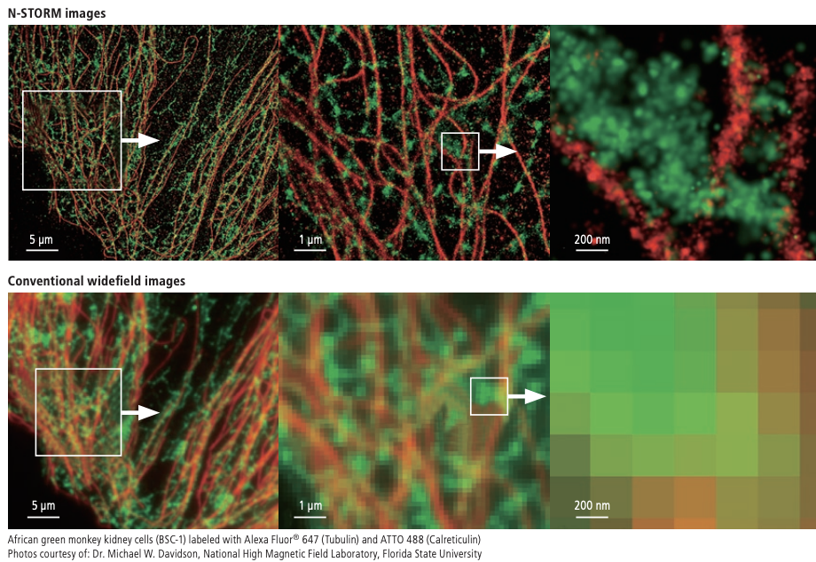
STORM-Stochastic Optical Reconstruction Microscopy
50 nm resolution
https://downloads.microscope.healthcare.nikon.com/phase4/literature/Brochures/Super-Resolution_2CE-SCJK-3.pdf
33

Slide 21
SUPER-RESOLUTION MICROSCOPY OF
BIOLOGICAL SAMPLES
Schermelleh, Lothar, Rainer Heintzmann, and Heinrich Leonhardt. 2010. “A guide to super-resolution fluorescence microscopy.” The Journal of Cell Biology 190 (2) (July 26): 165 -
175. doi:10.1083/jcb.201002021.
33

