Slide 1
Future

Slide 2
Four ways of expressing the future

Slide 3
Will + infinitive
To be going to + infinitive
Present continuous
Present simple

Slide 4
Will (he'll he won't will he?)
A prediction or calculation
A snap decision, offer, promise
To express (un)willingness
With you – give an order
With you interrogative – to give an invitation
It will rain tomorrow.
I'll pay for lunch by credit card.
He won't leave until he sees the manager.
You will finish this work now!
Will you come to lunch with me?

Slide 5
to be going to (he is going to – he isn't going to– is he going to?)
To make a prediction based on evidence in the present
To talk about your intentions
1a) Look at those black clouds! It's going to rain.
1b) Our team is going to win; the score is already 7-0.
2a) She's going to write the report later.
2b) We're going to study together next week.

Slide 6
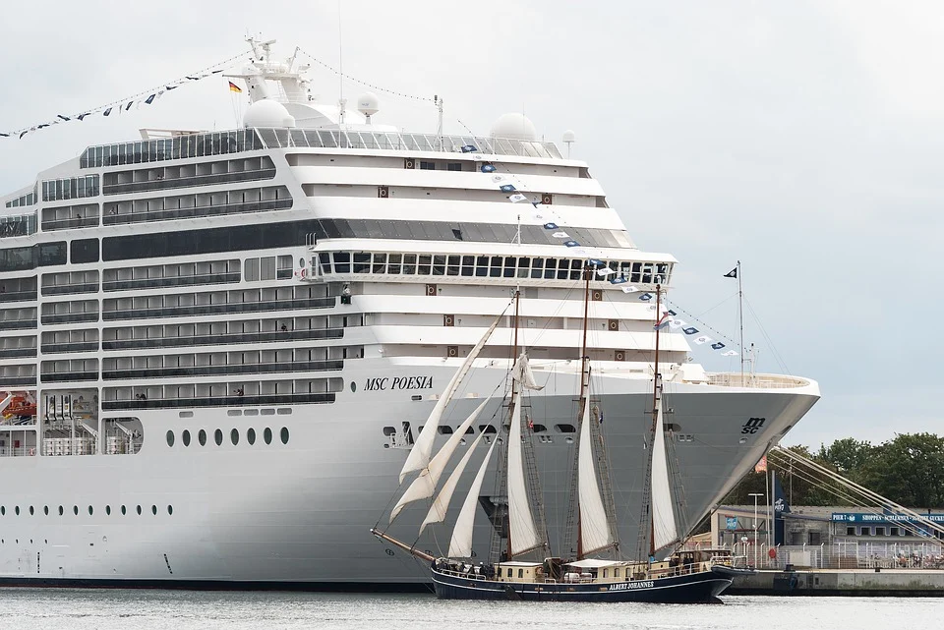
Present continuous I'm working – he isn't working – are we working?
Arranged actions (with a ticket, appointment etc)
As this is also a present tense, it needs a time expression.
We're seeing a theatre play tomorrow evening.
The ship is leaving tonight.
He is meeting his friend at 8pm.
They are flying to Rome later today.
Are you visiting your family at the weekend?

Slide 7
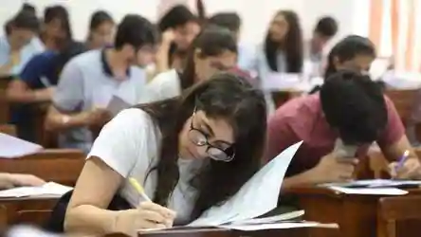
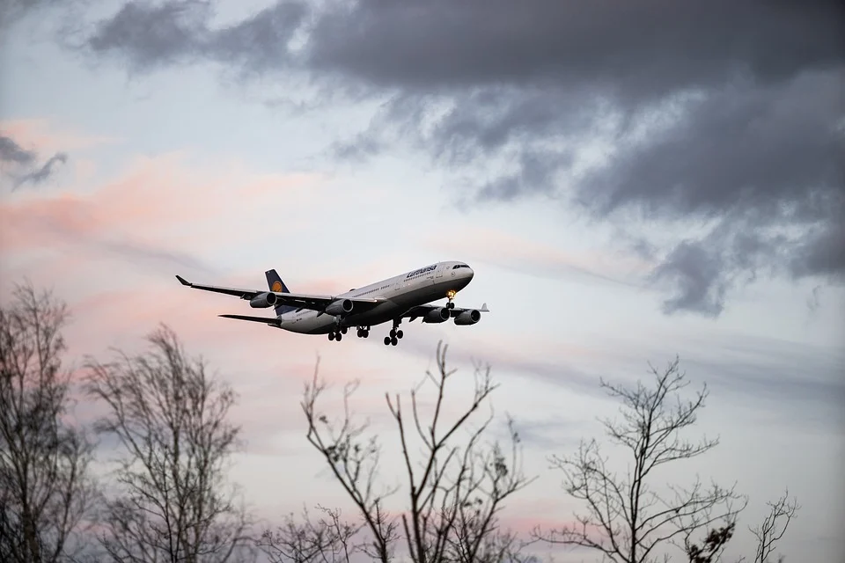
Present simple It starts – it doesn't start – does it start?
The train arrives at 6pm.
She has a yoga class tomorrow.
The restaurant opens at 7.30 tonight.
We have an exam next Monday at 2pm.
The plane leaves in ten minutes.
For future facts
For actions which are fixed like a time-table, schedule, calendar.

Slide 8
Exercise 1. He _____ (meet) his boss at 3pm. 2. We _____ (have) a party on Friday. Do you want come? 3. The car_______ (hit) the traffic light. Look out! 4. I think the cruise next month ______ (be) wonderful. 5. The course______ (start) next week. 6. I _______ (study) hard next month. 7. The film ______ (be) at 8pm at the cinema. 8. She ______ (be) 21 (years old) in January.

