Slide 1

Professor Francesco Stellacci
EPFL since 2010
MIT 2002-2010

Slide 2
a.a. 2022-2023
Corso di
Chimica delle Macromolecole I
Microscopia a scansione di sonda
Prof. Federico ROSEI
Dipartimento di Scienze Chimiche e Farmaceutiche federico.rosei@units.it
C11, Aula 3

Slide 3
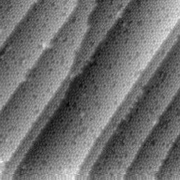
Si(111) 7x7
Si(111) clean surface
(reconstructed 7x7)
imaged with
atomic resolution
First STM work:
Binnig et al.,
Phys. Rev. Lett. (1983)
Si(111) 7x7 in real space

Slide 4
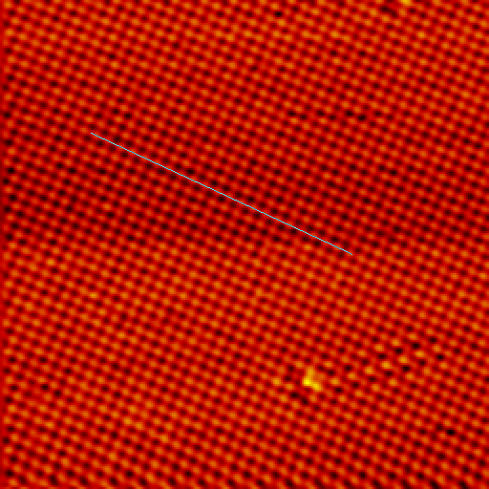
Cu(110) with atomic resolution
Cu(110) 1x1
[0 0 1]
[1 –1 0]
100 x 100 Å²

Slide 5
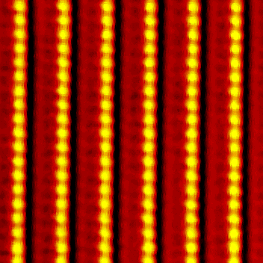
Au(110)-(1x2)
Missing row reconstruction

Slide 6
The Herringbone Reconstruction
on the Au(111) Surface
1211 x 1227 Å²
87 x 90 Å²

Slide 7
Nano–tools
By increasing by a factor of 10 the resolving power of the Human eye, Galileo was able to discover Jupiter’s satellites
”The principles of physics, as far as I can see, do not speak against the possibility of maneuvering things atom by atom”
“The problems of chemistry and biology can be greatly helped if our ability to see what we are doing, and to do things on an atomic level, is ultimately developed – a development which I think cannot be avoided”
From: R. Feynman: There's Plenty of Room at the Bottom (1959)

Slide 8
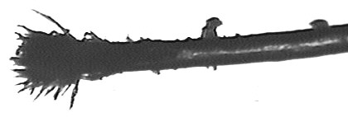
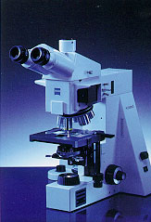
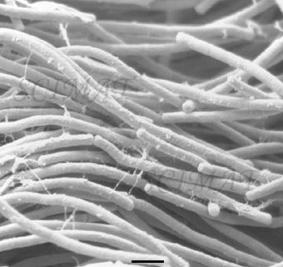
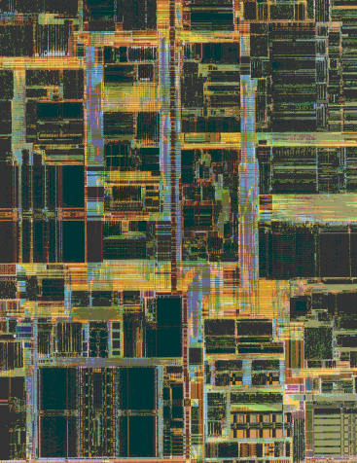
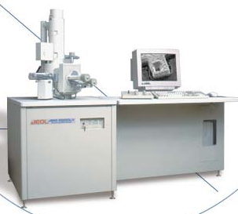
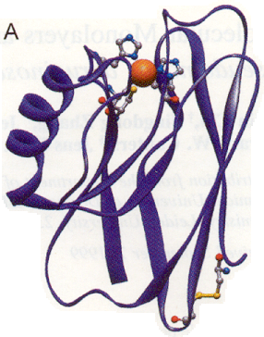
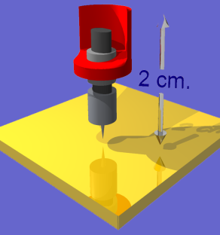
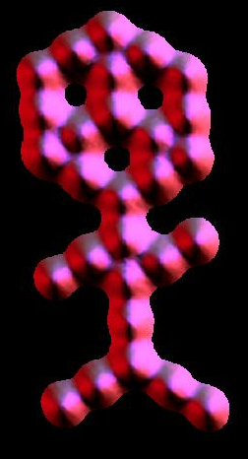
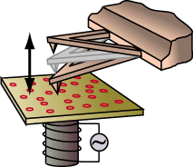
Length scales – Nano–tools
Human hair
100 μm
Optical
Microscopy
Cells
10 μm
1 μm
Lithography
Integrated circuits
Electron
Microscopy
100 nm
Biological
Macromolecules
10 nm
1 nm
Atoms and
molecules
Scanning Probe
Microscopy

Slide 9
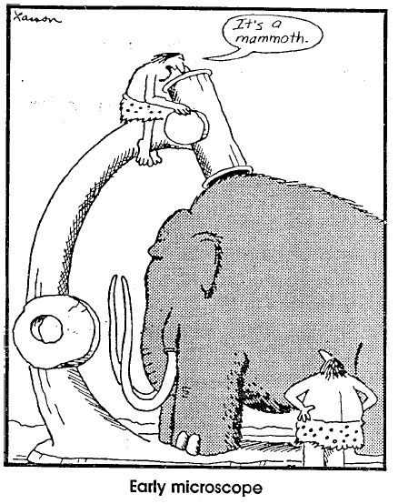

Slide 10
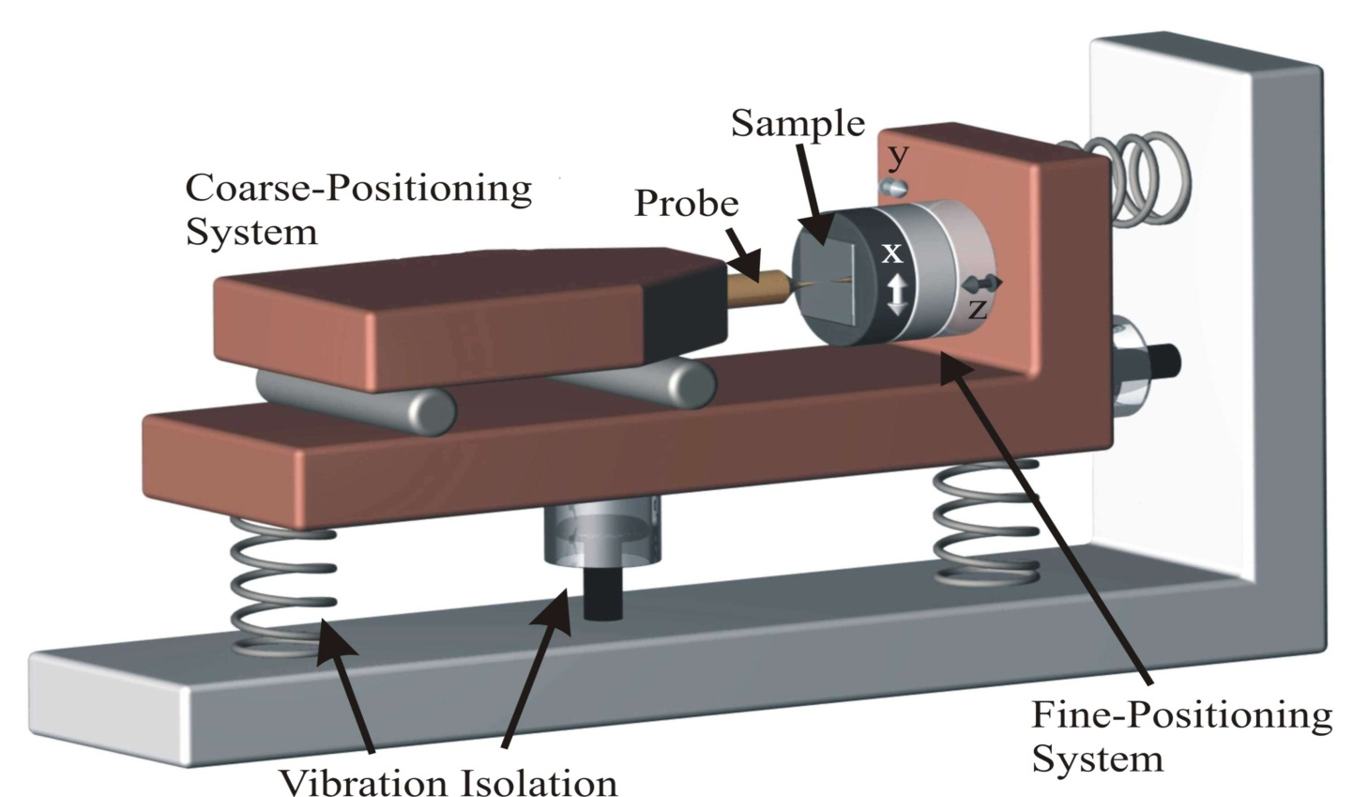
Scanning Probe Microscopy
Principle of a scanning probe microscope.
Surface is scanned line by line with a probe using a fine positioning system (scanner).
With a coarse positioning device, the distance between the sample and the probe is reduced until the interaction regime is reached.
Vibration isolation shields the microscope from external vibrations.

Slide 11
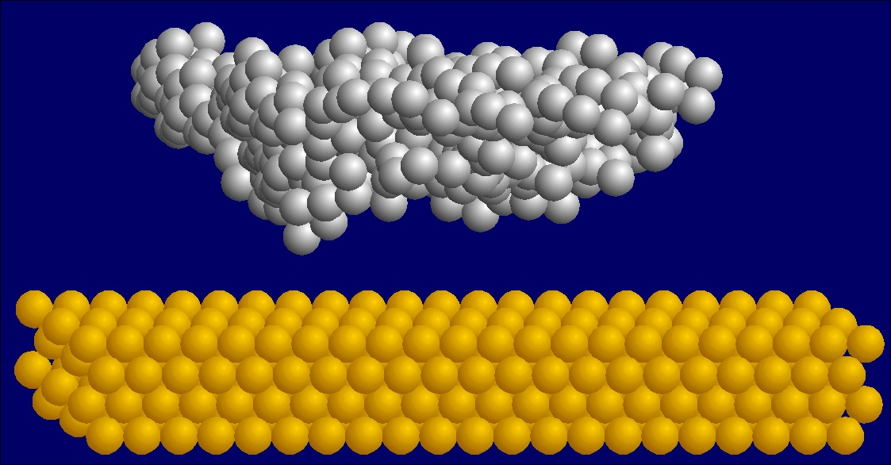
The STM principle
G. Binnig and H. Rohrer,
(Nobel Prize in Physics, 1986)
A sharp metal tip (W, Pt–Ir) is brought into close proximity
of a conducting sample, and a bias is applied:
electrons tunnel from tip to sample (or viceversa)

Slide 12
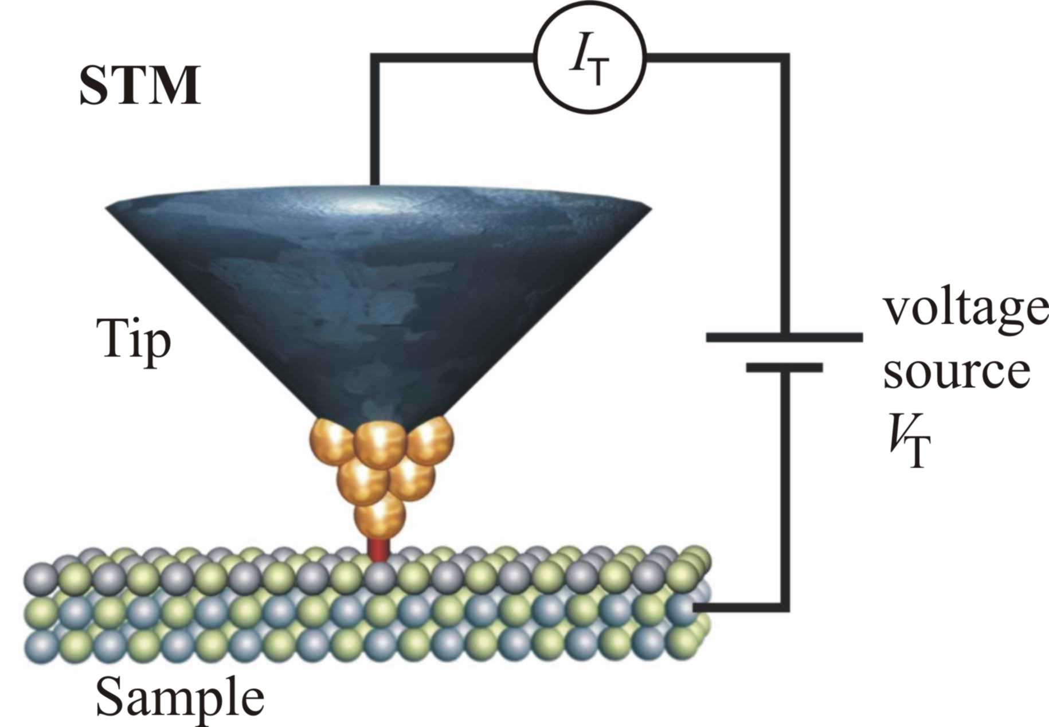
The STM principle
Principle of a scanning tunnelling microscope.
Once the gap between tip and sample is about as small as the diameter of an atom, a tunnelling current flows between a conductive tip and sample.

Slide 13
Operation of an STM^{1,2}
[1] C. Julian Chen, Introduction to Scanning Tunnelling Microscopy, Oxford (1993)
[2] G.A.D. Briggs and A. J. Fisher, Surf. Sci. Rep. 33, 1 (1999)

Slide 14
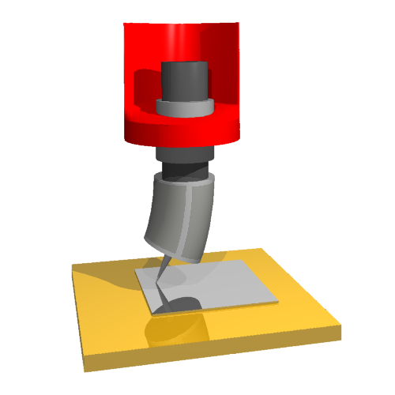
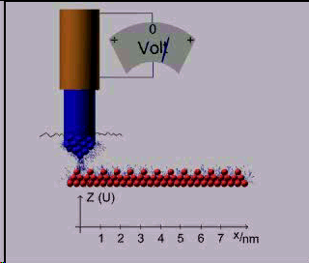
Scanning Tunneling Microscopy
Once the tip is in ”tunneling contact”, it is scanned above the surface using three separate piezoelectric transducers for precise movements in x,y,z
Pt(110)–(1x2)
with atomic resolution

Slide 15
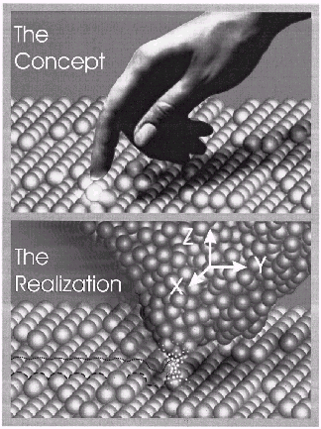
Principle of a local probe
gentle touch of a nano-finger:
If the interaction between tip and sample decays sufficiently rapidly on the atomic scale, only the two atoms that are closest to each other are able to ‘‘feel’’ each other.
G. Binnig, H. Röhrer,
Rev. Mod. Phys. 71, S324 (1999)

Slide 16
Scanning Probe Microscopy was developed following the need to obtain local information on morphology, structure, etc.
Other advantages over “similar” techniques (e.g. SEM): SPM is less damaging, and it can be used to “manipulate” objects on the atomic scale

Slide 17
Tunneling Current
I_{t} ∝ V_{t} exp(-A√Θ z)
Θ…. Workfunction, typically 3-5 eV
z….. Tip-sample separation, typically 4-10 A
Δ z = 1 A --> Δ I one order of magnitude !

Slide 18
Unknown/Challenges:
1. Chemical nature of STM tip
(problem for spectroscopy, corrugation)
2. Relaxation of tip/surface atoms
(tip sample separation not equal to piezo scale)
3. Effect of tip potential on electronic
surface structure (quenching of surface states)
4. Influence of magnetic properties
on tunnelling current/surface corrugation
(is spin-STM possible?)
5. Relative importance of the effects

Slide 19
Lateral Manipulation of individual atoms and molecules by STM
STM tip
adsorbed atom or molecule
Surface
The tunneling resistance R = V / I measures the separation of the tip from the surface:
I ~ V exp (-2kz)
By reducing V / I, the tip approaches the substrate, thus leading to a stronger tip–surface interaction

Slide 20
Important features for STM manipulation
”freezing” the motion of single adsorbates: low (variable)
temperature STM
long operating time and working at low coverages
(0.001–0.01 ML); requirements:
    high cleanliness: scanner completely surrounded by 4 K
  Radiation shield
    controlled deposition of small amounts of adsorbates:
  small hole in the radiation shield, with small solid angle
  (1:3000)
  flexible and precise tip positioning; requirements:
    high x,y,z stability
    I(V): electronic / vibrational spectroscopy
    I(z): tip – adsorbate interaction
    Tip height / current during manipulation

Slide 21
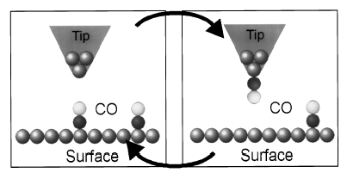
Vertical Manipulation of
CO on Cu(111)
Idealized sketch of picking up / putting down of CO molecules on Cu(111).
CO stands upright on the surface and has
to switch its orientation when transferred to the tip.
Bartels et al., Appl. Phys. Lett. 71, 213 (1997)

Slide 22
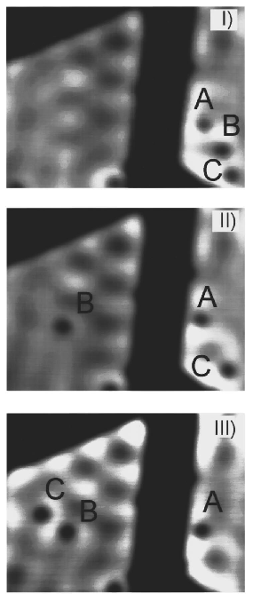
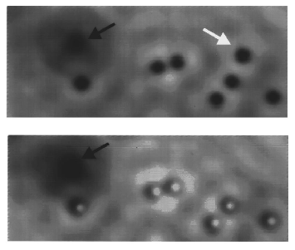
Vertical Manipulation of
CO on Cu(111)
Transfer of single CO
molecules from the right to the left terrace by vertical manipulation
Cu(111) terrace
intersected by
a lower terrace
CO molecules are imaged as depressions with a metal tip and as protrusions with a CO tip
Bartels et al., Appl. Phys. Lett. 71, 213 (1997)

Slide 23
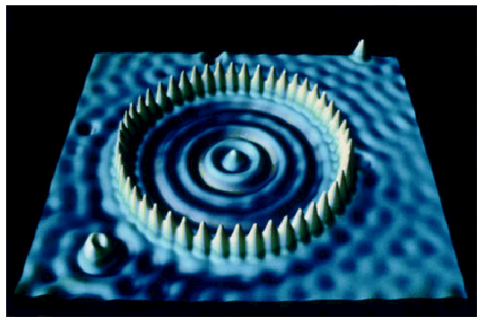
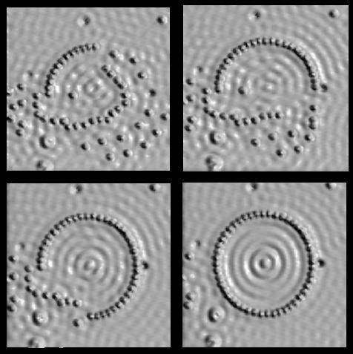
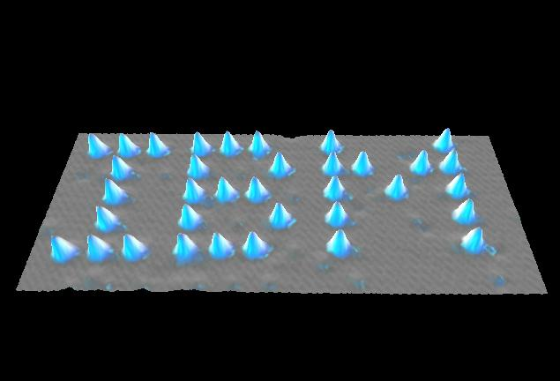
Pushing and pulling single atoms
Using the tip of a Scanning Tunnelling Microscope
Quantum Corral (Fe on Cu):
Visualization of electron wavelets
D. Eigler, IBM Almaden
Xe on Ni(111) at 4 K
D. Eigler, IBM Almaden

Slide 24
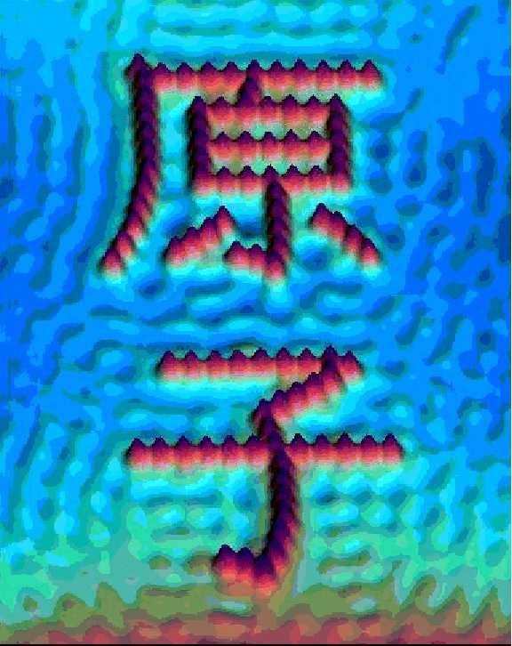
Manipulation – Atom by atom
Japanese Kanji
character for Atom, written with atoms
D. Eigler, IBM Almaden

Slide 25
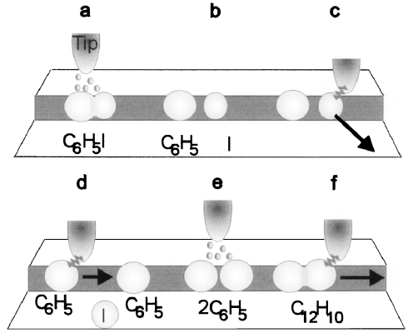
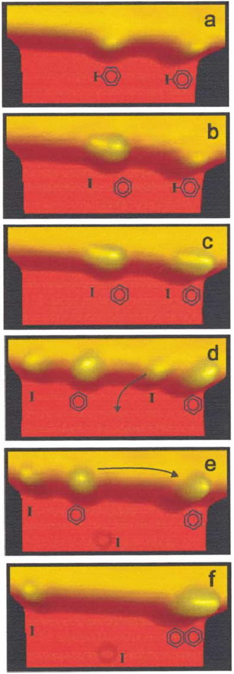
Single–molecule synthesis by STM
Synthesis of biphenyl (C₁₂H₁₀) from iodobenzene (C₆H₅I)
STM tip-induced synthesis steps of a biphenyl molecule. (a), (b) Electron–induced abstraction of iodine from iodobenzene. (c) Removal of iodine by lateral manipulation. (d) Bringing together two phenyls by lateral manipulation. (e) Electron–induced chemical association of the phenyl couple to biphenyl. (f ) Pulling the synthesized molecule with the STM tip to confirm the association.
S.W. Hla et al., Phys. Rev. Lett. 85, 2777 (2000)

Slide 26
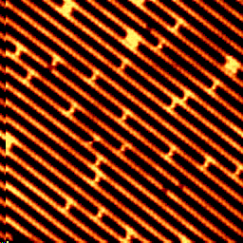
STM movies: Diffusion of Pt adatoms
Diffusion of Pt adatoms on Pt(110)–(1x2)
T.R. Linderoth et al., Phys. Rev. Lett. 78, 4978 (1997)
More STM Movies: www.phys.au.dk/camp

Slide 27
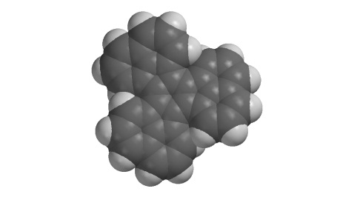
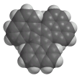
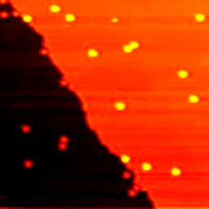
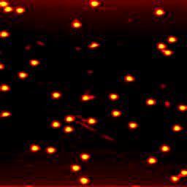
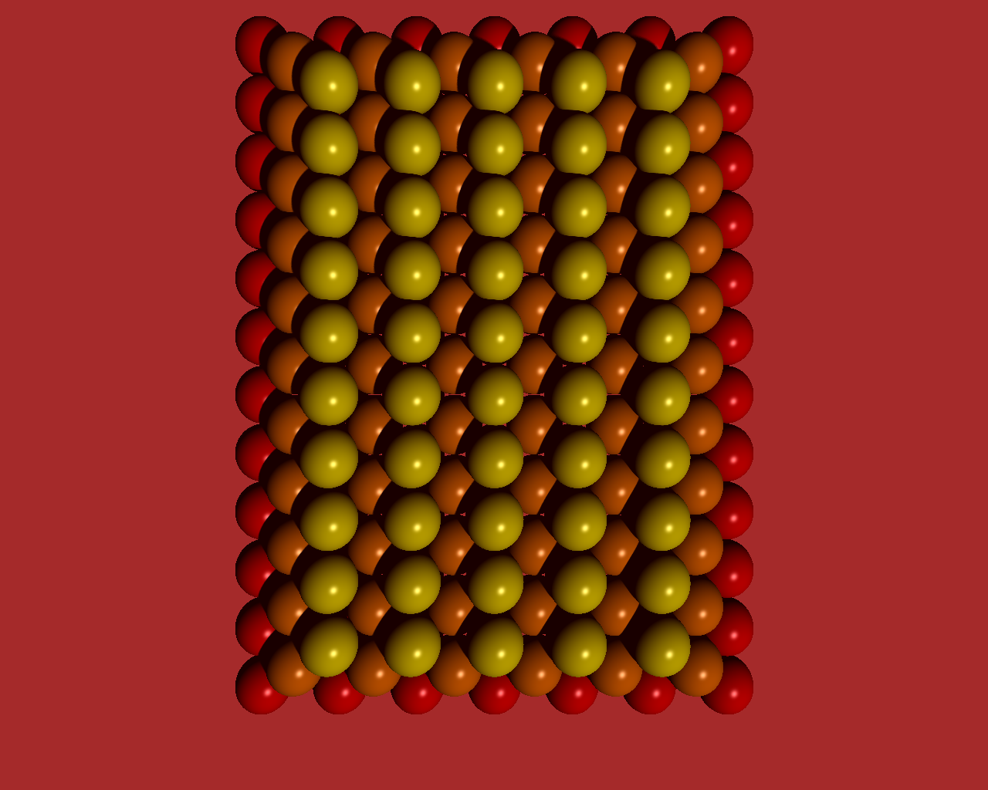
DC Movies
1 D Diffusion along the close packed direction [110] of Cu(110)
[001]
[1,-1,0]
500x500 Å²
T = 235 K
15 seconds
per image
500x500 Å²
T = 251 K
image size:
compromise between good statistics and good resolution
M. Schunack, T.R. Linderoth, F. Rosei et al., Phys. Rev. Lett. 88, 156102 (2002)

Slide 28
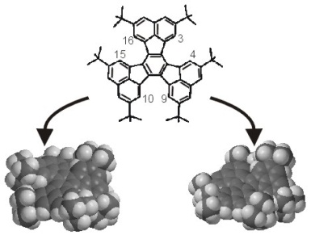

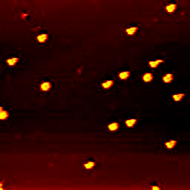
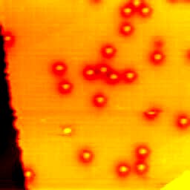
HtBDC Movies
1 D Diffusion along the close packed direction [110] of Cu(110)
500x500 Å²
T = 194 K
~15 seconds per image
500x500 Å²
T = 203 K
M. Schunack, T.R. Linderoth, F. Rosei et al., Phys. Rev. Lett. 88, 156102 (2002)

Slide 29
Surface diffusion:
in general, it is a 2 D random walk
E_{D}
ν = ν₀ exp(-E_{D}/kT)
    Hopping rate: counting the proportion of molecules that have not moved between two consecutive images:
    P₀ = M / N = F(ht)

Slide 30
Surface diffusion
E_{D}
hopping rate:
h = h₀ exp(-E_{D}/kT)
random walk:
⟨(Δx)²⟩ = λ² ht
T₁ T₂
λ - RMS jump length
P_{Δx}
tracer diffusion coefficient:
Δx
D = ⟨(Δx)²⟩/2t
D₀
E_{D}
D = D₀ exp(-E_{D}/kT)
ln D
with D₀ = h₀λ²/2
1/kT

Slide 31
Displacement distribution: HtBDC
Temperature: 185 K
Time per image: 13.5 sec
Temperature: 194 K
Time per image: 13.7 sec

Slide 32
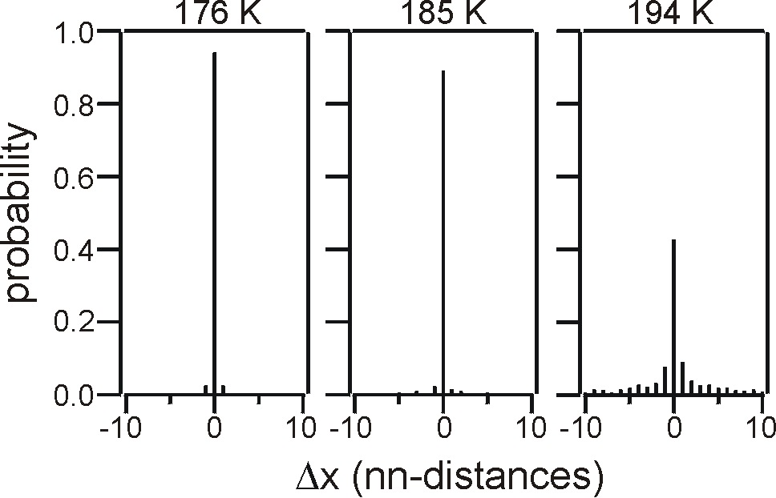
Tip influence? - No!
Tunneling resistance ≥ 5 GΩ (V ≈ -1.5 V, I ≈ -0.3 nA)
Displacement distribution:
  symmetric
  ⟨Δx⟩ ≈ 0.0 ± 0.8 Å
Controlled manipulations
  DC: ≤ 0.1 GΩ
  HtBDC: ≤ 1 GΩ
}
below usual imaging conditions

Slide 33
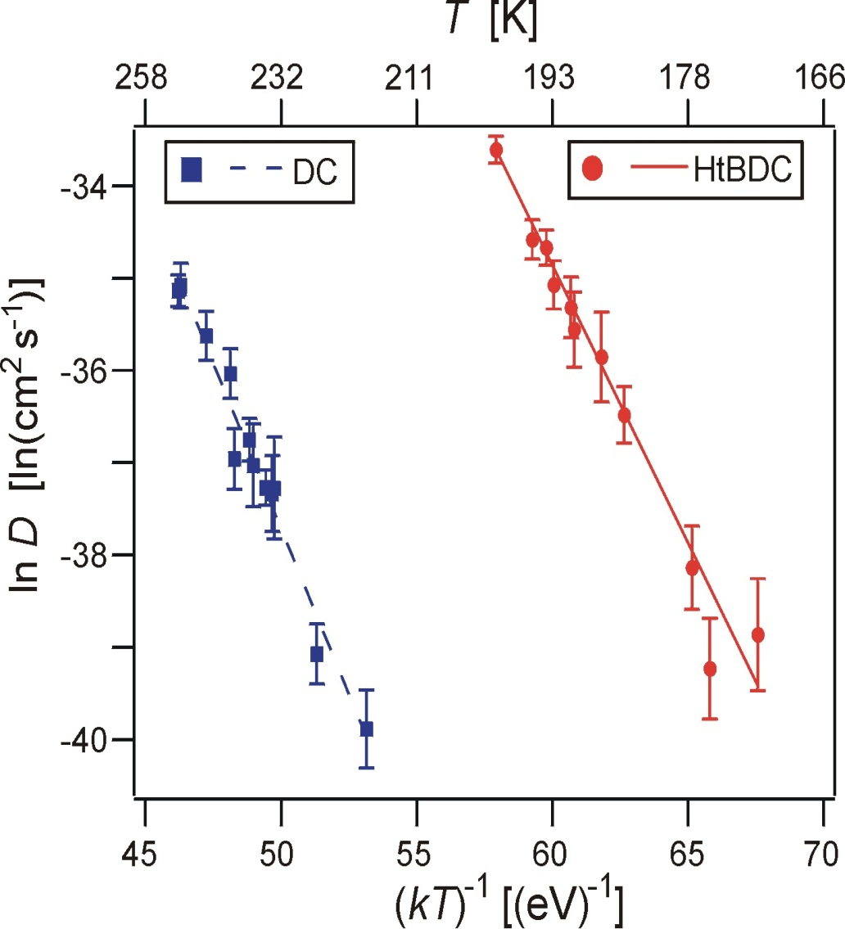
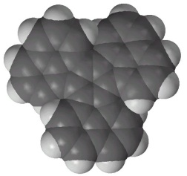
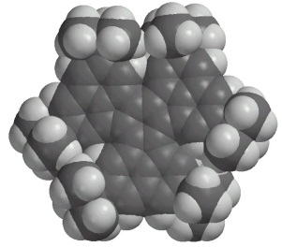
Arrhenius analysis: D
DC
220 – 250 K
HtBDC
170 – 200 K
E_{D}=0.71±0.05 eV
E_{D}=0.62±0.04eV
D₀ =10^{-1.0±1.0} cm²s⁻¹
D₀=10^{0.9±1.0}cm²s⁻¹
=> Arrhenius parameters are related to molecular structure

Slide 34
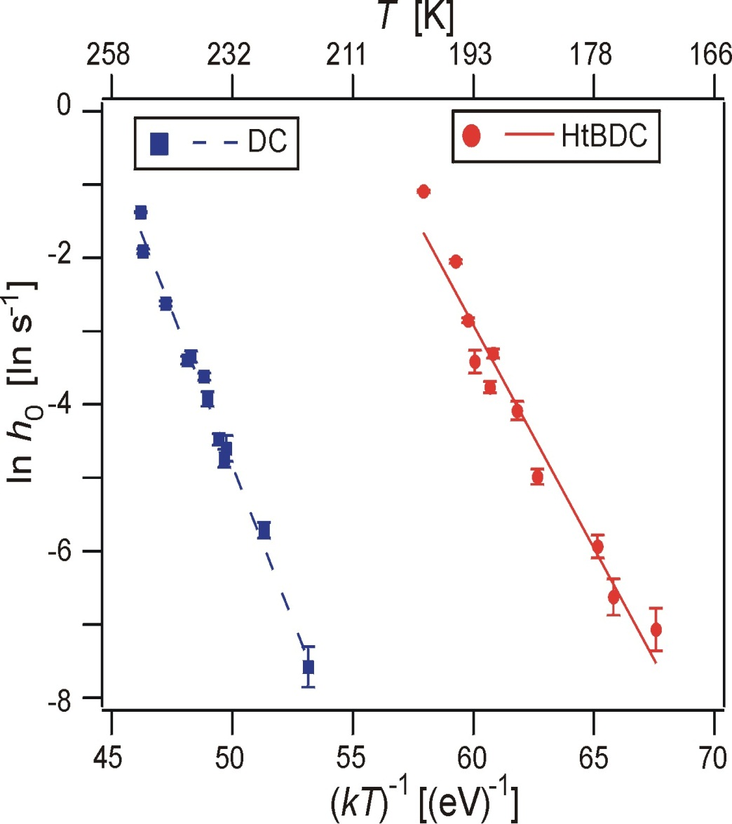
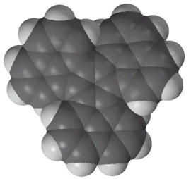
Arrhenius analysis: h
DC
220 – 250 K
HtBDC
170 – 200 K
E_{D}=0.71±0.05 eV
E_{D}=0.62±0.04eV
h₀ =10^{13.9±0.7} s⁻¹
h₀=10^{13.5±0.4} s⁻¹
In general, E_{D} is a fraction of the adsorption energy

Slide 35
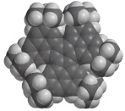
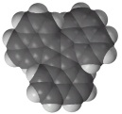
Jump lengths – results
  ⟨(Δx)²⟩ = λ² ht
HtBDC/Cu(110) λ = 6.8 ± 0.3
DC/Cu(110) λ = 3.9 ± 0.2
⟨(Δx)²⟩ [(NN-dist)²]
Pt/Pt(110) λ = 1.11 ± 0.01
(10% of jumps are non- nearest neighbor)
ht
M. Schunack, T.R. Linderoth, F. Rosei et al., Phys. Rev. Lett. 88, 156102 (2002)

Slide 36
Molecular conformations
Upon adsorption, the molecule adapts to the substrate
The conformation(s) it adopts will largely determine its properties on the surface (diffusion, conductivity, etc.)
This is true for molecular devices for nanoelectronics as it is for biomolecules (proteins, etc.)

Slide 37
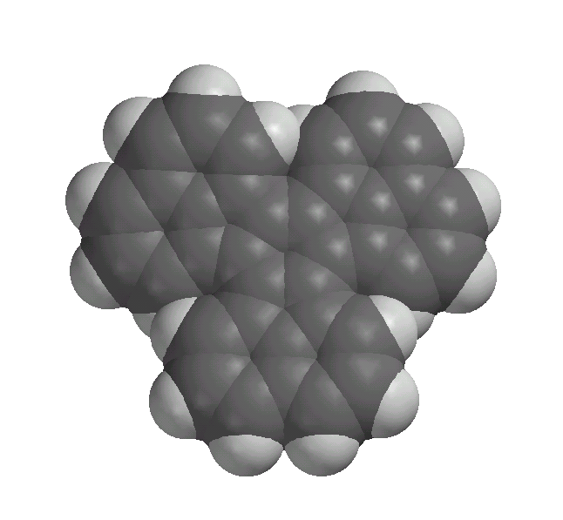
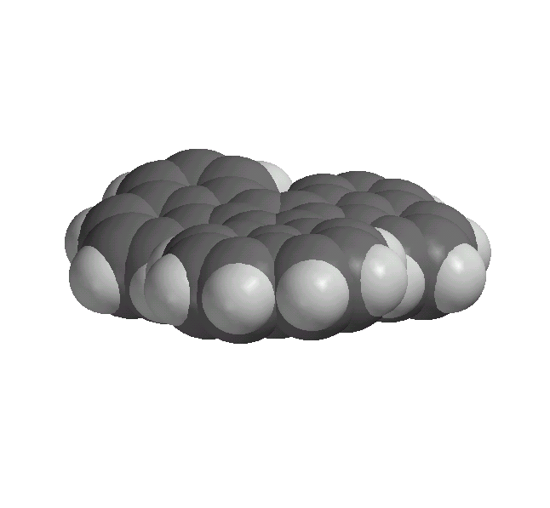
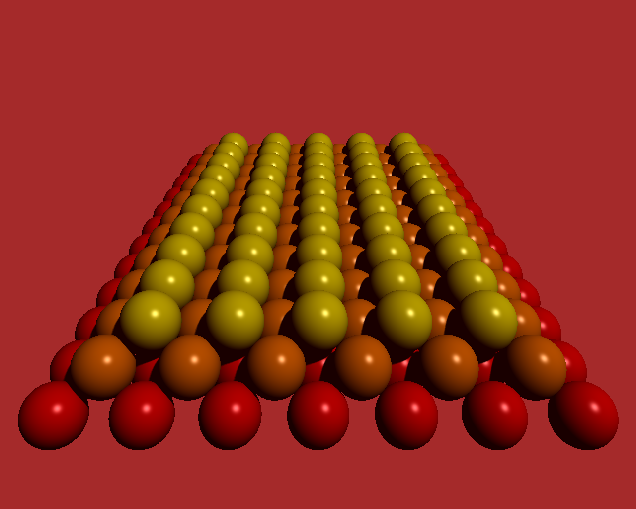
Molecular diffusion on Cu(110)
Cu(110) is anisotropic!
[110]
[001]

Slide 38
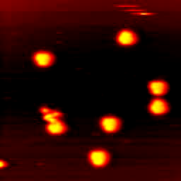
Diffusion coupled to rotation
Diffusion of DC
on Cu(110), high
resolution movie
200 x 200 Å²
with high resolution we observed the rotation of single molecules, coupled to diffusion: the molecules behave like nano-disks

Slide 39
Atomic Force Microscope (AFM)
It also works
on insulators!
Binnig, Quate, Gerber (1986)

Slide 40
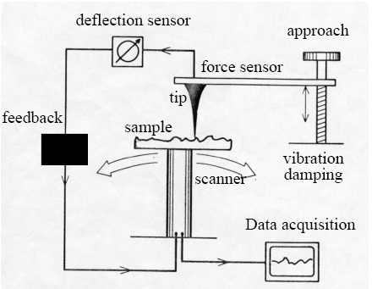
Atomic Force Microscope

Slide 41
The first AFM

Slide 42


Atomic Force Microscopy

Slide 43

AFM principle
Principle of a atomic force microscope. A sharp tip is brought close to the sample.
The forces acting between tip and sample lead to a deflection of the spring.
The deflection is then measured e.g. optically

Slide 44
Measuring Forces

Slide 45
Forces between atoms
Bonding energies:
• Quantum mechanical
(covalent, metallic
bonds): 1–3 nN
• Coulomb (dipole, ionic): 0.1–5 nN
• Polarization (induced dipoles): 0.02–0.1 nN
‘Back of the envelope’:
• Atomic energy scale:
E_{bond} ~ 1-4 eV ~ 2-6 • 10⁻¹⁹ J
• Typical bonding length:
a~0.2 nm
• Typical forces:
F = E/a ~ 1-3 nN
J. Israelachvili, ‘Intermolecular and Surface Forces’, Academic Press

Slide 46

Comparing forces
Comparison of the distance dependence of a short range force with the tunneling current.

Slide 47
Electrostatic forces

Slide 48


Slide 49

Deflection sensors

Slide 50

Laser beam deflection detection systems as often used in ambient AFMs.
Interferometric cantilever detection system, a popular choice for low-temperature AFMs.

Slide 51
Feedback modes

Slide 52
Piezoelectric scanners

Slide 53

The tunneling current is measured with a current-to-voltage converter and is used to measure the distance between tip and sample. The current noise sources in the current-to-voltage converter have to be small enough such that the corresponding vertical noise is considerably smaller than the atomic corrugation of the sample.
A simple form of such a circuit is shown in figure 3. It uses a low noise operational amplifier (OPA) and a feedback resistor (Rfb) with a typical impedance of R = 100 MW. To get a maximum signal-to-noise ratio the bandwidth should be maximized while the noise should be as small as possible.

Slide 54
Imaging artifacts

Slide 55
Thermal drift
Touching the microscope (e.g. sample, cantilever) will change its temperature T. Shining light on it too! Cantilever has a mass of ~ 1 ng, and thus a VERY small heat capacity.
So what!?!
ΔL/L = const ΔT; const ~ 10⁻⁵

Slide 56
Van der Waals forces

Slide 57


AFM on biological systems
(a) The cytoplasmic surface of the hexagonally packed intermediate layer is an essential part of the cell envelope of Deinococcus radiodurans. It has a protective function and acts as a molecular sieve. The pores in protruding cores are the channels of this sieve, and exhibit two conformations that change dynamically. The unit cell size is 18 nm, and the brightness range corresponds to 3 nm. (b) Two-dimensional crystals of bacteriophage F 29 head-tail connectors recorded with AFM in buffer solution. The connectors are packed in up-and-down originations, exposing their narrow ends that connect to the tail and their wide ends that connect to the head. The unit cell size is 16.5 nm, whereas the brightness range corresponds to 4 nm.

Slide 58


Slide 59


Slide 60


DNA in buffer (200nm x 200nm)
Bacterial cellulose (2.0µm x 2.0µm)

Slide 61


Bacterial cell (H. pylori) (5.5µm x 5.5µm)
Living fibroblast cells in PBS (60µm x 60µm)

Slide 62

polivinilpiridina

Slide 63

Amino-functionalized
polymethacrylate

Slide 64

Immagine della grafite mediante AFM. L’alta risoluzione permette di vedere la disposizione esagonale degli atomi nella cella unitaria.
Dimensioni dell’immagine 2×2
nm².

Slide 65


Studi sulla morfologia di polimeri biologici
Fibre di actina visualizzate in modo contatto AFM
L'actina è una proteina globulare con peso molecolare di 43 kDa. Ha un diametro di 5,46nm e determina la possibilità di movimenti cellulari. E’ presente in tutte le cellule del corpo e specialmente nelle cellule muscolari. La quantità di actina nelle cellule può raggiungere il 10% di quella proteica totale.

Slide 66

Immagine AFM
di segmenti di DNA doppia elica
depositato su mica. La dimensione laterale della doppia elica di DNA è 2 nm (anche utilizzata come standard di calibrazione).
Immagine prodotta dal Dr. Andy Baker.

Slide 67

diverse morfologie che il DNA assume in seguito al compattamento dovuto all’aggiunta di una proteina chiamata AbF2.
Questa serie di immagini visualizza in modo molto accurato la capacità di ripiegamento del DNA similmente a quanto avviene nei nucleosomi che costituiscono la base della struttura dei cromosomi.

Slide 68

L’AFM può anche essere utilizzata per visualizzare oggetti più grandi come cellule
Cellula alveolare di topo. Immagine ottenuta in modo contatto.
pneumociti di tipo I, definiti anche piccole cellule alveolari, ricoprono circa il 90% della superficie alveolare totale. Sono cellule piccole, sottili le quali si sviluppano come un sottile film che ricopre la superficie dell' alveolo.

Slide 69

Immagine 3D di un Biofilm batterico
Film senza batteri
Batteri disidratati dopo divisione
15x15 μm²
Graffio con parziale rimozione del film

Slide 70

Stretching polysaccharides on live cells using single molecule force
spectroscopy
Nature Protocols volume 4, pages 939–946 (2009) 28 May 2009

Slide 71







Slide 72


Conclusions….

Slide 73




Slide 74



Campioni di aggregati marini

Slide 75
Outlook
AFM provides imaging, spectroscopy and
manipulation capabilities in almost any
environment:
ambient, UHV, liquid
at temperatures ranging from mK – 900 K
with atomic resolution and sensitivity
Derivative techniques:
  Magnetic Force Microscopy (MFM)
  Piezoresponse Force Microscopy (PFM)

Slide 76
Molecule–molecule interactions –
STM studies at the solid–liquid interface: physisorption on graphite

Slide 77



















Assembly, Self–Assembly, Forced Assembly
Molecular self–assembly is the spontaneous association of molecules under equilibrium conditions into stable, structurally well defined aggregates joined by non–covalent bonds. Whitesides et al. Science 254, 1312 (1991)
Useful interactions (Non–covalent) for self–assembly:
Hydrogen bonds
Van der Waals interactions
Metal–organic coordination
Self–assembly of
15–hydroxypentadecanoic acid (HO(CH₂)₁₄COOH) on graphite (HOPG)
J.A. Miwa et al., unpublished

Slide 78



Molecule–Molecule Interactions
15–hydroxypentadecanoic acid
Trimesic acid (TMA)
Graphite HOPG:
Fairly inert, so that
coupling to the
substrate is weak
hydrogen bonding:
physisorption; geometry & functionality

Slide 79
Trimesic Acid SAM structures
Two possible structures for TMA:
Chickenwire or Flower (depending on the solvent)
Models of the different crystallographic structures found with their corresponding H–bonding scheme:
chickenwire structure, a ) b ) 1.7 nm, γ) 60°, area ) 2.5 nm², 2 molecules per unit cell
(b) flower structure, a ) b ) 2.5 nm, γ) 60°, area ) 5.4 nm², 6 molecules per unit cell.
Langmuir 20, 9403 (2004)

Slide 80





Molecule–Molecule Interactions
TMA + Heptanoic Acid on HOPG
Trimesic acid (TMA)
hydrogen bonding:
physisorption; geometry & functionality
Graphite HOPG: fairly inert, so that coupling to the substrate is weak
Flower Structure
Chicken–wire structure
a = b = 1.66 nm
a = b = 2.63 nm
V_{s} = –0.95 V, I_{t} = 200 pA
V_{s} = –0.95 V, I_{t} = 250 pA

Slide 81

H-bonded TMA molecular networks on HOPG
These structures were first observed in low temperature UHV-STM of TMA on HOPG
  Griessl et al., Single Mol. 3 (2002) 1, 25-31
At the solution/solid interface, these TMA structures exhibit a solvent-induced polymorphism
  Lackinger et al., Langmuir 21(2005), 4984-4988
Chicken-wire
a = b = 1.66 nm
V_{s} = –0.95 V, I_{t} = 250 pA
Flower structure
Solvents
carboxylic acids with the general formula
C_{n}H_{2n}O
n > 7 = chicken wire TMA
n < 7 = flower TMA
Heptanoic acid
(n = 7)
a = b = 2.63 nm
V_{s} = –0.95 V, I_{t} = 200 pA

Slide 82

Mixing TMA and undecanol
TMA co-adsorbs with undecanol on HOPG
The alcohol ‘breaks’ the 3-fold symmetry of the substrate and the H-bonding unit, forming 1-dimensional tapes spaced by the alcohol itself
spacing: 3.5 nm
C₁₁H₂₃OH,
D = 1.85 nm, P = 3.5 nm
J. Am. Chem. Soc. 128, 4212-4213 (2006)

Slide 83



Linear TMA patterns formed through cooperative adsorption
When alcohols co-adsorb with TMA, a linear pattern forms, made of dimerized TMA separated by alcohol lamellae
TMA/C₁₇H₃₅OH (heptanoic acid)
Alcohols
Fatty alcohols with the general formula
C_{n}H_{2n+1}OH
Undecanol
(n = 11)
5.5 x 5.5 nm², V_{s} = -800 mV, I_{t} = 20 pA
J. Am. Chem. Soc. 128, 4212-4213 (2006)
J. Phys. Chem. C 111, 16996 (2007)
where 7 ≤ n ≤ 30

Slide 84


Dependence on Alcohol chain
TMA+ Heptanoic acid + Hexadecanol (C16) on HOPG
C16, d~3.4 nm
16.3 x 16.3 nm²
6.5 x 6.5 nm²
J. Am. Chem. Soc. 128, 4212-4213 (2006)

Slide 85


Modulation induced by alcohol chains
C₁₆H₃₃OH, D = 1.7 nm, P = 3.4 nm
C₁₇H₃₅OH, D = 2.4 nm, P = 4.1 nm
60⁰ Tilted orientation
(zigzag plane II to HOPG)
Orthogonal orientation
(zigzag plane ┴ to HOPG)

Slide 86
Modulation induced by different
Alcohol chains
d
d
d
C11, d~3.5 nm
C16, d~3.4 nm
C17, d~4.1 nm

Slide 87


Rational modulation & Odd-even effect
All odd alcohols assemble with ~90º tilt vs lamellas direction
All even alcohols assemble with ~60º tilt vs lamellas direction
J. Phys. Chem. C 111, 16996 (2007)

Slide 88



Parity effect
Geometry of the TMA/alcohol bond depends on the parity of carbon count in the alcohol
  Odd alcohols prefer to orient at ~90° to the TMA dimer tape
  Even alcohols prefer to orient at ~60° to the TMA dimer tape
Even
Odd
TMA/C₂₂H₄₅OH
(heptanoic acid)
7.5 × 7.5 nm²
V_{s} = –2.1 V, I_{t} = 100 pA
TMA/C₁₇H₃₅OH
(heptanoic acid)
8.3 × 8.3 nm²
V_{s} = –0.9 V, I_{t} = 90 pA
J. Phys. Chem. C 111, 16996 (2007)

Slide 89
Rational modulation
Alcohol | L (nm)^{[a]} | P (nm)^{[b]} | α (º)^{[c]}
C₇H₁₅OH | 1.06 | 2.74±0.16 | 83±2
C₈H₁₇OH | 1.19 | 2.69±0.12 | 64±2
C₁₀H₂₁OH | 1.44 | 2.91±0.07 | 64±2
C₁₁H₂₃OH | 1.57 | 3.36±0.09 | 86±2
C₁₆H₃₃OH | 2.21 | 3.57±0.10 | 66±2
C₁₇H₃₅OH | 2.34 | 4.10±0.09 | 83±2
C₂₂H₄₅OH | 2.99 | 4.29±0.07 | 64±3
C₂₇H₅₅OH | 3.63 | 5.32±0.15 | 82±3
C₃₀H₆₁OH | 4.02 | 5.08±0.11 | 66±2
Shortest alcohol chains: C7, C8 (C6 does not work)
Longest chains: C27, C30
The adsorption properties of the alcohol are related to the length of the chain and to the parity of C atoms in the chain
J. Am. Chem. Soc. 128, 4212-4213 (2006)
J. Phys. Chem. C 111, 16996 (2007)

Slide 90



Chirality in TMA/alcohol SAMNs
TMA dimer tapes are prochiral
In STM images, chirality is communicated through the alcohol tilt
TMA/alcohol SAMN forms chiral domains
TMA (half) dimer enantiomers
TMA/C₈H₁₅OH (heptanoic acid)
13.5 × 13.5 nm²
V_{s} = –0.87 V, I_{t} = 250 pA
(b) 13.5 × 13.5 nm²
V_{s} = –0.93 V, I_{t} = 278 pA
J. Phys. Chem. C 111, 16996 (2007)

Slide 91




X-ray crystallography of 3D crystals
The in-plane structure of TMA/alcohol SAMN is mimicked in 3D crystals
Even
Odd
TMA/C₆H₁₃OH crystal
TMA/C₅H₁₁OH crystal
Plan view
Section
TMA bonding/alcohol lamellae are analogous to SAMN
Parity effect is suppressed by additional freedom for bond rotation
J. Phys. Chem. C 111, 16996 (2007)

Slide 92


New polymorphs at domain boundaries
Unusual TMA bonding geometries can be stabilized at domain boundaries in the TMA/alcohol SAMN
TMA/C₁₆H₃₃OH (octanoic acid)
15 × 15 nm², V_{s} = -1.0 V, I_{t} = 300 pA
TMA/C₁₆H₃₃OH (octanoic acid)
20 × 20 nm², V_{s} = -1.0 V, I_{t} = 300 pA
Boundaries of three domains can contain a fully-trimerically bonded TMA region
The “superflower” structure, predicted
by Lackinger et al. (Langmuir 2005)
The incomplete structure has the features of a next-generation polymorph related to chicken-wire and flower structure.
Nanotechnology 18, 424031 (2007)

Slide 93

Homologic order of TMA polymorphs
Together with the known chicken-wire and flower structures, these new polymorphs imply a homologic order of TMA phases comprising trimeric and dimeric associations
Nanotechnology 18, 424031 (2007)

Slide 94






TMA guest/host architectures
TMA/C₁₇H₃₅OH + chicken wire (heptanoic acid)
C₆₀
d ~ 0.7 nm
The open pores of the TMA chicken wire network can host C₆₀ molecules.
26 × 20 nm², V_{s} = -0.9 V, I_{t} = 75 pA
TMA/C₂₂H₄₅OH + flower (heptanoic acid)
Griessl et al., J. Phys. Chem. B, Vol. 108, No. 31, 2004.
62 × 53 nm², V_{s} = -1.2 V, I_{t} = 300 pA
Nanotechnology 18, 424031 (2007)

Slide 95



TMA networks host other molecules
New molecule: sulflower
(d ~ 0.79 nm)
TMA chicken wire + sulflower (heptanoic acid)
Chernichenko et al, Angew Chem Int Ed Engl. 2006 45:7367
TMA/C₂₂H₄₅OH chicken wire + sulflower (heptanoic acid)
29 × 29 nm², V_{s} = -1.2 V, I_{t} = 200 pA
60 × 60 nm², V_{s} = -0.8 V, I_{t} = 75 pA

Slide 96

Self-assembly of ‘sulflower’ molecules
Circulenes: a rare class of polyaromatic compounds built from arenes annulated into macrocycles.
Coronene: the only planar benzenoid circulene
Heterocirculenes: Sulflower, Selenosulflower – immobilized in a H-bonded matrix of TMA at the solid-liquid interface, imaged by STM
Synthesis: K. Yu. Chernichenko et al., Angew. Chem. Int. Ed, 2006, 45, 7367.
Organic Electronics: A. Dadvand, F. Cicoira, K.Yu. Chernichenko, E.S. Balenkova, R.M. Osuna, F. Rosei, V.G. Nenajdenko, D.F. Perepichka, Chem. Comm. 5354 (2008)
(a), (b) STM images with models (c), (d) of sulflower-TMA and selenosulflower-TMA SAMNs, respectively. 2.0×2.2 nm² zoom of TMA/sulflower image next to model in (c).
Chem. Comm. 10, 1192 (2009)

Slide 97


Modifying the TMA network
A larger, three-fold hydrogen-bonding unit can be accommodated in the TMA chicken-wire phase
TMA/TTB chicken wire + TMA chicken wire (heptanoic acid)
Terthienophenetricarboxylic acid
(TTB)
Strained TTB+TMA chicken-wire
1.2 nm
Unstrained TMA chicken-wire
30×30 nm², V_{s} = -1.0 V, I_{t} = 100 pA

Slide 98

TTBTA/C₆₀ guest/host architecture
10.7x10.7 nm²
18x18 nm²
18x18 nm²
18x18 nm²
TTBTA-C₆₀ host-guest architectures with sparse fullerene coverage (a); one (b), two (c), and three (d) fullerenes per chicken wire unit cell.
Tentative molecular models are assigned to a 10.7×10.7 nm² area of each image (indicated by dashed boxes in b-d).
J. Am. Chem. Soc. 131, 16844 (2009)

Slide 99


TTBTA: new polymorph (close packed)
STM image (a) and model (b) of the TTBTA chicken wire structure formed at the HOPG/heptanoic acid interface.
12.9x12.9 nm²
STM image (a) and model (b) of the TTBTA close-packed structure formed at the HOPG/heptanoic acid interface (high solution concentration).
7.5x7.5 nm²
J. Am. Chem. Soc. 131, 16844 (2009)

Slide 100


Substrate-SAMN interactions
Imaging the HOPG substrate and the SAMN in the same frame shows their relative alignment
SAMN
V_{s} = -1600 mV
I_{t} = 200 pA
[01-20]
HOPG
V_{s} = -200 mV
I_{t} = 200 pA
Molecular mechanics simulations find an energy minimum for alcohol alignment along [01-20].
TMA/C₁₇H₃₅OH (heptanoic acid)

Slide 101

Other bonding interactions:
halogen–halogen
C-Br bond is stronger than X-H in H-bonded SAMNs => Advantageous in charge transport
Halogen–H interactions => new binding motifs
(a) TBTTA. (b) TBTTA monolayer at 1,2,4-trichlorobenzene/HOPG interface. Blue rectangle: unit cell of moiré pattern. (c) TBTTA monolayer with molecular model. Blue Rectangle: unit cell with one molecule (single-molecule defect in blue) (d) Enantiomeric counterpart to (c).
I_{t} = 100 pA, V_{t} = -800 mV
Gutzler et al., Chem. Comm. 47, 9453 (2011)
Gutzler et al., Nanoscale 4, 5965 (2012)
Gatti et al., J. Phys. Chem. C 118, 25505 (2014)

Slide 102


Orientation of TMA/alcohol domains
Domain orientation is guided predominantly by attractive C–H···π interactions between the alcohol alkyl chains and HOPG.
Odd/even effect may be suppressed due to substrate interaction
In general, in large-area images only TMA dimer tapes are imaged
[01-20]
TMA/C₁₇H₃₅OH (heptanoic acid)
15 × 15 nm²
V_{s} = –800 mV (SAMN), V_{s} = –19 mV (HOPG), I_{t} = 80 pA
TMA/ C₁₇H₃₅OH (heptanoic acid)
150 × 150 nm²
V_{s} = –850 mV, I_{t} = 60 pA

Slide 103
From 2D to quasi-1D assemblies
Making anisotropic patterns
J. Phys. Chem. 1996, 100, 19636.
As in 3D crystal engineering, 2D assembly of molecules is not easy to predict

Slide 105
Studi Morfologici e Topologici (SHAPE & SIZE)
La microscopia di forza atomica (AFM: Atomic Force Microscopy) è una delle numerose possibilità che offre la microscopia che utilizza sonde di prossimità a scansione.
Tutte queste tecniche funzionano mediante la misura di proprietà locali (altezza, assorbimento di radiazione, magnetismo) attraverso una sonda o “punta” sistemata molto vicino al campione.

Slide 106
La piccola distanza che c’è tra campione e sonda (dell’ordine della risoluzione strumentale) rende possibile eseguire la misura su un’area molto piccola che viene sistematicamente esplorata dalla sonda contemporaneamente alla misura della proprietà fisica in studio.
Contrariamente ai microscopi tradizionali, i sistemi con sonde
a scansione non utilizzano generalmente lenti e quindi la risoluzione è limitata più dalle dimensioni del campione che dagli effetti di diffrazione.

Slide 107
Attraverso l’AFM si può non solo ottenere un’immagine (o meglio una mappa delle proprietà in studio) della superficie a risoluzione atomica, ma anche misurare la forza tra
superficie e sonda a livello di nano-newton.

Slide 108

(SPM)

Slide 109
La dimensione della porzione della sonda che si utilizza nella analisi (l’apice della punta) è di circa 10 nanometri.
La distanza tipica tra punta e campione negli SPM è circa 0.1 – 10 nm.
I diversi tipi di SPM sfruttano diversi tipi di interazione tra punta e campione. Per esempio l’STM si basa sul fenomeno della corrente di tunnel tra una punta metallica e un campione conduttore; e su diversi tipi di forza si basa il funzionamento dei microscopi a forza atomica, a forza magnetica e a forza elettrica.
Qui prendiamo in considerazione le caratteristiche comuni ai vari tipi di microscopi a scansione, supponendo che l’interazione punta campione sia descritta da un generico parametro P.

Slide 110


Slide 111

L’immagine topografica della superficie può essere ottenuta in due modi:
a corrente costante, illustrato in Fig. 42 (a), la punta si muove sopra la superficie mentre il sistema di retroazione (FS) mantiene costante la distanza punta-campione ed il segnale Z=f(x,y) fornito all’elettrodo Z del piezoelettrico viene memorizzato, ed in seguito visualizzato come topografia.
ad altezza costante (Z = cost), risulta più efficace nell’analizzare superfici straordinariamente piatte. In questo caso la punta si muove sopra la superficie ad una distanza di alcuni Angstrom, e si memorizza il segnale di corrente I=f(x,y) come immagine STM (Fig. 42 (b)).
Questa modalità di acquisizione permette altissime velocità di scansione consentendo di osservare cambiamenti della superficie praticamente in tempo reale.

Slide 112

(SPM)

Slide 113



Slide 114

Laser
Specchio
Fotorivelatore
Amplificatore
Registratore
Campione
Sonda
Micro-leva

Slide 115



Slide 116

L’effetto piezoelettrico=capacità di un
materiale di fornire una differenza di potenziale quando sollecitato
meccanicamente ovvero di deformarsi
se sottoposto ad un campo elettrico

Slide 117


Slide 118


Slide 119


Slide 120


la punta AFM viene attratta a grandi distanze e respinta a brevi distanze dal campione

Slide 121


Slide 122


Slide 123


Slide 124







Slide 125



Slide 126


Slide 127

Una visione ravvicinata delle punte mostra che esse sono arrotondate e la forma della punta generalmente limita la risoluzione della tecnica AFM per cui c’è una continua ricerca nel modo di produrre punte con una riproducibilità alta ed anche maggiormente affilate
1 μm
Microfotografia di una punta per microscopia AFM. La barra delle dimensioni indica la lunghezza di un micrometro

Slide 128


Slide 129


Slide 130


Slide 131


Slide 132


Slide 133

RISOLUZIONE DEGLI ESPERIMENTI AFM
La risoluzione laterale è generalmente definita dall’abilità di distinguere due punti separati su un’immagine. La risoluzione è determinata dalla geometria apicale della punta e dalla geometria del campione.
Generalmente la larghezza di una doppia elica di DNA viene utilizzata per valutare la risoluzione poiché il suo diametro è noto essere pari a 2,0 nm nella forma B.

Slide 134
Paragone di diverse tecniche microscopiche.
 | conventional optical microscopy | scanning electron microscopy (SEM) | atomic force microscopy (AFM)
microscopic environment | ambient liquid vacuum | vacuum | ambient liquid vacuum
field depth | small | high | medium
focus depth | medium | small | small
Resolution x,y z | 100 nm n/a | 5 nm n/a | 0,1 - 1,0 nm 0,01 nm
magnification | 1x – 2∗10³x | 10x - 10⁶x | 5x10²x - 10⁸x
necessary sample preparation | low | critical point drying or freeze-drying, coating | low
necessary sample properties | samples do not have to be completely transparent for visible light | samples should not be charged and have to be vacuum compatible | samples should do not have excessive changes in height compared to tip geometry

Slide 135



AFM imaging artifacts
West, Starostina, Pacific Nanotechnology, Inc.

Slide 136

(Fillosilicati KAl₂(Si₃Al)O₁₀(OH,F)₂ )

Slide 137


Slide 138


Slide 139


Slide 140
CURVE DI FORZA
Misura delle curve di forza
Il dispositivo AFM può anche registrare la quantità di forza sentita dalla leva quando la punta viene posta in vicinanza del campione – o anche tocca il campione – e poi viene allontanata.
Questa tecnica può essere utilizzata per misurare la forza attrattiva o repulsiva a lunga distanza tra la punta ed il campione; in questo modo si ottengono informazioni su proprietà chimiche e meccaniche locali del campione come per esempio l’adesione e l’elasticità oppure anche le dimensioni dello strato di molecole assorbite o la lunghezza di rottura di un legame.
Misure di questo tipo possono essere eseguite anche in modo oscillante sia in misura di ampiezza che in misura di fase che aggiungono ulteriori informazioni circa le proprietà dei campioni come dettagli circa le proprietà elettriche e magnetiche sulla superficie e le sue proprietà viscoelastiche.

Slide 141
Al contrario della cristallografia a raggi X e della
microscopia permette non solo di ottenere
elettronica (TEM/SEM), l’AFM immagini dei campioni in condizioni
fisiologiche, ma anche di
“vedere” processi biologici mentre si svolgono.
Inoltre, in virtù del rapporto segnale-rumore (S/N) alto le informazioni che possono essere ottenute non sono ristrette ai soli campioni cristallini. Quindi, singole (macro)molecole anche non simmetriche possono essere visualizzate direttamente nel loro ambiente nativo.

Slide 142


Slide 143


