Slide 1
Energie Rinnovabili
Laurea Magistrale in Chimica
Lezione n.13
Federico Rosei
Trieste, Aprile 2023

Slide 2
n.13
Other energy conversion technologies:
Thermoelectricity
Piezoelectricity
Fuel cells

Slide 3
Thermoelectric Energy
Thermoelectric effect: direct conversion of temperature differences to electric voltage & vice versa via a thermocouple.
Thermoelectric device: creates a voltage when there is a different temperature on each side.
Conversely: when a voltage is applied, heat is transferred from one side to the other, creating a temperature difference.
Atomic scale: an applied temperature gradient causes charge carriers in the material to diffuse from hot to cold side.
Can be used to generate electricity, measure temperature or change the temperature of objects.

Slide 4
Thermoelectric materials
Materials under consideration for thermoelectric device applications include:
Bismuth chalcogenides and their nanostructures.
Lead tellurides.
Inorganic clathrates.
Compounds of Mg and group-14 element.
Oxide thermoelectrics.
Cation-substituted copper sulfide thermoelectrics.

Slide 5
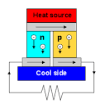
Thermoelectric generators
Why don't we use thermoelectric generator?
It is a very inefficient way to make electricity from a difference in temperature. It produces a voltage, and small current as long as one side of a stack of dissimilar metals is warm, and the other side is cold. The higher the temperature differential, the higher the voltage.

Slide 6
Piezoelectricity
Piezoelectricity: electric charge that accumulates in certain solid materials (such as crystals, certain ceramics & biological matter such as bone, & various proteins) in response to applied mechanical stress.
Piezoelectricity: electricity resulting from pressure & latent heat
Derived from the Greek word πιέζειν; piezein, which means to squeeze or press & ἤλεκτρον ēlektron, which means amber, an ancient source of electric charge.
Piezoelectric energy harvesting: piezoelectric materials can absorb energy from mechanical vibrations & transform into electricity

Slide 7
Piezoelectric materials
Piezoelectric materials (PMs) can be broadly classified as either crystalline, ceramic, or polymeric. The most commonly produced piezoelectric ceramics are lead zirconate titanate (PZT), barium titanate, and lead titanate. Gallium nitride and zinc oxide can also be regarded as a ceramic due to their relatively wide band gaps. Semiconducting PMs offer features such as compatibility with integrated circuits and semiconductor devices. Inorganic ceramic PMs offer advantages over single crystals, including ease of fabrication into a variety of shapes and sizes not constrained crystallographic directions. Organic polymer PMs, such as PVDF, have low Young’s modulus compared to inorganic PMs. Piezoelectric polymers (PVDF, 240 mV-m/N) possess higher piezoelectric stress constants (g₃₃), an important parameter in sensors, than ceramics (PZT, 11 mV-m/N), which show that they can be better sensors than ceramics. Moreover, piezoelectric polymeric sensors and actuators, due to their processing flexibility, can be readily manufactured into large areas, and cut into a variety of shapes. In addition polymers also exhibit high strength, high impact resistance, low dielectric constant, low elastic stiffness, and low density, thereby a high voltage sensitivity which is a desirable characteristic along with low acoustic and mechanical impedance useful for medical and underwater applications.

Slide 8
Among PMs, PZT ceramics are popular as they have a high sensitivity, a high g₃₃ value. They are however brittle. Furthermore, they show low Curie temperature, leading to constraints in terms of applications in harsh environmental conditions. However, promising is the integration of ceramic disks into industrial appliances moulded from plastic. This resulted in the development of PZT-polymer composites, and the feasible integration of functional PM composites on large scale, by simple thermal welding or by conforming processes. Several approaches towards lead-free ceramic PM have been reported, such as piezoelectric single crystals, and ferroelectric ceramics with a perovskite structure and bismuth layer-structured ferroelectrics (BLSF), which have been extensively researched. Also, several ferroelectrics with perovskite-structure (BaTiO₃ [BT], (Bi_{1/2}Na_{1/2}) TiO₃ [BNT], (Bi_{1/2}K_{1/2}) TiO₃ [BKT], KNbO₃ [KN], (K, Na) NbO₃ [KNN]) have been investigated for their piezoelectric properties.

Slide 9
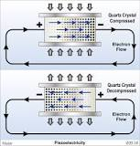
Piezoelectric generator
A piezoelectric crystal is placed between two metal plates. At this point, the material is in perfect balance and does not conduct an electric current. Mechanical pressure is then applied to the material by the metal plates, which forces the electric charges within the crystal out of balance.

Slide 10
Piezoelectric generators / Thermoelectricity
Overall efficiency of energy conversion is relatively low
=> So far, only niche applications / limited potential

Slide 11
“Smart” materials
Smart materials, also called intelligent or responsive materials, have one or more properties that can be significantly changed in a controlled fashion by external stimuli, such as stress, moisture, electric or magnetic fields, light, temperature, pH, or chemical compounds.
Usually this involves a coupling between two or more properties

Slide 12
Piezoelectric materials
Many materials exhibit a range of piezoelectric effects. Some naturally piezoelectric occurring materials include Berlinite (structurally identical to quartz), sugarcane, quartz, Rochelle salt, topaz, tourmaline, and bone (dry bone exhibits some piezoelectric properties due to the apatite crystals, and the piezoelectric effect is generally thought to act as a biological force sensor). Examples of man-made piezoelectric materials: barium titanate and lead zirconate titanate.
In recent years, due to the growing environmental concern regarding toxicity in lead-containing devices and the RoHS directive followed within the European Union, there has been a push to develop lead free piezoelectric materials. To date, this initiative to develop new lead-free piezoelectric materials has resulted in a variety of new piezoelectric materials which are more environmentally safe.

Slide 13
The ​main equation of piezoelectricity is​
P=d×stress
where ​d​ is the piezoelectric coefficient, a factor unique to each type of piezoelectric material.
The piezoelectric coefficient for quartz is 3 × 10⁻¹².
The piezoelectric coefficient for lead zirconate titanate (PZT) is 3 × 10⁻¹⁰.
Small displacements of ions in the crystal lattice create the polarization observed in piezoelectricity.
This only occurs in crystals that do not have a center of symmetry.

Slide 14
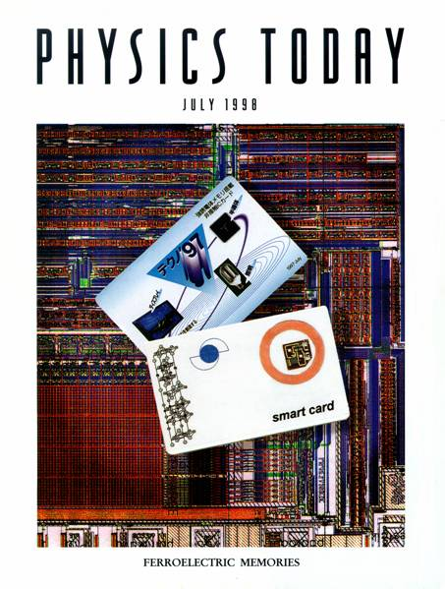
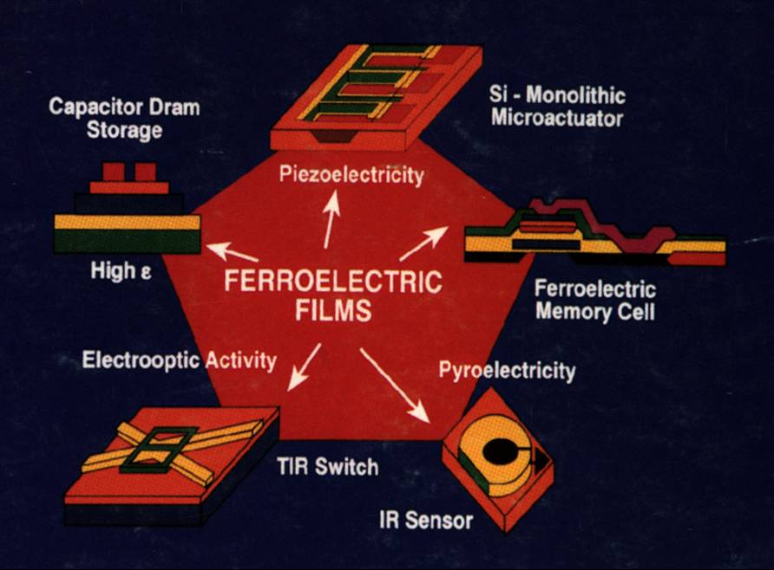
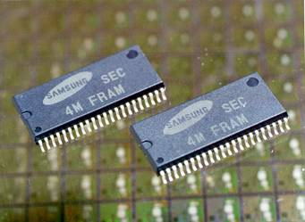
Ferroelectric thin films

Slide 15
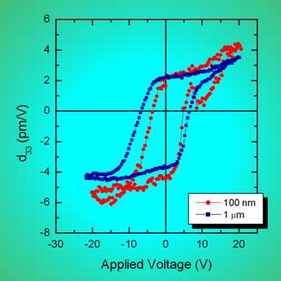
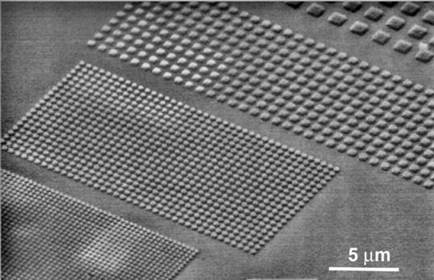
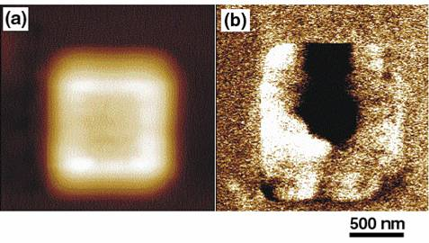
Ferroelectric nanostructures - Size effects
Switching @ nanoscale
P = 10 μC/cm²
ε = 200
a
a = 10 nm
a = 2 nm
Q = P·S ≈ 100 e⁻
Q = P·S ≈ 4 e⁻

Slide 16
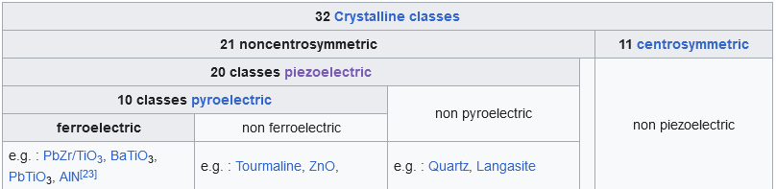

Slide 17
Ferroelectricity
pyro-electric10/32
ΔP_{i}=γ_{i}ΔT
piezo-
electric20/32
dielectric
32/32
point-groups
ferro-
electric
Î³d_{ijk}=d_{ijk}=0
η_{jk}=d_{ijk}E_{i}
polar axis
P_{i}=ε₀χ_{ij}E_{j}+ε₀χ_{ijk}E_{j}E_{k}+…

Slide 18
Pyro-,Ferroelectricity
Tetragonal distortion
O²⁻
O²⁻
O²⁻
O²⁻
P
Ba²⁺
Ba²⁺
Ba²⁺
Ba²⁺
Ti⁴⁺
Ti⁴⁺
Ti⁴⁺
Ti⁴⁺
≈0.4 nm
perovskite: BaTiO₃, PbTiO₃, Pb(Zr_{x}Ti_{1-x})O₃

Slide 19
Ferroelectric criteria
P
„1“
E
„0“
Saturation polarization
Remnant polarization
Coercive field

Slide 20
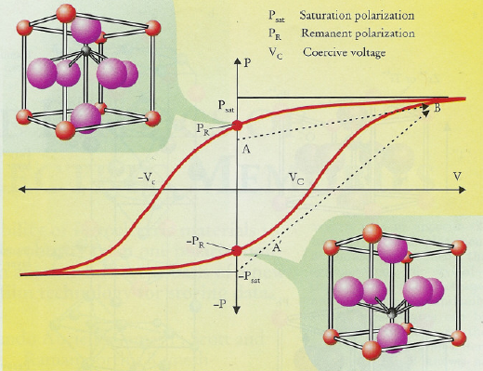
Ferroelectricity in ABO₃ type perovskites
2+
2+
2+
2+
A (Ba , Ca , Pb )
4+
4+
4+
4+
B (Ti , Zr , Mn )
O
2-
0.04A
Spontaneous polarization (electric dipole)
P
0.1A
Physics Today, July, 1998 -Ferroelectric Memories
0.06A
Ferroelectrics
(polar oxides)
spontaneous electric polarization
Applications
NV - FeRAMs

Slide 21
Piezoresponse Force Microscopy
Converse piezoelectric effect:
strain = (piezoelectric coefficient) × (electric field)
Δz
z
Δz
P
E
E
s
P
s

Slide 22
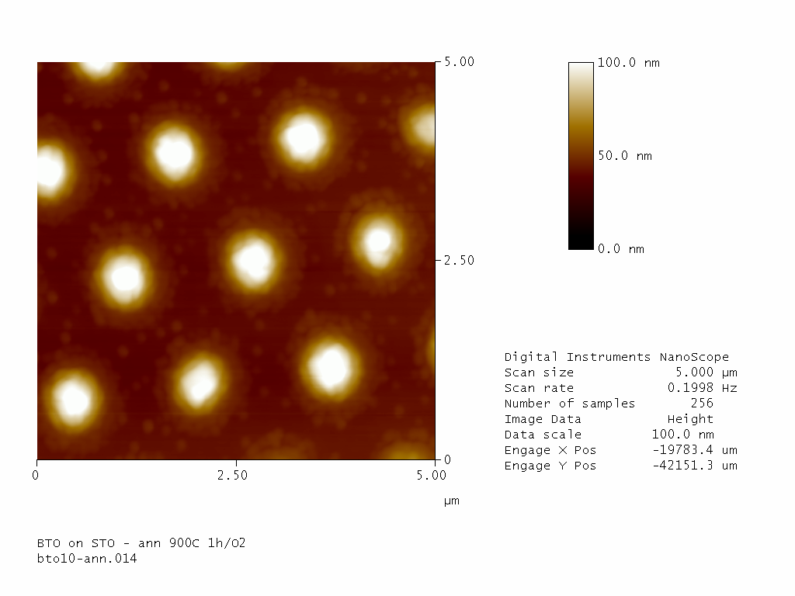
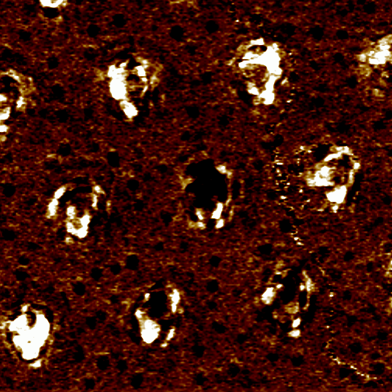
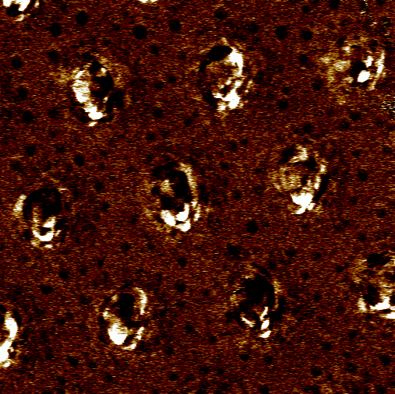
Ferroelectric switching
Detection of the out-of-plane polarization
BaTiO₃ on 0.1%Nb doped SrTiO₃ (100)
Before switching
AFM
topography
Ferroelectric domain structure
Piezoresponse hysteresis loop
After switching
Appl. Phys. Lett. 86, 183107 (2005)

Slide 23
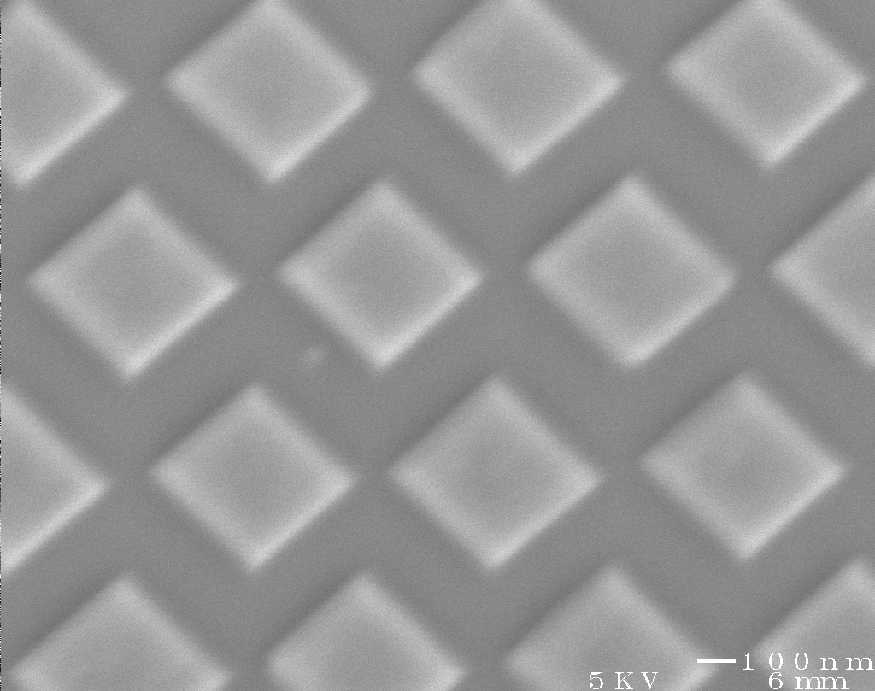
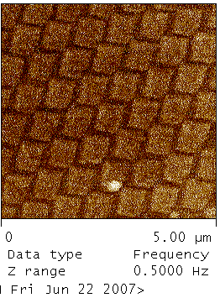
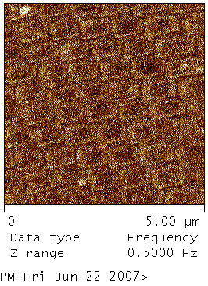
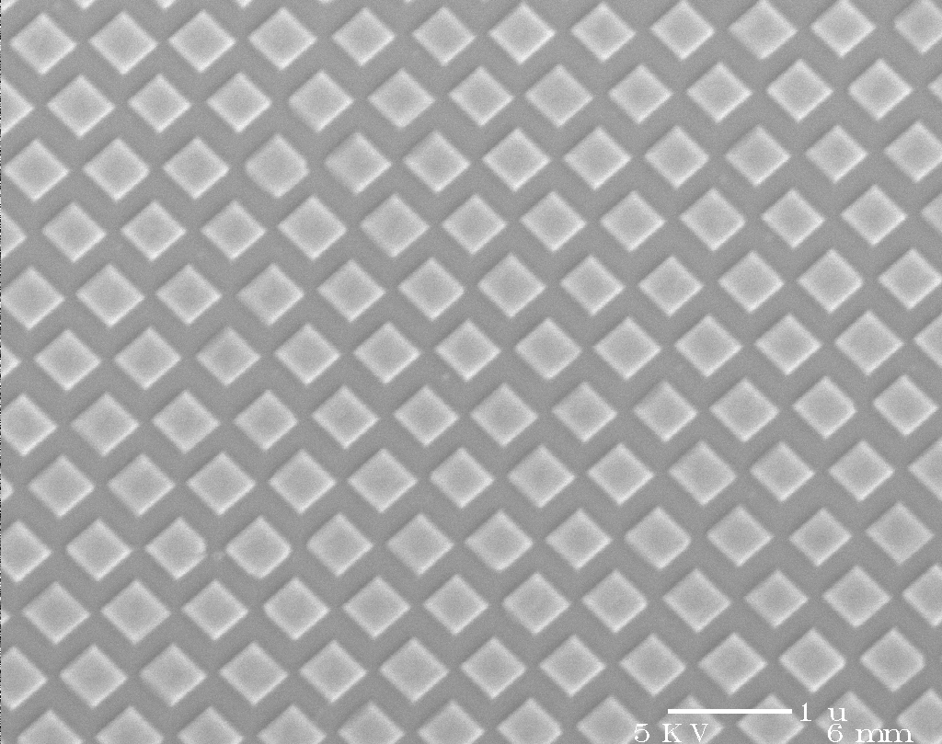
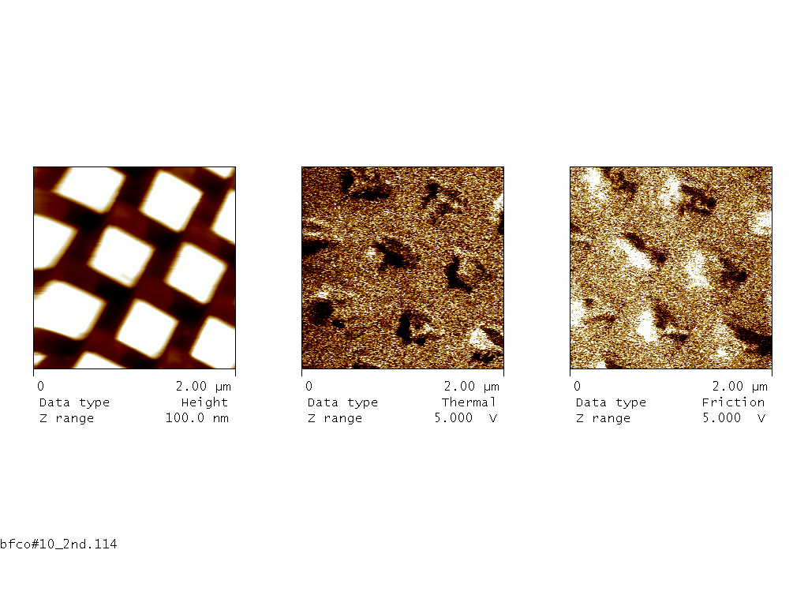
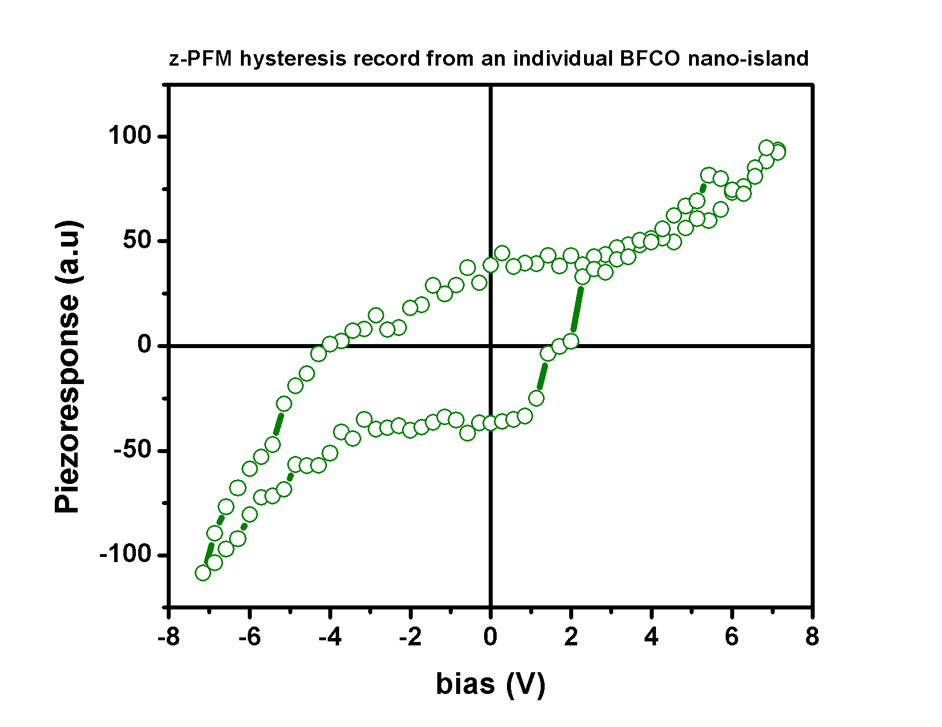
Epitaxial patterning of BFCO
Change of contrast in MFM (switching from one pole up to the other pole up)
Bi₂FeCrO₆ on 0.5% Nb-doped SrTiO₃(100)
Adv. Mater. 23, 1724 (2011)

Slide 24
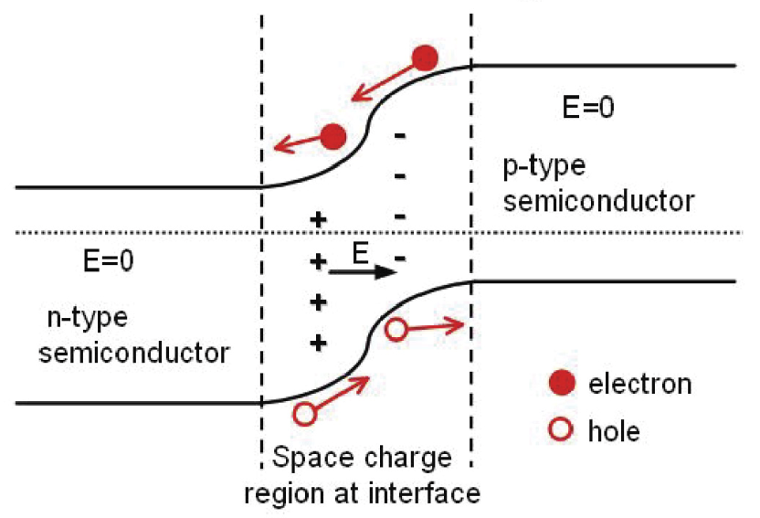
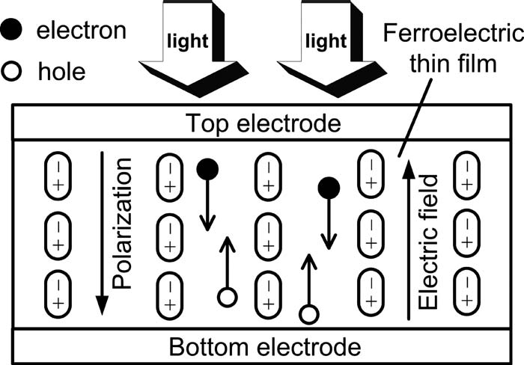
Bulk photovoltaic effect (A.M. Glass, et al. Appl. Phys. Lett. 25, 4 1974)
P-N junction
Bulk photovoltaic effect
M. Qin et al. Appl. Phys. Lett. 93, 122904 (2008)
Conventional semiconductor
Ferroelectric materials

Slide 25
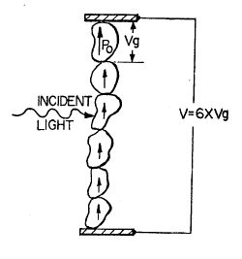
Ferroelectrics for PV: advantages & drawbacks
25
Advantages:
No need to form p–n junction.
Total photovoltage is series sum across grain voltages => can exceed band gap
Drawbacks:
Bulk ferroelectrics: typical current densities ~ nA/cm²
Large band gap (3.2~4 eV)
As a result, ferroelectric photovoltaics were ignored for energy conversion… until…

Slide 26
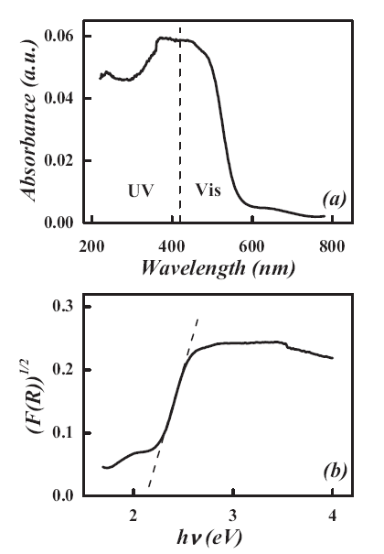
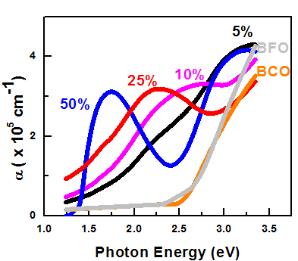

Multiferroics for PV
Large unidirectional spontaneous polarization through film thickness, especially in (111) epitaxial films (photocurrent proportional to polarization magnitude)
Higher current density than ferroelectrics
Smaller band gap than ferroelectric perovskites (due to d electrons)
Also: BiMnO₃ (1.1-1.2 eV)
J. Chakrabartty et al., Nature Photonics (2018)
BiFeO₃ (2.2-2.9 eV)
Bi₂FeCrO₆ (1.4-2.5 eV)
F. Gao, et al. Adv. Mater. 19, 2889 (2007)

Slide 27
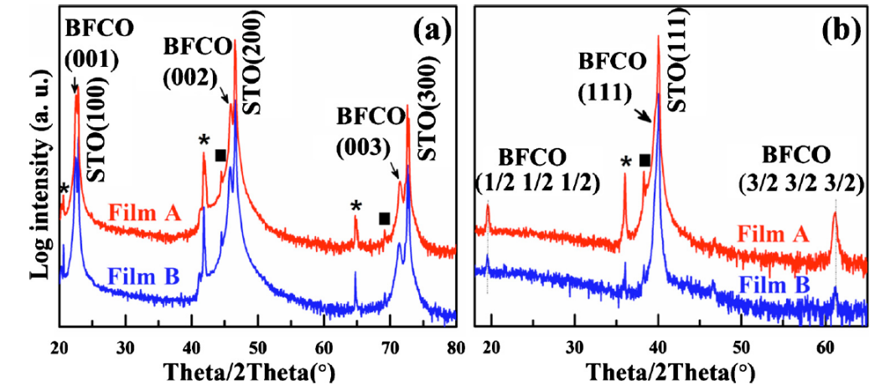
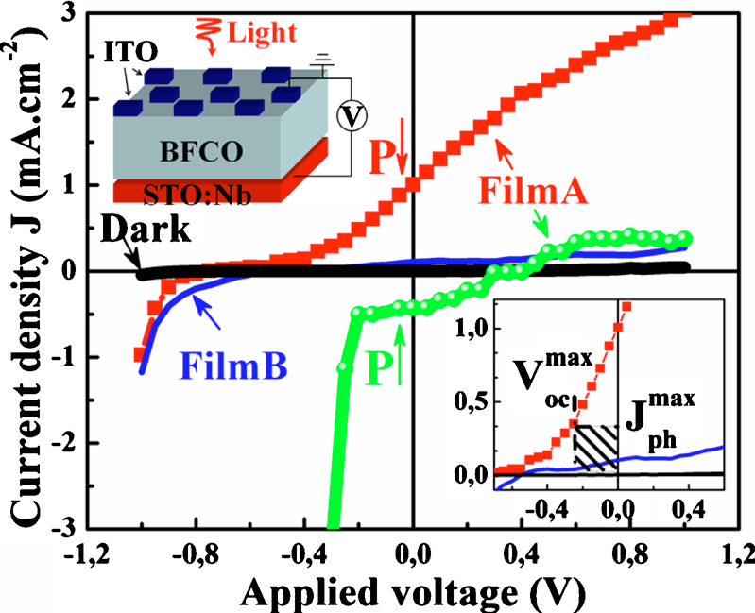
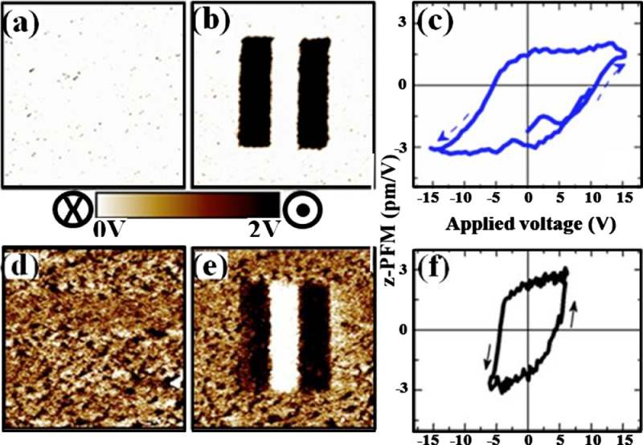
PV Properties of BFCO films
XRD patterns
PCE up to 6% under red illumination;
Polarization contribution to Jsc around 70%.
PFM imaging
J-V
curves
Appl. Phys. Lett. 98, 202902 (2011)

Slide 28
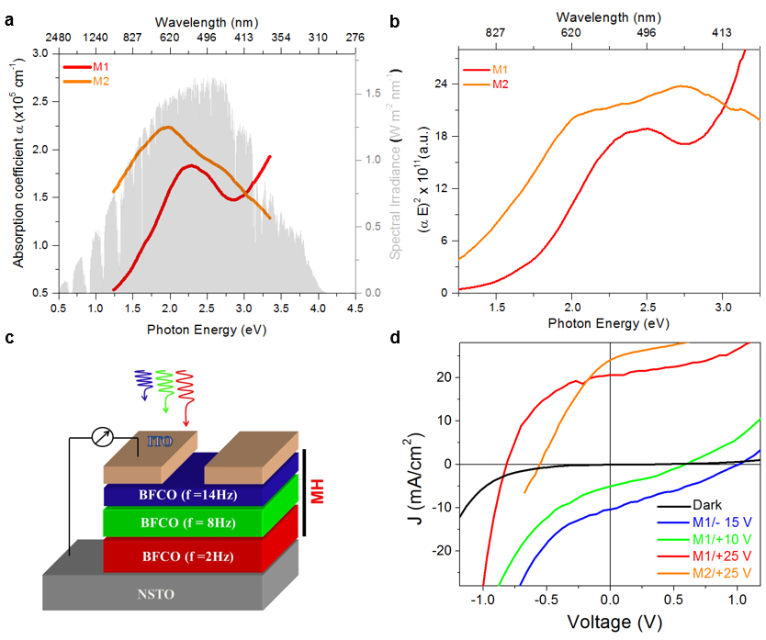
Tuning the band gap & Multilayer devices
Controlling Fe/Cr cation ordering in BFCO films
=> Tuning the band gap / optical properties
UV-Vis of BFCO multilayers (M1, M2): complementary absorption of solar spectrum from 1.4 to 3.2 eV (885 to 388 nm)
E_{g} of highly ordered BFCO: 1.4 eV
b, (a E)² versus energy plots.
c, Device geometry of BFCO multilayer based-structure.
d, J-V characteristics of BFCO single layer devices under AM1.5G illumination.
Nature Photonics 9, 61 (2015)

Slide 29
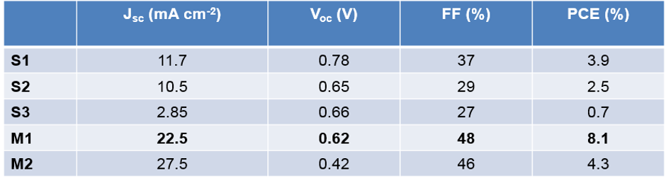
Tuning band gap in BFCO
Controlling Fe/Cr cation ordering in BFCO films
=> Tuning the band gap / optical properties
Device performance for various BFCO based-devices under 1 Sun: Optimal performance for multilayer structures
Growth of BFCO on Si
Nature Photonics 9, 61 (2015)
Nanoscale 8, 3237 (2016)

Slide 30
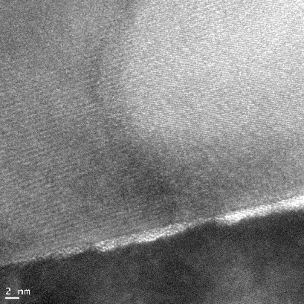
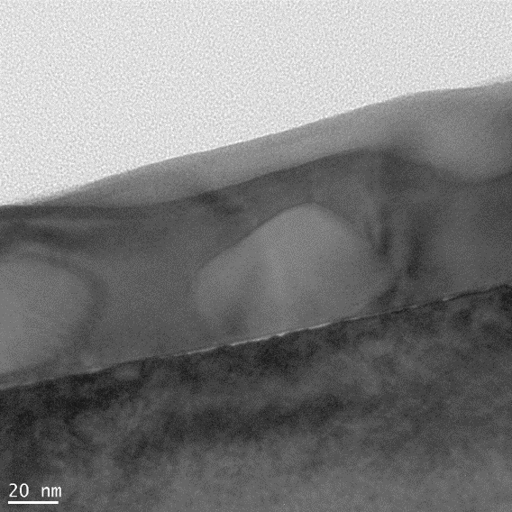
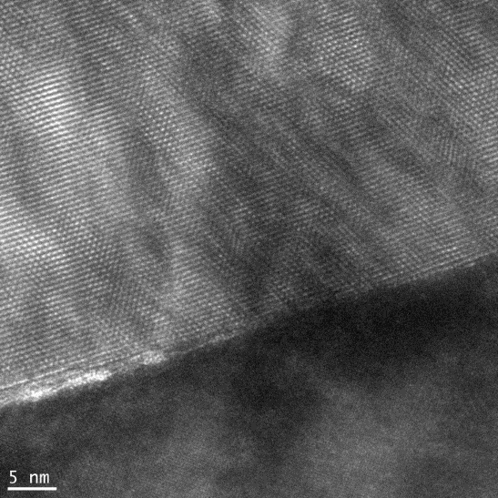
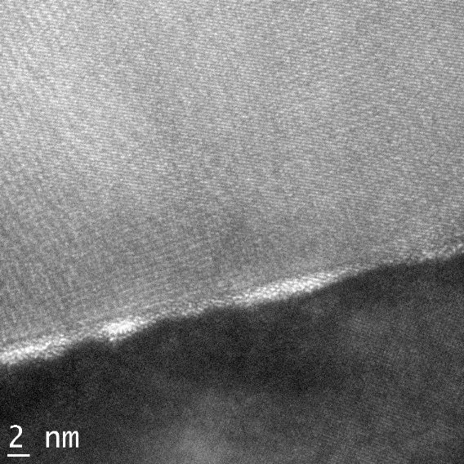


Composite BMO for FerroPV
a
BiMn₂O₅
Film Thickness ~ 110 nm
BiMnO₃
2
Sequence of deposition
ITO
STO
composite film
1
2
c
Nb:STO (100)
2
1
BiMn₂O₅
b
BiMnO₃
[001_{O}]*
001
[100]*
110pc
110
[100]*
[100]
STO
Two distinct phases:
BiMnO₃ & BiMn₂O₅
STO
Nature Photonics 12, 271 (2018)

Slide 31
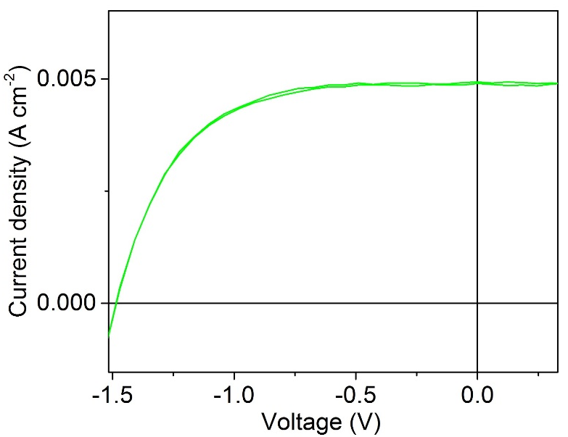
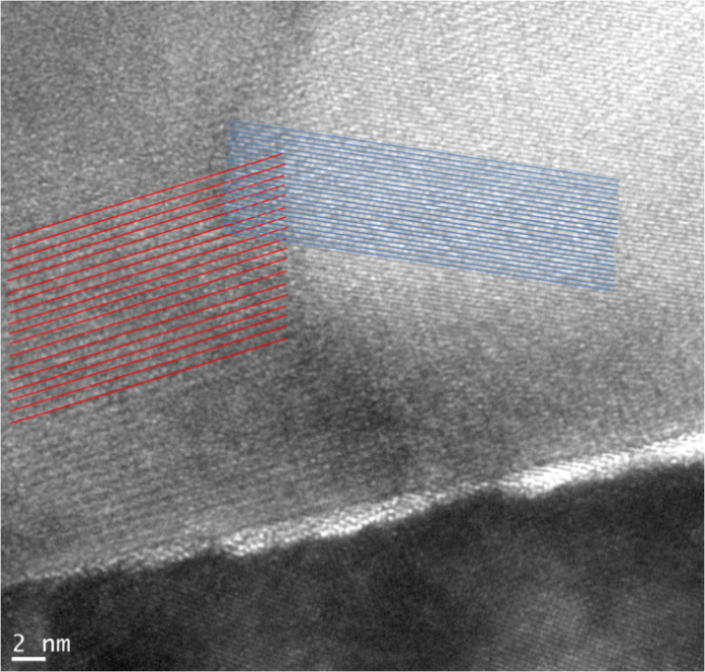
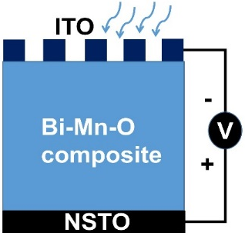
BiMn₂O₅
PCE= 4.2 %
BiMnO₃
PV performance
Device No. | PCE (%)
1 | 4.20
2 | 4.00
3 | 3.90
4 | 3.80
5 | 3.96
Average | 3.97
PCE calculated from five randomly selected samples
Nature Photonics 12, 271 (2018)

Slide 32
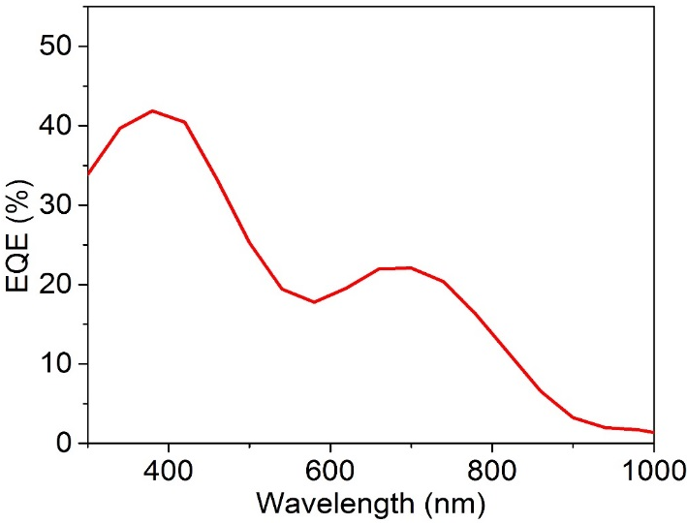
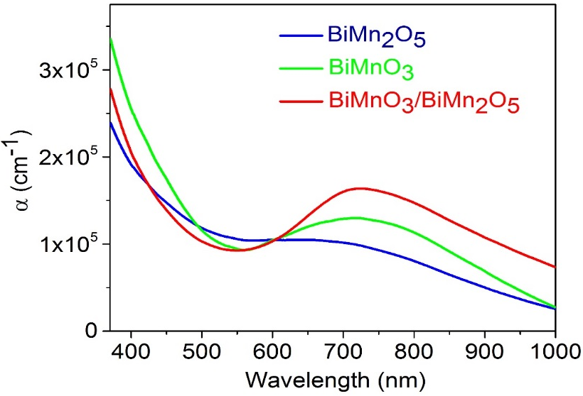
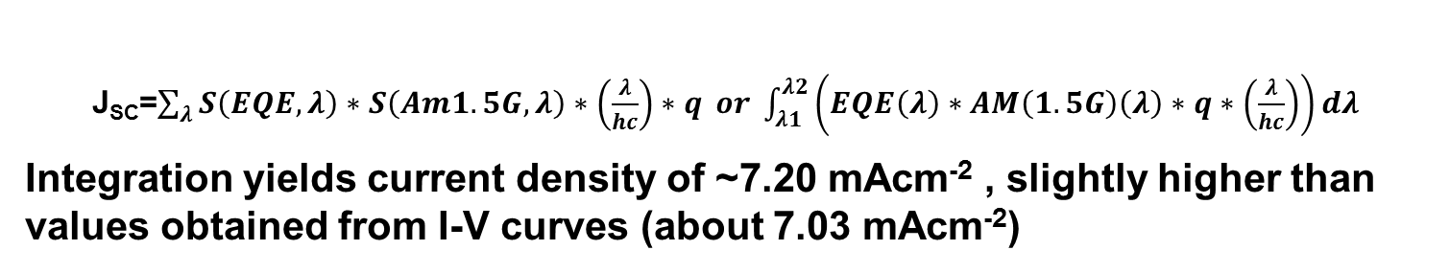
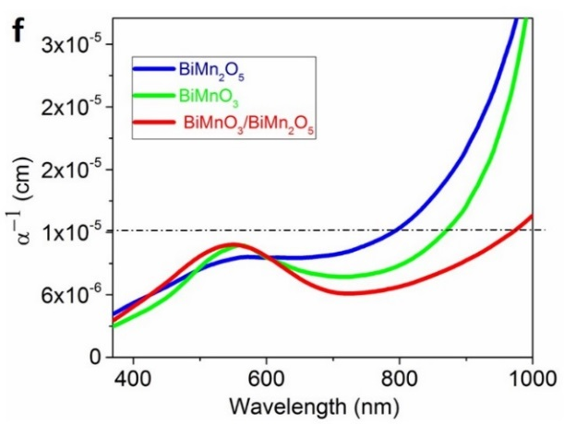

EQE & optical absorption
Composite films
c
d
Estimated bandgaps:
BiMnO₃ = 1.25±0.05 eV;
BiMn₂O₅ = 1.27±0.05 eV;
BMO-BiMn₂O₅ = 1.24±0.05 eV
Nature Photonics 12, 271 (2018)

Slide 33
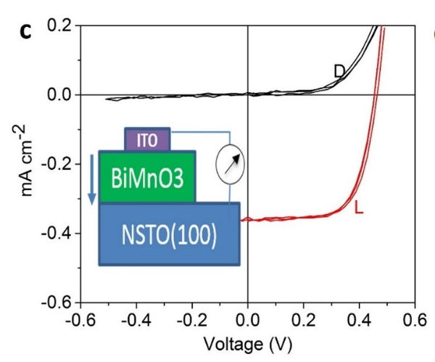
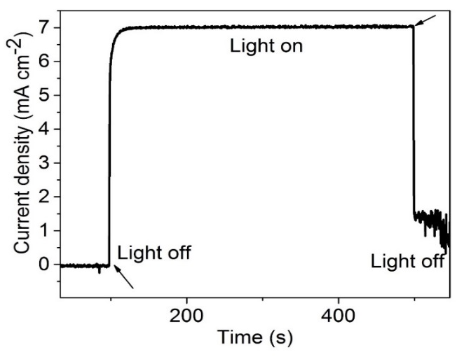
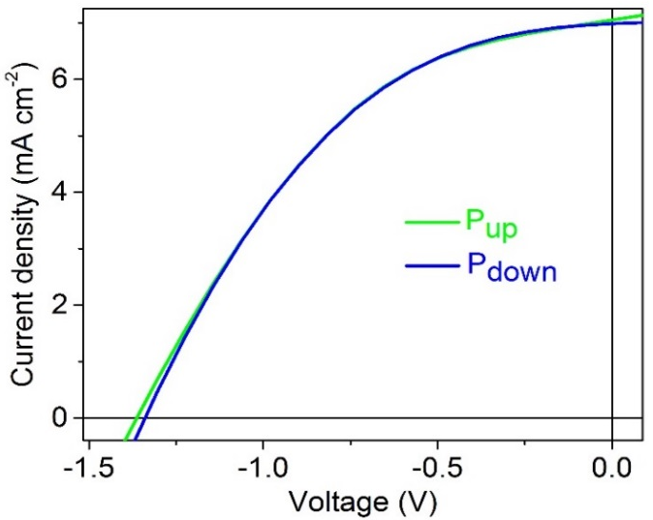

PV performance: Comparative analysis
Composite films, PCE=3.96%
a
b
Composite films: higher PCE
 | J_{SC} (mA cm⁻² ) | V_{OC} (V) | FF | PCE (%)
Best composite film | 4.91 | 1.48 | 0.58 | 4.2
BiMnO₃ | 0.35 | 0.46 | 0.66 | 0.11
BiMn₂O₅ | 0.0002 | 0.22 | 0.33 | 0.000014
BiMn₂O₅
Effect described in terms of grain boundary barrier potential
Nature Photonics 12, 271 (2018)

Slide 34
Fuel cells
A fuel cell uses the chemical energy of hydrogen or other fuels to cleanly and efficiently produce electricity. If hydrogen is the fuel, the only products are electricity, water, and heat. Fuel cells are unique in terms of the variety of their potential applications; they can use a wide range of fuels and feedstocks and can provide power for systems as large as a utility power station and as small as a laptop computer.
Solid Oxide Fuel Cells
(PEM) Fuel Cells
Possible fuels:
Hydrogen, formic acid, etc.

Slide 35
How Fuel Cells Work
Fuel cells work like batteries, but they do not run down or need recharging. They produce electricity and heat as long as fuel is supplied.
A fuel cell consists of two electrodes—a negative electrode (or anode) and a positive electrode (or cathode)—sandwiched around an electrolyte.
A fuel, such as hydrogen, is fed to the anode, and air is fed to the cathode.
In a hydrogen fuel cell, a catalyst at the anode separates hydrogen molecules into protons and electrons, which take different paths to the cathode. The electrons go through an external circuit, creating a flow of electricity. The protons migrate through the electrolyte to the cathode, where they unite with oxygen and the electrons to produce water and heat.

Slide 36
Polymer electrolyte membrane fuel cells
Polymer electrolyte membrane (PEM) fuel cells—also called proton exchange membrane fuel cells—deliver high power density and offer the advantages of low weight and volume compared with other fuel cells. PEM fuel cells use a solid polymer as an electrolyte and porous carbon electrodes containing a platinum or platinum alloy catalyst. They need only hydrogen, oxygen from the air, and water to operate. They are typically fueled with pure hydrogen supplied from storage tanks or reformers.
PEM fuel cells operate at relatively low temperatures, around 80°C. Low-temperature operation allows them to start quickly (less warm-up time) and results in less wear on system components, resulting in better durability. However, it requires that a noble-metal catalyst (typically platinum) be used to separate the hydrogen's electrons and protons, adding to system cost. The platinum catalyst is also extremely sensitive to carbon monoxide poisoning, making it necessary to employ an additional reactor to reduce carbon monoxide in the fuel gas if the hydrogen is derived from a hydrocarbon fuel. This reactor also adds cost.
PEM fuel cells are used primarily for transportation applications and some stationary applications. PEM fuel cells are particularly suitable for use in vehicle applications, such as cars, buses, and heavy-duty trucks.

Slide 37
Direct methanol fuel cells
Most fuel cells are powered by hydrogen, which can be fed to the fuel cell system directly or can be generated within the fuel cell system by reforming hydrogen-rich fuels such as methanol, ethanol, and hydrocarbon fuels. Direct methanol fuel cells (DMFCs), however, are powered by pure methanol, which is usually mixed with water and fed directly to the fuel cell anode.
Direct methanol fuel cells do not have many of the fuel storage problems typical of some fuel cell systems because methanol has a higher energy density than hydrogen—though less than gasoline or diesel fuel. Methanol is also easier to transport and supply to the public using our current infrastructure because it is a liquid, like gasoline. DMFCs are often used to provide power for portable fuel cell applications such as cell phones or laptop computers.

Slide 38
Solid oxide fuel cells
Solid oxide fuel cells (SOFCs) use a hard, non-porous ceramic compound as electrolyte. SOFCs are around 60% efficient at converting fuel to electricity. In applications designed to capture and use the system's waste heat (co-generation), overall fuel use efficiencies could top 85%.
SOFCs operate at very high temperatures—as high as 1,000°C. High-temperature operation removes the need for precious-metal catalyst, thereby reducing cost. It also allows SOFCs to reform fuels internally, which enables the use of a variety of fuels and reduces the cost associated with adding a reformer to the system.
SOFCs are also the most sulfur-resistant fuel cell type; they can tolerate several orders of magnitude more sulfur than other cell types can. In addition, they are not poisoned by carbon monoxide, which can even be used as fuel. This property allows SOFCs to use natural gas, biogas, and gases made from coal. High-temperature operation has disadvantages. It results in a slow startup and requires significant thermal shielding to retain heat and protect personnel, which may be acceptable for utility applications but not for transportation. The high operating temperatures also place stringent durability requirements on materials. The development of low-cost materials with high durability at cell operating temperatures is the key technical challenge facing this technology.
Scientists are currently exploring the potential for developing lower-temperature SOFCs operating at/below 700°C that have fewer durability problems and cost less. Lower-temperature SOFCs have not yet matched the performance of the higher temperature systems, however, and stack materials that will function in this lower temperature range are still under development.

Slide 39
Electrochromic materials
Electrochromism: a material displays changes in colour or opacity in response to an electrical stimulus. A smart window made of an electrochromic material can block specific wavelengths of UV, visible or (near) infrared light. The ability to control transmittance of near infrared light can increase the energy efficiency of a building, reducing the amount of energy needed to cool during summer and heat during winter.
As the colour change is persistent and energy need only be applied to effect a change, electrochromic materials are used to control the amount of light and heat allowed to pass through a surface, most commonly "smart windows". One popular application is in the automobile industry where it is used to automatically tint rear-view mirrors in various lighting conditions.

Slide 40
Among metal oxides, tungsten oxide (WO₃) is the most extensively studied and well-known electrochromic material. Others include molybdenum, titanium and niobium oxides (less effective)
Viologens (4,4′-bipyridine compounds) display reversible colour changes between a colourless and a deep-blue colour due to redox reactions. Can be tuned to deep blue or intense green.
Viologens are promising for electronic applications, compared to metal-based systems which tend to be expensive, toxic and a problem to recycle. Advantages include their optical contrast, coloration efficiency, redox stability, ease of design and potential to scale up.
Viologens have been used with phenlyenediamine by Gentex Corporation (auto-dimming rearview mirrors and smart windows in Boeing 787) and with TiO₂ to create small digital displays. A variety of conducting polymers are also of interest for displays: polypyrrole, PEDOT, and polyaniline.

Slide 41
Principle[edit]
The phenomenon of electrochromism occurs in some transition metal oxides which conduct both electricity and ions, such as tungsten trioxide (WO₃).^{[4]} These oxides have octahedral structures of oxygen which surround a central metal atom and are joined together at the corners. This arrangement results in a three-dimensional nanoporous structure with "tunnels" between individual octahedral segments. These tunnels allow dissociated ions to pass through the substance when they are motivated by an electric field. Common ions used for this purpose are H⁺ and Li⁺.^{[5]} ^{[6]}
The electric field is typically induced by two flat, transparent electrodes which sandwich the ion-containing layers. As a voltage is applied across these electrodes, the difference in charge between the two sides causes the ions to penetrate the oxide as the charge-balancing electrons flow between the electrodes. These electrons change the valency of the metal atoms in the oxide, reducing their chargeThis is a redox reaction, since the electroactive metal is accepting electrons from the electrodes, forming a half-cell.^{[7]} Strictly speaking the electrode as a chemical unit comprises the flat plate as well as the semiconducting substance in contact with it. However, the term "electrode" often refers to only the flat plate(s), more specifically called the electrode "substrate".^{[8]}
Photons which reach the oxide layer can cause an electron to move between two nearby metal ions. The energy provided by the photon causes movement of an electron which in turn causes optical absorption of the photon.^{[9]}

Slide 42
Photochromic materials
Photochromic materials are transparent materials which exhibit increased light absorption when exposed to light. They can be optical glasses or plastic materials, or sometimes delivered as a powder. The photochromic properties usually result from the addition of a photochromic substance to a transparent material.
Typically, photochromic materials are used in sunglasses which automatically adapt to the light conditions: they transmit most light if it is not too bright, but get increasingly dark when exposed to sunlight. Photodarkening can occur within less than a minute; recovery to the clear state may take several minutes, depending on the temperature.
Photochromic windows are useful for automatically regulating the illumination with incoming daylight.

Slide 43
Operation Principle
Photochromic glasses are often made by embedding silver chloride (AgCl) or another silver halide in microcrystalline form into some glass. When silver chloride is exposed to UV light in the UV_{A} spectral region, it forms tiny silver particles which absorb light. The process is reversed thermally when exposure to ultraviolet light ends. Over longer times, the recovery to the clear state may not be complete due to aging processes.
Photochromism can also result from other physical mechanisms, e.g. involving the formation of colour centers.
Plastic optics can be made photochromic by adding certain organic dyes such as oxazines or naphthopyrans to a surface layer, applied as a photochromic coating. They also react to ultraviolet light.

Slide 44
Photochromic molecules can belong to various classes:
triarylmethanes, stilbenes, azastilbenes, nitrones, fulgides, spiropyrans, naphthopyrans, spiro-oxazines, quinones etc.

Slide 45
Thermochromic materials
Thermochromism is the property of substances to change colour due to a change in temperature.
Practical examples: baby bottles which change to a different color when cool enough to drink, or kettles which change color when water is at or near boiling point.

Slide 46


Slide 47
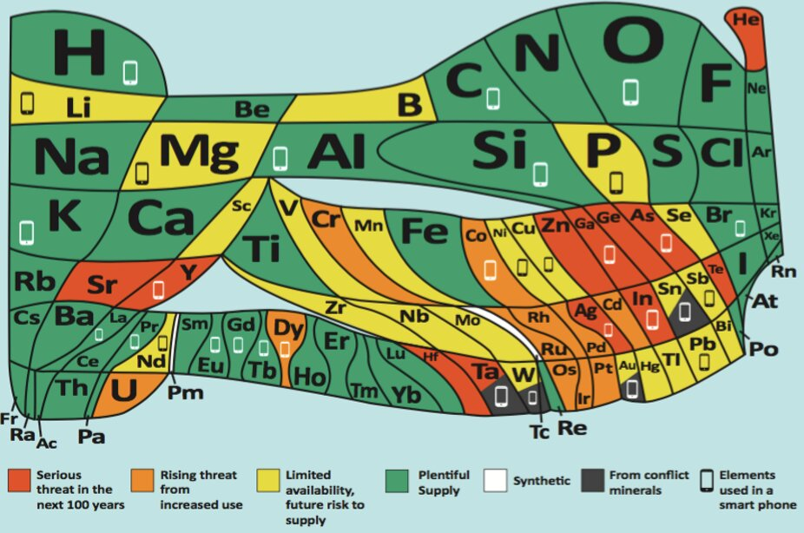
Responsible Production
& Consumption
Many key elements are increasingly scarce
Integrate recycling principles into design & fabrication of new technologies
Develop biodegradable technologies
Focus on low energy intensive technologies

Slide 49
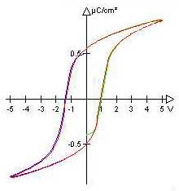
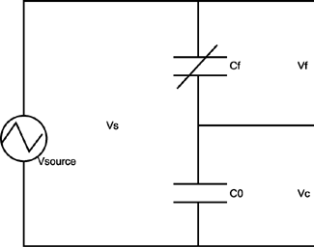
Conventional detection
Sawyer-Tower circuit

Slide 50
Polarization [C/m²]
P_{typical} ≈ 0.1Cm⁻² = 6.2×10¹⁷ electrons/m²
6000 e⁻
60 e⁻
1 e⁻
100 nm
10 nm
1.3 nm
300 nm × 300 nm
PZT
T. Schmitz et al., J. Eur. Cer. Soc., 24 ,1145 (2004)

Slide 51
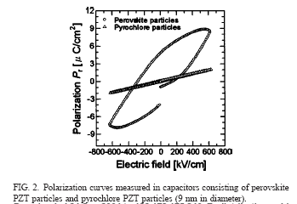
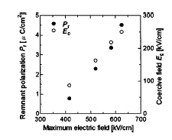
How do you monitor polarization reversal on the nanoscale? „Hysteresis“ loops? Hopefully not!
9 nm PZT grains
K.S. Seol et al. Appl. Phys. Lett., 85, 2325 (2004)
Comment : A. Rüdiger, Appl. Phys. Lett., 86, 256101 (2005)

Slide 52
Tensor inversion
inversion of the piezoelectric tensor also inverts the polarization
sufficient criterion for ferroelectricity

Slide 53
Tensor quantification
d₃₃₃=2ε₀ε₃₃Q₃₃₃₃P_{S3}

Slide 54
Piezoresponse Force Microscopy (PFM)

Slide 55
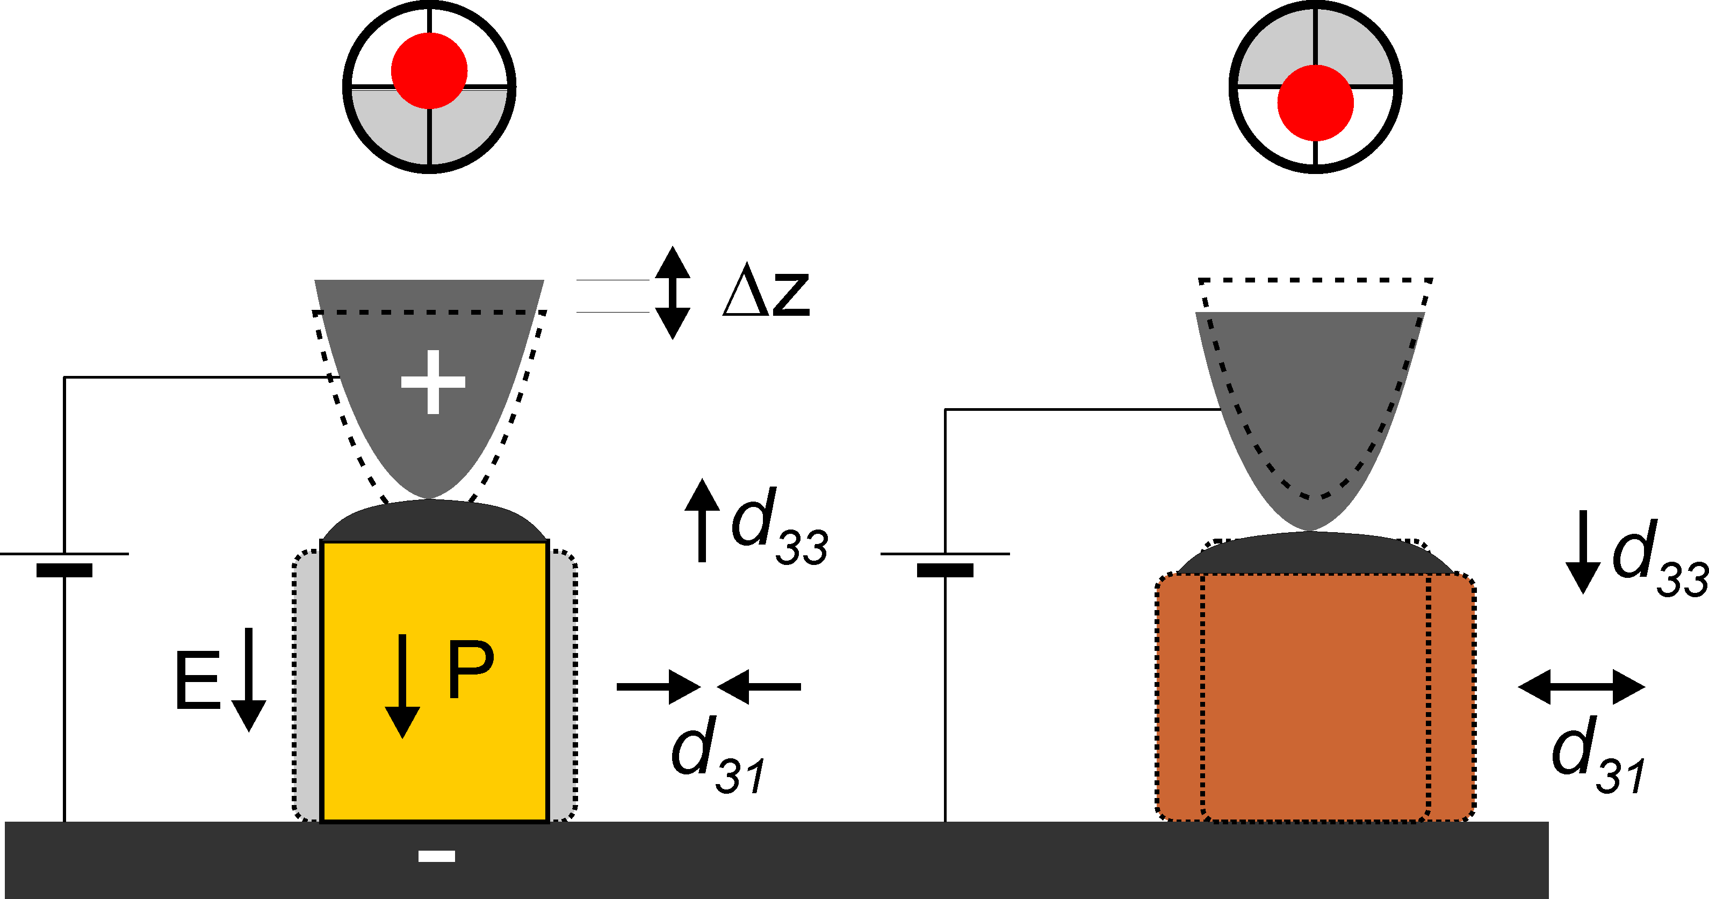
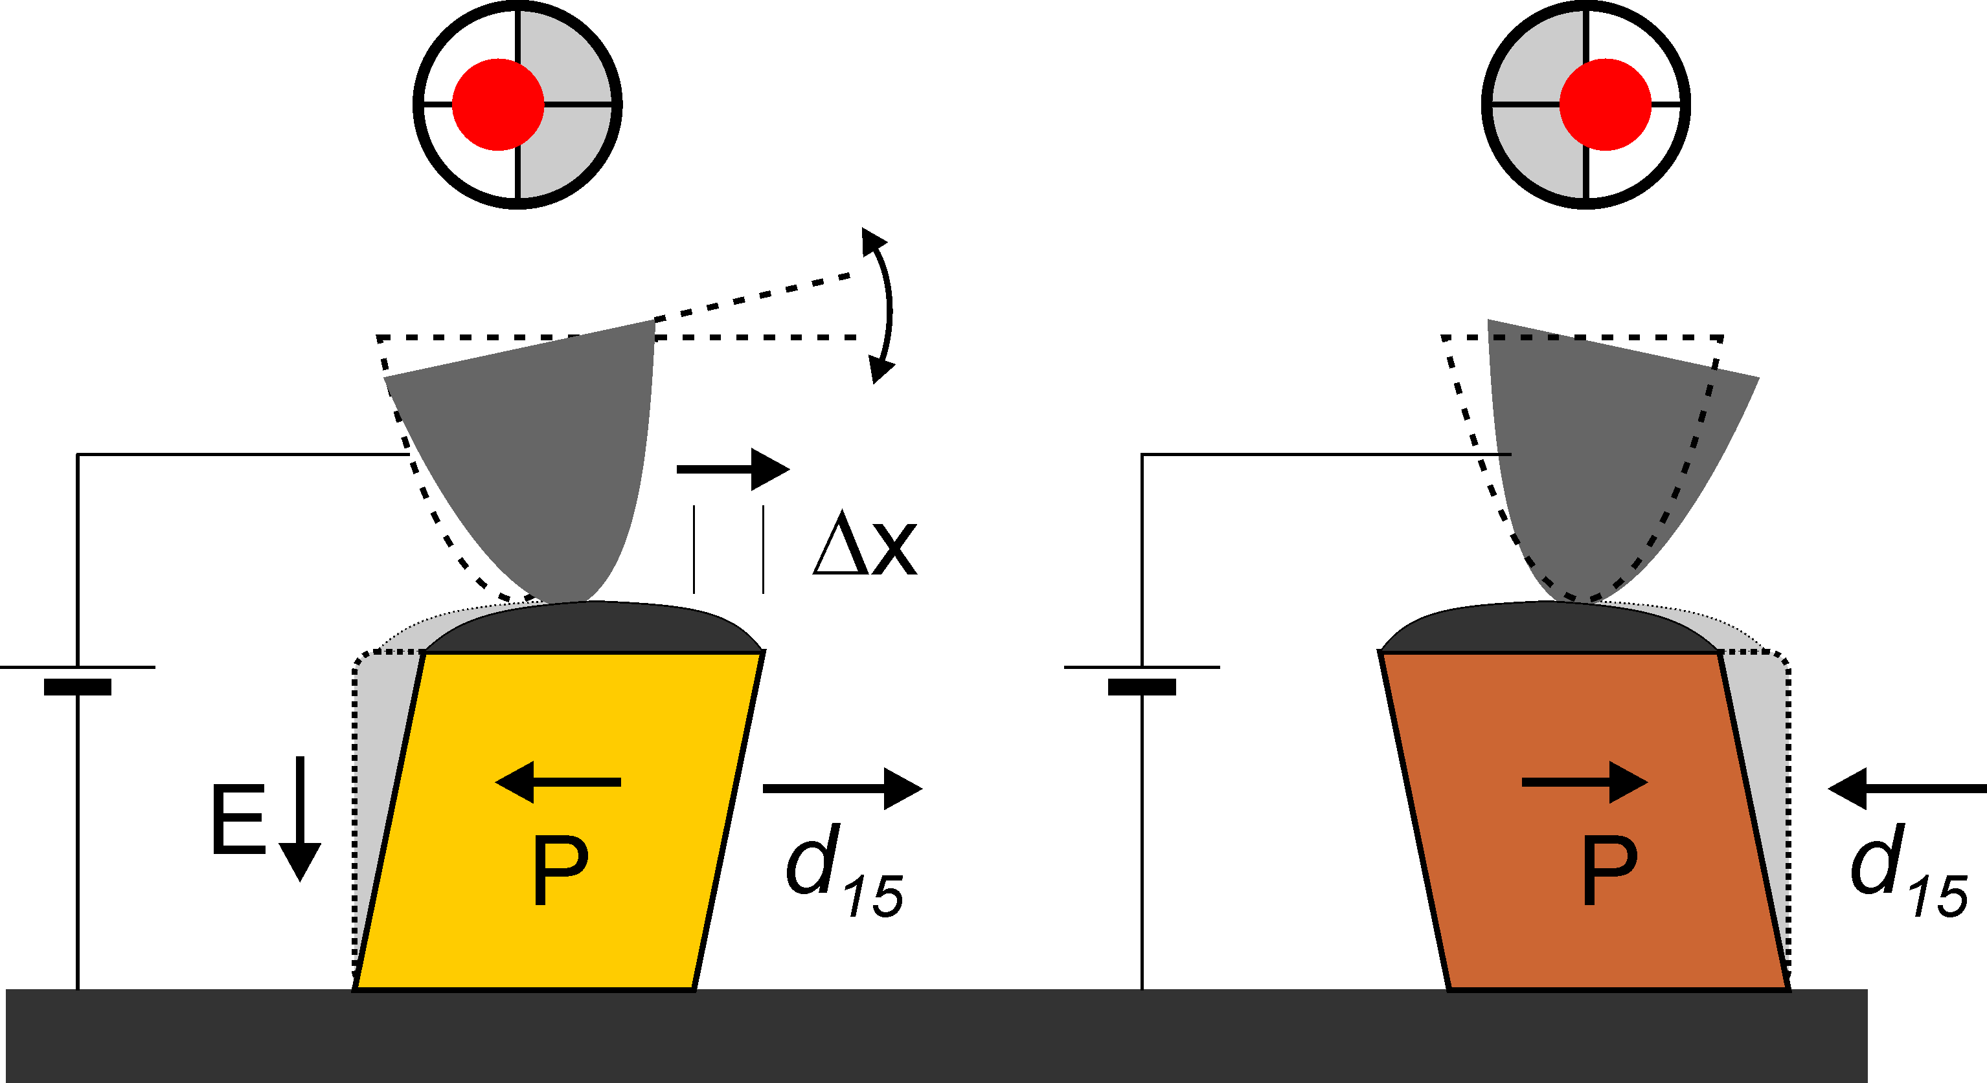

Detection scheme: contact mode
vertical
lateral
P
Adapted from:
A. Rüdiger et al., Applied Physics A (80), 1247, 2005
L.M. Eng et al., Adv. In Solid State Physics. 41, 287-298 (2001)
Assumption: Electric field has only z-component
Converse piezo-electric effect:
η_{jk} =d_{ijk}E_{i}

Slide 56


PFM Amplitude and Phase
Advantage of X and Y: Higher bandwidth
Amp
Excitation
Response I
180º shift
Response II
X
R
Y
ϕ
Out-of-plane
A_{E}
t
A_{II}
A_{I}
In-plane
Assumption: Linear response
For complete characterization:
- Amplitude and Phase
- In-plane and Out-of-plane response
- 4 inputs required
→ restriction to commercially available tools

Slide 57

PFM as an imaging tool

