Slide 1
a.a. 2022-2023
Corso di
Chimica delle Macromolecole I
Presentazioni Orali
Prof. Federico ROSEI
Dipartimento di Scienze Chimiche e Farmaceutiche federico.rosei@units.it
C11, Aula 3

Slide 2
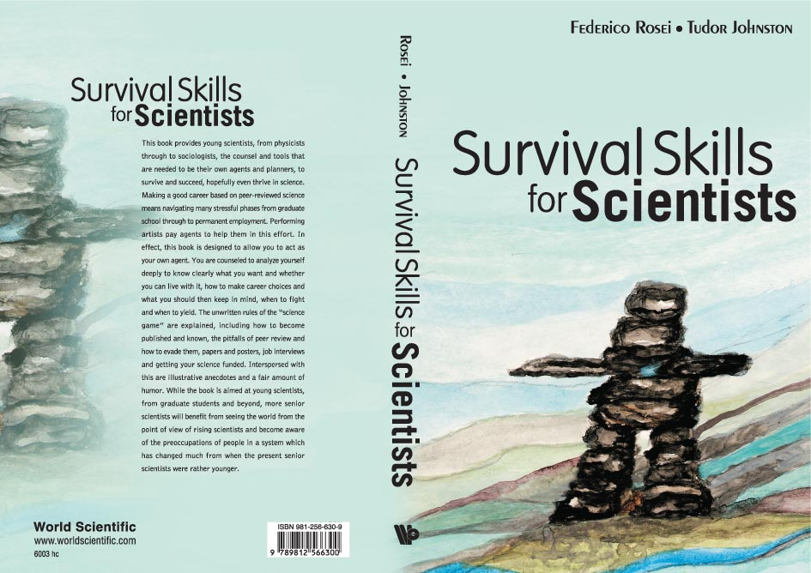

‘Survival Skills For Scientists’

Slide 3


Scientific meetings and conferences
The 3(+1) reasons to attend a conference
1. To present your work
2. To learn from your peers’ work
3. To network with your peers
+1. the conference is in a nice location, e.g. Hawaii, Florida,
Australia, Paris, Rome, etc. (not uncommon)

Slide 4

Networking is important!
Networking can help you to:
  Find a job
  Develop collaborations
  Recruit good people (students, post–docs, professors, etc.)
Some of the scientists you meet at conferences are the ones who referee your manuscripts and grant applications. (Likewise, you will be asked to comment on their work at some point in your career).
Having them know you personally can help.

Slide 5
A few tips on presenting to an audience
Don’t try their patience!
Don’t go over time (never ever…!)
Rehearse in front of a ‘friendly’ audience, and use their (hopefully constructive) criticism to improve your presentation (both content and form)
Prepare backup slides for questions that come repeatedly
(15 ways…)

Slide 6
15 ways…
Cover too much material
Include too many details
Start with too much small talk
Run over the allotted speaking time
Avoid telling the audience why your research has been done
Overestimate, or at least fail to assess, the audience’s level of knowledge
Fail to make contact with the audience
Ignore the inherent difference that exists between written and oral communication
Waste time searching for a specific overhead file somewhere in your pile
Use unexplained terminology, abbreviations and acronyms
Use unexplained symbols in text or equations
Use unexplained graphics
Present overhead transparencies that are unreadable
Read in extenso from projected transparencies
If the moderator has just introduced you to the audience, alienate both parties by opening your presentation with such details as your name, your affiliation and the title of your talk
Peter Sigmund, Odense University (Denmark), Physics Today, August 1998

Slide 7
Guidelines for a truly terrible talk
Strict adherence to the following time-tested guidelines will ensure that both you and your work remain obscure and will guarantee an audience of minimum size at your next talk.
Slides and Viewgraphs
Use lots of slides, ~one for each 10 seconds of time allotted for your talk. If you don't have enough, borrow the rest from the previous speaker, or cycle back and forth between slides.
2. Put as much information on each slide and viewgraph as possible. Graphs with a dozen or so crossing lines, tables with at least 100 entries, and maps with 20 or 30 units are especially effective; but equations, particularly if they contain at least 15 terms and 20 variables, are almost as good. A high density of detailed and marginally relevant data usually preempts penetrating questions from the audience.
3. Use small print. Anyone who has not had the foresight to either sit in the front row or
bring a set of binoculars is probably not smart enough to understand your talk anyway.
4. Use graphs and tables from publications. They will help you accomplish goals
2 and 3 above and minimize the amount of preparation for the talk. If you haven't
published the work, use illustrations from an old publication. Only a few people in the
audience will notice anyway.
5. Make sure at least one slide is upside down or sideways. This relieves tension in the room.

Slide 8
Guidelines – part II
Presentation
1. Don't organize your talk in advance. It is usually best not even to think about it until your name has been announced by the session chair. Above all, don't write the talk out, for it may fall into enemy hands.
2. Never, ever, rehearse, even briefly. Talks are best when they are given spontaneously with thoughts organized in a random fashion. Leave it as an exercise for the listener to assemble your thoughts properly and make some sense out of what you say.
3. Discuss each slide in complete detail, especially those parts irrelevant to the main points of your talk. If you suspect that there is anyone in the audience who is not asleep, return to a previous slide and discuss it again.
4. Face the projection screen, mumble, and talk as fast as possible, especially while making important points. An alternate strategy is to speak very slowly, leave every other sentence uncompleted, and punctuate each thought with \ahhh," \unhh," or something equally informative.
5. Wave the light pointer around the room, or at least move the beam rapidly about the slide image in small circles. If this is done properly, it will make 50% of the people in the front three rows (and those with binoculars) sick.
6. Use up all of your allotted time and at least half, if not all, of the next speaker's. This avoids foolish and annoying questions and forces the chairman to ride herd on the following speakers. Remember, the rest of the speakers don't have anything important to say anyway. If they had, they would have been assigned times earlier then yours.

Slide 9
Oral Presentations
Start with an outline (not to be included)
Speak clearly
Put yourself in the audience’s position
You are telling / selling a story
Be critical in your choice of Figures and words to describe them.
Ask colleagues to listen to you speak (both experts and non-experts in your field)
Be demanding of yourself

Slide 10
Outline (Scaletta)
Title
Authors + affiliations
Introduction (Why)
Experimental / Methods (How)
Results / Discussion (What)
Conclusions (Outlook: What’s Next)
Acknowledgements

Slide 11
Tell a Story
Make sure the Introduction can be understood/appreciated by non specialists in your field.
Whenever possible use Figures (micrographs, spectra, etc.)
Use technical jargon only when absolutely necessary
Convince the audience that your work is outstanding and that they should go read your papers to learn more about it

Slide 12
Story
Introduction: it’s like the store window. If you don’t captivate your audience here, consider it lost [explain WHY you did this work]
Prepare clear Figures; write clear captions.
Tell your story around the Figures.
Figures should be made up of graphs, spectra, microscopy images. Discuss them in detail.

Slide 13
Conclusions
Summarize your work and why it is important
Outline perspectives for future work:
Good Science Opens New Doors!

