Slide 1
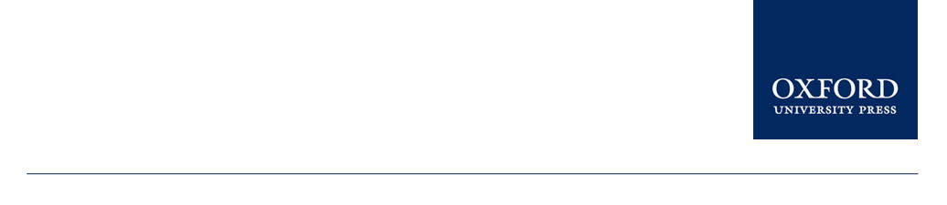
Economics of Monetary Union 14e
Paul De Grauwe
How to complete a monetary union

Slide 2
Introduction
The Eurozone is an incomplete construction.
How can such a union can be completed so that it becomes sustainable in the long run?
Collective action can be taken at the central banks and at governments levels

Slide 3
The role of the central bank: lender of last resort
In a monetary union there should be a role of the central bank as a lender of last resort in the domestic bond markets
Analogy with banks
Governments’ assets and liabilities in a monetary union have the same structure as those of the banks
ECB became lender of last resort in government bond markets in 2012 (‘Outright Monetary Transactions’ -OMTs)
the ECB attached a number of conditions to the application its OMT facility
Yet, programme was very successful: yields declined fast immediately after announcement, while ECB did not have to buy government bonds.

Slide 4
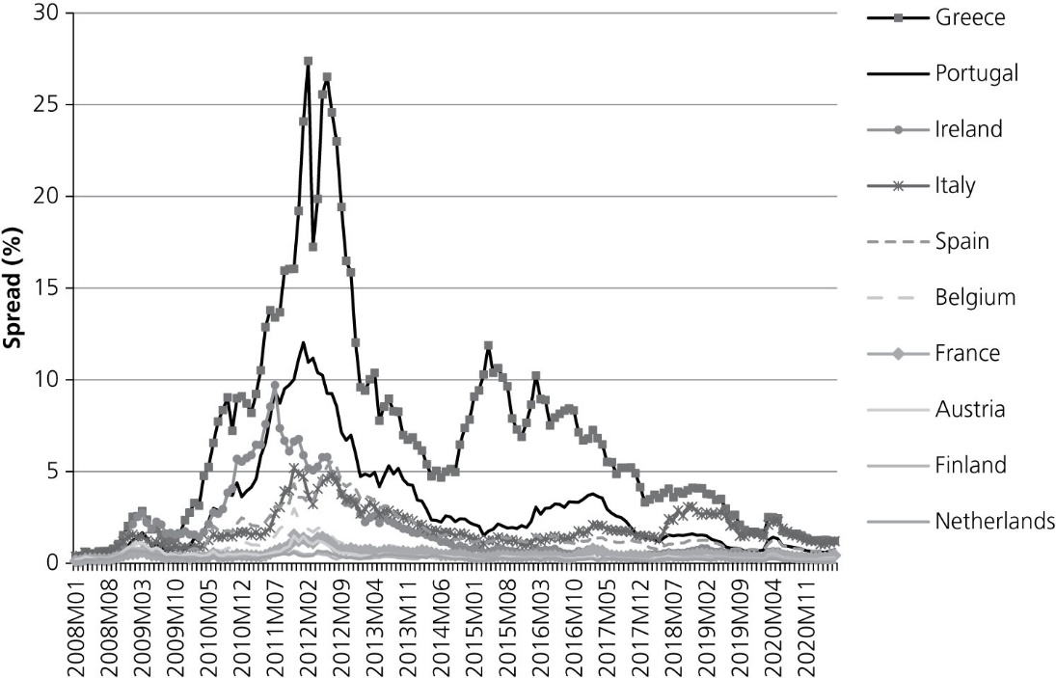
Figure 7.1 Spreads of 10-year government bond rates in the Eurozone, 2008–21.
Source: Eurostat

Slide 5
Criticism against lender of last resort function
Despite the success of the OMT programme, the latter is severely criticized especially in Germany
The Criticism:
inflation risk
money base vs money stock

Slide 6
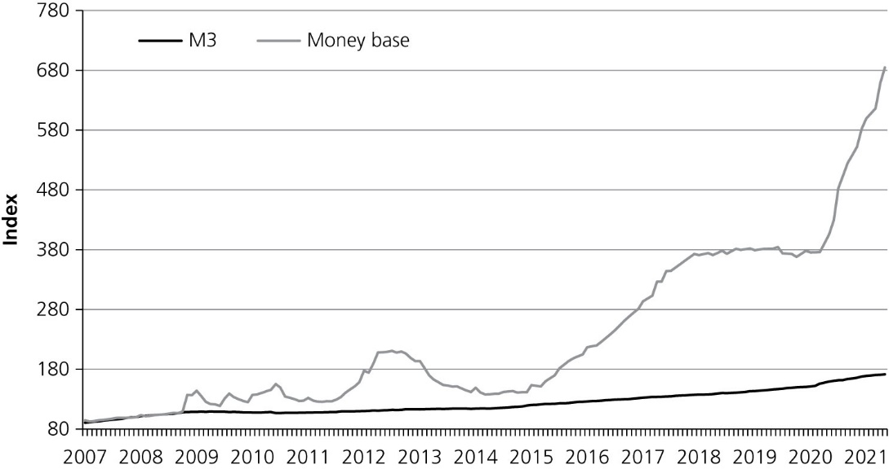
Figure 7.2 Money base and money stock (M3) in the Eurozone December 2007 = 100.
Source: ECB

Slide 7
Criticism against lender of last resort function
Despite the success of the OMT programme, the latter is severely criticized especially in Germany
The Criticism:
inflation risk
money base vs money stock
fiscal implications
Yet, all open market operations carry risk of losses
moral hazard
Liquidity provision should be performed by a central bank; the governance of moral hazard by another institution, the supervisor (European Commission)

Slide 8
Consolidating Government budget and debts
Second building block in the completion of the monetary union is budgetary.
Two dimensions of a budgetary union:
it implies a (partial) consolidation of the national government debts into one common debt
Creation of a common fiscal authority
By centralizing national government budgets into one central budget a mechanism of automatic transfers can be organized.
insurance mechanism
Budgetary union requires political union

Slide 9
A strategy of small steps
Joint issue of Eurobonds
Creating fiscal space: common unemployment insurance
A banking union
Coordination of budgetary and economic policies
to set some constraints on the national budgetary and economic policies of the member states of the Eurozone.
Six pack’ of measures: SGP; ‘European Semester’, monitoring of a number of macroeconomic variables
Road to political union: the omitted “deep” variable

Slide 10
Political economy of
deconstructing the Eurozone

Slide 11
Political union in the OCA theory
OCA theory has been used almost exclusively to analyse whether countries should join a monetary union.
It can also be used to study the conditions in which existing members of a monetary union will want to leave the union.
OCA theory says that if the benefits of the monetary union exceed the costs, member countries have no incentive to leave the union. They form an optimal currency area.

Slide 12
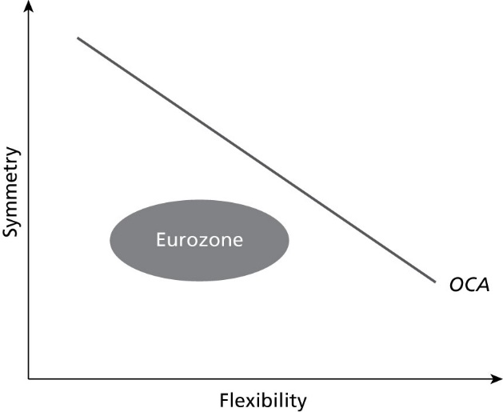
OCA analysis and sustainability of Eurozone
Figure 8.1 Symmetry and flexibility as OCA criteria.

Slide 13
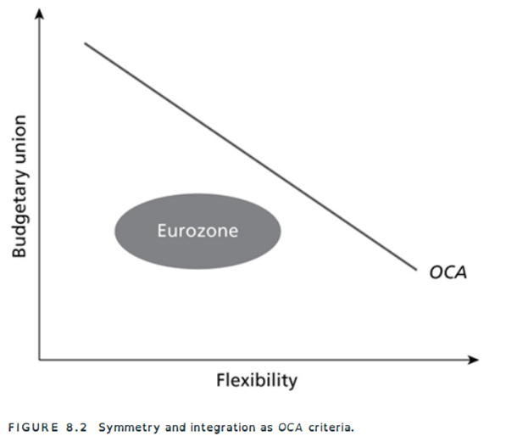
OCA analysis and sustainability of Eurozone
Figure 8.2 Symmetry and integration as OCA criteria.

Slide 14
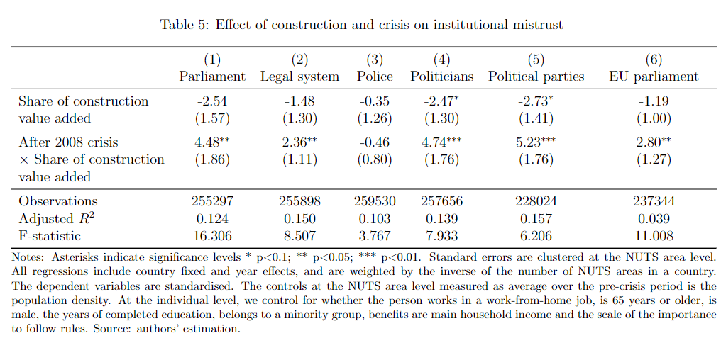
Source: Aghajanian, Caeiro, Egger, Justino and Lo Bue (2022)

Slide 15
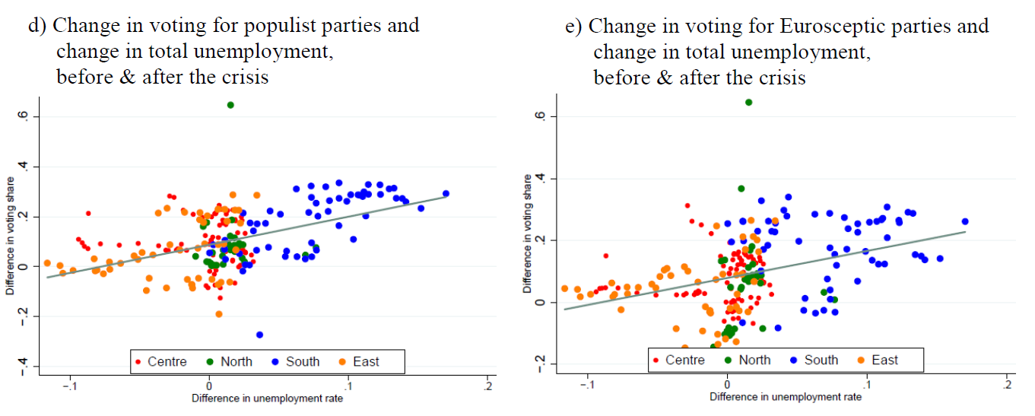
Source: Algan, Guriev, Papaioannou, Passari (2018)

Slide 16
Case studies of Greece and Italy
Cases studies of Greece and Italy show that the temptation to leave the Eurozone in these countries is high.

Slide 17
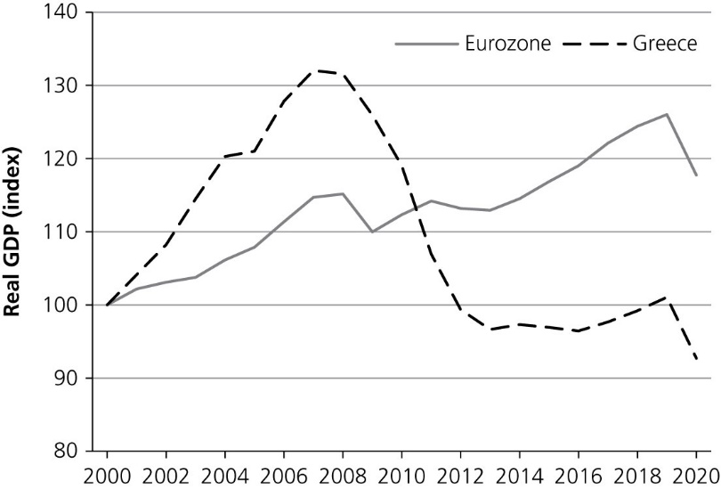
Greece
Figure 8.3 Real GDP Greece and Eurozone (2000 = 100).
Source: Eurostat.

Slide 18
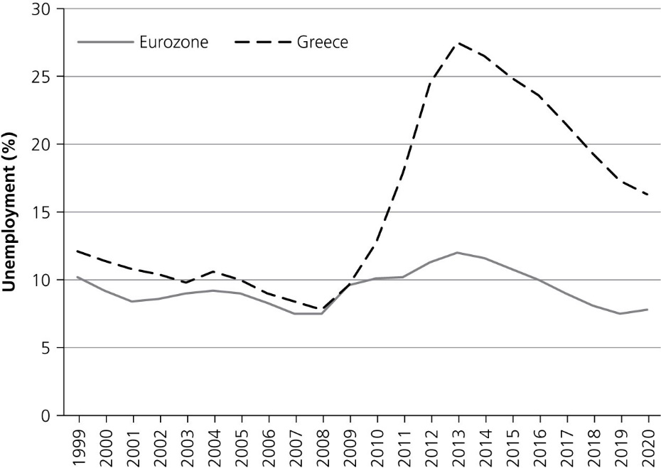
Greece
Figure 8.4 Unemployment rate in Greece and the Eurozone, 1999–2020 (%).
Source: Eurostat.

Slide 19
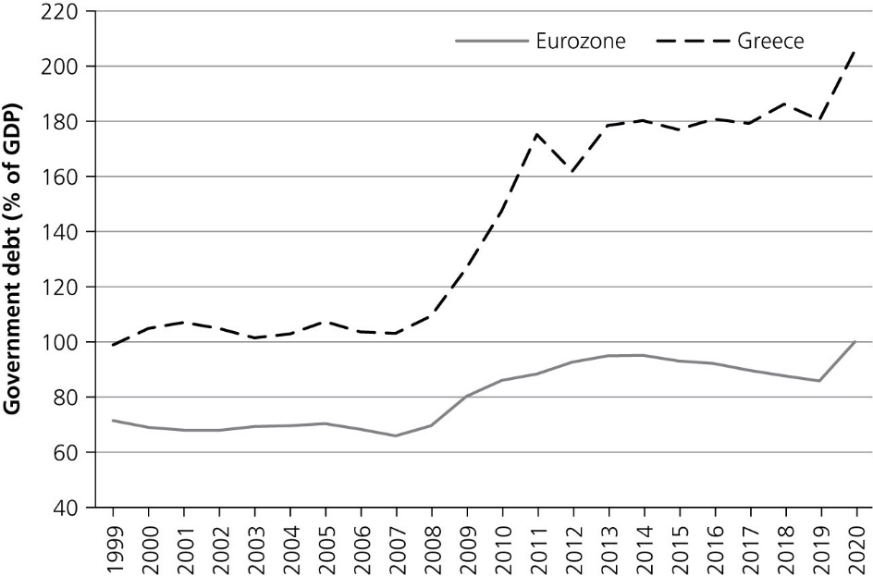
Greece
Figure 8.5 Government debt in Greece and the Eurozone, 1999–2020 (% of GDP).
Source: Eurostat.

Slide 20
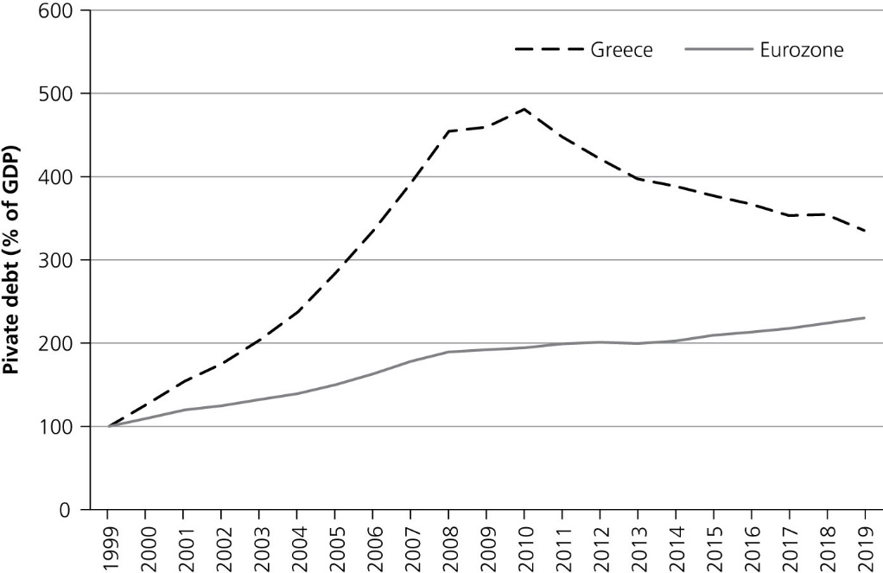
Greece
Figure 8.6 Private debt in Greece and Eurozone (1999 = 100).
Source: Eurostat.

Slide 21
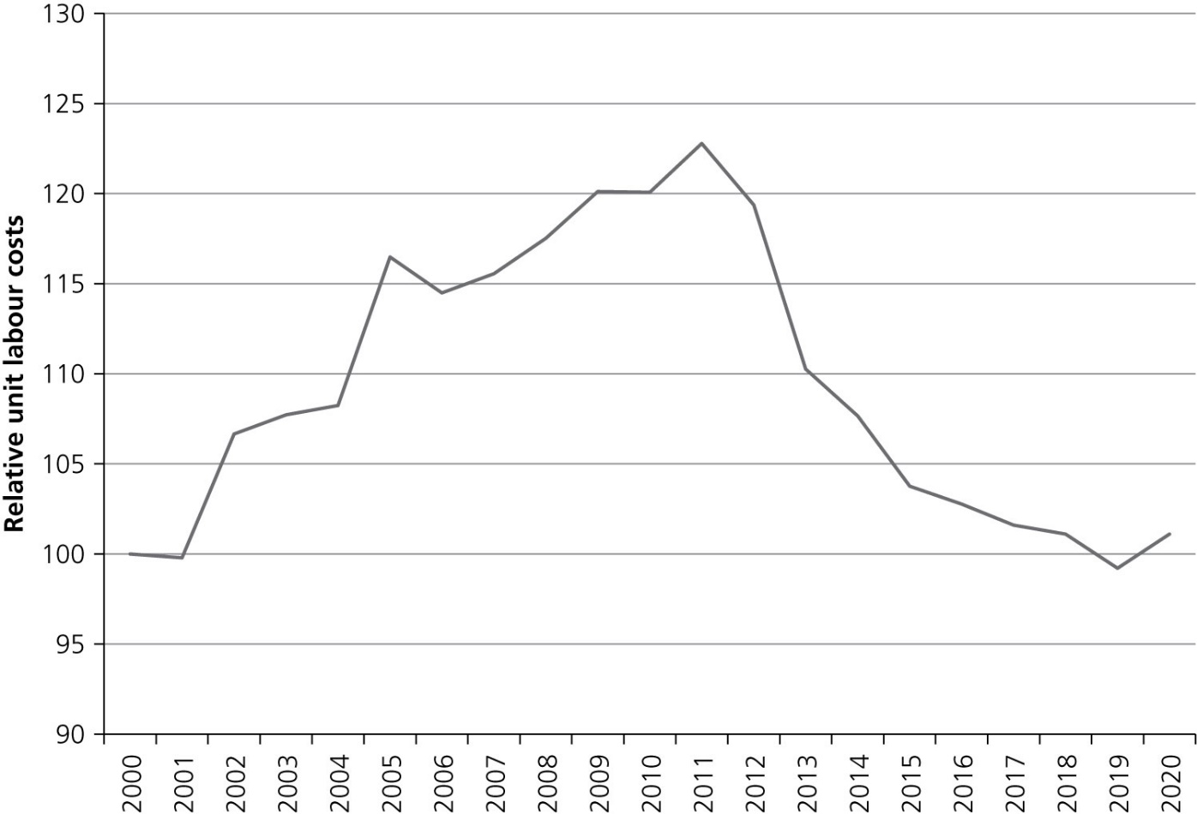
Greece
Figure 8.7 Relative unit labour costs in Greece, 2000–2020.
Source: European Commission, AMECO databank.

Slide 22
Greek drama illustrates two points about costs of monetary union
Adjustment costs after large asymmetric shock can be very high in a monetary union.
The fact that the government cannot issue debt in its own currency makes it prone to being pushed into illiquidity and insolvency

Slide 23
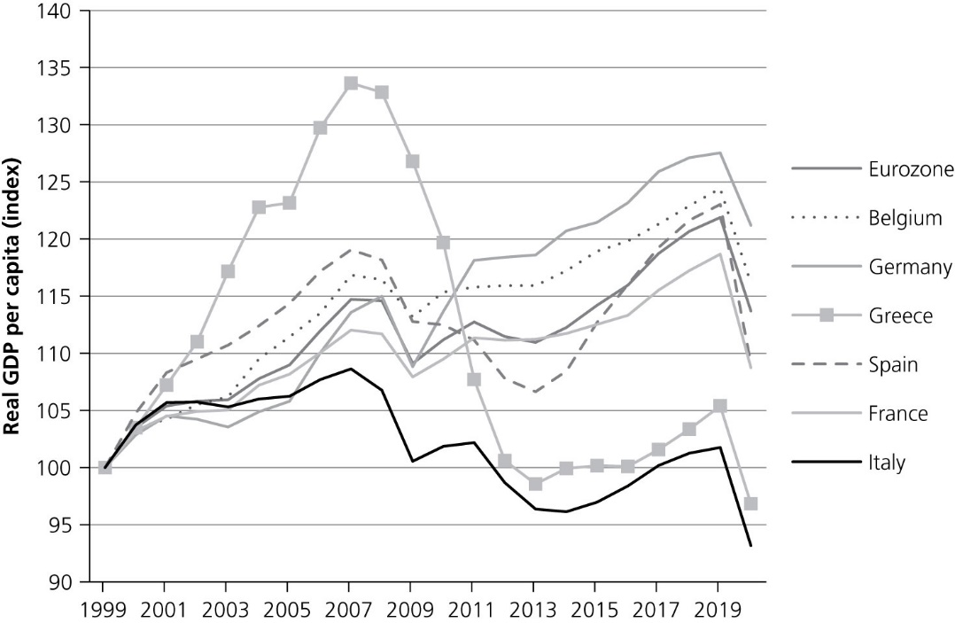
Italy
Figure 8.8 Real GDP per capita, 1999–2020 (1999 = 100).
Source: European Commission, AMECO databank.

Slide 24
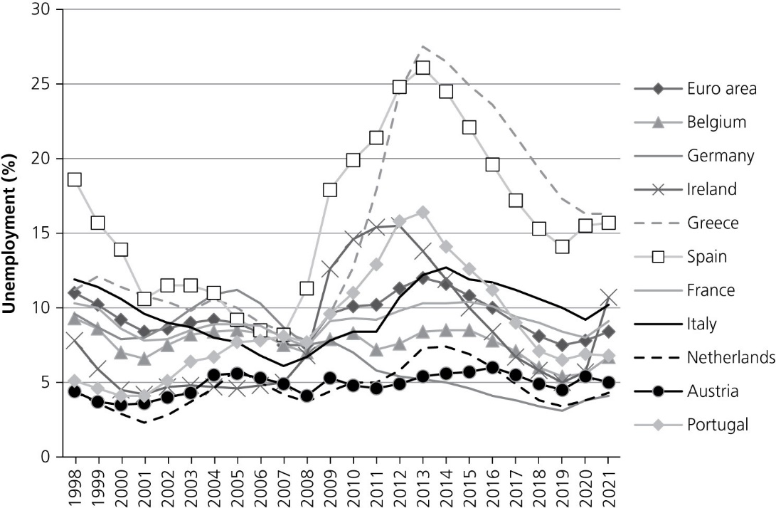
Italy
Figure 8.9 Unemployment rate (% of active population).
Source: European Commission, AMECO databank.

Slide 25
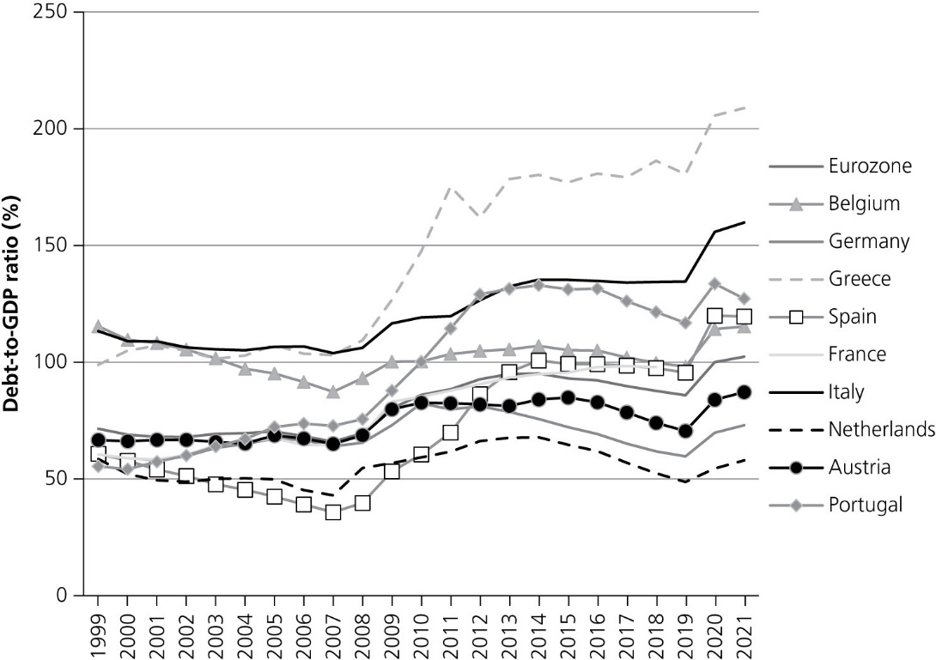
Italy
Figure 8.10 Government debt-to-GDP ratio, 1999–2021 (%).
Source: European Commission, AMECO databank.

Slide 26
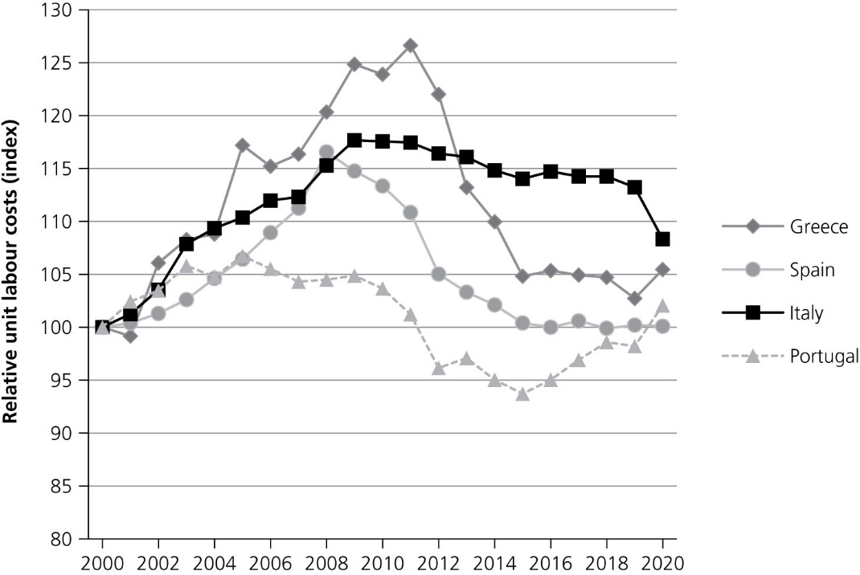
Italy
Figure 8.11 Relative unit labour costs in the Eurozone periphery, 2000–2020 (2000 = 100).
Source: European Commission, AMECO databank.

Slide 27
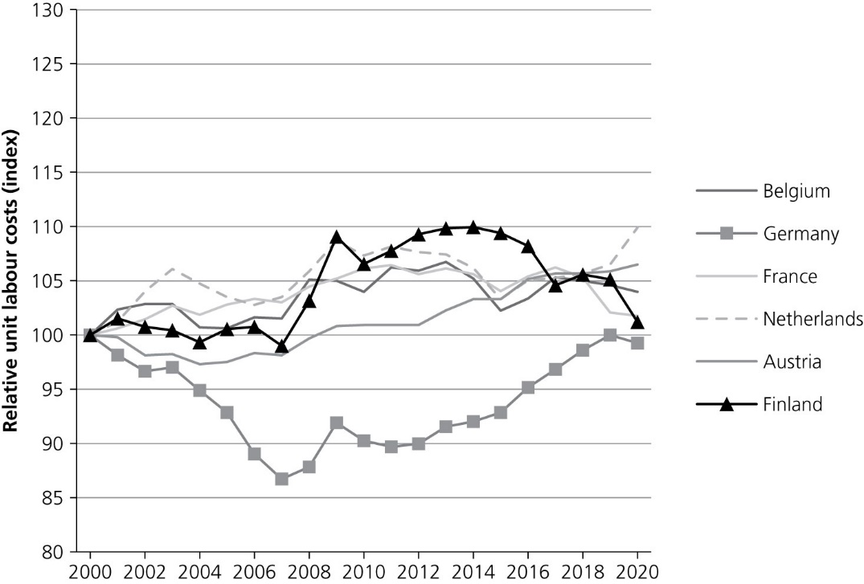
Not all the fault of Greece and Italy
Figure 8.11 Relative unit labour costs in the Eurozone periphery, 2000–2020 (2000 = 100).
Figure 8.12 Relative unit labour costs in Eurozone core (2000 = 100).
Source: European Commission, AMECO databank.

Slide 28
Towards deconstructing the Eurozone?
Adjustment costs in countries like Greece and Italy to asymmetric developments have been very high.
Should countries like Greece or Italy leave the Eurozone?
The costs and benefits of exiting are not just the reverse of the costs and benefits of being in the monetary union
Exit process itself may create large costs that have to be taken into account when deciding about exiting.

Slide 29
Costs of deconstruction
Capital flight
Default on the debt+depreciation of the new currency→Banking crisis
Combination of sovereign default, capital controls, and banking crisis would most certainly lead to a deep recession, leading to even more unemployment and fiscal problems

Slide 30
Devaluation will offset these results.
But this may take time
Testing the resilience of political system.
Two scenarios:
Greece’s political system is weak: Greece falls into political upheaval which could lead to exit from EU
Greece’s political system overcomes all this and after some time (thanks to devaluation) Greece recovers.

Slide 31
Will the rest of Eurozone be better off?
Two scenarios:
one optimistic
one pessimistic.
Uncertain which one will prevail.

Slide 32
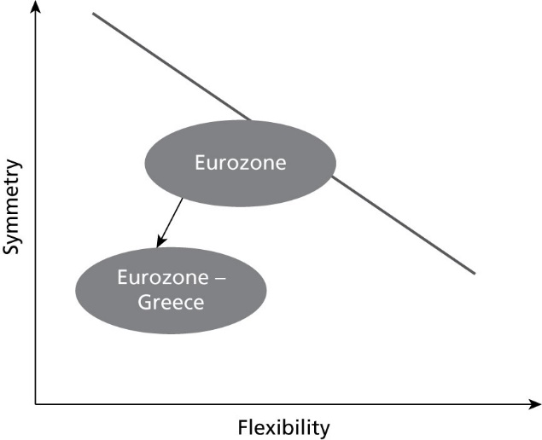
Pessimistic scenario
Figure 8.13 Grexit makes the Eurozone less optimal.
Permanent union becomes temporary union.
Leading to question: who is next?
This is likely to destabilize government bond markets.
Crises become endemic.
Further complication: denomination risk which leads to financial disintegration.

Slide 33
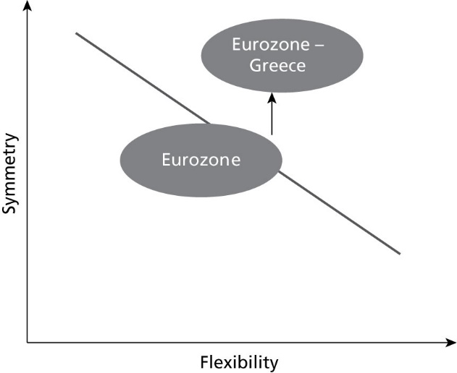
Optimistic scenario
Figure 8.14 Grexit makes the Eurozone an optimal currency area.
Fewer asymmetric shocks among remaining members.
Strengthens union.
Incentive to intensify political union increases.

