Slide 1
Energie Rinnovabili
Laurea Magistrale in Chimica
Lezione n.18
Federico Rosei
Trieste, Maggio 2023

Slide 2
n.18
Nuclear energy:
  nuclear fission
  nuclear fusion

Slide 3
Challenges of energy transition
The challenges of changing energy paradigm:
  we do not have a “silver bullet” solution;
  even if we had a quasi ideal solution, transitioning to a new paradigm will cause massive carbon emissions;
  (certain major technologies (e.g. long haul flights) can only function using liquid (usually fossil) fuels.

Slide 4
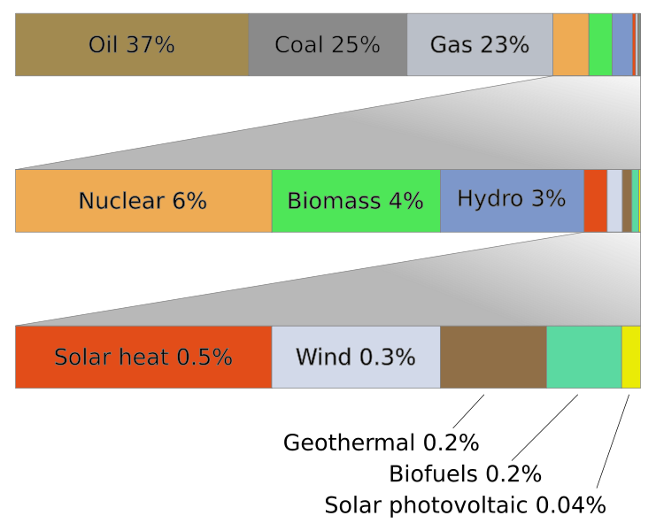
Alternative energy sources/vectors
Nuclear fission
Wind power
Hydroelectric
Solar
Nuclear fusion*
Hydrogen*
* Under development
“The nuclear power industry remains as safe as a chocolate factory”
-The Economist, March 29th 1986
(4 weeks before Chernobyl catastrophe)
Alternative is not enough! *Sustainable!*

Slide 7
Fission in Nuclear Plants

Slide 8
Efficiency of Nuclear Power
Energy released: E = mc²
Efficiency of generating plant: determined by using amount of energy used to generate 1 kWh of electricity (Btu/kWh)
Nuclear power plant efficiency relates to difference in temperature between steam from reactor & cooling water => thermal efficiency
The thermal efficiency range of current nuclear plants is about 33-37%

Slide 9
Advantages of Nuclear Energy
Energy efficiency
  Very high energy density compared to other current energy sources
Greenhouse gas emissions
  Nuclear reaction does not release carbon dioxide, methane or any other GHGs
Transportation
  Nuclear energy does not require large amounts of raw material (uranium) to generate power => easier to transport than other fuels.
Consistency and reliability
  Natural outside conditions (sun, wind, rain, etc.) have no impact on efficiency of nuclear power plants => can be used all year round with proper maintenance.

Slide 10
Disadvantages of Nuclear Energy
Radioactive waste emissions can last hundreds of years => requires long term storage with high safety measures
Uranium: non-renewable fuel; not available in many countries
When available, there are very strict rules set by the international community to prevent its mishandling
Nuclear accidents / explosions - very devastating in not only the short term, but also long term as radiation remains in the atmosphere
Exposure to nuclear radiation leaks is very harmful

Slide 11
Energy density: Nuclear vs. Fossil
*U-235: Uranium isotope
*LNG: liquidnaturalgas
*STP: Standard Temperature and Pressure

Slide 12
Major accidents
… that have undermined public confidence in nuclear energy:
  Chernobyl, 1986
  Fukushima, 2011
Most countries have phased out / are phasing out nuclear power

Slide 13
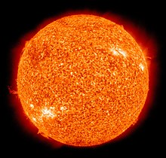
Nuclear fusion
Nuclear reactions that occur in stars
Theoretically unlimited clean energy
In practice, not (yet?) a viable technology
Never converges… 30 years ago ⬄ in 30 years
Today ⬄ another 30 years

Slide 14
Nuclear fusion
Reaction in which two or more atomic nuclei are combined to form one or more different atomic nuclei & subatomic particles (neutrons, protons). Difference in mass between reactants & products is manifested as release of energy
E = mc²
Major challenge: confining the reaction

