Slide 1
Energie Rinnovabili
Laurea Magistrale in Chimica
Lezione n.21
Federico Rosei
Trieste, Maggio 2023

Slide 2
n.21
Is it possible to develop a model for sustainability?

Slide 3
UN Definition of Sustainable Development:
“Meeting the needs of the present without compromising the ability of future generations to meet their own needs.”

Slide 4
Sustainable vs. Development
A contradiction in terms???

Slide 5
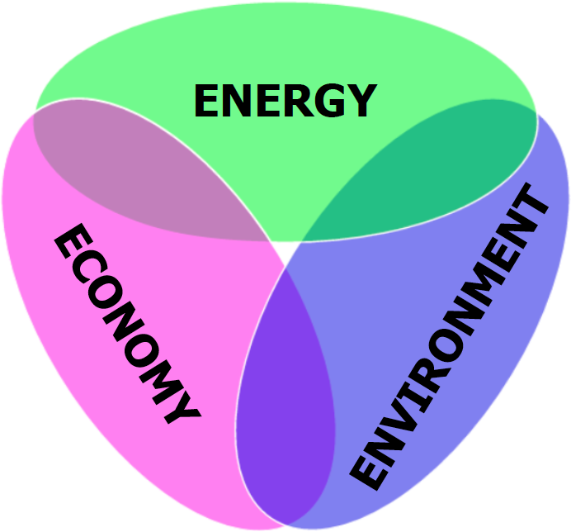
The Energy Trilemma
What is good for the economy, is bad for the environment

Slide 6
Energy, Environment
& Economy
Which variable drives the other ones?
Energy or Economy?

Slide 7
Connection between energy & other SDGs
1 No poverty
9 Industry, innovation
& infrastructure,
2 Zero hunger
3 Good health
& well-being
10 Reduced inequalities
11 Sustainable cities
& communities
4 Quality education
7 Affordable & clean energy
5 Gender equality
12 Responsible
Consumption & production
6 Clean water & sanitation
13 Climate Action
8 Decent work &
economic growth
15 Life on land

Slide 8
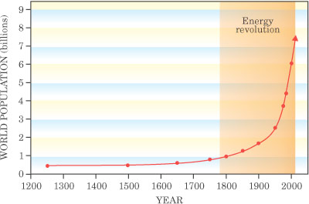
World Energy consumption increases continuously
Oil (in general: *non-renewable* fossil fuels) is still the most widely used Fuel of modern society
World population increases at a rate of ~200.000 inhabitants per day
(70 million per year)
Source: Physics Today

Slide 9
Population
Key towards attaining sustainability, or failing
More people need:
  more energy,
  more food,
  more clean water,
  more jobs,
  more health services
More people will:
  pollute more,
  create more waste,
  increase carbon emissions…

Slide 10
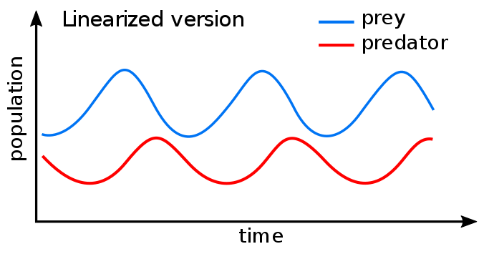
Lotka-Volterra model
Lotka-Volterra equations / predator-prey equations: pair of first-order nonlinear differential equations used to describe dynamics of biological systems in which two species interact: predator & prey

Slide 11
Variables in the model
x is the population density of prey;
y is the population density of some predator;
t represents time;
The prey's parameters, A and B, describe, respectively, the maximum prey per capita growth rate, and the effect of the presence of predators on the prey growth rate.
The predator's parameters, C, D, respectively describe the predator's per capita death rate, and the effect of the presence of prey on the predator's growth rate.

Slide 12
Sharks vs. fish
Typical behaviour: oscillating populations of predator vs. prey

Slide 13
Exponential vs. logistics

Slide 14
St. Paul island reindeer
Reindeer: predator
Grass: prey
St Paul island reindeer

Slide 15
Simplest case: hunter gatherer society
Humans are the predator
Food is the prey

Slide 17
Sustainability model
Population: Predator
Energy: Prey
This would be the simplest version.
However there are other variables, some of which also behave as prey or predator: food (prey), raw materials (prey), available surface (prey), waste, economic indicators, carbon emissions, etc.

Slide 18
Variables in the model
Time t is the only independent variable
H is human population (predator)
F is food (prey)
S is available surface (prey); F should be proportional to S.
R is raw materials (prey)
E = E_{f} + E_{r}
E_{f} is fossil fuels (prey); E_{r} is renewable energy (prey)
W is waste
C_{e} is greenhouse gas emissions (could be simplified as CO₂)
P is global domestic product
D is level of dissatisfaction
E is extreme events (random variable)

Slide 19
Brownian motion
Brownian motion is the random movement of particles in a liquid or gas. The movement occurs even if no external forces are applied. Particles never stay completely still.
Movement occurs because of particles colliding with each other in a liquid or gas. Similar to how billiard balls hitting cause them each to change direction, the same is true of molecules. Particle one hitting particle two will cause both particles to shift their momentum (direction and speed).

Slide 20
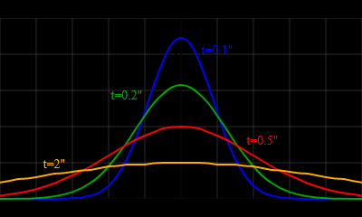
Random walk
Brownian movement is often modeled using a ‘random walk’. The distance of a particle from its starting position follows a Gaussian distribution, with the width of the Gaussian increasing over time => as time goes on, the particle is more likely to be further away from its starting location.

Slide 21
Surface diffusion: a 2 D random walk
E_{D}
ν = ν₀ exp(-E_{D}/kT)

Slide 22
Surface diffusion
E_{D}
hopping rate:
h = h₀ exp(-E_{D}/kT)
random walk:
⟨(Δx)²⟩ = λ² ht
T₁ T₂
λ - RMS jump length
P_{Δx}
tracer diffusion coefficient:
Δx
D = ⟨(Δx)²⟩/2t
D₀
E_{D}
D = D₀ exp(-E_{D}/kT)
ln D
with D₀ = h₀λ²/2
1/kT

Slide 23
Einstein and Brownian Motion
Albert Einstein published a paper in 1905 that described in precise detail how the motion that Brown had observed was a result of the pollen being moved by individual water molecules. This description of Brownian motion served as definitive confirmation that atoms and molecules actually exist, and was further verified experimentally by Jean Perrin in 1908. Perrin was awarded the Nobel Prize in Physics in 1926 for his work on the discontinuous structure of matter.

Slide 24
Brownian motion
& financial markets
Stock price movements form a random pattern. The prices fluctuate everyday resulting from market forces like supply and demand, company valuation and earnings, and economic factors like inflation, liquidity, demographics of country and investors, political developments, etc. Market participants try to anticipate stock prices using all these factors and contribute to make price movements random by their trading activities.

Slide 25

Black Scholes model
The Black–Scholes model assumes that the market consists of at least one risky asset, usually called the stock, and one riskless asset, usually called cash or bond.
If V is the price of the option (derivative financial product) as a function of stock price S and time t, r is the risk-free interest rate, and σ is the volatility of the stock
For a European call or put on an underlying stock paying no dividends, the equation is:

Slide 26


An Energy ‘Crisis’?
The word crisis has a Greek origin.
It means a divergence of paths, or “choice”
This character means “crisis” in Chinese; it is a composite character
=>
Means “Danger!”
=>
Means “Opportunity”

