Slide 1
Flame Pyrolysis
Particle Formation and Growth by Gas Phase Chemical Reaction, Coagulation, Sintering and Surface Growth:
O₂
TTIP
Molecules
TiO₂
Molecules
TiO₂
Particles
TiO₂
Aggregates
Decreasing Temperature
Titanium-Tetra-Iso-Propoxide
C₃H₇O
OC₃H₇
Ti
C₃H₇O
OC₃H₇

Slide 2
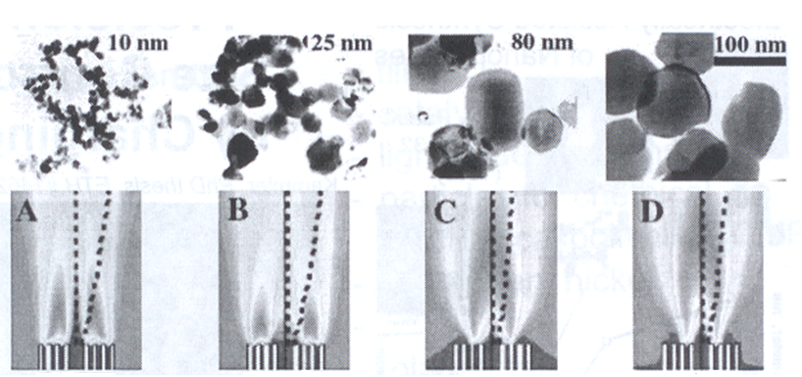
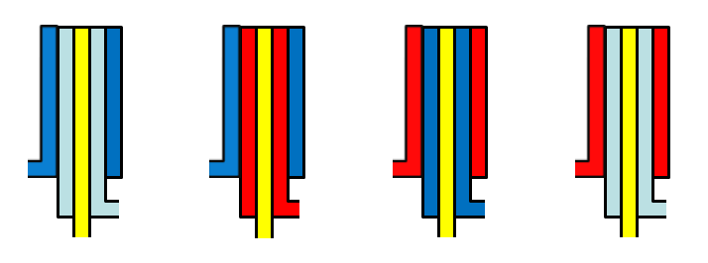
Flame Pyrolysis: Jet Design
CH₄
CH₄
Air
Air
Air
CH₄
Air
Air
TiCl₄
TiCl₄
TiCl₄
TiCl₄

Slide 3
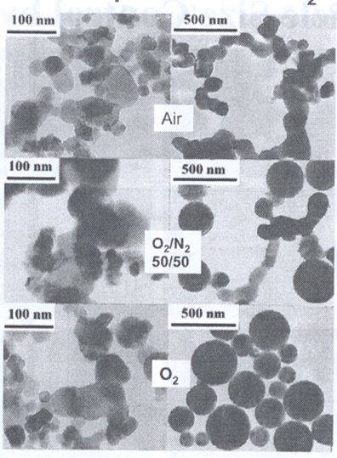
Flame Pyrolysis: Jet Design
Effect of Oxidant Composition on TiO₂ Morphology:
Flame mixing B
Flame mixing C
CH₄
Oxidant
Oxidant
CH₄
TiCl₄
TiCl₄

Slide 4
Flame Pyrolysis: Nozzle Quenching
Desired
Flame length is controlled by rapid quenching
Prevents agglomeration by inhibiting growth processes in the early stages of growth.
Provides precise control of particle size
Vapor

Slide 5
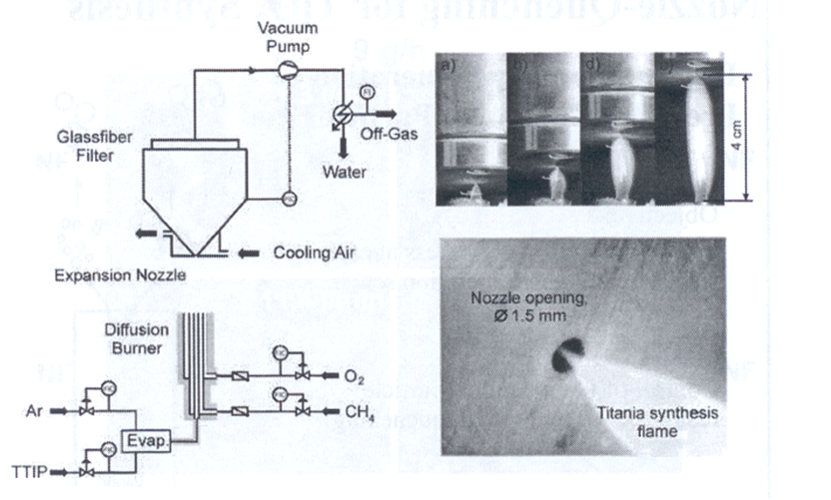
Flame Pyrolysis: Nozzle Quenching
Nozzle Quenching controls flame length and particle size.

Slide 6
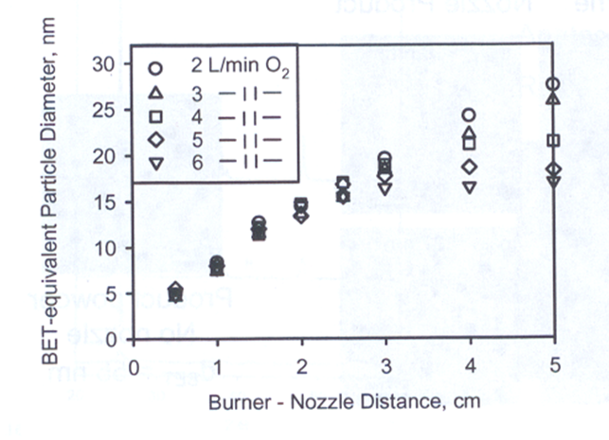
Flame Pyrolysis: Nozzle Quenching
TiO₂ Particle Size Control by Nozzle Quenching

Slide 7
Pyrolysis: Electrostatic Charging
Particle size can also be controlled by generating an electric field across the flame.
A large electric field (hundreds of kV/m) is generated between two plate electrodes situated on opposite sides of the flame.
Similar to nozzle quenching, the electric field limits particle growth by reducing the residence time in the high temperature region of the flame.
In addition, the electric field charges the particles. This results in electrostatic repulsion between newly formed particles, preventing coagulation.
S. Vemury, S.E. Pratsinis, L. Kibbey, Electrically-controlled flame synthesis of nanophase TiO₂, SiO₂, and SnO₂ powders. JMR, Vol. 12, 1031-1042. 1997.

Slide 8
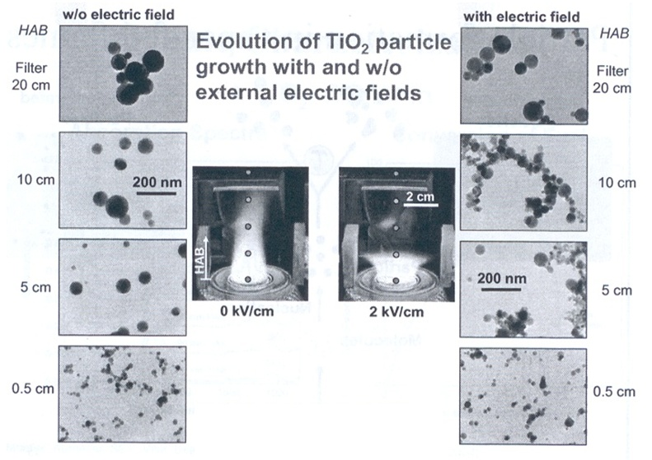
Pyrolysis: Electrostatic Charging

Slide 9
Flame Pyrolysis: Advantages & Disadvantages
Pyrolysis is a high yield method that can fulfill the strong demand for nanoparticles.
Can be customized to produce unique nanoparticles.
Broad distribution of particle sizes and morphology.

Slide 10
Spray Pyrolysis
An aerosol process that
atomize a solution and
heats the droplets to
produce solid particles.
Simple and low cost for powder and thin film deposition process
Applicable to large areas;
No need of exotic or expensive precursors;
No need of vacuum.

Slide 11
Spray Pyrolysis
Metals (Cu, Ni, Co,…) and metal oxides powders
Converting microsized liquid droplets of precursors or precursors mixture into solid particles trough heating
Droplets → evaporation → solute condensation → decomposition & reaction → sintering
e.g. silver particles made from Ag₂CO₃ or AgNO₃ with NH₄HCO₃ @ 400 °C

Slide 12
Spray Pyrolysis
The precursor must be dissolved in the liquid, but not react with it.
The product must not dissolve in the liquid, and must not react with the liquid.
There must be a large volume decrease for the reaction of precursor to product.
Transport of the leaching agent in the liquid and the fugitive compounds formed must be sufficiently rapid.

Slide 13
Spray Pyrolysis Advantages
Spherical morphology
Narrow particle size distribution
Easy preparation of powders with complex formation
Relatively homogeneous composition
Continuously production
Reaction occurs at the microcapsule reactor (droplets)

Slide 14
Spray Pyrolysis limitations
Technique is quite empirical, with a number of variables that can affect the final product:
- solute concentration
- atomization technique
- temperature, temperature gradient
- residence time in furnace
- carrier gases

Slide 15
Spray Pyrolysis

Slide 16
Spray Pyrolysis
Nozzle to substrate distance
Droplet size: relates to size of product
Substrate temperature
Solution concentration
Solution flow rate
Atomization rate – affects scalability of the process
Droplet velocity – affects residence time with the furnaces and ultimately size particle

Slide 17
Spray Pyrolysis

Slide 18
Spray Pyrolysis
Messing et al. J. Am.Ceram.Soc 1993

Slide 19
Spray Pyrolysis
Droplet to particles conversion process

Slide 20
Heating Time, Heating Temperature

Slide 21
Spray Pyrolysis

Slide 22
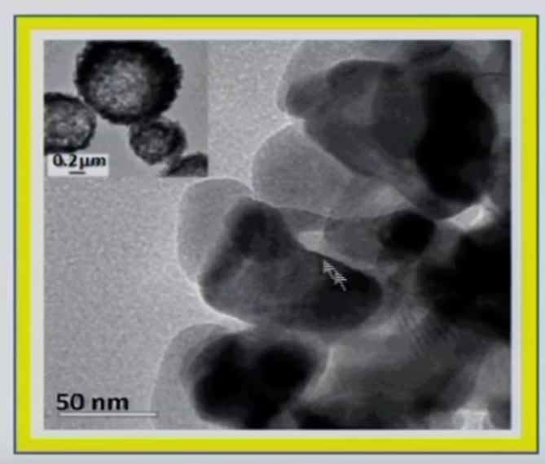
Spray Pyrolysis
Low temperature and high initial solute concentrations Dense particles (aggregates of nanocrystals)
High temperature and high solvent evaporation rate Hallow particles
Nanoparticle < 100 nm
Dilute solutions and
very small initial droplet size

Slide 23
Conventional Spray Pyrolysis

Slide 24
Low Pressure Spray Pyrolysis

Slide 25
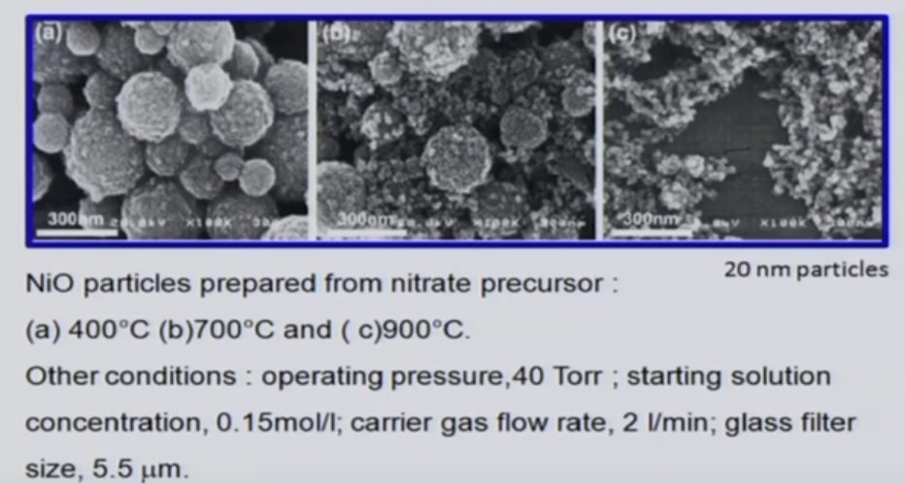
Low Pressure Spray Pyrolysis

Slide 26
Salt-assisted Spray Pyrolysis

Slide 27
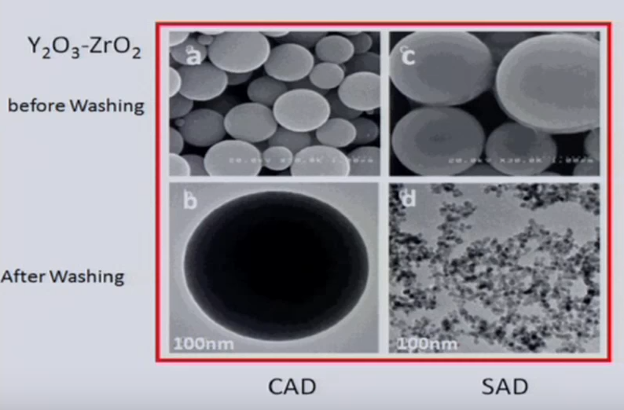
Conventional vs Salt-assisted Spray Pyrolysis
Conventional Salt-assisted

Slide 28
Electrospray Pyrolysis
By applying a 3KV electric field to the liquid coming from a cylindrical tube, it becomes conic.

Slide 29
Electrospray Pyrolysis

Slide 30
https://www.youtube.com/watch?v=I4w0nlrVU94

Slide 31
https://www.youtube.com/watch?v=hRDD4l1dzaI

Slide 32
Spray Process
https://www.youtube.com/watch?v=mmtXFlIQD9E

Slide 33
Spray Pyrolysis: nanofilm
https://www.youtube.com/watch?v=eJbuY4HJFV0

Slide 34
Flame Spray Pyrolysis: nanofilm
https://www.youtube.com/watch?v=pAYsH7xnV6s

Slide 35
Chemical Vapor Deposition
Chemical vapor deposition (CVD) is a vacuum deposition method used to produce high quality, high-performance, solid materials from a gas precursor.
Thermal decomposition :
SiH₄ (g) ⟶ Si (s) + 2 H₂ (g) 650 °C
Reduction :
WF₆ (g) + 3 H₂ (g) <-> W(s) + 6 HF (g) 300 °C
Oxidation :
SiH₄ (g) + O₂ (g) ⟶ SiO₂ (s) + 2 H₂ (g) 450 °C
Compound formation :
BF₃ (g) + NH₃ (g) ⟶ BN (s) + 3 HF (g) 1100 °C

Slide 36
Chemical Vapor Deposition

Slide 37
https://www.youtube.com/watch?v=9XKGVHPXXho

Slide 38
Oxides preparation
Various metal oxides can be prepared by the reaction of a volatile metal compound (often a chloride) with O₂ or water vapor:
MX_{n} (g) + (n/4) O₂ (g) → MO_{n/2} (s) + (n/2) X₂ (g)
MX_{n} (g) + (n/2) H₂O (g) → MO_{n/2} (s) + n HX₂ (g)
The water vapor can be directly introduced or obtain in the reaction chamber from a suitable reaction:
1) CO₂ + H₂ ↔ CO + H₂O
2) O₂ + H₂ → H₂O
3) C_{x}H_{y} + O₂→ CO₂ + H₂O

Slide 39
Chemical Vapor Deposition
Ultrahigh vacuum CVD (UHVCVD) – CVD at very low pressure, typically below 10⁻⁶ Pa ( ≈ 10⁻⁸ torr).
Low-pressure CVD (LPCVD) – CVD at sub-atmospheric pressures. Reduced pressures tend to reduce unwanted gas-phase reactions and improve product uniformity.
Atmospheric pressure CVD (APCVD) – CVD at atmospheric pressure.

Slide 40
LPCVD
https://www.coursera.org/lecture/nanotechnology/chemical-vapor-deposition-process-demonstration-EWSQl

Slide 41
CVD Classification by type of substrate heating
Hot wall CVD – CVD in which the chamber is heated by an external power source and the substrate is heated by radiation from the heated chamber walls.
Cold wall CVD – CVD in which only the substrate is directly heated either by induction or by passing current through the substrate itself or a heater in contact with the substrate. The chamber walls are at room temperature.

Slide 42
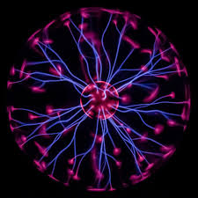
CVD and Plasma methods
Plasma is a state of matter in which an ionized gases becomes highly electrically conductive to the point that long-range electric and magnetic fields dominate the behavior of the matter.
Plasma Enhanced CVD (PECVD)
CVD that utilizes plasma to enhance chemical reaction rates of the precursors. PECVD processing allows deposition at lower temperatures, which is often critical in the manufacture of semiconductors. The lower temperatures also allow for the deposition of organic coatings, such as plasma polymers, that have been used for nanoparticle surface functionalization.

Slide 43
https://www.youtube.com/watch?v=gtJqNqXLg9w

Slide 44
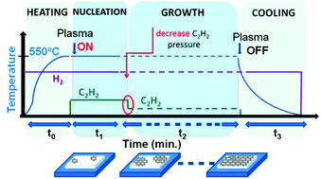
Direct synthesis of graphene on silicon oxide by low temperature plasma enhanced chemical vapor deposition
Nanoscale, 2018,10, 12779-12787

Slide 45
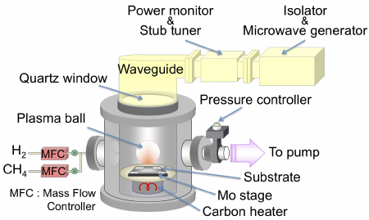
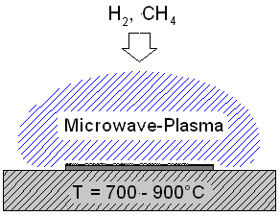
Microwave plasma-assisted CVD (MPCVD)

Slide 46
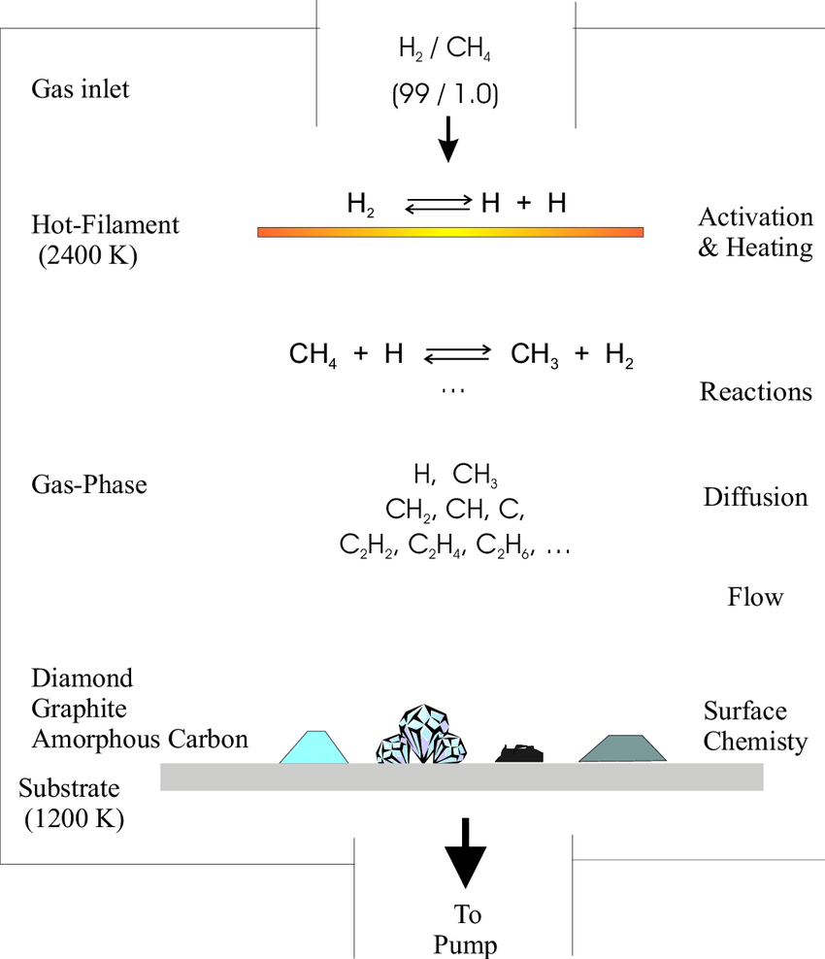
MW Plasma
Dissociation

Slide 47
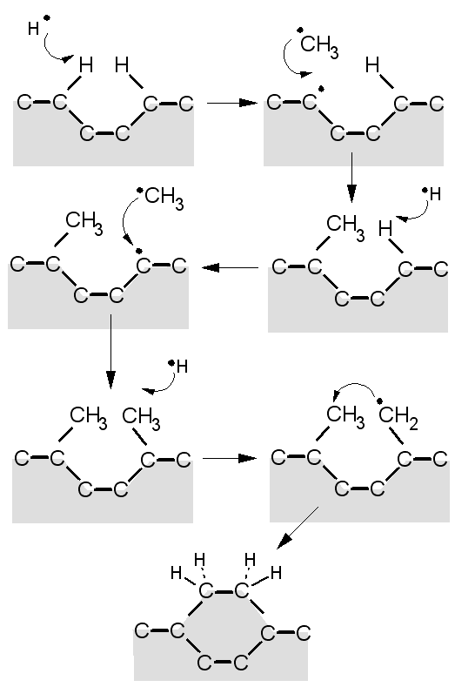
https://www.youtube.com/watch?v=n4hjudErUsQ
http://www.chm.bris.ac.uk/pt/diamond/mwpecvd1.htm

Slide 48
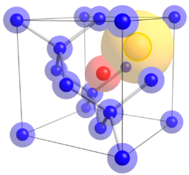
N-V center defect consists of a nitrogen atom in place of a carbon atom next to a vacancy within the diamond’s lattice structure.
Nitrogen-vacancy Center: the blue atoms represent Carbon atoms, red atom represents Nitrogen atom substituting for a Carbon atom, and yellow atom represents a lattice vacancy

Slide 49
Nanodiamonds: inertness and hardness
Skin care: Nanodiamonds are well-absorbed by human skin. They also absorb more of the ingredients in skin care products than skin itself. Thus they cause more of the ingredients to penetrate the deeper layers of the skin. Nanodiamonds also form strong bonds with water, helping to hydrate the skin.
Micro-abrasive: Polishes and engine oil additives for lubrication.
Catalysis: Support or metal free catalyst
Medical: low cytotoxicity of diamond nanoparticles affirms their utilization as biologically compatible materials. Drug delivery.
Sensors: electro- mechanical- system and response to magnetic field.
Optical and Quantum computing: Single-defect nanodiamonds.

Slide 50
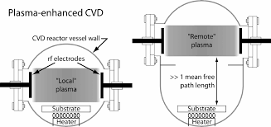
Remote Plasma-Enhanced CVD (RPECVD)
Similar to PECVD except that the wafer substrate is not directly in the plasma discharge region. Removing the wafer from the plasma region allows processing temperatures down to room temperature.

Slide 51
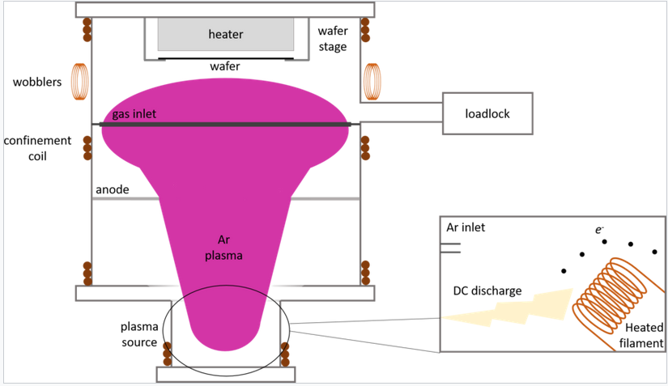
Low-Energy Plasma-Enhanced CVD (LEPECVD)
CVD employing a high density, low energy plasma to obtain epitaxial deposition of semiconductor materials at high rates and low temperatures.

Slide 52
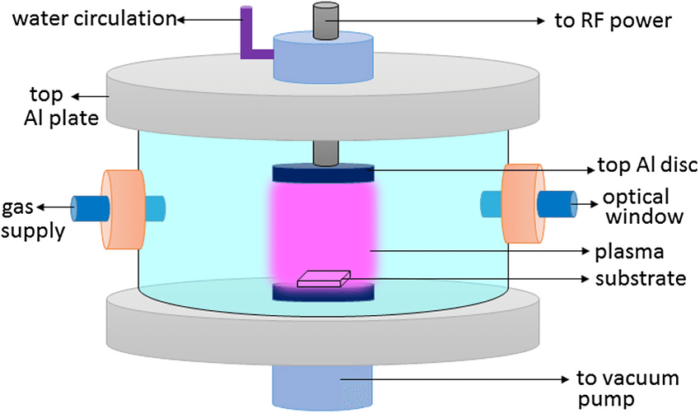
RF Plasma Synthesis

Slide 53
RF Plasma Synthesis
https://www.youtube.com/watch?v=5Un_HnOl6lQ

