Slide 1
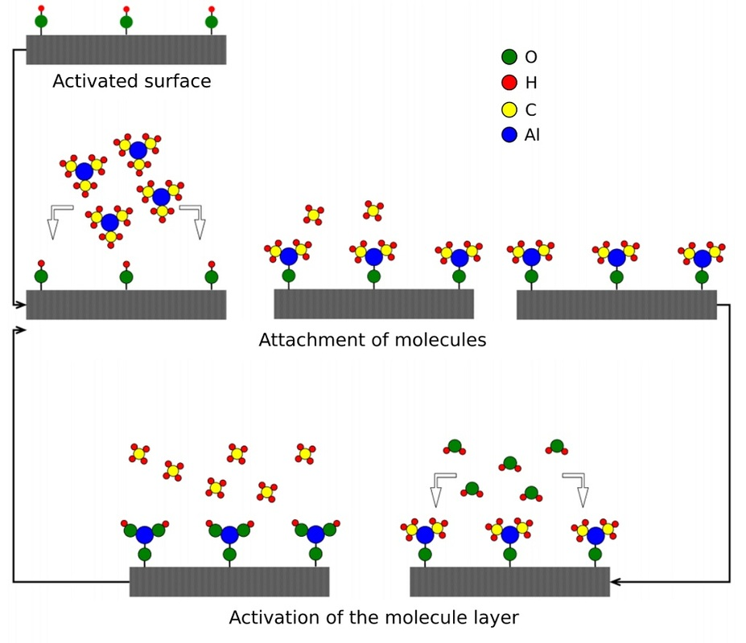
Atomic-layer CVD (ALCVD or ALD)
Deposits successive layers of different substances to produce layered, crystalline films.
Alternate sequence of reactant
gasses
Metal halides, alkoxides,
β-diketonates, alkyls, and cyclopentadienyls
Temperature to induce a chemical reaction but not metal precursor decomposition!!!

Slide 2
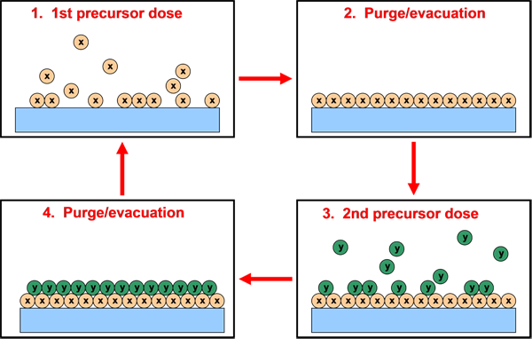
Atomic-layer CVD (ALCVD)
Advantages: Disadvantages:
Very high film quality Very slow: 0.01 nm/s
Wide range of materials Costs of precursors
Thickness control on atomic scale Waste of precursors in gas feed
Superior processability Limeted temperature windows

Slide 3
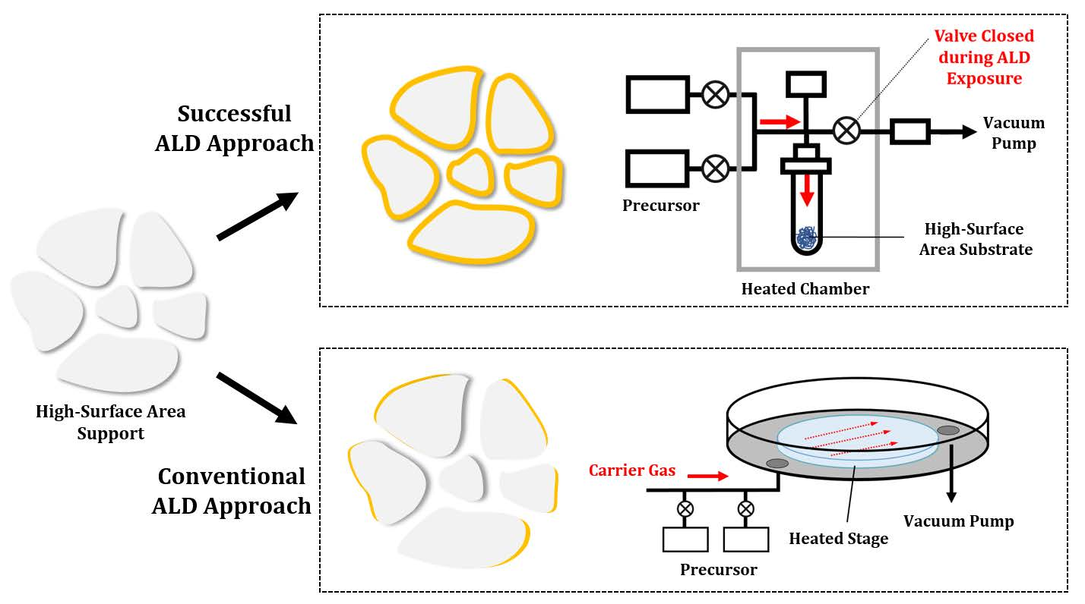
Atomic-layer CVD (ALCVD)
Inorganics, 2018, 6, 34.

Slide 4
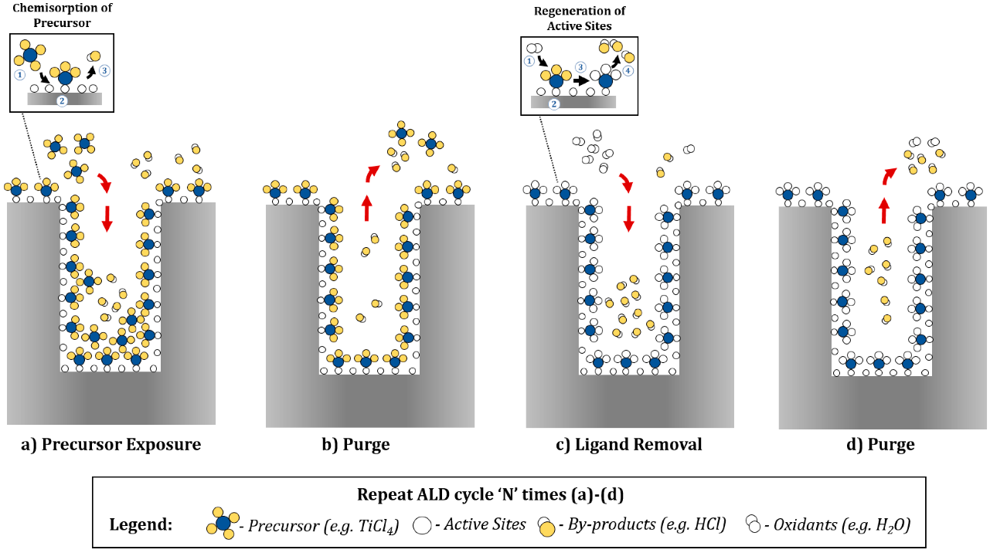
Atomic-layer CVD (ALCVD)
Inorganics, 2018, 6, 34.

Slide 5
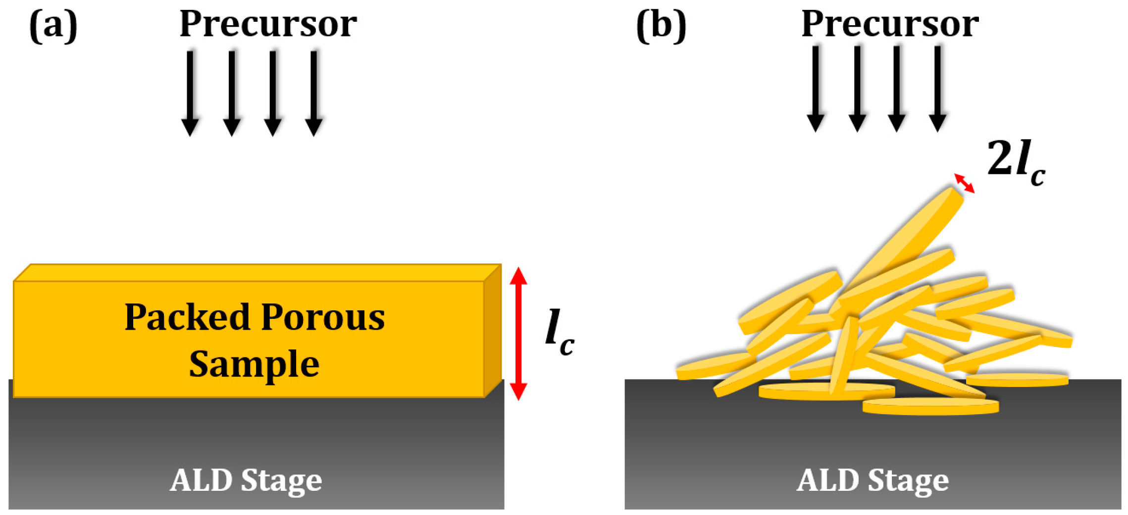
Atomic-layer CVD (ALCVD)
Exposure times can be very long. The diffusion length must be kept short. This can be accomplished by forming the powders into thin wafers, rather than having a freestanding bed of powder. Increasing the pressure of the precursor also can significantly decrease the required exposure time. In some cases, the development of new, highly volatile precursors may be necessary.

Slide 6
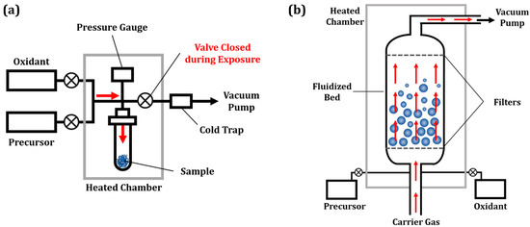
Atomic-layer CVD (ALCVD)
After the exposure step, excess precursor molecules and byproducts from the substrate must be removed by purging. This can be the longest step in the ALD cycle. In order to increase the production rate of wafers in the semiconductor industry, flow ALD systems with He as the carrier gas are used to flush gas-phase and physisorbed molecules from the sample. This is not trivial for a porous sample, since the excess precursor molecules and byproducts in the pores must diffuse to the to the exterior of the pore while in the presence of the carrier gas molecules.

Slide 7
Atomic-layer CVD (ALCVD)
Obviously, when the purging step is incomplete, physisorbed precursor molecules may remain within the pore. Introducing the next reactant will lead to the reaction of these condensed species.
the formation of non-uniform films;
the formation of porous films;
the production of films that are much thicker than would be expected for ALD.
The reaction of condensed films has been invoked as an explanation for the thick porous films formed by ALD procedures in SOFC electrodes.

Slide 8
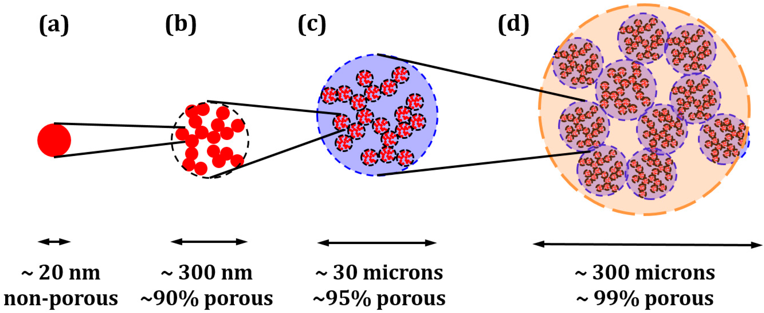
Atomic-layer CVD (ALCVD)
Fluidized bed ALD reactor designed for deposition on porous samples.

Slide 9
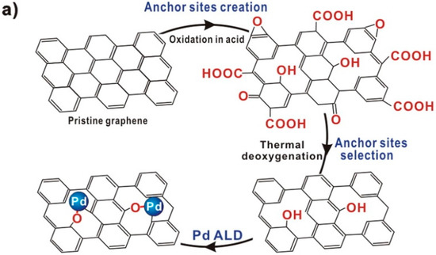
Atomic-layer CVD (ALCVD)

Slide 10
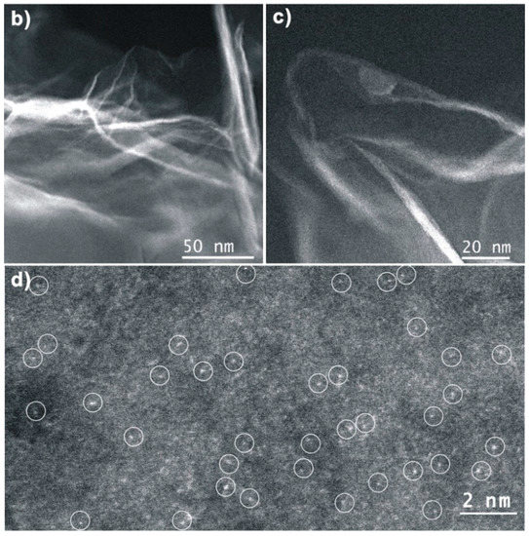
Atomic-layer CVD (ALCVD)

Slide 11
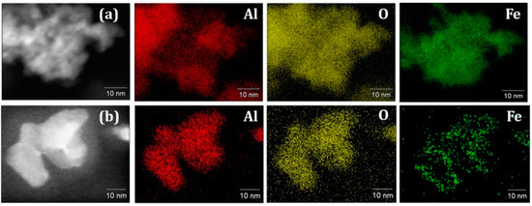
Atomic-layer CVD (ALCVD)

Slide 12
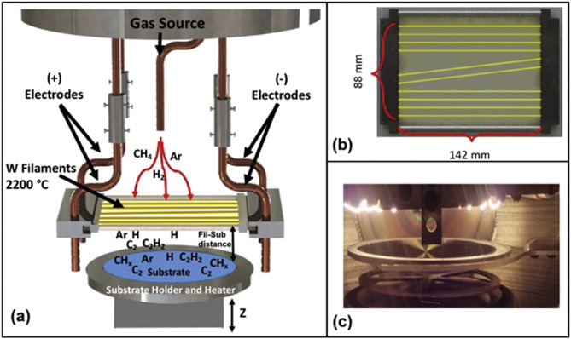
Hot filament CVD (HFCVD)
This process uses a hot filament to chemically decompose the source gasses. The filament temperature and substrate temperature thus are independently controlled, allowing colder temperatures for better absorption rates at the substrate and higher temperatures necessary for decomposition of precursors to free radicals at the filament.
It is also known as catalytic CVD (Cat-CVD) or more commonly, initiated CVD (iCVD).

Slide 13
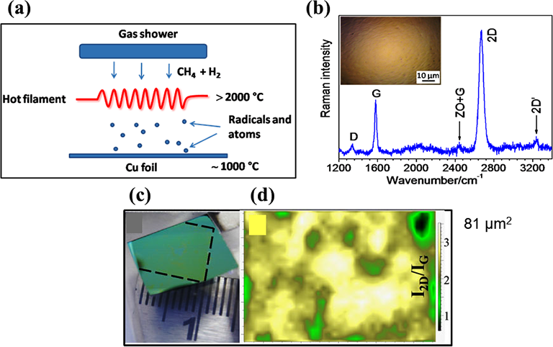
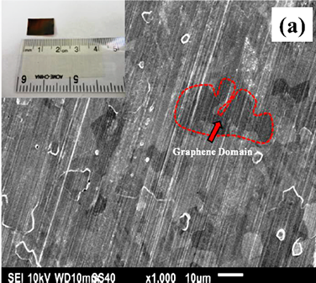
Hot filament CVD (HFCVD)
(a) Schematic diagram of the HFCVD used, (b) Raman spectra of the graphene obtained, (c) picture of the graphene transferred on SiO₂ substrate, and (d) Raman mapping of a selected area of the hydrogenated graphene.
(a) SEM micrograph of graphene films on Cu surface with optical photograph shown in the inset
https://www.intechopen.com/books/chemical-vapor-deposition-recent-advances-and-applications-in-optical-solar-cells-and-solid-state-devices/hot-filament-chemical-vapor-deposition-enabling-the-scalable-synthesis-of-bilayer-graphene-and-other

Slide 14
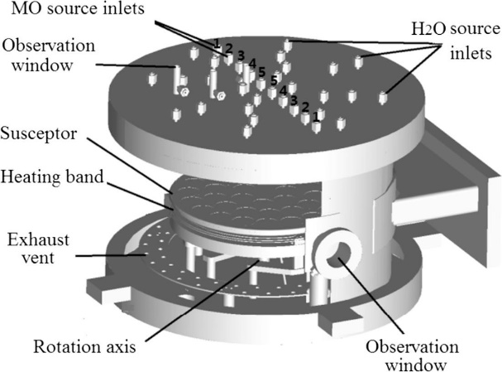
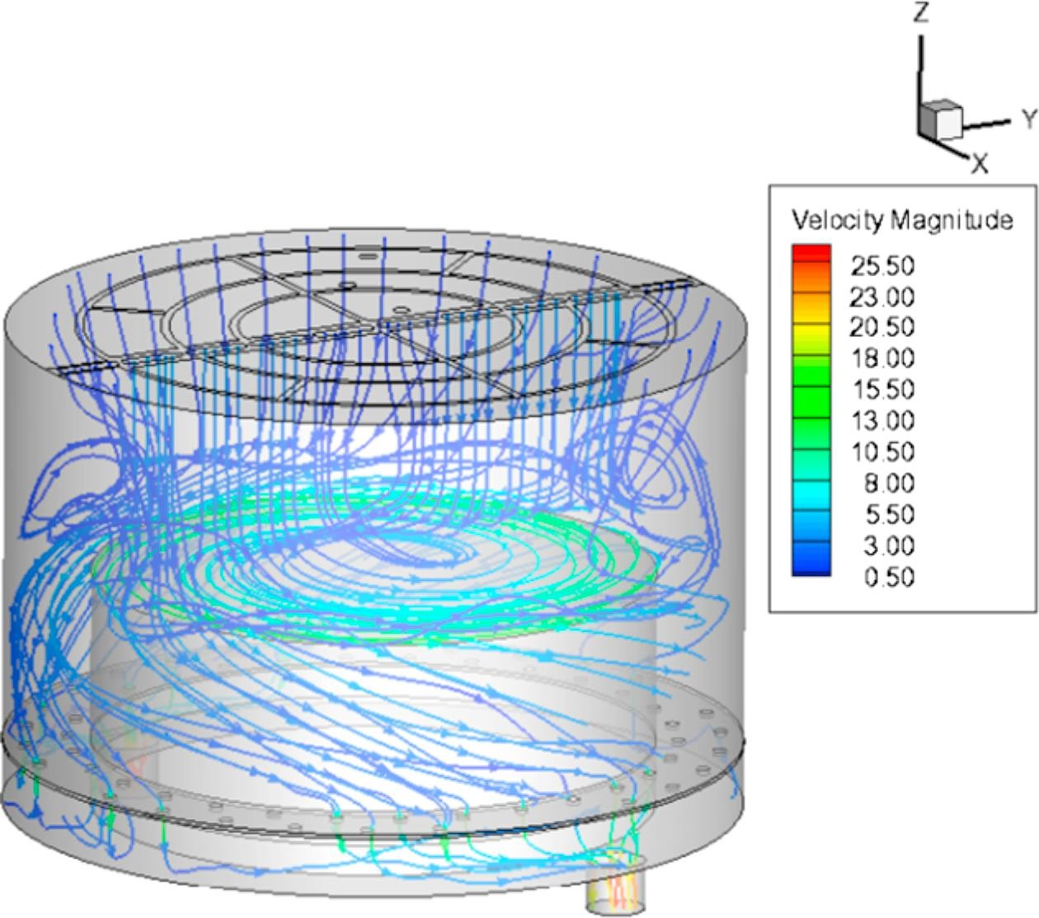
Metalorganic chemical vapor deposition (MOCVD)
This CVD process is based on metalorganic precursors.
Zn(CH₂CH₃)₂ / H₂O / Ar
Applied Thermal Engineering
Volume 136, 25 May 2018, Pages 108-117
Geometry of the ZnO-MOCVD reactor.

Slide 15
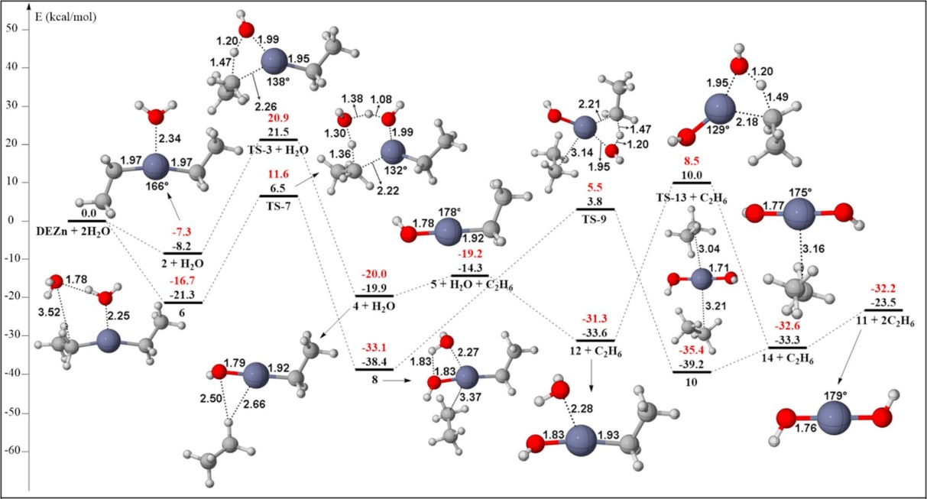
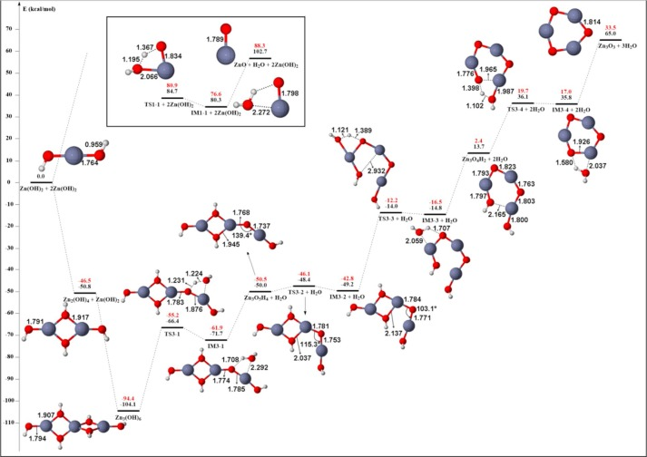
Metalorganic chemical vapor deposition (MOCVD)
This CVD process is based on metalorganic precursors.
Applied Thermal Engineering
Volume 136, 25 May 2018, Pages 108-117

Slide 16
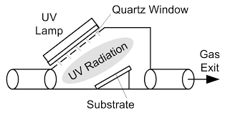
Photo-initiated CVD (PICVD)
This process uses UV light to stimulate chemical reactions. Under certain conditions, photo initiated CVD can be operated at or near atmospheric pressure.

Slide 17
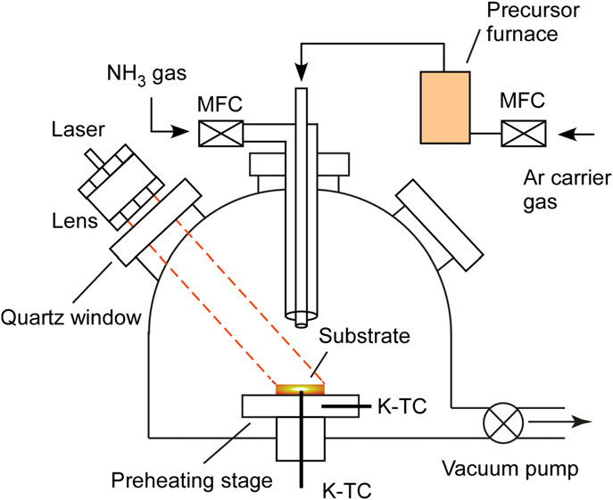
Laser Chemical vapor deposition (LCVD)
This CVD process uses lasers to heat spots or lines on a substrate in semiconductor applications. In Micro Electro-Mechanical Systems (MEMS) and in fiber production the lasers are used rapidly to break down the precursor gas to build up a solid structure.
Laser induced temperature can exceed 2000 °C.

Slide 18
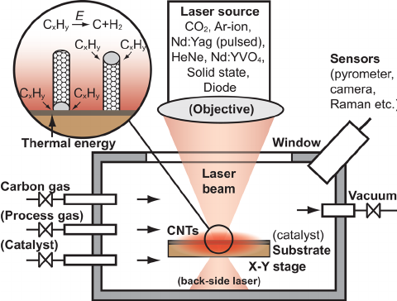
Laser Chemical vapor deposition (LCVD)

Slide 19
Rapid thermal CVD (RTCVD) – This CVD process uses heating lamps or other methods to rapidly heat the wafer substrate. Heating only the substrate rather than the gas or chamber walls helps reduce unwanted gas-phase reactions that can lead to particle formation.
Hybrid Physical-Chemical Vapor Deposition (HPCVD) – This process involves both chemical decomposition of precursor gas and vaporization of a solid source.

Slide 20
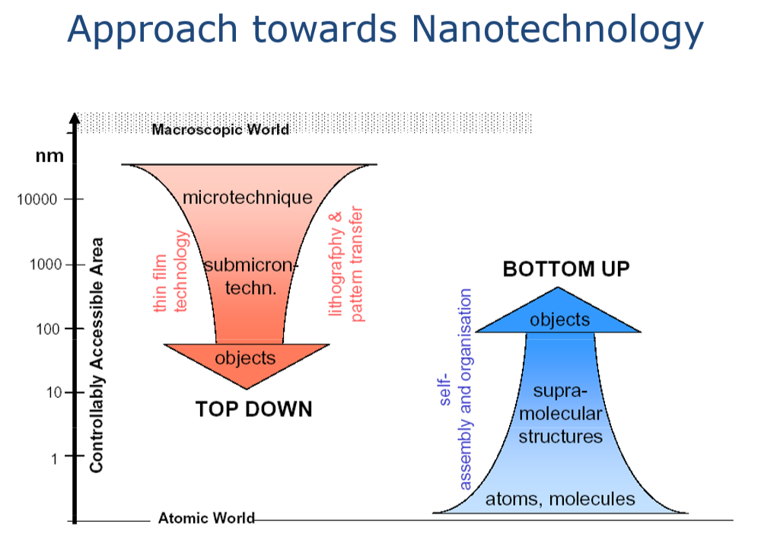

Slide 21
Nanolithography
Lithography uses simple chemical processes to create an image. The printing is from a stone (lithographic limestone) or a metal plate with a smooth surface.
Nanolithography deals with the engineering (etching, writing, printing) of nanometer-scale structures.
All nanolithographic techniques can be separated into two categories:
- etch away molecules leaving behind the desired structure;
- directly write the desired structure to a surface.
• in the fabrication of integrated circuits (IC)
• information storage devices
• fabrication of micro-electromechanical systems (MEMS)
• minute sensors
• nano and microfluidic devices
• biochips
• photonics
.

Slide 22
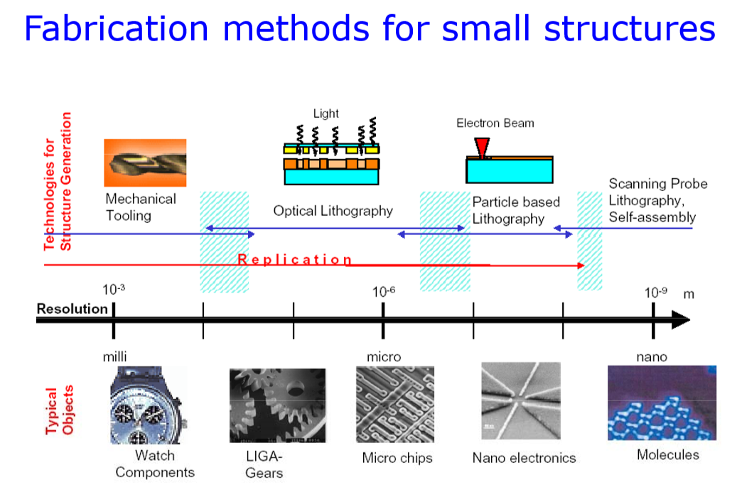

Slide 23
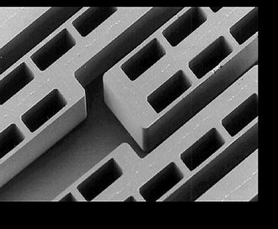
LIGA
Lithographie, Galvanoformung, Abformung (Lithography, Electroplating, and Molding)
There are two main LIGA-fabrication technologies, X-Ray LIGA, which uses X-rays produced by a synchrotron to create high-aspect ratio structures, and UV LIGA, a more accessible method which uses ultraviolet light to create structures with relatively low aspect ratios.
high aspect ratios on the order of 100:1
parallel side walls with a flank angle on the order of 89.95°
smooth side walls with suitable for optical mirrors
structural heights from tens of micrometers to several millimeters
structural details on the order of micrometers over distances of centimeters
SEM picture of a polymer LIGA structure made by moulding. Smallest polymer width is 6 µm; polymer height is 120 µm, the aspect ratio is, therefore, 20.

Slide 24
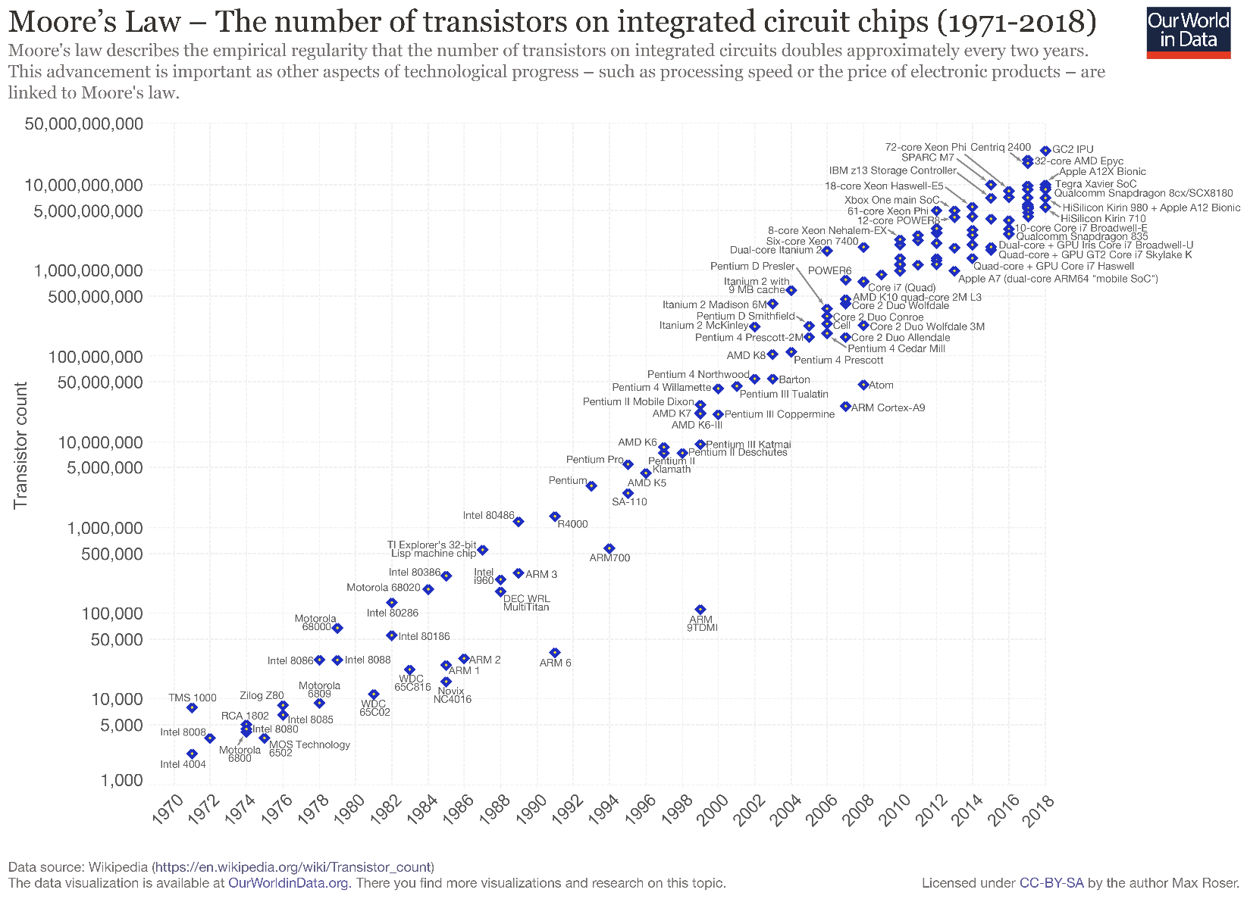
The field of nanolithography was born out of the need to increase the number of transistors in an integrated circuit in order to maintain Moore's Law.

Slide 25
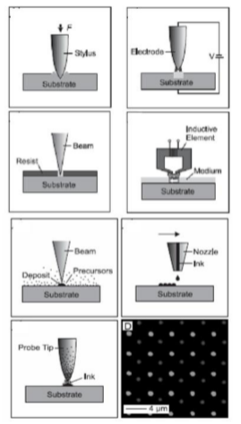
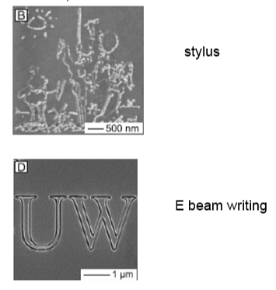

Slide 26
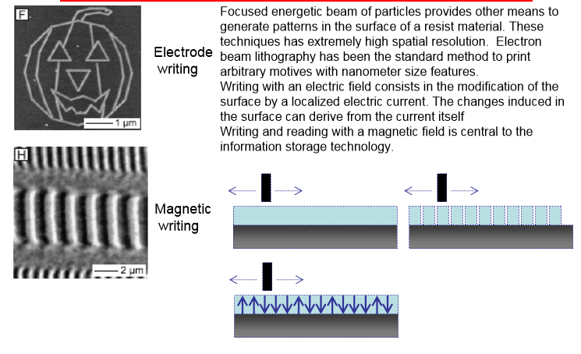

Slide 27
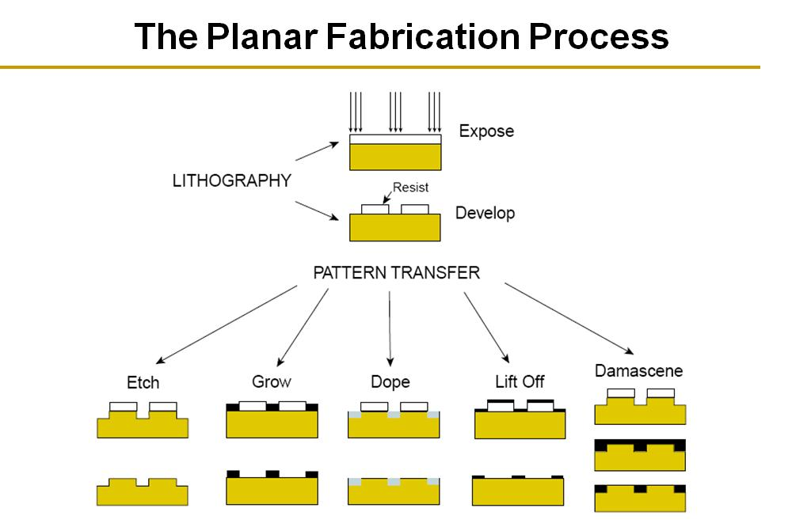

Slide 28
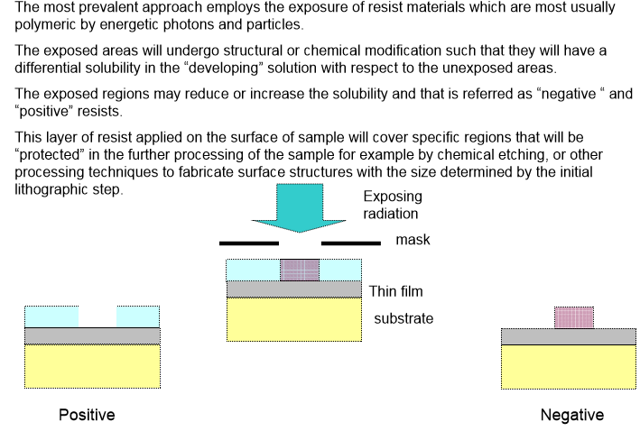

Slide 29
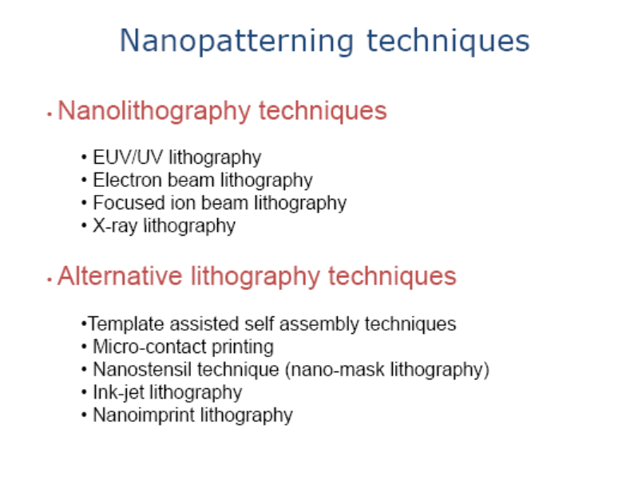

Slide 30
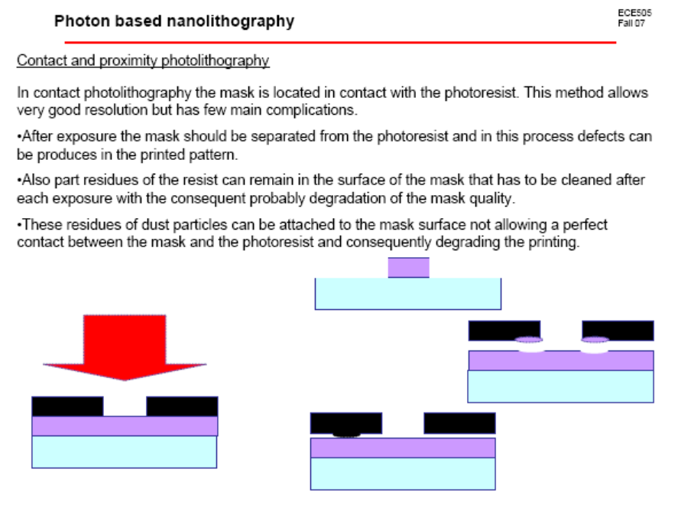
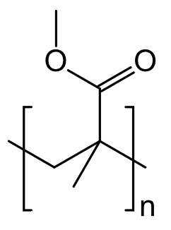
Resists must have the necessary mechanical properties to be useful in the subsequent processing of the sample. Considering its chemical characteristics, resists can be characterized in two categories:
Conventional photoresists: the energy of the radiation in the exposure directly converts into a chemical reaction in the resist.
Chemically amplified: an intermediate catalytic process happens prior to development.
Polymethylmethacrylate (PMMA) is a positive tone resist that can be activated with UV light, X-rays, electrons or ions.
Molecular weights form 500k to 1000 k with slightly different properties.

Slide 31
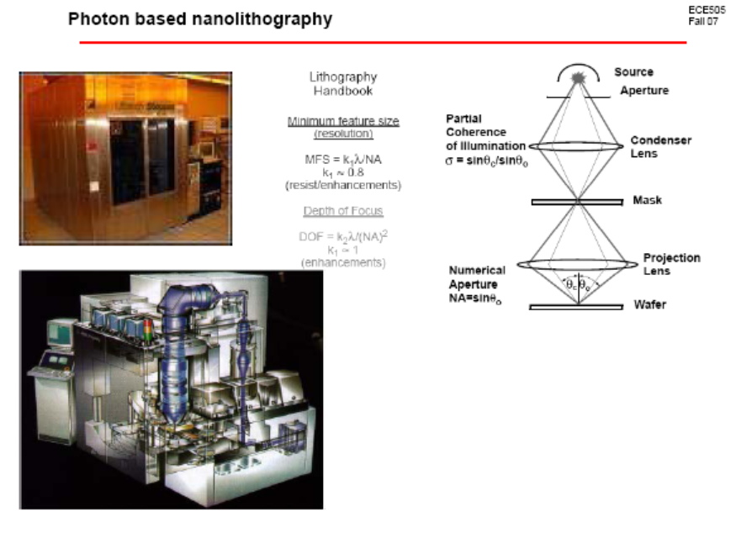

Slide 32
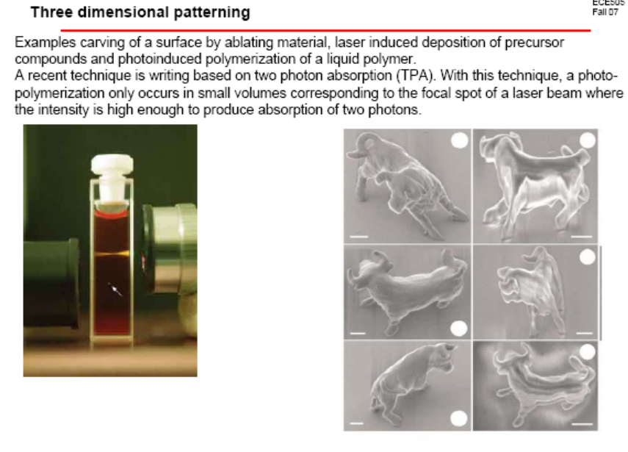

Slide 33
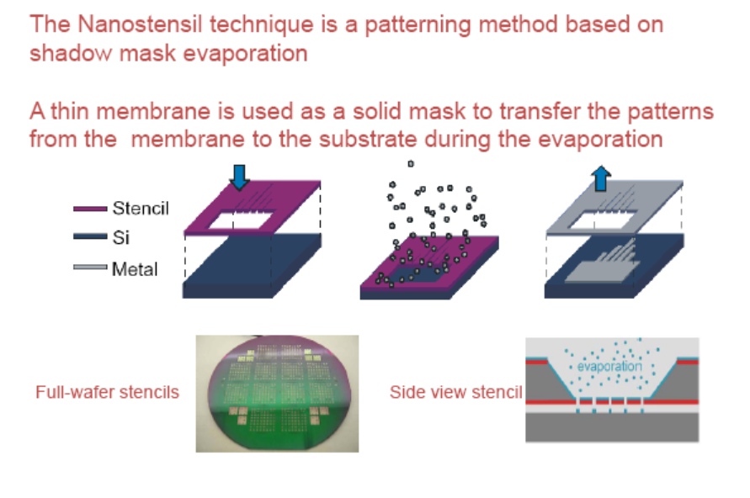
NanoStencil lithography

Slide 34
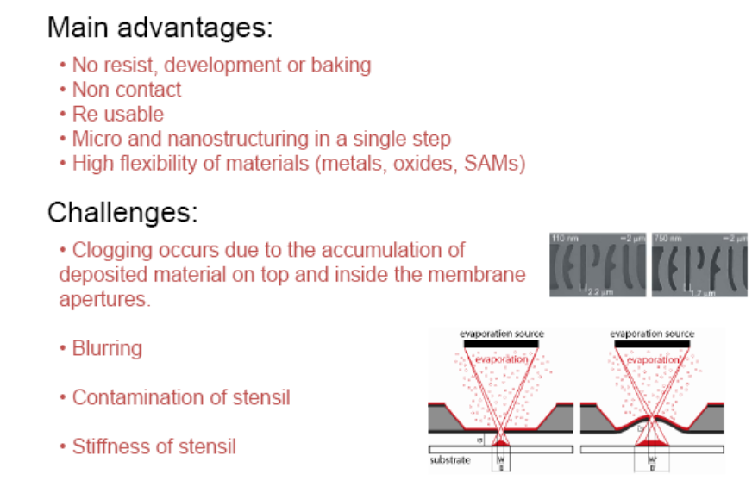
NanoStencil lithography

