Slide 1
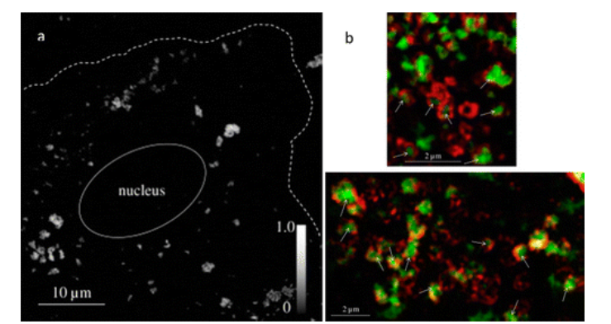
STXM (a) and fluorescence-overlay STXM (b) images of mouse alveolar type II epithelial cells exposed to CeO₂ nanoparticles. Cerium distribution within a cell was observed using STXM by subtracting a scan acquired below the cerium X-ray absorption edge from that acquired above it (a). The cell perimeter and nucleus were observed in scans acquired above the cerium X-ray absorption edge and are indicated with white lines. Cerium absorbance intensity is indicated in the gray scale-bar. Cerium distribution was also observed with respect to fluorescently labeled lysosomes present in the cell cytoplasm (b). Cerium (green, observed using STXM) was observed to be encased by lysosomes (red, observed using structured illumination microscopy) in overlaid STXM and fluorescence images, indicated by white arrows. Biomaterials2015, 62, 147–154 (ref 141).

Slide 2
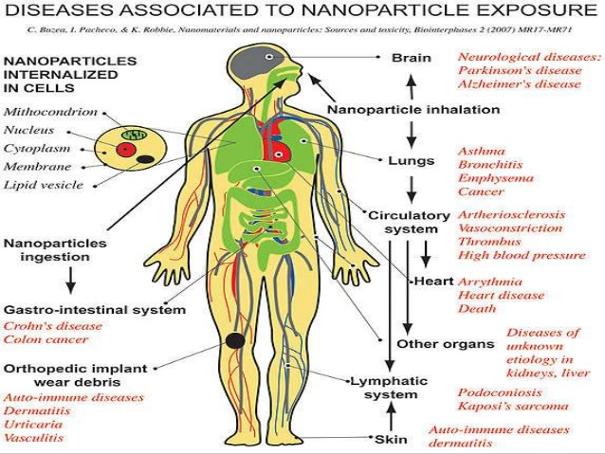

Slide 3
Nanotoxycology
https://www.youtube.com/watch?v=s0BLhHAC6b4
https://www.youtube.com/watch?v=s0BLhHAC6b4
https://www.youtube.com/watch?v=wxFbYoF7SLc
Example of C-nanotube
https://www.youtube.com/watch?v=lq_l09kxzh0
https://www.youtube.com/watch?v=4XDJC64tDR0

Slide 4
Incidental Nanoparticles’ Health Effects
Human Origin (Incidental) | Health Impacts
Cooking smoke
Diesel exhaust
Welding fumes
Industrial emissions/effluents
Sandblasting
Notes:
Trainer Notes:
Here are some of the documented effects from small particulate matter of human origin.
Sources
Cooking smoke: http://www.who.int/mediacentre/factsheets/fs292/en/index.html
Diesel exhaust: http://www.arb.ca.gov/research/diesel/diesel-health.htm
Welding fumes: http://www.osha.gov/SLTC/healthguidelines/weldingfumes/recognition.html
Industrial effluents: http://oehha.ca.gov/public_info/facts/airkids.html
Silicosis: http://www.cdc.gov/niosh/92-102.html

Slide 5
Incidental Nanoparticles’ Health Effects
Human Origin (Incidental) | Health Impacts
Cooking smoke | Pneumonia; chronic respiratory disease; lung cancer
Diesel exhaust | Cancer; respiratory disease
Welding fumes | Metal fume fever; infertility; benign pneumoconiosis
Industrial emissions/effluents | Asthma, atherosclerosis, chronic obstructive pulmonary disease
Sandblasting | Silicosis
Notes:
Trainer Notes:
Here are some of the documented effects from small particulate matter of human origin.
Sources
Cooking smoke: http://www.who.int/mediacentre/factsheets/fs292/en/index.html
Diesel exhaust: http://www.arb.ca.gov/research/diesel/diesel-health.htm
Welding fumes: http://www.osha.gov/SLTC/healthguidelines/weldingfumes/recognition.html
Industrial effluents: http://oehha.ca.gov/public_info/facts/airkids.html
Silicosis: http://www.cdc.gov/niosh/92-102.html

Slide 6
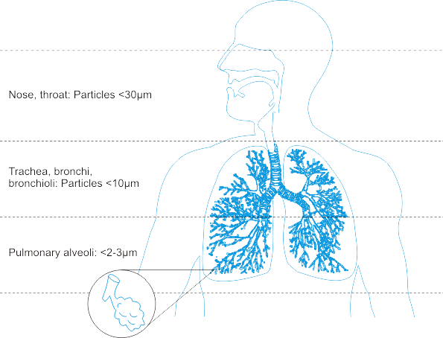
Routes of Exposure: Inhalation
Inhalation has been a major focus of the nanotoxicology community;
NP penetration into the lung depends on its aggregation state
Airborne NPs can be inhaled and deposit in the respiratory tract
Inhaled NPs may enter the blood stream and translocate to other organs
Image: http://upload.wikimedia.org/wikipedia/commons/3/36/Respiratory_Tract.png
Notes:
Trainer Notes:
The ability of a particle to deposit in the respiratory tract depends on its size. Particles larger than about 10 microns (10,000 nm) get trapped by the mouth, nose and throat; only particles less than ~10 microns enter the conductive airways (trachea and bronchi). Many of these particles are trapped by mucus and ultimately ingested. Nanoparticles’ small size permits them to be inhaled into the alveolar (deep) region of the lung where gas exchange occurs. For this reason, many studies and guidance documents have focused on inhalation as the primary route of exposure to nanoparticles in the workplace.
Animal studies have indicated that nanoparticles in the lung may be able to enter the bloodstream and translocate to other organs.
In many of these studies the nanoparticles were modified to prevent them from agglomerating together into particles larger than 2-3 microns. Some studies have shown that the primary effect of nanoparticles in the lung was asphyxiation when the particles clumped together and physically blocked the airways. The actual impact of a nanoparticle encountered in the workplace will depend critically on whether or not that nanoparticle agglomerates prior to or after entering the body.
SOURCE
Image: http://upload.wikimedia.org/wikipedia/commons/3/36/Respiratory_Tract.png

Slide 7
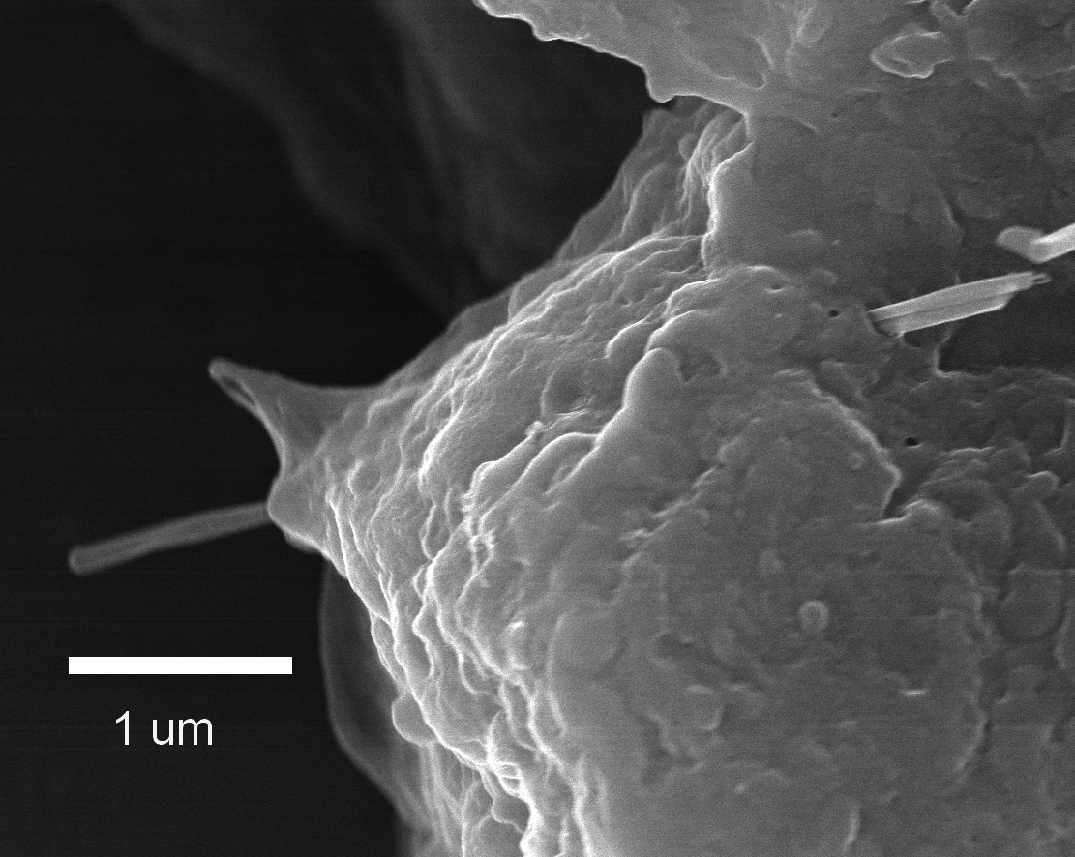
Inhalation Hazards
Certain nanomaterials can
Induce cancers, including mesothelioma
Cause rapid and persistent pulmonary fibrosis
Cause cardiovascular dysfunction
Migrate along the olfactory nerve into the brain
Alveolar Epithelial Penetration by Multi-walled Carbon Nanotube
Courtesy of R. Mercer, NIOSH
Notes:
Trainer Notes:
The growing body of research into the hazards of inhalation exposure of nanomaterials demonstrates the potential for unwanted health outcomes IF there is exposure. Not all types of nanoparticles have demonstrated these hazards and not all the research has been done on commercially relevant forms of the nanoparticles. With those caveats in mind here are some examples of significant findings from the hazard literature.
The image shows a multi-walled carbon nanotube penetrating the alveolar epithelium. This is significant because it suggests that MWNTs that get into the lung have the potential to penetrate the epitehlium and get into the space where mesothelioma originates.
Certain multi-walled carbon nanotubes were able to induce fibrosis and mesothelioma-like symptoms when instilled in rodent lungs. The effect was observed for long, stiff nanotubes (that resemble the shape of the harmful form of asbestos) but not for short, tangled nanotubes. The researchers hypothesized that the mechanism of injury was similar to asbestos because of the fibrous nature of stiff nanotubes.
Single-walled carbon nanotubes and titanium dioxide nanoparticles have been implicated in the formation of arterial plaques
Certain nanoscale metals and metal oxides have been shown to travel along the olfactory nerve and get into the brain.
Sources
Mesothelioma: Nature Nanotechnology 3, 423 - 428 (2008) and The Journal of Toxicological Sciences Vol. 33 (2008) , No. 1 February 105-116
Cardiovascular: Environ Health Perspect 115 (3): 377–382 (2007)
Olfactory: Journal of Nanoscience and Nanotechnology, 9(8): 4996-5007 (August 2009) and Environmental Health Perspectives Volume 114, Number 8, August 2006

Slide 8
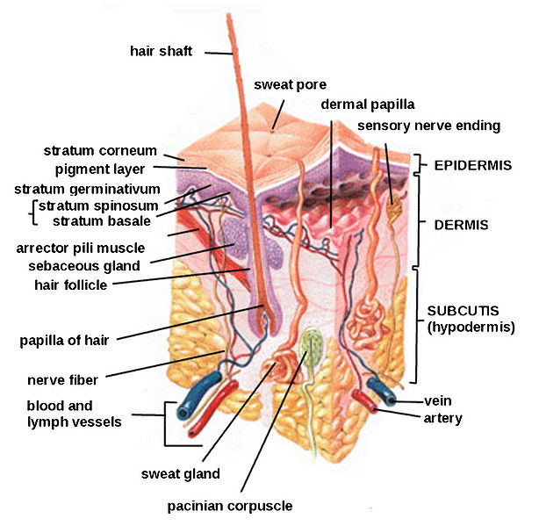
Routes of Exposure: Dermal
Available data are limited and often conflict;
Skin cannot be ruled out as a potential route of exposure
Several studies show little to no penetration of nanoscale oxides beyond surface skin layers
Polysaccharide and metal nanoparticles have been shown to penetrate flexed, damaged or diseased skin
Quantum dots were found to penetrate intact pig skin within 8-24 hours at occupationally relevant doses
Notes:
Trainer Notes:
Research on skin as a route of exposure is more limited than that on inhalation. The methods for measuring skin penetration are still evolving and better validation and standardization are needed.
Dozens of papers demonstrate the ability of intact skin to protect against penetration of nanoparticles beyond the surface layers of the skin. This is particularly evident for titanium dioxide and zinc oxide nanoparticles used in topical sunscreens.
Fluorescently tagged polysaccharide (dextran) beads of 500- and 1000-nm diameter were found to penetrate to the dermis when the skin was mechanically flexed. Silver nanoparticles embedded in a wound dressing caused elevated levels of silver to be detected in plasma and urine and graying of the skin (argyria) of a burn patient.
Quantum dots of various sizes, surface coatings and shapes were found to penetrate intact skin to the epidermal and dermal layers within 8 hours. The researchers concluded that the time scale (typical work day) and dosage were relevant for occupational exposures.
Sources
Int Arch Occup Environ Health (2009) 82:1043–1055
IMAGE: http://en.wikipedia.org/wiki/File:HumanSkinDiagram.jpg

Slide 9
Dermal Hazards
Various nanoparticles have been shown to
Inhibit cell proliferation (iron oxide, nanotubes, TiO₂, silver)
Affect cell morphology (silver, nanotubes)
Initiate irritation response (quantum dots, nanotubes)
Damage cell membrane (fullerenes)
Induce DNA damage (cobalt chrome alloy)
Notes:
Trainer Notes:
Dozens of studies have tested toxicity of various nanoparticles to human skin cells in culture. Oxides, metals, quantum dots and carbonaceous nanoparticles have all demonstrated the ability to damage skin cells through a variety of mechanisms, most notably as a result of oxidative stress.
Source
Review of dermal toxicity literature: Int Arch Occup Environ Health (2009) 82:1043–1055

Slide 10

Routes of Exposure: Ingestion
Ingestion is a viable route of exposure;
Ingested nanoparticles can translocate throughout the body
Ingestion may occur after inhalation exposure when mucus is brought up the respiratory tract and swallowed.
Poor work practice can result in hand-to-mouth transfer
Ingested nanoparticles do translocate to other organ systems
  SWCNT delivered into gut for treating Alzheimer’s disease were found in liver, brain and heart
  Ingestion of colloidal silver can result in permanent discoloration of skin, nails and eyes
Notes:
Trainer Notes:
Unintentional ingestion of nanoparticles may result subsequent to inhalation when mucus moves up out of the respiratory tract and is swallowed. (This clearance mechanism is called the mucociliary escalator.)
And, as is the case with other substances in the workplace, poor work practices, such as eating or smoking in the work area, can result in unintentional ingestion.
Occupational exposure via ingestion is perhaps the least well researched of the three pathways discussed in this module. However, the use of nanoparticles as drug delivery agents is a huge area in medical research. Some of these agents are meant to be ingested and then translocate to other areas of the body. This is itself demonstrates that ingested nanoparticles have routes out of the digestive tract and into other bodily systems. For example recently a single-walled carbon nanotube (SWCNT) agent introduced into rodent stomachs through gastrogavage was subsequently found in the liver, heart and brain as well as the lower intestine.
Excess ingestion of “colloidal” silver (much of which contains nanosilver) can result in a permanent discoloration of the skin (argyria) and eyes (argyrosis) from silver depositing into these tissues.
Sources
IMAGE: Microsoft image gallery
SWCNT: Nanomedicine: Nanotechnology, Biology, and Medicine 6 (2010) 427–441
Silver: Journal of Applied Biomedicine 2008, 6(3): 117-129

Slide 11
Ingestion Hazards
Various nanoparticles have been shown to
Slightly damage liver (silver)
Trigger immune response in intestinal dendritic cells (TiO₂ and SiO₂)
Be cytotoxic to human intestinal cells (TiO₂, SiO₂ and ZnO)
Damage DNA of human intestinal cells (ZnO)
Be genotoxic to liver and lungs after oral adminstration (C₆₀ and SWNT)
Notes:
Trainer Notes:
There is limited research about the effects of nanoparticles post-ingestion. However, some studies indicate that certain nanoparticles have the potential to damage intestinal cells and, after translocating out of the gut, induce unwanted health effects in other organs. This research is too preliminary to draw major conclusions and most papers conclude that more research is needed to better understand the effects of ingested nanoparticles.
Sources
Silver liver damage: Particle and Fibre Toxicology, 2010, 7:20 (11 pp)
Intestinal dendritic cells: Nanotoxicology, 2010 Early Online, DOI: 10.3109/17435390.2010.506957
Cytotoxic: Nanotoxicology, 2009 3(4): 355-364
DNA damage: Nanotoxicology, 2009 3(4): 355-364
Genotoxicity: Environ Health Perspect 117(5), 703-708 May 2009

Slide 12
Much of the early nano research has focused on simple systems of limited relevance to human health (e.g., cytotoxicity)
Some nanoparticles can translocate throughout the body after exposure via inhalation, contact with skin or ingestion
Some nanoparticles can induce unwanted health effects in animals or cell cultures
It makes sense to control exposure to those nanomaterials for which preliminary hazard data show unwanted health effects or hazards are unknown

Slide 13
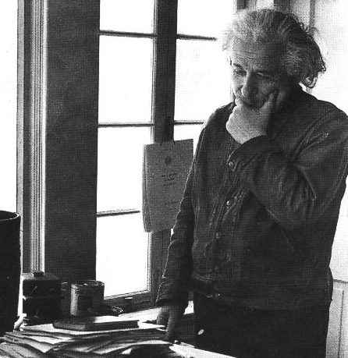
“In the long term, nanotechnology will demand a revolutionary re-thinking of occupational health and safety.” John Howard, MD, NIOSH
Notes:
Trainer Notes:
“In the long term, nanotechnology will demand a revolutionary re-thinking of occupational health and safety.” John Howard, MD, NIOSH

Slide 14
“It is likely that no single metric will completely characterize exposure.”
Linda Abbott and Andrew Maynard, Risk Analysis, 2010
Notes:
Trainer Notes:
[Emphasize with the class that this is the main message from this module.]
“It is likely that no single metric will completely characterize exposure.” Linda Abbott and Andrew Maynard, Risk Analysis, 2010

Slide 15
Let’s start with an exposure pathway model (Mulhausen and Damiano)
Work surfaces
Skin
Ingestion
Inhalation
Skin absorption
Process
Air
Notes:
Trainer Notes:
This model is helpful for thinking about how inhalation hazards can also be problems associated with ingestion and absorption. Ask for examples of each of the pathways of exposure.

Slide 16
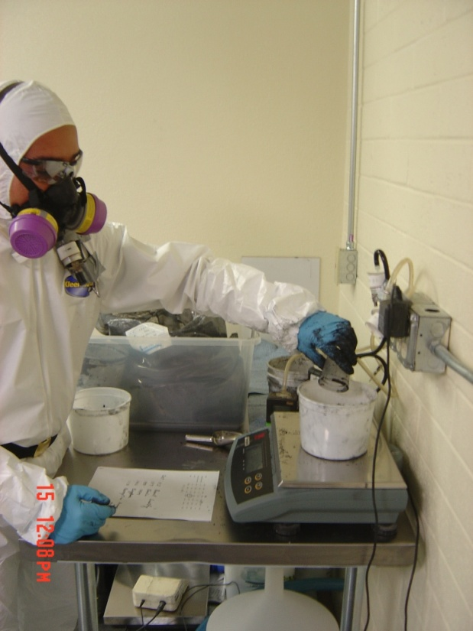
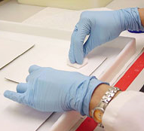
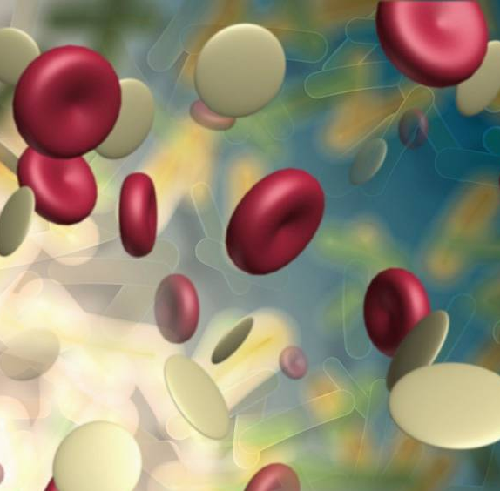
Monitoring is classified as personal, area or biological
personal
area
biological
Notes:
Trainer notes:
Personal monitoring is the most common but area and biological monitoring also serve important purposes in ensuring occupational health.
Fundamentals of Industrial Hygiene: Chapter 15 - Evaluation

Slide 17
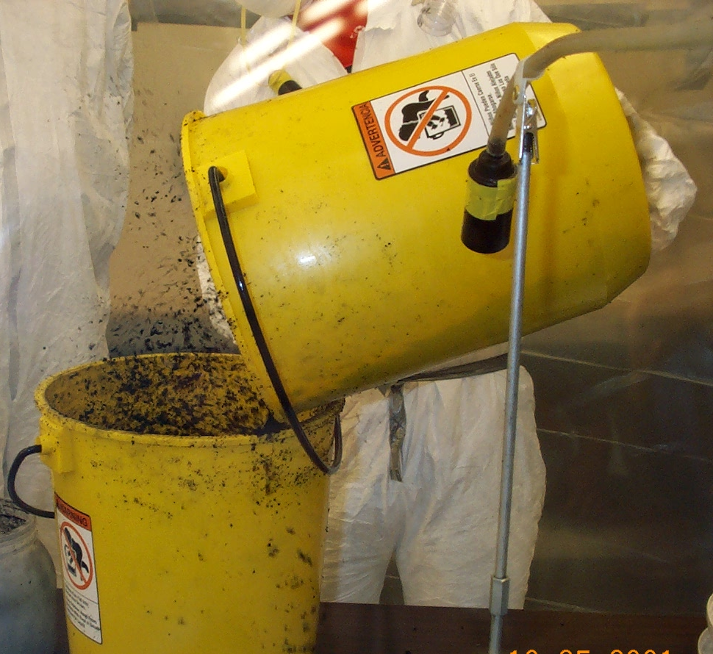
Area monitoring determines concentration at a location over time
Photo courtesy NIOSH
Notes:
Trainer notes:
Area monitoring is often used to measure concentration in ambient air prior to, during or after a job or event. Area monitoring can be used to establish background concentrations, trigger alarms in the event of elevated concentrations and monitor long-term changes in air quality.

Slide 18
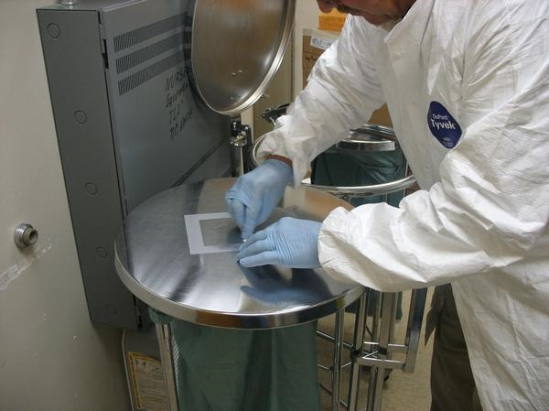
Wipe sampling is another form of area monitoring
Photo courtesy NIOSH
Notes:
Trainer notes:
Wipe sampling is another form of area monitoring. Instead of sampling a known volume of air, a known surface area is sampled or wiped. Notice the template being used to ensure the area sampled is consistent between samples. A clean template should be used for each sample to reduce the likelihood of contaminating samples. Currently, there are no standards for nanoparticles on surfaces.

Slide 19
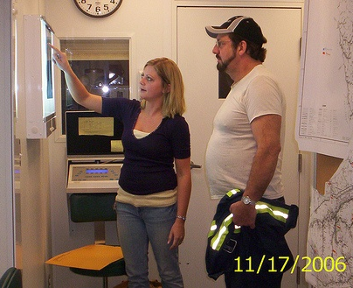
Biological monitoring measures contaminants, metabolites or enzymes in the blood, urine or exhaled breath
Notes:
Trainer notes:
Biological monitoring measures contaminants, metabolites or enzymes in the blood, urine or exhaled breath.

Slide 20
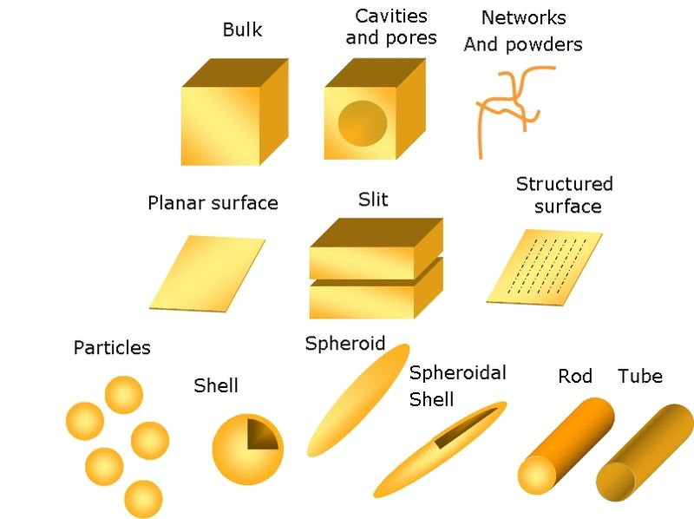
Group exercise:
What could we sample?
Typical nanostructure geometries.
Illustration courtesy of the Opensource Handbook of Nanoscience and Nanotechnology
Notes:
Group exercise: What could we sample?
[Ask the class to work in their group or pair up and discuss what industrial hygiene sampling method they know about and whether they could be applied to nanoparticles. Tell them to specifically consider these various structures of nanoparticles].

Slide 21
What should we sample?
Metric | Qualification
Mass | Not always relevant
Surface area | Better for low solubility particles
Surface chemistry | Tox studies show effects
Particle number | Within ranges
Particle size | Implicated in particles translocating
Particle shape | Fiber-like, spheres, mats
Notes:
Trainer Notes:
Point out that there are limitations to any metric we choose.

Slide 22
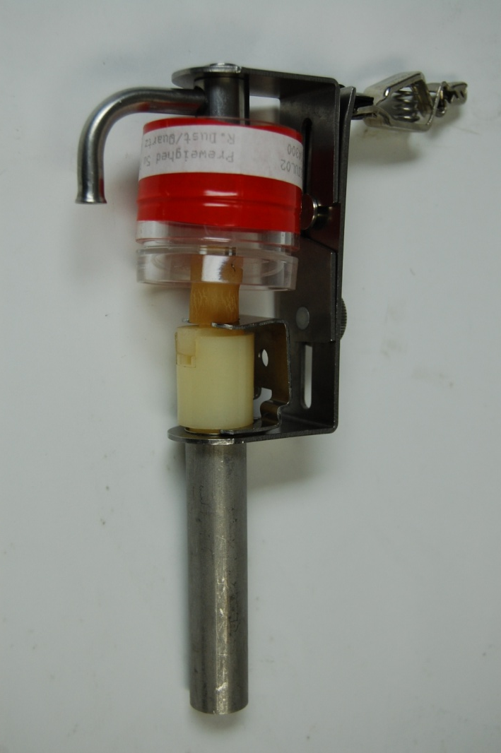
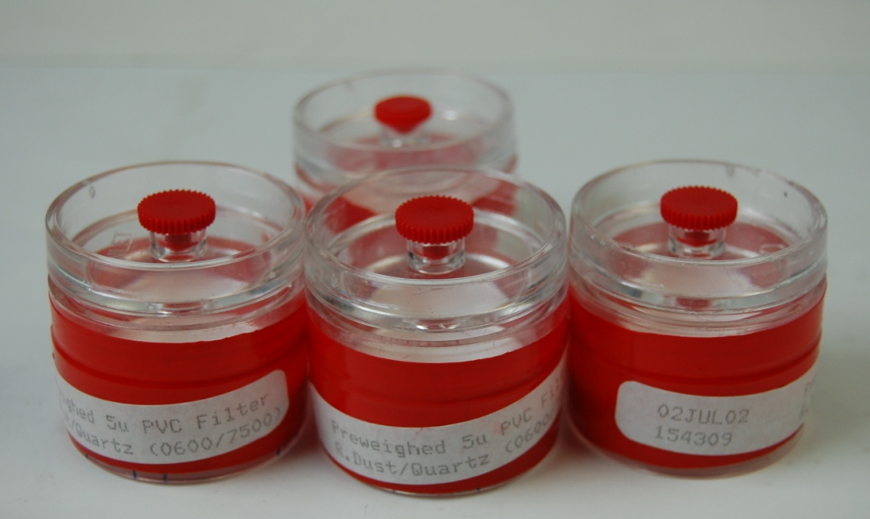
Can we use standard industrial hygiene methods?
Yes!
Pre-weighed cassettes for gravimetric sampling
Respirable dust sampling
Notes:
Trainer Notes:
Take the opportunity to pass out sampling cassettes so folks can see them and make sure they understand that we can definitely use much of the equipment and many of the techniques we have always used in industrial hygiene.

Slide 23

Active sampling uses pumps to pull contaminated air through appropriate media
Photo courtesy SKC
Notes:
Trainer notes:
Active sampling uses a pump to pass contaminated air through media. Pumps are generally classified as “high flow” if they draw more than 1 liter per minute and “low flow” if they draw less than 1 liter per minute.

Slide 24
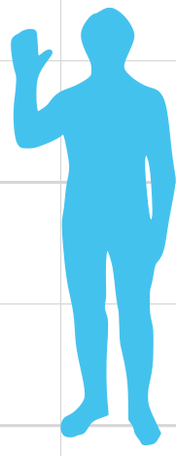
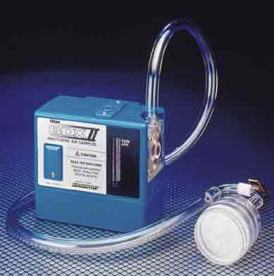
Personal pumps are hung on a worker’s belt with the media in the breathing zone
Photo courtesy Lawrence Berkeley National Laboratory
Image courtesy Wikimedia

Slide 25
Most exposure limits are based on 8 hour time-weighted averages
exposure
limit
1 2 3 4 5 6 7 8
hours
Increasing
Exposures
This includes recommendation for carbon nanotubes
Notes:
Draw a line that goes above and below the exposure limit. Show the dip for work stopping at lunch.

Slide 26
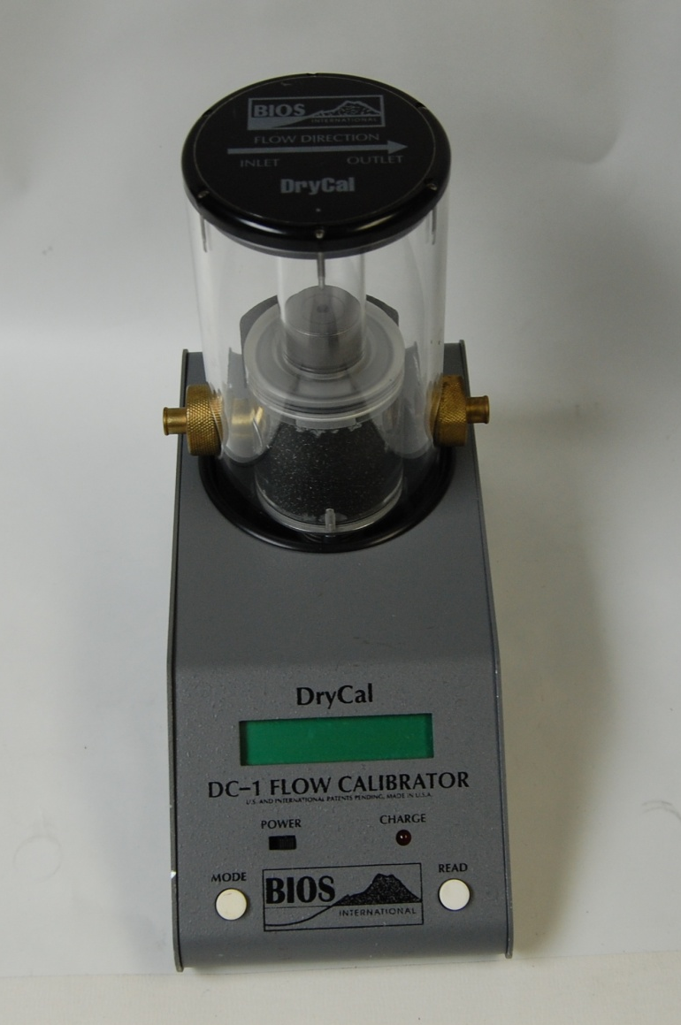
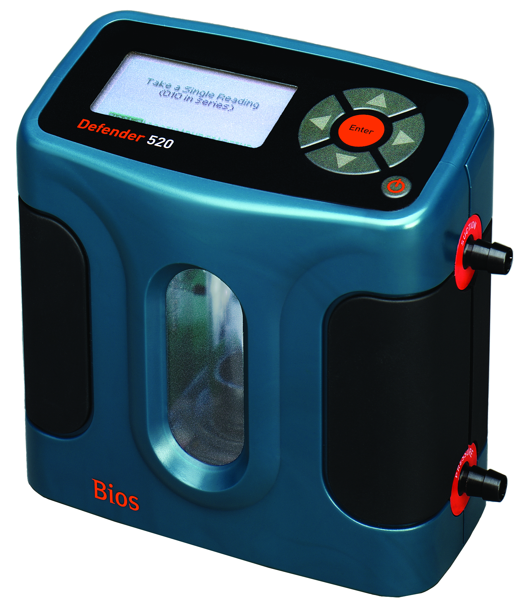
Pumps must be calibrated before and after sampling
Photo courtesy SKC, Inc.
3-26
Notes:
Trainer notes:
Pumps must be calibrated before and after sampling. Calibration devices are classified as “primary” or “secondary”. Primary calibration devices are preferred because they directly measure the dimensions of a physical space and are traceable to a standard. The National Institute of Standards Technology’s (NIST) standards are the most common in the United States. Examples of primary calibration instruments include a glass bubble burette, a spirometer, similar to those used in doctor’s offices to test lung capacity, and an electronic bubble meter, such as the Bios Defender show here. Secondary calibration devices do not have a fixed volume, are likely to become less accurate with use and are not traceable to a NIST or other standard. Examples of secondary calibration devices include rotameters, wet-test meters and dry gas meters. The dry gas meter used by industrial hygienist operates in much the same way as the natural gas meter on a home.
Calibration of sampling pumps should be performed before and after air sampling and with all sampling media inline. In most cases the post use flow rate is within a few percent of the pre use flow rate and an average flow rate can be determined. If the flow rates are more than a few percent different then we can not be sure of the sample volume and the sample will likely be considered invalid.

Slide 27
Particles are classified by their penetration. Where do nanoparticles fit?
Inhalable
100 μm diameter
Thoracic
10 μm diameter
Respirable
4 μm diameter
Notes:
Trainer Notes:
[Ask the question and let the class tell you that nanoparticles are well below 4 micrometers in at least one dimension so they are respirable.]
Particles are classified by their penetration. Where do nanoparticles fit?

Slide 28
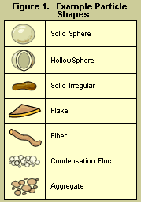
Particle size
Defining particle size for spherical particles is easy; it is simply the diameter of the particle. For non-spherical particles, the term "diameter" does not appear to be strictly applicable. For example, what is the diameter of a flake of material or a fiber? Also, particles of identical shape can be composed of quite different chemical compounds and, therefore, have different densities. The differences in shape and density could introduce considerable confusion in defining particle size.

Slide 29
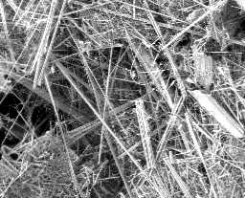
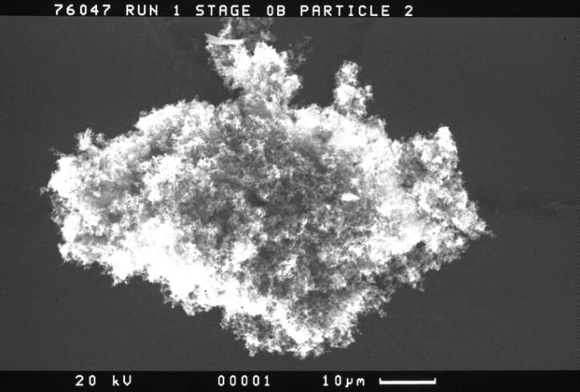
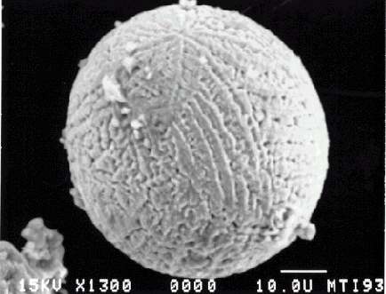
Particulate: Shape and Density
500 μm
10 μm
10 μm
asbestos
carbon
Iron rich
The aerodynamic diameter is the diameter of a spherical particle having a density of 1 g/cm³ that has the same inertial properties in the gas as the particle of interest.

Slide 30
Aerodynamic diameter
The aerodynamic diameter for all particles greater than 0.5 μm can be approximated using the following equation.
d_{pa} = d_{ps} (ρ_{p})^{1/2}
d_{pa} = Aerodynamic particle diameter, μm
d_{ps} = Stokes diameter, μm
ρ_{p} = Particle density, g/cm³
Particle density affects the motion of a particle through a fluid and is taken into account in the Equation. The Stokes diameter for a particle is the diameter of the sphere that has the same density and settling velocity as the particle. It is based on the aerodynamic drag force caused by the difference in velocity of the particle and the surrounding fluid. For smooth, spherical particles, the Stokes diameter is identical to the physical or actual diameter.

Slide 31
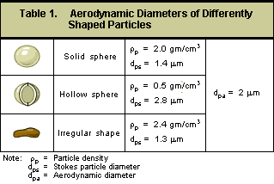
Particles that appear to have different physical sizes and shapes can have the same aerodynamic diameter

Slide 32
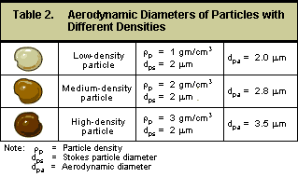
Conversely some particles that appear to be visually similar can have somewhat different aerodynamic diameters

Slide 33
Nanoparticles Have Almost No Mass
Edge of a single 10 micron particle
Relative size of 10 nanometer particles for comparison
A 10 μm particle weighs the same as one billion 10 nm particles
Notes:
A 10 μm particle weighs the same as one billion 10 nm particles

Slide 34
Large particles bias mass measurements
Standard
37-mm filter cassette
If you’re carrying a grocery bag full of cantaloupes, you’re not going to notice a handful of cherries
Notes:
Trainer Notes:
Large particles bias mass measurements

Slide 35
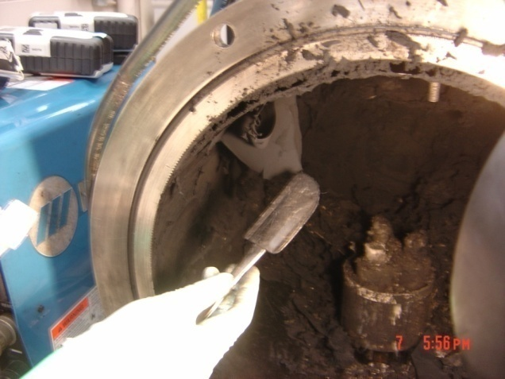
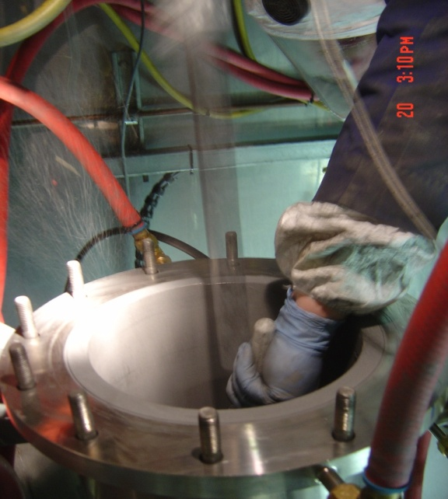
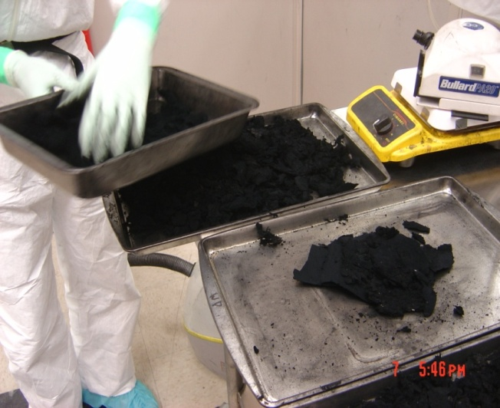
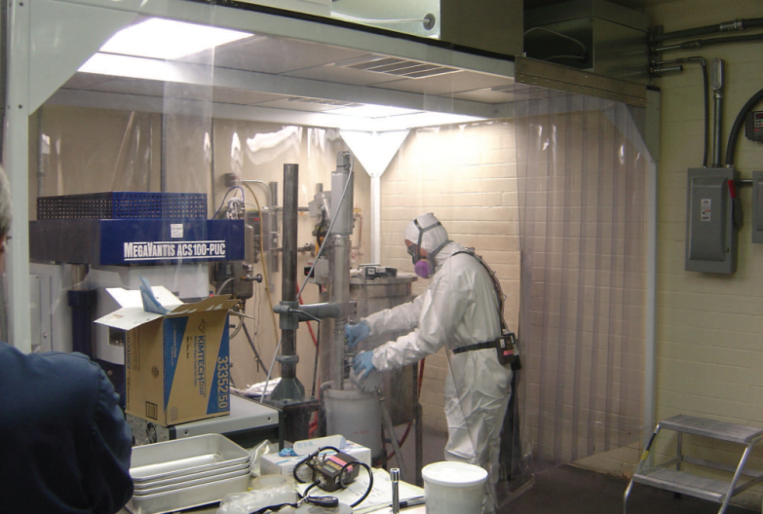
Examples of Potential Exposures
Photos courtesy of M. Methner, NIOSH

Slide 36
Graded approach to measurement
Step 1: screen area and process
Particle counters and simple size analyzers
Step 2: collect samples at source
Filter based samples for EM and elemental analysis
Step 3: collect personal samples
Filter-based samples for EM and elemental analysis
Step 4: use less portable equipment
More sensitive aerosol sizing equipment

Slide 37

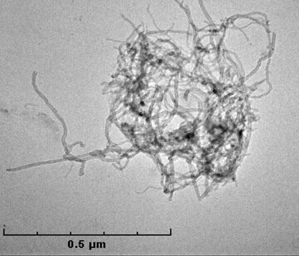
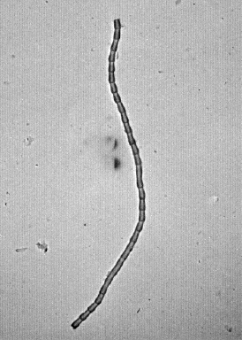
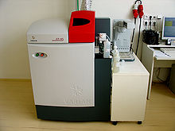
Simple and complex measurements
Starting Point
Particle Counters and Size Analyzers
TEM and Elemental Analysis
More complex
Notes:
37

Slide 38
Condensation particle counter operation
Pump
Laser
Detector
What difference does this make?
Condenser
Heated
saturator
Alcohol-soaked felt
Notes:
Trainer Notes:
[Review this diagram to help students understand why condensation particle counters are able to measure smaller particles than optical counters, but why they can’t provide particle size ranges. The alcohol droplets are all about the same size.]
This diagram is reconstituted from a more detailed explanation on the TSI website. They also have a good description of the process: “In general, laminar-flow CPCs operate by drawing an aerosol sample continuously through a heated saturator, in which alcohol is vaporized and diffuses into the sample stream. Together, the aerosol sample and alcohol vapor pass into a cooled condenser where the alcohol vapor becomes supersaturated and ready to condense. Particles present in the sample stream serve as condensation sites for the alcohol vapor. Once condensation begins, particles grow quickly into larger alcohol droplets and pass through an optical detector where they are counted easily.

Slide 39
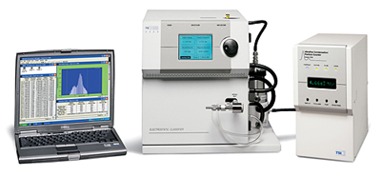
Scanning mobility particle sizers provide more data, but are more difficult to use in the field
2.5 - to 1,000 nm particles
167 size channels
TSI Series 3936
Notes:
The Series 3936 Scanning Mobility Particle Sizer TSI Series 3936 systems feature a versatile Series 3080 Electrostatic Classifier and your choice of Condensation Particle Counter (CPC). The end result is unmatched flexibility due to the many configurations possible. Collectively, SMPS systems measure particles from 2.5 to 1000 nm and display data using up to 167 actual size channels (up to 64 channels per decade).Model 3034 Scanning Mobility Particle SizerThe Model 3034 Scanning Mobility Particle Sizer (SMPS) spectrometer from TSI is a simple alternative to multicomponent systems. It houses an Electrostatic Classifier and a Condensation Particle Counter in the same cabinet. The integrated design means easy transport and quick set up. Th Model 3034 SMPS measures aerosol particles in the size range from 10 to 487 nm. It displays data using 54 size channels (32 channels per decade).Submicrometer Particle SizingTSI offers many choices for applications involving submicrometer particle sizing. See detailed descriptions Series 3936 systems and Model 3034.Features and Benefits· High-resolution measurements of ultrafine particles· Component and single-box options for specific measurement needs· Choice of CPC and DMA (Series 3936 systems only) provides the ultimate in sizing flexibility

Slide 40
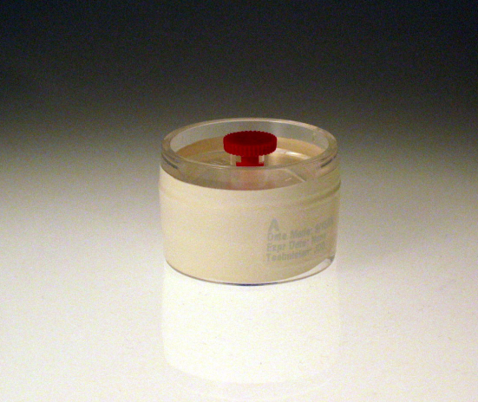
Method 5040 to quantify exposure to airborne carbon nanotubes
37-mm quartz-fiber filter
Flow rate of 2 to 4 liters per minute
Size selective samplers may be needed
Reported as elemental carbon
37-mm
quartz-fiber filter

Slide 41

Mesotheliomas have been produced in mice with MWCNTs that are fibers with long aspect ratios (Takagi 2008, Poland 2008)
Multi-walled carbon nanotube penetrating the pleura of the lung. Courtesy of Robert Mercer, and Diane Schwegler- Berry, NIOSH

Slide 42
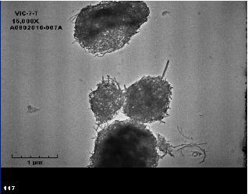
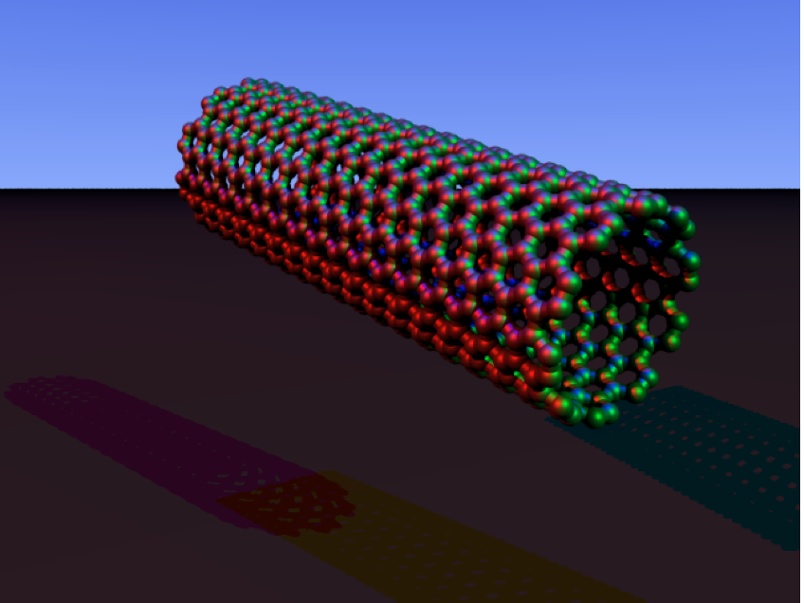
10,000 carbon nanotube combinations are possible
≠
Notes:
Trainer Notes:
[The key point with this slide is that the graphic of a carbon nanotube on the left doesn’t represent the reality of what they look like in airborne samples, like the aggregated mass of nanotubes on the right.]
NIOSH says 10,000 carbon nanotube combinations are possible.

Slide 43






The counting protocols will be similar to asbestos TEM methods now in place
1 structure (fiber)
1 structure (bundle)
2 structures (fibers)
1 structure (cluster)
3 structures (fibers)
1 structure (matrix)
EPA AHERA Method Appendix A to Subpart E of Part 763
Notes:
Trainer Notes:
The counting protocols will be similar to asbestos TEM methods now in place.

Slide 44
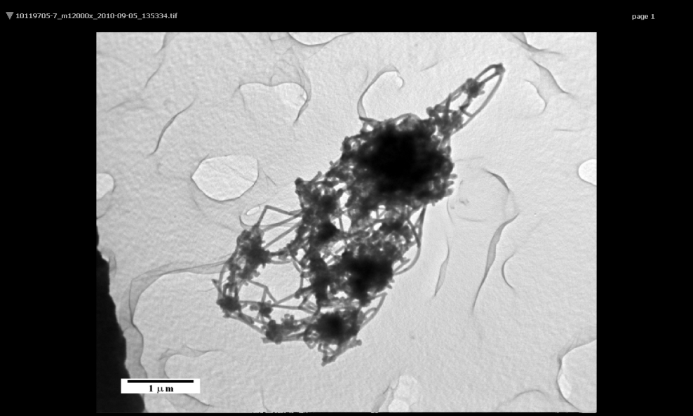
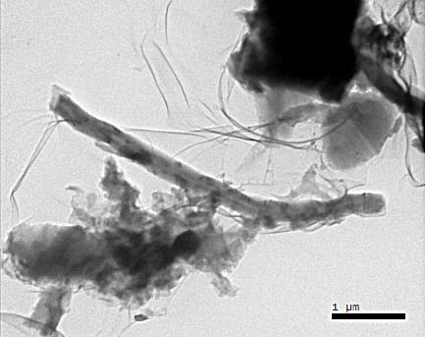
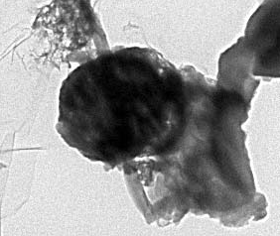
Your turn! Categorize and count the following structures
1.__________________
2.__________________
3.__________________
4.__________________

Slide 45
Electron microscopy is the gold standard. It allows:
Characterization of bulk material for comparison to airborne particles
Indication of the presence of specific engineered nanomaterial (ENM)
Notes:
Trainer Notes:
Electron microscopy is the gold standard. It allows:
Characterization of bulk material for comparison to airborne particles
Indication of the presence of specific engineered nanomaterial (ENM)

Slide 46
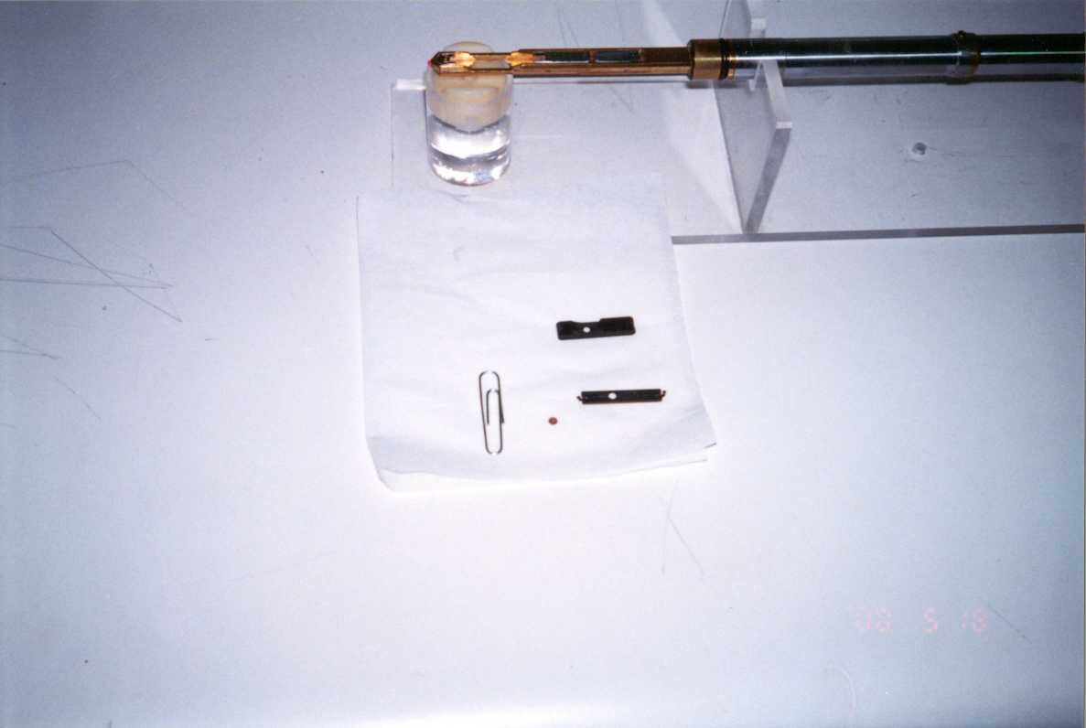
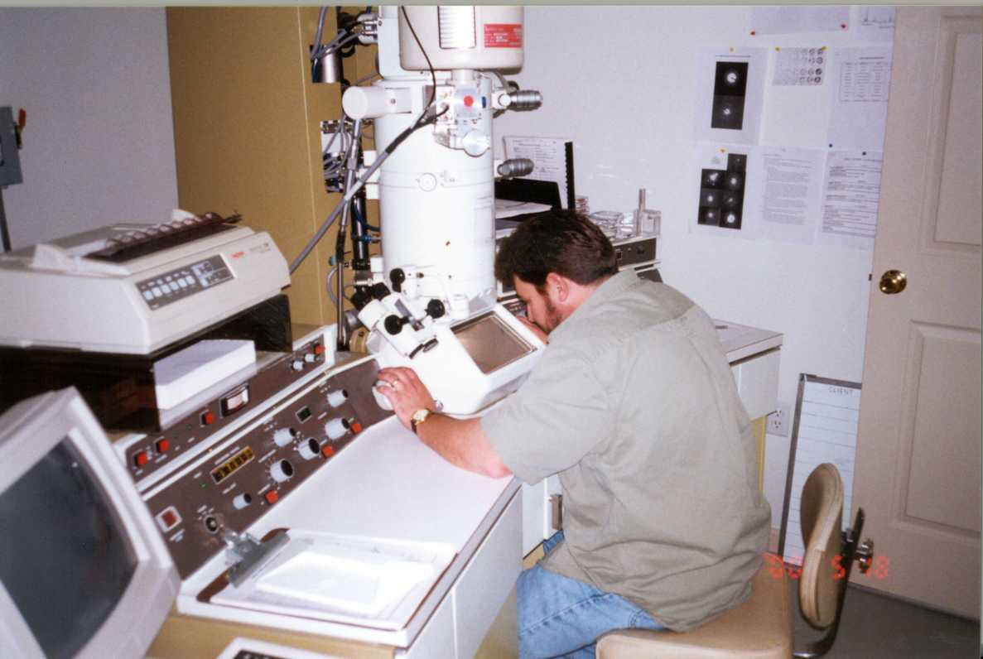
Transmission electron microscopy methods resemble asbestos analysis
Grid inserted into holder
Grid with sample
Notes:
Trainer Notes:
Transmission electron microscopy methods resemble asbestos analysis.
[Make the point of indicating how small the TEM grid that holds the sample. It is helpful for those familiar with phase contrast microscopy to see how much smaller the section of filter is that gets onto the grid compared with the pie wedge that is cut out and mounted on a standard glass slide for PCM.]

Slide 47
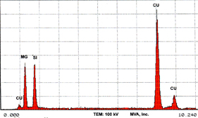

TEM allows several measurements
Morphology
EDS (EDXA) for chemical composition
Particle count
Particle length and diameter
EDS
3-47
Notes:
Trainer Notes:
TEM allows several measurements:
Morphology
EDS (EDXA) for chemical composition
Particle count
Particle length and diameter
[Point out that this is the strength of TEM: you can see the shape of the particles to compare to the raw stock, you can use the electron beam to generate x-rays that are characteristic for each element thus identifying the chemical composition, you can count particles (as long as you have counting rules) and you can measure the particles length and diameter. For a tube, with a measured length and diameter, you can determine volume and choose a density to calculate mass.]

Slide 48

Elemental analysis for metals allows better characterization
Sampling high emission areas: both breathing zone and area
Conduct elemental analysis
Characterize and verify by TEM
Raw single walled nanotubes,
photo courtesy NIOSH
Notes:
Trainer Notes:
Elemental analysis for metals allows better characterization:
NIOSH recommends sampling high emission areas: both breathing zone and area
Conduct elemental analysis (NIOSH 7300, metals with ICP)
Characterize and verify by TEM
[Some nanoparticles are metals or oxides of metals so Inductively coupled plasma analysis will detect them in low concentrations. Additionally, metals, such as iron, nickel and cobalt, are used as catalysts for the production of carbon nanotubes.]

Slide 49
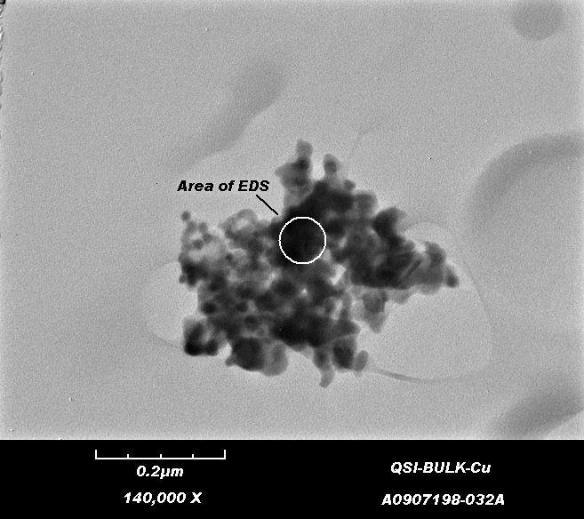
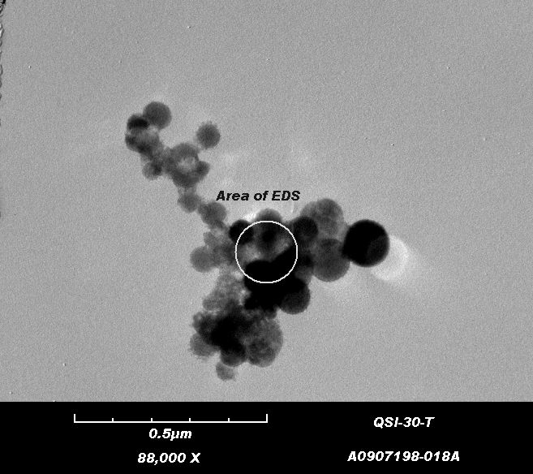
Analysis of metal reactor cleanout provides good example of EM capabilities
Bulk product sample
Air sample
Notes:
Trainer Notes:
NIOSH analysis of metal reactor cleanout provides good example of EM capabilities
[Use a laser pointer to illustrate how focused the beam of a TEM is to perform Energy Dispersive analysis of the materials to determine its elemental composition. Production of many nanomaterials requires metal catalysts and EDS analysis will show that as a peak.]

Slide 50
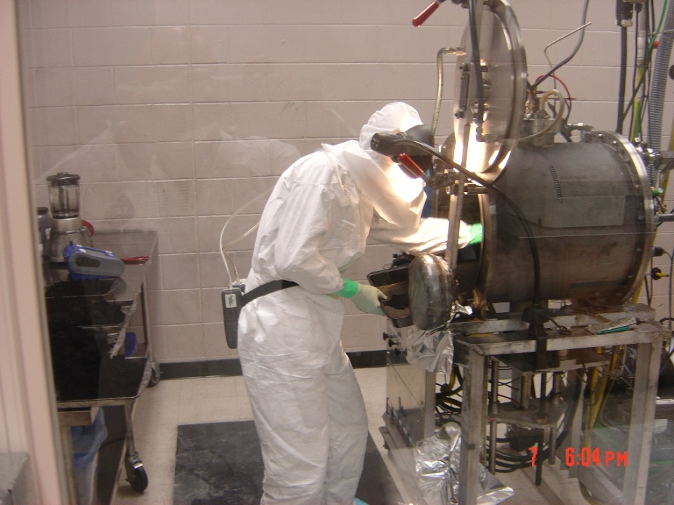
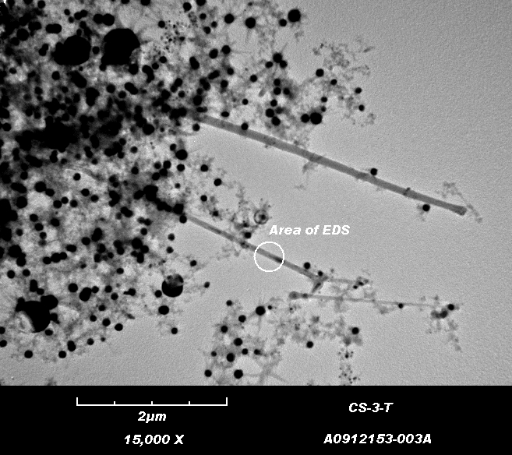
Harvesting SWCNTs from a Carbon Arc Reactor
Task-based BZ air sample analyzed via TEM w/EDS
Images courtesy NIOSH
Notes:
[These are shots from NIOSH of a worker in full protective clothing harvesting single-walled carbon nanotubes from a carbon arc reactor inside an enclosed work area. Note the reflection in the glass. The lower image is a TEM shot of SWCNTs collected in the breathing zone of that worker. Point out that the black dots are metal catalyst that wasn’t cleaned from the final product.

