Slide 1
English for Specific Purposes
(ESP)
English for Occupational Purposes

Slide 2
ESP
English for Specific Purposes (ESP) is a learner-centered approach to teaching English as an additional language, which focuses on developing communicative competence in a specific discipline.
ESP is ESL (English as a Second Language) instruction for a particular speech community, occupational field, or workplace situation. The basis of ESP is the teaching of language using content or subject matter.
English for Occupational Purposes is a branch of ESP and covers situations in which learners are studying English for work-related reasons, therefore based on an analysis of their specific communicative needs in their work.

Slide 3
Key terms for language ability
Proficiency Ability to think in the language, voice opinions and ideas, extrapolate, put voice to humor, no hesitation in communication, possession of decision-making skills, ability to use synonyms with competency.
Fluency Ability to communicate orally in the language with little hesitation or need for translation before speaking, yet less able to engage in complex discussions or utilize advanced or technical vocabulary.
May face challenges with listening, reading and/or writing.
Command Possession of and ability with a broad, general vocabulary that allows a person to function in the new language to connect with others on an everyday basis. May equate to a degree of fluency if repertoire and ease are sufficient.

Slide 4
Medical language
A Language for Specific Purposes
Medical language is a distinct variation of language: an advanced form of standard language (Hull, 2014).
It is a Language for Specific Purposes. Medical language exists in languages worldwide.
Hull (2014, 2013b, 2010) believes it is a universal construct applicable to all health and allied health professions. It is their shared language and non-members of this group can struggle to comprehend it. Medical language is not simply medical terminology and the synonymous use of these two terms is inaccurate.
While medical terminology is foundational to medical language, it is simply a corpus – a body of words. A very large vocabulary that still requires an understanding of context, grammar and syntax in order to be used correctly.
Medical terminology has to be put to use effectively and appropriately in a healthcare context. It is neither reasonable nor safe to assume that a health professional can function in such an environment with only a large repertoire of medical terms (Hull, 2014, 2013b).
Proficiency with medical language is necessary for successful communication.
Effective communication can be, in fact, linked to clinical outcomes.

Slide 5
Scientific English
Pharmacists need to be able to communicate, both verbally and in a written format, with people in the community, colleagues and other health professionals using educated, “elaborated” English.
English language skills and communication skills are not one and the same, the latter implying the effective use of written or spoken language to impart information or ideas. Good English language skills however, underpin good communication in English.
The need for English as a professional language in medicine (and allied health professions) is nowadays beyond doubt.
Scientific literature and the internet are just two examples that reveal the overriding necessity for understanding and expressing ourselves in written and spoken English.
(Ribes & Ros, Medical English)

Slide 6
Terminology in context

Slide 7
Scientific English
At present scientists are compelled to publish their papers and studies in English because science has adopted English as its lingua franca.
Knowing how to succeed in any scientific environment framed by the English language is, therefore, vital.
What makes a scientific paper, scientific?
Scientific papers have four major characteristics:
They use technical language (i.e. words which embody facts and principles belonging to a particular scientific field or research area);
They start with an abstract (a brief, reasoned summary);
They are written in accordance with the IBC strategy, i.e. the requirement on the authors’ part to address the topic keeping in mind three different modules: Introuction, Body and Conclusion.
They are published in specialized journals and reviews.

Slide 8
Scientific English
Scientific papers can be classified in two broad categories: research and descriptive papers.
They all follow the IBC strategy: true premises are set in the introduction, a valid argument is made in the body and true conclusions are then derived in the final sections.
Even simple paragraphs can be composed according to this structure: a topic can be introduced with an opening sentence and a conclusion can be drawn by way of a closing sentence, but not before developing the topic further – arguing for or against it in the body of the paragraph.
This is the way successful academic writers phrase their thought process: in a logically sound way.

Slide 9
Scientific English
A research paper is a written document that presents the results of original research, analysis, and interpretation of data and information related to a specific topic or question.
Research papers are typically written by researchers or scholars in various fields, including science, social science, humanities, and engineering. They follow a standard format and structure, which includes an introduction, literature review, methodology, results, discussion, and conclusion.

Slide 10
Scientific English
In a research paper, the author(s) present their research findings, analysis, and interpretation, supported by evidence and citations from previous research. The paper may also include tables, figures, graphs, or other visual aids to help present the data and results.
Research papers are often published in academic journals or presented at conferences, and are subject to peer review by other experts in the field. The purpose of a research paper is to contribute new knowledge or insights to the field, and to support the ongoing conversation and advancement of knowledge within that field.

Slide 11
Scientific English
A descriptive paper is a type of academic writing that describes a person, place, object, or event. Unlike a research paper, which presents original research and analysis, a descriptive paper focuses on providing a detailed and vivid description of a particular subject.
In a descriptive paper, the author uses sensory details such as sight, sound, smell, taste, and touch to create a vivid picture of the subject in the reader's mind. The author may also use literary techniques such as metaphor or personification to enhance the description and create a more engaging reading experience.

Slide 12
Scientific English
Descriptive papers can be written in a variety of styles and formats, depending on the intended audience and purpose.
For example, a descriptive paper about a historical monument may be written in a more formal and objective style, while a descriptive paper about a personal experience may be written in a more subjective and emotional style.
Overall, the goal of a descriptive paper is to provide the reader with a clear and engaging picture of the subject being described, without necessarily presenting original research or analysis.

Slide 13
Scientific English
No matter their typology, all research papers generally deal with large quantities of data, procedures, and theoretical constructs, giving rise to the issue of how to convey in an easily accessible and standardized way that bulk of information.
The IMRaD format is a solution to this problem, and the most widely used layout for organizing empirical content into paper sections.
The term ‘IMRaD’ is an acronym standing for the words Introduction, Mehtod, Results and Discussion.
It refers to the way in which information should be presented in a paper.

Slide 14
Scientific English
Abstracts
All scientific papers start with a reasoned summary. That reasoned summary is known as abstract. Abstracts are documents in themselves; as a rule, readers should never need to review an entire paper in order to understand its abstract. Abstracts are concise paper overviews providing explicit information on a paper’s topic, and contain keywords of the larger work: the more self-contained they are, the better. Sometimes abstracts also anticipate the theses, experiments, lines of argument and conclusions contained in the body of the paper, however in an abridged and highly condensed way.

Slide 15
Scientific understanding
The major components of scientific construction sentence connectors.
The backbone of both scientific understanding and academic publications.
Grammatical categories such as conjuntions, adverbs and phrases serve a precise function: they link one or more linguistic units together:
Conjuntions: for, and, or, nor, but, so, yet, because, although, despite, even though, while, whereas, whenever […]
Adverbs: always, sometimes, before, after, usually, never, arguably, likewise, similarily, hence, therefore, nevertheless […]
Phrases: according to the theory, on the contrary, to sum up, in other words, unlike many other resesarchers... […]

Slide 16
Scientific understanding
Sentence connectors, therefore, serve a precise communication function: they mirror logical relations holding among and between ideas. This is their function in discourse.
Sentence connectors are conjuctions, adverbs and phrases used to logically join some expressions in a text.
They help writers to convey their thoughts and reasoning on a particularr topic – they are discourse markers.
Reading scientific texts is not comparable to reading poetry – in science, what really matters is logical relations among words, thoughts and facts.

Slide 17
Scientific understanding
A paper is divided into paragraphs, and thus it is a chain of paragraphs.
A paragraph can accomplish several different actions, such as describing an experimental method, arguing a theory, explaining cause-effect relationships. It generally focuses on something, or has a topic. Paragraphs must develop their topic in a logical, coherent way. Often a paragraph will clearly state its purpose within the first sentence, bringing into focus its key concepts and how they will be discussed.
Experienced academic readers are capable of grasping the meaning of entire paragraphs simply by identifying their topic sentences. Active academic readers can read quickly because they are skilled in perceiving paragraph content, while skimming through pages, thus increasing their reading speed. Such and ability can help them retain only the most relevant information and omit everything else.

Slide 18
Scientific writing
Verbs describe actions and events, with their role being to explicate that particular action and/or event in question, and to point out when – along the timeline – they occur.
Verbs convey time and content information.
Typically, academic writers make extensive use of nouns specifying action verbs, and Italian writers tend to share this inclination towards this grammar structure. However, this can have a negative impact on reading speed, because sentences become longer and less coherent.
Due to the massive amount of information one has to handle, it appears academic writers would benefit from a focus on reading simplicity, therefore wording their thoughts accordingly, i.e. by expressing specific actions with specific action verbs, and avoid using nouns.
This is the most incisive, explicit, and effective way to properly communicate in Scientific English.

Slide 19
Scientific writing
When considering academic English, it might be pertinent and even convenient to notice that verb tenses vary according to paper sections.
The reason for this is that paper sections express different categories of information, such as background knowledge, aims, methodological information, assumptions, laws, findings.
Tense changing occurs according to paper sections precisely because data sets and action types also change across those sections.
Such a variance can be adapted into the IMRaD format, and structured into a verb tens pattern that university students and academics might follow and conform to when writing abstracts as well as any papers they might undertake:

Slide 20
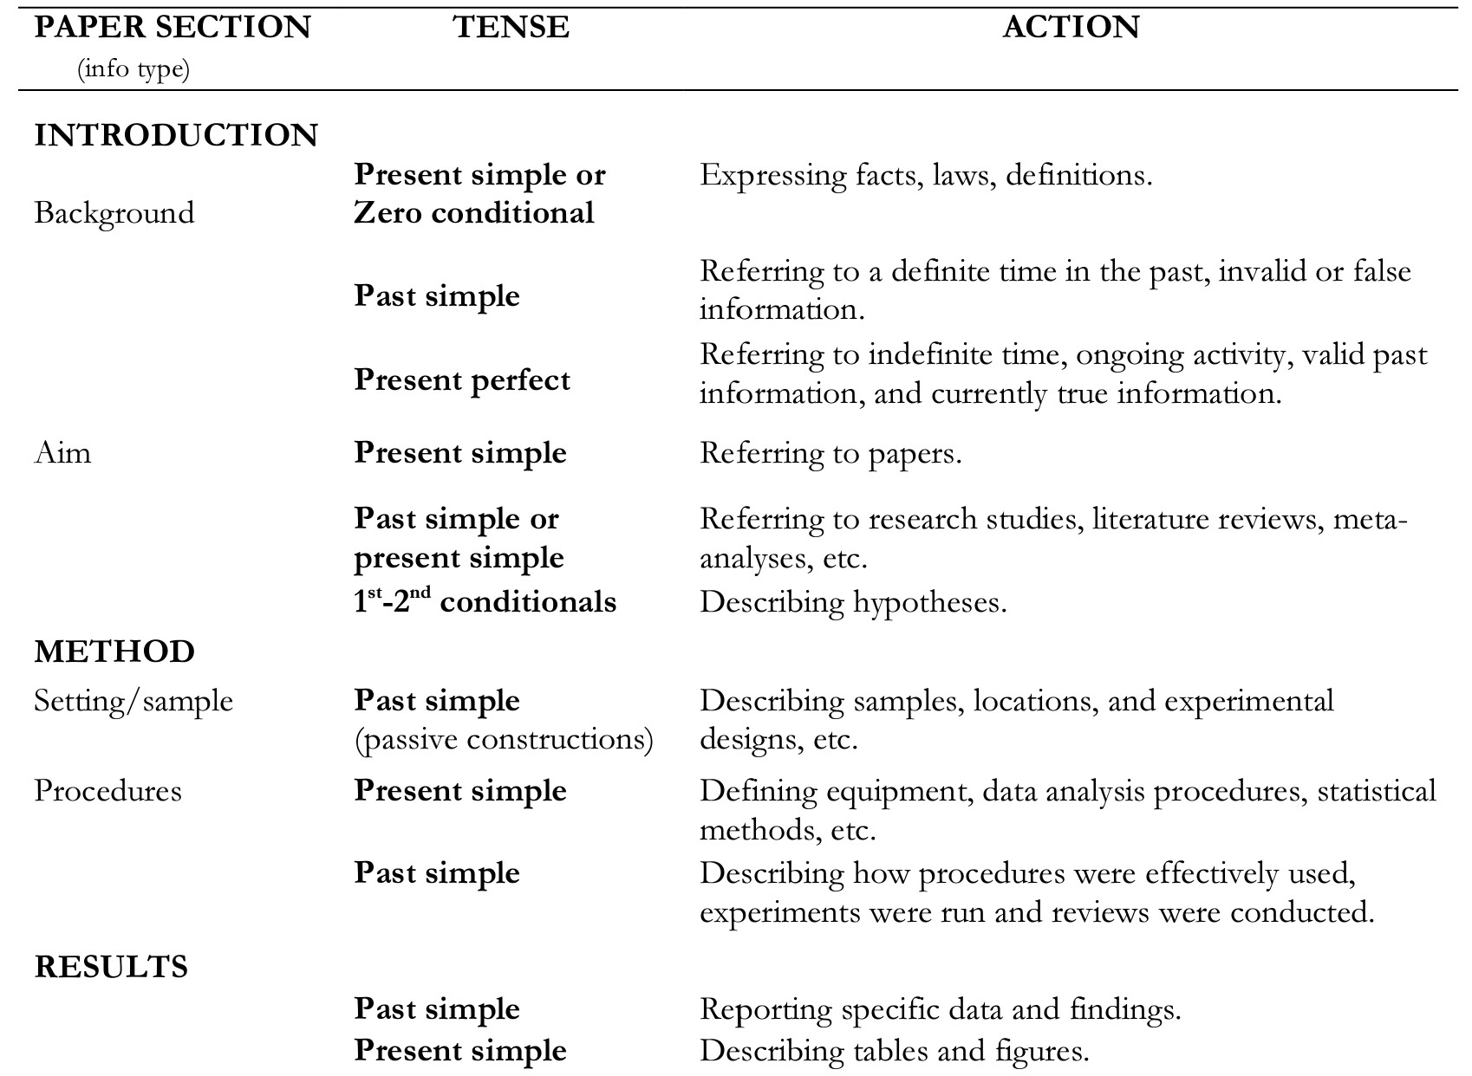
Scientific writing

Slide 21
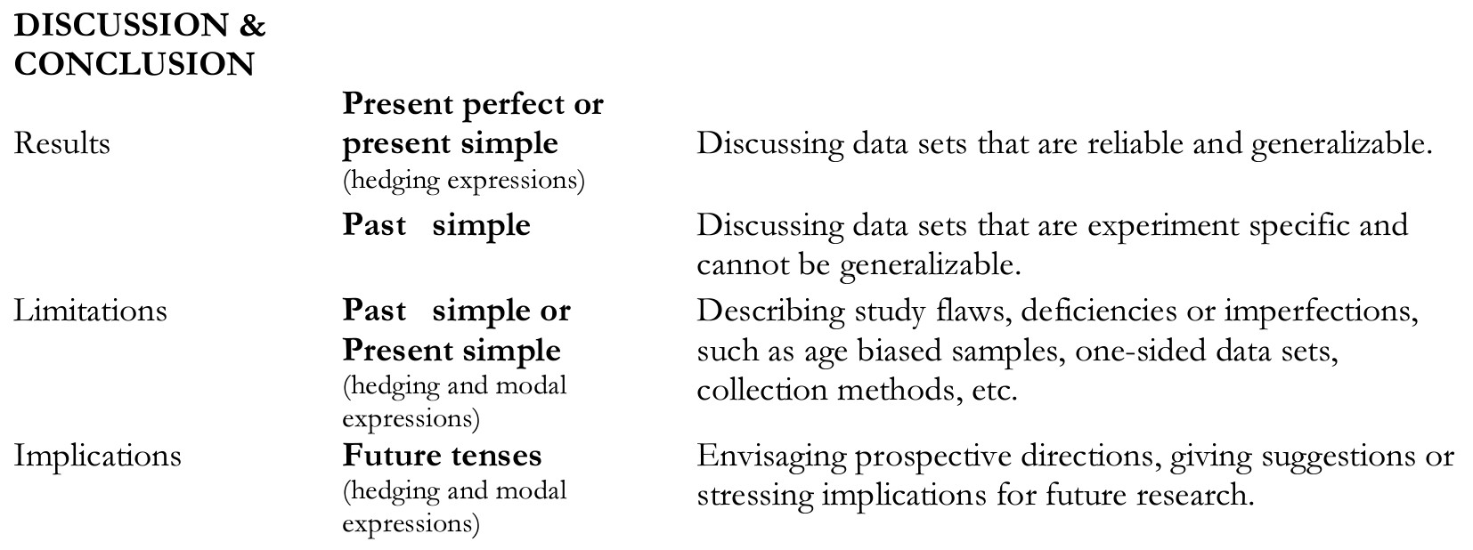
Scientific writing

