Slide 2
The 12 Basic English Tenses
Simple Present I do
Present Progressive I am doing
Present Perfect I have done
Present Perfect Progressive I have been doing
Simple Past I did
Past Progressive I was doing
Past Perfect I had done
Past Perfect Progressive I had been doing
Simple Future I will do
Future Progressive I will be doing
Future Perfect I will have done
Future Perfect Progressive I will have been doing

Slide 3
Simple Present
The simple present says that something was true in the past, is true in the present, and will be true in the future.
It expresses general statements of fact and general truths.
Water consists of hydrogen and oxygen
The average person breathes 21,600 times a day
The world is round
The simple present is used to express habitual or everyday activities.
I get up at seven every morning
I always eat a salad for lunch

Slide 4
Present Progressive
The present progressive expresses an activity that is in progress at the moment of speaking.
The students are sitting at their desks right now.
The present progressive is a temporary activity that began in the past, is continuing at present, and will probably end at some point in the future.
I need an umbrella because it is raining.
I am taking five courses this semester.

Slide 5
Simple Present and Present Progressive
Simple Present
now
past XXXXXXXXXXXXXXXX future
Present Progressive
X X
start now finish?
---------------------------------------
…in progress…

Slide 6
Exercises Complete the sentences. Use the simple present or the present progressive of the verbs in parentheses:
1) a. Kristin is in the shower. She (wash) ___________________ her hair.
b. Kristin (wash) ________________ her hair every other day or so.
2) a. Tony usually (sit) _________________ in the front row during class.
b. Today he (sit) ____________________ in the last row.
a. Andrew (work) __________________ the night shifts on weekends.
b. He’s not home now. He (work) _____________________ a double shift.
a. After six days of rain, I’m glad that the sun (shine) ____________________.
b. Every morning, the sun (shine) ______________ in my bedroom window and (wake) _____________________ me up.
a. Babies (grow) ________________ very quickly. Newborn babies are very different from three-month olds.
b. Your baby (grow) ________________ so fast. She isn’t a newborn anymore!
a. Please, be quiet. I (try) _____________ to concentrate on my math homework.
b. Each day, our math teacher (try) ______________ to explain the material clearly, but I am very confused.

Slide 7
Simple Present and Present Progressive: affirmative, negative, question forms
 | Simple Present | Present Progressive
AFFIRMATIVE | I help You, We, They help He/She/It helps | I am helping You, We, they are helping He/She/It is helping
NEGATIVE | I do not help You, We, They do not help He/She/It does not help | I am not helping You, We, they are not helping He/She/It is not helping
QUESTION | Do I help? Do you, we, they. help? Does he/she/it help? When do I help? | Am I helping? Are you, we, they helping? Is he/she/it helping? When am I helping?

Slide 8
Exercises Complete the sentences with Do, Does, Is or Are
On an airplane
________________ you ready for takeoff?
________________ the plane taking off soon?
________________ you nervous?
________________ you have your seat belt on?
________________ the seats comfortable?
________________ your seat comfortable?
________________ the seat go back more?
________________ they serve food on this flight?
________________ the movie beginning?
________________ you like to fly?
________________ the co-pilot flying the plane?
________________ the co-pilot sleep during the flight?
________________ the pilots sleep during the flight?
________________ the plane on autopilot?

Slide 9
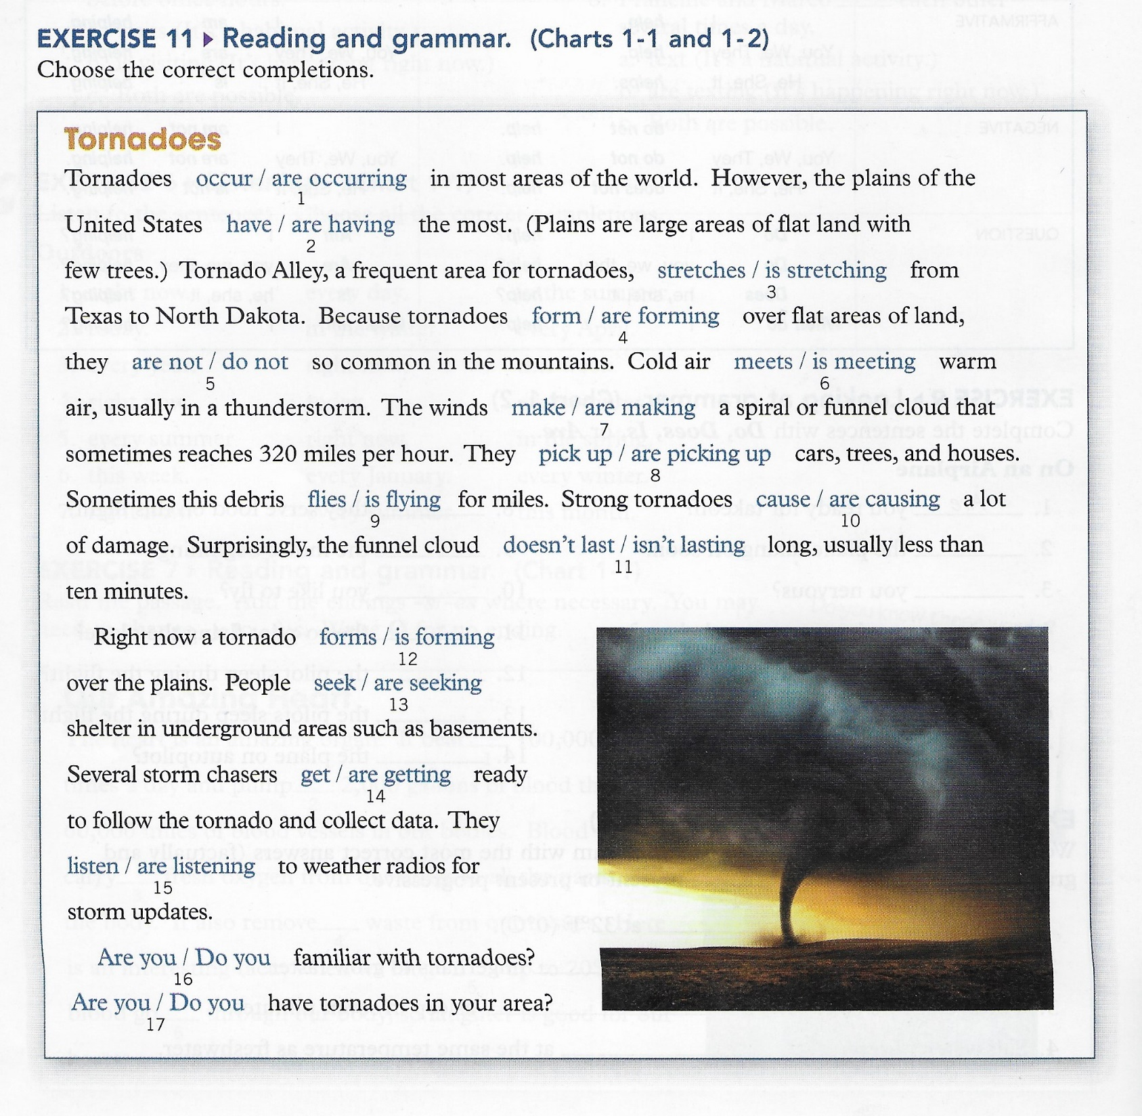

Slide 10
Verbs not usually used in the progressive (stative verbs)
Some verbs – like know – are stative or non-progressive.
They describe states, not actions, and are rarely used in progressive tenses.
States are conditions or situations that exist.
Ex. I know your cousin.
Common verbs that are usually non-progressive
Know | Like | Dislike | Belong | Consist of | Hear | Agree
Believe | Appreciate | Fear | Possess | Contain | Sound | Disagree
Doubt | Care about | Hate | Own |  |  | Mean
Recognize | Please | Mind |  | Exist | Seem | Promise
Remember | Prefer |  | Desire | Matter | Look like | Amaze
Suppose |  |  | Need |  | Resemble | Surprise
Understand |  |  | Want
 |  |  | Wish

Slide 11
Stative verbs that can be used in progressive tenses
Some verbs – like think – have both non-progressive and progressive meanings.
I think that your cousin is very nice (think = believe)
I’m thinking about my trip to Rome (am thinking = thoughts are going around in my mind right now)
Common verbs with both non-progressive and progressive meanings
Look | It looks cold outside | Amy is looking out of the window
Appear | Jack appears to be tired today | She’s appearing on a TV show today
Think | I think that Mr. Smith is a good teacher | I’m thinking about my family right now
Feel | I feel that Mr. Smith is a good teacher | I’m feeling a little tired today
Have | I have a bike | I’m having a good time
See | Do you see that bird? | The doctor is seeing a patient right now
Taste | The soup tastes salty | The chef is tasting the soup
Smell | Something smells bad. What is it? | Ann is smelling her new perfume
Love | John loves his baby daughter | John is enjoying parenthood. He’s loving it!
Be | Mary is young, but wise | You’re being foolish! Go see a doctor!

Slide 12
ENGLISH FOR BIOMEDICAL SCIENCE
Biomedical Science is the branch of biology focused on understanding how the body functions, what goes wrong when illness strkes, and how to prevent and treat illness in people and animals.
It pulls together knowledge of biological structure function and the major body systems towards medical application.
What do biomedical scientists do?
What happens to a medical sample after it is taken by a nurse or doctor? Teams of biomedical scientists analyze all samples taken from patients by nurses and doctors.
Without these specialists, doctors could not make diagnoses or treat patients. Biomedical scientists investigate conditions ranging from food poisoning to HIV. They play an essential part in preventing and treating illnesses.
In fact, laboratory services are critical in disease treatment and prevention, as up to 70 per cent of diagnoses are based on their pathology results.
Without this support, accident and emergency wards would shut down, organ transplants could not take place and premature babies would struggle to survive.
Biomedical science provides important information about illnesses that affect us all. it is a fast-changing science that requires attention to detail. Scientists within this field concentrate on many aspects of living organisms. These include the study of anatomy, physiology and pathology to understand basic biological structures and pathways.

Slide 13
Trainees are also likely to study more specialized fields, such as immunology and genetics, to better understand the disease process.
In this way, qualified scientists continue to investigate the causes, diagnoses and treatment of diseases.
Graduates in biomedical science are employed in various roles in the public and private sectors. In the public sector, employers include health service laboratories and forensic departments, which help catch criminals.
In the private sector, graduates might work in resesarch and development (R&D) departments for pharmaceutical companies.
Companies which make medical devices and laboratory instruments also need the specialist knowledge of biomedical scientists.
It doesn’t matter which role is chosen. The work of a biomedical scientist is exciting and at the forefront of technology.
One career path is medical microbiology, often based in a hospital laboratory. In this role, microbiologists detect, isolate and identify micro-organisms such as bacteria, fungi and parasites that cause disease.
High-profile infections include tuberculosis, salmonella and Methicillin-resistant Staphylococcus aureus (MRSA).

Slide 14
Microbiologists also investigate food-poisoning outbreakes and work with the food and drinks industry to ensure quality control.
Microbiologists usually work in bright, modern laboratories, not the small, dark rooms that some people might imagine. These laboratories are the high-tech centers of hospitals at the cutting edge of medical technology.
Clinical chemistry offers another area of employment. Here the focus is on human biochemical pathways and mechanisms.
Biomedical scientists provide detailed pictures of patients with conditions such as kidney failure or diabetes. They do this through analysis of tissue and fluid samples taken by medical staff. Like microbiologists, they provide information that is essential to preserve health and to fight and control disease.
Transfusion science is a further option for biomedical scientists. In this role, they identify blood groups and test the compatibility of a donor’s blood with that of a patient who needs a transfusion. In addition, biomedical scientists make sure that there are enough blood products available to deal with road traffic accidents, operations and cancer treatments.
The future for biomedical scientists is challenging and exciting as developments push techniques forward. Their work is constantly evolving as new infections emerge and ‘older’ diseases recur. Biomedical science moves into new areas as the field develops.

Slide 15
For example, in the emerging discipline of cytogenetics, there is an increasing focus on the link between inheritance and cell structure. There is also greater interest in molecular biology, which looks at the nature and function of biological structures.
Clearly, biomedical scientists will play an ever-increasing role in categorizing, preventing, and treating disease. The discipline will continue to offer a wide variety of exciting career opportunities with good promotion prospects.
These will include specialist laboratory work, research, education and management.
There will also be a need for experts and consultants.

Slide 16
Study the words in box A and give two common meanings of each word
Study the words in box B:
What is the Base word in each case? What part of speech is the base word?
Does the prefix/suffix change the part of speech?
A
Condition catch instrument picture failure
tissue fluid donor
B
Immunology genetics treatment infections
poisoning biochemical compatibility
What are the key aims of biomedical science?
Where do biomedical scientists work?
Why are biomedical scientists becoming more important?

