Slide 1


Slide 2
Simple Past
The simple past tense describes an event that occurred at one particular time in the past.
Most simple past verbs add –ed to the base form, but some verbs have irregular past tense forms.
It snowed yesterday
Tom watched TV last night
Jack went to work early
I came to work late
We saw a great movie last night
The simple past forms of be are was and were:
Emily was at the office this morning
You were tired yesterday

Slide 3
Simple Past
When describing a series of actions that all happened in the past, the verbs are in same tense.
Andrew caught the ball, ran down the field, and scored a point.
In general, the simple past is used when:
the event is in the past
the event is completely finished
we say (or understand) the time and/or place of the event
Note that when we tell a story, we usually use the simple past. We may start with the past progressive to "set the scene", but we almost always use the simple past for the action:
"The wind was howling around the hotel and the rain was pouring down. It was cold. The door opened and James Bond entered. He took off his coat, which was very wet, and ordered a drink at the bar. He sat down in the corner of the lounge and quietly drank his..."

Slide 4
Simple Past: affirmative, negative, question forms
Regular verb forms
AFFIRMATIVE | NEGATIVE | QUESTION
I You He/She/It helped We They | I You He/She/It did not help We They | Did I Did You Did He/She/It help? Did We Did They
Irregular verb forms
AFFIRMATIVE | NEGATIVE | QUESTION
I You He/She/It ate We They | I You He/She/It did not eat We They | Did I Did You Did He/She/It eat? Did We Did They
Be verb forms
AFFIRMATIVE | NEGATIVE | QUESTION
I, He/She/It was here You, We, They were here | I, He/She/It was not here You, We, They were not here | Was I, He/She/It here? Were You, We, They here?

Slide 5
Exercise:
Complete the sentences with the correct simple past form of the verb
An online order:
Tom (order) _________________ printer ink online last Monday.
The next morning he (realize) ___________ he (need) ___________ colored ink too.
He (try) ____________ to call the company to add more, but no one (answer)_____________, and there (be) ____________ no voicemail.
Tom (worry) _______________ that the website (be) _____________ fake.
He (email) _____________ the company and (explain) ____________ his situation.
The manager (respond) _____________ a few hours later and (fix) ___________ the order quickly.
Tom (relax) ______________ when he (receive) _____________ a confirmation email from the company.

Slide 6
Exercise:
Complete the sentences with the correct forms of verbs that make sense.
More than one verb may be appropriate. Some answers are negative.
Situation 1: Maria visited a friend at the hospital. A woman in the elevator had a cold and sneezed several times. The next day…
Maria _______________ in the morning with a fever and headache.
She ________________ well.
Her entire body _____________.
She ____________ her temperature with a thermometer.
She ____________ a high fever.
She ____________ the house all day.
She ____________ a few spoonfuls of chicken soup.
She ____________ to the nurse at the doctor’s office.
She ____________ an appointment for the following day.
ache feel leave schedule take eat have make speak to wake up

Slide 7
Exercise:
Complete the sentences with the correct forms of verbs that make sense.
More than one verb may be appropriate. Some answers are negative.
Situation 2: Professor Moore is our new math teacher. He is very hard to follow.
Yesterday, he…
______________ too fast.
______________ the material to us quickly.
______________ the board with examples.
______________ time for questions, unfortunately.
______________ everyone in the class.
confuse fill introduce leave speak

Slide 8
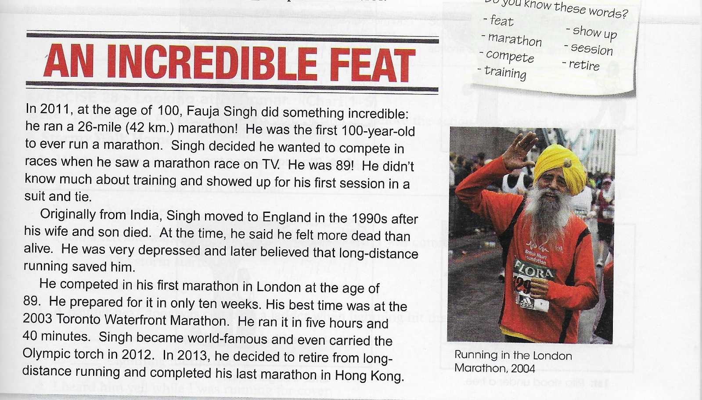
An incredible feat
Read the passage. Point out the past tense verbs

Slide 9
Exercise:
Complete the sentences with the verbs in the box.
Fauja Singh _______________ a marathon runner when he was depressed.
He _______________ a suit and tie to his first training.
He _______________ India after the death of his wife and son.
At the age of 89, he ______________ his first marathon.
Before he began training, he said that he _____________ more dead than alive.
His best running time __________________ five hours and 40 minutes.
He _______________ the Olympic torch in 2012.
He _______________ from marathon running in 2013.
be carry leave run become feel retire wear

Slide 10
Simple Past and Past Progressive
Simple Past
now
past X future
Past Progressive
X
start - finish
X---------------X
…in progress…

Slide 11
Simple Past vs. Past Progressive
The simple past indicates that an activity or situation began and ended at a particular time in the past.
I walked to school yesterday.
John lived in Paris for ten years, but now he lives in Rome.
I bought a new car three days ago.
If a sentence contains when (adverb clause) and has the simple past in both clauses, the action in the when-clause happens first.
Rita stood under a tree when it began to rain.
When Mrs. Taylor heard a strange noise, she got up to investigate.
When I dropped my cup, the coffee spilled on my lap.

Slide 12
Simple Past vs. Past Progressive
The past progressive is used to describe an action at a particular moment in the past. The action started before that moment but is not over at that moment.
When we use the past progressive, our listener usually knows or understands what time we are talking about:
I was working at 10pm last night.
They were not playing football at 9am this morning.
What were you doing at 10pm last night?
What were you doing when he arrived?
She was cooking when I called her.
We were having dinner when it started to rain.
John went home early because it was snowing.

Slide 13
Simple Past vs. Past Progressive
In the past progressive two actions occur at the same time in the past, but one action begins earlier and is in progress when the other action occurs.
I was walking down the street when it began to rain
While I was walking down the street, it began to rain.
Rita was standing under a tree when it began to rain.
The past progressive can also describe an action that began in the past and continued for an indefinite period of time.
At eight o’clock last night I was studying = “My studying began before 8:00 pm, was in progress at that time, and probably continued”.
Sometimes the past progressive is used in both parts of a sentence when two actions are in progress simultaneously.
While I was studying in one room of our apartment, my roommate was having a party in the other room.

Slide 14
Past Progressive + Simple Past
We often use the past progressive with the simple past. We use the past progressive to express a long action.
And we use the simple past to express a short action that happens in the middle of the long action.
We can join the two ideas with when or while:
Long action:
I was watching TV from 7pm to 9pm.
Short action:
You called at 8pm.

Slide 15
Past Progressive + Simple Past
Long action (watching TV): expressed with past progressive
Short action (called): expressed with simple past
We can join these two actions with when:
I was watching TV when you called.
Notice that "when you called" is also a way of defining the time (8pm).
But also:
While I was watching TV, you called.
We use:
when + short action (Simple Past)
while + long action (Past Progressive)

Slide 16
Exercise:
Complete the sentences. Use the simple past or the past progressive of the verbs in parentheses.
Last night
Between 5:00 and 7:00 pm, I (sit) __________________ in class. I had a lot of things on my mind. I (think) _____________ about some family issues. I (listen, not) _____________ to the teacher.
It was a beautiful evening when I walked home. The moon (shine) ____________ over the water , and warm breeze (blow) _______________.
I (stop) _______________ by a friend’s apartment, but he (be, not) _____________ home. He (sit) ________________ in heavy traffic. He (get, not) _____________ home until 10:00.
My neighbors (argue) ______________ about something when I (walk) __________ by them outside my apartment building.
A package (wait) _______________ for me at home. I (open) _____________ it and (find) _____________ an early birthday present.
While I (read) _______________ to my nephew, he (fall) _______________ asleep, so I (cover) ______________ him up and (sneak) _______________ out of the room.

Slide 17
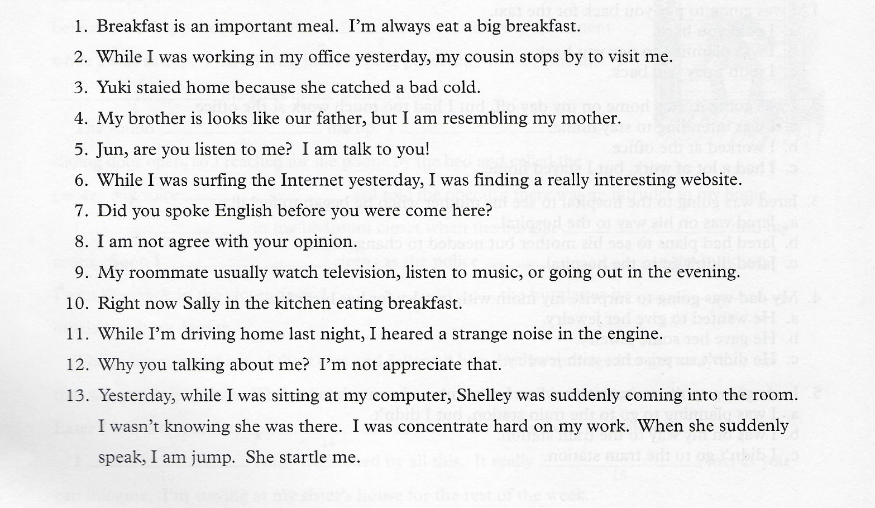
Exercise: correct the errors

Slide 18
Blink and you really do ‘miss it’
The following article describes a recent study about what happens in our brains when we blink.
Read the text and answer the questions below.
Parts of the brain are temporarily "switched off" when we blink, scientists have found. Writing in the journal Current Biology, a team from the University College London says that this is true even if light is still entering the eyes. The researchers said this could explain why people do not notice their own blinking, allowing us to have an "uninterrupted view of the world."
A blink lasts for between 100 and 150 milliseconds. We automatically blink 10 to 15 times a minute to moisten and oxygenate the cornea. During a blink, although no light enters the eyes, we do not consciously recognize that everything has momentarily gone dark.
The UCL team set out to discover why humans are not disturbed by these "mini blackouts". They used a specially-designed device that was placed in the mouths of volunteers while they were lying in a magnetic resonance imaging (MRI) scanner. MRI scanners allow brain activity to be monitored.
The device emitted a strong light that lit up the eyeballs through the roof of the mouth. Because of this, the light falling on the eye remained constant even when the participants blinked. This meant that the scientists were able to measure the effects of blinking on the participants’ brain activity independently of the amount of light hitting the eye.
In the experiment, the researchers found that blinking suppressed brain activity in certain parts of the brain, in particular the visual cortex and other areas which are usually activated when people become conscious of visual events or objects in the outside world.
Davina Bristow, who led the research, said: "We would immediately notice if the outside world suddenly went dark, especially if it was happening every few seconds. But we are rarely aware of our blinks, even though they cause a similar reduction in the amount of light entering the eye. Transiently suppressing the brain areas that are involved in visual awareness during blinks may be a neural mechanism for preventing the brain from becoming aware of the world going dark with every blink."

Slide 19
1. Why don't we see darkness when we blink?
1. Because blinking is so fast that the brain does not have time to truly "see" any change in the amount of light.
2. Because even when we blink there is constant light falling on the eyes.
3. Because parts of the brain shut down when we blink to keep us from noticing the darkness.
4. It is impossible to say based on this article.
2. What did the scientists learn when they examined the patients by MRI?
1. That the activity of some brain regions drops when we blink.
2. That there is always some light falling on the eyes.
3. That blinking alters the amount of light hitting the eyes.
4. That darkness causes the activity of certain brain regions to change.
3. What was the purpose of the “device” described in the third paragraph of the article?
1. To improve the quality of the MRI scanning.
2. To make it possible for the participants to blink without it affecting the amount of light reaching the eyes.
3. To make it unnecessary for the participants to blink.
4. To induce blinking in the participants.
4. What would happen if you were in a room and the lights went out for just 100 milliseconds?
1. You wouldn’t notice it.
2. You would blink.
3. There would probably be a reduction in the activity of certain regions of your brain.
4. You would be aware of the sudden change in light.
5. Why do we normally blink?
1. To allow our brain to rest occasionally.
2. To keep our eyes from drying out.
3. To prevent too much light from entering the eyes.
4. All of the above.

Slide 20
Each of the following sentences is missing one of the words from the article.
Fill in the missing word.
1. An mp3 player is a ______________________ for storing and playing music.
2. When neon atoms are excited by electrons, the atoms _____________________ red light.
3. The concert was very long: it ____________________ more than three hours.
4. Suddenly, I was ___________________ of someone standing behind me.
5. After the drug was administered, there was a ___________________ increase in the patient's heart rate, which soon returned to normal.
6. The doctors _____________________ the patient's heart rate all night.
7. Installing anti-virus software on your computer can help _____________________ it from being infected.
8. Scientists have recently _____________________ a computer that will only cost $100. They will soon begin to produce it and distribute it to children around the world.

Slide 21
“Marathon Mouse”
Put the verbs in brackets into the appropriate form, making any necessary changes
By ........................... (enhance) the function of a single protein, Howard Hughes Medical Institute researchers .......................... (produce) a “marathon mouse” with altered muscle composition and enough physical endurance to run twice as far as normal mice. Mice with the enhanced protein also showed an innate resistance to weight gain, even when .................. (feed) a high-fat diet that caused normal mice ........................ (become) obese.
According to the researchers, their finding ............................ (offer) important insights into the machinery that powers muscle development and the physiological changes produced by exercise. The finding also suggests a route to designing drugs that enhance muscle development and mimic all the benefits of exercise. The researchers said such drugs could aid patients whose debilitating diseases prevent them from .......................... (exercise). The researchers recognize that such drugs - already .................... (test) by pharmaceutical companies - could be abused as a way to enhance athletic performance. In their studies, the researchers .......................... (explore) the effects of altering the gene for a protein called PPAR-delta — a master regulator of numerous genes — to enhance that protein's activity. According to Evans, they............................. (not/expect) the profound and far-reaching physiological effects of this single genetic alteration.
“In a previous work, we had shown that in various tissues, particularly adipose tissues, activating PPAR-delta increased fat burning and, as a result, decreased fat-tissue mass,” said Evans.
“Going into this experiment, the possibility of an effect on muscle fibers was not on our radar screen.”

