Slide 1
Passive verb forms

Slide 2
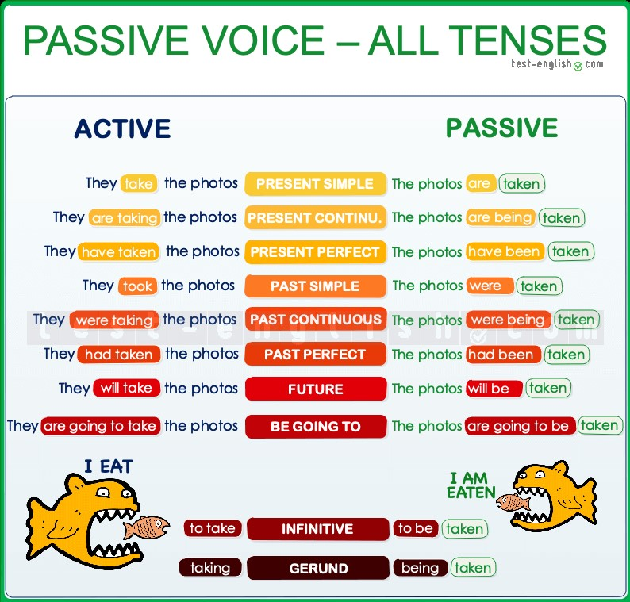
To make a passive verb form, we have to use be in a particular verb tense and add the past participle of the main verb after it. Active and Passive
In a passive sentence, the object of an active sentence becomes the subject.
In a passive sentence, the subject is therefore the receiver the action, not the doer of the action.
They take the photos in Africa. (active)
The photos are taken in Africa. (passive)

Slide 3
When do we use the passive
The passive is more formal than the active form, and it is more common in written language.
We often use the passive when we ‘don’t know’, when it is obvious, or when we don’t want to say who or what is responsible for the action.
A bank was robbed yesterday. (We don’t know who robbed the bank.)
The robber was arrested last night. (It’s obvious that the police arrested the robber.)
I was told that you insulted my brother. (I don’t want to say who told me.)
Jurassic Park was filmed by Spielberg in 1993. (I’m talking about Jurassic Park, not Spielberg.)
The passive voice is very common in the news and in formal and scientific writing.
Arsenal have been defeated 3‐0 and they are now 4th in the table.
The classroom has been cleaned by the janitor.
The Catalan election will be held next September.
Passive voice + by
We can use by to say who or what is responsible for the action.
The painting was bought by a very rich American.
Penicillin was invented by Alexander Fleming.

Slide 4
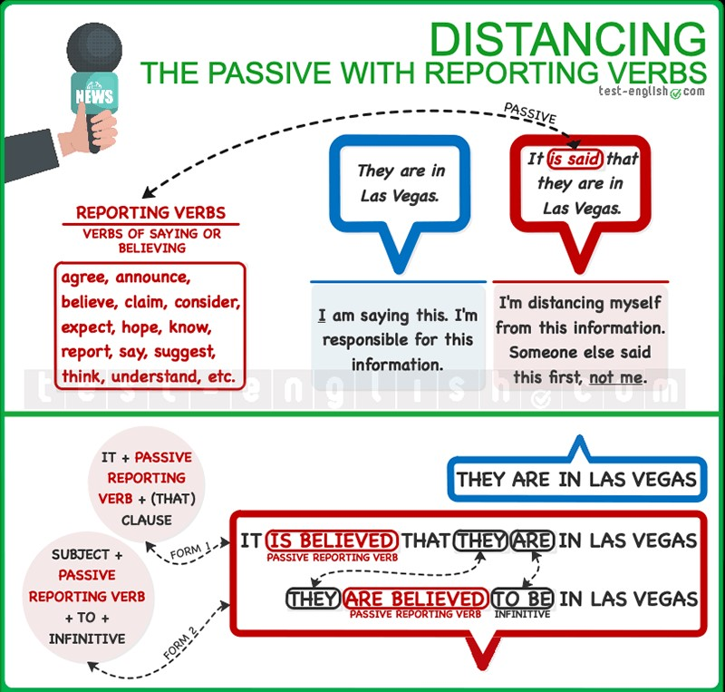
The passive with reporting verbs
In news reports and formal writing, it is common to use the passive forms of reporting verbs.
Using this resource allows us to give information when we don’t know for sure whether it is true or not, or when we want to distance ourselves from the source of the information.
Reporting verbs are verbs of saying or believing such as agree, announce, believe, claim, consider, expect, hope, know, report, say, suggest, think, understand, etc.
And we can use their passive form for distancing in two different ways.
It is said that they are in Las Vegas.
They are said to be in Las Vegas.

Slide 5
It is said that… + subject + verb
We can use the passive of a reporting verb in a sentence after an introductory it:
It + passive reporting verb + (that) + clause (subject + verb)
It is believed that the murderer is no longer in the country.
It has been announced that they are going to cancel the tour.
It has been suggested that the team can’t be trusted defensively.
It was thought the building could collapse.
Someone is said to + infinitive
When we use the passive form of a reporting verb after the real subject of sentence (and NOT after it), we need to use an infinitive after the passive of the reporting verb.
Someone is said to do
When the reported action is simultaneous to the reporting, we can use use:
subject + passive reporting verb + to + infinitive.
He is said to have the biggest private art collection in the country.
They were believed to be secretly in love.
We can also use this form to refer to the future.
She is expected to become a super star.

Slide 6
Someone is said to be doing
When the reported action is in progress simultaneously to the reporting, we can also use subject + passive reporting verb + to be + -ing (continuous infinitive) with dynamic verbs.
They are thought to be living under strict protection.
Someone is said to have done
When the reported action is previous to the reporting (earlier in the past), we use subject + passive reporting verb + to have + past participle (perfect infinitive).
She was thought to have left the previous week (=she left before people thought about it)
He is claimed to have hit another student (=he hit another student first and people claimed he did it later)

Slide 7
Choose the correct form, active or passive, for each gap below.
1. The new musical _____________ next week at 12th Street's Old Auditorium.
a. is going to be performed
b. is going to perform
c. is performed
2. A lot of measures _______________ to fix the economy.
a. have been taken
b. are taking
c. have taken
3. I _________________ you exactly what to do when we arrive.
a. will be shown
b. am shown
c. will show
4. The police discovered a group of women who _______________ in an illegal factory.
a. have been exploited
b. were being exploited
c. were exploiting
5. When do you think they ______________ us the copy of the contract?
a. will send
b. will be sent
c. are they being sent

Slide 8
6. Chicken thighs ________________ for 40 to 50 minutes.
a. should be baking
b. should be baked
c. should bake
7. After five months the children _______________ to say many things in English.
a. had learned
b. had been learned
c. had learning
8. Five people _______________ after a car _________________ into a bus last night.
a. were injured / crashed
b. injured / was crashed
c. injured / crashed
9. Road safety __________________ in every school of the country.
a. should teach
b. should be teaching
c. should be taught
10. He has no initiative. He needs ________________ what to do all the time.
a. to tell
b. to be told
c. to been told

Slide 9
Fill in the gaps with the verbs in brackets in the correct tense (in active or passive voice)
Authorities _____________________(just/announce) that Saint Pauls Bank _______________ (rob) yesterday. Two men ____________________(go) into the bank at 9.30 armed with automatic guns. The customers and workers _______________ (tell) to lie down on the floor and one of the bank clerks _______________ (ask) at gunpoint to give them all the money. Then the two robbers _____________(leave) the building quickly.
Local authorities have informed that about 500,000 dollars ________________ (steal) yesterday, but fortunately nobody _________________(injure). Police investigators __________________ (assure) residents that the robbers ________________ (find) soon.
Wine _______________ (produce) for thousands of years. The earliest known evidence of wine _______________ (come) from Georgia (Caucasus), where 8000-year-old wine jars _____________ (find) in 2008. Wine ________________ (reach) the Balkans by c. 4500 BC and ________________ (consume) in ancient Greece, Thrace and Rome. Throughout history, wine ______________ (consume) for its intoxicating effects, which are evident at normal serving sizes. Wine ________________ (also/play) an important role in religion for centuries. Red wine _________________ (associate) with blood by the ancient Egyptians and _______________ (use) by both the Greek cult of Dionysus and the Romans in their Bacchanalia. Nowadays, both Judaism and Christianity ___________________ (incorporate) wine in their religious rituals.

Slide 10
Turn the following active sentences into passive sentences. Keep the same verb tense
1. Then I noticed that someone had stolen my wallet. ⇒ Then I noticed that my wallet ___________________.
2. He said that the police had arrested him 13 times. ⇒ He said that he _____________________ 13 times.
3. They will not make a decision until next week. ⇒ A decision ________________________ until next week.
4. They are going to clean the room today. ⇒ The room ___________________ today.
5. Someone should open the window. ⇒ The window ________________________.
6. We must keep the secret. ⇒ The secret ______________________.
7. I'm tired of people telling me what to do. ⇒ I'm tired of _________________ what to do.
8. They used to send Anna to her room after dinner. ⇒ Anna used ________________ to her room after dinner.
9. Someone might discover the truth. ⇒ The truth _____________________.
10. We can do nothing ⇒ Nothing _______________________

Slide 11
Choose the correct option for each gap below
1. The prime minister _________________ his resignation tomorrow.
a. is expected to have announced
b. is expected that he will
c. is expected to will announce
d. is expected to announce
2. A suspect _________________ after the murder.
a. is reported to have been arrested
b. is reported that was arrested
c. is reported that he was arrested
d. is reported to be arresting
3. The couple ________________ by the end of the year.
a. are rumored they will get married
b. are rumored to get married
c. are rumored that will get married
d. are rumored to have got married
4. He _________________ the best neurosurgeon of all time.
a. is considered be
b. is considered that he was
c. is considered to have been
d. is considered that it was
5. The side effects of this drug _______________ severe.
a. think to be
b .are thought that they are
c. are thought they have been
d. are thought to be

Slide 12
6. It ______________ for quite some time.
a. is said to happen
b. is said that this has been happening
c. is said this to be happening
d. is said this to have happened
7. These measures ___________________ necessary for the safety and security of the nation.
a. are claimed that they are
b. are claimed are
c. are claimed to being
d. are claimed to be
8. He ___________________ innocent until we can find evidence proving that he is guilty.
a. is presumed to be
b. is presumed that he is
c. is presumed is
d. is presumed be
9. Hundreds of people _________________ killed in the earthquake.
a. are reported that they were
b. are reported to have been
c. are reported that they are
d. are reported to be
10. The illness __________________ an hereditary condition.
a. is thought to be
b. is thought be
c. is thought that it is
d. is thought is

Slide 13
Fill in the gaps with a passive structure using the passive form of the underlined reporting verbs
People believe that the dolphins have died due to water pollution.
1 The dolphins __________________ due to water pollution.
2 It ________________ due to water pollution.
People think she is in Wales.
3 She ________________ in Wales.
4 It __________________ in Wales.
The police say that he is hiding in the city.
5 He ________________ in the city.
6 It _________________in the city.
People know the suspect is dealing with drugs.
7 The suspect ___________________with drugs.
8 It _____________________ with drugs.
People considered the government had spent too much.
9 The government _______________________ too much.
10 It _______________________too much.

Slide 14
Read the article. What is the meaning of the words in bold?
If you look 'chemistry' up in Webster's Dictionary, you'll see the following definition:
"chem·is·try n., pl. -tries. 1. the science that systematically studies the composition, properties, and activity of organic and inorganic substances and various elementary forms of matter. 2. chemical properties, reactions, phenomena, etc.: the chemistry of carbon. 3. a. sympathetic understanding; rapport. b. sexual attraction. 4. the constituent elements of something; the chemistry of love. [1560-1600; earlier chymistry]."
A common glossary definition is short and sweet: Chemistry is the "scientific study of matter, its properties, and interactions with other matter and with energy".
Relating Chemistry to Other Sciences
An important point to remember is that chemistry is a science, which means its procedures are systematic and reproducible and its hypotheses are tested using the scientific method. Chemists, scientists who study chemistry, examine the properties and composition of matter and the interactions between substances. Chemistry is closely related to physics and to biology. Chemistry and physics both are physical sciences. In fact, some texts define chemistry and physics in exactly the same way. As is true for other sciences, mathematics is an essential tool for the study of chemistry.

Slide 15
1. How many meanings of the word chemistry are mentioned in the article?
2. Which branches of science are, according to the article, closely related to chemistry? Do you agree?
3. Why, according to the article, is chemistry a science? What criteria are mentioned?
4. Do you think that mathematics is an essential tool for the study of chemistry, as the article says?
Fundamental concepts of chemistry
Read the text and fill in the gaps with the following expressions in appropriate forms. Use
each expression only once.
chemical formula, chemical equation, proton, neutron, element, electron, atomic nucleus,
molecule, cation, anion, chemical compound, chemical reaction, chemical bonds, ion,
molecule, atomic number

Slide 16
An atom is a collection of matter consisting of a positively charged core (the _________
_______ ) which contains ____________ and ____________ and which maintains a number of
electrons to balance the positive charge in the nucleus. The atom is also the smallest portion into
which an ____________ can be divided and still retain its properties, made up of a dense,
positively charged nucleus surrounded by a system of ____________.
The most basic chemical substances are the chemical elements. They are building blocks of
all other substances. An element is a class of atoms which have the same number of protons in the
nucleus. This number is known as the ___________ ____________ of the element. For example, all
atoms with 6 protons in their nuclei are atoms of the chemical element carbon, and all atoms with
92 protons in their nuclei are atoms of the element uranium. Each chemical element is made up of
only one kind of atom. The atoms of one element differ from those of all other elements. Chemists
use letters of the alphabet as symbols for the elements. In total, 117 elements have been observed as
of 2007, of which 94 occur naturally on Earth. Others have been produced artificially.
An ____________ is an atom or a molecule that has lost or gained one or more electrons.
Positively charged ____________ (e.g. sodium cation Na+) and negatively charged ___________
(e.g. chloride Cl−) can form neutral salts (e.g. sodium chloride NaCl).
Electrical forces at the atomic level create _____________ __________ that join two or
more atoms together, forming ____________.

Slide 17
Some molecules consist of atoms of a single element. Oxygen molecules, for example, are made up of two oxygen atoms. Chemists represent the oxygen molecule O2. The 2 indicates the number of atoms in the molecule.
When atoms of two or more different elements bond together, they form a ___________
_________. Water is a compound made up of two hydrogen atoms and one oxygen atom. The
__________ _________ for a water molecule is H2O.
Compounds are formed or broken down by means of ____________ __________. All chemical reactions involve the formation or destruction of chemical bonds. Chemists use ___________ ___________ to express what occurs in chemical reactions. Chemical equations consist of chemical formulas and symbols that show the substances involved in chemical change.
For example, the equation
C + O2 CO2
expresses the chemical change that occurs when one carbon atom reacts, or bonds, with an oxygen
molecule. The reaction produces one molecule of carbon dioxide, which has the formula CO2.

