Slide 1
Cell division and protein synthesis

Slide 2
Cell division
Introduction
Cell division is the process in which a cell divides to form two new cells. The original cell is called the parent cell.
The two new cells are called daughter cells. All cells contain DNA.
DNA is the nucleic acid that stores genetic information. Before a cell divides its DNA must be copied.
That way, each daughter cell gets a complete copy of the parent cell’s genetic material.
Copying DNA
DNA stands for deoxyribonucleic acid. It is a very large molecule. It consists of two strands of smaller molecules called nucleotides.
DNA Structure
As you can see in Figure 1, each nucleotide includes a sugar, a phosphate, and a nitrogen base.
The sugar in DNA is called deoxyribose. There are four different nitrogen bases in DNA:
adenine (A), thymine (T), cytosine (C), and guanine (G).
Chemical bonds between the bases hold the two strands of DNA together.
Adenine always bonds with thymine, and cytosine always bonds with guanine.
These pairs of bases are called complementary base pairs.

Slide 3
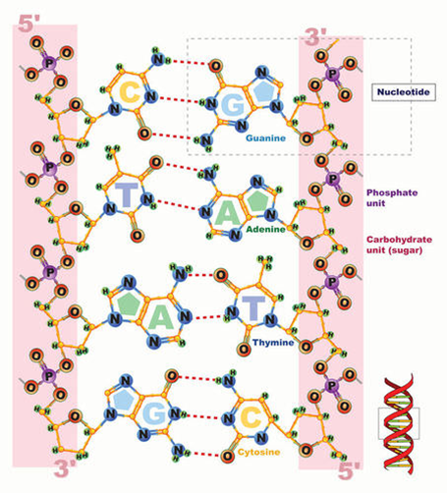
Figure 1
Structure of DNA
Chromosomes
As a cell prepares to divide, its DNA first forms one or more structures called chromosomes.
A chromosome consists of DNA and protein molecules coiled into a definite shape. Chromosomes are circular in prokaryotes and rodlike in eukaryotes. You can see an example of a human chromosome in Figure 2 below.
The rest of the time, DNA looks like a tangled mass of strings.
In this form, it would be very difficult to copy and divide.

Slide 4
Figure 2
Human chromosome
DNA Replication
The process in which DNA is copied is called DNA replication. You can see how it happens in Figure 3 below.
An enzyme breaks the bonds between the two DNA strands. Another enzyme pairs new, complementary nucleotides with those in the original chains. Two daughter DNA molecules form. Each contains one new chain and one original chain.

Slide 5
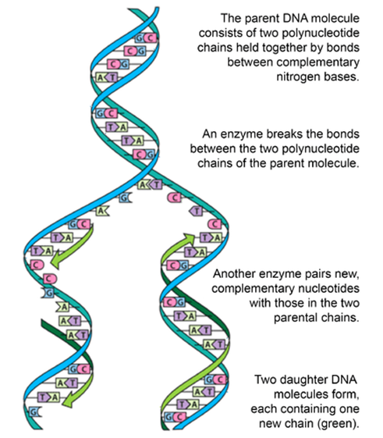
Figure 3
DNA replication
Cell Division in Prokaryotic and Eukaryotic Cells
How cell division proceeds depends on whether a cell has a nucleus. Prokaryotic cells lack a nucleus. Their DNA is in the cytoplasm. It forms just one circular chromosome.
Eukaryotic cells have a nucleus holding their DNA. Their DNA forms multiple rodlike chromosomes.
Eukaryotic cells also have other organelles. For these reasons, cell division is more complex in eukaryotic cells.

Slide 6
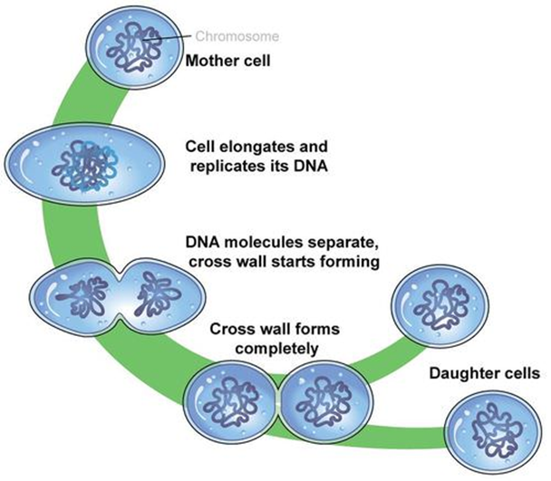
Prokaryotic Cell Division
You can see how a prokaryotic cell divides in Figure 4 below. This type of cell division is called binary fission. The cell simply splits into two equal halves. Binary fission occurs in bacteria and other prokaryotes. It takes place in three continuous steps:
1. The cell’s chromosome is copied to form two identical chromosomes. This is DNA replication.
2. The copies of the chromosome separate from each other. They move to opposite poles, or ends, of the cell.
This is called chromosome segregation.
3. The cell wall grows toward the center of the cell. The cytoplasm splits apart, and the cell pinches in two.
This is called cytokinesis.
Figure 4
Binary fission in a prokaryotic cell

Slide 7
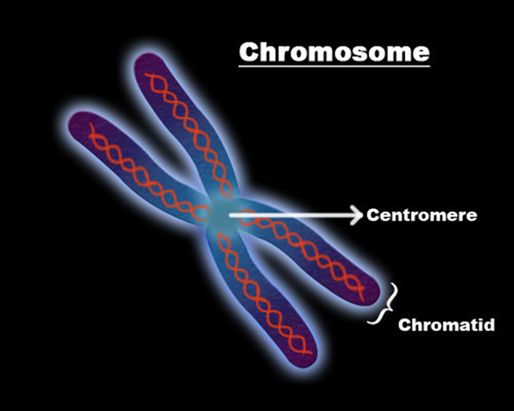
Eukaryotic Cell Division
Before a eukaryotic cell divides, the nucleus and other organelles must be copied.
Only then will each daughter cell have all the needed structures.
1. The first step in eukaryotic cell division, as it is in prokaryotic cell division, is DNA replication. As you can see in Figure 5 below, each chromosome then consists of two identical copies. The two copies are called sister chromatids. They are attached to each other at a point called the centromere:
Figure 5
DNA replication

Slide 8
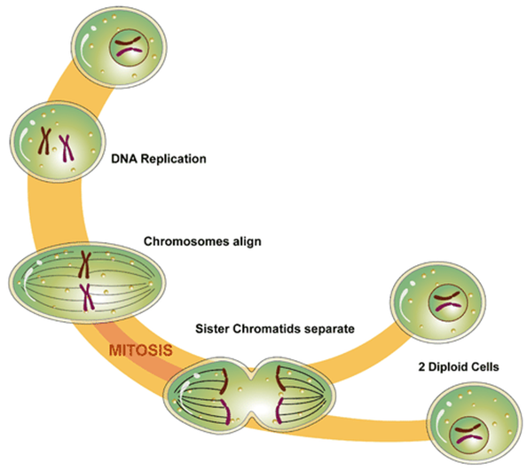
2. The second step in eukaryotic cell division is division of the cell’s nucleus. This includes division of the chromosomes. This step is called mitosis. It is a complex process that occurs in four phases.
3. The third step is the division of the rest of the cell. This is called cytokinesis, as it is in a prokaryotic cell. During this step, the cytoplasm divides, and two daughter cells form.
These three steps are shown in Figure 6 below.
Figure 6
Cell division in a eukaryotic cell

Slide 9
Mitosis
Mitosis, or division of the nucleus, occurs only in eukaryotic cells. By the time mitosis occurs, the cell’s DNA has already replicated. Mitosis occurs in four phases, called prophase, metaphase, anaphase, and telophase.
Phases of mitosis
1. Prophase: Chromosomes form, and the nuclear membrane breaks down. In animal cells, the centrioles near the nucleus move to opposite poles of the cell. Fibers called spindles form between the centrioles.
2. Metaphase: Spindle fibers attach to the centromeres of the sister chromatids. The sister chromatids line up at the center of the cell.
3. Anaphase: Spindle fibers shorten, pulling the sister chromatids toward the opposite poles of the cell. This gives each pole a complete set of chromosomes.
4. Telophase: The chromosomes uncoil, and the spindle fibers break down. New nuclear membranes form.
The Cell Cycle
Cell division is just one of the stages that a cell goes through during its lifetime. All of the stages that a cell goes through make up the cell cycle.
Prokaryotic Cell Cycle
The cell cycle of a prokaryotic cell is simple. The cell grows in size, its DNA replicates, and the cell divides.
Eukaryotic Cell Cycle
In eukaryotes, the cell cycle is more complicated. The diagram in Figure 7 below shows the stages that a eukaryotic cell goes through in its lifetime. There are two main stages: interphase and mitotic phase.

Slide 10
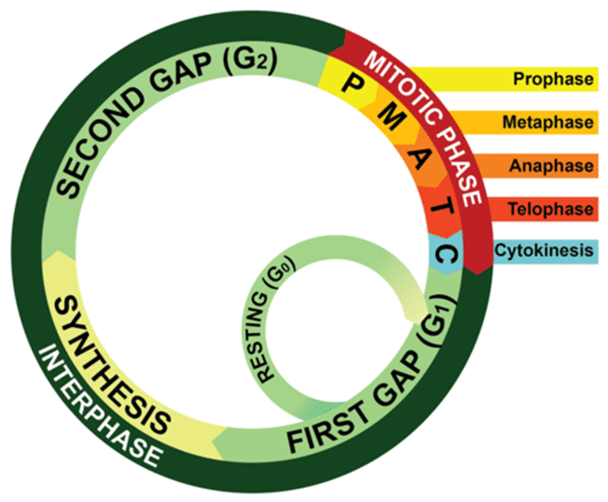
Figure 7
Eukaryotic cell cycle
Interphase is longer than mitotic phase. Interphase, in turn, is divided into three phases:
1. Growth phase 1 (G1): The cell grows rapidly. It also carries out basic cell functions. It makes proteins needed for DNA replication and copies some of its organelles. A cell usually spends most of its lifetime in this phase.
2. Synthesis phase (S): The cell copies its DNA. This is DNA replication.
3. Growth phase 2 (G2): The cell gets ready to divide. It makes more proteins and copies the rest of its organelles.
Mitotic phase is when the cell divides. It includes mitosis (M) and cytokinesis (C).

Slide 11
Lesson Vocabulary
anaphase
binary fission
cell cycle
cell division
chromosome
cytokinesis
DNA (deoxyribonucleic acid)
DNA replication
interphase
metaphase
mitosis
prophase
telophase

Slide 12
Lesson Summary
DNA is the nucleic acid that stores genetic information. It must be copied before a cell divides. DNA replication is the process in which DNA is copied.
Cell division is the process in which a parent cell divides to form two daughter cells. It occurs by binary fusion in most prokaryotic cells. It is more complex in eukaryotic cells.
Mitosis is the process by which the nucleus of a eukaryotic cell divides. It happens in four phases: prophase, metaphase, anaphase, and telophase.
Cell division is just one stage of the cell cycle. The cell cycle includes all of the stages in the life of a cell. The cell cycle is more complex in eukaryotic than prokaryotic cells.
Lesson Review Questions
What is DNA replication? When and why does it occur?
What are chromosomes? When do chromosomes form?
Identify the steps of cell division in a prokaryotic cell.
List the phases of mitosis and what happens during each phase.
Think Critically
Explain why cell division is more complicated in eukaryotic than prokaryotic cells.
Compare and contrast the cell cycles of prokaryotic and eukaryotic cells.

Slide 13
Multiple choice
Circle the letter of the correct choice.
1. The sugar in DNA is called:
a. ribose
b. deoxyribose
c. glucose
d. none of the above
2. Which nitrogen base binds with cytosine?
a. adenine
b. thymine
c. guanine
d. uracil
3. Which organisms have rodlike chromosomes?
a. bacteria
b. archaea
c. protists
d. all of the above
4. Which statement about sister chromatids is false?
a. They are attached at a point called a centromere
b. They are found in all cells during cell division
c. They form when the DNA in a cell replicates
d. They separate from each other during anaphase
5. The two main stages of the cell cycle in a eukaryotic cell are interphase and…
a. prophase
b. synthesis phase
c. growth phase
d. mitotic phase

Slide 14
True or False
_____ The last phase of mitosis is telophase.
_____ Interphase is divided into four phases.
_____ The cell cycle of a prokaryotic cell includes mitotic phase.
_____ Sister chromatids line up at the center of a cell during metaphase.
_____ DNA replication occurs during the second phase of mitosis.
Fill in the Blank
The phase of the cell cycle in which the cytoplasm splits apart and the cell pinches in two is called _________________.
The stage of mitosis in which the nuclear membrane breaks down is known as _________________.
During the stage called _________________, a eukaryotic cell grows and prepares to divide.
A nucleotide consists of a sugar, a phosphate, and a nitrogen _________________.
A chromosome is a coiled structure that consists of DNA and _________________ molecules.
Short Answer
Answer the following question in complete sentences:
Describe how the nucleus divides in a eukaryotic cell.

Slide 15
Protein Synthesis
Introduction
Blueprints contain the instructions for building a house. Your cells also contain “blueprints.” They are encoded in the DNA of your chromosomes.
DNA, RNA and Proteins
DNA and RNA are nucleic acids. DNA stores genetic information. RNA helps build proteins. Proteins, in turn, determine the structure and function of all your cells. Proteins consist of chains of amino acids. A protein’s structure and function depend on the sequence of its amino acids.
Instructions for this sequence are encoded in DNA.
In eukaryotic cells, chromosomes are contained within the nucleus. But proteins are made in the cytoplasm at structures called ribosomes. How do the instructions in DNA reach the ribosomes in the cytoplasm? RNA is needed for this task.
Comparing RNA with DNA
RNA stands for ribonucleic acid. RNA is smaller than DNA. It can squeeze through pores in the membrane that encloses the nucleus. It copies instructions in DNA and carries them to a ribosome in the cytoplasm. Then it helps build the protein.

Slide 16
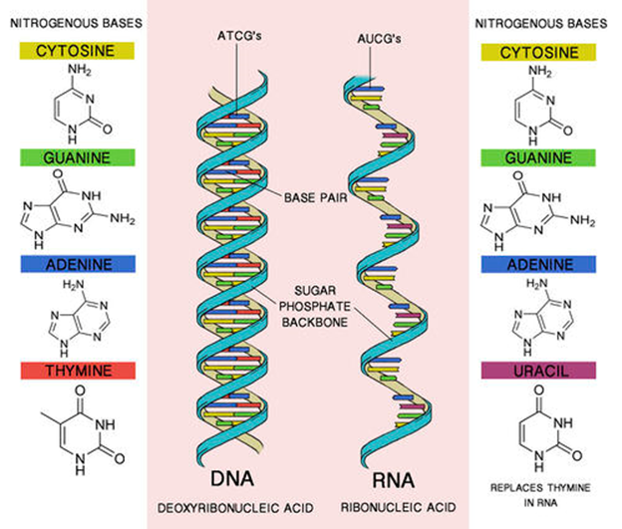
RNA is not only smaller than DNA. It differs from DNA in other ways as well. It consists of one nucleotide chain rather than two chains as in DNA. It also contains the nitrogen base uracil (U) instead of thymine (T). In addition, it contains the sugar ribose instead of deoxyribose. You can see these differences in Figure 1 below.
Figure 1
Comparison of RNA and DNA

Slide 17
Types of RNA
There are three different types of RNA. All three types are needed to make proteins.
Messenger RNA (mRNA) copies genetic instructions from DNA in the nucleus. Then it carries the instructions to a ribosome in the cytoplasm.
Ribosomal RNA (rRNA) helps form a ribosome. This is where the protein is made.
Transfer RNA (tRNA) brings amino acids to the ribosome. The amino acids are then joined together to make the protein.
The Genetic Code
How is the information for making proteins encoded in DNA? The answer is the genetic code. The genetic code is based on the sequence of nitrogen bases in DNA. The four bases make up the “letters” of the code. Groups of three bases each make up code “words.” These three-letter code words are called codons. Each codon stands for one amino acid or else for a start or stop signal.
There are 20 amino acids that make up proteins. With three bases per codon, there are 64 possible codons. This is more than enough to code for the 20 amino acids plus start and stop signals.

Slide 18
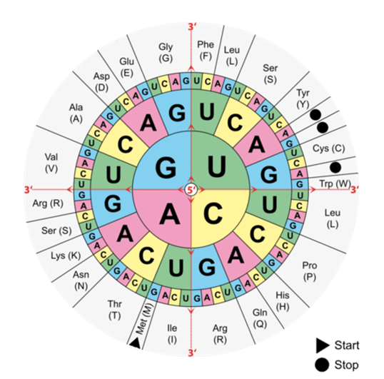
You can see how to translate the genetic code in Figure 2 below.
Start at the center of the chart for the first base of each three-base codon. Then work your way out from the center for the second and third bases.
Figure 2
Translating the genetic code
Find the codon AUG in Figure 2 above. It codes for the amino acid methionine. It also codes for the start signal. After an AUG start codon, the next three letters are read as the second codon. The next three letters after that are read as the third codon, and so on.

Slide 19
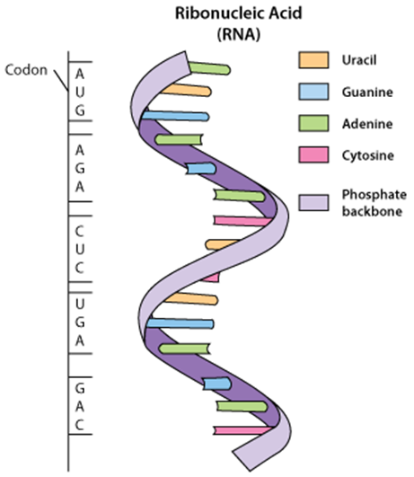
You can see how this works in Figure 3 below. The figure shows the bases in a molecule of RNA. The codons are read in sequence until a stop codon is reached. UAG, UGA, and UAA are all stop codons. They don’t code for any amino acids.
Figure 3
How the genetic code is read

Slide 20
Characteristics of the Genetic Code
The genetic code has three other important characteristics.
The genetic code is the same in all living things. This shows that all organisms are related by descent from a common ancestor.
Each codon codes for just one amino acid (or start or stop). This is necessary so the correct amino acid is always selected.
Most amino acids are encoded by more than one codon. This is helpful. It reduces the risk of the wrong amino acid being selected if there is a mistake in the code.
Protein Synthesis
The process in which proteins are made is called protein synthesis. It occurs in two main steps. The steps are transcription and translation.

Slide 21
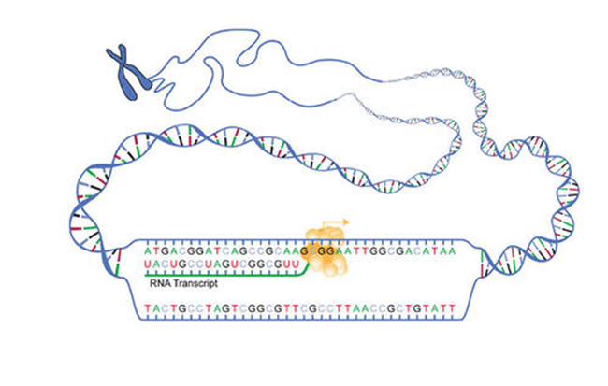
Transcription: DNA → RNA
Transcription is the first step in protein synthesis. It takes place in the nucleus. During transcription, a strand of DNA is copied to make a strand of mRNA. How does this happen? It occurs by the following steps, as shown in Figure 4 below:
An enzyme binds to the DNA. It signals the DNA to unwind.
After the DNA unwinds, the enzyme can read the bases in one of the DNA strands.
Using this strand of DNA as a template, nucleotides are joined together to make a complementary strand of mRNA. The mRNA contains bases that are complementary to the bases in the DNA strand.
Figure 4
Transcription step of protein synthesis

Slide 22
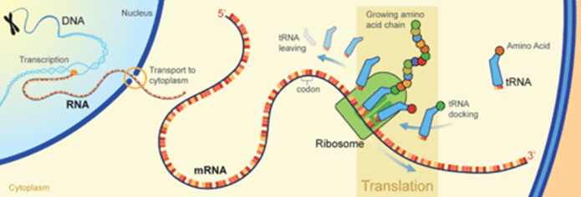
Translation is the second step in protein synthesis. It is shown in Figure 5 below.
Translation takes place at a ribosome in the cytoplasm. During translation, the genetic code in mRNA is read to make a protein. Here’s how it works:
The molecule of mRNA leaves the nucleus and moves to a ribosome.
The ribosome consists of rRNA and proteins. It reads the sequence of codons in mRNA.
Molecules of tRNA bring amino acids to the ribosome in the correct sequence.
At the ribosome, the amino acids are joined together to form a chain of amino acids.
The chain of amino acids keeps growing until a stop codon is reached. Then the chain is released from the ribosome.
Figure 5
Translation step of protein synthesis

Slide 23
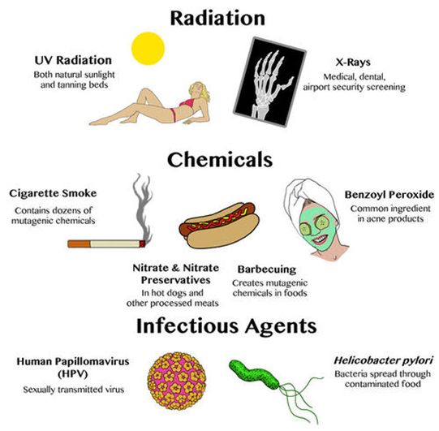
Causes of Mutations
Mutations have many possible causes. Some mutations occur when a mistake is made during DNA replication or transcription. Other mutations occur because of environmental factors. Anything in the environment that causes a mutation is known as a mutagen.
Examples of mutagens are shown in Figure 6 below. They include ultraviolet rays in sunlight, chemicals in cigarette smoke, and certain viruses and bacteria.
Figure 6
Examples of mutagens

Slide 24
Effects of Mutations
Many mutations have no effect on the proteins they encode. These mutations are considered neutral. Occasionally, a mutation may make a protein even better than it was before. Or the protein might help the organism adapt to a new environment. These mutations are considered beneficial.
An example is a mutation that helps bacteria resist antibiotics. Bacteria with the mutation increase in numbers, so the mutation becomes more common.
Other mutations are harmful. They may even be deadly. Harmful mutations often result in a protein that no longer can do its job. Some harmful mutations cause cancer or other genetic disorders.
Mutations also vary in their effects depending on whether they occur in gametes or in other cells of the body.
Mutations that occur in gametes can be passed on to offspring. An offspring that inherits a mutation in a gamete will have the mutation in all of its cells.
Mutations that occur in body cells cannot be passed on to offspring. They are confined to just one cell and its daughter cells. These mutations may have little effect on an organism.

Slide 25
Types of Mutations
The effect of a mutation is likely to depend as well on the type of mutation that occurs.
A mutation that changes all or a large part of a chromosome is called a chromosomal mutation. This type of mutation tends to be very serious. Sometimes chromosomes are missing or extra copies are present. An example is the mutation that causes Down syndrome. In this case, there is an extra copy of one of the chromosomes.
Deleting or inserting a nitrogen base causes a frameshift mutation. All of the codons following the mutation are misread. This may be disastrous. To see why, consider this English-language analogy. Take the sentence “The big dog ate the red cat.” If the second letter of “big” is deleted, then the sentence becomes: “The bgd oga tet her edc at.” Deleting a single letter makes the rest of the sentence impossible to read.
Some mutations change just one or a few bases in DNA. A change in just one base is called a point mutation. Table 1 below compares different types of point mutations and their effects.

Slide 26
Table 1
Lesson summary
DNA encodes instructions for proteins. RNA copies the genetic code in DNA and carries it to a ribosome. There, amino acids are joined together in the correct sequence to make a protein.
The genetic code is based on the sequence of nitrogen bases in DNA. A code “word,” or codon, consists of three bases. Each codon codes for one amino acid or for a *Protein synthesis is the process in which proteins are made. In the first step, called transcription, the genetic code in DNA is copied by RNA. In the second step, called translation, the genetic code in RNA is read to make a protein.
A mutation is a change in the base sequence of DNA or RNA. Environmental causes of mutations are called mutagens. The effects of a mutation depend on the type of mutation and whether it occurs in a gamete or body cell.
Type | Description | Example | Effect
Silent | mutated codon codes for the same amino acid | CAA (glutamine) → CAG (glutamine) | none
Missense | mutated codon codes for a different amino acid | CAA (glutamine) → CCA (proline) | variable
Nonsense | mutated codon is a premature stop codon | CAA (glutamine) → UAA (stop) | serious
Types of point mutations

Slide 27
Lesson Vocabulary
codon
genetic code
mutagen
mutation
protein synthesis
RNA (ribonucleic acid)
transcription
translation
Multiple Choice
1. Types of mutagens include:
a. radiation
b. viruses
c. bacteria
d. all of the above
2. When a mutated codon codes for a different amino acid, the mutation is called a:
a. silent mutation
b. nonsense mutation
c. missense mutation
d. chromosomal mutation

Slide 28
3. Each gene codes for one:
a. codon
b. nucleotide
c. amino acid
d. protein
4. Which type of RNA carries genetic information from the nucleus to a ribosome?
a. rRNA
b. tRNA
c. mRNA
d. none of the above
5. The “backbone” of the DNA molecule consists of:
a. sugars
b. phosphates
c. nitrogen bases
d. two of the above

Slide 29
True or False
6. _____ Some mutations occur when errors are made in copying DNA.
7. _____ The genetic code is the same in all living things.
8. _____ The translation step of protein synthesis takes place in the nucleus.
9. _____ RNA is a double-stranded nucleic acid.
10. _____ Uracil is a nitrogen base found only in RNA.
Fill in the Blank
11. _________________ is the nucleic acid that stores genetic information.
12. The process in which proteins are made is called protein _________________.
13. Deleting or inserting a nitrogen base in DNA causes a(n) _________________mutation.
14. The type of RNA that brings amino acids to a ribosome is called _________________.
15. The point mutation CAA (glutamine) → UAA (stop) is an example of a(n) _____________ mutation.
Short Answer
Answer the following question in complete sentences:
Name and summarize the two steps of protein synthesis.

