Slide 1

University of Trieste
Department of Political and Social Sciences
INTERNATIONAL RELATIONS AND POLITICAL
DEVELOPMENT IN AFRICA
Academic year 2016-17
Lesson NINE: DEMOCRATIC EXPERIENCES

Slide 2
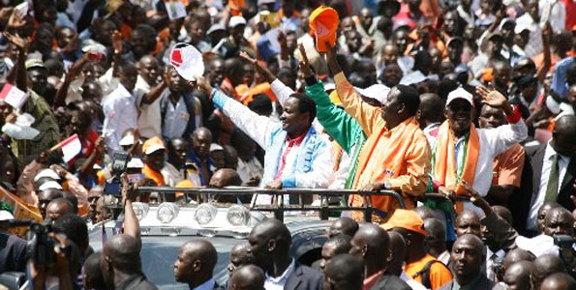
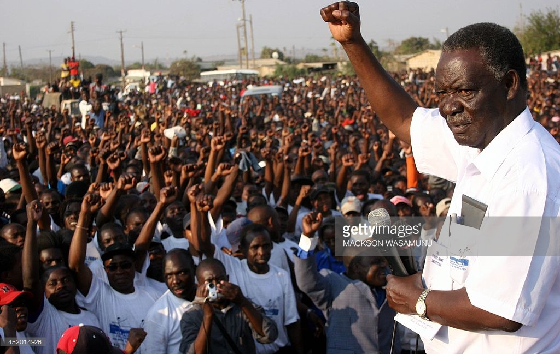

Slide 3
SCHUMPETER DEFINITION OF DEMOCRACY (Capitalism, Socialism and Democracy, 1954):
“THE DEMOCRATIC METHOD IS THAT INSTITUTIONAL ARRANGEMENT FOR ARRIVING AT POLITICAL DECISIONS IN WHICH INDIVIDUALS ACQUIRE THE POWER TO DECIDE BY MEANS OF A COMPETITIVE STRUGGLE FOR THE PEOPLE’S VOTE”.
IT IS NOT ABOUT PERFORMANCE! (→PERFORMANCES ARE MORE RELATED TO STATE CAPACITY)

Slide 4
QUALITY OF ELECTIONS:
LIST OF AFRICAN COUNTRIES THAT MEET THIS REQUIREMENT (FREE & FAIR): TAB 9.1 (CLASSIFICATION EXEMPLES)
OBSTACLES RELATED TO THE ELECTORAL PROCESS:
  MEDIA ARE LARGELY CONTROLLED BY THE GOVERNMENT
  ELECTORS’ REGISTERS ARE MANIPULATED
  NON-INDEPENDENCE OF ELECTORAL COMMISSIONS
  OPPOSITION IS INTIMIDATED
  FREUD DURING ELECTIONS
  VOTE BUYING
  POLITICAL VIOLENCE RELATED TO ETHNIC POLARIZATION & MOBILIZATION (ALSO BY THE OPPOSITION)

Slide 5
THE THREE DIMENSION OF DEMOCRATIC SYSTEMS:
  QUALITY OF COMPETITION
  PARTICIPATION (VS. FACTIONALISM)
  EXECUTIVE CONTROLS (BY LEGISLATIVE POWER & JUDICIARY): THE FIRST IS RELATED TO PARTY-SYSTEM
SEE POLITY IV RESULTS (TAB 9.1)

Slide 6
PARTY SYSTEM:
WHAT IS PARTY SYSTEM: THE NO. OF SIGNIFICANT PARTIES IN NAs
THERE IS NO PARTICULAR «AFRICAN» PARTY SYSTEM, TWO MODELS PREVAIL:
  FRAGMENTED & INCHOERENT: MOST OF THE PARTIES LACK INSTITUTIONALIZATION, ARE HIGHLY PERSONALIZED OR «ETHNIC»
  DOMINANT PARTY-SYSTEM: THE PARTY SYSTEM IS DOMINATED BY ONE PARTY, WHICH IS THE MOST INSTITUTIONALIZED
  A TWO-PARTY SYSTEM IS THE EXCEPTION (GHANA, SIERRA LEONE, ZAMBIA?)
→ SEE TABLE 9.2

Slide 7
WHY NO. 2?:
  SOME DEMOCRATIC EXPERIENCES WERE INAUGURATED BY FORMER LIBERATION MOVEMENTS
  DEMOCRATIC EXPERIENCE WAS INAUGURATED BY A «NEW» MOVEMENT WHICH PRECLUDED OTHER PARTIES TO SUCCESSFULLY DEFY IT (THE CASE OF ZAMBIAN MMD?)
  FORMER LIBERATION MOVEMENTS ARE GENERALLY MORE INSTITUTIONALIZED THAN «NEW» MOVEMENTS WHICH ARE RATHER WEAK COALITIONS OF FRAGMENTED INTERESTS (EX. NARC, MMD, PDS, ETC.)
GENERALLY, PARTIES ARE WEAK & LACK INSTITUTIONALIZATION; NOTWITHSTANDING, AN IMPROVEMENT IS RECORDED (TAB 9.2 IN YELLOW)

Slide 8
WHY AFRICAN PARTIES ARE WEAK & LACK INSTITUTIONALIZATION?
  AFRICAN PARTIES ARE FOR THE MOST THIRD GENERATION PARTIES, IDEOLOGICAL DIFFERENTIATION IS POOR
  IDEOLOGICAL DIFFERENTIATION IS NOT NEEDED SINCE CLASSES ARE LESS STRUCTURED
  INTERESTS ARE WEAKLY REPRESENTED
  AS A CONSEQUENCE, PROGRAMMATIC DIFFERENTIATION IS POOR
  POLITICS IS LARGELY DEPENDENT FROM PATRONAGE & CLIENTELISM
  ETHNIC VOTE STILL DOES COUNT
  POLITICS IS LARGELY PERSONALIZED & THE LIMIT OF A DUAL-MANDATE BREAKS UP PRESIDENTIAL COALITIONS
  GIVEN THE CONFUSION BETWEEN STATE & GOVERNMENT, INCUMBENT PARTIES ARE MORE INSTITUTIONALIZED
  GVMTS’ PERFORMANCES & POLICIES ARE GENERALLY DEPENDANT FROM DECISIONS TAKEN OUTSIDE (DONORS, MARKETS, ETC.)

Slide 9
WHAT IS INSTITUTIONALIZATION?
  REFERS TO THE PROCESS OF EMBEDDING SOME INSTITUTION WITHIN A SOCIAL AND/OR POLITICAL SYSTEM
  THE PROBLEM OF TIME
  THE IMPORTANCE OF PARTIES FOR THE CONSOLIDATION OF DEMOCRACY (→ DEMOCRACY WITHOUT PARTIES?)
INSTITUTIONALIZATION OF PARTY SYSTEM
INSTITUTIONALIZATION OF PARTIES

Slide 10
HOWEVER, PARTIES ARE EVOLVING STRUCTURES (SEE TABLE 9.3), TYPES:
  «ETHNIC» PARTIES, CHARACTERISTICS
  CONGRESS TYPE, CHARACTERISTICS: THE ROLE OF CLIENTELISM IN BRIDGING COALITIONS → LOW PARTY INSTITUTIONALIZATION
  PROGRAMMATIC:
    MOBILIZATION PARTIES: ENDOWED BY LEGITIMIZATION
    NEW POPULIST PARTIES: NEW COALITIONS BETWEEN MIDDLE & POOR URBAN CLASSES

Slide 11
FOUR CASES: GHANA, KENYA, ZAMBIA, NIGERIA
  COMMON FEATURES: BRITISH COLONIES, ETHNIC FRAGMENTATION, A RELATIVE MAJORITY IN A GIVEN ETHNIC GROUP PERCEIVED AS DOMINANT, SAME ELECTORAL SYSTEM
  DIFFERENCES: ASHANTI WAS A POWERFUL KINGDOM, BEMBAS HAD A SYSTEM OF DECENTRALIZED CHIEFS, GIKUYU USE A SEGMENTARY SOCIETY, SETTLERS IN KENYA, NIGERIA THE THREE
THE GHANA CASE:
  1896 ANNEXATION OF ASHANTI
  1900 ASHANTI UPRISING
  1935 RESTORATION OF ASHANTI KINGDOM WITHIN THE GOLD COAST COLONY
  1947 FORMATION UGCC
  1949 SPLIT OF UGCC AND FORMATION OF CPP BY NKRUMAH
  1954 ULM FORMATION BY ASHANTI DISAFFECTED BY THE CPP (BUSIA JOINS THE NLM)

Slide 12
  INDEPENDENCE 1957 AND ONE-PARTY STATE BY CPP
  1957 UP IS FORMED DOMINATED BY THE NLM
  FILIATION BETWEEN UP (IN POWER BETWEEN 1969-72) – PFP (MAJOR OPPOSITION PARTY 1979-81) – NPP (FORMED IN 1992)
  MILITARY COUPS: 1966; 1972; 1979; 1981
  1992 FIRST MULTIPARTY ELECTIONS: NDC – RAWLINGS
  1996: NDC – RAWLINGS
  2000 & 2004: NPP – KUFUOR
  2008: NDC - ATTA MILLS
  2012: NDC – DRAMANI MAHAMA
  2016/7: NPP – AKUFO ADDO

Slide 13
THE KENYA CASE:
  THE ROLE OF SETTLERS & THE POLICY OF RESETTLING
  1952-59 MAU-MAU UPRISING
  1960 KANU (KENYATTA) & KADU (R. NGALA & ARAP MOI): THE STRUGGLE OVER FEDERALISM VS. CENTRALISM
  1961 MAJORITY OF LEGCO MEMBERS ELECTED (KANU VS. KADU) BIPARTITISM
  1963 INDEPENDENCE
  1966 KANU-KPU STRUGGLE & THE MERGER BETWEEN KANU & KADU
  1969 DE FACTO ONE-PARTY STATE
  1978 KENYATTA DEATH
  1982 ONE-PARTY STATE
  1992 RETURN TO MULTIPARTITISM BUT STILL KANU DOMINATE

Slide 14
  FURTHER GENERAL ELECTIONS HAVE BEEN HELD IN 1997, 2002, 2007, 2013
  2002 ELECTIONS WON BY NARC – KIBAKI PRESIDENT
  BETWEEN 2002 & 2007 THE NARC COALITION SPLIT
  2007 ELECTIONS WON BY KIBAKI (PNU) AGAINST ODM (ODINGA): ODM WON A MAJORITY OF SEATS IN THE NA
  2010 ADMINISTRATIVE REFORM: COUNTIES INTRODUCED
  2013 ELECTIONS WON BY KENYATTA (TNA-Jubilee) VS.ODINGA (ODM-CORD)
  2017ELECTIONS WON BY KENYATTA (Jubilee) VS.ODINGA (ODM-NASA)

Slide 15
THE ZAMBIA CASE:
THE ROLE OF COPPERBELT: MINING HUB → TRADEUNIONISM (MUZ)
THE ANC OF NKUMBULA (1951) & THE UNIP OF KAUNDA (1959)
1959 MAJORITY OF LEGCO (FOUNDED IN 1924) MEMBERS ELECTED
INDEPENDENCE (1964)
1972 ONE PARTY-STATE
1990 MULTIPARTITTISM REINTRODUCED AFTER MASS PROTESTS
1991 UP TO 2006-2008 FIVE SUBSEQUENT ELECTIONS WON BY MMD AGAINST UNIP, UPND & PF
2000 CHILUBA’S ATTEMPT TO CHANGE THE CONSTITUTION TO RUN FOR A THIRD MANDATE DEFEATED BY HIS OWN PARTY
2011 & 2016 ELECTIONS WON BY PF AGAINST MMD & UPND

Slide 16
THE NIGERIA CASE:
  1960 INDEPENDANCE ON A TRI-PARTITION CENTERED AROUND THE THREE MAIN ETHNIC GROUPS – IGBO, HAUSA/FULANI & YORUBA – AND THEIR RESPECTIVE PARTIES: NCNC, NPC, AG → CONFLICT
  BIAFRA WAR: 1967-70
  1967 GOWON REFORM → MULTIPLICATION OF STATES
  FROM 1967 TO 1998: 6 MAJOR MILITARY COUPS (1976 & 1998 PRO-DEMOCRATIC)
  1999 FIRST MULTI-PARTY ELECTIONS WON BY PDP AND OBASANJO
  1999 INTRODUCTION OF SHARIA LAW IN TWELVE STATES
  SINCE 1999 ELECTIONS HAVE BEEN HELD EVERY 4 YEARS: ALL PRODUCED A MAJORITY FOR THE PDP WITH THE EXCEPTION OF THE LAST TWO
  SINCE 1999 PREVAILS THE UNWRITTEN RULE OF ALTERNATION BETWEEN MUSLIM AND CHRISTIAN CANDIDATES: EXCEPTIONS 2011 & 2015

Slide 17
TRENDS:
FROM TYPE 1 & 2 TO TYPE 3? : DEPENDENT ON URBANIZATION → WHY? (FIG. 9.1)
CLIENTELISM IS EVOLVING (VAN DE WALLE, CHANDRA see below): RURAL VOTERS MORE ATTACHED TO CLIENTELISM/PATRONAGE
THE FLEXIBLE NATURE OF ETHNICITY (POSNER see below)
STRATEGIES TO WIN ELECTIONS: THE ROLE OF URBAN & RURAL VOTERS (ATTACHED TO ETHNIC VOTE) → SEE POPULIST STRATEGIES (below) RESNICK (2010)
THE SWING VOTERS MODEL
ELECTORAL RULES → EFFECTS
THE ROLE OF FEDERALISM & DECENTRALIZATION:
  DIFFERENT ARENA

Slide 18
CHANDRA:
  PATRONAGE DEMOCRACIES:
“Democracy” → a system where the political leadership is chosen through competitive elections.
“Patronage democracy” → is a democracy which fulfills the following two conditions:
The state controls the private sector and it is thus the main source of jobs;
Elected officials have significant discretion in allocating the jobs and services controlled by the state
  THE EFFECTS OF THAT ON VOTING:

Slide 19
  VOTES ARE INSTRUMENTS TO SECURE BENEFITS IN PATRONAGE-DEMOCRACIES and VICEVERSA
  VOTERS IN PATRONAGE DEMOCRACIES EXPECT TO OBTAIN GREATEST ACCESS TO BENEFITS FROM POLITICIANS FROM THEIR “OWN” ETHNIC CATEGORY
  VOTERS IN PATRONAGE-DEMOCRACIES FORMULATE PREFERENCES ACROSS POLITICAL PARTIES BY COUNTING HEADS BELONGING TO THEIR “OWN” ETHNIC CATEGORY RATHER THAN ASSESSING PARTY ISSUE POSITIONS
  VOTERS IN PATRONAGE-DEMOCRACIES ARE STRATEGIC ACTORS, VOTING FOR THEIR PREFERRED PARTY ONLY IF IT IS LIKELY TO WIN OR EXERCISE INFLUENCE AFTER THE ELECTION AND NOT OTHERWISE.
  →
  THEREFORE IN PATRONAGE DEMOCRACIES PATRONAGE REINFORCE ETHNICITY AND VICEVERSA BECAUSE:
A: Voters can maximize the purchasing power of their vote by voting on group bases.
B. For the candidate: dealing with groups makes it easy for the politician to monitor the contract.

Slide 20
POSNER:
CHEWA & TUMBUKA ARE LARGER GROUPS IN MALAWI (28 AND 12%) AND PERIPHERAL IN ZAMBIA (7 AND 4%)
IN ZAMBIA NEITHER CHEWA NOR TUMBUKA ARE LARGE ENOUGH TO BE MOBILIZED AS SUCH THEY ARE THEREFORE PART OF A COLLECTIVE GROUP («EASTERNERS»)
POLITICAL IMPACT ON SOCIAL REPRESENTATION: CHEWAS IN MALAWI PERCEIVE THEMSELVES AS DIFFERENT FROM TUMBUKA, AND VICEVERSA, WHILE IN ZAMBIA PERCEIVE THEMSELVES AS PART OF A COMMON COMMUNITY WITH SHARED VALUES AND A COMMON LANGUAGE (NYANJA)
CONCLUSIONS:
  THE POWER OF ADMINISTRATIVE BOUNDARIES
  CULTURAL DIFFERENCES ARE NEITHER SUFFICIENT NOR NECESSARY FOR THE EMERGENCE OF POLITICAL OR SOCIAL CLEAVEGES

Slide 21
RESNICK (POPULIST STRATEGIES):
POPULISM: charismatic leadership; closeness with the «common people»; leader as an outsider; against the political establishment; non-mediated relation with the “people”
KEY SOCIAL & POLITICAL FACTORS: NATURE OF PARTY COMPETITION (→ WEAK PARTIES PROGRAMMATIC DIFFERENTIATION & PERSONALISTIC & CLIENTELISTIC PARTIES); URBANIZATION; INFORMALIZATION (OF THE ECONOMY)
“MINIMUM WINNING COALITION” DEPENDENT ON THE SIZE OF THE URBAN & RURAL CONSTITUENCIES

Slide 22
THE EFFECTS OF DEMOCRATIZATION IN LITERATURE (PROS & CONS):
  ON STATE: LEGITIMIZING & INTEGRATIVE FACTOR (HORIZONTAL & VERTICAL)← PARTISAN POLITICS
  ON INTERNAL PEACE & WAR: IS DEMOCRACY INSTRUMENTAL TO ENSURE PEACE & REDUCING VIOLENCE?
  ON THE QUALITY OF DEMOCRACY ITSELF: BY MAKING THE POLITICAL CLASS MORE ACCOUNTABLE ARE VOTERS LESS INTERESTED IN VOTING BY GROUPS AND WILLING TO VOTE ACCORDING DIFFERENT PREFERENCES?
  ON CORRUPTION & CLIENTELISM: YES BUT IN THE LONG DISTANCE (→ SEE FIG)
  ON GROWTH (ROBUSTNESS OF GVMT POLICIES)
  ON EQUALITY & POVERTY (REDISTRIBUTIVE EFFECTS) (see below)

Slide 23
ON EQUALITY & POVERTY (MKANDAWIRE):
“Full belly thesis” (60s):
  Democracy is a luxury the poor cannot afford, precedence has to be given to the “right to
  development”;
  earlier literature on democracy warned that democracy pushes policy towards short-term gratification of myopic voters by increasing public consumption and redistributive policies.
  Authoritarian governments were more likely to adopt and enforce unpopular economic stabilization and adjustment measures; Make long-run plans, less influenced by popular pressures;
By mid-1980s democracies could do just as well, if not better by adopting a liberal agenda → CONSEQUENCES: INCREASING URBAN POVERTY, INFORMALIZATION & REDUCTION OF SAFETY NETS → DIESMPOWERING NEW DEMOCRACIES & THE STATE

